Slide 1

July 17th, 2024
Time Series Analysis (TSA)
RAVEN Workshop

Slide 2

Objectives
Learn Time Series Analysis (TSA)
Characterization
Transformation
Generation
TSA in RAVEN
Applications
Getting Started

Slide 3
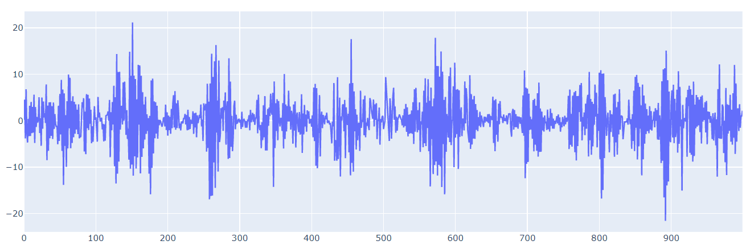
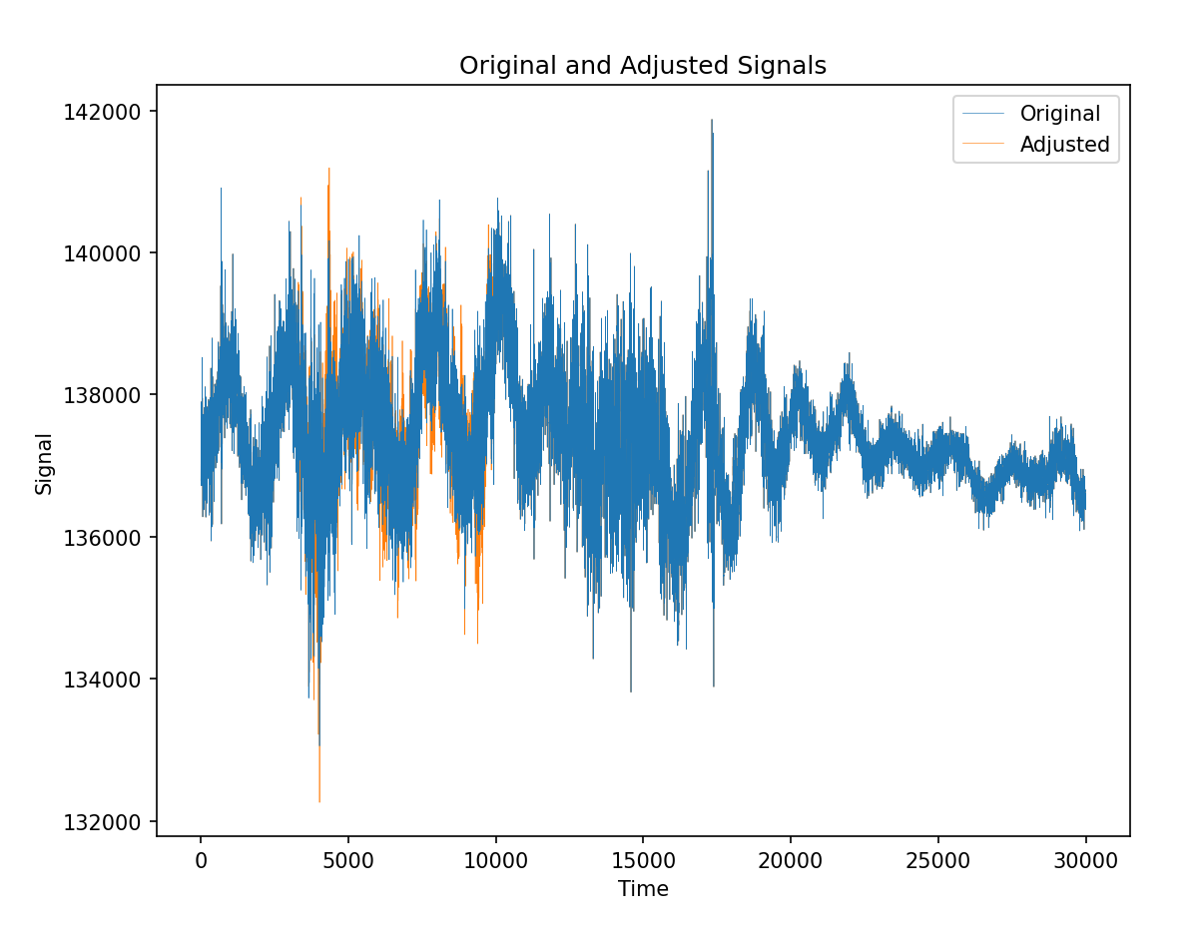
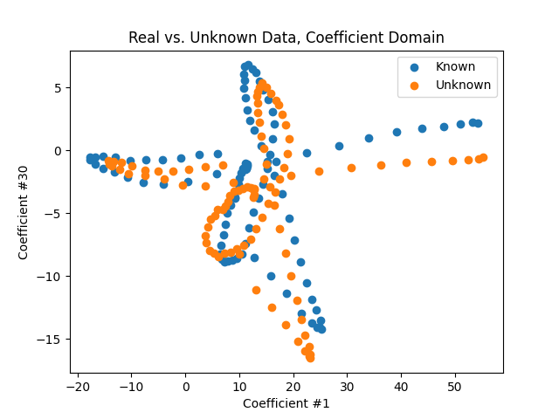
Time Series Analysis
Simple: Analyzing Data in a Time Series
Applications
Signal characterization
Anomaly detection
Synthetic data generation
Forecasting

Slide 4
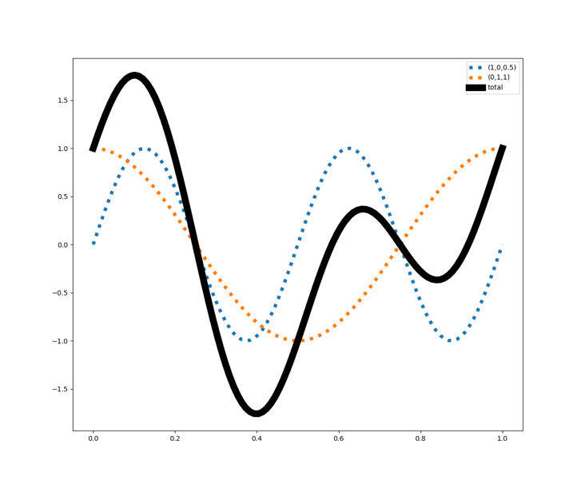
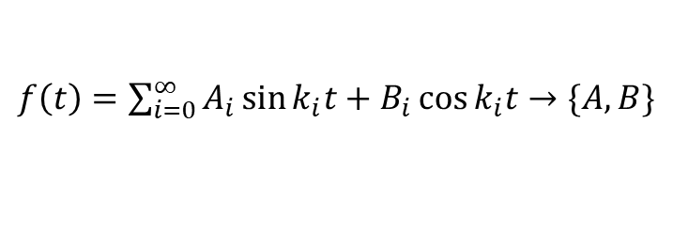
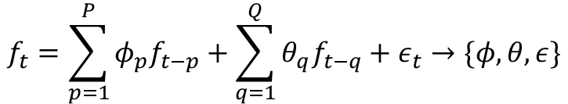
Three Kinds of TSA: Characterization
Characterization
Mapping signals into functional Hilbert spaces
Finding distances between signals in abstract space
Fitting coefficients, functions to signals
Examples:
Fourier transform
ARMA
$f\left(t\right)=\sum_{i=0}^{∞}{A_{i}\sin{k_{i}t+B_{i}\cos{k_{i}t}}}→\{A,B\}$
$$f_{t}=\sum_{p=1}^{P}{φ_{p}f_{t−p}}+\sum_{q=1}^{Q}{θ_{q}f_{t−q}}+ε_{t}→\{φ,θ,ε\}$$

Slide 5
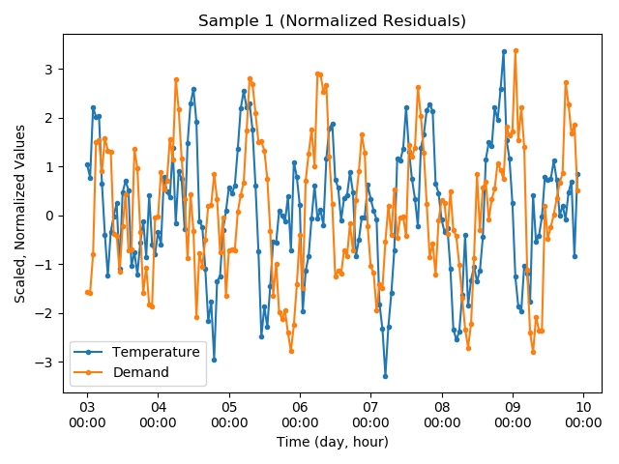
Three Kinds of TSA: Transformation
Transformer
Converts to/from signal within the same space
Examples
Normalization ([0,1], [z-score], etc)
ZeroFilter
Differencing
PreserveCDF

Slide 6
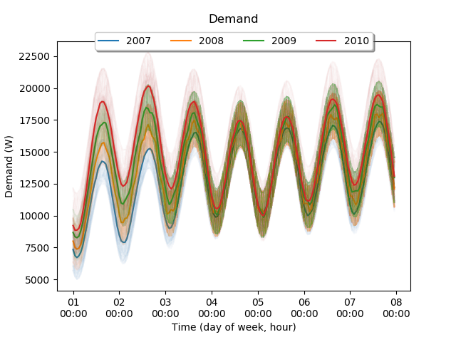
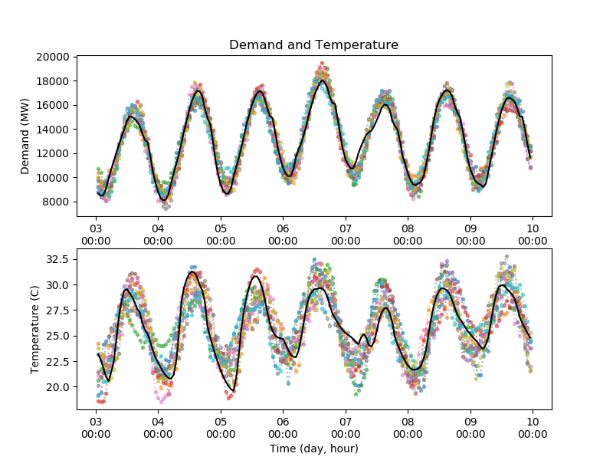
Three Kinds of TSA: Generation
Generation
Synthetic Histories

Slide 7
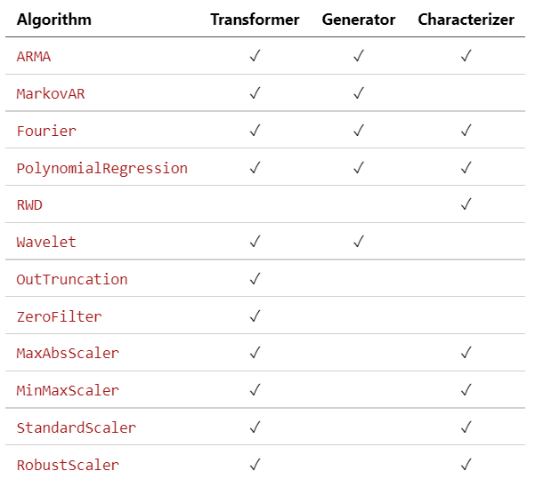
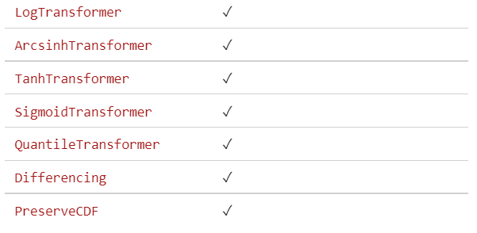
Algorithms in RAVEN TSA module
List is maintained in raven/ravenframework/TSA/README.md

