Slide 1

RAVEN Input Templating
Simplifying RAVEN for Specific Use
Idaho National Laboratory - Idaho Falls, ID
INL/CON-19-55757

Slide 2
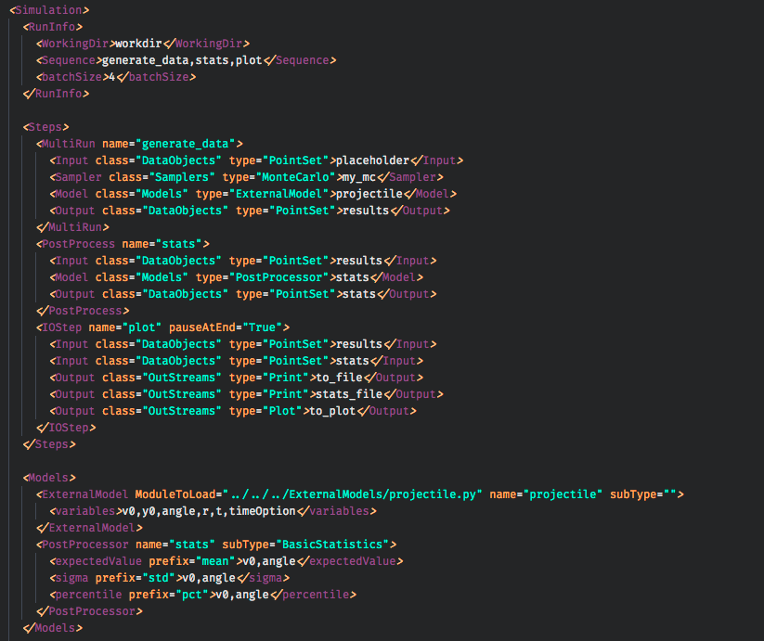
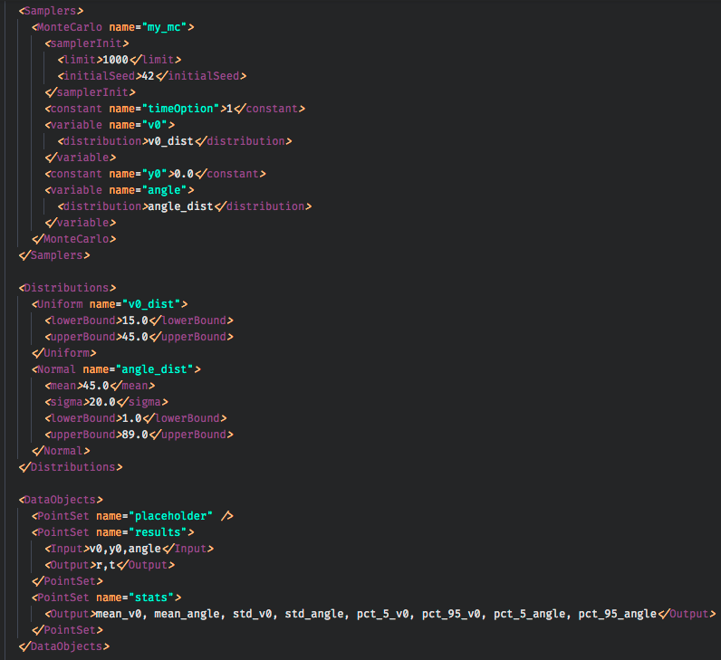

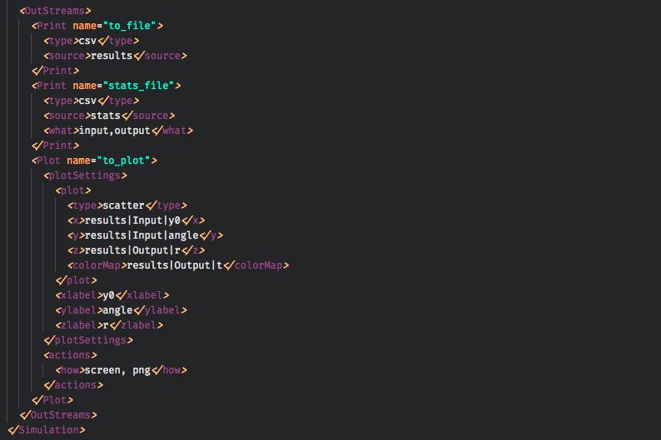
Motivation
Why templated inputs?

Slide 3
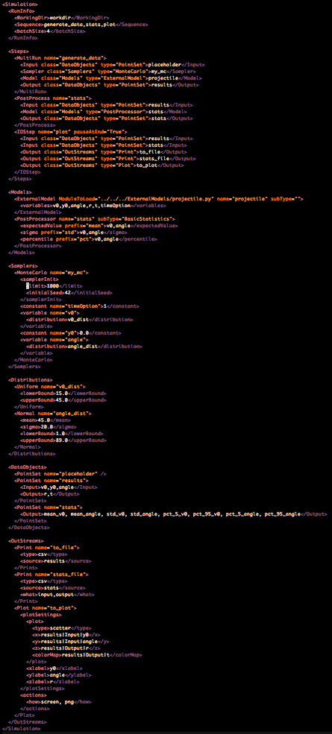
Templating

Slide 4
Objectives
Learn when to create a TemplateInput
Learn how to create a TemplateInput
Learn how to make RAVEN more accessible to users
Create and use a TemplateInput

Slide 5
Template Inputs
RAVEN Inputs
Incredibly flexible
XML is user- and computer-readable
Entity-Step structure can do almost anything
XML mirrors underlying code structure
Steep learning curve
Must learn many elements just to get started
DataObjects, Steps, Sequences, Entities
XML is not comfortable to some users
Templating Inputs lets you simplify RAVEN workflow writing
Trade off
Get simplicity at the cost of flexibility

Slide 6
Template Inputs
Example
I have a team of RELAP/MELCOR/etc users
I want them to use RAVEN to do PRA/UQ/etc on their inputs
Challenge
Training all users in RAVEN could be time consuming
They all need to use almost the same RAVEN setup
Just with a few minor differences
Solution: templating!
Allows fast creation of specific RAVEN workflows
Allows custom input files that are physics-oriented
Users know about inlets, pressure, pipes
Users don’t know about DataObjects, EnsembleModels

Slide 7
When to use a TemplateInput
RAVEN Templating can be highly beneficial when:
Complex RAVEN workflows
Long, involved RAVEN input files
Workflow hardly changes
Mostly the same for each user
Some small changes allow flexibility
RAVEN Templating is unlikely to be useful when:
Many changes to the workflow are needed to change calculations
The workflow is small and easy to understand
Changing RAVEN inputs manually is easier than automating

Slide 8
Creating a Template Input
Defining some roles:
RAVEN Developers created the templating system
Template Designers create new Templates
Template Users use the Templates

Slide 9
Creating a Template Input
Structure
Template
Base
python
Creates RAVEN input
Uses information from user input
Inherits from Template Base class
XML template
Based on standalone run
Read by TemplateClass
Format chosen by Designer
Filled in by user
Template
Workflow
xml
Template
Class
python
Template
Interface
python
User
Input
?
RAVEN
Inputs
xml
Reads in user inputs
Calls methods on TemplateClass
Designer creates input reader
Generated RAVEN inputs
Based on user input
Ready to run

Slide 10
Example
Let’s create a TemplateInput
UQ template for running Projectile model
User should use template to adjust:
Distribution types, parameters
Statistical metrics to calculate (mean, etc)
We (designers) need to choose an Input format
For this example: simple keyword entry
Note: this is probably too simple for effective templating
the user could modify RAVEN input directly!
# my_proj_uq.i
v0 = Uniform(15, 45) # low, hi
angle = Normal(45, 20, 1, 89) # mean, std, low, hi
y0 = Constant(0) # value
metric = mean, std # options

Slide 11
Creating a Template Input
Process:
Creating a Template Workflow
Write a working RAVEN input (Templated Workflow)
Decide what to template
Creating the Template Algorithms
Create a user input file
Create a Template Interface
Create a Template Class
Optional: inherit from Template Base
Finish
Test and Run

Slide 12
1. Template Workflow
Template
Base
python
Template
Workflow
xml
Template
Class
python
Template
Interface
python
User
Input
?
RAVEN
Inputs
xml

Slide 13
1. Template Workflow
Write a RAVEN Templated Workflow
We did this earlier; we can use forward sampling example
I copied it for you to start from
> cd ~/projects/raven/docs/workshop/templateInputs/exercises
> ~/projects/raven/raven_framework 1_running_workflow.xml

Slide 14
2. Decide what to Template
What shall we template?
Distributions
Allow either Uniform or Normal
Uniform requires lowerBound, upperBound
Normal requires mean, sigma, lowerBound, upperBound
If no distribution given, use constant
Metrics
Mean, Standard Deviation, Percentiles
How will TemplateClass algorithms modify the template input?
Write new distributions
Add variables or constants to Sampler
Add requested metrics (statistics)

Slide 15
2. Decide what to Template
We need to clean up the working run to make a good template
This is prep work for the designer to do for this example
Copy working run to a new file
Edit “templated_workflow.xml” with your favorite editor
Remove distributions
Remove all <constant> and <variable> from MonteCarlo sampler
Leave timeOption constant, though!
Note: everything we are removing is dynamically added at run time
This will be done in the TemplateClass
> cp 1_running_workflow.xml templated_workflow.xml
> vim 2_soln_template.xml # finished template example

Slide 16
3. Creating a User Input File
Template
Base
python
Template
Workflow
xml
Template
Class
python
Template
Interface
python
User
Input
?
RAVEN
Inputs
xml

Slide 17
3. Creating a User Input File
User input should be friendly to your target users
Use syntax they are familiar with
Keyword entries
YAML or JSON
GUI
Use structure specific to the problem
Should be obvious to the user what is being run
Should not require much knowledge of RAVEN

Slide 18
3. Creating a User Input File
For our example, we will use keyword entry
Acceptable keys
variables (v0, angle, y0)
Uniform(low, high)
Normal(mean, std, low, high)
Constant(value)
“metric” for the statistical metrics to use
options: mean, std, percentile
# my_proj_uq.i
v0 = Uniform(15, 45) # low, hi
angle = Normal(45, 10, 1, 89) # mean, std, low, hi
y0 = Constant(0) # value
metric = mean, std # options

Slide 19
4. Creating a Template Interface
Template
Base
python
Template
Workflow
xml
Template
Class
python
Template
Interface
python
User
Input
?
RAVEN
Inputs
xml

Slide 20
4. Creating a Template Interface
Now we need to read in our user input file
We can use Python for this (doesn’t have to be Python though!)
Methods:
read_input, parses the user input
interpret_input, converts the user input into items we can use
interpret_distribution, specifically to read in distributions
> cd ~/projects/raven/docs/workshop/templateInputs/exercises
> vim 4_template_interface.py

Slide 21
5. Creating a Template Class
Template
Base
python
Template
Workflow
xml
Template
Class
python
Template
Interface
python
User
Input
?
RAVEN
Inputs
xml

Slide 22
5. Creating a Template Class
Finally, to the central system of the template
TemplateClass needs to:
Read the Template Workflow
Modify the Template Workflow using the User Input settings
Write working RAVEN input files
Can inherit from the Template Base Class
Located in RAVEN
Has some commonly-used methods available for RAVEN XML
xmlUtils
self.namingTemplate
self._updateCommaSeperatedList
etc

Slide 23
5. Creating a Template Class
TemplateClass implementation
Main methods (common to all templates)
loadTemplate (inherited)
Reads the Template Workflow
createWorkflow
takes inputs
copies and modifies Template Workflow
prepares new input XML
writeWorkflow (inherited)
writes new RAVEN inputs
Helper methods (specific to this example template)
_modifyVariables: add variable distributions, sampling
_applyMetrics: add statistical metrics
> cd ~/projects/raven/docs/workshop/templateInputs/exercises
> vim 5_template_class.py

Slide 24
5. Creating a Template Class
TemplateClass implementation
Methods need to be called by TemplateInterface
Modify TemplateInterface to:
Instantiate a TemplateClass
Call loadTemplate
Call createWorkflow
Call writeWorkflow
(optional) run RAVEN input directly
> cd ~/projects/raven/docs/workshop/templateInputs/exercises
> vim 4_template_interface.py

Slide 25
6. Test and Run
Template
Base
python
Template
Workflow
xml
Template
Class
python
Template
Interface
python
User
Input
?
RAVEN
Inputs
xml

Slide 26
6. Test and Run
For some OS, TemplateInterface can run RAVEN on new inputs
If not …
Some additional effort could make it happen for your template
Can run generated input files
Try changing my_proj_uq.i and running again!
Extra credit: dynamically choose variables for the plotting!
> bash.exe
> source activate raven_libraries
> cd ~/projects/raven/docs/workshop/templateInputs/exercises
> python 4_template_interface.py my_proj_uq.i
> ~/projects/raven/raven_framework 6_ProjUQInput.xml

Slide 27
Summary
Templated Inputs
Increase simplicity at cost of flexibility
Great for modifying existing RAVEN runs in simple ways
Lowers barrier to new RAVEN users
Needs development from designer
Someone who knows enough RAVEN to make a template
Starting from working run
Using Python to modify inputs
Once one in place, making new templates even faster

