Slide 1

Time Dependent Statistics and Relational Analysis
RAVEN Workshop

Slide 2
Overview
Time-series post-processors:
Quick overview
Time dependent basic statistics
Scalar FOMs
Time dependent relational analysis
Relational FOMs

Slide 3
Data Pre-Processing: Re-Sampling
Objective: reduce memory space of each time series
Method: re-sampling the time series
Smartly locate sample points on strategically important regions
e.g. high derivative (gradient) regions
Uniform sampling
First-order derivative sampling

Slide 4
RAVEN Time-Series Post-Processors
Class: Interfaced Post-Processors
RAVEN provides a generic interface to create user-defined generic Post-Processors
Act on both PointSets and HistorySets

Slide 5
RAVEN Time-Series Post-Processors: Examples
HSPS: it converts an HistorySet into a PointSet
Each history is converted into a multi-dimensional vector
HistorySetSampling
Original HistorySet is re-sampled accordingly to a specific sampling strategy
HistorySetSync
Time series contained in the original HistorySet are synchronized in time
Identical initial and final time
Identical number of samples
dataObjectLabelFilter
Filter the dataObject for a specific value of the clustering label

Slide 6
RAVEN Example 1 Time Dependent Basic Statistics – Scalar FOMs

Slide 7
RAVEN Scalar FOMs
Scalar FOMs
Expected value
Variance
Sigma
Kurtosis
Skewness
Variational Coefficient
Median
Percentile (e.g. 5%, 95%, etc.)
Etc.

Slide 8
RAVEN Example 1: Time-Dep. Basic Statistics
Steps
Generate time-dependent data
Post-Process the data (scalar FOMs)
Create a DataObject (PointSet) from processed data

Slide 9
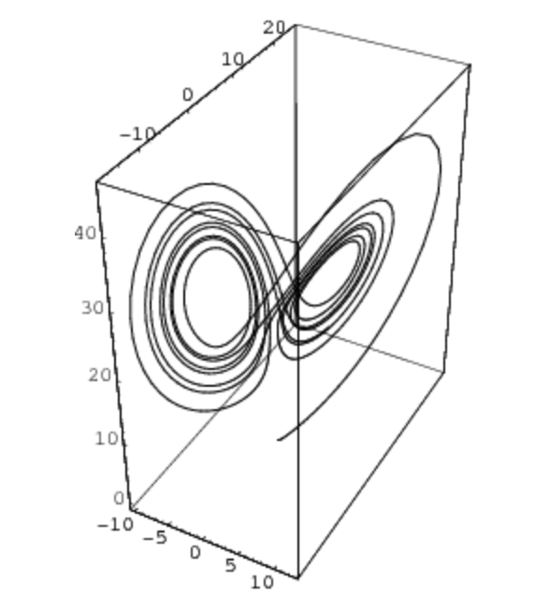
RAVEN Example 1: Time-Dep. Basic Statistics
Distributions
Models
Samplers
Databases
DataObjects
Steps
<Models>
...
<PostProcessor name="timeDepBasicStat" subType="BasicStatistics">
<pivotParameter>time</pivotParameter>
<expectedValue>x,y,z</expectedValue>
<percentile_5>x,y,z</percentile_5>
<percentile_95>x,y,z</percentile_95>
</PostProcessor>
<PostProcessor name="readStats" subType="RavenOutput">
<dynamic>true</dynamic>
<File ID="0" name="output_TD_BS.xml">
<output name="mean" >x | expectedValue </output>
<output name="percentile_5" >x | percentile_5 </output>
<output name="percentile_95" >x | percentile_95 </output>
</File>
</PostProcessor>
</Models>
Input file name: time_dep.xml

Slide 10
RAVEN Example 1: Time-Dep. Basic Statistics
Distributions
Models
Samplers
Databases
DataObjects
Steps
<Steps>
<MultiRun name="FirstMRun">
<Input class="DataObjects" type="PointSet" >inputPlaceHolder</Input>
<Model class="Models" type="ExternalModel" >PythonModule</Model>
<Sampler class="Samplers" type="MonteCarlo" >MC_external</Sampler>
<Output class="DataObjects" type="HistorySet" >HistorySet</Output>
</MultiRun>
<PostProcess name="timeDepBasicStatPP">
<Input class="DataObjects" type="HistorySet" >HistorySet</Input>
<Model class="Models" type="PostProcessor" >timeDepBasicStat</Model>
<Output class="Files" type="" >output_TD_BS.csv</Output>
<Output class="Files" type="" >output_TD_BS.xml</Output>
<Output class="DataObjects" type="HistorySet" >HistorySet</Output>
</PostProcess>
<PostProcess name="readStats">
<Input class="Files" type="" >output_TD_BS.xml</Input>
<Input class="DataObjects" type="HistorySet" >HistorySet</Input>
<Model class="Models" type="PostProcessor" >readStats</Model>
<Output class="DataObjects" type="PointSet" >stats</Output>
<Output class="OutStreams" type="Plot" >Plotdata</Output>
<Output class="OutStreams" type="Plot" >PlotRawdata</Output>
</PostProcess>
</Steps>
Input file name: time_dep.xml

Slide 11
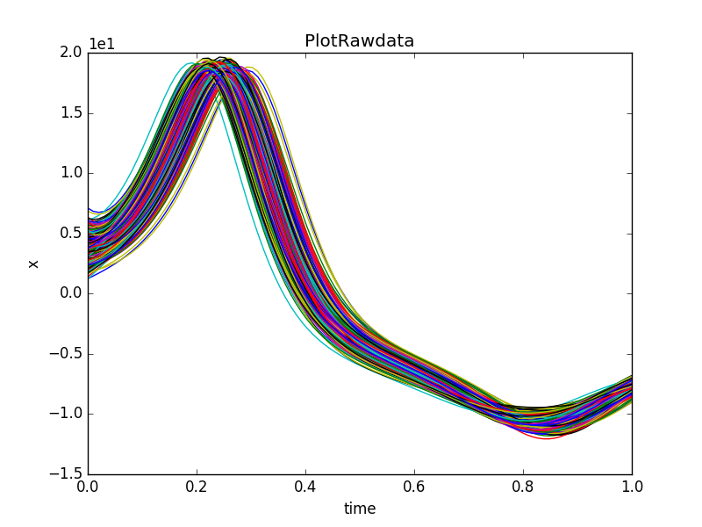
RAVEN Example 1: Time-Dep. Basic Statistics
Input file name: time_dep.xml

Slide 12
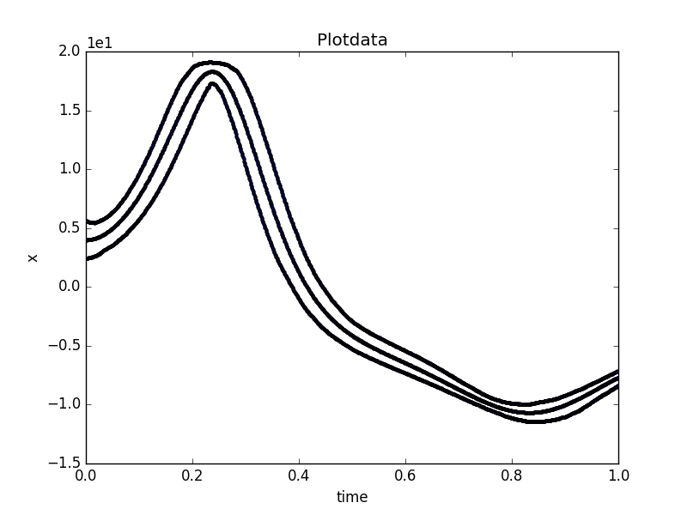
RAVEN Example 1: Time-Dep. Basic Statistics
Input file name: time_dep.xml

Slide 13
RAVEN Example 2 Time Dependent Basic Statistics – Relational FOMs

Slide 14
RAVEN Scalar FOMs
Relational FOMs
Sensitivity (linear regression) coefficients
Covariance coefficients
Correlation coefficients (Pearson)
Normalized sensitivity coefficients
Variance Weighted Sensitivity coefficients
Etc.

Slide 15
RAVEN Example 2: Time-Dep. Basic Statistics
Steps
Generate time-dependent data
Post-Process the data (relational FOMs)
Create a DataObject (PointSet) from processed data

Slide 16
RAVEN Example 2: Time-Dep. Basic Statistics
Distributions
Models
Samplers
Databases
DataObjects
Steps
<Models>
...
<PostProcessor name="timeDepBasicStat" subType="BasicStatistics">
<covariance>
<features>x0,y0,z0,x,y,z</features>
<targets>x,y,z</targets>
</covariance>
<pearson>
<features>x0,y0,z0,x,y,z</features>
<targets>x,y,z</targets>
</pearson>
<--! We are going to build the sensitivity block -->
<sensitivity>
<features>x0,y0,z0,x,y,z</features>
<targets>x,y,z</targets>
</sensitivity>
</PostProcessor>
...
</Models>
Input file name: time_dep_relational.xml

Slide 17
RAVEN Example 2: Time-Dep. Basic Statistics
Distributions
Models
Samplers
Databases
DataObjects
Steps
<Models>
...
<PostProcessor name="readStats" subType="RavenOutput">
<dynamic>true</dynamic>
<File ID="0" name="output_TD_BS.xml">
<output name=”pearson_x0_x" > x0 | pearson | x </output>
<output name=”pearson_y0_y" > y0 | pearson | y </output>
<output name=”pearson_z0_z" > z0 | pearson | z </output>
<output name=”pearson_x_y" > x | pearson | y </output>
<output name=”pearson_x_z” > y | pearson | z </output>
<output name=”covariance_x0_x" > x0 | covariance| x </output>
<output name=”covariance_y0_y" > y0 | covariance| y </output>
<output name=”covariance_z0_z" > z0 | covariance| z </output>
<output name=”covariance_x_y" > x | covariance| y </output>
<output name=”covariance_x_z” > y | covariance| z </output>
<!-- we are going to add the sensitivity here-->
</File>
</PostProcessor>
</Models>
Input file name: time_dep_relational.xml

Slide 18
RAVEN Example 2: Time-Dep. Basic Statistics
Distributions
Models
Samplers
Databases
DataObjects
Steps
<Steps>
<MultiRun name="FirstMRun">
<Input class="DataObjects" type="PointSet" >inputPlaceHolder</Input>
<Model class="Models" type="ExternalModel" >PythonModule</Model>
<Sampler class="Samplers" type="MonteCarlo" >MC_external</Sampler>
<Output class="DataObjects" type="HistorySet" >HistorySet</Output>
</MultiRun>
<PostProcess name="timeDepBasicStatPP">
<Input class="DataObjects" type="HistorySet" >HistorySet</Input>
<Model class="Models" type="PostProcessor" >timeDepBasicStat</Model>
<Output class="Files" type="" >output_TD_BS.csv</Output>
<Output class="Files" type="" >output_TD_BS.xml</Output>
<Output class="DataObjects" type="HistorySet" >HistorySet</Output>
</PostProcess>
<PostProcess name="readStats">
<Input class="Files" type="" >output_TD_BS.xml</Input>
<Input class="DataObjects" type="HistorySet" >HistorySet</Input>
<Model class="Models" type="PostProcessor" >readStats</Model>
<Output class="DataObjects" type="PointSet" >stats</Output>
<Output class="OutStreams" type="Plot" >Plotdata</Output>
<Output class="OutStreams" type="Plot" >PlotRawdata</Output>
</PostProcess>
</Steps>
Input file name: time_dep_relational.xml

Slide 19
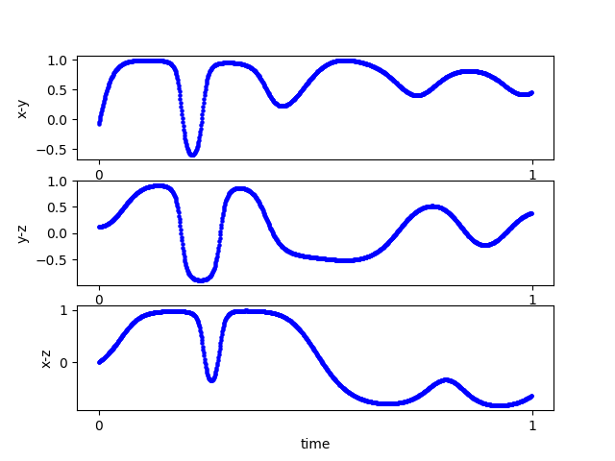
RAVEN Example 2: Time-Dep. Basic Statistics
Pearson
Input file name: time_dep_relational.xml

Slide 20
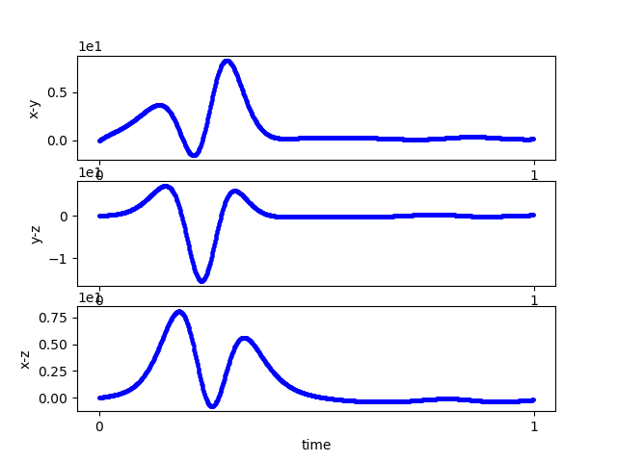
RAVEN Example 2: Time-Dep. Basic Statistics
Covariance
Input file name: time_dep_relational.xml

Slide 21
RAVEN Example 2: Time-Dep. Basic Statistics
Questions?

