Slide 1

Which Model Does Not Belong? A Dialogue (Monologue?)
Michael R. Gryk & Bertram T. Ludäscher
Center for Informatics Research in Science & Scholarship (CIRSS)
School of Information Sciences
University of Illinois, Urbana-Champaign
JCDL SIGCM Workshop on
Conceptual Modeling
August 1, 2020
https://github.com/sig-cm/JCDL-2020

Slide 2
1 Introduction
B: Tell me my student, which of these pots is unlike the others?
M: The silver one of course. The others are made of gold.
B: Please hoist each one above your head.
M: Ah, master. I beg forgiveness. The one without handles is truly unique.
B: Would you please use them to milk the cow.
M: Once again master, I have changed my mind. The smaller one is inferior.
B: Several times I have given you a task and each time you have made a different choice. What task could I assign which would convince you to choose the large, handled pot of gold?
M: There is no such task, master. That pot is not unique in any way.
B: … Isn’t it the only pot of that kind … grasshopper??
A monk was summoned to the Buddha’s chamber.
Upon a table were four pots: three gold and one silver.
The first gold pot was large with ornate handles.
The second could have been its younger sibling, sharing the same shape and handles yet of a diminutive size.
The third was as big as the first but had no handles.
The silver pot was large with handles.

Slide 3
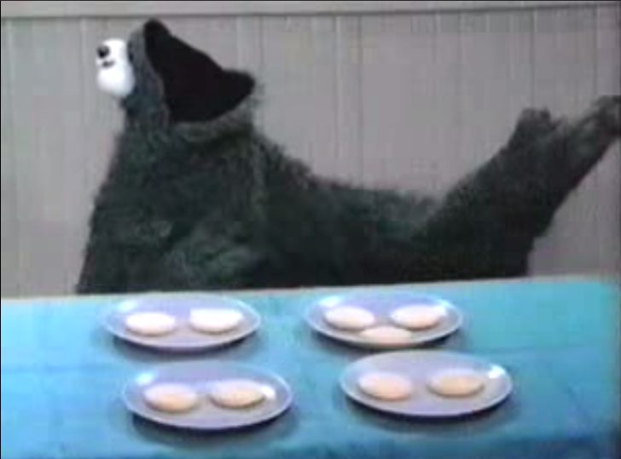
2. Cutting to the Chase …
WODB (which one doesn’t belong) is a great educational tool for CM!
... Datalog and Answer Set Programming are power tools for WODB (and CM in general)
Step 1: Define what is (and isn’t!) part of your model:
Observables (things/concepts you can ask about)
Ignorables (… you cannot ask about!)
Step 2: Fitness-for-Purpose (FFP) and Conceptual Resolution (CR) via Queries:
FFP/Q: Can you answer the questions you care about?
CR/Q: What questions can you answer (what concepts can you distinguish) in principle?

Slide 4
... cutting to the chase …
Step 3 (The WODB Point): Explainable Answers:
How do you justify Which-One-Doesn’t-Belong (WODB)?
i) Agree on Observables (color; shape; size; … )
… and Ignorables (object-ID; object location: NE, SE, SW, N; …)
ii) Formalize what you mean using a Query:
In UX: What you see is what you get! (WYSIWYG!)
In CMX: What you get, is it what you see? (WYGiiWYS?)
... b/c if you can’t pick the thing which isn’t like the other via a query
… maybe your query and your ideas/concepts don’t agree!
… or your model doesn’t mean what you think it means!!
iii) Even if WYGiWYS(!), compare justifications with those for alt-answers by others:
Beware: minimal change of your justification = my justification!
… or rather: different quality of justifications (cf. Koan .. WODB Ex. 5 below) – being “meta-special”
1
2
3
4
1
2
3
4

Slide 5
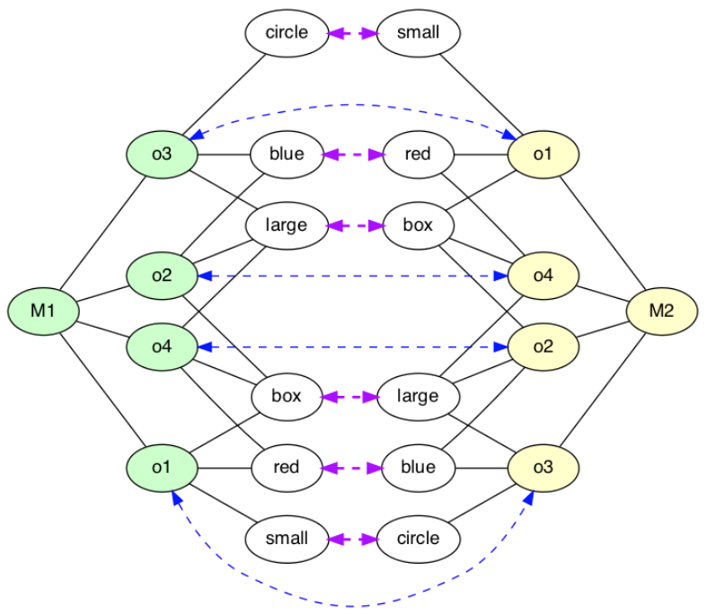
... cutting to the chase …
Step 4: Quantifying over all Queries: Semantics from Structure!
How semantics permeates (conceptual) models:
… via Vocabulary (Controlled Vocabs; Ontologies (eg in DLs); etc.)
➔ Terminological Perspective (another day!)
… via Structure & Connections
➔ Database Theory / Mathematical Logic Perspective (today!)
Tools to obtain semantics from structure:
Queries, Queries, QUERIES! (cf. Steps 2 & 3)
Automorphisms
Compute in a few easy steps with ASP (= Datalog + Generate & Test / Constraints)
… and visualize with Possible-Worlds-Explorer (PWE); tool created by Sahil Gupta!

Slide 6
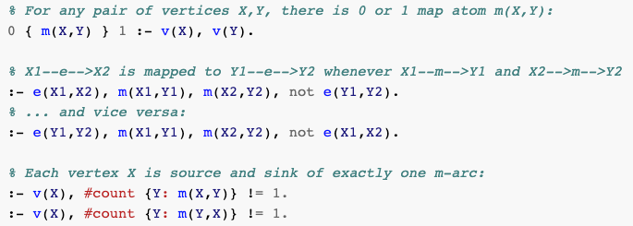
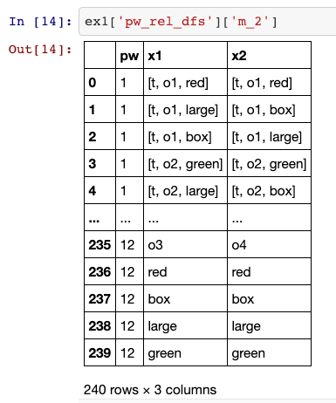
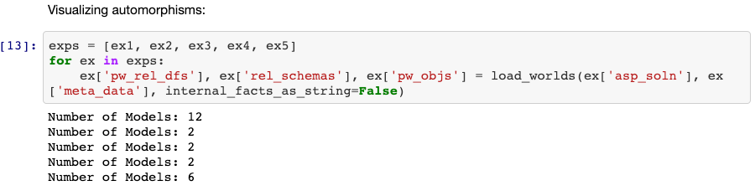
... Some PWE Snippets …
Ex. 1
Ex. 2
5 logic rules (ASP) to find automorphisms
Ex. 3 / Ex. 4
Ex. 5
PWE listing of a model
Batch processing several models.
PWE visualization of the automorphism
Ex. 1: three red boxes are indistinguishable.
Ex. 3: by swapping constants, non-trivial symmetries (automorphisms) are found! => What can and cannot be picked w/ queries!
https://github.com/idaks/WODB/blob/master/automorphisms/Automorphism%20Exps%20ID-V.ipynb

Slide 7
Example 1: It’s so easy …
property(fig1, color, red).
property(fig1, shape, box).
property(fig1, size, large).
property(fig2, color, green).
property(fig2, shape, box).
property(fig2, size, large).
property(fig3, color, red).
property(fig3, shape, box).
property(fig3, size, large).
property(fig4, color, red).
property(fig4, shape, box).
property(fig4, size, large).
1
2
3
4
% Fig. X is unique wrt property P and value V, if there is no ..
unique(X,P,V) :- property(X,P,V), not another(X,P,V).
% .. other figure Y that has the same property/value pair:
another(X,P,V) :- property(X,P,V), property(Y,P,V), X != Y.
% clingo -n0 example1.lp4 unique.lp4
unique(fig2,color,green)
Notes:
WODB: Which ones doesn’t belong?
First, the four figures are distinguishable (unless one is red-green colorblind .. see later) only in one property: color.
We model what is observable about figures using properties (color, shape, size) and values.
We can then formalize and solve the WODB problem using a database query:
Here we use the query that asks: what property(s) X have a property P with value V that is unique?
The answer is (unsurprisingly): figure 2 – it is the only figure that is unique w.r.t. a property (color) and value (green).
special(X) if exists property P s.t. forall X2: if X != X2 then not property(X2,P)

Slide 8
Example 1: It’s even easier … (drop property column; values suffice..)
% We could add this
% but don’t really need it:
type(red, color).
type(blue, color).
type(small, size).
type(large, size).
type(box, shape).
type(circle, shape).
property(fig1, red).
property(fig1, box).
property(fig1, large).
property(fig2, green).
property(fig2, box).
property(fig2, large).
property(fig3, red).
property(fig3, box).
property(fig3, large).
property(fig4, red).
property(fig4, box).
property(fig4, large).
1
2
3
4
% Fig. X is unique wrt property-value V, if there is no ..
unique(X,V) :- property(X,V), not another(X,V).
% .. other figure Y that has the same property/value pair:
another(X,V) :- property(X,V), property(Y,V), X != Y.
% clingo -n0 example1.lp4 unique.lp4
unique(fig2,green)

Slide 9
Example 2: There’s still only one …
property(fig1, red).
property(fig1, box).
property(fig1, large).
property(fig2, blue).
property(fig2, box).
property(fig2, large).
property(fig3, blue).
property(fig3, circle).
property(fig3, large).
property(fig4, red).
property(fig4, box).
property(fig4, large).
1
2
3
4
% Fig. X is unique wrt property-value V, if there is no ..
unique(X,V) :- property(X,V), not another(X,V).
% .. other figure Y that has the same property/value pair:
another(X,V) :- property(X,V), property(Y,V), X != Y.
% clingo -n0 example2.lp4 unique.lp4
unique(fig3,circle)
Notes:
This WODB problem is similarly “obvious”: Here, in Ex.2, fig1 and fig4 (the two red squares) are indistinguishable, i.e., no matter what query Q you run, you either get both figures or none of the two.
Both fig2 and fig3 can be picked out with special query, e.g., “is there a blue box?” yields fig2.
However only fig3 is unique in the sense defined by the given query (it’s the only circle).
In contrast, fig2 is neither the only box, nor they only blue figure.

Slide 10
Example 3: who is unique here … ?
property(fig1, red).
property(fig1, box).
property(fig1, small).
property(fig2, blue).
property(fig2, box).
property(fig2, large).
property(fig3, blue).
property(fig3, circle).
property(fig3, large).
property(fig4, red).
property(fig4, box).
property(fig4, large).
2
1
3
4
% Fig. X is unique wrt property-value V, if there is no ..
unique(X,V) :- property(X,V), not another(X,V).
% .. other figure Y that has the same property/value pair:
another(X,V) :- property(X,V), property(Y,V), X != Y.
% clingo -n0 example3.lp4 unique.lp4
unique(fig1,small)
unique(fig3,circle)
Notes:
Sahil’s automorphism code finds that fig1 ⬄ fig3 and fig2 ⬄ fig4 under the permutation: blue/red, large/box, circle/small ..
ID Size Color Shape
fig1 is a small red box
fig2 is a large blue box
fig3 is a large blue circle
fig4 is a large red box
ID Shape Color Size
fig3 is a circle blue large
fig4 is a box red large
fig1 is a box red small
fig2 is a box blue large

Slide 11
Example 3&4: circle/small, blue/red, large/box
2
2
small ⬄ circle
large ⬄ box
1
2
1
1
red ⬄ blue
3
4
3
4
4
3
o1 ⬄ o3
o2 ⬄ o4
Automorphism: {red⬄blue, small⬄circle, large⬄box, o1⬄o3, o2⬄o4}
3
4
Raw ASP output of automorphism map:
2
1
m(t(o3,blue),t(o1,red)) m(t(o3,large),t(o1,box)) m(t(o3,circle),t(o1,small)) m(t(o4,red),t(o2,blue)) m(t(o4,large),t(o2,box)) m(t(o4,box),t(o2,large)) m(t(o1,red),t(o3,blue)) m(t(o1,small),t(o3,circle)) m(t(o1,box),t(o3,large)) m(t(o2,blue),t(o4,red)) m(t(o2,large),t(o4,box)) m(t(o2,box),t(o4,large)) m(blue,red) m(large,box) m(circle,small) m(red,blue) m(box,large) m(small,circle) m(o3,o1) m(o4,o2) m(o1,o3) m(o2,o4)
PWE visualization of the automorphism
Notes:
Sahil’s automorphism code finds that fig1 ⬄ fig3 and fig2 ⬄ fig4 under the permutation: blue/red, large/box, circle/small ..
ID Size Color Shape
fig1 is a small red box
fig2 is a large blue box
fig3 is a large blue circle
fig4 is a large red box
ID Shape Color Size
fig3 is a circle blue large
fig4 is a box red large
fig1 is a box red small
fig2 is a box blue large

Slide 12
Example 5: You’re oh so special (not!?) …
property(fig1, red).
property(fig1, box).
property(fig1, small).
property(fig2, green).
property(fig2, box).
property(fig2, large).
property(fig3, red).
property(fig3, circle).
property(fig3, large).
property(fig4, red).
property(fig4, box).
property(fig4, large).
2
1
3
4
% Fig. X is unique wrt property-value V, if there is no ..
unique(X,V) :- property(X,V), not another(X,V).
% .. other figure Y that has the same property/value pair:
another(X,V) :- property(X,V), property(Y,V), X != Y.
% clingo -n0 example4.lp4 unique.lp4
unique(fig1,small)
unique(fig2,green)
unique(fig3,circle)
Notes:
The challenge example: almost every figure is unique. Only one figure isn’t. That makes it “uniquely non-unique” ;-)
Just like in the koan ..

Slide 13
Example 5: ... if (almost) everyone is special, who really does stand out? The only “unspecial” or “most normal” figure!
property(fig1, red).
property(fig1, box).
property(fig1, small).
property(fig2, green).
property(fig2, box).
property(fig2, large).
property(fig3, red).
property(fig3, circle).
property(fig3, large).
property(fig4, red).
property(fig4, box).
property(fig4, large).
% Fig. X is unique wrt property-value V, if there is no ..
unique(X,V) :- property(X,V), not another(X,V).
% .. other figure Y that has the same property/value pair:
another(X,V) :- property(X,V), property(Y,V), X != Y.
% Which figure X is special (wrt some property / value)
special(X) :- unique(X,_).
normal(X) :- property(X,_), not special(X).
% clingo -n0 example5.lp4 unique.lp4
unique(fig1,small)
unique(fig2,green)
unique(fig3,circle)
special(fig1)
special(fig2)
special(fig3)
normal(fig4)
2
1
3
4
Notes:
If everyone is “special” (with some uniqueness argument), then the only non-special (”most normal” / “most boring”) figure is ”meta-special” ..
That’s Fig. 4 here …

Slide 14
$ source run-wodb.sh
*** Processing example1.lp4 ***
normal(fig1) normal(fig3) normal(fig4)
special(fig2)
*** Processing example2.lp4 ***
normal(fig1) normal(fig2) normal(fig4)
special(fig3)
*** Processing example3.lp4 ***
normal(fig2) normal(fig4)
special(fig1) special(fig3)
*** Processing example4.lp4 ***
normal(fig4)
special(fig1) special(fig2) special(fig3)
Couldn’t resist: Voila! Behold the Meta-WODB …
Notes:
This might be too meta …
Maybe the lower left is outlier, since it has 2 special/unique and 2 non-special/normal figures.
Or the lower right (my favorite) since it has 3 special and 1 meta-special figure..

Slide 15
Observations/ Preliminary Conclusions
A WODB puzzle can have several “right” answers.
To be comprehensible, answers need justifications.
Questions and answers become comprehensible via queries:
queries formalize concepts: what is meant by a unique/special/… figure (and what isn’t meant .. )
answers to queries come with derivations (a form of provenance) which provide the justification needed to understand the answer
Each query generates a possible solution space.
For a given query (i.e., within a solution space), answers can be clustered into equivalence classes:
we disagree which one doesn’t belong, because we care about different properties
… but if a minimal change will turn your argument into mine and vice versa ➔ same equivalence class!
Non-equivalent answers correspond to different types of argument (not just different preferences)
WODB is a great educational tool for CM!
ASP (= Datalog Queries + Generate&Test / Constraints) is a power tool for CM!
Possible World Explorer (PWE) combines ASP + Python/Jupyter Notebooks: CM super powers!

Slide 16
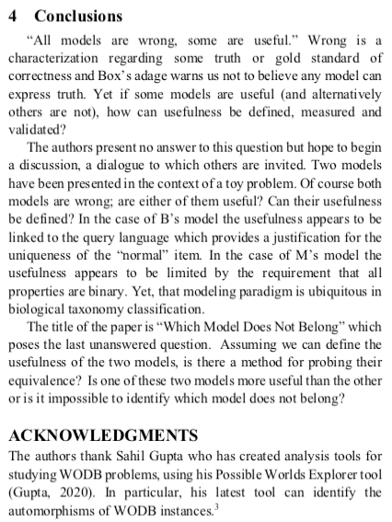
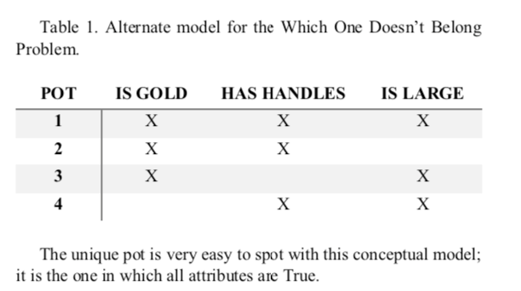
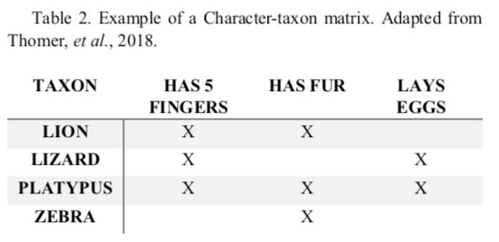
3. M’s Story (cont’d)
The “binary trick” !?
Is it really needed to find the meta-special?
(B has questions or even doubts … )
FYI: There are other solution methods e.g.
FCA (Formal Concept Analysis)
Notes:
The dialogue needs to be continued, I think ..

Slide 17
Character Matrix
isLarge isBox isRed
1: 0 1 1
2: 1 1 0
3: 1 0 1
4: 1 1 1
isSmall isCirc isGreen
1: 1 0 0
2: 0 0 1
3: 0 1 0
4: 0 0 0
isLarge isCirc isGreen
1: 0 0 0
2: 1 0 1
3: 1 1 0
4: 1 0 0
… 5 more combinations
(can generate all via ASP …)
3. M’s Story (Cont’d)
.. B responds with more questions …
Here the matrix works great to find WODB:
“1 1 1” stands out!
property(fig1, color, red).
property(fig1, shape, box).
property(fig1, size, small).
property(fig2, color, green).
property(fig2, shape, box).
property(fig2, size, large).
property(fig3, color, red).
property(fig3, shape, circle).
property(fig3, size, large).
property(fig4, color, red).
property(fig4, shape, box).
property(fig4, size, large).
… still OK: the “0 0 0” stands out …
… but what about here? Now #4 does not stand out ..
Notes:
Here is a glimpse of the argument that B makes to M: your trick assumes the right choice of characters … else you can’t pick out the outlier..

Slide 18
Some References
WODB/ASP/PWE Source code: https://github.com/idaks/WODB
WODB web site: http://wodb.ca/index.html
A book: https://www.stenhouse.com/content/which-one-doesnt-belong
Sesame Street: One of these things is not like the others ..
Easy: https://www.youtube.com/watch?v=rsRjQDrDnY8
A bit more tricky: https://www.youtube.com/watch?v=lqegob0v9W8
Quite tricky:
https://twitter.com/mcnally_gerry/status/1243582829507813376?s=20
https://twitter.com/search?q=%23wodb&src=typd

Slide 19
THE END
(additional fun stuff ahead .. )

Slide 20
Enjoy WODB! Challenge Example …
1
2
3
4
5

Slide 21
Which one doesn’t belong?
1
2
3
4
5
Typical justification:
Figure X doesn’t belong because it’s the only figure having property P:
special(X) :- has_prop(X,P), not another(X,P).
another(X,P) :- has_prop(X,P), has_prop(Y,P), X != Y.
.. but this doesn’t work here… (why not?)

Slide 22
WODB? FCA to the rescue..
Which of the 5 figures doesn’t belong?
Formal Concept Analysis can tell!
Figures 2,3,4,5 all have …
have 3 out of 4 common properties
have 1 out of 4 “special” properties
Figure 1 is special because it …
has 4 out of 4 common properties
has 0 out of 4 “special” properties
Red
Square
Border
Large
1
2
3
4
5
not-Large
not-Border
not-Square
not-red
We can understand the justification easily using a second-order model, i.e., looking at sets of properties.

