Slide 1
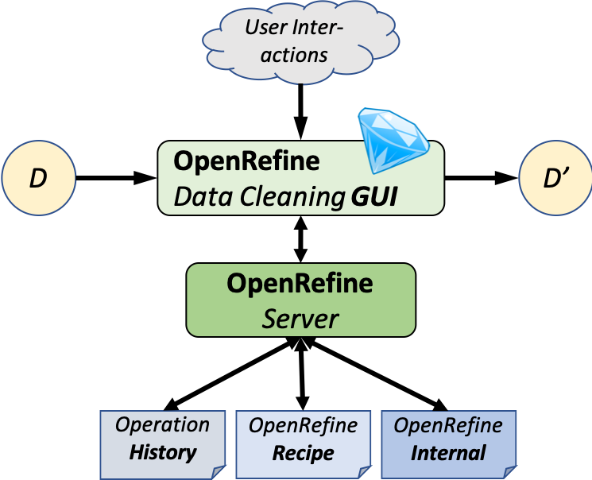



Modeling Provenance and Understanding Reproducibility
for OpenRefine Data Cleaning Workflows
Timothy McPhillips, Lan Li, Nikolaus Parulian, and Bertram Ludäscher School of Information Science, University of Illinois at Urbana-Champaign
Introduction
Revealing the steps taken to clean a data set is critical to making any research using the data transparent and reproducible. OpenRefine^{[1]} is a popular tool for exploring, profiling, and cleaning datasets using a spreadsheet-like interface. Here we report early results from an investigation into how the records captured by OpenRefine can:
Facilitate reproduction of complete, real-world data cleaning workflows.
Support queries and visualizations of the provenance of cleaned data sets for review.
Fig 1. OpenRefine stores records of operations carried out by a researcher in the process of transforming input dataset D to yield cleaned data set D’. It exposes these records as a browsable operation history that serves as the interface to its undo/redo feature; and as exportable recipes that can be reused to clean other data sets.
Approach
Extract, transform, load. We extract the data cleaning records captured by OpenRefine and store them using a relational schema more amenable to query and visualization.
Objects with identities. Queries useful to researchers are posed and interpreted in light of the meanings of columns, rows, cells, and values in a data set. We support such meaningful queries by assigning to these objects identifiers that persist as they are rearranged, renamed, reformatted, copied, transformed, corrected, and edited, And we associate each update of an object with the state at which the change was introduced.
Views of data set states. OpenRefine natively provides access to past data set states only by undoing all changes made subsequent to the state of interest. Our schema supports views and queries over multiple past states concurrently—without storing a complete snapshot of the data set at each state.
Separation of concerns. The schema we use to represent the data-cleaning history of a data set is independent of the columns, rows, and values comprising the data set. A researcher neither needs to understand the schema representing the history, nor take into account the queries of interest to them prior to cleaning a data set.
Logic programming. We support rapid experimentation and prototyping by representing data cleaning histories in formats easily queried using logic programming languages such as Datalog and Prolog.
Reproducible reproducibility research. Research into provenance and reproducibility should be held to the highest standards of reproducibility and transparency. To this end we employ reproducible computing environments, and we aim to make it easy for other researchers easily to repeat our observations and to evaluate our claims.
Example Data Cleaning History – Work in Progress
%%%% STATE AFTER INITIAL IMPORT STEP %%%%%
% source(SourceId, SourceUri, SourceFormat).
source(source_1, 'biblio.csv', 'text/csv').
% dataset(DatasetId, SourceId, ArrayId).
dataset(dataset_1, source_1, array_9).
% array(ArrayId, DatasetId).
array(array_1, dataset_1).
% column(ColId, ArrayId).
column(col_1, array_1). column(col_2, array_1). column(col_3, array_1).
% row(RowId, ArrayId).
row(row_1, array_1).
row(row_2, array_1).
row(row_3, array_1).
% cell(CellId, ColId, RowId).
cell(cell_1, col_1, row_1). cell(cell_4, col_2, row_1). cell(cell_7, col_3, row_1).
cell(cell_2, col_1, row_2). cell(cell_5, col_2, row_2). cell(cell_8, col_3, row_2).
cell(cell_3, col_1, row_3). cell(cell_6, col_2, row_3). cell(cell_9, col_3, row_3).
% state(StateId, ArrayId, PreviousStateId).
state(state_1, array_9, nil).
% content(ContentId, CellId, StateId, ValId, PrevContentId).
content(content_11, cell_1, state_1, val_1, nil).
content(content_12, cell_2, state_1, val_2, nil).
content(content_13, cell_3, state_1, val_3, nil).
content(content_14, cell_4, state_1, val_4, nil).
content(content_15, cell_5, state_1, val_5, nil).
content(content_16, cell_6, state_1, val_6, nil).
content(content_17, cell_7, state_1, val_7, nil).
content(content_18, cell_8, state_1, val_8, nil).
content(content_19, cell_9, state_1, val_9, nil).
% value(ValId, ValText).
value(val_1, 'Against Method’). value(val_4, 'Paul Feyerabend’). value(val_7, '1975').
value(val_2, 'Changing Order’). value(val_5, 'H.M. Collins’). value(val_8, '1985').
value(val_3, 'Exceeding our Grasp’). value(val_6, 'P. Kyle Stanford’). value(val_9, '2006').
% column_schema(ColSchemaId, ColId, StateId, ColType, ColName, PrevColId, PrevColSchemaId).
column_schema(col_schema_1, col_1, state_1, 'string', 'Book Title’, nil, nil).
column_schema(col_schema_2, col_2, state_1, 'string’, 'Author’, col_1, nil).
column_schema(col_schema_3, col_3, state_1, 'string’, 'Date’, col_2, nil).
% row_position(RowPosId, RowId, StateId, PrevRowId).
row_position(row_pos_1, row_1, state_1, nil).
row_position(row_pos_2, row_2, state_1, row_1).
row_position(row_pos_3, row_3, state_1, row_2).
%%%% Rename column 1 from ‘Book title’ to ‘Title’ %%%%%
state(state_2, array_1, state_1).
column_schema(col_schema_4, col_1, state_2, 'string', 'Title', nil, col_schema_1).
%%%% Place surname first and abbreviate given names to initials in Author column %%%%%
state(state_3, array_1, state_2).
value(val_10, 'Feyerabend, P.’).
value(val_11, 'Collins, H.M.’).
value(val_12, 'Stanford, P.K.’).
content(content_20, cell_4, state_3, val_10, content_14).
content(content_21, cell_5, state_3, val_11, content_15).
content(content_22, cell_6, state_3, val_12, content_16).
%%%% Sort rows by Author %%%%%
state(state_4, array_1, state_3).
row_position(row_pos_5, row_2, state_4, nil).
row_position(row_pos_4, row_1, state_4, row_2).
row_position(row_pos_6, row_3, state_4, row_1).
%%%% Swap order of second and third columns %%%%%
state(state_5, array_1, state_4).
column_schema(col_schema_6, col_3, state_5, 'string’, 'Date’, col_1, nil).
column_schema(col_schema_5, col_2, state_5, 'string’, 'Author’, col_3, nil).
Acknowledgments
Research reported in this poster was supported in The Whole Tale program and NSF (National Science Foundation). And the author wishes to thank for Prof. Bertram Ludäscher and Qian Zhang guidance and support during Summer 2018, to Yi-Yun Cheng and Santiago Núñez-Corrales , for their collaborate with user story construction.
References
[1] OpenRefine: A free, open source, powerful tool for working with messy data. http://openrefine.org/ (2018)
[2] 2. Makepeace, P., Lohmeier, F.: OpenRefine Python client library. https://github.com/opencultureconsulting/openrefine-client/ (2018)
[3] What’s on the Menu? http://menus.nypl.org/data (03/16/2019)
Goals & Desiderata
Modeling. OpenRefine has its own idiosyncratic terminology for describing the records it keeps and the capabilities it provides using them. We are mapping the OpenRefine concepts of data, operations, and recipes to those of the reproducible research and provenance communities.
Reproducibility. Recipes exported from OpenRefine include neither the initial data import step, nor any edits made manually to individual cells. We are providing means to use the records kept by OpenRefine to facilitate end-to-end reproducibility of data cleaning workflows.
Transparency. Displaying lists of operations and the ability to revisit past states one at a time provide limited means for interrogating how data was cleaned. We aim to make data cleaning workflows and their products easy to query — prospectively and retrospectively — to answer any questions researchers may have about the provenance of cleaned data sets.
Tools & Methods
OpenRefine. We carry out our experiments on OpenRefine version 3.1 [7] in Java 8 environments on multiple platforms. We automate interactions with OpenRefine via its native HTTP API by using and extending the OpenRefine Python Client Library [3].
Queries. We employ XSB Prolog [9] for expressing and performing Datalog-style graph and provenance queries, and Graphviz for rendering visualizations of query results.
Reproducible computing. We depend on Ansible, Vagrant, and Docker for making research environments reproducible across coauthors’ computers and for enabling other researchers to repeat our experiments on their own systems.
Contact Information
Email: tmcphill@illinois.edu
GitHub Project Repositories:
https://github.com/idaks/openrefine-provenance
https://github.com/idaks/openrefine-reproducibility
Notes:
The model implicit in histories and recipes exhibits both prospective and retrospective provenance features, but is incomplete in at least two ways:
Functions resulting in mass edits.
Single cell edits are not captured.
➔
OpenRefine contains prospective and retrospective provenance features.
Single cell edits are not captured in the recipe (b/c they are not reusable)
Not all function names, types, and parameters are recorded.
Fig.1 caption text: use smaller font size than Introduction contents text.
Header Challenges: use the same font color as for Motivations and Introduction
Subleaders Transparency, reproducibility, reusability: use special font (color, italics, underline, etc.) to highlight them
In Contributions: highlight “complete the missing information” instead of “internal project files”
In Prototype: format as follows:
comprehensive paragraph
CLOPER ()
CLOPER is developed … as follows:
when users …
for operations ….
after the user has …
ER3 ()
ER3 is developed to ...
Use case:
Move bullet point 1 and 2 both to the rightmost column
Don’t repeat input and output in 1 & 2
Naming convention:
Input: Menu.csv
Output: CleanedMenu.csv
fig.3 RHS: highlight json code with rectangular box corresponding to cluster information and single-edit, respectively
Blue for highlight part : …
Code font: consoles , bold, different color and font , italic…
Author and acknowledgement …
Graph description….
Rearrange the column for use-case part
Motivation ----terminologies
Contribution s : delete?
Introduction--> figure 1. → challenges → motivation → contributions Native OR && Enhance OR (side by side or in different ) ----screenshot, fig 1. from paper; editor for enhanced recipe …(code block) before prototype / after prototype…
Check
Description (three different colors for the enhanced recipe , same color with paper,… improvement part keep the same )
ER3 and CLOPER (naming…) mention the naming restriction
Separate the blocks under titles
comprehensive paragraph
CLOPER ()
CLOPER is developed … as follows:
when users …
for operations ….
after the user has …
ER3 ()
ER3 is developed to ...
Logo issue … ischool logo
Acknownledgement && references separate

