Slide 1
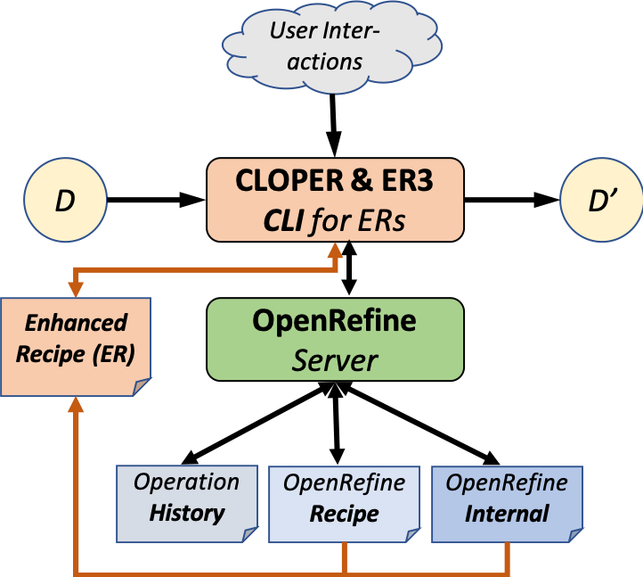
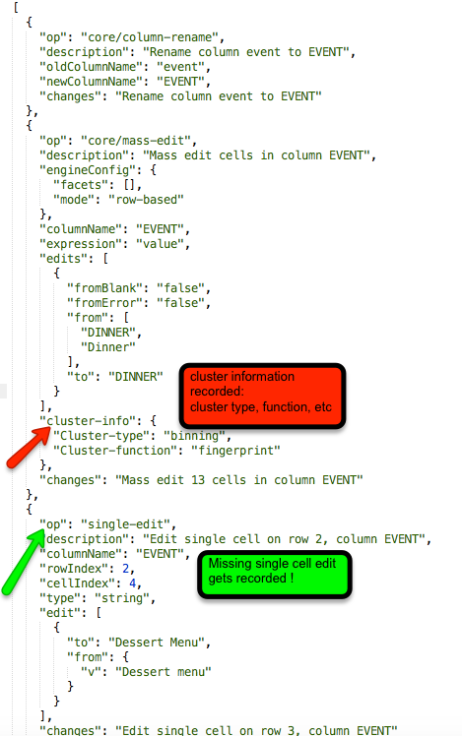
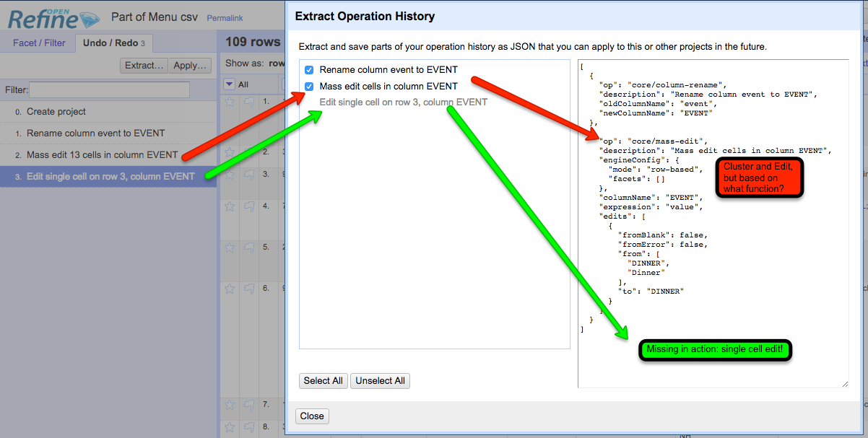
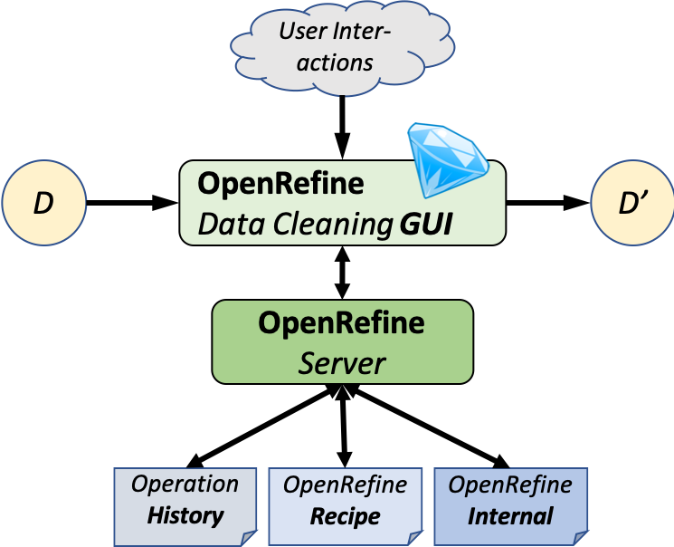
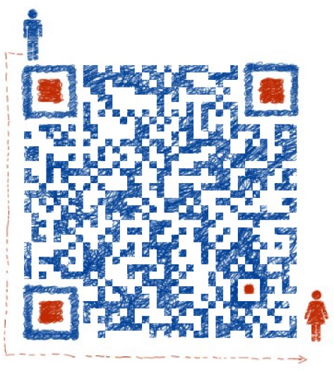


Modeling Provenance and Understanding Reproducibility
for OpenRefine Data Cleaning Workflows
Timothy McPhillips, Lan Li, Nikolaus Parulian, and Bertram Ludäscher School of Information Science, University of Illinois at Urbana-Champaign
Introduction
Revealing the steps taken to clean a data set is critical to making any research using the data transparent and reproducible. OpenRefine^{[1]} is a popular tool for exploring, profiling, and cleaning datasets using a spreadsheet-like interface. Here we report early results from an investigation into how the records captured by OpenRefine can:
Facilitate reproduction of complete, real-world data cleaning workflows.
Support queries and visualizations of the provenance of cleaned data sets for review.
Fig 1. OpenRefine stores records of operations carried out by a researcher in the process of transforming input dataset D to yield cleaned data set D’. It exposes these records as a browsable operation history that serves as the interface to its undo/redo feature; and as exportable recipes that can be reused to clean other data sets.
Prototype
Fig.2. CLOPER and ER3
The prototype consists of two systems, CLOPER (Command-Line OpenRefine Prototype for Enhanced Recipes) and ER3 (Enhanced Recipe Re-Runner) (Fig.2), both of which use a Python client library [2] to communicate with an OpenRefine server. CLOPER can execute OpenRefine operations via a command-line driven interface (i.e. without a GUI) and adds missing prospective information to recipes. ER3 can then run those enhanced recipes and demonstrate the improved transparency, reproducibility, and reusability.
CLOPER (Command-Line OpenRefine Prototype for Enhanced Recipes):
CLOPER is developed to enhance the native OpenRefine recipes as follows：
- When users select operations as Cluster & Edit , CLOPER is able to capture prospective information such as the clustering method with associated functions and parameters.
For operation single cell edit , the missing retrospective information can be extracted from internal OpenRefine files and made it explicit by CLOPER.
After the user has finished the data cleaning procedure with CLOPER, an enhanced recipe would be generated, which has captured more necessary and complete provenance information compared with the native OpenRefine recipe.
ER3 (Enhanced Recipe Re-Runner):
ER3 is developed to verify the reusability of the enhanced recipe generated by CLOPER.
- Input messy dataset, enhanced recipe to ER3.
- ER3 will activate OpenRefine server and execute the clean dataset which is same as the output clean dataset from CLOPER.
Use Case
Fig.3. In the left part, from step 1-3 of the history H (background, left) the user can extract a machine-readable JSON recipe R (bright foreground, right). The mass edit in step 2 is captured via a set of rules {from:old → to:new}, but it is not recorded which function was used to create these rules. The single cell edit in step 3 is greyed out and cannot be selected by the user for inclusion in R. Neither H nor R indicate what this edit was. In the right part, compared with the original R, CLOPER helps to generate the Enhanced Recipe which can fix these missing info problems
2. ER3
Input : Menu.csv, Enhanced.json
Software: ER3
Output : CleanedMenu.csv, OpenRefine By-products (Operation history, OpenRefine Recipe, OpenRefine Internal project files)
Approach
We propose to complete the missing information by capturing names and parameters of user-invoked functions, and by exposing retrospective provenance hidden in internal project files.
Acknowledgments
Research reported in this poster was supported in The Whole Tale program and NSF (National Science Foundation). And the author wishes to thank for Prof. Bertram Ludäscher and Qian Zhang guidance and support during Summer 2018, to Yi-Yun Cheng and Santiago Núñez-Corrales , for their collaborate with user story construction.
Goals & Desiderata
Modeling. OpenRefine has its own idiosyncratic terminology for describing the records it keeps and the capabilities it provides using them. We are mapping the OpenRefine concepts of data, operations, and recipes to those of the reproducible research and provenance communities.
Reproducibility. Recipes exported from OpenRefine include neither the initial data import step, nor any edits made manually to individual cells. We are providing means to use the records kept by OpenRefine to facilitate end-to-end reproducibility of data cleaning workflows.
Transparency. Displaying lists of operations and the ability to revisit past states one at a time provide limited means for interrogating how data was cleaned. We aim to make data cleaning workflows and their products easy to query — prospectively and retrospectively — to answer any questions researchers may have about the provenance of cleaned data sets.
References
[1] OpenRefine: A free, open source, powerful tool for working with messy data. http://openrefine.org/ (2018)
[2] 2. Makepeace, P., Lohmeier, F.: OpenRefine Python client library. https://github.com/opencultureconsulting/openrefine-client/ (2018)
[3] What’s on the Menu? http://menus.nypl.org/data (03/16/2019)
Contact Information
Email: tmcphill@illinois.edu
GitHub Project Repositories:
https://github.com/idaks/openrefine-provenance
https://github.com/idaks/openrefine-reproducibility
Use Case
1. CLOPER
Input : Menu.csv [3] (“messy” input dataset)
Software : CLOPER
Output: CleanedMenu.csv (“clean” output dataset), Enhanced Recipe (Enhanced.json), OpenRefine By-products (Operation history, OpenRefine Recipe, OpenRefine Internal project files)
Notes:
The model implicit in histories and recipes exhibits both prospective and retrospective provenance features, but is incomplete in at least two ways:
Functions resulting in mass edits.
Single cell edits are not captured.
➔
OpenRefine contains prospective and retrospective provenance features.
Single cell edits are not captured in the recipe (b/c they are not reusable)
Not all function names, types, and parameters are recorded.
Fig.1 caption text: use smaller font size than Introduction contents text.
Header Challenges: use the same font color as for Motivations and Introduction
Subleaders Transparency, reproducibility, reusability: use special font (color, italics, underline, etc.) to highlight them
In Contributions: highlight “complete the missing information” instead of “internal project files”
In Prototype: format as follows:
comprehensive paragraph
CLOPER ()
CLOPER is developed … as follows:
when users …
for operations ….
after the user has …
ER3 ()
ER3 is developed to ...
Use case:
Move bullet point 1 and 2 both to the rightmost column
Don’t repeat input and output in 1 & 2
Naming convention:
Input: Menu.csv
Output: CleanedMenu.csv
fig.3 RHS: highlight json code with rectangular box corresponding to cluster information and single-edit, respectively
Blue for highlight part : …
Code font: consoles , bold, different color and font , italic…
Author and acknowledgement …
Graph description….
Rearrange the column for use-case part
Motivation ----terminologies
Contribution s : delete?
Introduction--> figure 1. → challenges → motivation → contributions Native OR && Enhance OR (side by side or in different ) ----screenshot, fig 1. from paper; editor for enhanced recipe …(code block) before prototype / after prototype…
Check
Description (three different colors for the enhanced recipe , same color with paper,… improvement part keep the same )
ER3 and CLOPER (naming…) mention the naming restriction
Separate the blocks under titles
comprehensive paragraph
CLOPER ()
CLOPER is developed … as follows:
when users …
for operations ….
after the user has …
ER3 ()
ER3 is developed to ...
Logo issue … ischool logo
Acknownledgement && references separate

