Slide 1
Regular Path Query with SQLite Implementation
Qiwen Wang¹, Hui Lyu², Yang Cao^{2,3}, Bertram Ludäscher^{1,2,3}
¹Department of Computer Science, University of Illinois at Urbana-Champaign,
²School of Information Sciences, University of Illinois at Urbana-Champaign,
³ National Center for Supercomputing Applications

Slide 2
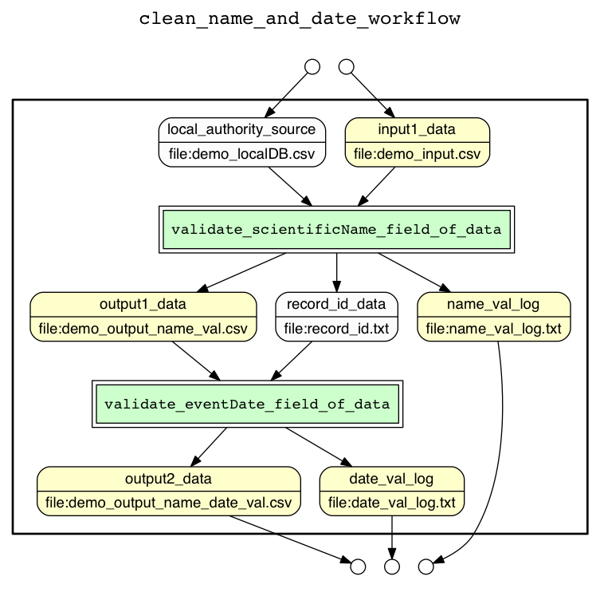
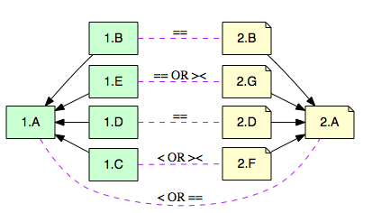
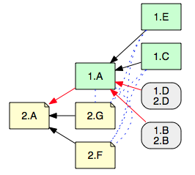
Our Group
Lead by Bertram Ludäscher
Data and knowledge management
Design and optimize scientific workflow
Data provenance
YesWorkflow Project/
Scientific workflow modeling
Euler Project/
Taxonomic alignment

Slide 3
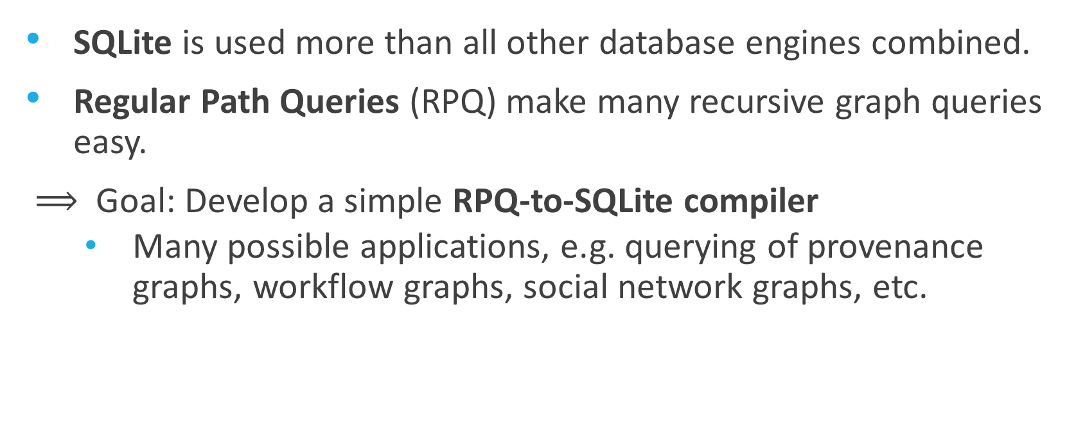
Motivation
SQLite is used more than all other database engines combined.
Regular Path Queries (RPQ) make many recursive graph queries easy.
$⟹$ Goal: Develop a simple RPQ-to-SQLite compiler
Many possible applications, e.g. querying of provenance graphs, workflow graphs, social network graphs, etc.
Notes:
Zero-configuration and serverless
Data provenance are crucial to understand in data-oriented research
Seek a way to better understand how and why the result was derived in a workflow system.
Trace the origin of the resulting data back by analyzing dependencies of results in terms of inputs and intermediate data and steps often needed

Slide 4
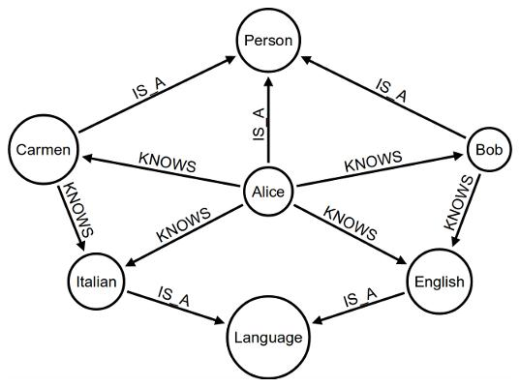

What is Regular Path Query(RPQ)
A Data Graph $G = ⟨V,E,ρ⟩$, where:
$V$ is a finite set of nodes;
$E⊆V ×Σ×V$is a set of labeled edges, $Σ$ is the set of labels
$ρ$is a function that assigns a data value to each node
Regular Path Query:
A query in the form of regular expression
Find matching in the data graph to the regular expression
Return pairs of nodes in a graph
Question: Who is a person?
Query: IS_A.[Person]
Result: (Alice , Person)
(Bob , Person) (Carmen, Person)

Slide 5
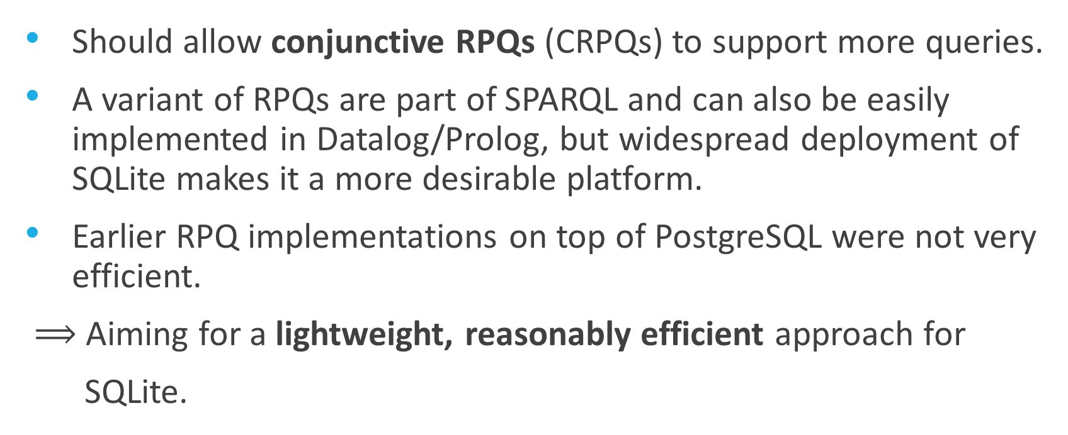
Challenge
Should allow conjunctive RPQs (CRPQs) to support more queries.
A variant of RPQs are part of SPARQL and can also be easily implemented in Datalog/Prolog, but widespread deployment of SQLite makes it a more desirable platform.
Earlier RPQ implementations on top of PostgreSQL were not very efficient.
$⟹$ Aiming for a lightweight, reasonably efficient approach for
SQLite.

Slide 6
Approach – a SQLite Compiler

Slide 7
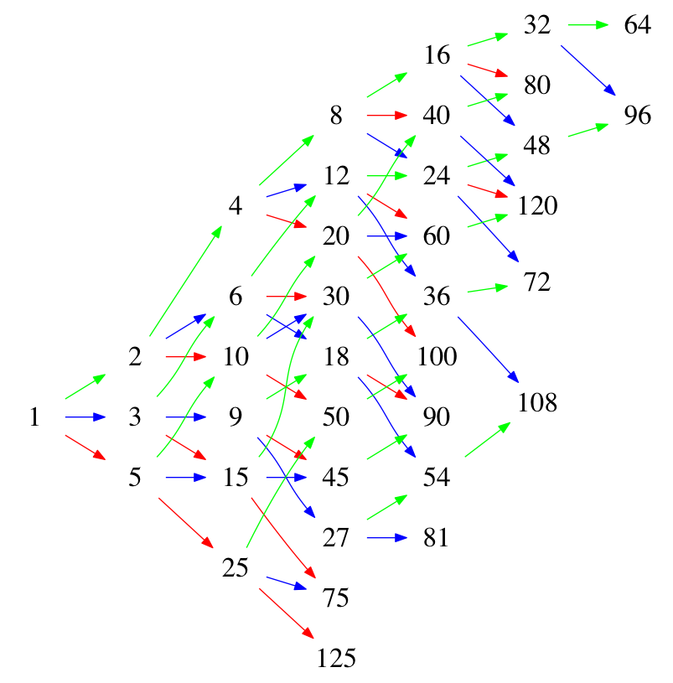
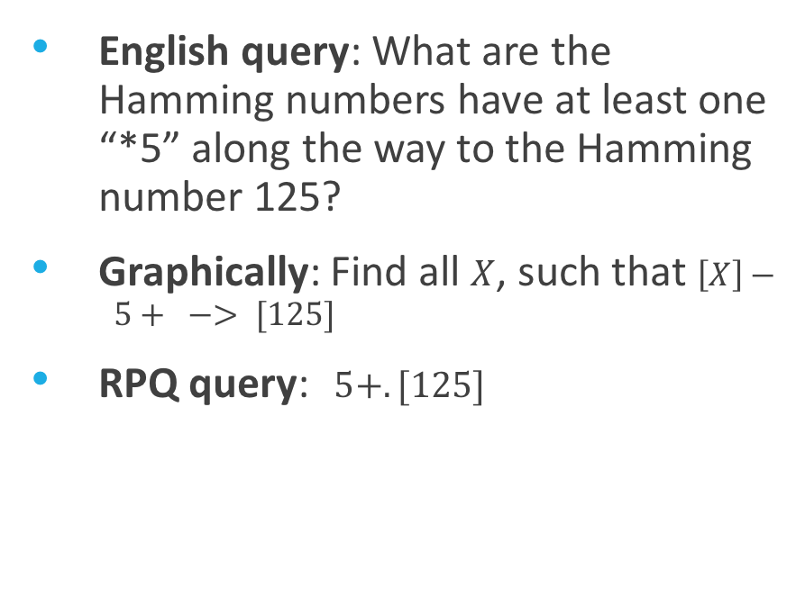
Hamming Numbers
English query: What are the Hamming numbers have at least one “*5” along the way to the Hamming number 125?
Graphically: Find all $X$, such that $\left[X\right]− 5+ −> [125]$
RPQ query:$5+.[125]$
*2
*3
*5
Fish

Slide 8

Hamming Numbers
RPQ query:$5+.[125]$
*2
*3
*5
Conc
5+.[125]
Plus
5+
125
5
Traverse with Post-order traversal
Fish

Slide 9

Hamming Numbers
RPQ query$5+.\left[125\right]$ to SQLite
Template to Generate CTE for a label:
Temp{0}(start, end) AS (
SELECT fish.startNode, fish.endNode
FROM fish
WHERE fish.label = "{1}")
Conc
5+.[125]
Temp1(start, end) AS (
SELECT fish.startNode, fish.endNode
FROM fish
WHERE fish.label = "5")
Plus
5+
125
5
Traverse with Post-order traversal

Slide 10

Hamming Numbers
RPQ query$5+.\left[125\right]$ to SQLite
Template to Generate CTE for PLUS:
{0}(start, end) AS (
SELECT * FROM {1}
UNION
SELECT a.start, b.end
FROM {0} AS a,{1} AS b
WHERE a.end = b.start)
Note: {0} is the new temp table,
{1} is the previously generated temp table corresponds to label 5
Conc
5+.[125]
temp2(start, end) AS (
SELECT * FROM temp1
UNION
SELECT a.start, b.end
FROM temp2 AS a, temp1 AS b
WHERE a.end = b.start)
Plus
5+
125
5
Traverse with Post-order traversal

Slide 11

Hamming Numbers
RPQ query$5+.\left[125\right]$ to SQLite
WITH RECURSIVE
Temp1(start, end) AS (
...
WHERE fish.label = "5"),
temp2(start, end) AS (
...
WHERE a.end = b.start),
temp3(start, end) AS (
…
WHERE a.endNode = "125”),
temp4(start, end) AS (
…
WHERE a.end = b.start
select * from temp4;

Slide 12
Hamming Numbers
Run SQLite representing RPQ query 5+.[125]
Results:
*2
*3
*5
StartNode | EndNode
1 | 125
5 | 125
25 | 125
1
5
Can you find the corresponding path on the fish graph?
25
Fish

Slide 13
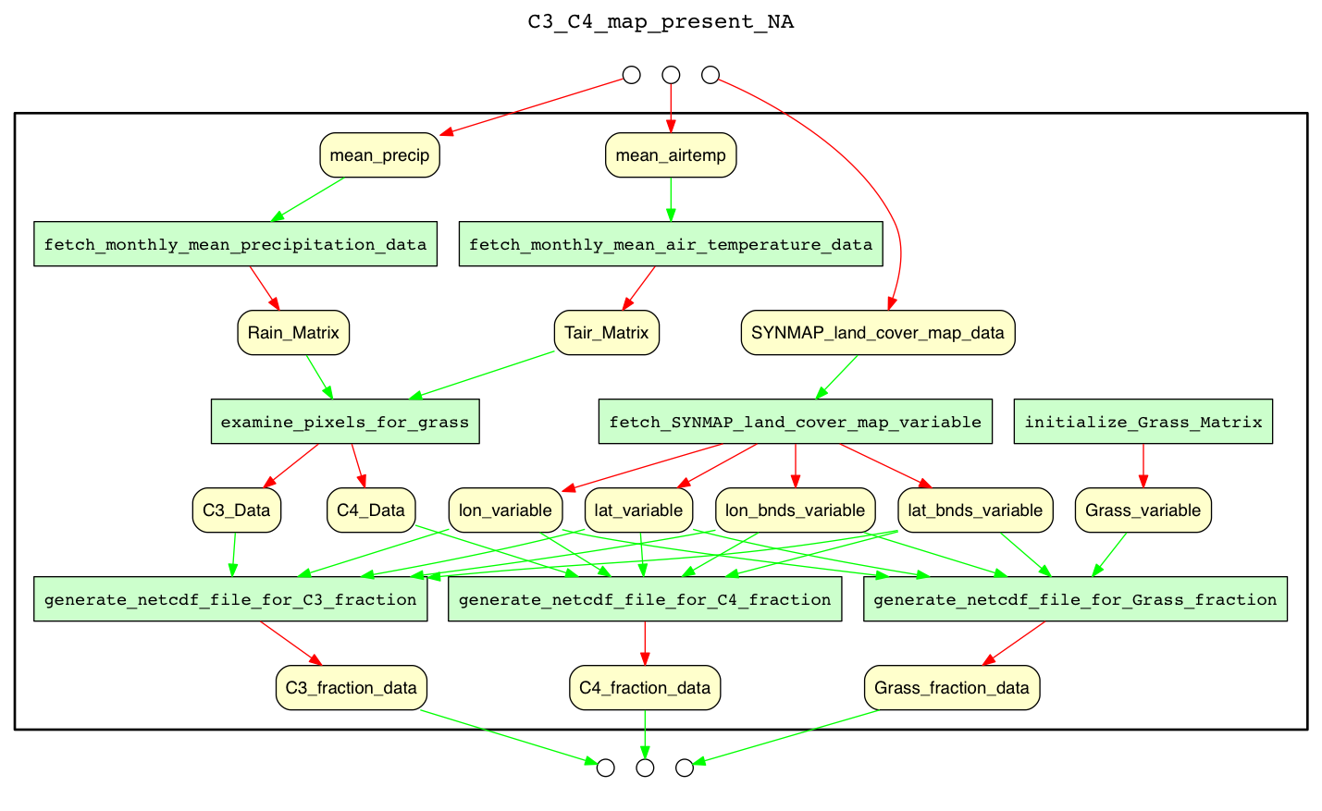

YesWorkflow(YW) Use Case
English query: what are script outputs that are downstream of input data mean_precip?
RPQ query: $[\text{mean}\text{_}precip].(in.out)+$
Notes:
We apply YW in a DataONE use case called C3C4, i.e., a MATLAB script to process climate science datasets

Slide 14
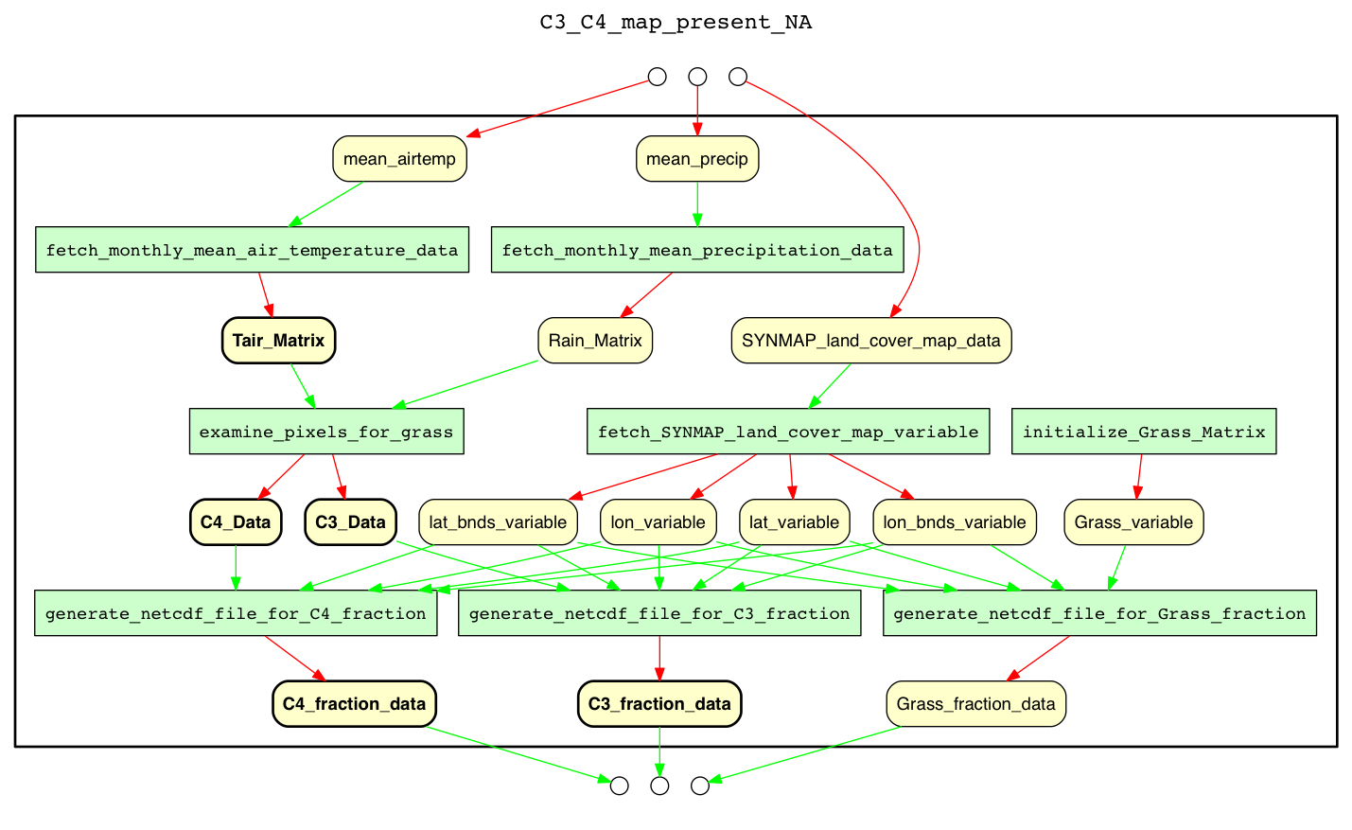
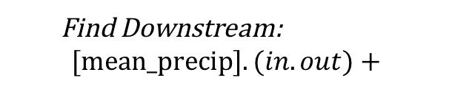
Find Downstream:
$$[\text{mean}\text{_}\text{precip}].(in.out)+$$
in
out
Notes:
From this RPQ, we can see that among three outputs of the workflow, only two of them are related to the input mean_airtemp, that would otherwise hardly be observed only from the original workflow.

Slide 15
Conclusion
In this research, we implemented an RPQ to SQLite compiler that uses CTEs to express recursive queries.
This engine can be run on any system that comes with SQLite.
It also supports complex traversals on any type of graph, but is especially useful in answering data dependency queries over workflow and provenance graphs.
Git Repo: https://github.com/qwang70/rpq-engine-project

