Slide 1

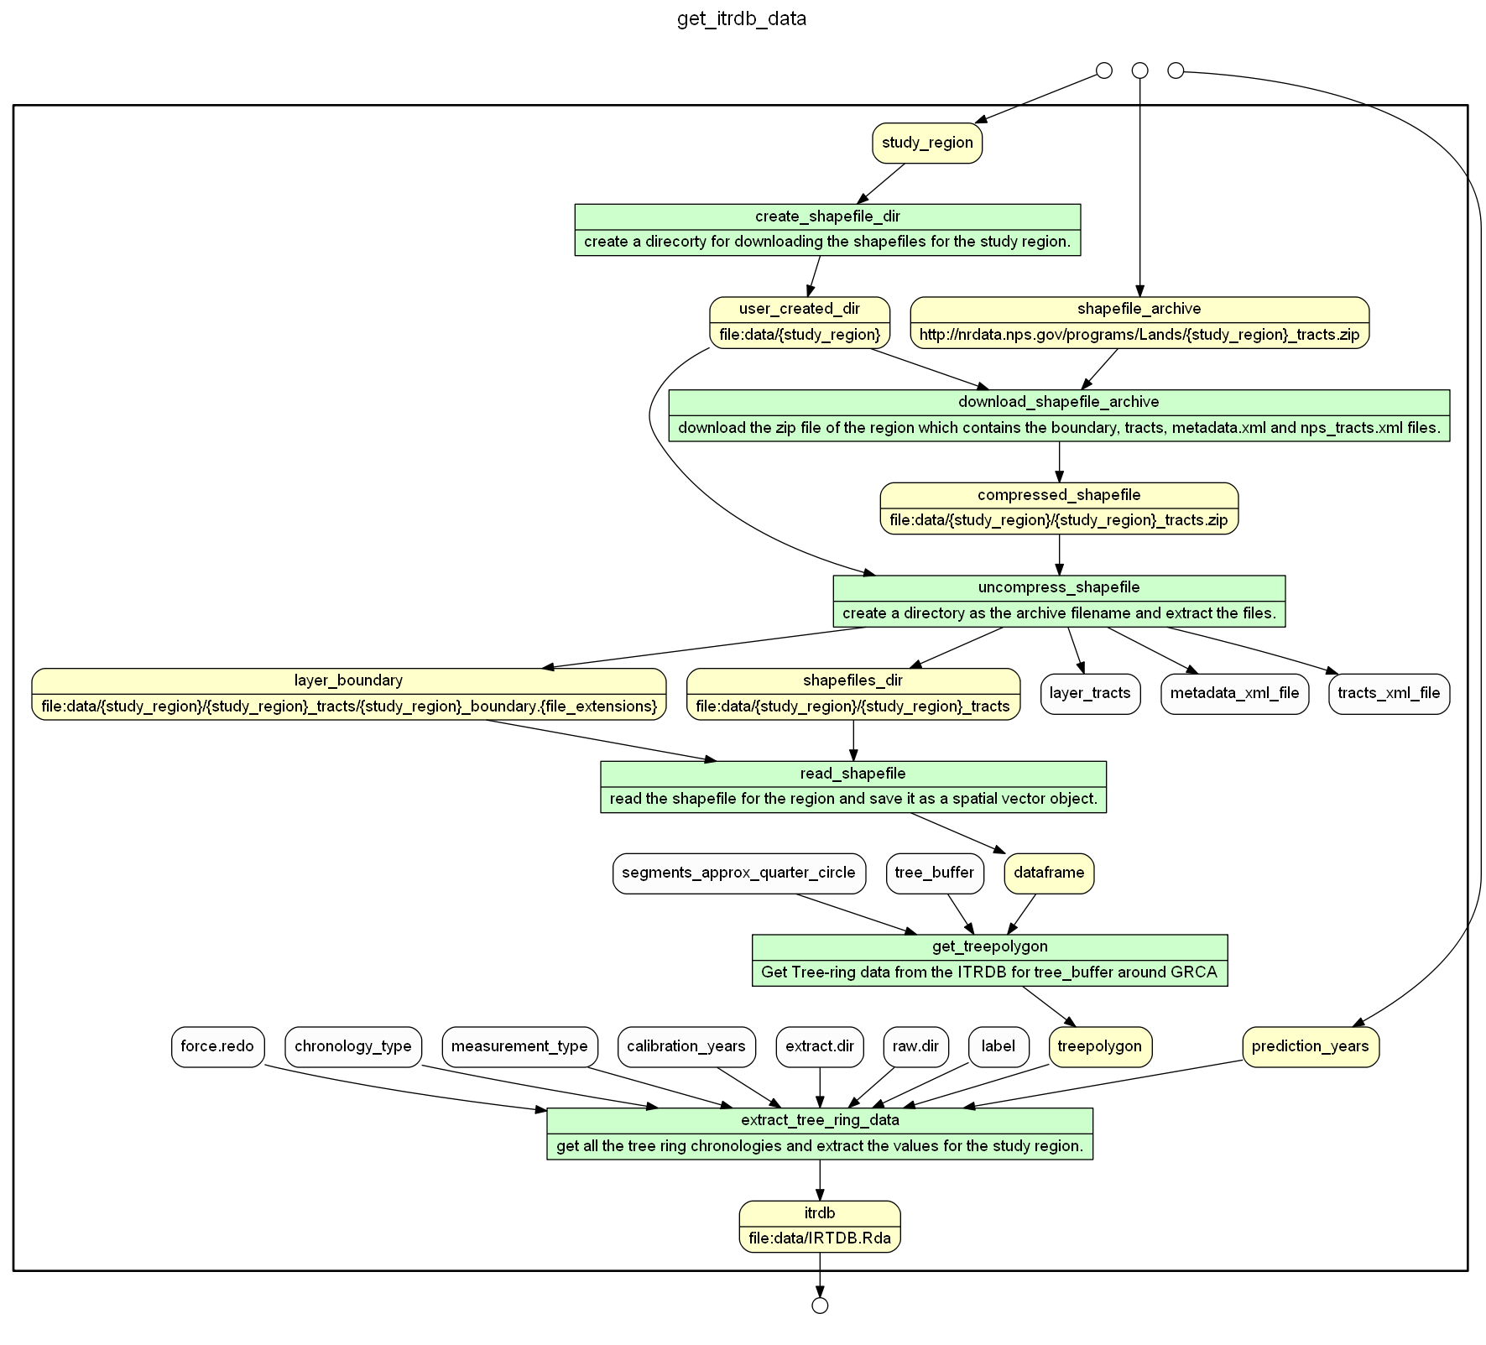
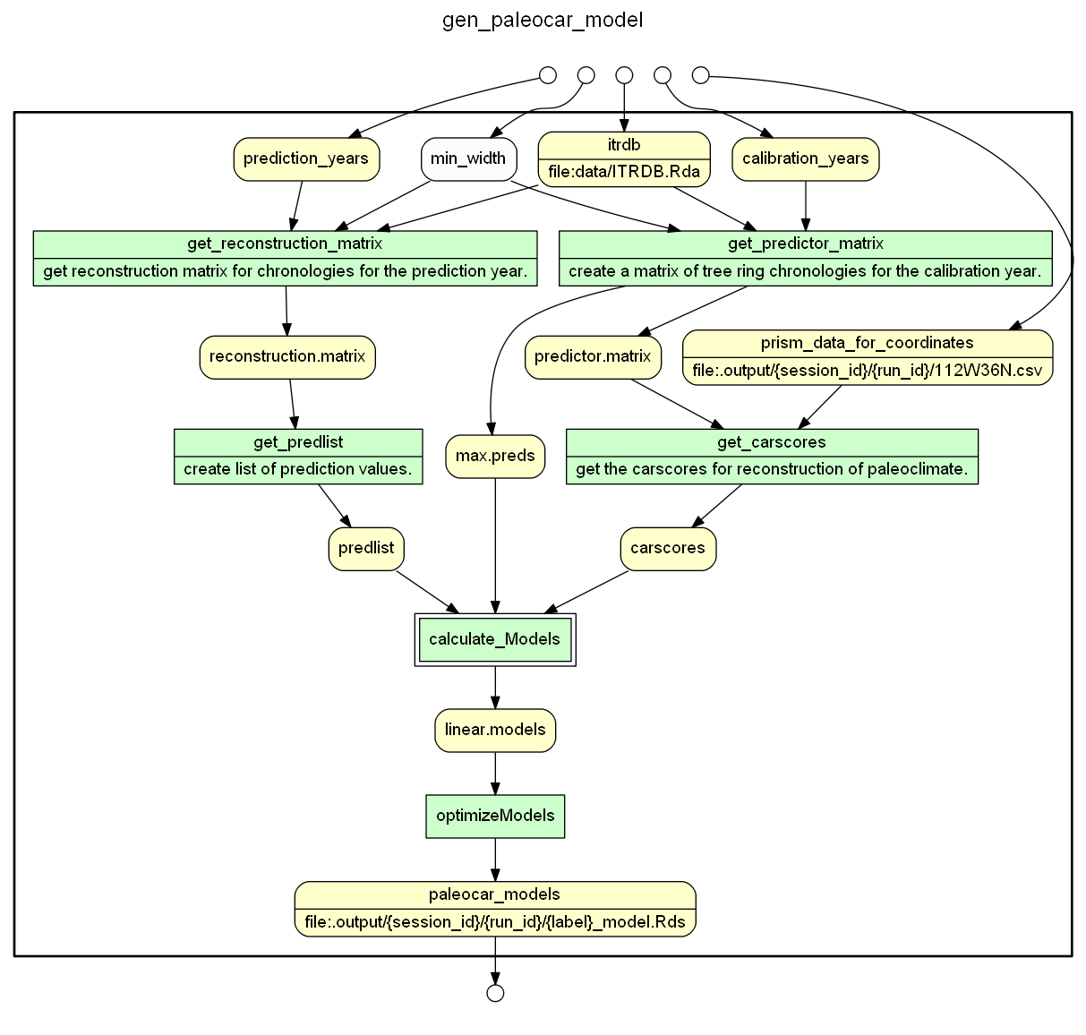
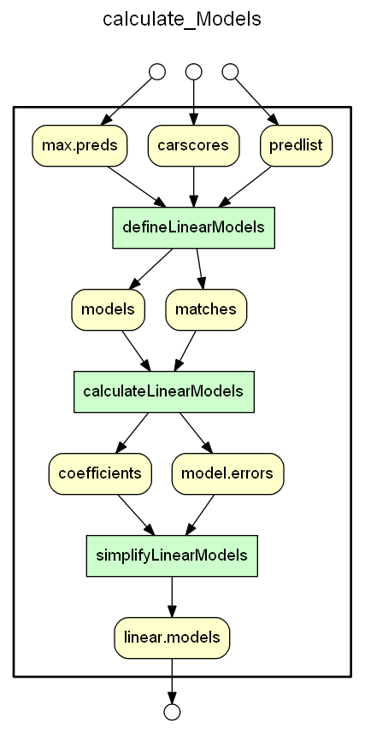
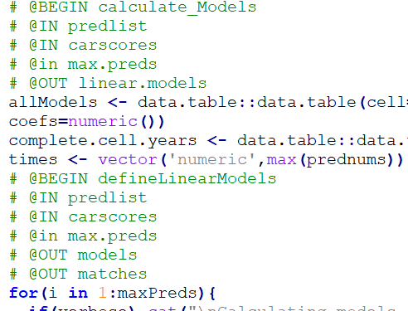
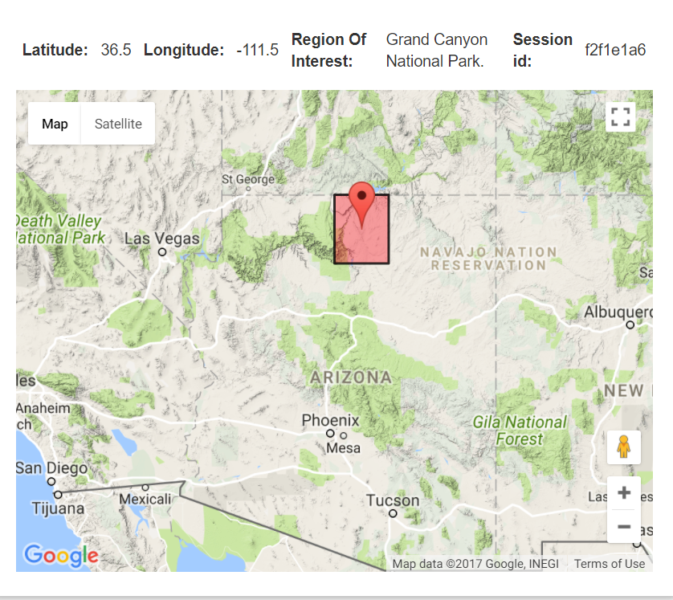
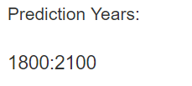
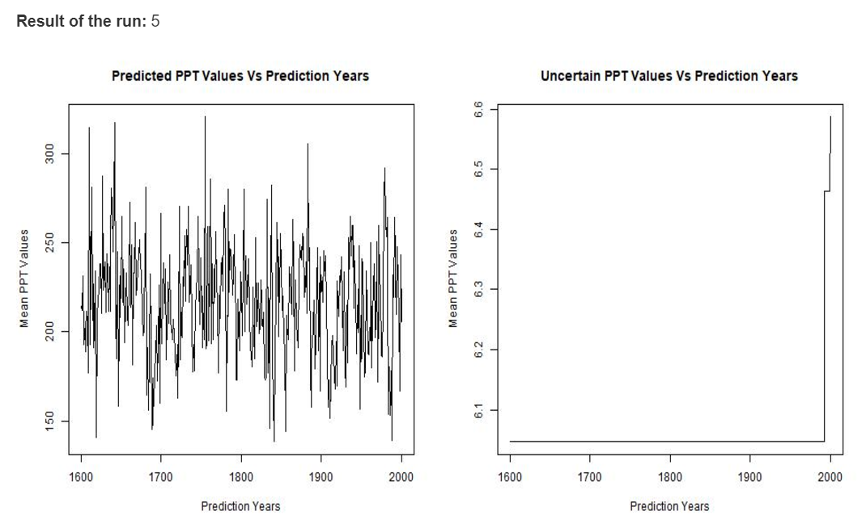
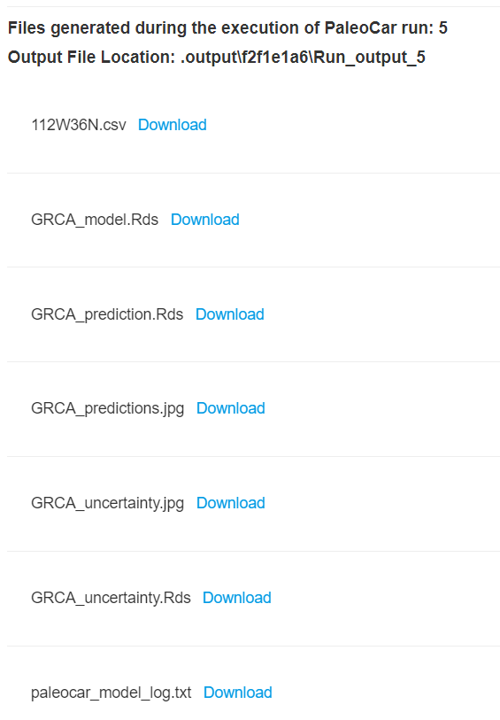
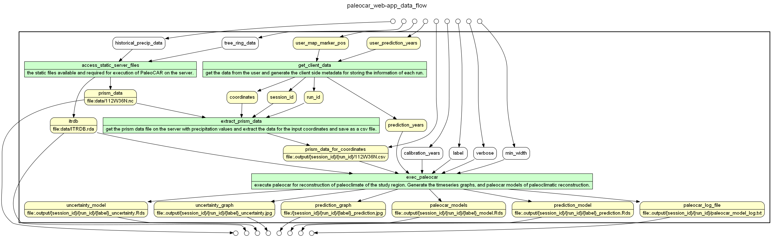
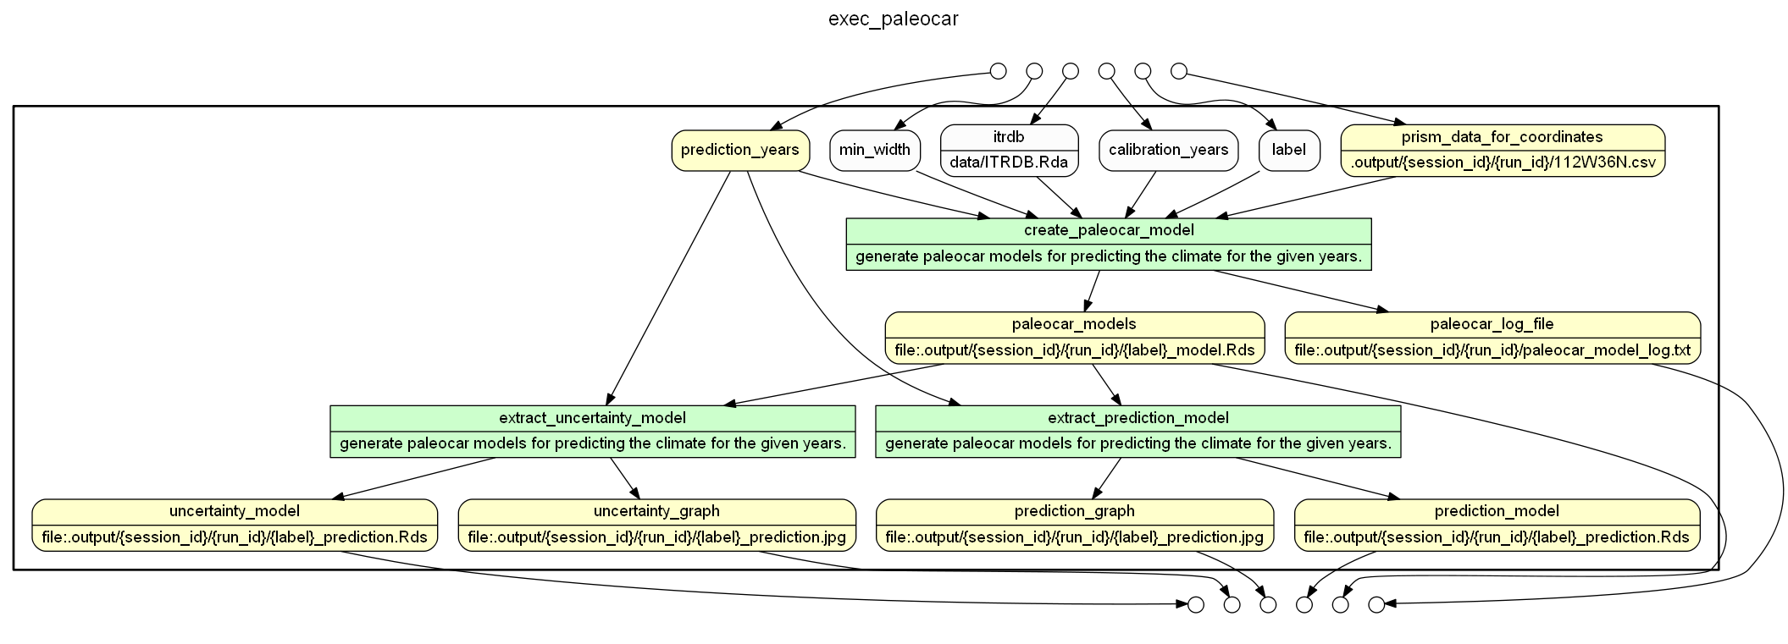
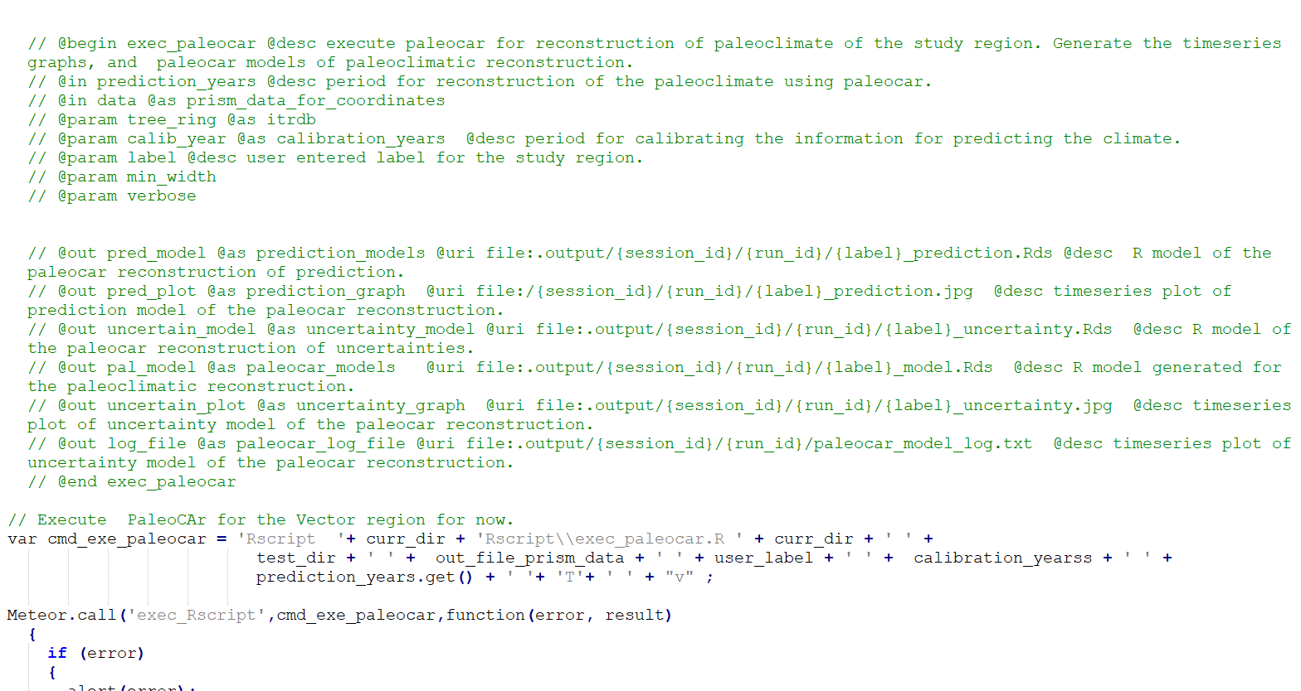


Opening the Black Box of a Paleoclimate Reconstruction based on PaleoCAR
Pratik Shrivastava¹, Timothy McPhillips¹, Kyle Bocinsky², Bertram Ludäscher¹
¹University of Illinois Urbana-Champaign, ²Washington State University
Challenges
Software comprising a scientific study or method often are black boxes.
Web applications can simplify tool usage but may further obfuscate the workings of the underlying software.
Information about prerequisite, intermediate, and the result dataset remains screened.
The information about overall dataflow between code blocks also remains hidden.
The relationship between parameters and the code block is not exposed.
Inputs for Web Application
Location coordinates:
Year Range
Results of PaleoCAR
YW graph of tree ring data
YW graph of PaeloCAR Models
YW annotations for nested Sub-workflow
Findings & Future Work:
The web application YesWorkflow graph tallies with working of the web application which integrates PaleoCAR.
YesWorkflow graph helped in identification of the pre-requisite dataset and the parameters required for execution of PaleoCAR.
The parts which are executed once or multiple times by changing the user input can be easily distinguished.
The data dependencies are tracked using graph and provenance queries.
The prospective provenance information of the pre-requisite dataset is also generated.
YesWorkflow can facilitate querying of the prospective provenance.
YesWorkflow can be used to reconstruct retrospective provenance information.
Enable YW to extract retrospective provenance from R data files (analogous to log file extraction in YW now).
Ability to view the actual code corresponding to a particular script or code block via the web app.
YesWorkflow (YW)
YesWorkflow helps in uncovering shrouded information from the software-based scientific methods.
Users declare scientifically significant steps and reveal data dependencies and dataflow via YW annotations, typically embedded in script comments.
The resulting YW models (a.k.a. prospective provenance) can be rendered as a workflow graph, showing what kinds of provenance graphs can be expected after execution.
The expected (prospective) provenance graph can be linked with retrospective (runtime) observables, providing additional cross-validation and checking opportunities: the observed provenance then either corroborates the declared YW model or indicates possible modeling errors.
YW graph of PaleoCAR Web Application
YW Graph for exec PaloeCAR block
What is PaleoCAR?
PaleoCAR implements a correlation-adjusted regression of tree-ring series with 100+ years of contemporary data modeled by PRISM at an 800-m scale to retrodict climatic variables, notably precipitation and temperature over the last 2000 years.
PaleoCAR is an R package, which consists of the functions that helps users to recreate the spatiotemporal paleoclimate reconstructions.
The information generated by PaleoCAR is stored in R object (*.rds)
Scripts with YW annotations
Interesting Questions that YW graphs helps to answer.
The data results that are directly influenced by the input year range.
The data used by application for every run.
Which parameters were required for each and every run.
How were the data sets used in every run of the application acquired or (pre)computed?
References
Bocinsky R Kyle, Kohler A. Timothy. (2014, October 21). A 2,000-year reconstruction of the rain-fed maize agricultural niche in the US Southwest. Nature Communications(5618). doi:10.1038/ncomms6618
Bocinsky, R. K. (2016, February). paleocar. Retrieved from github: https://github.com/bocinsky/paleocar#paleocar
McPhillips, T. (2015, March 30). YesWorkFlow. Retrieved from GitHub: https://github.com/yesworkflow-org/yw-prototypes/wiki
Github Repository
WholeTale Internship 2017 GitHub Repo : https://github.com/idaks/wt-prov-summer-2017
Provenance Queries.
EQ3 : What out ports are qualified with URIs?
eq3(uncertainty_model).
eq3(paleocar_models).
eq3(uncertainty_graph).
eq3(prediction_model).
eq3(paleocar_log_file).
eq3(prism_data).
eq3(prism_data_for_coordinates).
eq3(itrdb).
eq3(prediction_graph).
EQ2 : What are the names N of all program blocks?
eq2(exec_paleocar).
eq2(extract_prism_data).
eq2(access_static_server_files).
eq2(get_client_data).
eq2('paleocar_web-app_data_flow').
Approach
Built a new web application for running PaleoCAR.
Users can execute PaleoCAR for a single location of GRCA region and reconstruct the paleoclimate for the user entered year range.
YW annotations are embedded in the web application file and in the PaleoCAR to expose the information of the data used and produced while reconstruction of the paleoclimate.
The YW graphs are integrated with the web application.
The data artifacts generated during the run are exposed to the user which can be compared with the YW graphs for better assessment and understanding.
Creation of datalog facts from the YW model, for querying prospective and retrospective provenance information.
Creation of the retrospective provenance information such as the tree-ring chronologies or species of trees used for reconstruction of the paleoclimate using PaleoCAR.

