Slide 2
Project ideas
Caio Silva
29-08-2023

Slide 3
Polyphenol oxidases

Slide 4
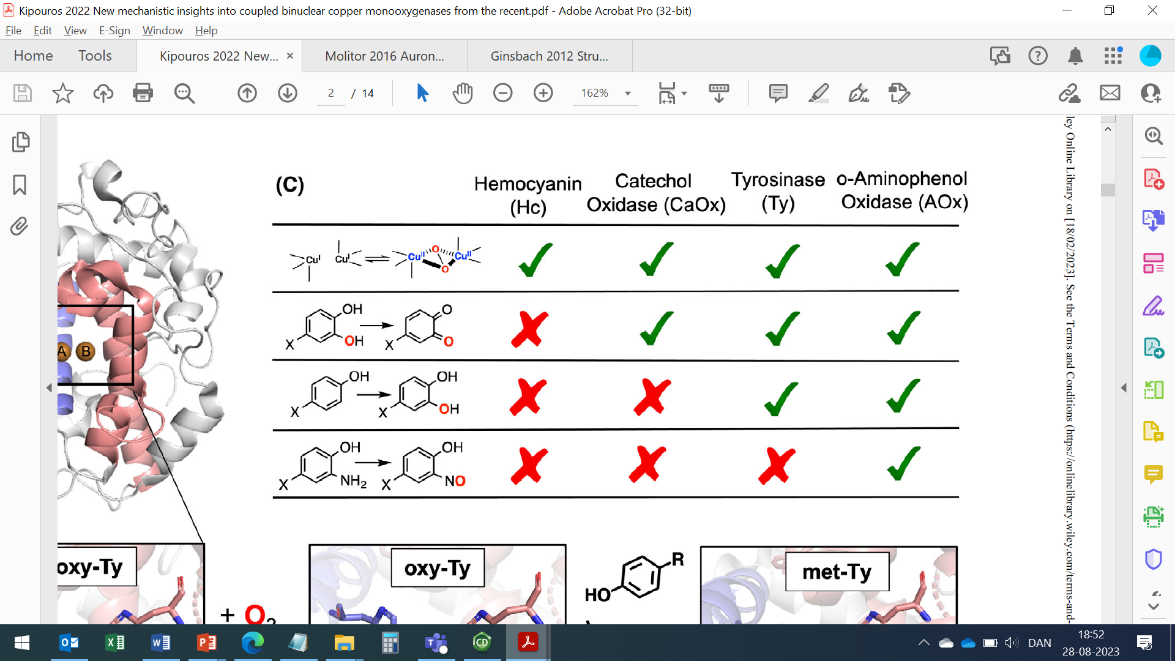
Coupled binuclear copper (CBC) proteins
Polyphenol oxidases
Hemocyanins
O₂ transportation
Tyrosinases
Catechol oxidases
O-Aminophenol oxidase
Monooxygenase + 2 e⁻ oxidation
2 e⁻ oxidation
C-nitrosation

Slide 5
(Kipouros et al. 2022)

Slide 6
Monophenolase
(Monooxygenase)
(Cresolase)
Diphenolase
(2 e- oxidation)
(Dehydrogenation)
(Cathecholase)
Non-enzymatic spontaneous polymerization
Pigments

Slide 7
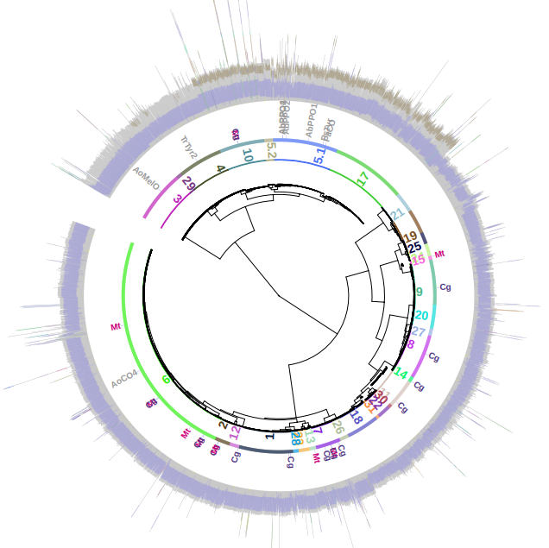
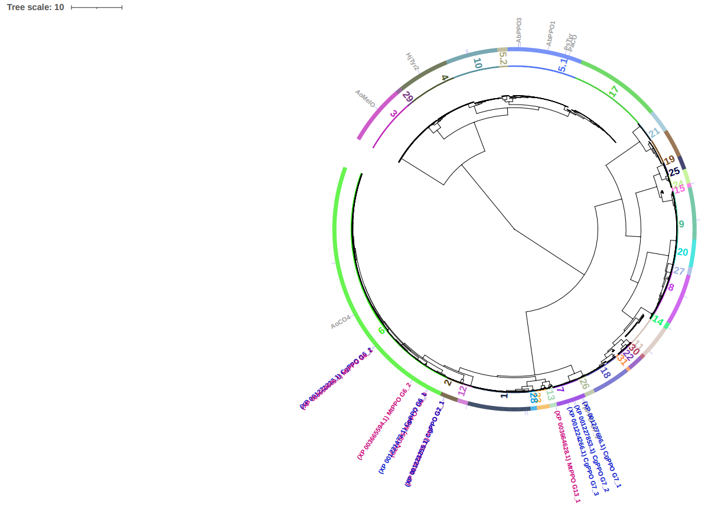
Long vs Short PPOs (Filamentous fungi)
C-terminal shielding domain
Structural differences in catalytic site (e.g. histidine pattern for CuA)
Substrate specificities
AbPPO3
MtPPO7
AbPPO3
Long PPOs
Even shorter PPOs
MtPPO-809
Lignin-derived phenolics
Methoxylated monophenols
Non-methoxylated monophenols
CgPPO-1473
Short PPOs
MtPPO7
SP
MtPPO-010
PpPPO-c2092
Short PPOs
( )
PF00264
CgPPO-266
Long PPOs
( )
PF00264
PF18132
Selected enzymes
Shielding domain

Slide 8
G
G
G
All short-PPOs
Not AbPPO3 (long PPO)
Guaiacyl (G) units
Some short-PPOs
Not AbPPO3 (long PPO)
S
S
S
Syringyl (S) units
Not short-PPOs (one exception)
AbPPO3 (long PPO)
H
H
H
p-Coumaroyl (H) units

Slide 9
MtPPO7
MtPPO-809
MtPPO-010
CgPPO-1473
CgPPO-266
PpPPO_c2092
(not AbPPO3)
G
Reducing agents
PPO
PPO
PPO
Only:
MtPPO7
CgPPO-1473
CgPPO-266
S

Slide 10
Some questions
Why do short-PPOs and long-PPOs differ in their ability to attack H and G-type compounds?
Why do short-PPOs differ in their ability to attack G and S-type compounds?

Slide 11
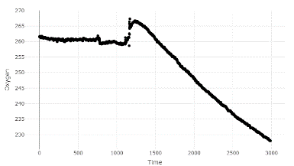
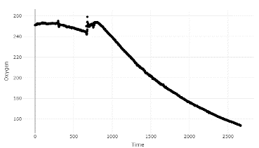
MtPPO7 uses lignin and raw birchwood as a substrate
MtPPO7
MtPPO7
[O₂]
[O₂]
Organosolv lignin
Birchwood
0 1000 2000 3000
0 1000 2000 3000
Time (s)
Time (s)

Slide 12
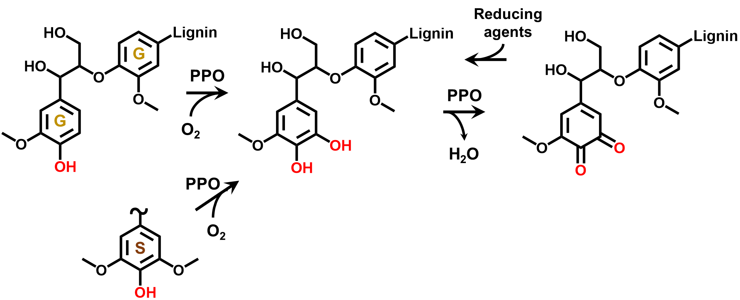
Can we use PPOs to introduce catechol groups in lignin?

Slide 13
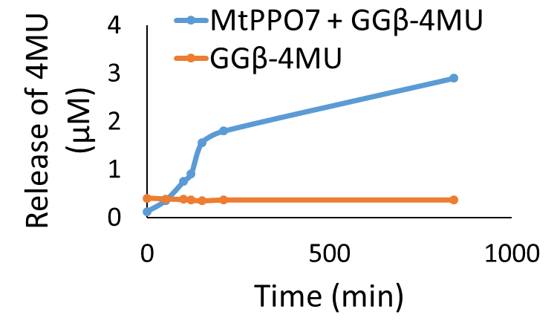
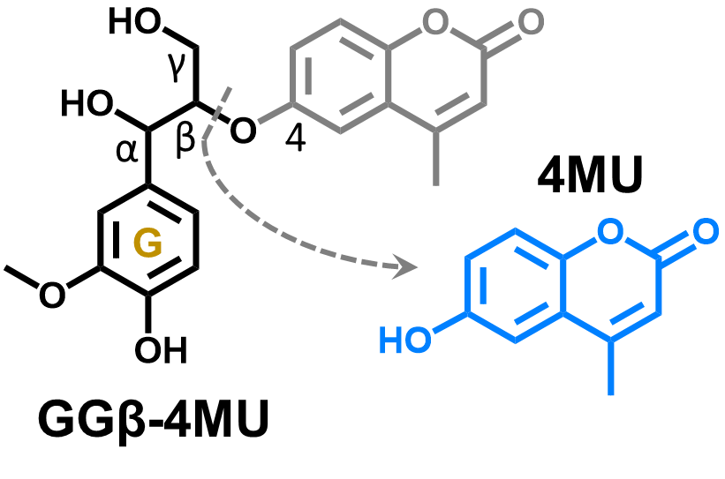
MtPPO7 leads to β-O-4 bond cleavage in lignin model dimer

Slide 14
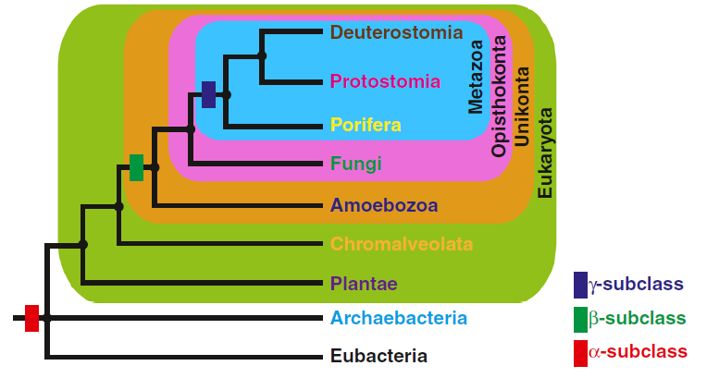
Aguilera et al (2013)

Slide 15
Research questions/goals
Do a classification of Coupled Binuclear Copper (CBC) proteins across all domains of life
Find key differences in the sequence/structure of CBC proteins
Find Structure-function relationship among PPOs

Slide 16
VAO/PCMH family

Slide 17
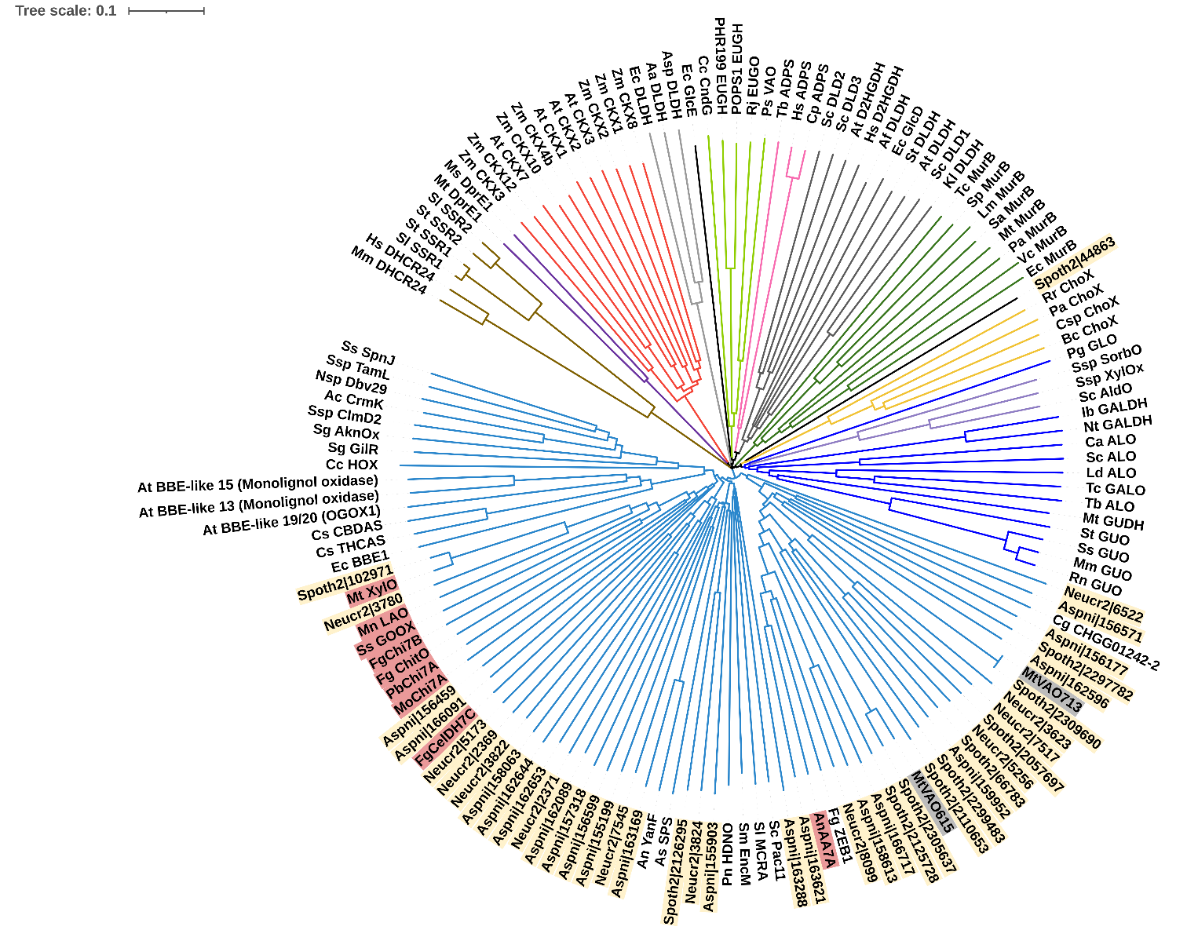
CAZy AA4 ≈
4-phenol
oxidizing (4PO)
Alkyl-dihydroxyacetone phosphate synthases
VAO/PCMH flavoprotein family
Cytokinin dehydrogenases
α-hydroxy acid dehydrogenases
UDP-N-acetylglucosamine enolpyruvate reductase (MurBs)
DprEs
Sterol reductases
Cholesterol oxidases
Alditol oxidases
Active on monolignols
Aldonolactone oxidoreductases
Oligoglucurononide oxidase
Cannabidiolic acid synthase
Tetrahydrocannabinolic acid synthase
BBE-like
Biosynthesis of secondary metabolites
AA7 (oligosaccharide oxidases/dehydrogenases)
AA7(?)
AA7(?)
AA7(?)
AA7(?)
Biosynthesis of secondary metabolites
AA7(?)
Biosynthesis of secondary metabolites
Biosynthesis of secondary metabolites

