Slide 1
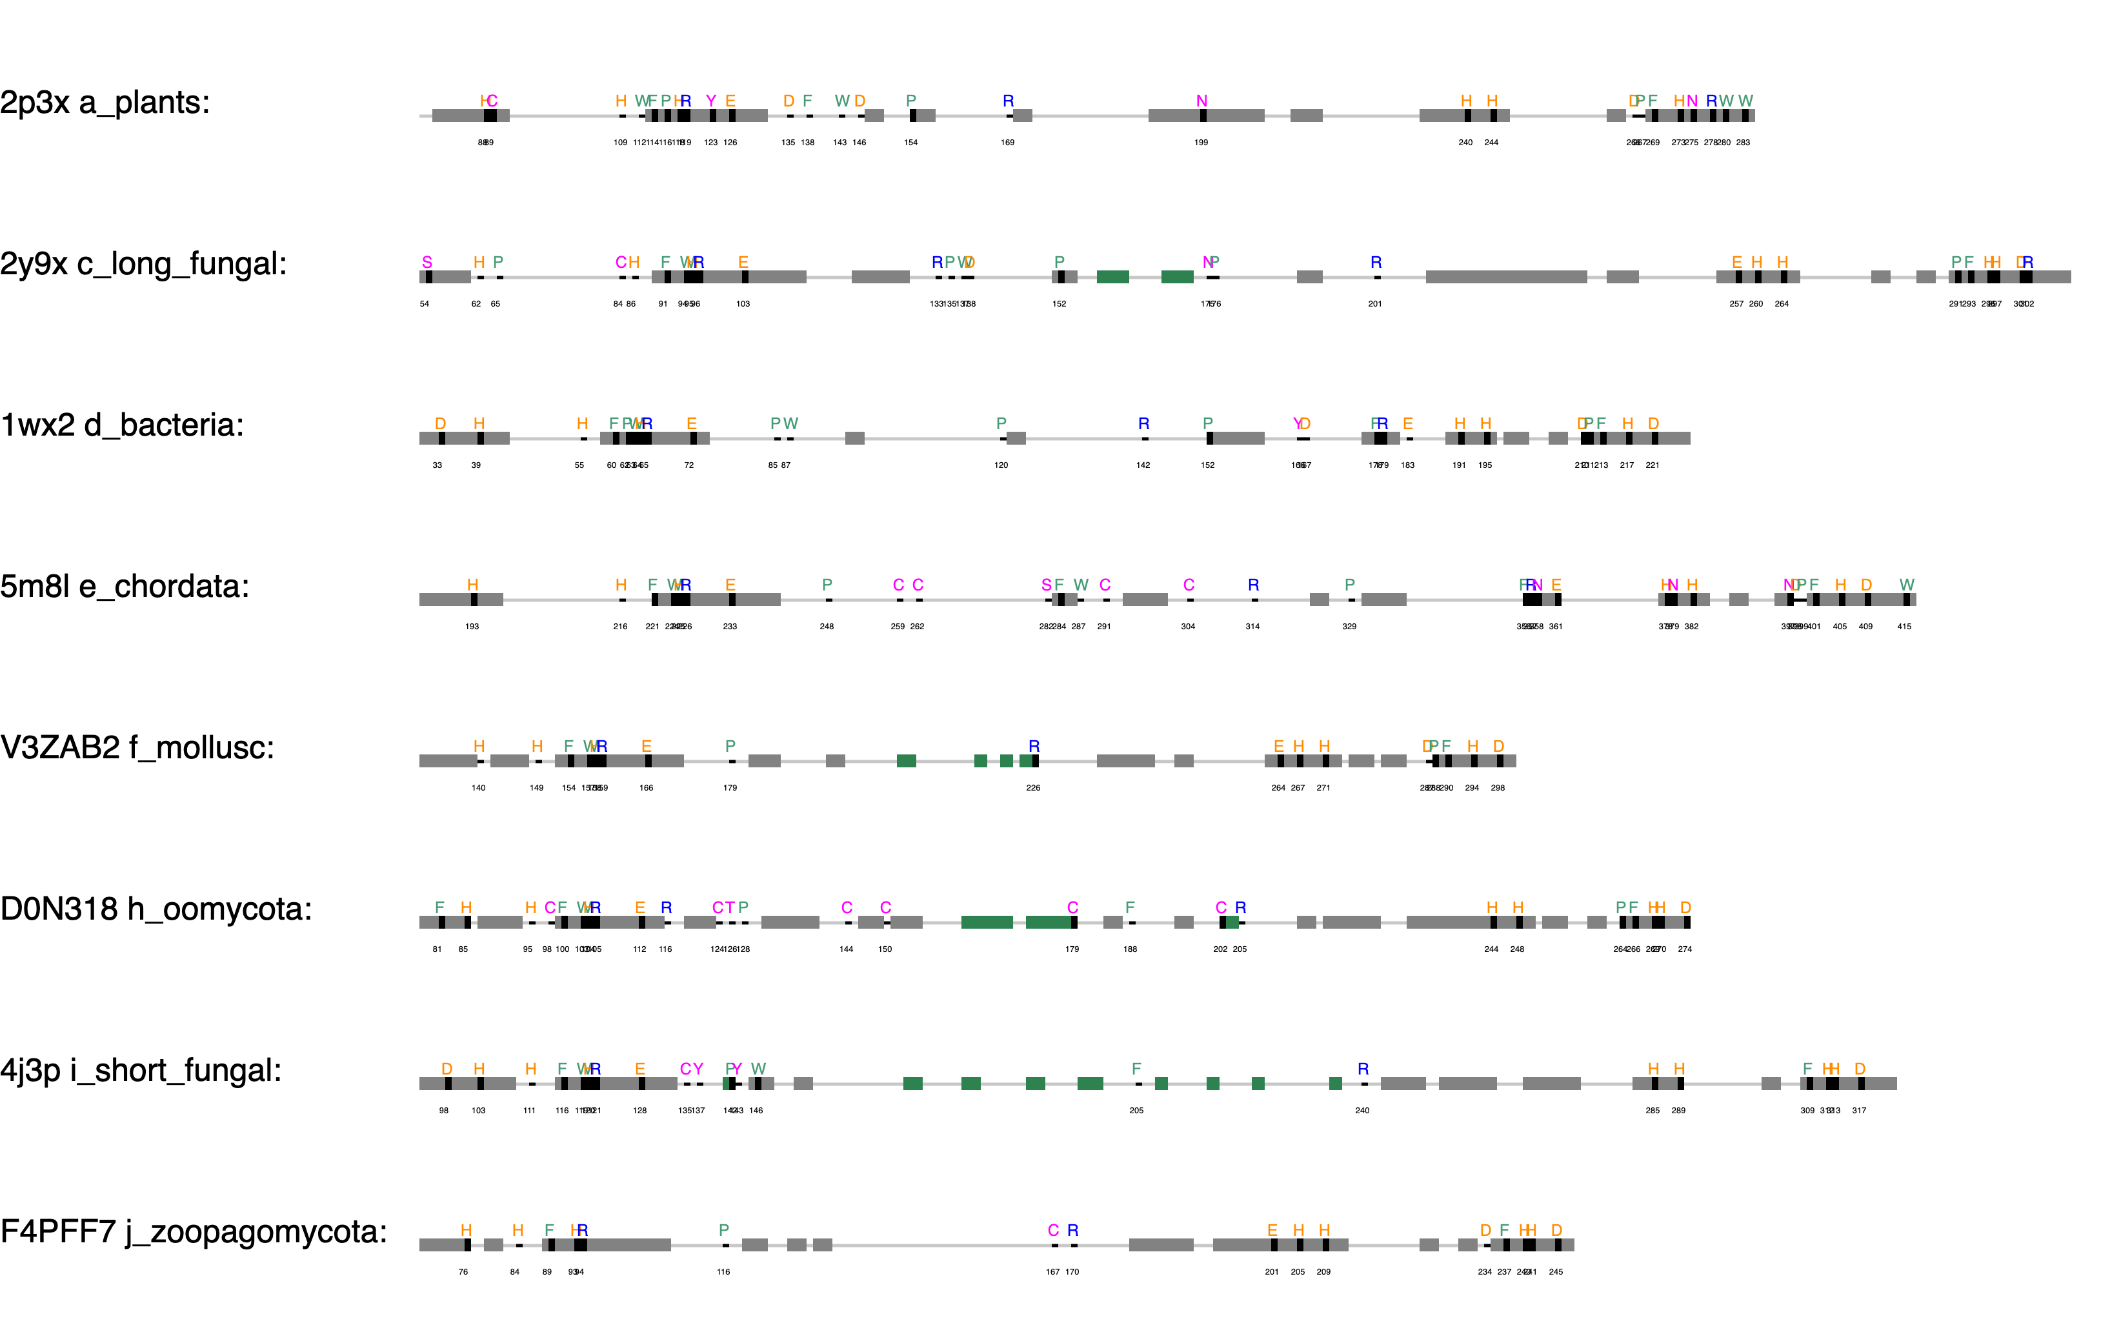
+84
+62
+32
+202
+130
+77
+93
aoco4
+68

Slide 2
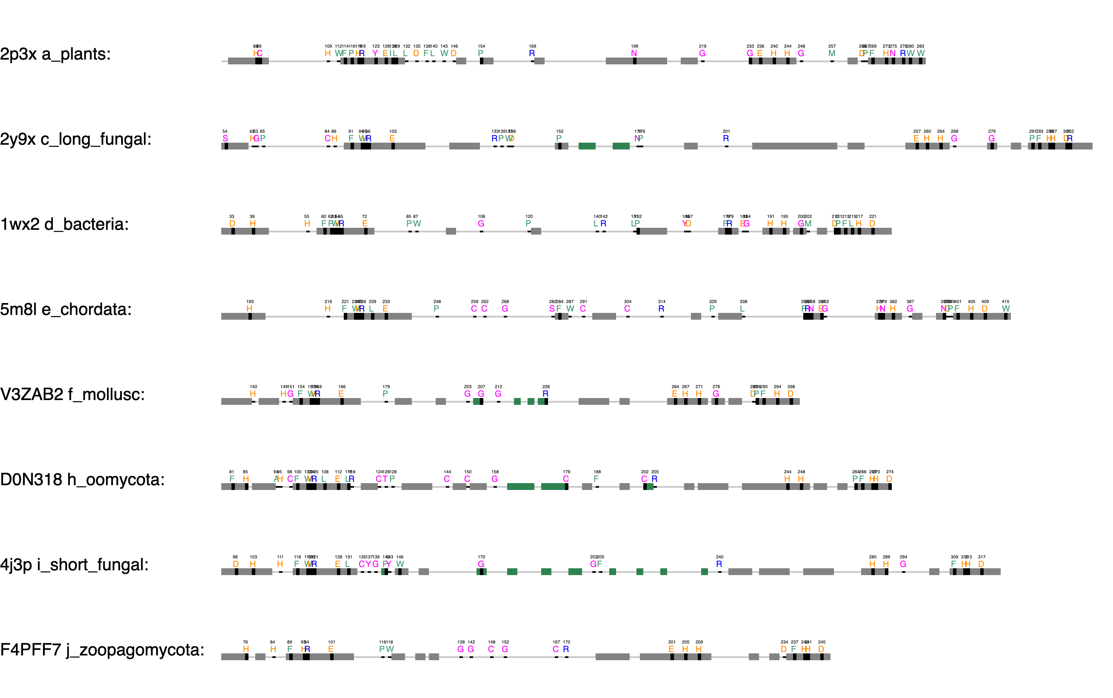
Thioether
Gatekeeper, F259, 68%, Kampatsikas
+84
+62
Blocker residue, Kanteev
+32
+202
First activity controller (HisB₁+1), Kampatsikas
+130
+77
aoco4
+93
+68
The seventh His (HisB₃-1), Kampatsikas

Slide 3
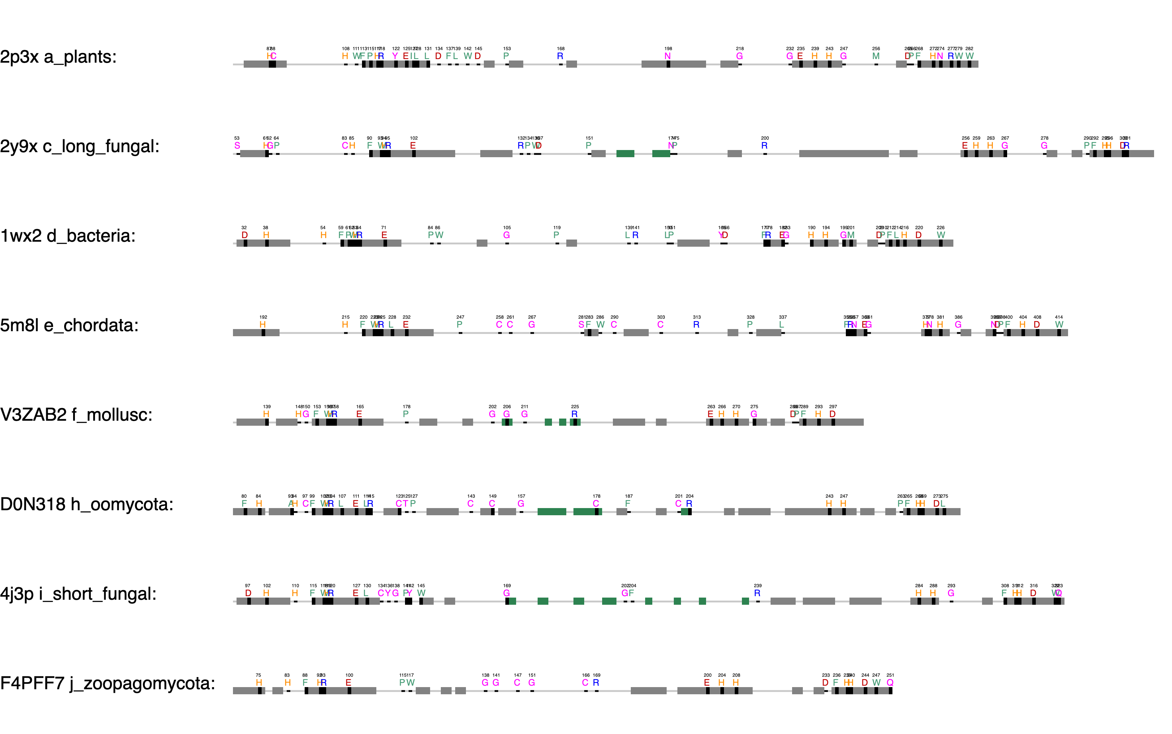
Thioether
Gatekeeper, F259, 68%, Kampatsikas
ppovv
+84
+62
Blocker residue, Kanteev
+32
+202
First activity controller (HisB₁+1), Kampatsikas
+130
+77
aoco4
+93
+68
The seventh His (HisB₃-1), Kampatsikas

