Slide 1
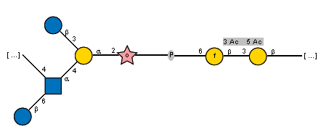

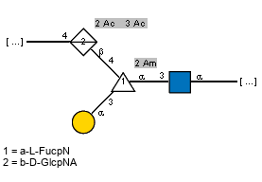

a
b
4D-p-1D, 4U-p-1D, 2N-l-5N, P, 6N-f-1U, 3U-p-1U
4D-p-1D, 4U-p-1D, 2D-f-1D, 4U-p-1U, 3U-p-1U

Slide 2
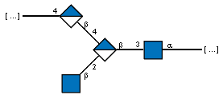
a
b
4D-p-1U','4D-p-1U','3U-p-1D
4D-p-1D, 4U-p-1D, 2N-l-5N, P, 6N-f-1U, 3U-p-1U
4D-p-1D, 4U-p-1D, 2D-f-1D, 4U-p-1U, 3U-p-1U
4D-p-1U','4D-p-1U','3U-p-1D
4D-p-1U','4D-p-1U','3U-p-1D

Slide 3
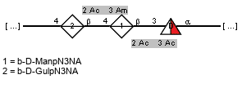
Organism
BP-Pol
Glycan
Streptococcus
pneumoniae 47A
CAI34641.1
GTxx7
Identity: 22.3%
4D-p-1D, 4U-p-1D, 2N-l-5N, P, 6N-f-1U, 3U-p-1U
Glycan score:
Escherichia
coli O178
AIG62747.1
4D-p-1D, 4U-p-1D, 2D-f-1D, 4U-p-1U, 3U-p-1U
Pseudomonas
aeruginosa O16
AAM27662.1
4D-p-1U,4D-p-1U,3U-p-1D
Identity: 20.7%
Glycan score:
Yersinia
pseudotuberculosis O:9
CDF66396.1
GTx15
4D-p-1U,4D-p-1U,3U-p-1D
Identity: 25.0%
Glycan score:
Escherichia
coli O30
BAQ00780.1
4D-p-1U,4D-p-1U,3U-p-1D

Slide 4
Organism
BP-Pol
Glycan
Streptococcus
pneumoniae 47A
CAI34641.1
GTxx7
4D-p-1D, 4U-p-1D, 2N-l-5N, P, 6N-f-1U, 3U-p-1U
Identity: 22.3%
Escherichia
coli O178
AIG62747.1
4D-p-1D, 4U-p-1D, 2D-f-1D, 4U-p-1U, 3U-p-1U
Pseudomonas
aeruginosa O16
AAM27662.1
4D-p-1U,4D-p-1U,3U-p-1D
Identity: 20.7%
Yersinia
pseudotuberculosis O:9
CDF66396.1
GTx15
4D-p-1U,4D-p-1U,3U-p-1D
Identity: 25.0%
Escherichia
coli O30
BAQ00780.1
4D-p-1U,4D-p-1U,3U-p-1D

Slide 5
Organism
BP-Pol
Glycan
Streptococcus
pneumoniae 47A
CAI34641.1
GTxx7
4D-p-1D, 4U-p-1D, 2N-l-5N, P, 6N-f-1U, 3U-p-1U
Escherichia
coli O178
AIG62747.1
4D-p-1D, 4U-p-1D, 2D-f-1D, 4U-p-1U, 3U-p-1U
Pseudomonas
aeruginosa O16
AAM27662.1
4D-p-1U,4D-p-1U,3U-p-1D
GTx15
Yersinia
pseudotuberculosis O:9
CDF66396.1
4D-p-1U,4D-p-1U,3U-p-1D
Escherichia
coli O30
BAQ00780.1
4D-p-1U,4D-p-1U,3U-p-1D

