Slide 1
active site
growing polysaccharide chain
donor subsites
acceptor subsites
-2
-1
+1
+2
n
P
P
Und
P
P
Und

Slide 2
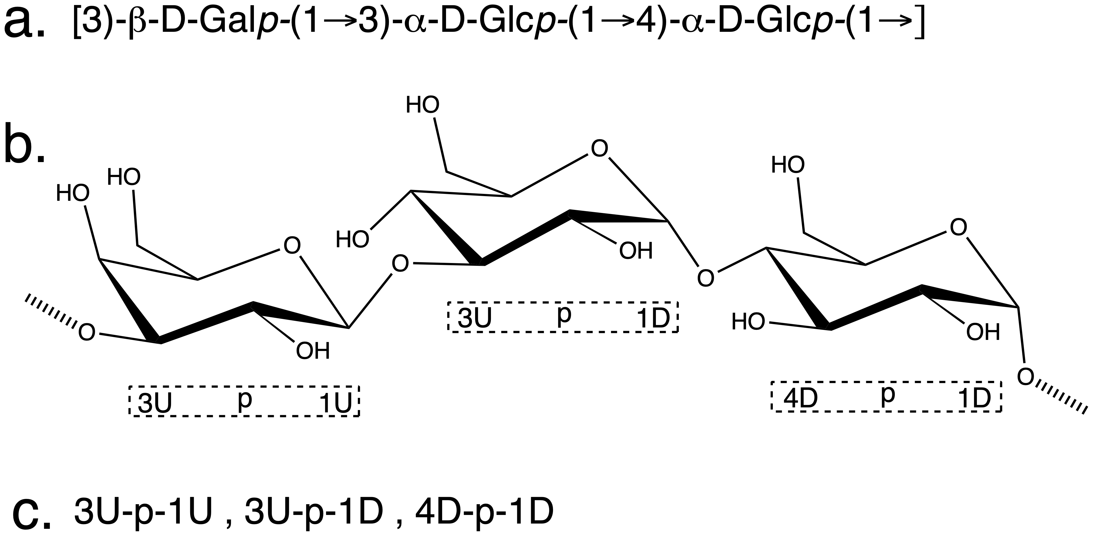

Slide 3
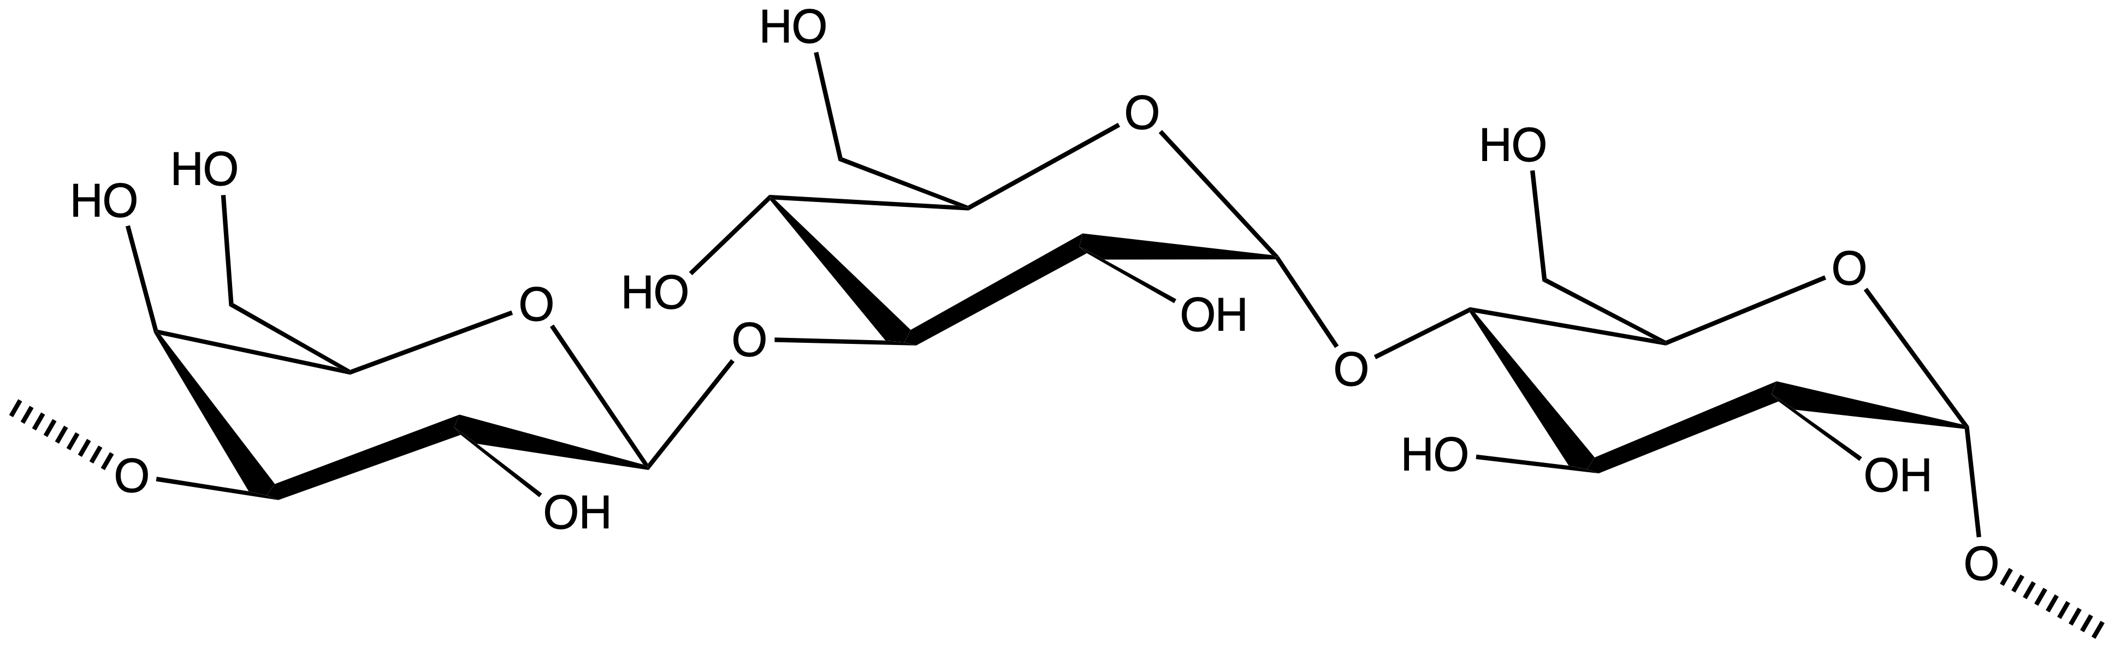
a
[3-β-D-Galp-(1→3)-⍺-D-Glcp-(1→4)- ⍺-D-Glcp-(1→]
b
3U p 1D
3U p 1U
4D p 1D
c
3U-p-1U, 3U-p-1D, 4D-p-1D

