Slide 1

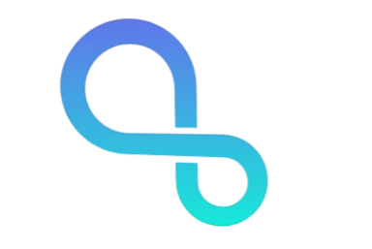
INFINITY

Slide 2
Problem Statement
Patients’ medical histories often get lost between hospitals, forcing repeated tests and risking misdiagnosis. There’s no simple, patient-controlled way to carry accurate health records across doctors.
2
2
Notes:
2

Slide 3
Solution
A secure, portable Electronic Health Record (EHR) system where patients fully control their data and can share it with doctors instantly using a secure QR code.
3
3
Notes:
3

Slide 4
Key Features
Secure Medical Record Storage: Encrypted cloud storage for all documents in one place.
OCR-Powered Data Extraction: Automatically extracts text & important details from medical files.
Auto-Generated Health Timeline: System creates a chronological medical history for quick insights.
QR-Based Record Sharing: Patient generates a temporary secure QR → Doctor gets instant read-only access.
Full Patient Data Control: Patient decides who can view their records; access can be revoked anytime.
Doctor’s Notes (Read-Only for Patient): Doctors can add diagnosis, recommendations, and follow-up notes.
Secure Emergency Profile (ICE QR): Non-expiring emergency QR with blood group, allergies, conditions, and contacts.
Audit Logging: Tracks which doctor accessed what and when for full transparency.
3
3
Notes:
3

Slide 5
Architecture & Tech Stack
4
4
Notes:
4

Slide 6
Architecture
Modular Node.js + Express backend with REST APIs
MongoDB database for users, records, timeline, QR tokens, doctor notes & audits
Cloudinary for secure document storage (images & PDFs)
Tesseract.js OCR pipeline for automatic text extraction
JWT Authentication for users + Time-limited QR Tokens for doctors & hospitals
Emergency QR (ICE) with non-expiring token for rapid medical access
Audit Logging for every access event (token, IP, timestamp)
Clean route structure: auth, records, qr, doctor, hospital, ice, timeline, audit
4
4
Notes:
4

Slide 7
Tech Stack
Node.js – Backend API
Python – AI Summariser
React.js (Vite) – Frontend
Tailwind CSS – UI styling
MongoDB – Database
Cloudinary – Document & image storage
4
4
Notes:
4

Slide 8
Flow Chart
User
Authentication (Login/Register)
Upload / View Records
Auto-Generated Timeline
Generate QR For Doctor/Hospital
Emergency Profile (ICE)
Doctor/Hospital Scan QR
Emergency QR Access
Read-Only Access To Records
5
5
Notes:
5

Slide 9
Backend and Front-end Screens
* IMAGES ONLY/ github link of code and output
6
6
Notes:
6

Slide 10
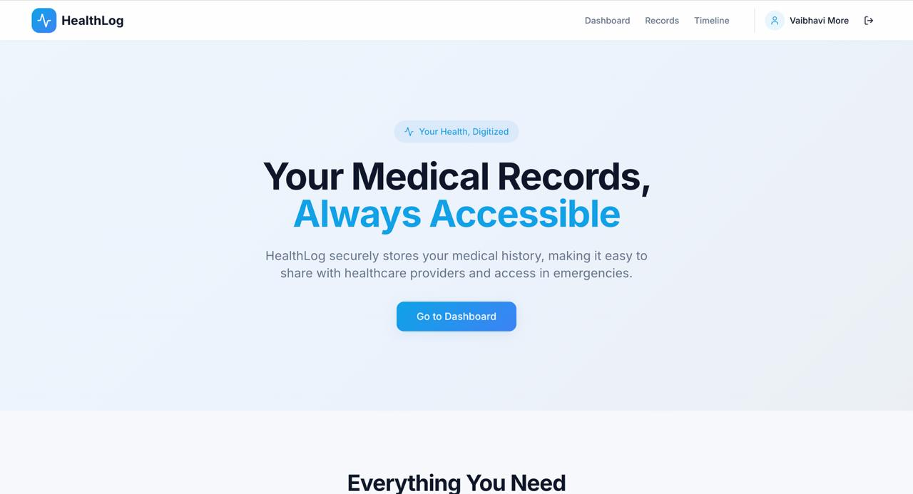
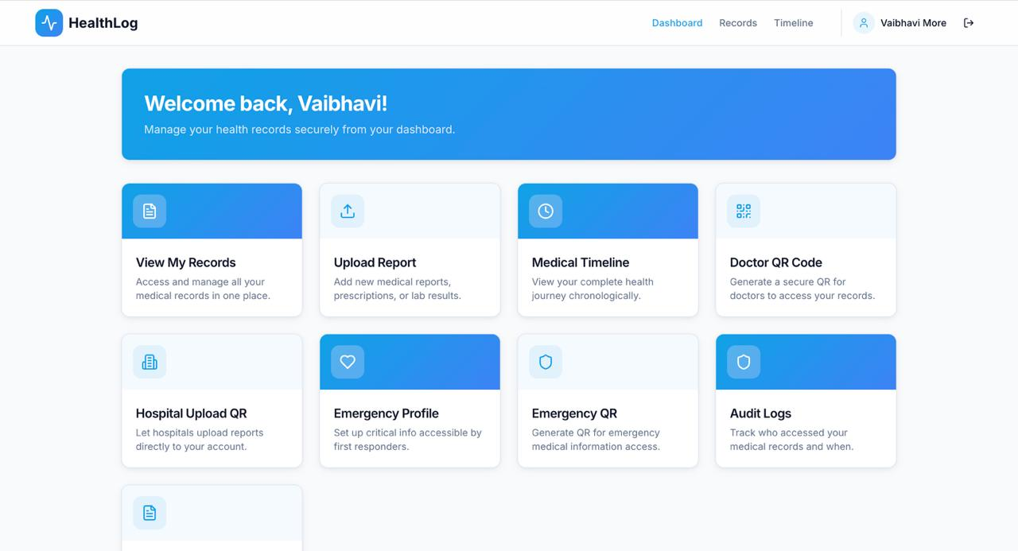
6
6
Notes:
6

Slide 11
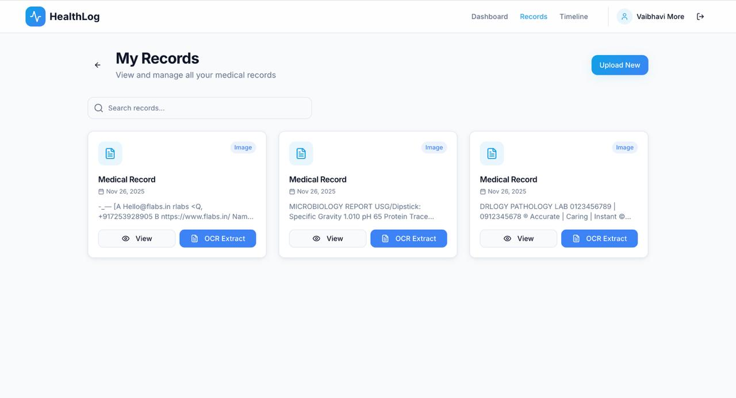
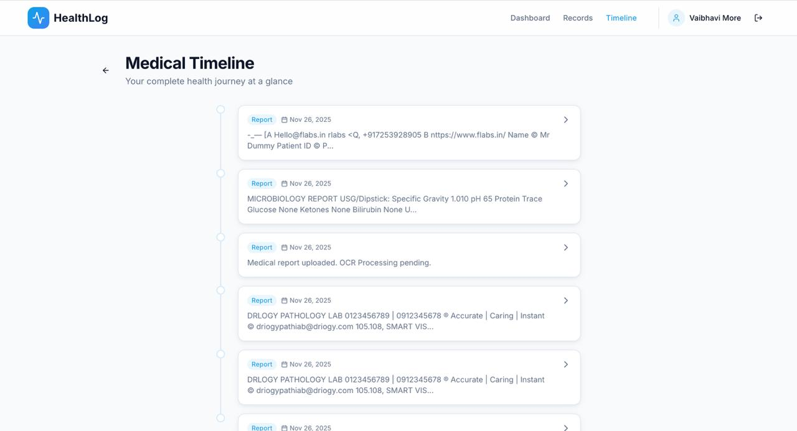
6
6
Notes:
6

Slide 12
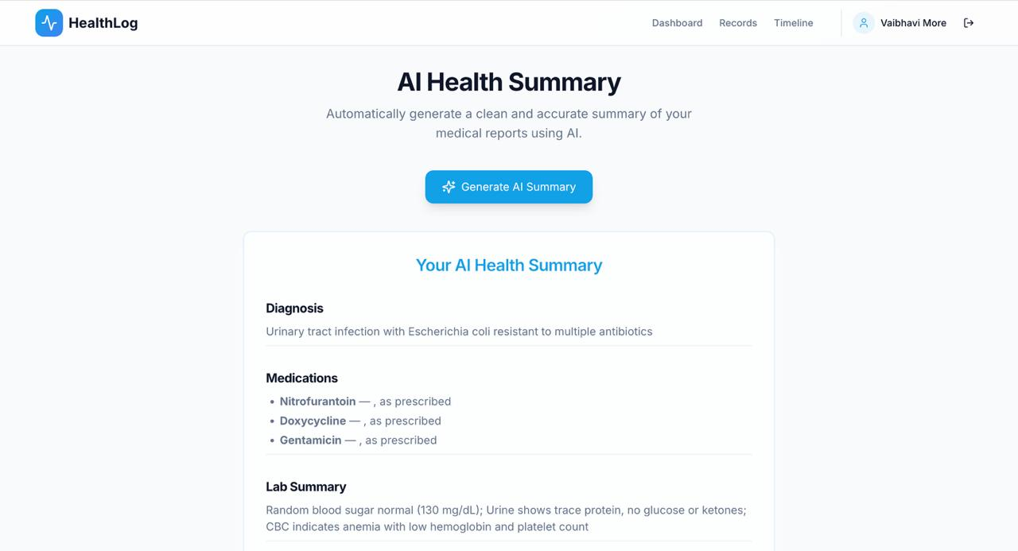
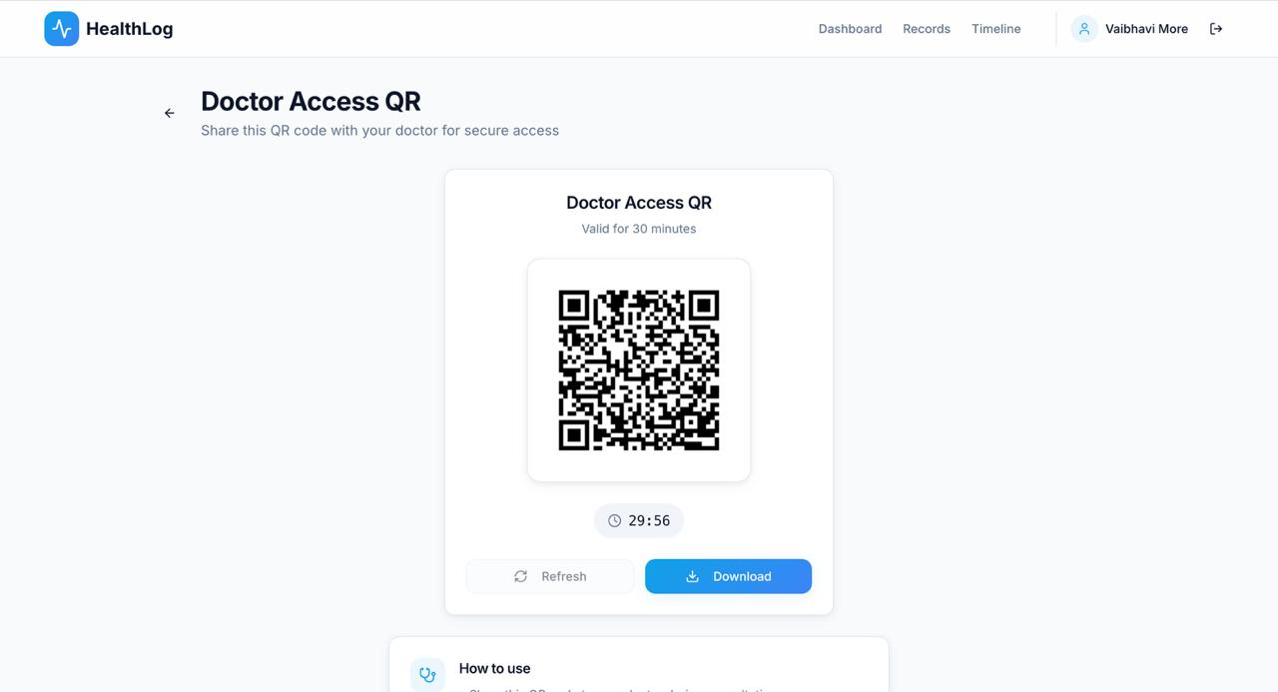
GitHub Link: https://github.com/idamodhar17/HealthLog.git
6
6
Notes:
6

