Slide 1

כל מה שרצית לדעת על createCleanFile ולא העזת לשאול
* הכותרת מנוסחת בלשון זכר ונקבה כאחד אך מתייחסת בעיקר לנשים ☺

Slide 2
Outline
Artifacts in MEG
createCleanFile (&more)
LF
Accelerations
HB
Troubleshoot
Work Flow

Slide 3
Introduction
MEG amplitudes are very low and even small artifacts can distort the recordings.
LF
Mechanical Vibrations
Heart Beat
Step Correction
These types of artifacts can be removed by recording external cues along with the MEG.
These external cues are then used to register the exact times or spectra of the artifacts and thus contain minimal risk of distorting the data.
Other methods:
Filtering
ICA

Slide 4
How To … Default Values
Input_file = ‘c,rfhp0.1Hz’;
p = pdf4D(input_file);
chi = channel_index(p, {‘MEG’}];
MEG = read_data_block(p, [], chi);
meanMEG = mean(MEG);
plot(meanMEG’)
cleanCoefs = createCleanFile(p, input_file,'outFile', ‘cleanFile’, 'byLF', [] , 'Method', ’Global' , 'xClean', [4 5 6], 'chans2ignore',[] , 'byFFT', 0, 'HeartBeat', [], 'noQuestions', 0 , 'stepCorrect', 1, ‘maskTrigBits’, [], ‘ECG’, meanMEG, ‘cleanPartOnly’, [startT endT]);
save cleanCoefs cleanCoefs

Slide 5
How To … Recommended Values
Input_file = ‘c,rfhp0.1Hz’;
p = pdf4D(input_file);
chi = channel_index(p, {‘MEG’}];
MEG = read_data_block(p, [], chi);
meanMEG = mean(MEG);
plot(meanMEG’)
cleanCoefs = createCleanFile(p, input_file, 'byLF', [] , 'Method', ’Adaptive' , 'xClean', [4 5 6], 'chans2ignore', [], 'byFFT', 0, 'HeartBeat', [], 'stepCorrect', 1, ‘Hbperiod’, []);
save cleanCoefs cleanCoefs

Slide 6
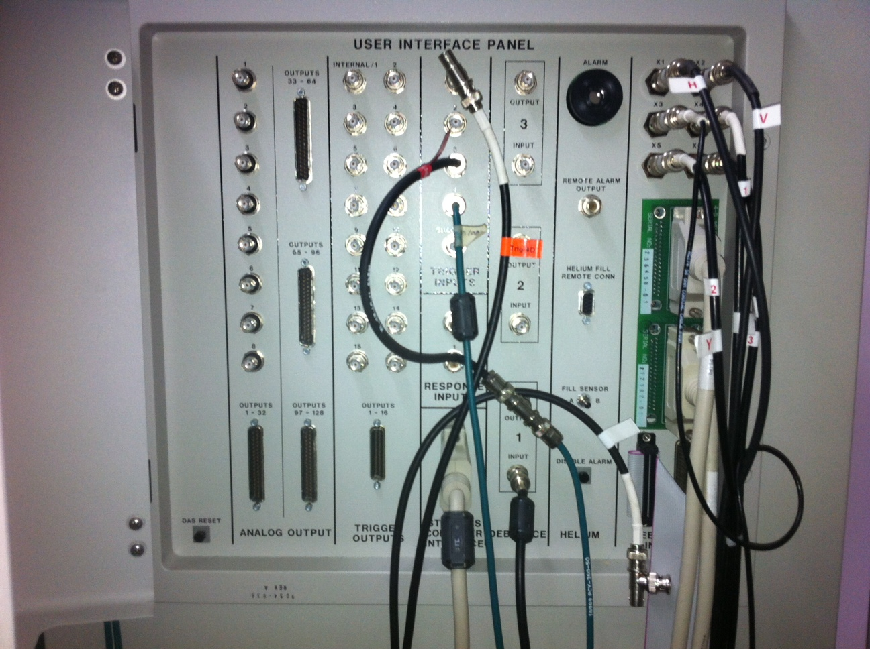
Line Frequency

Slide 7
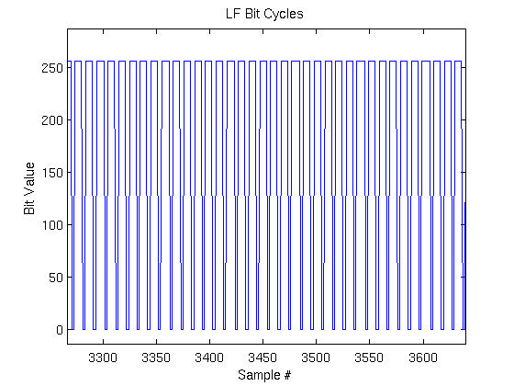
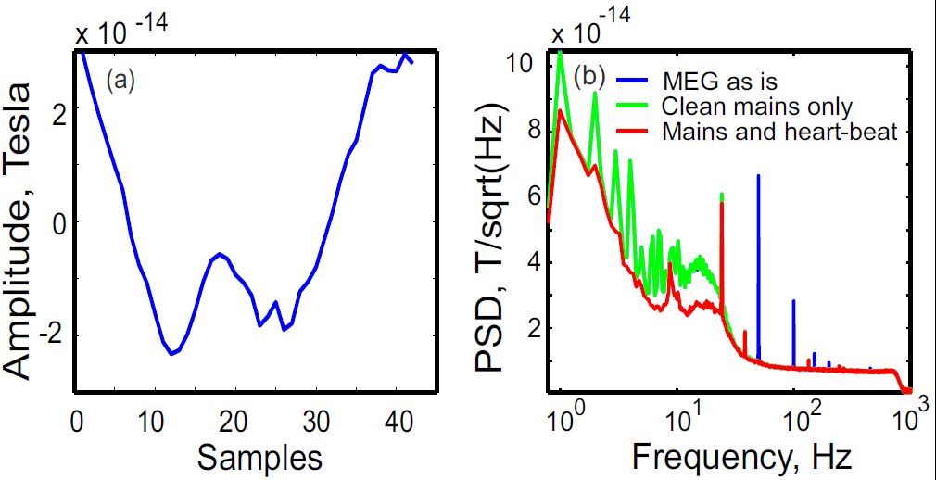
Line Frequency

Slide 8
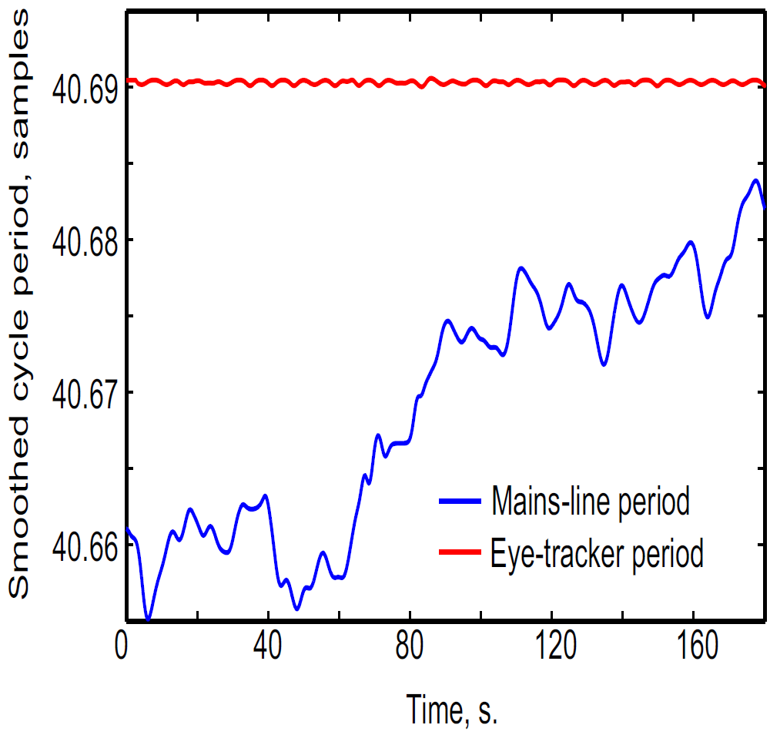
‘Global’ vs. ‘Adaptive’

Slide 9
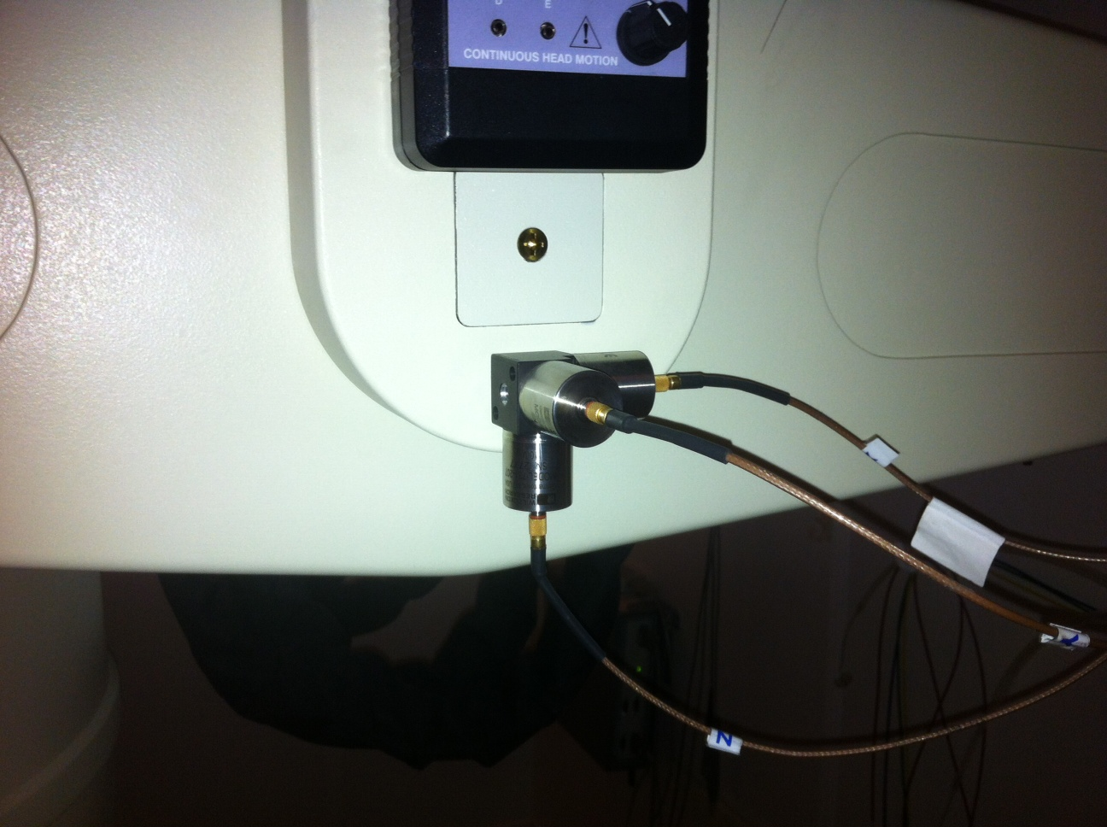
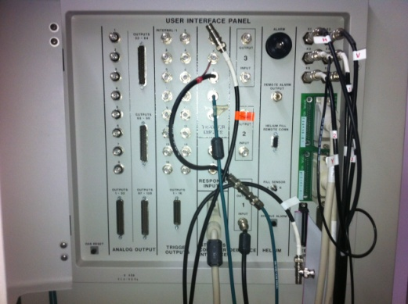
Mechanical Vibrations

Slide 10
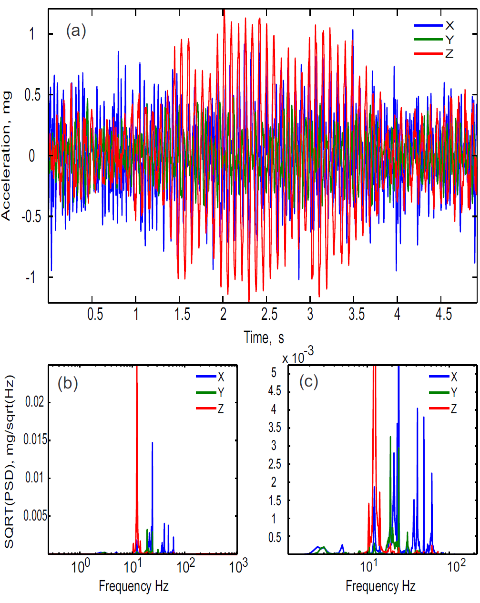
Mechanical Vibrations

Slide 11
Mechanical Vibrations

Slide 12
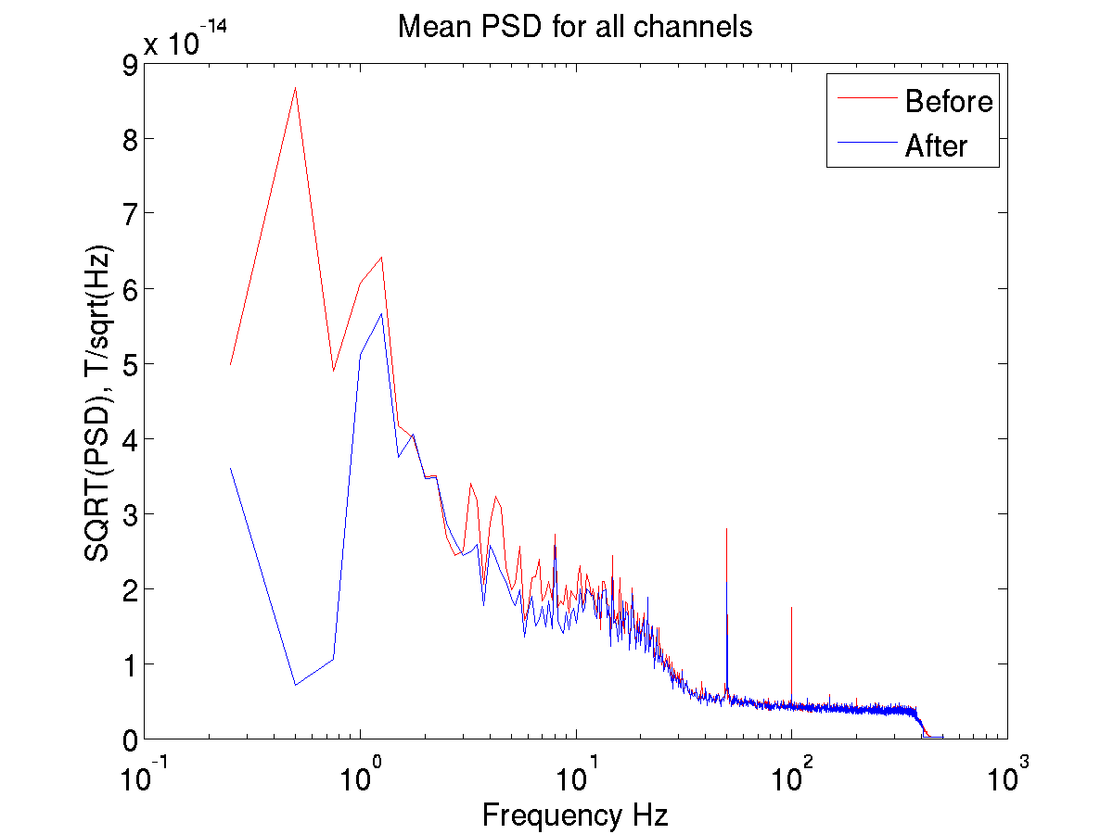
Mechanical Vibrations

Slide 13
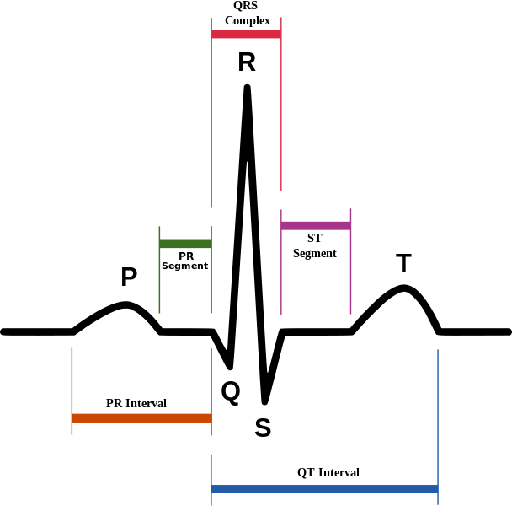
Heart Beats
Ventricles Depolarization
Ventricles Repolarization
Atrium Depolarization

Slide 14
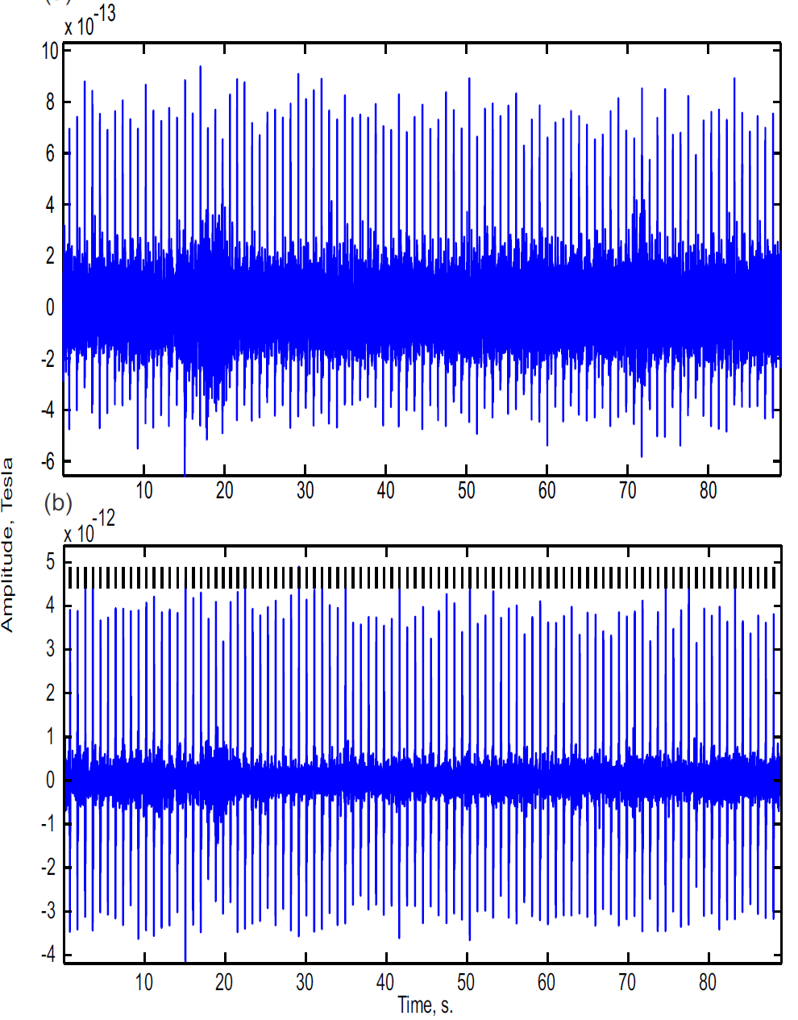
Heart Beats - Detection
numSD = 2.5 – Standard deviation for peak detection
Default Hbperiod = 1 sec (findHBperiod = true)
minPeakSize = 2.7 (MEG – mean(MEG)/sd)
biggest = 2 (*meanPeak)
smallest = 0.5
mni = 0.25
mxi = 2
Notes:
Filter – 4 – 50 Hz ( 2 – 100)

Slide 15
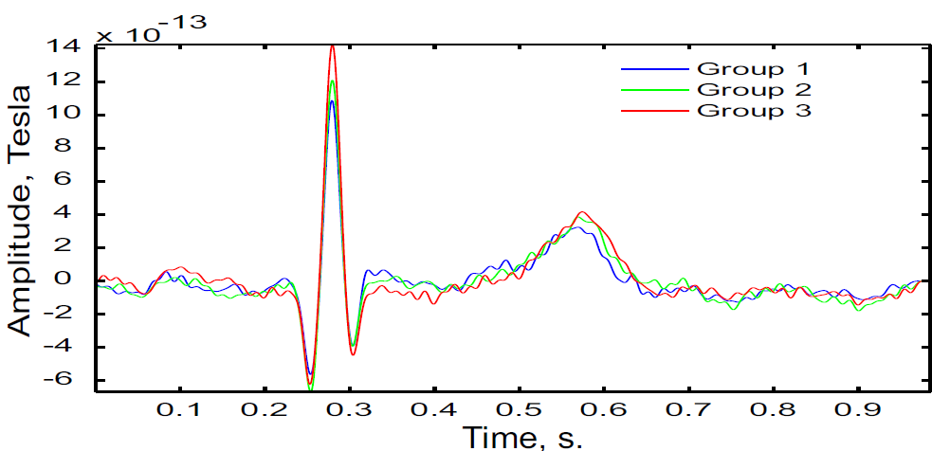
Heart Beats – Amplitude

Slide 16
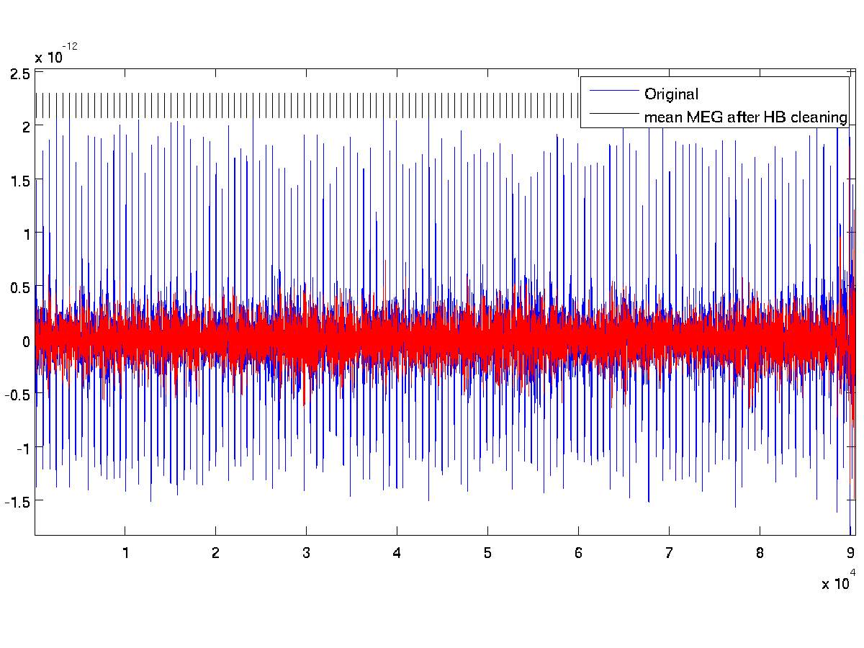
Heart Beats - Results

Slide 17
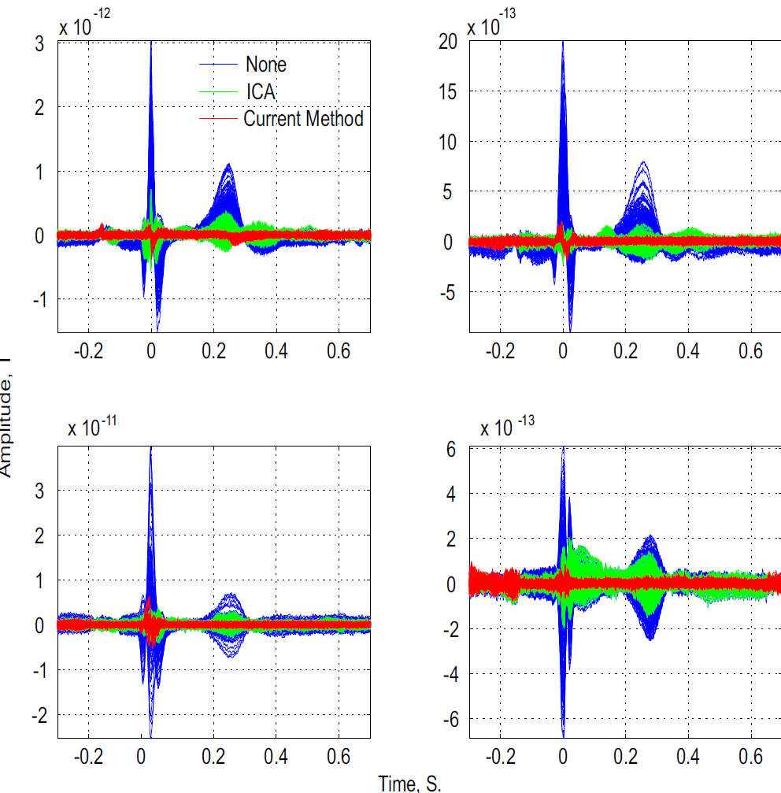

Heart Beats - Results

Slide 18
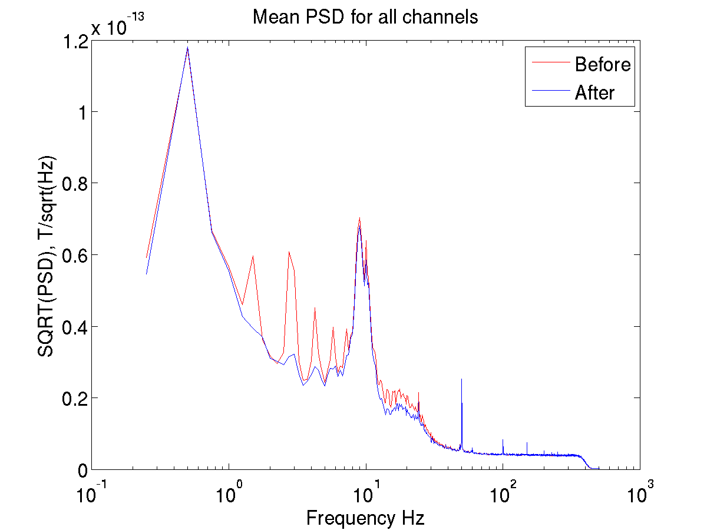
Heart Beats - Results

Slide 19
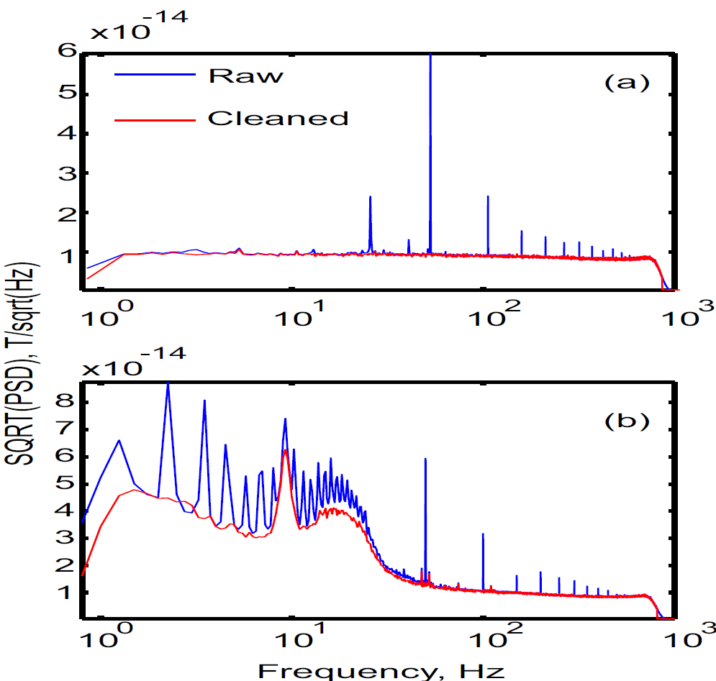
All Cleanings – Frequency Domain

Slide 20
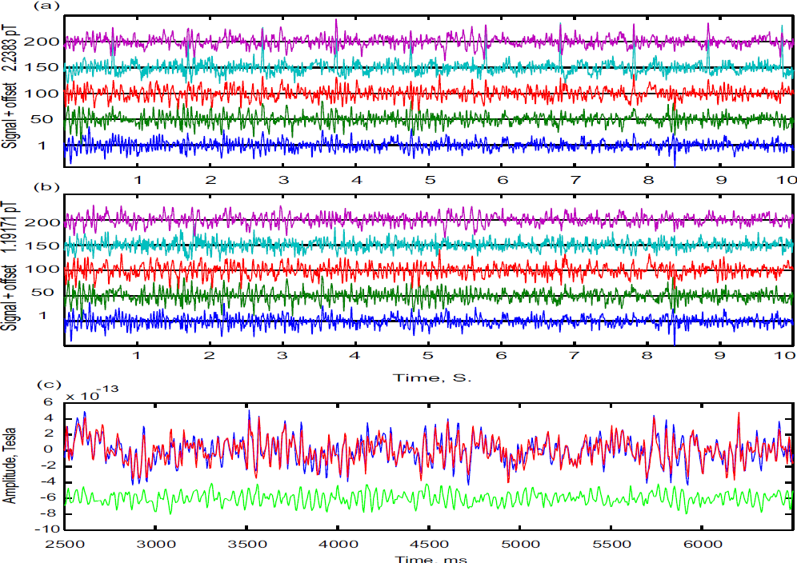
All Cleanings – Time Domain

Slide 21

Troubleshoot
warning('MATLAB:MEGanalysis:ImproperData','Heart beat signal not clear enough No HB cleaning done')
'MATLAB:MEGanalysis:unreasonableValue 'Too slow Heart beat periods in 305.6
'MATLAB:MEGanalysis:unreasonableValue
Too small Heart beat amplitude in 105.8
'MATLAB:MEGanalysis:unreasonableValue\n',...
'Too large Heart beat amplitude in

Slide 22
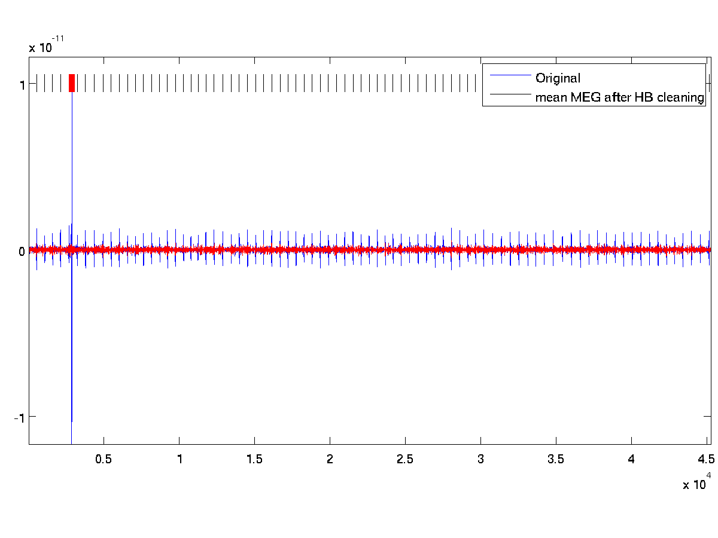
Troubleshoot - Jump

Slide 23
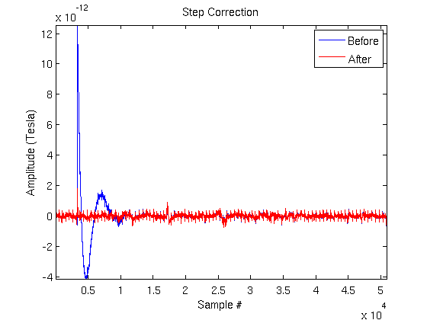
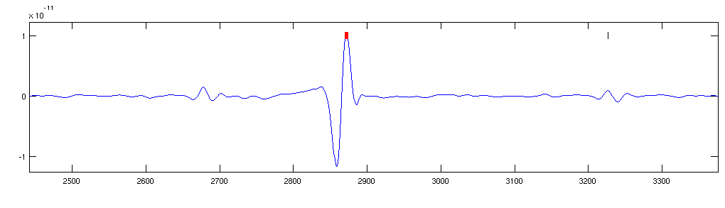
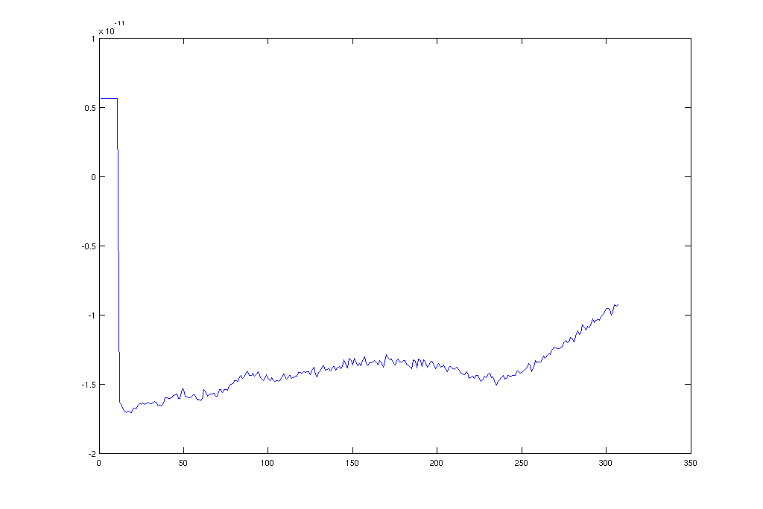
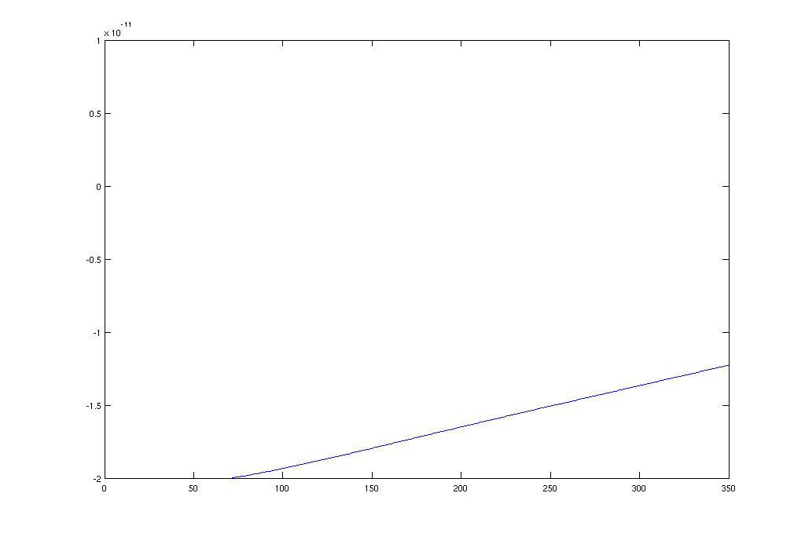
Troubleshoot - stepCorrect

Slide 24
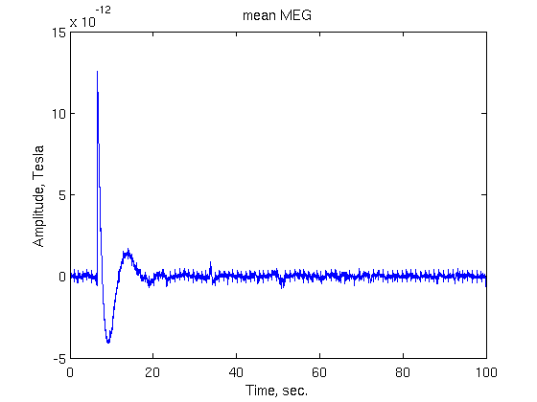
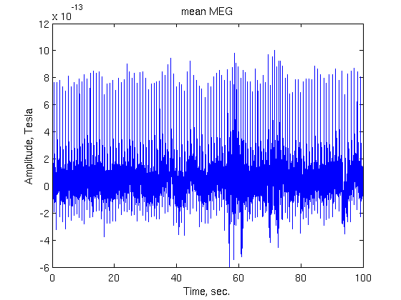
Troubleshoot - cleanPartOnly
Look at the mean MEG
fileName = 'c,rfhp0.1Hz';
p=pdf4D(fileName);
samplingRate = get(p,'dr');
% read all the MEG channels
chi = channel_index(p, 'meg');
data = read_data_block(p, [], chi);
tMEG = (0:size(data,2)-1)/samplingRate;
figure
plot(tMEG,mean(data))
Detect jump time or other artifacts interrupting the HB detection.

Slide 25
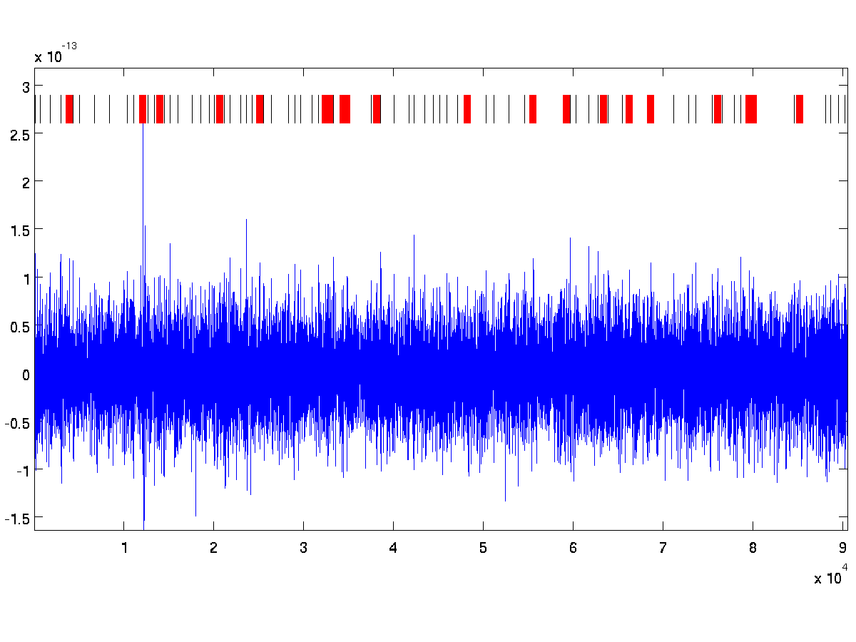
Troubleshoot – Muscle & more

Slide 26
Troubleshoot – Changing Parameters
Use ‘Hbperiod’
tryClean function:
Change the Errors threshold (line 326).
findHB01 function:
numSD = 2.5 – Standard deviation for peak detection
Default Hbperiod = 1 sec (findHBperiod = true)
minPeakSize = 2.7 (MEG – mean(MEG)/sd)
biggest = 2 (*meanPeak)
smallest = 0.5
mni = 0.25
mxi = 2

Slide 27
Recommendations
Always look at the mean MEG before starting the cleaning process to detect jumps or other large visible artifacts
Always check your cleaning in the frequency domain (fftIdan) and in the time domain (compareHBclean).
Reversing the order of cleaning (HB first) might help HB peak detection
Save the variable cleanCoefs and use the function listErrorInHB

Slide 28
Work Flow
Look at the mean MEG
No Jumps
Jumps
Stuck on other artifacts
Detect jump time and run with ‘cleanPartOnly’
Successful cleaning
Look at the PSD and ‘compareHBclean’
Consult Idan
Stuck on other artifacts
Cleaning passed OK
Stuck on HB cleaning
Try cleaning HB without xClean and then use xClean on the cleaned file
Look at the PSD and on compareHBclean
Run with ‘stepCorrect’

Slide 29
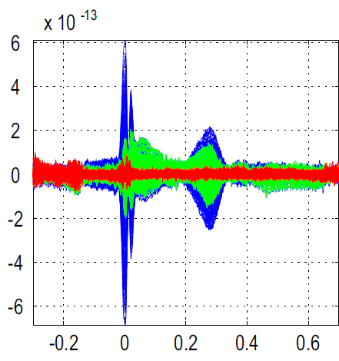
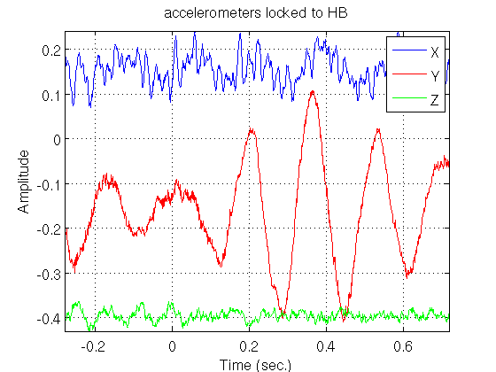
Problems to be solved
ECG recording –amplitude issue
xClean - Balistocardiogram

Slide 30
Thank you

Slide 31
cleanCoefs
Holds information regarding the cleaning process.
cleanCoefs.HBparams.Errors – holds times of errors in the HB cleaning process.
tList = listErrorsInHB(cleanCoefs) – list the times at which there was a difficulty with finding Heart Beats.

Slide 32
fft
Input_file = ‘c,rfhp0.1Hz’;
Clean_file = ‘xc,hb,lf_c,rfhp0.1Hz’;
file3 = [];
file4 = [];
file5 = [];
fftIdan(input_file, clean_file, file3, file4, file5);

Slide 33
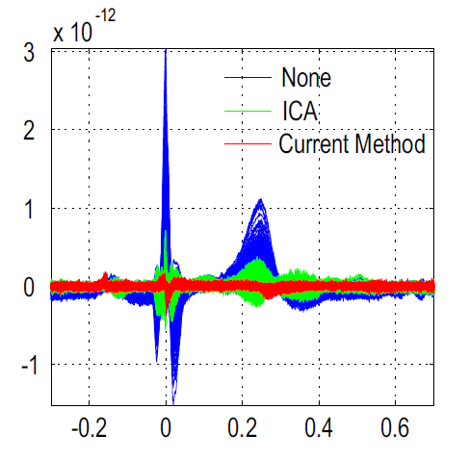
compareHBclean
compareHBclean('-file1', 'c,rfhp0.1Hz', '-file2', 'clean1_c,rfhp0.1Hz','-acc','both');
More parameters are in the help of the function
Must have cleanCoefs in the directory

Slide 34
Mean MEG
fileName = 'c,rfhp0.1Hz';
p=pdf4D(fileName);
samplingRate = get(p,'dr');
% read all the MEG channels
chi = channel_index(p, 'meg');
data = read_data_block(p, [], chi);
tMEG = (0:size(data,2)-1)/samplingRate;
figure
plot(tMEG,mean(data))

