Slide 1
SPL - PS6
Threads and concurrency / safety

Slide 2
Overview
Threads
Threads in Java
Callback functions
Concurrency & Safety

Slide 3
Threads

Slide 4
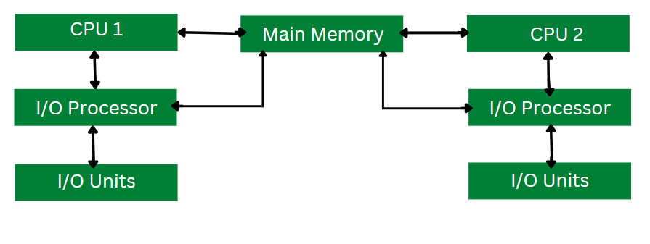
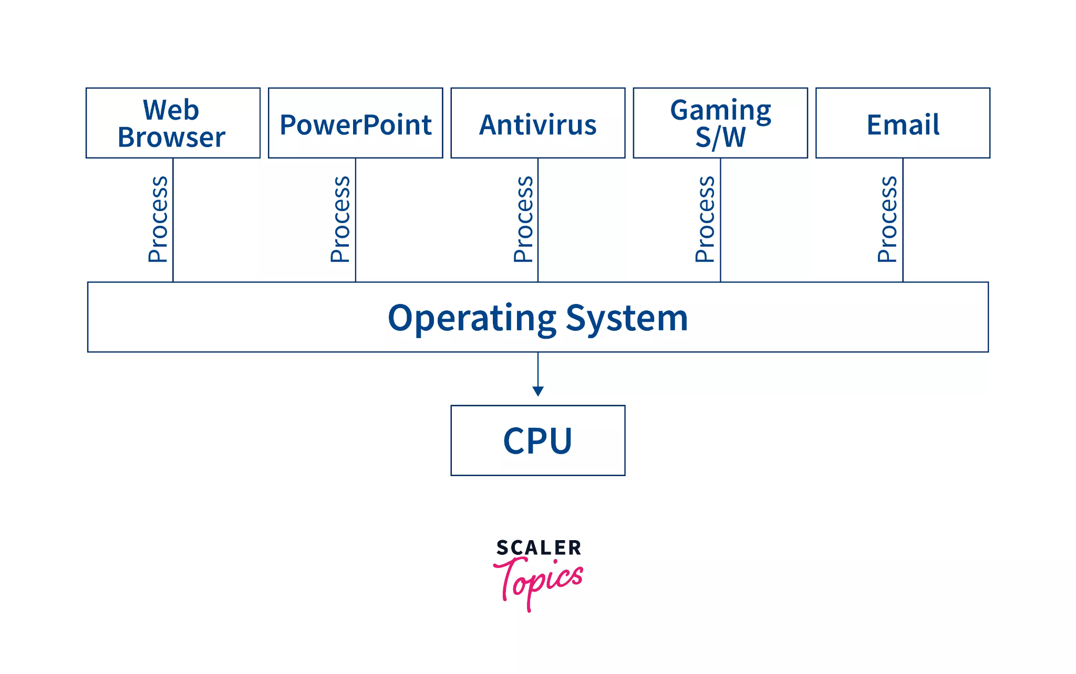
OS & CPU
Up until now, all the programs we’ve seen were sequential.
To take advantage of multi-processor systems, the OS assigns different processes to different processors
What if we had one big process that could benefit from multiple processors?

Slide 5
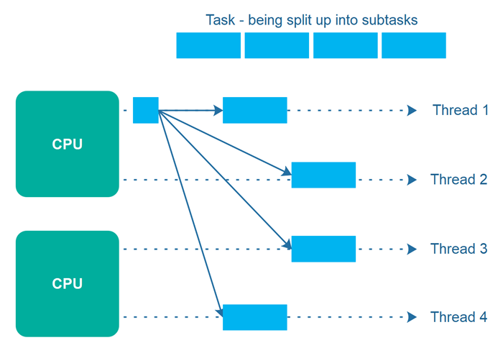
Threads
Threads are parts of a program which can run in parallel
Unlike processes, threads share the same memory space
Threads can be scheduled quicker and more efficiently

Slide 6
Threads
To run a task in parallel using threads
  Split the task into subtasks
  Create threads
  Assign each subtask to it’s own thread

Slide 7

Threads in

Slide 8
Java Threads
class PrimeThread extends Thread {
long minPrime;
PrimeThread(long minPrime) {
this.minPrime = minPrime;
}
public void run() {
// compute primes larger than minPrime
. . .
}
}
Threads in Java can be created by extending the Thread class and overriding the run method
Threads can be run by creating an object and calling start method of the thread
This allocates a new thread and executes the code in it’s run method
PrimeThread p = new PrimeThread(143);
p.start();

Slide 9
Java Threads
class PrimeRun implements Runnable {
long minPrime;
PrimeRun(long minPrime) {
this.minPrime = minPrime;
}
public void run() {
// compute primes larger than minPrime
. . .
}
}
Alternatively, you can implement the Runnable interface and override it’s run method
Create and instance and pass it to the constructor of a thread, then start as usual
class Main {
public static void main(String[] args) {
Runnable r = new PrimeRun(10);
for (int i = 0; i < 10; i++) {
Thread t = new Thread(r);
t.start();
}
}
}

Slide 10
Java Threads
Recall: When an interface defines a single method, we can implement using lambda function
public static void main(String[] args) {
for (int i = 0; i < 10; i++) {
Runnable r = () -> {
System.out.println(i);
for (int j = 0; j < 9; j++) {
System.out.println(", " + i);
}
};
Thread t = new Thread(r);
t.start();
}
}
public static void main(String[] args) {
for (int i = 0; i < 10; i++) {
Thread t = new Thread(() -> {
System.out.println(i);
for (int j = 0; j < 9; j++) {
System.out.println(", " + i);
}
};
);
t.start();
}
}

Slide 11
Java Threads
public static int arrAverage(int[] data, int numThreads) throws InterruptedException {
Thread[] threads = new Thread[numThreads];
long[] partialSums = new long[numThreads];
int chunkSize = data.length / numThreads;
// Create & start threads using lambdas
for (int i = 0; i < numThreads; i++) {
int index = i;
int start = i * chunkSize;
int end = (i == numThreads - 1) ? data.length : start + chunkSize;
threads[i] = new Thread(() -> {
long sum = 0;
for (int j = start; j < end; j++) {
sum += data[j];
}
partialSums[index] = sum;
});
threads[i].start();
}
// Join all threads and accumulate results
long totalSum = 0;
for (int i = 0; i < numThreads; i++) {
threads[i].join();
totalSum += partialSums[i];
}
double average = totalSum / (double) data.length;
return average;
}
When starting multiple threads, It is often desirable to wait for all of them to end
To do this, we can use the .join() method of the thread class

Slide 12
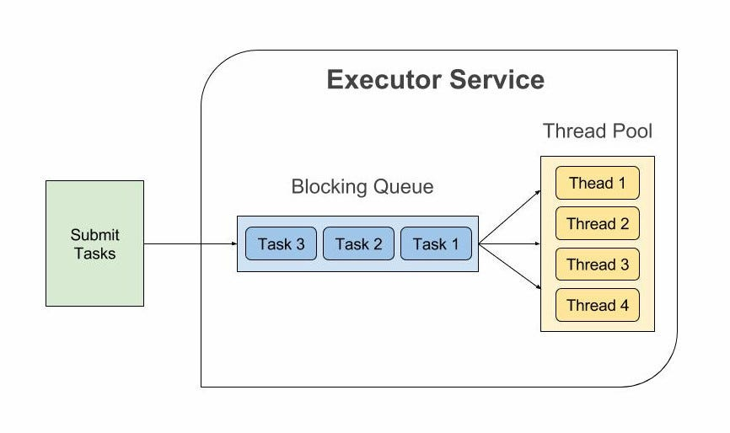
Executor
Another option is to use an executor service instead of directly managing threads
Threads can be reused until all tasks are completed

Slide 13
Executor Service
class SerialExecutor implements Executor {
final Queue<Runnable> tasks = new ArrayDeque<Runnable>();
final Executor executor;
Runnable active;
SerialExecutor(Executor executor) {
this.executor = executor;
}
public synchronized void execute(final Runnable r) {
tasks.offer(new Runnable() {
public void run() {
try {
r.run();
} finally {
scheduleNext();
}
}
});
if (active == null) {
scheduleNext();
}
}
protected synchronized void scheduleNext() {
if ((active = tasks.poll()) != null) {
executor.execute(active);
}
}
}
Executor is an object that executes submitted Runnable tasks.
Executor interface provides a way of decoupling task submission from the mechanics of how each task will be run, including details of thread use, scheduling, etc.
class ThreadPerTaskExecutor implements Executor {
public void submit(Runnable r) {
new Thread(r).start();
}
}
Executor executor = new SerialExecutor();
executor.submit(new RunnableTask1());
executor.submit(new RunnableTask2());

Slide 14
Executor Service
public static void main(String[] args) {
// Create an executor:
ExecutorService ex = Executors.newFixedThreadPool(3);
// Create several Runnables and execute them.
for (int i = 0; i < 10; i++) {
System.out.println("creating a new task: " + i + " ");
ex.execute(() -> {
System.out.println(i);
for (int j = 0; j < 9; j++) {
System.out.println(", " + i);
}
};
);
}
ex.shutdown(); // this causes the executor not to accept any more tasks, and to
// kill all its threads when all the submitted tasks are done.
}

Slide 15
Callback functions

Slide 16
Callbacks
A callback function is a function that can be passed as an argument
In Java we cannot pass functions as arguments
We’ve seen a work around in using interfaces (Runnable)
Trivial implementation can be done using Java Callable interface
public interface Callable<V> {
/**
* Computes a result, or throws an exception if unable to do so.
*
* @return computed result
* @throws Exception if unable to compute a result
*/
V call() throws Exception;
}

Slide 17
public class CallbackDemo {
static void g(Runnable cb) {
cb.run(); // call the callback
}
public static void main(String[] args) {
g(() -> System.out.println("Callback called!"));
}
}
public class CallbackInterfaceDemo {
interface Callback {
void call();
}
static void g(Callback cb) {
cb.call(); // invoke callback
}
public static void main(String[] args) {
g(() -> System.out.println("Callback called!"));
}
}

Slide 18
Concurrency & Safety

Slide 19
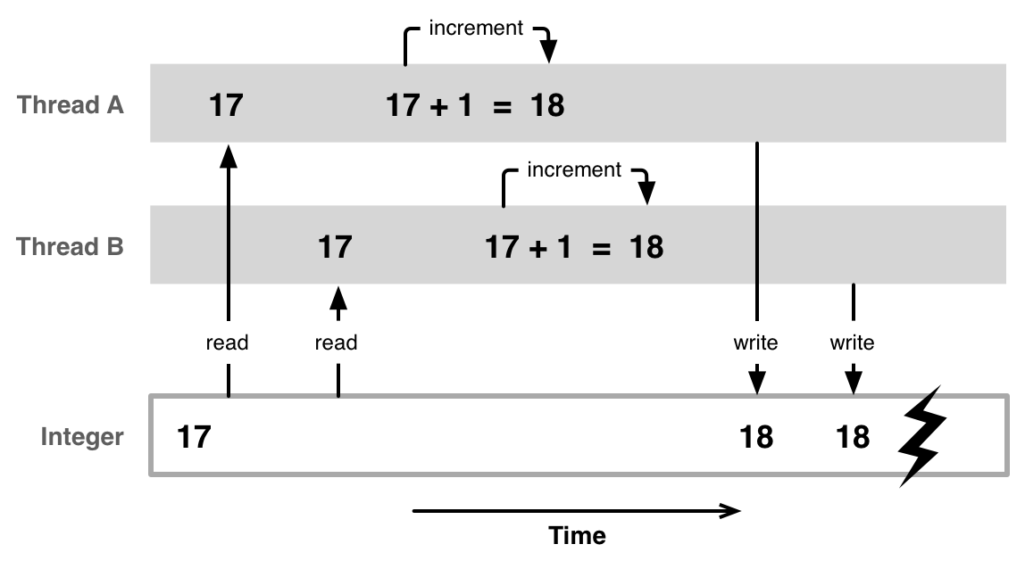
Shared Memory
What's wrong here?
When multiple threads try to access the same piece of memory, various behaviours may arise, depending on the exact time each thread accesses the memory which causes
We want our programs to behave predictably and produce a correct output in timing scenario
  Safety: invariants should be kept.
  Correctness: the code should yield expected results.

Slide 20
Shared Resource
A shared resource (or memory) is every object which is visible (accessible) to more than one thread.
That includes global objects, class members. Does not include local function variables.

Slide 21
Counter example 😉
public class Counter {
private int count;
public Counter(){
count = 0;
}
public void increment(){
count++;
}
public int getValue(){
return count;
}
}
Consider the following class which implements a simple counter object
What would happen if two threads call cnt.increment() at the same time?
Counter cnt = new Counter();

Slide 22
Counter example
The output of the program would be unpredictable
Consider what the increment method actually does:
  Read value of count from memory to register
  Add 1 to register
  Write value of count to from register to memory
public void increment(){
count++;
}

Slide 23
Counter example
Counter globalCounter = new Counter();
Runnable task = () -> globalCounter.increment();
Thread t1 = new Thread(task);
Thread t2 = new Thread(task);
t1.start();
t2.start();
t1 reads count = 0 to it’s local register
t2 reads count = 0 to it’s local register
t1 adds 1 to it’s local register
t2 adds 1 to it’s local register
t1 writes count = 1
t2 writes count = 1
Thus globalCounter.getValue() returns 1, Wrong.
We expect globalCounter.getValue() to return 2 since two threads called increment once.
Safe, but not correct

Slide 24
Pitfalls when sharing resources
As we’ve seen sharing resources between threads can be dangerous
Threads can interfere with each another’s memory, leading to unpredictable behaviour
In the next practical session, we will see how to avoid such pitfalls

Slide 25
Final Example
public static int arrAverage(int[] data, int numThreads) throws InterruptedException {
Thread[] threads = new Thread[numThreads];
long[] partialSums = new long[numThreads];
int chunkSize = data.length / numThreads;
// Create & start threads using lambdas
for (int i = 0; i < numThreads; i++) {
int index = i;
int start = i * chunkSize;
int end = (i == numThreads - 1) ? data.length : start + chunkSize;
threads[i] = new Thread(() -> {
long sum = 0;
for (int j = start; j < end; j++) {
sum += data[j];
}
partialSums[index] = sum;
});
threads[i].start();
}
// Join all threads and accumulate results
long totalSum = 0;
for (int i = 0; i < numThreads; i++) {
threads[i].join();
totalSum += partialSums[i];
}
double average = totalSum / (double) data.length;
return average;
}
Is this example of a multi-threaded function which computes the average of an array of integers safe and correct?

