Slide 1
SPL – PS12
Basic SQL and basic Python

Slide 2
Overview
SQL
Data definition language
Data manipulation language
Basic Python

Slide 3
SQL
We would like to have a system that stores data that will have the following features:
Store and access data without having to deal with the low level implementation details of storing it.
Access specific records without having to read entire files
Define relations between different “files”.
SQL is the standard way to interact with relational databases.

Slide 4
SQL (cont)
SQL consists of two parts:
Data Definition Language
Data Manipulation Language

Slide 5
Some definitions
Table – A table in the database, it holds only one kind of records.
For example, TEACHING_ASSISTENTS table:
OfficeHours | Name | ID
Thu 08:00-10:00 | Shaked | 1
Wed 16:00-18:00 | Matan | 2
Mon 10:00-12:00 | Yair | 3
Tue 13:00-14:45 | Linoy | 4
Wed 10:00-12:00 | Dolav | 5
Wed 12:00-14:00 | Hagit | 6
Mon 10:30-12:00 | Marina | 7
Mon 12:15-14:00 | Irit | 8
Mon 18:00-20:00 | Hussien | 9

Slide 6
More definitions
Record – A row from the table:
Primary key – A field that is unique in a table.
The field ‘ID’ is a primary key in the TA’s table.
Foreign key – A “pointer” to another record in another table. This will allow us to define relations between tables.
Thu 08:00-10:00 | Shaked | 1

Slide 7
Foreign keys
Let’s see an example to a foreign key.
Time | Location | GroupNum | TA_ID
Sun 14-16 | 90/145 | 11 | 1
Sun 18-20 | 28/103 | 12 | 1
Mon 18-20 | 34/005 | 22 | 4
Sun 12-14 | 90/236 | 23 | 5
Mon 16-18 | 72/212 | 62 | 5
OfficeHours | Name | Id
Thu 08:00-10:00 | Shaked | 1
… | … | …
Tue 13:00-14:45 | Linoy | 4
Wed 10:00-12:00 | Dolav | 5
… | … | …

Slide 8

Data Definition Language
The Data Definition Language is used to create and destroy databases.
These commands will primarily be used by the administrators during the setup and removal phases of a database object.

Slide 9
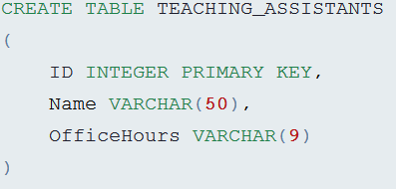
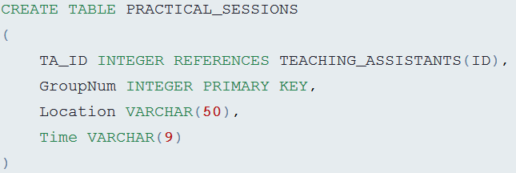
Data Definition Language (cont)
The TA table from earlier could be created using the following syntax:
And the Practical Sessions table could be created by this command:

Slide 10
Data Manipulation Language
The Data Manipulation Language is used to retrieve, insert, and modify databases.
These commands will be used by all database users during the routine operation of the database.

Slide 11
Insert
Time | Location | GroupNum | TA_ID
Sun 14-16 | 90/145 | 11 | 1
Sun 18-20 | 28/103 | 12 | 1
Mon 18-20 | 34/005 | 22 | 4
Sun 12-14 | 90/236 | 23 | 5
Mon 16-18 | 72/212 | 62 | 5
Tue 16-18 | 90/328 | 43 | 8
Insert INTO PRACTICAL_SESSIONS (TA_ID,GroupNum,Location,Time) Values (8,43,’90/328’,’Tue 14-16’)

Slide 12
Update
Time | Location | GroupNum | TA_ID
Sun 14-16 | 90/145 | 11 | 1
Sun 18-20 | 28/103 | 12 | 1
Mon 18-20 | 34/005 | 22 | 4
Sun 12-14 | 90/236 | 23 | 5
Mon 16-18 | 72/212 | 62 | 5
Tue 16-18 | 90/328 | 43 | 8
Tue 14-16 | 90/328 | 43 | 8
Update PRACTICAL_SESSIONS Set Time=“Tue 14-16” Where GroupNum=43

Slide 13
Delete
Time | Location | GroupNum | TA_ID
Sun 14-16 | 90/145 | 11 | 1
Sun 18-20 | 28/103 | 12 | 1
Mon 18-20 | 34/005 | 22 | 4
Sun 12-14 | 90/236 | 23 | 5
Mon 16-18 | 72/212 | 62 | 5
Tue 16-18 | 90/328 | 43 | 8
Delete From PRACTICAL_SESSIONS Where GroupNum=43

Slide 14
Simple Select
The Select command is the must commonly used command in SQL.
It enables database users to retrieve the specific information they desire from an operational database.

Slide 15
Select example
Select * From TEACHING_ASSISTANTS
OfficeHours | Name | ID
Thu 08:00-10:00 | Shaked | 1
Wed 16:00-18:00 | Matan | 2
Mon 10:00-12:00 | Yair | 3
Tue 13:00-14:45 | Linoy | 4
Wed 10:00-12:00 | Dolav | 5
Wed 12:00-14:00 | Hagit | 6
Mon 10:30-12:00 | Marina | 7
Mon 12:15-14:00 | Irit | 8
Mon 18:00-20:00 | Hussien | 9

Slide 16
Another Select Example
Select Name From TEACHING_ASSISTANTS
Name
Shaked
Matan
Yair
Linoy
Dolav
Hagit
Marina
Irit
Hussien

Slide 17
Using Select with Where
Select * From TEACHING_ASSISTANTS Where OfficeHours Like ‘Wed%’
OfficeHours | Name | ID
Wed 16:00-18:00 | Matan | 2
Wed 10:00-12:00 | Dolav | 5
Wed 12:00-14:00 | Hagit | 6

Slide 18

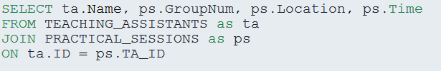
Join Operation
We could use the Select operation to retrieve the cartesian product of two tables.
Most of the time we would like to connect related information. We could use the Join query for that.

Slide 19
Join Operation(cont)
The ON operation lets us choose what is the connection between the two tables we would like to connect.
The AS keyword can be used to give a table a temporary name.
The basic Join operation will ignore any lines in TEACHING_ASSISTANTS that doesn’t fit any line in PRACTICAL_SESIONS.
We can force the Join to show these lines anyway using Left Join.

Slide 20
Join Example
ps.Time | ps.Location | ps.GroupNum | ta.Name
Sun 14-16 | 90/145 | 11 | Shaked
Sun 18-20 | 28/103 | 12 | Shaked
Mon 18-20 | 34/005 | 22 | Linoy
Sun 12-14 | 90/236 | 23 | Dolav
Mon 16-18 | 72/212 | 62 | Dolav

Slide 21

Join Example (cont)
ps.Time | ps.Location | ps.GroupNum | ta.Name
Sun 14-16 | 90/145 | 11 | Shaked
Sun 18-20 | 28/103 | 12 | Shaked
NULL | NULL | NULL | Matan
NULL | NULL | NULL | Yair
Mon 18-20 | 34/005 | 22 | Linoy
Sun 12-14 | 90/236 | 23 | Dolav
Mon 16-18 | 72/212 | 62 | Dolav
NULL | NULL | NULL | Hagit
NULL | NULL | NULL | Marina
NULL | NULL | NULL | Irit
NULL | NULL | NULL | Hussien

Slide 22
Basic Python
Python is an open-source, general purpose programming language, that is dynamic, strongly-typed, object-oriented, functional, and memory-managed.
Python is an interpreted language, meaning that it uses an interpreter to translate and run its code.
The interpreter reads one line of code at a time, just like a script, hence the term “scripting-language”.
Python is dynamic, meaning that types are only checked at runtime. But Python is also strongly-typed, meaning that just like Java, you can only execute operations that are supported by the target type.

Slide 23
Coding Python
Being an interpreted language, there are more than one way to code Python.
One is using Python’s REPL.
Another ono is by using files.
Python source files use the “.py” extension, and are called modules.
You can run modules through the shell.

