Slide 1
SPL – PS5
Generics, DBC, Lambdas and Reflection

Slide 2
Overview
Return to Java
Generics
Anonymous classes and lambdas
Default methods
Exceptions

Slide 3
Java collections
Collections are objects that holds other objects in some
manner.
For example: List, Map, and Set.
Java platform provides many ready to use collection classes.
(At the minimum, we are interested in the List and Map
interfaces, and in ArrayList and HashMap classes.)

Slide 4
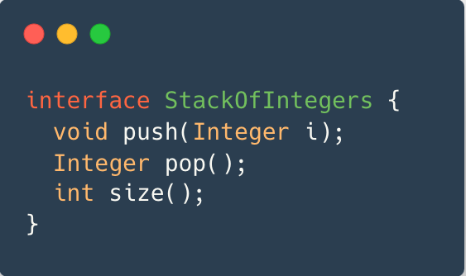
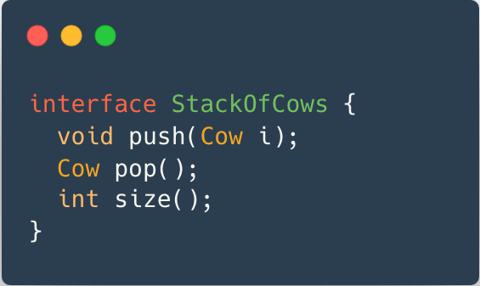
Generics
A mechanism for creating objects parameterized by a type.
For example – a stack.
We want to create a stack of integers
and a stack of cows

Slide 5
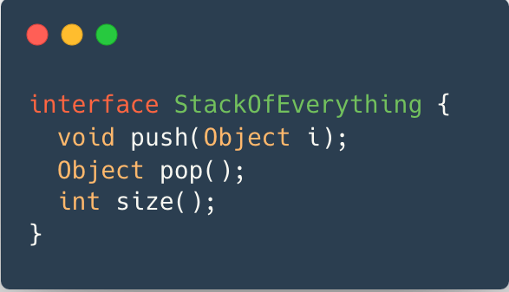
Generics (cont)
Since there is code duplication, we may want to create
a generalized stack.
This stack can hold both cows and integers at the same time!
Usually that’s not what we want.

Slide 6
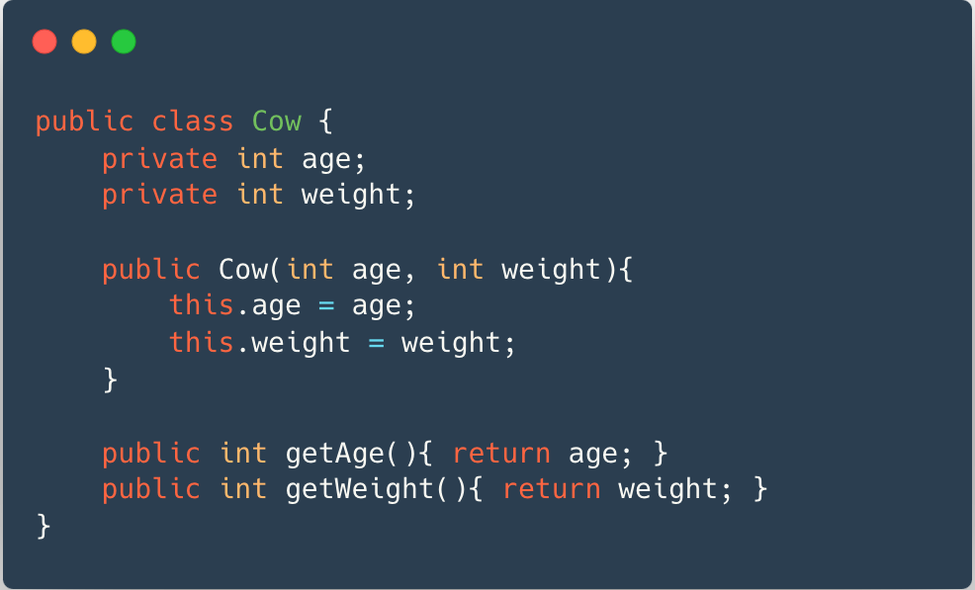
Generics (cont)
Let’s assume this is our Cow class:

Slide 7
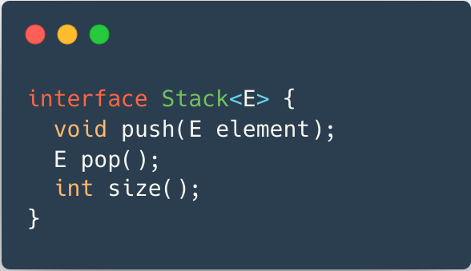
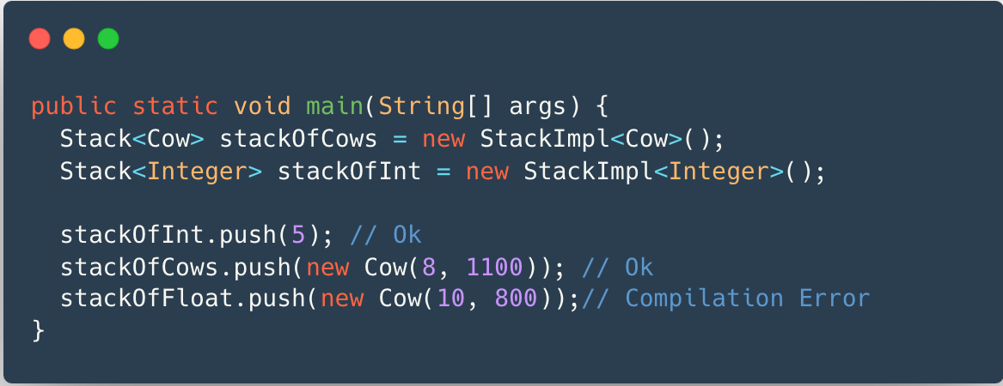
Generics (cont)
We want both type-safety and a general stack:
An implementation using Generics.

Slide 8
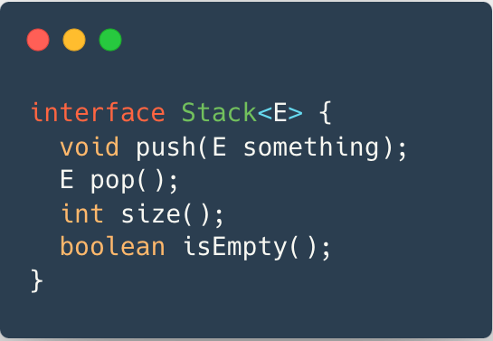
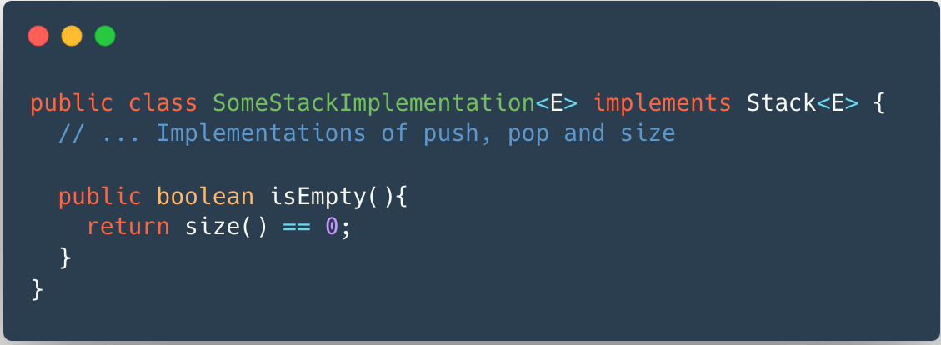
Default methods
A default method is a method which is implemented directly in the interface.
There’s a straight-forward way to implement the method isEmpty:

Slide 9
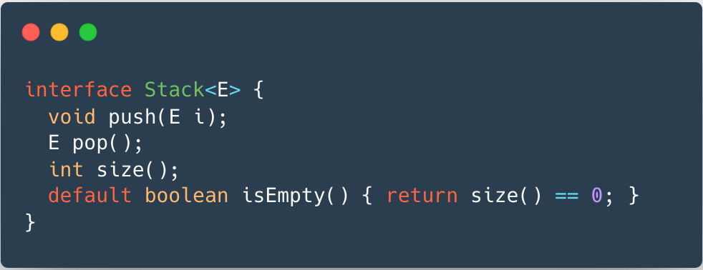
Default methods(cont)
This implementation can suit most implementations of stack.
Only requires calling methods that was already defined in the Stack interface.

Slide 10
Generic methods
In addition to generic classes and interfaces, Java supports generic methods.
A reminder - this is our Cow class:
How can we find the maximal Cow in a collection?

Slide 11
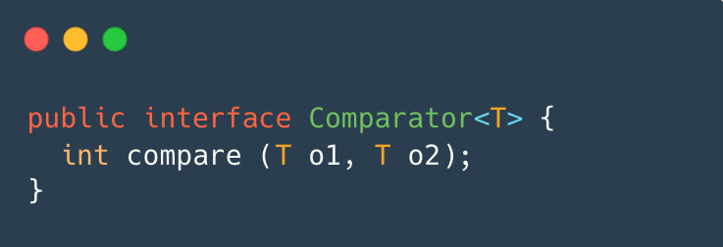
Reminder: Comparator
Given two objects of type T, the method compare will compare them and return:
A positive integer if o1>o2
A negative integer if o2>o1
Zero if both objects are equal

Slide 12
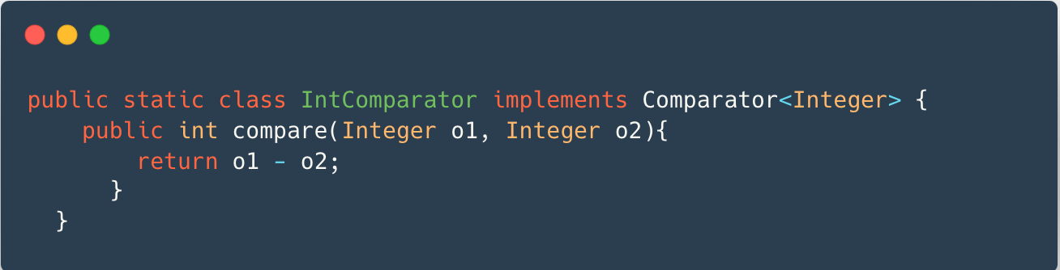
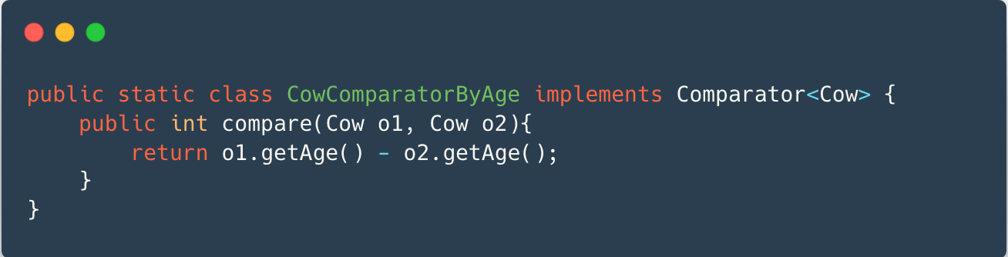
Examples - Comparator Implementations
Given two objects of type Integer, the method compares their values using o1 - o2.
Compares 5 and 10 and returns -5 (5 is less than 10).
Given two objects of type Cow, the method compares their age using o1.getAge() - o2.getAge().
Compares a 5-year-old cow and a 3-year-old cow and returns 2 (5 is older than 5).

Slide 13
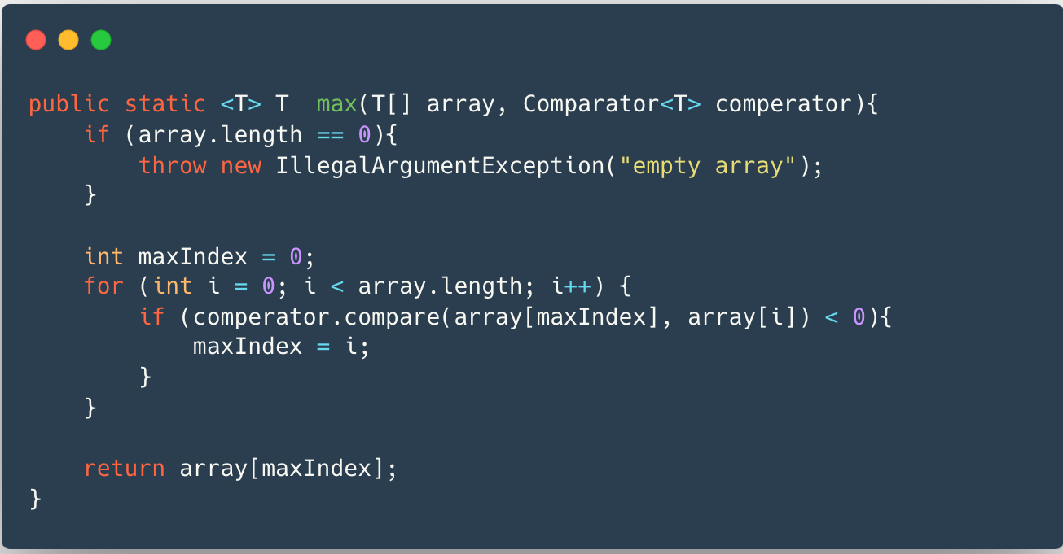
Generic methods(cont)
The following is a generic method used to find a maximal
element in an array.

Slide 14
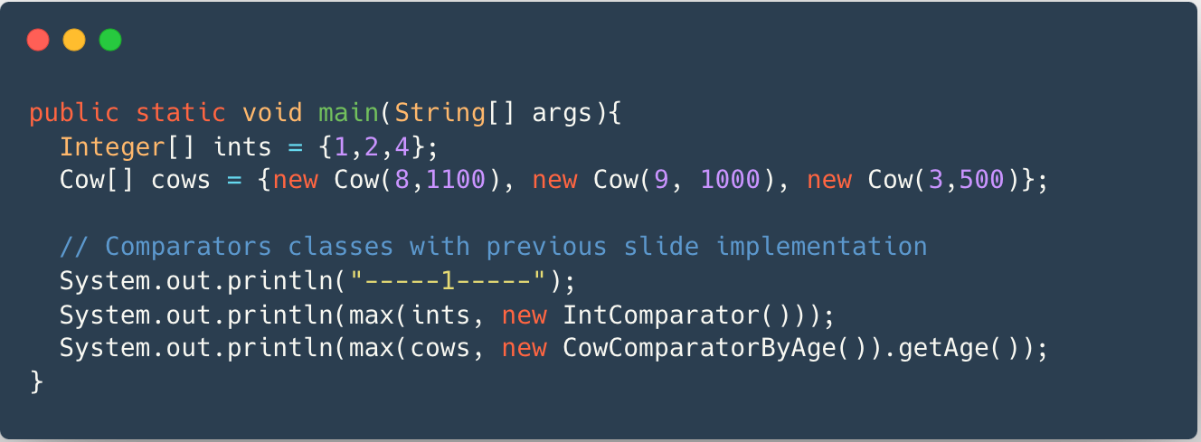
Generic methods(cont)
Max integer is 4
The eldest cow is 9 years old

Slide 15
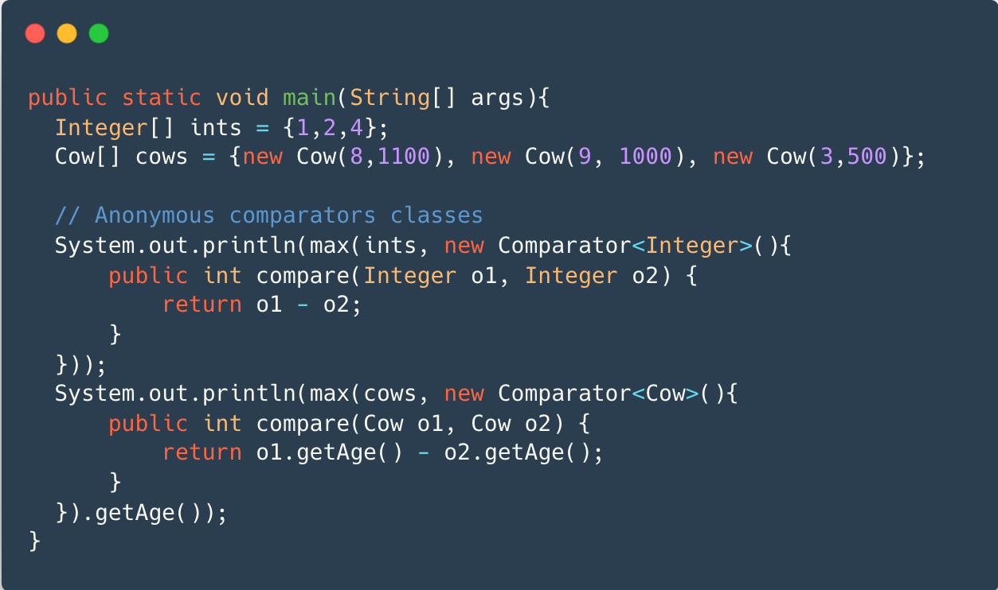
Anonymous classes
Anonymous classes help make you your code more concise.
Enable you to declare and instantiate a class at the same time.
Use them if you need to use a local class only once.
Max integer is 4
The eldest cow is 9 years old

Slide 16
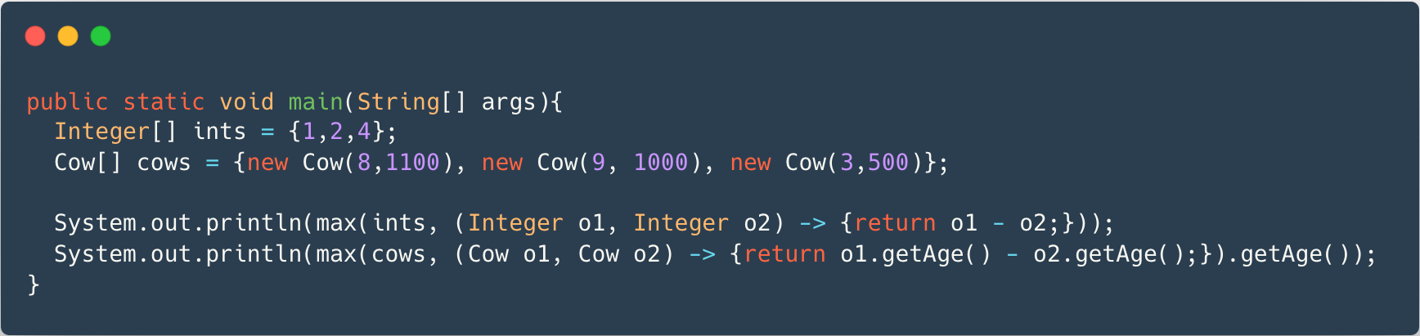
Lambda expressions
An issue with anonymous classes is that their syntax can be a bit unclear.
We can use Lambda expressions instead:

Slide 17
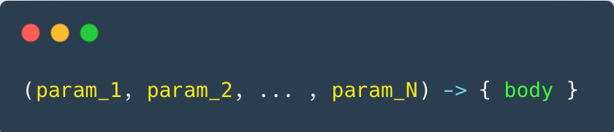
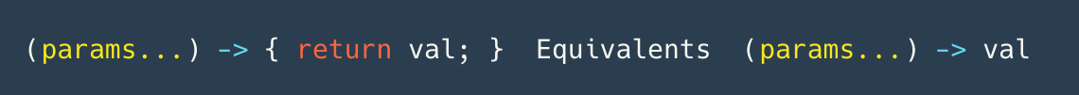
Lambda expressions (cont)
The lambda syntax is
You can replace an anonymous class with a lambda expression only if the class has a single non-default method.
If all your lambda does return a value, you can write both
No need to declare the type of the parameter
No need to declare a single parameter in parenthesis (Required for multiple parameters)
Can drop the {} if it is a single expression.

Slide 18
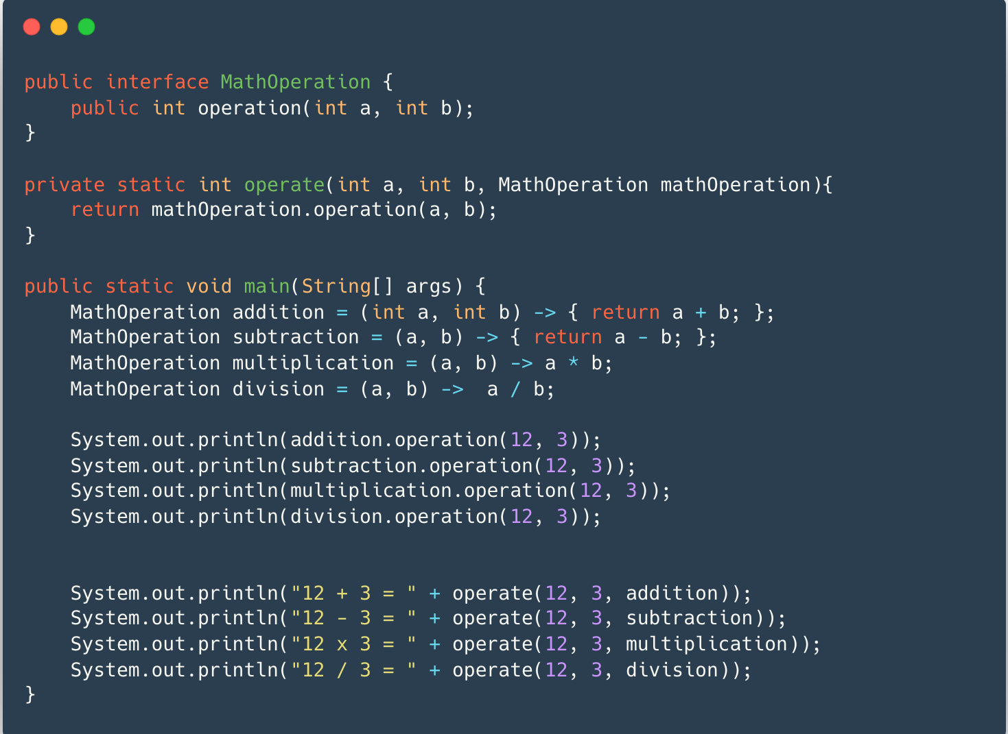
Lambda expression example

Slide 19
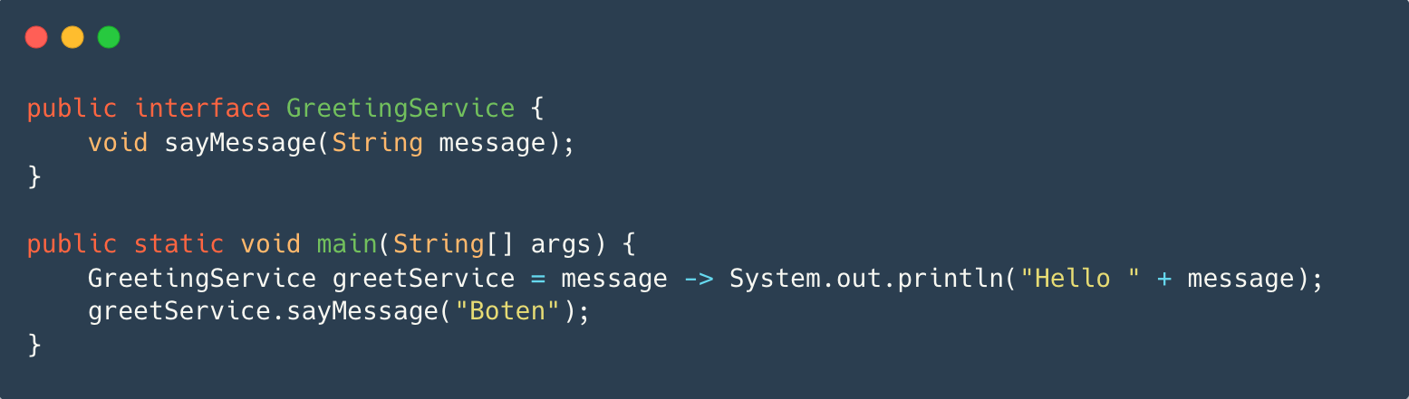
Lambda expression example (cont)

Slide 20
Class object
There’s a special class in Java called Class.
Instances of class Class represents classes and instances running in the Java application.
Every class in Java has a corresponding Class object.
You can receive the object Class in runtime using the static class property, or the method getClass().
The class Object has several methods, getName() which returns the name of the class, and isAssignableFrom(some_class).
Generally can be used to do ‘reflection’, i.e., get meta
information on the class.

Slide 21
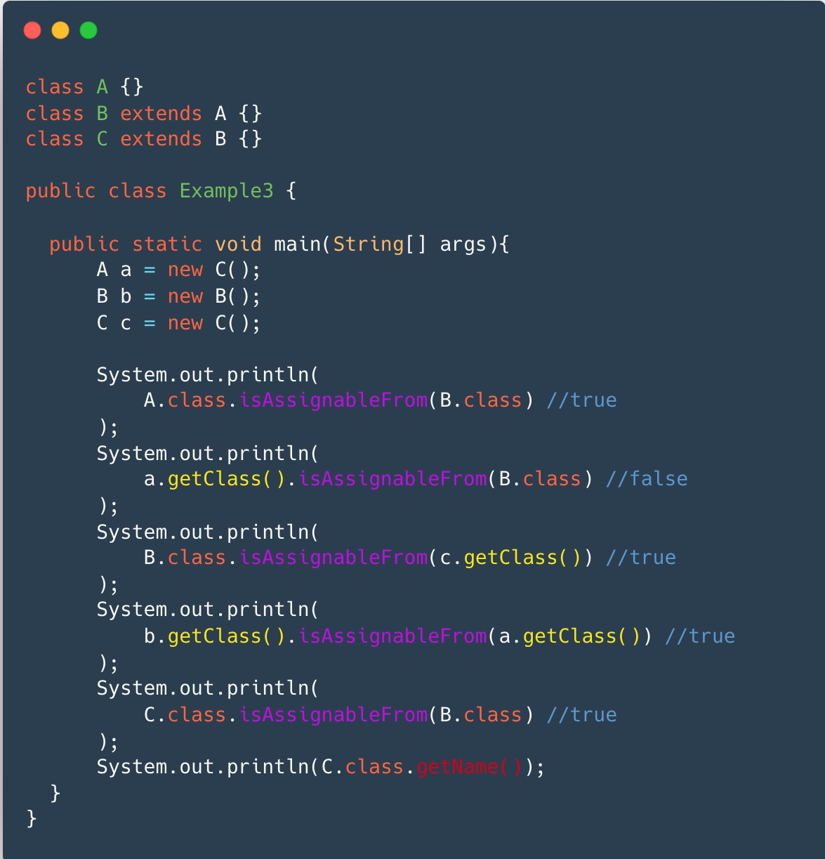

Class object example

Slide 22
Design by contract
DBC is a simple terminology that helps us express contracts between specification and implementation.
DBC relies on three words:
Precondition – things that must be true before a method is invoked.
Postcondition – things that must be true after a method is invoked.
Invariants - things that must be true both before and after any method is invoked and immediately after construction.

Slide 23
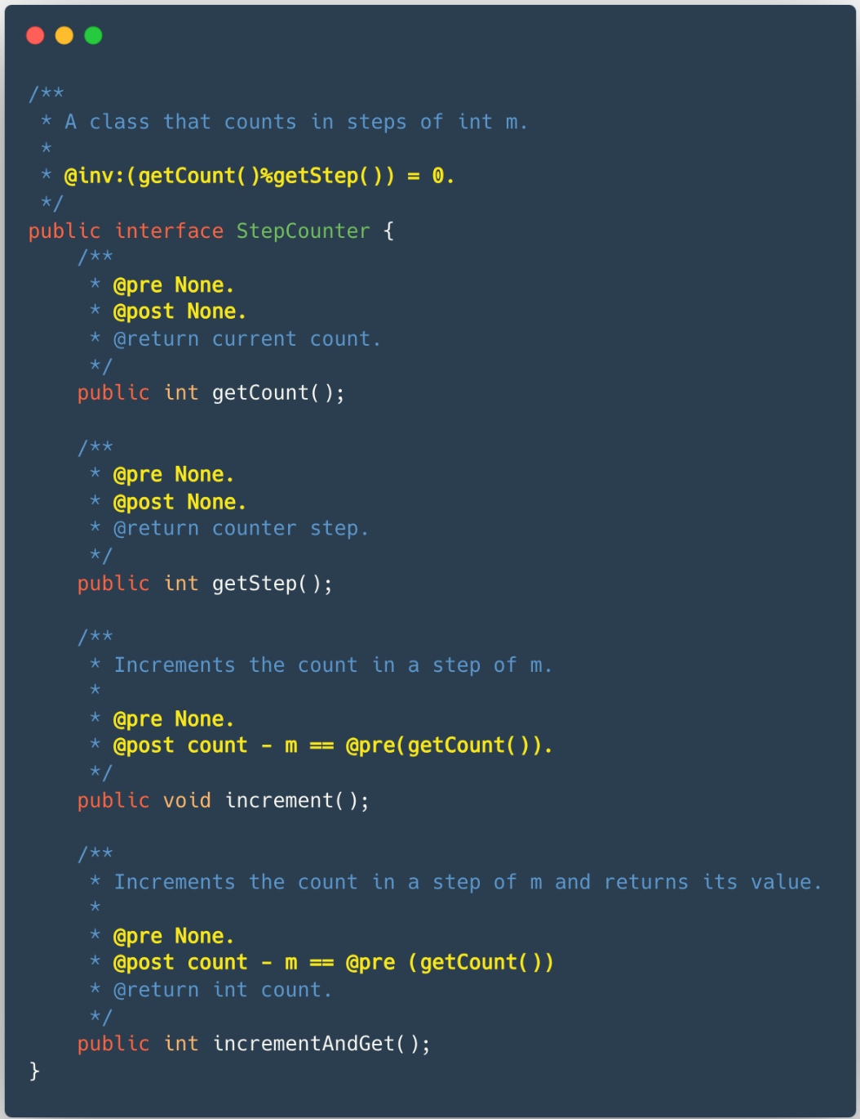
Design by contract - StepCounter

Slide 24
Rules that ensure testability
Separate commands and queries.
pop -> top, removeTop
Separate basic queries and derived queries.
isEmpty is basic while top is derived.
Define derived queries in terms of basic queries.
top uses isEmpty to check if the stack is empty and throw exception
For each basic command, write post-condition which specify the value of every basic query.
For each basic command and basic query, express the pre-conditions in terms of basic queries.
Specify class invariants that impose constraints that must remain always true on the basic queries.
if the stack is empty then size should be 0.

Slide 25
/**
* An interface for Stack collection.
*
* @inv: if (this.isEmpty() == true) this.size() == 0.
* @inv: this.size() >= 0.
*/
public interface Stack<T> {
/**
*
* @param obj any non null T object.
* @pre: none.
* @post: this.isEmpty() == false.
* @post: this.pop();
* this.size() == @pre(this.size())
* @post: this.top() == @param obj
*/
void push(T obj);
/**
* Will return the top object in the stack.
*
* @return the top most object if there is one.
* Throws an exception if the stack is empty.
* @throws Exception
* @pre: this.isEmpty() == false.
* @post: None.
*/
T top() throws Exception;
/**
* @return the current size of the stack.
* @pre: none.
* @post: none.
*/
T size();
/**
* Will remove the top object in the stack.
*
* @throws Exception
* @pre: this.isEmpty() == false
* @post: this.size() == @pre(this.size()) - 1
*/
void removeTop() throws Exception;
/**
* Will remove the first object in the stack and return it.
*
* @return the top most object if there is one, otherwise null.
* @pre: none.
* @post: @return == @pre(this.top()).
* @post: this.size() == @pre(this.size()) - 1
*/
T pop();
/**
* @return true if the Stack is empty, or false if the stack
* contains at least on {@link Object}
* @pre: none.
* @post: none.
*/
boolean isEmpty();
}

Slide 26
Exceptions
Java uses exceptions to handle errors and other exceptional events.
Some examples:
Reading a file that doesn’t exist (FileNotFoundException)
Dividing by zero (ArithmeticException)
Networks problem (ConnectException)
An attempt to access an element out of the array’s bounds.
(ArrayIndexOutOfBoundsException)

Slide 27
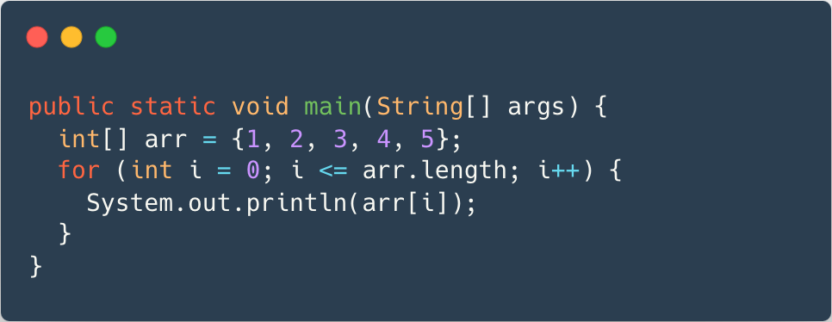
Exceptions Example
What type of error might occur?

Slide 28
Exceptions (cont)
When an error occurs within a method, the method creates an object and hands it off to the runtime system.
The object, called an exception, contains information about the error.
After an exception was thrown, the runtime system attempts to find someone to handle it. By searching the call stack in reverse order looking for a block of code that can handle the exception.
If no such block of code was found, the exception is passed to the JVM which terminates the program.

Slide 29
Exceptions
Main
Function call
Function with handler
Function call
Function without handler
Ex

Slide 30
Exceptions
Main without handler
JVM
Function call
Function without handler
Terminates program
Function call
Function without handler
Ex

Slide 31
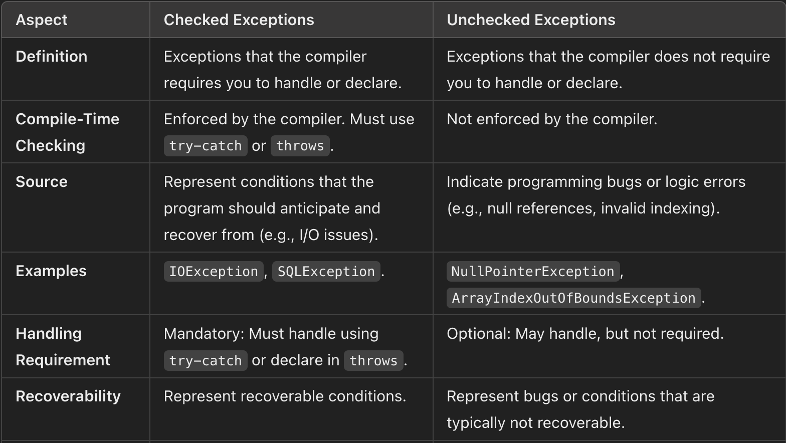
Exceptions types
There are two types of exceptions, unchecked exceptions and checked exceptions.
Unchecked exceptions could be divided into errors, and runtime exceptions.
Unchecked exceptions usually indicate conditions which the application cannot anticipate or recover from.
(unchecked exceptions are bugs)
Checked exceptions are conditions which a well-written application should anticipate and recover from.
For example, not finding a file.

Slide 32
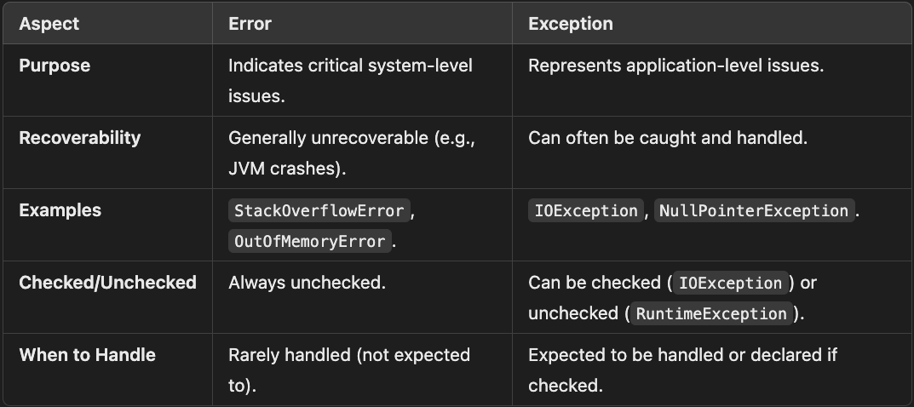
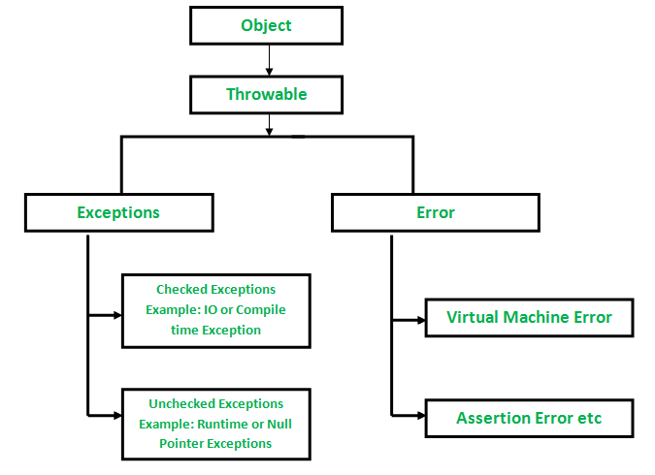
Exceptions types (cont)

Slide 33
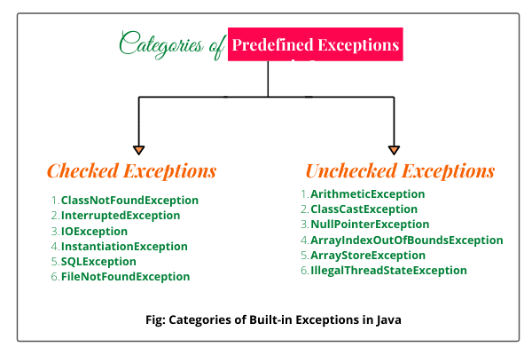
Exceptions types (cont)

Slide 34
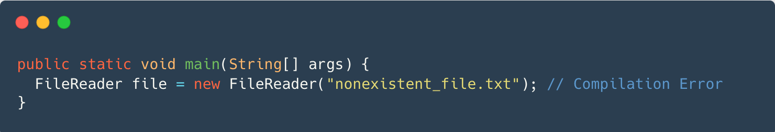
Examples
An example to unchecked exception:
An example to checked exception:
Code compiles even if exception isn’t handled.
Handling is optional but recommended.
Code won’t compile unless exception is handled.
Requires try-catch or throws.

Slide 35
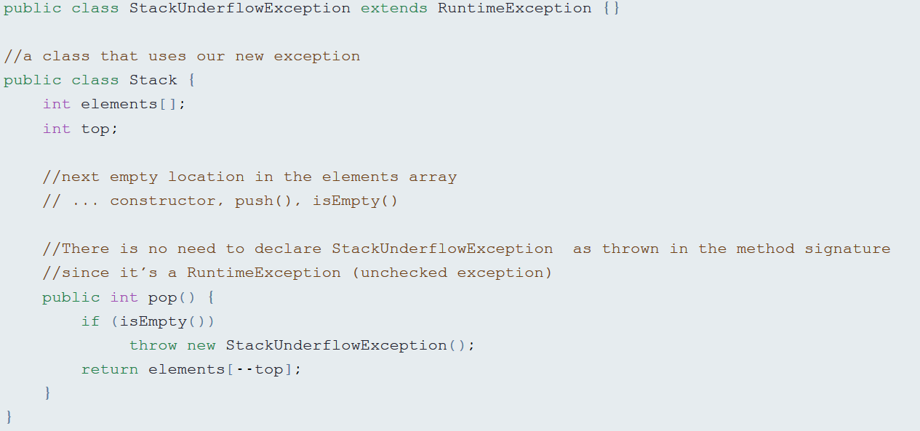
Creating new exceptions

Slide 36
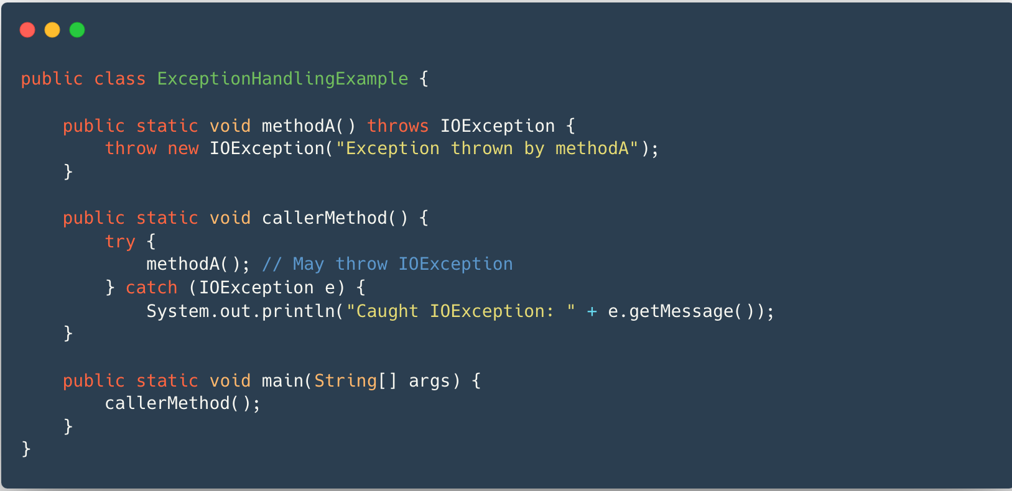
You don’t have to handle exceptions where they occur, by declaring you throw them you can pass the responsibility to the calling method.

Slide 37
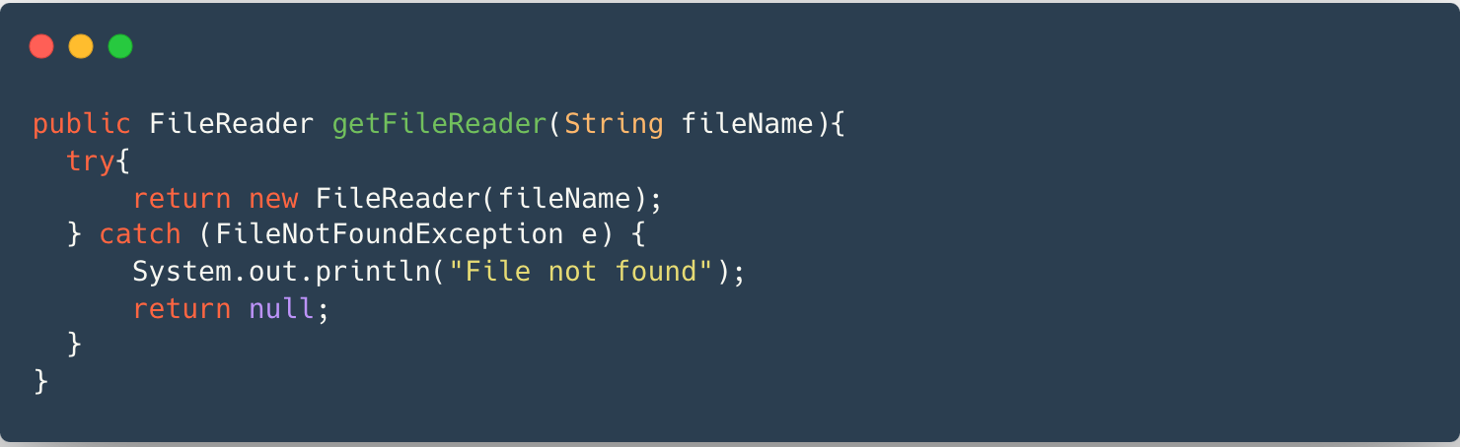
Handling exceptions
If we decide to handle an exception, we need to use the try-catch block.
When handling exceptions, we could do one of the following:
  Change conditions and retry.
  Clean up and fail (maybe rethrow exception, if it’s unchecked), for example when attempting to open a file that doesn’t exist.

Slide 38
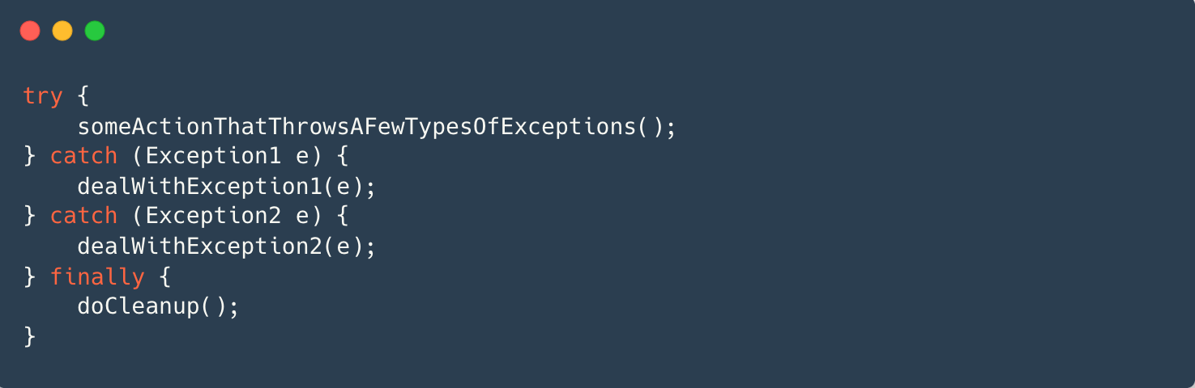
The finally block
The finally block comes right after all catch blocks in a try-catch clause.
The code in the finally block is always executed before exiting the try-catch clause, even if an exception occurred, or return/continue/break statement was encountered.
Usually used for cleanup code, and to close resources.

Slide 39
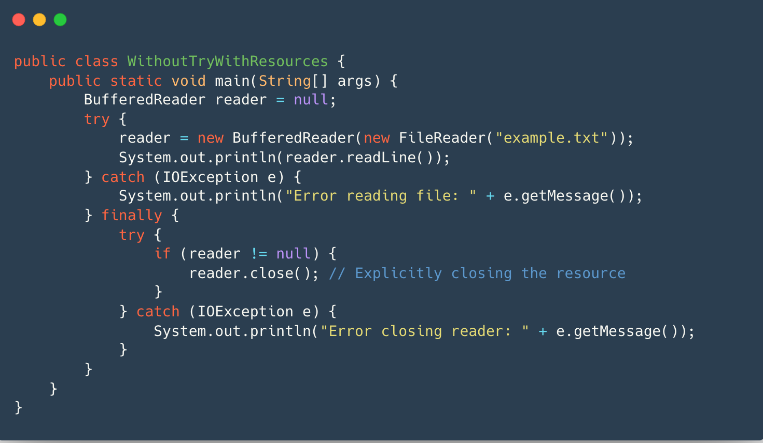
The problem? Closing the resource can throw an exception by itself!

Slide 40
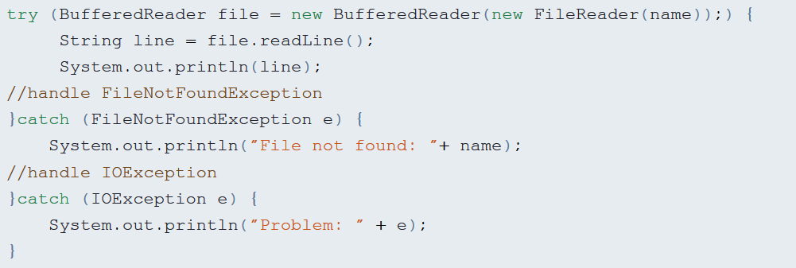
Try with resources
In order to handle an event in which the closing of the resource would cause an exception, we put a try/catch block inside the finally block.
Since Java 7, there is a more elegant solution – try with resources.
An object that implements the interface AutoCloseable can be declared as part of the try statement.

Slide 41
Suppressed Exceptions
Suppose that during a try with resource block, an exception was thrown when trying to close the object.
If this is the only exception thrown, then we will simply throw it upwards.
But(!) what if an exception occurred before trying to close the object, and then another one occurred when closing the object?
In that case, the second exception would be suppressed.

Slide 42
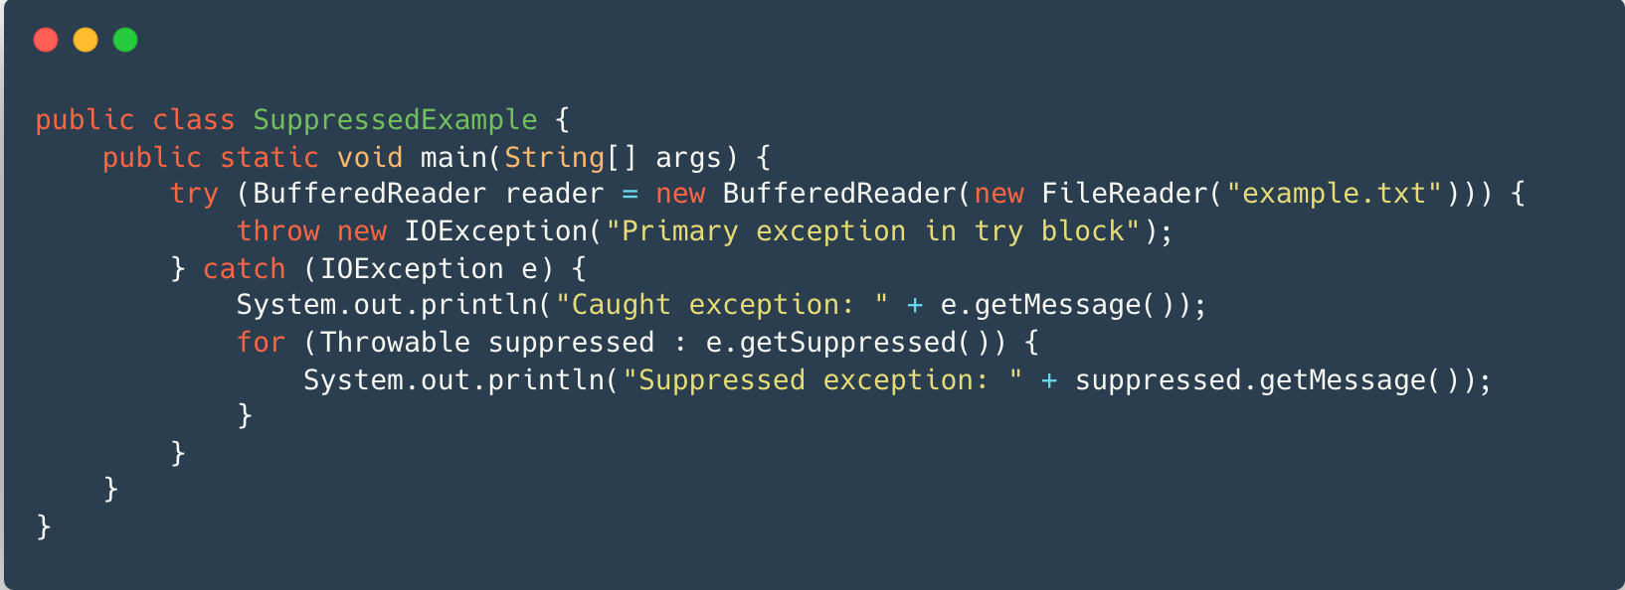
Suppressed Exceptions

