Slide 1
SPL – PS8
More concurrency issues

Slide 2
Overview
A reminder to Liveness:
  Deadlock
  Starvation
  Livelock
Atomic actions – another example
Thread safe singleton design pattern
Callables and Futures
Thread (safe) cancellation – Interrupt mechanism

Slide 3
Liveness – a reminder
A concurrent application’s ability to execute in a timely manner is known as it’s liveness.
There are several situations that can hinder liveness, we’ll go over some of them in this practical session.
We can estimate a program’s performance by its:
  Throughput
  Latency
  Efficiency
  Scalability
What could hurt our program’s performance?
  I/O: Such as network requests, file access, or keyboard input.
  Poor Synchronization: Inefficient coordination of concurrent tasks.

Slide 4
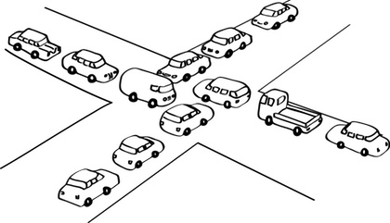
Deadlock
A situation in which two or more threads are blocked, waiting for each other forever.
Can be solved by resource ordering.

Slide 5
Starvation
Describes a situation in which a thread is unable to gain regular access to a shared resource.
Can happen when a shared resource is being held for a long period of time by a “greedy” thread.
Can also happen when using priority scheduling.
Can be solved by introducing fairness to the allocation of the shared resource.
In Java, can be done using fair semaphores.

Slide 6
Livelock
Two threads are unable to make further progress – like in a deadlock.
Unlike deadlock, the threads are not blocked – they are too busy responding to each other to resume work.

Slide 7
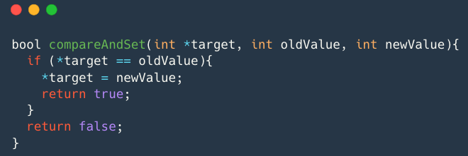
Atomic instructions
Most CPU’s today offer a set of atomic instructions designed for multi-threading.
An important such action is the CAS (Compare and set) action.
The CAS action is atomic, meaning that the scheduler can’t stop the thread during the action, only before or after.
A reminder:

Slide 8
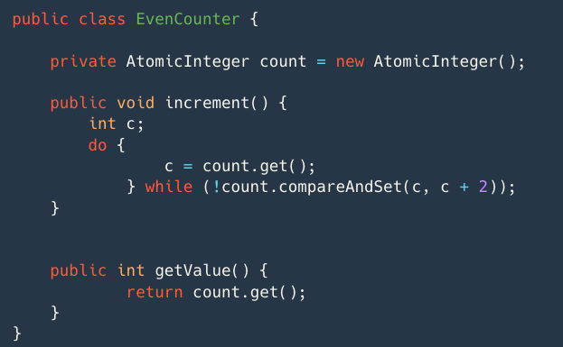
Atomic instructions
The CAS action can be used through the Java’s atomic library.
We could use the CAS action to write lock-free implementations for thread-safe classes.
A reminder to ”counter” free-lock class implementation:

Slide 9
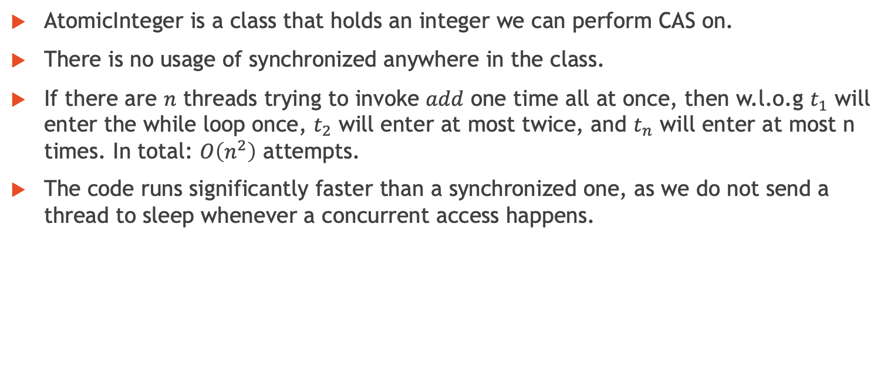
Atomic instructions – Counter Summary
AtomicInteger is a class that holds an integer we can perform CAS on.
There is no usage of synchronized anywhere in the class.
If there are $n$ threads trying to invoke $add$ one time all at once, then w.l.o.g $t_{1}$ will enter the while loop once, $t_{2}$ will enter at most twice, and $t_{n}$ will enter at most n times. In total: $O\left(n^{2}\right)$ attempts.
The code runs significantly faster than a synchronized one, as we do not send a thread to sleep whenever a concurrent access happens.

Slide 10
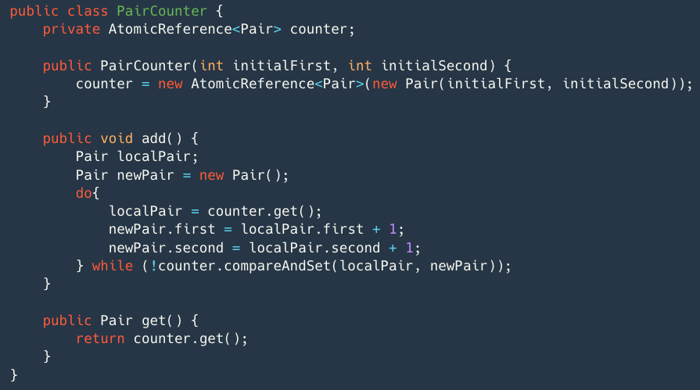
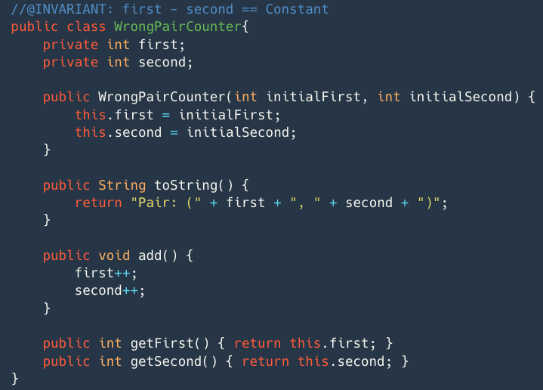
Atomic Reference - Pair Example
Pair class has two class members – first, second.
We wish to implement Pair in a lock-free design pattern.
How would you do it?
We’ll use AtomicReference to wrap a Pair

Slide 11
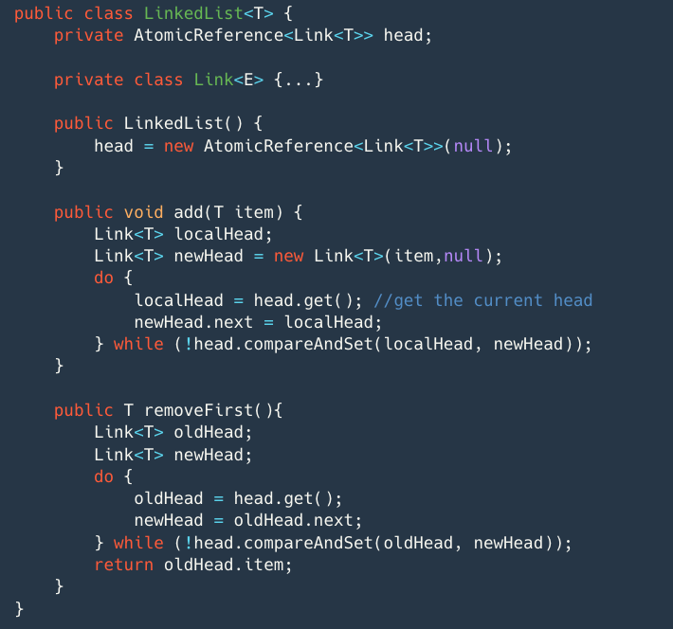
Atomic Reference - LinkedList Example
Using the AtomicReference, we can create lock-free implementations for more advanced data structures.
For example, lock-free implementation of a LinkedList:

Slide 12
Lock-free Implementations (Summary)
Using the Lock-free data structures have their limitations.
Since there are no locks we cannot block threads, which may be a required property of the data structure, for example blocking queues.
Lock-free data structures are harder to write.
There are some cases in which the state of the data structure may be complex, and may require a lock-free implementation to copy a large amount of data, in such cases a synchronized approach may be better.

Slide 13
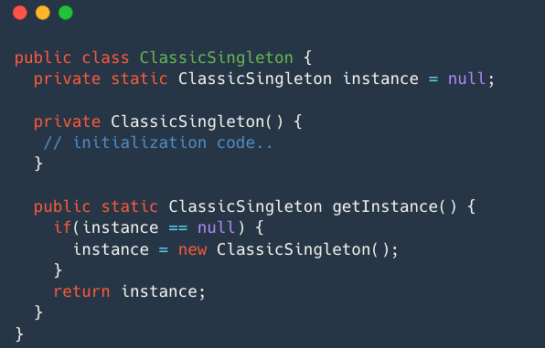
The Singleton Design Pattern
In some cases you’ll want to have exactly one instance of a class in your program.
Those types of objects are accessed throughout the program, and therefore require a global point of access.
We call such objects singletons. A naïve implementation could be as follows:

Slide 14
The Singleton Design Pattern
In some cases you’ll want to have exactly one instance of a class in your program.
Those types of objects are accessed throughout the program, and therefore require a global point of access.
We call such objects singletons. A naïve implementation could be as follows:

Slide 15

Singleton (cont)
This naïve implementation of the singleton works well in a single threaded environment, but not in a multi-threaded one.
Can we try to create a thread-safe implementation?
if(instance == null) {
instance = new ClassicSingleton();
}

Slide 16
Singleton (cont)
This naïve implementation of the singleton works well in a single threaded environment, but not in a multi-threaded one.
Can we try to create a thread-safe implementation?
if(instance == null) {
instance = new ClassicSingleton();
}

Slide 17
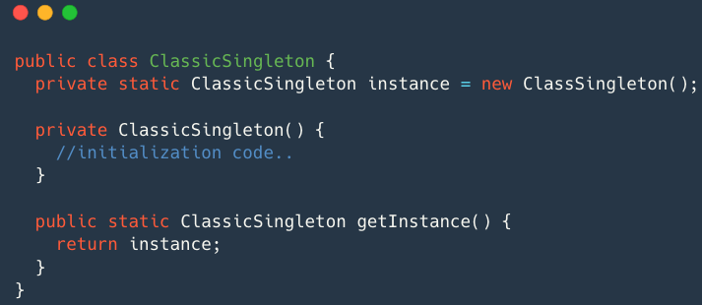
Thread safe singleton using eager initalization
Since the instance is initialized at the time of class loading, this approach is called eager initialization.
The instance is created even if it is never used in the program.

Slide 18
Thread safe singleton using eager initalization
Since the instance is initialized at the time of class loading, this approach is called eager initialization.
The instance is created even if it is never used in the program.

Slide 19
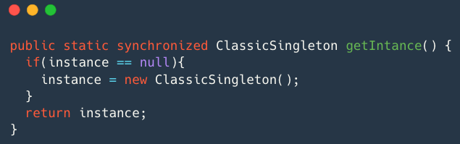
Thread safe singleton using locks
Will work, because the initialization is done in a synchronized block.
Problem: every time we would want to get the instance of the singleton our thread could be blocked. Damages the liveness of our program.
A better solution?

Slide 20
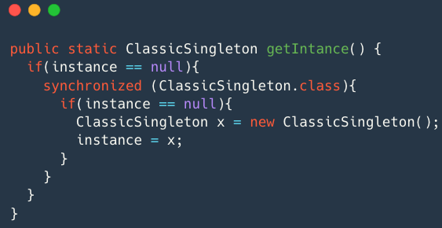
Alternative thread safe singleton using locks
Why is a double null check necessary?
Which monitor is held within the synchronized block?
Will it solve our previous problems? No, due to Java optimization.

Slide 21
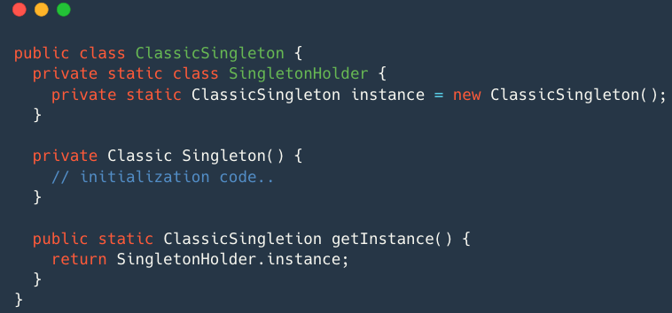
Thread safe singleton solution.
The SingletonHolder class would only be initialized once we call the getInstance() method.
Java guarantees us that the loading and initialization of the static class will be done once, and the static fields will be published safely.

Slide 22
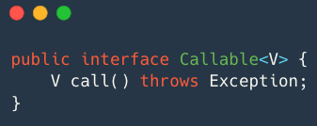
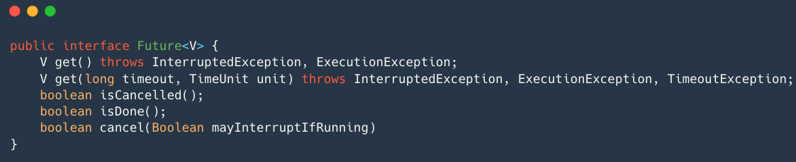
Callables and Futures
If you want your threads to return a completed result you could use java.util.concurrent.Callable.
Callables allow returning of values after a computation.
Since you wish to receive the computed result, you need to keep a connection to the thread executing the Callable.
To do so, you may use Futures and Executors (specifically the ExecutorCompletionService).
(This could be done using normal threads with the use of the FutureTask java class)

Slide 23
Callables and Futures
The Future and Callable interfaces:

Slide 24
Executor Completion Service
When giving a Callable to the Executor, it returns a Future
C
C
F
F
F
A data structure we created

Slide 25
Executor Completion Service - cont
We can use Executor Completion Service if we don’t want to manage the futures by ourselves.
We can use the take method on
the ECS to receive a finished
Future.
ECS
C
C
F
F

Slide 26
Thread cancellation
Each thread has a predefined task it works on, when the task ends, the thread exits.
Sometimes we want to tell a thread to stop working before it finished the task.
One way is calling the thread’s stop() method. This is always unsafe, and you should never do that.

Slide 27
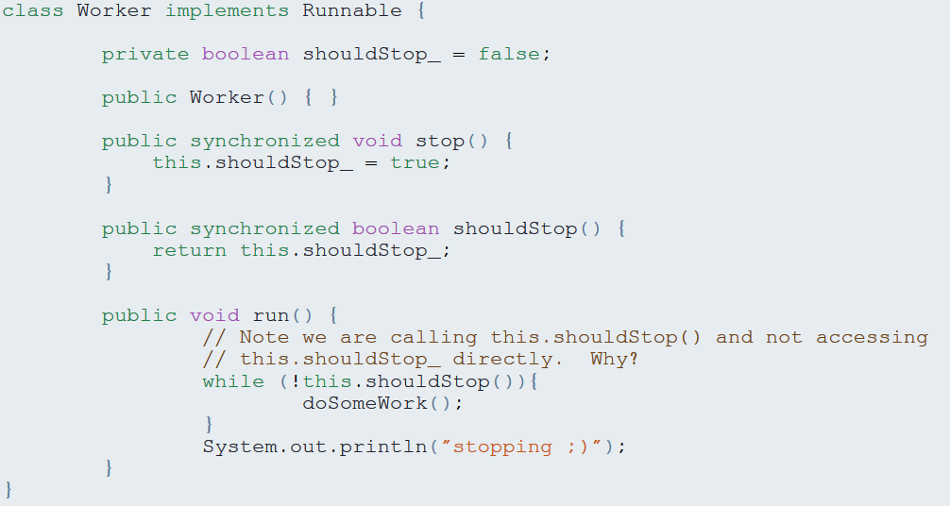
Thread cancellation (cont)
Another way is by changing a variable which the thread sees, for example:

Slide 28
The interrupt mechanism
What if the thread waits or sleeps when receiving the stop signal?
In Java that issue is solved with the interrupt mechanism.
When calling the interrupt method on a thread, a flag (similar to the shouldStop flag) value is changed to true.
If the thread is waiting or sleeping, an InterruptedException is thrown, and he wakes up.
If the thread starts sleeping while the flag is raised, the exception will be thrown immediately.
Note that after an interrupted exception is thrown, the value of the interrupted flag receives false value.

