Slide 1
SPL – PS10
Thread per client, C++ Threads, Java NIO, Stomp protocol

Slide 2
Overview
Thread per client server
Threading in C++
Java’s new IO classes
STOMP protocol

Slide 3
Message Encoder Decoder
The message encoder-decoder interface is responsible for encoding and decoding objects for transmission to and from our server.
The messages are sent and received as bytes.

Slide 4
Message Encoder Decoder
public interface MessageEncoderDecoder<T> {
/**
* add the next byte to the decoding process
*
* @param nextByte the next byte to consider for the currently decoded message
* @return a message if this byte completes one or null if it doesn't.
*/
T decodeNextByte(byte nextByte);
/**
* encodes the given message to bytes array
*
* @param message the message to encode
* @return the encoded bytes
*/
byte[] encode(T message);
}
The message encoder-decoder interface is responsible for encoding and decoding objects for transmission to and from our server.
The messages are sent and received as bytes.

Slide 5
Messaging Protocol
Similar to the messaging protocol we saw in the last PS, this time the protocol is generic.
public interface MessagingProtocol<T> {
/**
* process the given message
*
* @param msg the received message
* @return the response to send or null if no response is expected by the client
*/
T process(T msg);
/**
* @return true if the connection should be terminated
*/
boolean shouldTerminate();
}

Slide 6
Thread per Client Server
In the previous practical session, we saw a simple server implementation in Java.
Recall that reading and writing to sockets, as well as awaiting new connections on the server side, block the execution of the thread.
A simple solution to this problem is to create a thread for each client.

Slide 7
Blocking Connection Handler
The blocking connection handler is a runnable that handles a single client's connection on the server.
It has its own Message encoder decoder, its own instance of the protocol, and its own socket.
In the TPC, each non-blocking connection handler runs on its own thread.

Slide 8
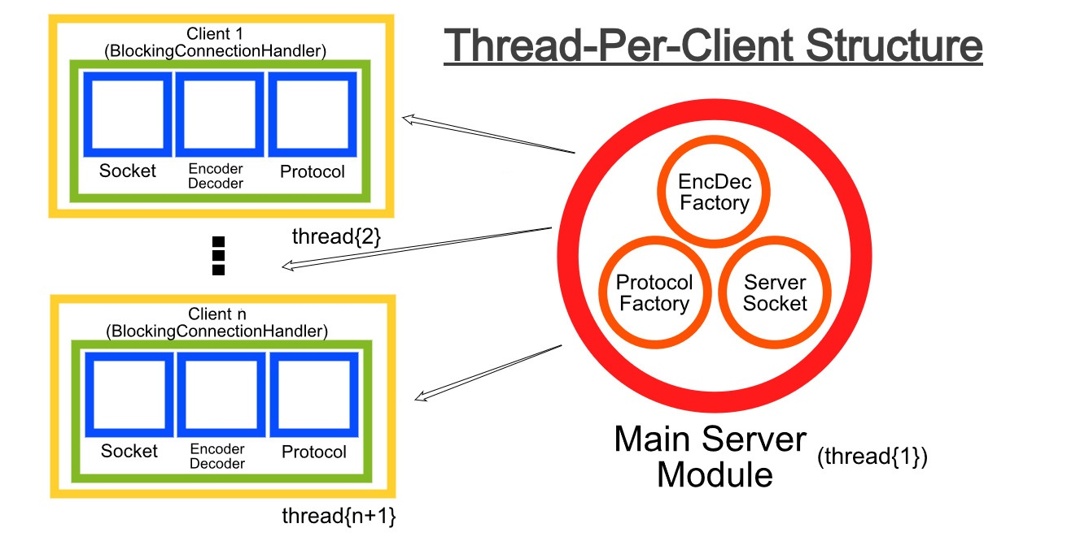
Thread per client server (cont)

Slide 9
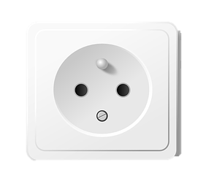

Connection Handler (Runnable)
ServerSocket
.
.
.
EncDec
Protocol
EncDec
Protocols
EncDecs
Protocol
Connection Handler (Runnable)
Notes:
Check code example!

Slide 10
Thread per Client in Java
Check “Code Example” for PS 10.

Slide 11
Multi-Threading in C++
Why do we need threads?
  Multiple execution flows inside the same process
  Useful for:
    handling multiple clients
    background tasks
  Same idea in Java and C++ but different syntax
  Psst…You need it for assignment 3

Slide 12
Multi-Threading in Java vs. C++
In java:
Runnable r = () -> {
System.out.println("Hello from thread");
};
Thread t = new Thread(r);
t.start();
Runnable = “what to run”
Thread = “how it runs”
start() creates a new execution flow
In C++:
#include <thread>
void task() {
std::cout << "Hello from thread\n";
}
int main() {
std::thread t(task);
t.join();
}
task = what to run (like Runnable)
std::thread = the thread object
join() = wait until finished (mandatory)

Slide 13
Multi-Threading in Java vs. C++
In java:
Thread t = new Thread(() -> {
System.out.println("Hello from thread");
});
t.start();
Runnable = “what to run”
Thread = “how it runs”
start() creates a new execution flow
In C++:
#include <thread>
int main() {
std::thread t([](){std::cout << "Hello from thread\n";});
t.join();
}
task = what to run (like Runnable)
std::thread = the thread object
join() = wait until finished (mandatory)

Slide 14
Multi-Threading in C++
There is no runnable interface in C++.
Assigning tasks to threads involves giving each thread a pointer to the function it should run.
RULE: A std::thread must be either join()-ed or detach()-ed before it is destroyed.
Locking can be done using std::mutex and std::lock_guard.

Slide 15
Mutex: the C++ version of synchronized
std::mutex m;
Java
C++
synchronized(obj)
automatic unlock
JVM-managed
std::mutex
RAII
programmer-managed

Slide 16
RAII locking with std::lock_guard
std::lock_guard is a small helper object that locks a std::mutex when it is created and automatically unlocks it when it goes out of scope.
  Constructor → locks the mutex
  Destructor → unlocks the mutex
  Unlocking happens automatically, even if the function returns early or an exception occurs
{
std::lock_guard<std::mutex> lock(m);
std::cout << "Safe output\n";
} // mutex automatically unlocked here

Slide 17
Threading in C++ example
#include <iostream> // Provides input/output streams (e.g., std::cout for printing to the console)
#include <mutex> // Provides mutex primitives for mutual exclusion between threads
#include <thread> // Provides std::thread for creating and managing threads
class Task {
private:
int _id;
std::mutex& _mutex;
public:
Task(int id, std::mutex& mutex) : _id(id), _mutex(mutex) {}
void run() {
for (int i = 0; i < 100; i++) {
std::lock_guard<std::mutex> lock(_mutex); // constructor locks, destructor unlocks
std::cout << i << ") Task " << _id << " is working" << std::endl;
}
}
};

Slide 18
Threading in C++ example(cont)
int main() {
std::mutex mutex;
Task task1(1, mutex);
Task task2(2, mutex);
std::thread th1(&Task::run, &task1);
std::thread th2(&Task::run, &task2);
th1.join();
th2.join();
return 0;
}

Slide 19
Publisher/Subscriber in C++
Check “Code Example” for PS 10.

Slide 20
TCP Client in C++
Check “Code Example” for PS 10.

Slide 21
Java NIO
In the client-server implementation, we used blocking I/O.
For example, in this line in the client:
The client is blocked until the server responds.
We want non-blocking IO so the network buffer keeps working even when we reach the code above.
Java’s java.nio package is an efficient IO package. It also supports Non-blocking IO.
String line = in.readLine();

Slide 22
Channels
A channel is something you can read from or write to.
Channels can be either blocking (by default) or non-blocking.
We will discuss SocketChannel and ServerSocketChannel, which are like Socket and ServerSocket, but their read(), write(), and accept() can be non-blocking.
The ServerSocketChannel’s accept() returns a SocketChannel.

Slide 23
Channels example
Setting up a non-blocking ServerSocketChannel listening on a specific port is done as follows:
Setting up a non-blocking SocketChannel and connecting to a server is done as follows:
int port = 9999;
ServerSocketChannel ssChannel = ServerSocketChannel.open();
ssChannel.configureBlocking(false);
ssChannel.socket().bind(new InetSocketAddress(port));
SocketChannel sChannel = SocketChannel.open();
sChannel.connect(new InetSocketAddress("localhost", 1234));
sChannel.configureBlocking(false);

Slide 24
Buffers
All the IO in NIO goes through buffers.
Channels know how to read and write into buffers, and buffers can read and write into other buffers.
We’ll discuss ByteBuffer, which holds bytes.
We can create a new ByteBuffer in the following manner:
We can also create a ByteBuffer from an array of bytes:
final int NUM_OF_BYTES = 1024;
ByteBuffer buf = ByteBuffer.allocate(NUM_OF_BYTES);
byte[] bytes = new byte[10];
ByteBuffer buf = ByteBuffer.wrap(bytes);

Slide 25
Flipping
Each buffer has a current position, limit, and capacity.
The capacity is the maximum amount of data that can be stored in the buffer.
The limit is the amount of data actually stored in the buffer.
The position is where you currently read/write from the buffer.
The following inequality always holds: 0<=position<=limit<=capacity.
A read operation reads an amount of bytes from the buffer and updates the current position. Likewise, a write operation writes an amount of bytes to the buffer and updates the current position.

Slide 26
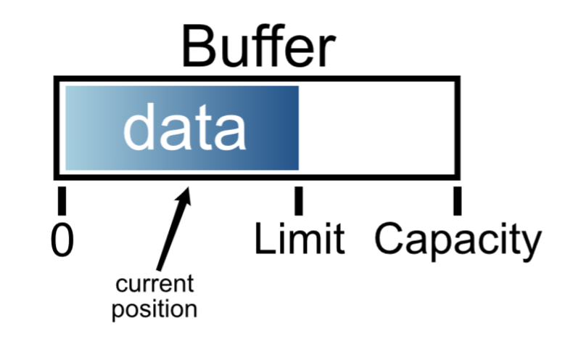
Flipping (cont)
If someone wrote to the buffer and you want to read those bytes, you need to set the position marker to the start of the buffer and the limit to the current position.
* This is what the buffer flip() action does.

Slide 27
Read
Flip
Write
Position
Limit
Capacity

Slide 28
From channel to buffer and back
Reading from channel to a buffer:
Writing from a buffer to a channel:

Slide 29
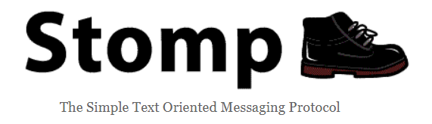
STOMP Protocol
OR...Brace Yourselves, Assignment 3 is coming ;)
Disclaimer: In any case of ambiguity between these slides and the assignment description, follow the assignment description.

Slide 30
STOMP Frames
STOMP uses frames to structure messages sent between clients and servers over a reliable two-way streaming protocol (e.g., TCP)
The structure of a STOMP frame is as follows:
COMMAND
header1:value1
header2:value2
Body^@
Command type
Zero or more headers in <key>: <value> format
Frame body
(can only be included in SEND, MESSAGE and ERROR commands)
Null character
(‘\0’)
Notes:
The order of the headers shouldn’t matter

Slide 31
Connecting
CONNECT
accept-version:1.2
host:stomp.github.org
login:user1
passcode:pass1
^@
Client initiates a connection by sending a CONNECT/STOMP frame.
accept-version – the version of STOMP the client supports
host – virtual host the client requests to connect to
Also includes login (username) and passcode (password) for authentication purposes.
If the server accepts the connection,
it will respond with a CONNECTED frame
Otherwise, it should send an ERROR frame.
CONNECTED
version:1.2
^@
Notes:
version – the version of the STOMP protocol the session will be using

Slide 32
Subscribing
Client subscribes to a specific destination (topic) by sending a SUBSCRIBE frame to the server.
SUBSCRIBE
id:0
destination:/topic/a
^@
Mandatory headers:
  id – subscription identifier
  destination – subscription destination
If the server can’t create the subscription, it must send the client an ERROR frame and close the connection.
UNSUBSCRIBE
id:0
^@
The client can cancel a certain subscription by sending the server an UNSUBSCRIBE frame with the subscription ID.
Notes:
possible ack values:
1. auto (default) – client doesn’t need to send ACK frames. server assumes client always receives the messages it sent.
2. client – client needs to send ACK frames, otherwise the server will infer client didn’t receive the message, and it will be retransmitted by the server.
3. client-individual – similar to “client”, but ACK’s are not cumulative.

Slide 33
Sending Messages
The client can send a message to a specific destination using the SEND frame.
SEND
destination:/topic/a
hello topic a
^@
Mandatory headers:
  destination – subscription destination
MESSAGE
subscription:0
message-id:27
destination:/topic/a
hello topic a
^@
The clients subscribed to this destination will receive the following frame from the server (each with a unique message-id value).

Slide 34
Disconnecting
The client can disconnect from the server by closing the socket, but the server may not have received all the sent frames.
Instead, the client can disconnect from the server by sending a DISCONNECT frame.
DISCONNECT
receipt:77
^@
By adding a receipt header, the server will
send back a RECEIPT frame
RECEIPT
receipt-id:77
^@
At last, the client can close the socket gracefully.

Slide 35
Errors
When something goes wrong, the server should send the client an ERROR frame that describes the issue.
ERROR
receipt-id:message-12345
message:malformed frame received
The message:
----
MESSAGE
destined:/topic/a
receipt:message-12345
Hello topic a!
----
Did not contain a destination header, which is REQUIRED for message propagation.
^@

Slide 36
Further Reading
C++11 Threads and Synchronization
  Concurrency std library (cppreference)
  Threads (cppreference), Mutex(cppreference), RAII (cppreference)
Java: TpC, Non-Blocking IO
  TpC, Non-Blocking Time Server NIO Example
Stomp

