Slide 1
SPL – PS11
The reactor design pattern

Slide 2
Overview
Why use the reactor pattern
Selector
The reactor

Slide 3
Why use the reactor design pattern
We saw in the previous PS the thread per-client server.
The main disadvantages of the TPC server are:
Wastefulness – Creating new threads is relatively expensive, each thread requires a fair amount of memory, threads are blocked most of the time waiting for IO.
Not scalable – A TPC server cannot grow to accommodate tens of thousands of requests.
Poor availability – Creating a new thread for each client takes a fair amount of time, the response time degrades as the number of clients increase.

Slide 4
What is the reactor design pattern
Use non-blocking IO, so threads don’t waste time waiting for IO.
Have one thread in charge of the network – accepting new connections and handling IO.
Have a fixed number of threads which are in charge of the protocol. These threads will be responsible for encoding and decoding messages, and processing them.
Unlike in the TPC server, each thread will handle multiple clients.

Slide 5
Selector
When we perform non-blocking IO, read for example reads the currently available bytes, and returns the number of bytes read.
That means that read/write can return 0, and probably would do that most of the time.
We would like to have a way for our thread to wait until any of our channels is ready, and only then perform the read(),write() or accept(), only on the ready channel.

Slide 6
Selector (cont)
The Selector registers itself to a channel.
Registration means that the channel informs the Selector when some event happens.
Such event can be – “The channel is ready to be read”, or “The channel can now be written to”, or “The channel can now accept”
During registration, the channel is told which events to monitor.
In addition when registering a Selector to a channel, one can add an attachment, which is an object we will have access to when the event occurs.

Slide 7
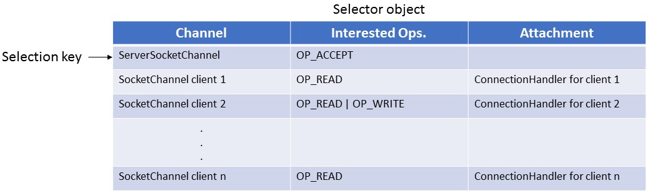
Selector registration
Registration can be done as follows:
The server tells the Selector: "Notify me when there's data to read from this clientChan."
The data structure the Selector maintains looks like this:

Slide 8
Bitmasks
We saw in the previous slide that the Selector maintains a field “Interested Ops” for every key.
SelectionKey.OP_READ is a number representing a read event.
Similarly, SelectionKey.OP_WRITE is a number represents a write event.
How would we represent a read or write event?
We could create SelectionKey.OP_READ_OR_WRITE, but this is cumbersome.

Slide 9
Bitmasks
OP_READ - 1
1 | 0 | 0 | 0 | 0 | 0 | 0 | 0
OP_WRITE - 4
0 | 0 | 1 | 0 | 0 | 0 | 0 | 0
OP_ACCEPT - 16
0 | 0 | 0 | 0 | 1 | 0 | 0 | 0
OP_READ | OP_WRITE - 5
1 | 0 | 1 | 0 | 0 | 0 | 0 | 0

Slide 10











Bitmasks
We could use bitmasks, We’ll define values of the flags so their 1-bits won’t overlap.
Read or write will be OP_READ | OP_WRITE.
When checking for read event, it’s enough to check e & OP_READ.
&
OP_READ
1 | 0 | 0 | 0 | 0 | 0 | 0 | 0
Different than 0 iff
 | 0 | 0 | 0 | 0 | 0 | 0 | 0

Slide 11
Selector’s select()
The Selector holds 3 lists of selection keys:
key – A set of all the selection keys in the Selector.
selected-key – A set of all the selection keys with a ready operation in the Selector.
cancelled-key – A set of all the selection keys that were cancelled but not yet unregistered in the selector.
Once a Selector is registered to some channel, one can use the “select()” method.
The method blocks until at least one of the channels is ready for the registered event. Then, a set of SelectionKeys is returned.

Slide 12
The Reactor
Now that we know how Java’s non-blocking IO works, we’ll take a closer look at the Reactor implementation which employs it.
We will concentrate on the “core” reactor classes – Reactor, NonblockingConnectionHandler, ActorThreadPool.
The Reactor is the main thread (a.k.a IO thread), which is tasked with reading, writing, and accepting new connections.
The reactor also holds a thread pool of workers, these workers are in charge of message tokenization and protocol handling.

Slide 13
Non blocking Connection Handler
No longer a runnable as it was in TPC.
Contains the handling of reading and writing from Channels to ByteBuffers and vice versa.
Uses a ByteBuffer pool for minimizing allocation on memory.
When bytes are read, creates lambda to pass as a task to the ActorThreadPool (our tuned version of ExecutorService)

Slide 14

Read Task
IO Thread
Actor thread pool

Slide 15
IO Thread
Actor thread pool
Protocol
EncDec
Read Task

Slide 16
IO Thread
Actor thread pool
Protocol
EncDec
Read Task

Slide 17
IO Thread
Actor thread pool
Protocol
EncDec
Read Task
Write Queue

Slide 18
IO Thread
Actor thread pool
Protocol
EncDec
Read Task
Write Queue

Slide 19
IO Thread
Actor thread pool
Protocol
EncDec
Write Queue

Slide 20
IO Thread
Actor thread pool
Protocol
EncDec
Write Queue
Notes:
Give example why regular thread pool is not enough.

Slide 21
ActorThreadPool
What would happen if a client sent two messages M1 and M2 to the server?
The server would create two runnables, R1 and R2 for tokenization and processing of these messages.
If these runnables would be executed in a regular thread pool, R2 can be executed before R1.
We want a special thread pool, which would make sure that the tasks for each client would be performed in the right order.
This is the ActorThreadPool

Slide 22


Actor thread pool
Internal thread pool
Actors (acts)
PlayingNow

Slide 23
Actor thread pool
Internal thread pool
Actors (acts)
PlayingNow

Slide 24
Actor thread pool
Internal thread pool
Actors (acts)
PlayingNow

Slide 25

Actor thread pool
Internal thread pool
Actors (acts)
PlayingNow

Slide 26
Actor thread pool
Internal thread pool
Actors (acts)
PlayingNow

Slide 27
Read-write lock
A ReadWriteLock is a concurrency utility in Java.
It allows multiple threads to read a shared resource simultaneously, while ensuring that write access is exclusive.
Read Lock:
Multiple threads can acquire the read lock simultaneously.
Ensures no thread holds the write lock while reading.
Used for non-modifying operations (e.g., fetching data).

Slide 28
Read-write lock
Write Lock:
Only one thread can acquire the write lock at a time.
Blocks all readers and writers.
Used for modifying operations (e.g., updating data).

