Slide 1
From Tirgul 12
      Join

Slide 2

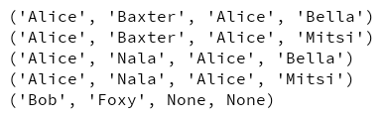
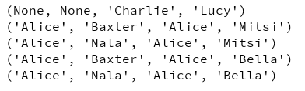
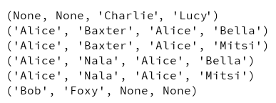
Dogs:
owner
name
Cats:
owner
name
Baxter | Alice
Nala | Alice
Foxy | Bob
Mitsi | Alice
Bella | Alice
Lucy | Charlie
SELECT * FROM Dogs
JOIN Cats ON Dogs.owner = Cats.owner
ORDER BY Dogs.owner
SELECT * FROM Dogs
LEFT JOIN Cats ON Dogs.owner = Cats.owner
ORDER BY Dogs.owner
SELECT * FROM Dogs
RIGHT JOIN Cats ON Dogs.owner = Cats.owner
ORDER BY Dogs.owner
SELECT * FROM Dogs
OUTER JOIN Cats ON Dogs.owner = Cats.owner
ORDER BY Dogs.owner
Inner join
Inner join
From left
From right
Inner join
From right
Inner join
From left
SQL Join Example

Slide 3
Tirgul 13
      Persistence Layer
      ORM

Slide 4
Persistence Layer - Intro
What is Persistence Layer - Introduction
A design pattern for managing the DB
It creates a separation between the application logic and the DB access
It has 3 types of objects:
  DTO - Data Transfer Object
  DAO - Data Access Object
  Repository
Q: Why we need it? Examples?
SQL commands
(“Physical part”)
Persistence Layer
PL’s methods
(“Logical part”)
DB
Program(s)
Direct access to DB
Data to be written to the DB
Data to be written to the DB
DB
Program(s)
Data retrieved from DB
Data retrieved from DB
Data to be written to the DB
Data retrieved from DB

Slide 5
Persistence Layer – Study case
Assignment tester (as seen in class):
A python application designed to grade students assignments.
The DB contains the following tables:
DB
students
grades
id
name
student_id
assignment_num
grade
assignments
num
expected_output

Slide 6
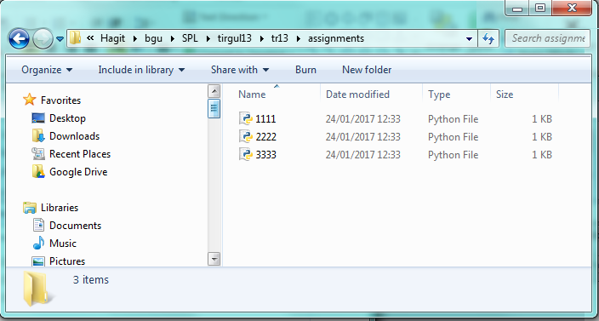
Persistence Layer – Study case
Assuming that Alice Bob and Charlie submited the following assignments
# Alice’s assignment 1111.py
def run_assignment():
return 'Main'
# Bob’s assignment 2222.py
def run_assignment():
return 'main'
# Charlie’s assignment 3333.py
def run_assignment():
return 'Main'
Assuming that Alice Bob and Charlie submited the following assignments
The Goal: To grade student assignments automatically

Slide 7
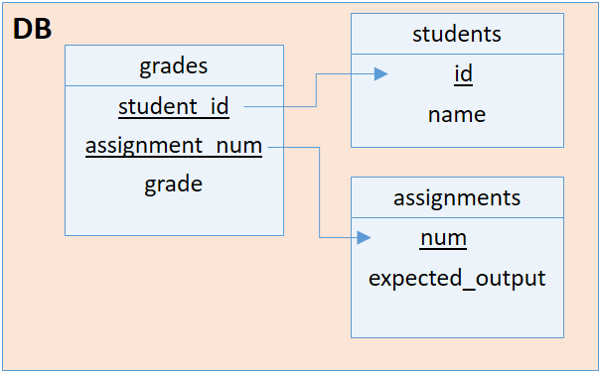
Persistence Layer - DTO
Step1: DTO - Data Transfer Object
An object that represents a record of a table
DTOs are the “agreed” data structure between the DB and
the application
Naming convention - DTO named 'Abc' represents a table named 'abcs' (or 'Abcs')
- DTO’s data fields names are same as the table record
class Student(object):
def __init__(self,
id,
name):
self.id = id
self.name = name
class Assignment:
def __init__(self,
num,
expected_output):
self.num = num
self.expected_output = expected_output
class Grade:
def __init__(self, student_id,
assignment_num,
grade):
self.student_id = student_id
self.assignment_num = assignment_num
self.grade = grade
* The __init__ method runs when an object of a class is instantiated. It is analogous to a constructor in C++ or Java

Slide 8
Persistence Layer - DTO
Step1: DTO - Data Transfer Object
An object that represents a record of a table
DTOs are the “agreed” data structure between the DB and
the application
Naming convention - DTO named 'Abc' represents a table named 'abcs‘
- DTO’s data fields names are same as the table record
class Student(object):
def __init__(self,
id,
name):
self.id = id
self.name = name
class Assignment:
def __init__(self,
num,
expected_output):
self.num = num
self.expected_output = expected_output
class Grade:
def __init__(self, student_id,
assignment_num,
grade):
self.student_id = student_id
self.assignment_num = assignment_num
self.grade = grade
* The __init__ method runs when an object of a class is instantiated. It is analogous to a constructor in C++ or Java

Slide 9
Persistence Layer - DAO
Step 2: DAO - Data Access Object
Object that contains methods for retrieving and storing DTOs
Usually a DAO is responsible for a single table and uses a single DTO.
Usually DAO are singletons (You can think of it as a static object with static methods)
Naming convention - DAO named ‘_Abcs' represents a table named 'abcs‘ (Optional)
class _Students:
def __init__(self, conn):
self._conn = conn
def insert(self, student): #Gets a Student object
self._conn.execute("INSERT INTO students (id, name) VALUES (?, ?)”,
[student.id, student.name])
def find(self, student_id):
c = self._conn.cursor()
c.execute("SELECT id, name FROM students WHERE id = ?", [student_id])
return Student(*c.fetchone()) #Returns a new Student object
Persistence Layer
DB
Program(s)
SQL
DTO
SQL
DTO

Slide 10
Persistence Layer – DAO (Cont…)
class _Assignments:
def __init__(self, conn):
self._conn = conn
def insert(self, assignment):
self._conn.execute(
"""INSERT INTO assignments (num,
expected_output)
VALUES (?, ?)""",
[assignment.num, assignment.expected_output])
def find(self, num):
c = self._conn.cursor()
c.execute("""SELECT num,expected_output
FROM assignments WHERE num = ?""",
[num])
return Assignment(*c.fetchone())
class _Grades:
def __init__(self, conn):
self._conn = conn
def insert(self, grade):
self._conn.execute(
"""INSERT INTO grades (student_id,
assignment_num,
grade)
VALUES (?, ?, ?)""",
[grade.student_id, grade.assignment_num, grade.grade])
def find_all(self):
c = self._conn.cursor()
all = c.execute("""SELECT student_id, assignment_num, grade
FROM grades""").fetchall()
return [Grade(*row) for row in all]
def find(self, sid, ass_num): … # Similare to _Assignment.find but uses
both field-keys in the WHERE clause
...SELECT * FROM grades WHERE student_id=? AND assignment_num=?...

Slide 11
Persistence Layer - Repository
Step 3: Repository - Inter-Tables Metods
methods that aren't related to just a single table
  create_table methods
  queries that span multiple tables (Exp: using join)
Similar to a DAO but manages group of related DTOs
class _Repository:
def __init__(self):
self._conn = sqlite3.connect('grades.db')
self.students = _Students(self._conn)
self.assignments = _Assignments(self._conn)
self.grades = _Grades(self._conn)
def _close(self):
self._conn.commit()
self._conn.close
os.remove('grades.db') #For debug only!!!!
def create_tables(self): … #See class material or
# Create the repository singleton
repo = _Repository()
# Register the _close() method to be called
# at exit
atexit.register(repo._close)

Slide 12
Persistence Layer - Repository
Repository – Create the tables
def create_tables(self):
self._conn.executescript("""
CREATE TABLE students (id INT PRIMARY KEY,
name TEXT NOT NULL
);
CREATE TABLE assignments (num INT PRIMARY KEY,
expected_output TEXT NOT NULL
);
CREATE TABLE grades (student_id INT NOT NULL,
assignment_num INT NOT NULL,
grade INT NOT NULL,
FOREIGN KEY(student_id) REFERENCES students(id),
FOREIGN KEY(assignment_num) REFERENCES assignments(num),
PRIMARY KEY (student_id, assignment_num)
);
""")

Slide 13
Using Persistence Layer
Step 4: The program (the logic) – Using the persistence layer to grade students assignments
def grade(ass_dir, ass_num):
#Get the expected output of assignment_num
assignment = repo.assignments.find(ass_num)
expected_output = assignment.expected_output
for ass_file in os.listdir(ass_dir):
#Assuming students file name consists od studentId.py
#Get student id from the file name
(student_id, ext) = os.path.splitext(ass_file)
if not (ext == ".py"):
continue
#Load the code
code = imp.load_source('test',
ass_dir + '/' + ass_file)
#Creates a DTO Grade object with 0 as default
student_grade = Grade(student_id, ass_num, 0)
if code.run_assignment() == expected_output:
student_grade.grade = 100
#Update the DB with student grade
repo.grades.insert(student_grade)
def print_grades():
print ('grades:‘)
for grade in repo.grades.find_all():
student = repo.students.find(grade.student_id)
print ("grade on assignment %d of student %-7s is %d" %
(grade.assignment_num, student.name, grade.grade))
def main():
repo.create_tables()
#Insert the assignment, i.e its number and its expected output
repo.assignments.insert(Assignment(1, 'Main'))
#Insert the students
repo.students.insert(Student(1111, 'Alice'))
repo.students.insert(Student(2222, 'Bob'))
repo.students.insert(Student(3333, 'Charlie'))
#Call the grade procedure and then print out the grades
grade("C:/Hagit/bgu/SPL/tirgul13/tr13/assignments", 1)
print_grades()
#Entry point to the module
main()

Slide 14
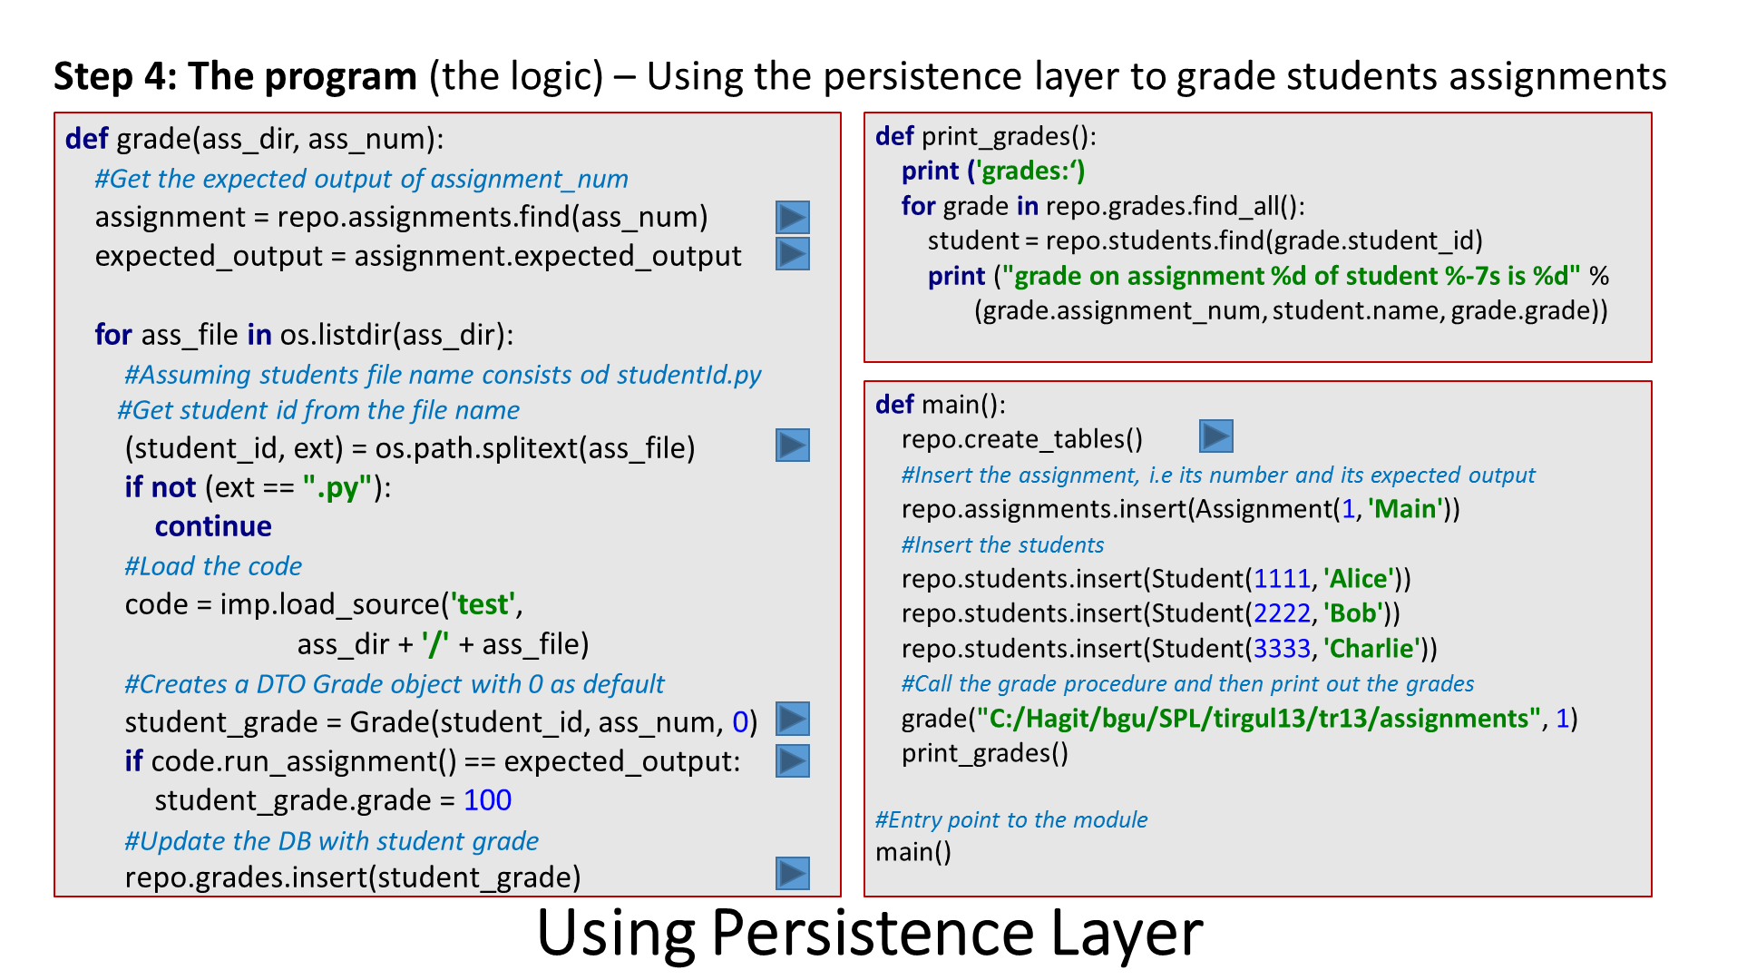
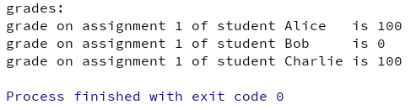
OUTPUT
Because Bob’s assignment returns “main” and not “Main”

Slide 15
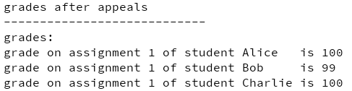
Persistence Layer – Extra fetures
UPDATE query – To Support appeals ☺
class _Grades: #DAO of Grades
def __init__(self, conn): ... # See slide
def insert(self, grade): ...
def find(self, sid, ass_num): ...
def find_all(self): ...
#A method to update a student's assignment grade.
def update(self, grade):
self._conn.execute("""
UPDATE grades SET grade=(?)
WHERE student_id=(?) AND assignment_num=(?)""",
[grade.grade, grade.student_id, grade.assignment_num])
#Update Bob grade
def main():
... #Same as before
sgrade = repo.grades.find(2222, 1)
sgrade.grade = 99
repo.grades.update(sgrade)
print ("\ngrades after appeals\n----------------------------“)
better_print_grades() #On next slide
1
2
3
4
4
The PL writes the updated grage to the DB
Persistence Layer
3
The program uses the PL to update the DB
DB
Program(s)
Q: Where should this code be added?
DTO
DAO
Repository
The program (The logic)
The PL retrieves the grade record from the DB
The program gets the grade object from the PL
1
2
OUTPUT
Tips: UPDATE, that involves only one table, most likely
should be written in the DAO of that table

Slide 16
Persistence Layer – Extra fetures
Join query – To improve print_grades() method
#This calss is used by get_grades_with_names bellow
class StudentGrade(object):
def __init__(self, name, assignment_num, grade):
self.name = name
self.assignment_num = assignment_num
self.grade = grade
# The method print_grades at the application logic (main) is inefficient because
# it goes over all the students, one by one, in order to find the name of a student.
# Using join query matches between the student's grade and his name.
def get_grades_with_names(self):
all = self._conn.cursor().execute("""
SELECT s.name, g.assignment_num, gr.grade
FROM grades g
JOIN students s ON g.student_id = s.id""").fetchall()
return [StudentGrade(*row) for row in all]
Q: Where should this code be added?
DTO
DAO
Repository
The program (The logic)
Tips: * If you see a SQL command -> it is not part of the program
* If you see a JOIN -> it is most likely part of the repository
# The old print_grades() method
def print_grades():
print ('grades:‘)
for grade in repo.grades.find_all():
student = repo.students.find(grade.student_id)
print ("grade on assignment %d of student %-7s is %d" %
(grade.assignment_num, student.name, grade.grade))
Loops on students table using additional SQLs to find student names
# The New and improved print_grades() method
def better_print_grades():
print ('grades:‘)
for item in repo.get_grades_with_names():
print ("grade on assignment %d of student %-7s is %d" %
(item.assignment_num, item.name, item.grade))
Tip: * If you have a repository “tool” function, define a class that
matches the columns of the returned record

Slide 17
ORM- Intro
ORM - Object Relational Mapping
The Motivation – A lot of repeating code in the DAOs that can be unify
The Challenge – 1. Mapping, DTOs ↔ table-record, in a generic way
2. Create a generic DAO class
ORM is part of the Persistance Layer
Reminder:
  Each DTO class represents a single table
  DTO constructors get arguments equevalent to the columns of their corresponding tables
  DTO classes are obeying a common naming conventions (By design)
Necessary Python methods
  getargspec (module “inspect”) - returns the names of the arguments of a function
  It is used to get the structure of the DTO class
  description (cursor’s method) - returns the column names of the last query (at position [0])
  It is used to get the structure of the DB data
  ** operator - dictionary with (column, value) entries
  It is used by methods that receive this kind of arguments

Slide 18
ORM- ORM() method
ORM() – A function that converts a table of records to an array of DTOs (method on next slide)
Maps record to DTO in a generic way and initiate with the the data
Tables
DTOs
class Tab_1:
def __init__(self, fN1,fN2,fN3, …):
self.fN1 = fN1
self.fN2 = fN2
self.fN3 = fN3
…
tab_1s
fN1
fN2
fN3
...
tab_2s
class Tab_2:
def __init__(self, f21,f22):
self.f21 = f21
self.f22 = f22
tab_Ns
class Tab_N:
def __init__(self, f11,f13,f12):
self.f11 = f11
self.f12 = f12
self.f13 = f13
f21
f22
f11
f12
f13
Fields order not necessary as in record
SQL result – Tab_i:
DTO instances of tab_i records
valueK_{[1]} | … | value2_{[1]} | Value1_{[1]}
DTOi:
self.fi1 = value1
…
self.fiK = valueK
ORM()
DTOi:
self.fi1 = value1
…
self.fiK = valueK
valueK_{[2]} | … | value2_{[2]} | Value1_{[2]}
DTOi₁:
self.fi1₁ = value1₁
…
self.fiK₁ = valueK₁
ORM input argument*
* The ORM input argument “Tabi” is represented in our code by the cursor that can be fetch in order to get last query response table
ORM output

Slide 19
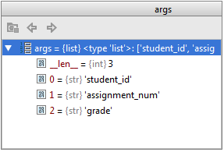
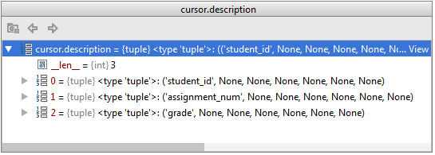
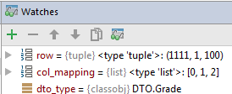
ORM – ORM.py
import inspect
def row_map(row, col_mapping, dto_type): #Transfer a row of the query to the corresponding TDO
ctor_args = [row[idx] for idx in col_mapping] #Arrange the list in correct order
return dto_type(*ctor_args) #Returns a new DTO of type dto_type
#orm() returns an array of DTOs object that fits the last SQL query records
def orm(cursor, dto_type):
#Retrieve the argument names of the constructor
args = inspect.getargspec(dto_type.__init__).args
#arg[0] is self - does not correspond to any database field
args = args[1:]
#gets the names of the columns returned in the cursor
#(cursor description returns the column names of the last query at position [0] )
col_names = [row[0] for row in cursor.description]
#map the names into the position of the corresponding constructor argument
col_mapping = [col_names.index(arg) for arg in args]
#Transfer each row of the query to a TDO and returns it
return [row_map(row, col_mapping, dto_type) for row in cursor.fetchall()]
** Each tuple represent 7 attributes of a single column of the table. We care only for the first one (index [0])

Slide 20
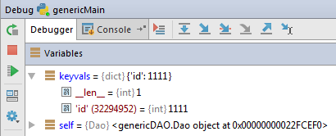
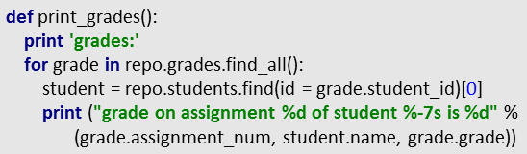
ORM – Generic DAO
Generic find() method as example
class _Assignments:
def find(self, num):
c = self._conn.cursor()
c.execute("""SELECT *
FROM assignments WHERE num = ?""",
[num])
return Assignment(*c.fetchone())
Q: What should be generalized?
def find(self, **keyvals): # ** operator - dictionary with (column, value) entries
column_names = keyvals.keys()
params = keyvals.values()
stmt = 'SELECT * FROM {} WHERE {}' \
.format(self._table_name,
' AND '.join([col + '=?' for col in column_names]))
c = self._conn.cursor()
c.execute(stmt, params)
return orm(c, self._dto_type)
Q: Who is ‘self’ when doing find on a student?
_Students (DAO) is self
stmt = 'SELECT * FROM students WHERE id=?
Go to pyCharm →

Slide 21
ORM– Generic DAO.py
#ALL NEW
from ORM import *
class Dao(object):
def __init__(self, dto_type, conn):
self._conn = conn
self._dto_type = dto_type
self._table_name = dto_type.__name__.lower() + 's‘ # dto_type is a class, its __name__ field
# contains a string representing the name of the class
def insert(self, dto_instance):
ins_dict = vars(dto_instance # Returns a dictionary corresponding to the dto var:value
# exp: {‘num’:1, ‘expected_output’:’Main’}
column_names = ','.join(ins_dict.keys()) # column_names: ‘num,expected_output’
params = ins_dict.values() # params: ([1, ‘Main’])
qmarks = ','.join(['?'] * len(ins_dict)) # ‘?,?’
stmt = 'INSERT INTO {} ({}) VALUES ({})'\
.format(self._table_name, column_names, qmarks)
self._conn.execute(stmt, list(params))
# stmt: ‘INSERT INTO assignments (num, expected_output) VALUES (?,?)’
def find_all(self):
c = self._conn.cursor()
c.execute('SELECT * FROM {}'.format(self._table_name))
return orm(c, self._dto_type)
def find(self, **keyvals):
column_names = keyvals.keys()
params = keyvals.values()
stmt = 'SELECT * FROM {} WHERE {}' \
.format(self._table_name, ' AND '.join([col + '=?' for col in column_names]))
c = self._conn.cursor()
c.execute(stmt, list(params))
return orm(c, self._dto_type)
#Update record(s) in table(self)
def update(self, set_values, cond):
set_column_names = set_values.keys()
set_params = set_values.values()
cond_column_names = cond.keys()
cond_params = cond.values()
params = list(set_params) + list(cond_params)
#Warning - In course site at following line there are 2 extra '()'
stmt = 'UPDATE {} SET {} WHERE {}'\
.format(self._table_name, ', '.join([set + '=?' for set in set_column_names]),
' AND '.join([cond + '=?' for cond in cond_column_names]))
self._conn.execute(stmt, params)
#Delete records from a table(self), keyVals are the condition
def delete(self, **keyvals):
column_names = keyvals.keys()
params = keyvals.values()
stmt = 'DELETE FROM {} WHERE {}' \
.format(self._table_name, ' AND '.join([col + '=?' for col in column_names]))
c = self._conn.cursor()
c.execute(stmt, list(params))

Slide 22
ORM – genericRepository.py
from genericDAO import Dao
from DTO import *
import sqlite3
import atexit
import os # for remove
class Repository(object):
def __init__(self):
self._conn = sqlite3.connect('grades.db')
self._conn.text_factory = bytes #ADDED
self.students = Dao(Student, self._conn) #CHANGED
self.assignments = Dao(Assignment, self._conn) #CAHNGED
self.grades = Dao(Grade, self._conn) #CAHNGED
def _close(self):
self._conn.commit()
self._conn.close()
os.remove('grades.db') #For debug - So we have one fresh each run
def create_tables(self):
self._conn.executescript("""
CREATE TABLE students (id INT PRIMARY KEY,
name TEXT NOT NULL
);
CREATE TABLE assignments (num INT PRIMARY KEY,
expected_output TEXT NOT NULL
);
CREATE TABLE grades (student_id INT NOT NULL,
assignment_num INT NOT NULL,
grade INT NOT NULL,
FOREIGN KEY(student_id) REFERENCES students(id),
FOREIGN KEY(assignment_num) REFERENCES assignments(num),
PRIMARY KEY (student_id, assignment_num)
);
""")
# singleton
repo = Repository()
atexit.register(repo._close)

Slide 23
ORM – genericMain.py
from genericRepository import repo #CHANGED
from DTO import *
import os, imp
def grade(ass_dir, ass_num):
#Get the expected output of assignment_num
assignment = repo.assignments.find(num=ass_num) #CHANGED (Passing dict with num:ass_num)
expected_output = assignment[0].expected_output.decode("utf-8") #convert bytes->string
#CHANGED
for ass_file in os.listdir(ass_dir):
#Assuming students file name consists od studentId.py
#Get student id from the file name
(student_id, ext) = os.path.splitext(ass_file)
if not (ext == ".py"):
continue
#Load the code
code = imp.load_source('test',
ass_dir + '/' + ass_file)
#Creates a DTO Grade object with 0 as default
student_grade = Grade(student_id, ass_num, 0)
if code.run_assignment() == expected_output:
student_grade.grade = 100
#Update the DB with student grade
repo.grades.insert(student_grade)
def print_grades():
print ('grades:')
for grade in repo.grades.find_all():
student = repo.students.find(id = grade.student_id)[0] #CHANGED
print ("grade on assignment %d of student %-7s is %d" %
(grade.assignment_num, student.name, grade.grade))
def main():
repo.create_tables()
#Insert the assignment, i.e its number and its expected output
repo.assignments.insert(Assignment(1, 'Main'))
#Insert the students
repo.students.insert(Student(1111, 'Alice'))
repo.students.insert(Student(2222, 'Bob'))
repo.students.insert(Student(3333, 'Charlie'))
#Call the grade procedure and then print out the grades
grade("assignments", 1)
print ("\ngrades before appeals\n--------------------------")
print_grades()
#Update Bob grade
sgrade = repo.grades.find(student_id=2222, assignment_num=1)[0] #CHANGED
repo.grades.update({
'student_id':sgrade.student_id, #CHANGED
'assignment_num':sgrade.assignment_num,
'grade':99
},{
'student_id':sgrade.student_id,
'assignment_num':sgrade.assignment_num
})
print ("\ngrades after appeals\n----------------------------")
print_grades()
#delete Charlie
repo.grades.delete(student_id=3333)
print ("\ngrades after deleting 3333\n----------------------------")
print_grades()
#Entry point
main()

Slide 24

המון המון בהצלחה במבחנים
!! See Practical Session13

