Slide 1
SPL – PS3
C++ Classes

Slide 2
Overview
Passing parameters to functions
Classes
  Declaration and implementation
  Differences from Java
  Member initialization list
Objects
  The dot and arrow operators
  The this pointer
  Creating and destroying objects

Slide 3
Passing parameter by value
The value is being copied to the argument list of the called function.
Usually (but not always) done for primitive values.
When an object is passed by value, it’s copy constructor will be implicitly invoked (could be slow for large objects)
int power(int i)
{
i = i * i;
return i;
}
int main(int argc, char **argv)
{
int number = 5;
power(number); // number is passed by value
}

Slide 4
Passing parameters by reference
Allows us to send a “link” to the original object without using pointers.
Must be initialized – you cannot pass a “null reference”.
void emphasize(std::string &word)
{
word.append(3, '!');
}
int main(int argc, char **argv)
{
std::string mySentence = "Everything is awesome";
emphasize(mySentence);
}

Slide 5
Passing pointers
To avoid passing objects by value you can also pass a pointer to an object.
Allows passing an “uninitialized reference” Allows passing an “uninitialized reference”.
Who’s responsible to free memory?
Its unclear
void emphasize(std::string *word)
{
if (word == nullptr)
return;
word->append(3, '!'); // same as (*word).append(3, '!');
}
int main(argc, char **argv)
{
std::string mySentence = "Everything is awesome";
emphasize(&mySentence);
}

Slide 6
Header files – a reminder
Contain declarations of variables, functions, and classes.
Usually no implementation in header files (not allowed in this course).
Use preprocessor directives to avoid including same header twice.
#ifndef POINT_H
#define POINT_H
// all the header file content goes here
#endif
Even easier with to do with #pragma once
#pragma once
// all the header file content goes here

Slide 7
C++ classes – declaration example
class Point
{
double x;
double y;
public:
Point();
Point(double xVal, double yVal);
void move(double dx, double dy);
double getX() const; // const method (cannot change the object's data)
double getY() const; // ditto
}; // note: a semicolon is required at the end of the class declaration

Slide 8
C++ classes – implementation example
Point::Point() : x(0), y(0) {}
Point::Point(double xVal, double yVal) : x(xVal), y(yVal) {}
void Point::move(double dx, double dy)
{
x = x + dx;
y = y + dy;
}
double Point::getX() const
{
return x;
}
double Point::getY() const
{
return y;
}

Slide 9
Syntax differences between C++ and Java
Separate declarations and implementations - the scope resolution operator (the :: operator) designates to which class the method belongs.
Semicolon at the end of the class - not placing it will result in a compilation error.
Public and private section - as opposed to Java where each individual class member must be tagged separately.
Const methods – like final in Java. Const methods do not change the state of an object and therefore cannot return non-const references or pointers to members of the class or call non-const methods.
Const objects - once an object is declared as `const`, one can only use `const` methods on that object.

Slide 10
Member initialization list
Used to initialize class members.
Executed before the body of the constructor.
Any class variable (field) that does not appear in this list it will be initialized with it's default constructor (if the object's class has no default constructor the compilation will fail).
Const class variables can only be initialized in the member initialization list.
The order of initialization is according to the order the fields in the class - not the order in the member initialization list. It is advisable to keep the order in the initialization list the same as in the class to avoid confusion.
Point::Point() : x(0), y(0) {}
Point::Point(double xVal, double yVal) : x(xVal), y(yVal) {}

Slide 11
C++ objects
In C++, object variables hold values, not references. In the variable declaration you supply the parameters to the constructor after the variable name:
If you do not supply construction parameters, then the object will be constructed using the default (no arguments) constructor:
In Java, `Point p` would create an uninitialized reference. In C++, it allocates and constructs an actual object.
// create using the constructor Point::Point(double xVal, double yVal)
Point p(1, 2);
// create the variable using the (default) constructor Point::Point()
Point p;

Slide 12
The dot and arrow operators
The dot operator in C++ is similar to Java's dot operator.
The arrow operator is used to dereference a point first and then reference the class member.
Any guess whats wrong?
int main( )
{
Point *p1 = new Point(0,0);
Point p2(0,0);
(*p1).getX();
p1->getX(); // exactly the same as (*p1).getX()
p2.getX();
(&p2)->getX(); // exactly the same as p2.getX()
}
There is a memory leak!

Slide 13
The this pointer
The this pointer holds the address of the object instance.
Not accessible from static member functions.
The this pointer is an rvalue (not modifiable).
//Class Definition
class Point
{
int x;
int y;
public:
void setVariables(int, int);
};
void MyClass:setVariables(int x, int y)
{
this->x = x; // possible, but not recommended
this->y = y;
}

Slide 14
Creating and destroying objects
Default constructor
Copy constructor
Other constructors
Destructor
Copy assignment operator

Slide 15
Default constructor
A default constructor is a constructor that can be called with no arguments.
If a class has no explicitly defined constructors (of any kind), the compiler will automatically create a default constructor for it.
//Class Definition
class List
{
...
public:
List(); // default constructor
};
//Example
List lst; // implicit call to the default constructor
List lst2(); // explicit call to the default constructor

Slide 16
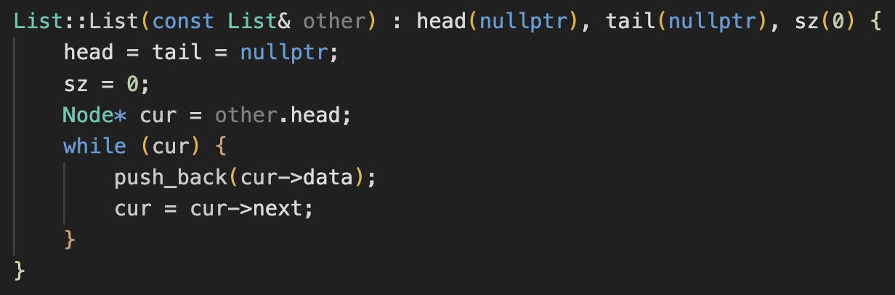
Copy constructor
A Copy constructor is a constructor who's first parameter is a reference of the same class (a regular reference or a const reference).
If a class has no explicitly defined copy constructor the compiler will automatically create a default copy constructor for it that receives a const reference.

Slide 17
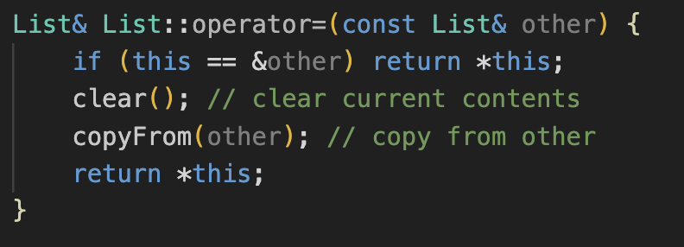
Copy assignment operator
The copy assignment operator is called whenever an object appears on the left side of an assignment expression.
If a class has no explicitly defined copy assignment constructor the compiler will automatically create a default copy constructor for it that receives a const reference.

Slide 18
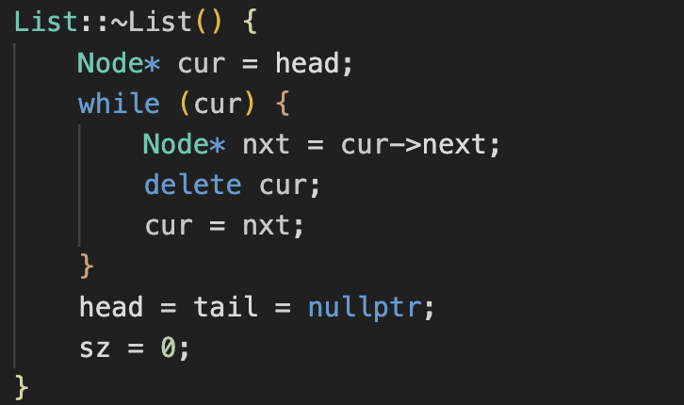
Destructor
Called when an object is going to be destroyed (out of scope or because of delete).
Does not receive any arguments and does not return a value.
If a class has no explicitly defined destructor, the compiler will automatically create a default destructor for it.
What might happen while using the Default destrucor?

Slide 19
The rule of 3
“If a class requires a user-defined destructor, a user-defined copy constructor, or a user-defined copy assignment operator, it almost certainly requires all three.”
Note that all automatically generated (default) constructor / destructor / copy assignment do not perform “deep” operations.

Slide 20
Copy assignment vs. copy constructor
Copy assignment operator | Copy constructor
Object already initialized (must free memory to avoid memory leaks) | Initializes and creates the object
Self assignment is possible (and need to be checked for by the programmer) | Self assignment not possible
Returns a reference to the object after assignment. Supports chained assignment. | A constructor (doesn’t return a value)

Slide 21
Exception safety in copy assignment
The copy assignment operator must not throw exceptions (this may leave the object in an invalid state).
If the automatically-generated default copy assignment operator may throw exceptions, one must be written explicitly
//Copy assignment operator
MyClass& MyClass ::operator=(const MyClass & other)
{
if (this != &other) { // is this not self-assignment?
// make some changes to this
methodThatMightThrowException(); // exception here = invalid state
// make more changes to this
return *this;
}

Slide 22
Derived Class Constructor - Example
class Person
{
public:
Person(std::string _name) : name(_name) {}
std::string getName();
protected:
std::string name;
};
class Student: public Person
{
public:
Student(std::string _name) : Person(_name) {}
void doHomework();
};
void Student::doHomework(){
std::cout << name << " is doing homework" << std::endl;
}
Entity.cpp

Slide 23
Constructors in Derived Classes
Explicit call to base class constructor:
Student(std::string _name) : Person(_name) {}
Implicit call to base class default constructor:
Student(std::string _name) {}
Compilation will fail if no constructor is explicitly called and:
  The base class has no default constructor.
  Or
  the default constructor is declared as private.

Slide 24
Virtual Functions
Regular methods: compile time (early) binding.
Virtual methods: runtime (late) binding.
class Person
{
public:
Person(std::string _name) : name(_name) {}
virtual std::string describe();
};
class Student: public Person
{
public:
Student(std::string _name) : Person(_name) {}
virtual std::string describe() override;
};
Person *p = new Student(“Omri”); //Example
p->describe();
Overridden method is also considered virtual in the derived class, even if you don’t explicitly use the virtual keyword.

Slide 25
Rules for Virtual Functions
Cannot be static.
Prototype of a virtual function must be the same in the base and derived classes.
If not overridden in the derived class ⇒ base class method is called.
Constructors cannot be defined as virtual.

Slide 26
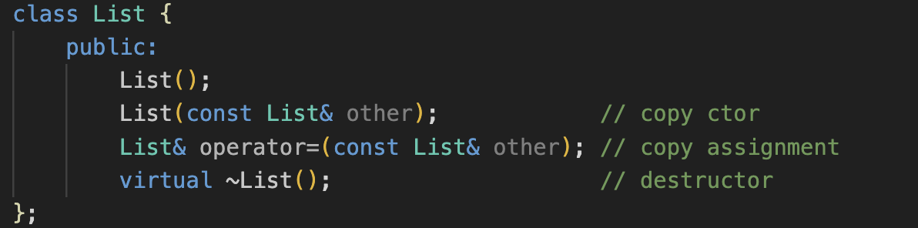
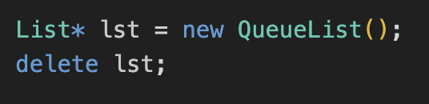
Virtual Destructor
Derived class is deleted using a pointer of a base class ⇒ undefined result.
Always use if a class is supposed to be inherited from.

Slide 27
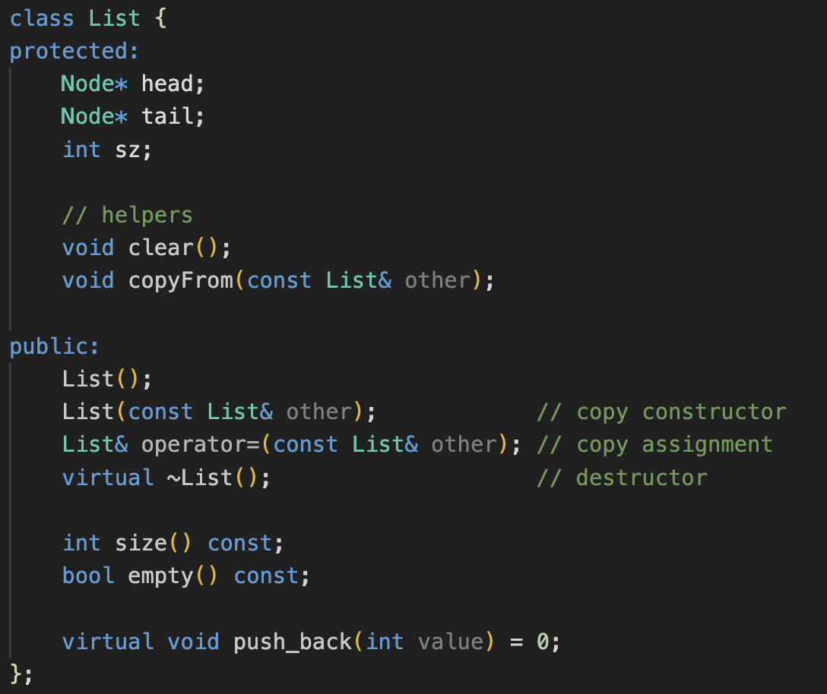
Pure Virtual Functions – Abstract Classes
Declare pure virtual by appending “=0“ in the function declaration.
Cannot be instantiated.
Similar to abstract classes in Java.

