Slide 1
SPL – PS4
C++ Advanced OOP

Slide 2
Overview
Namespaces
Move semantics
The Rule of 5
The auto keyword
Smart pointers

Slide 3
C++ namespaces
A declarative region that provides an artificial scope to identifiers
Organize code into logical groups.
Prevent name collisions.
Declared using the namespace keyword.
Accessed using the scope resolution operator (::)
Also by using the keywords “using” or “using namespace”

Slide 4
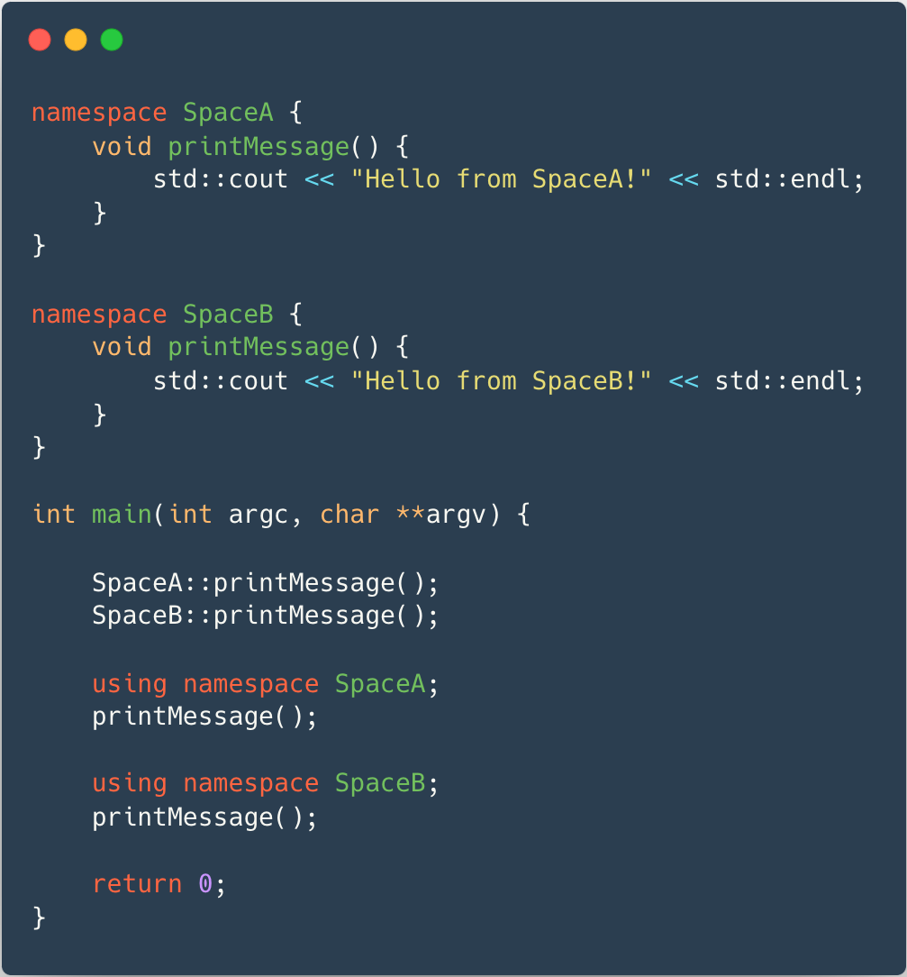
C++ Namespaces - Example
It's ambiguous, leading to a compilation error.
Which function gets invoked?

Slide 5
Object Lifetime
Begins when storage for it is obtained and it gets initialized.
Ends when the object is destroyed and the storage it used is freed.
Value Categories
lvalue - something that can appear in the left side of an assignment expression.
rvalue - something that can appear only in the right side of an assignment expression.

Slide 6
Temporary Objects
An rvalue.
Created temporarily in order to evaluate some expression.
Sometimes a mandatory - sometimes not.
Performance (and memory) penalty.
Temporary object lifetime expension (advanced topic – see lesson material).
How to avoid when unnecessary?
The “old” way: const references.

Slide 7
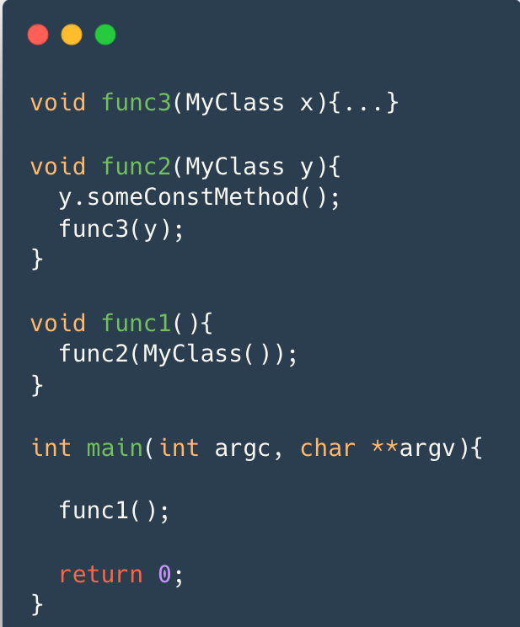
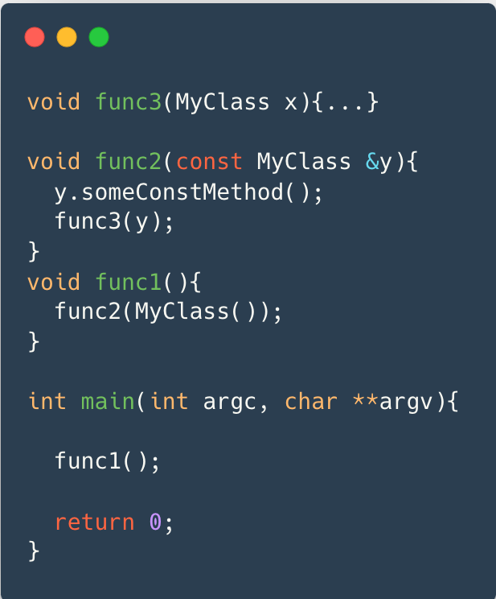
Example of Temporary Objects
How many times is MyClass's copy constructor called?
How many times is MyClass's copy constructor called?
Then, we changed func2 signature

Slide 8
Move Semantics
Avoiding unnecessary copying of objects.
Transferring ownership of resources that cannot be shared (locks, file handles).
Include:
rvalue references
Converting an lvalue to rvalue
The rule of 5

Slide 9
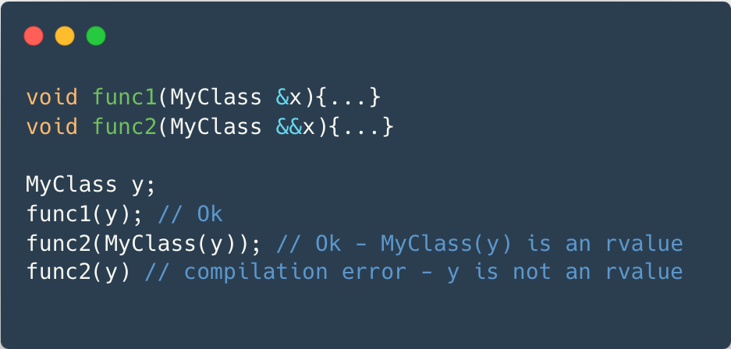
rvalue references
A reference to a temporary object
Declared with &&

Slide 10
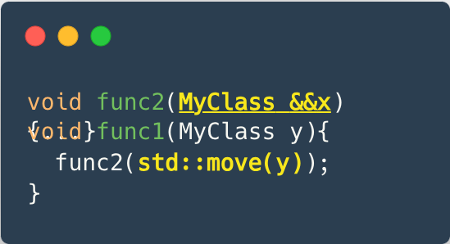
Converting an lvalue to rvalue with std::move
Doesn't actually move anything (it is essentially a cast)
allows the compiler to perform optimizations.

Slide 11
The Rule of 5
Includes "the rule of 3" plus:
  move constructor
  move assignment operator.
These methods "steals" the resources of the object it is given as an argument rather than make copies of them.
Leaves the other object in a valid state.
Should not throw exceptions.

Slide 12
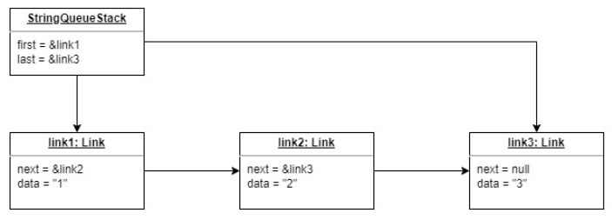
StringQueueStack
Data structure that can operate both as a queue and as a stack.
Implemented using dynamic linked list of strings.
Strings can be added from both ends of the list,
but can be removed only from the head.

Slide 13
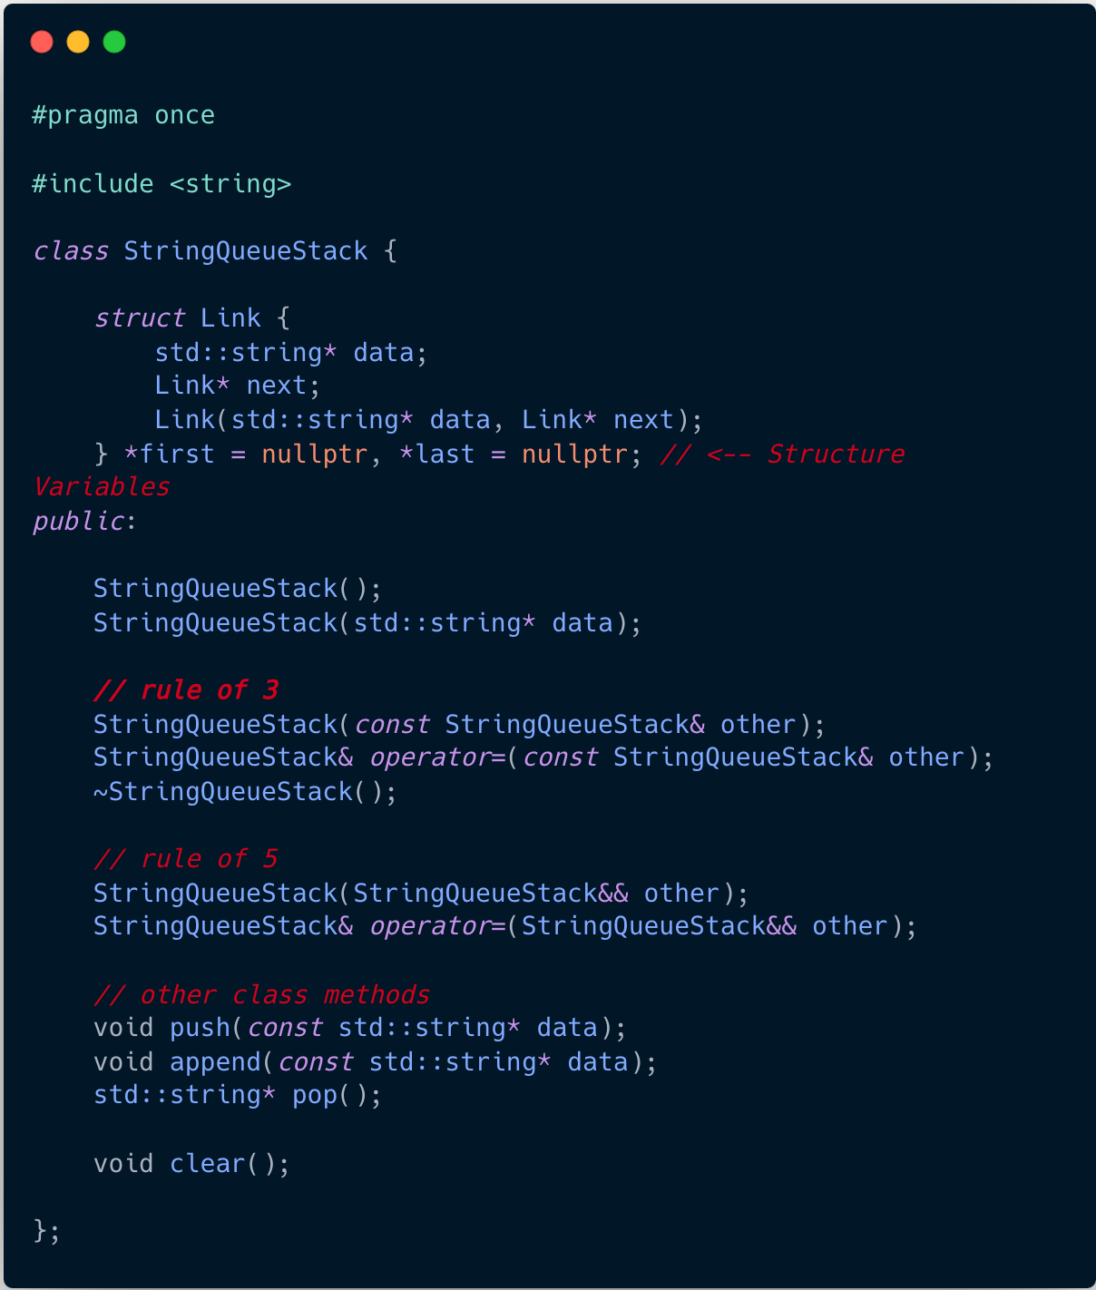
StringQueueStack.h

Slide 14
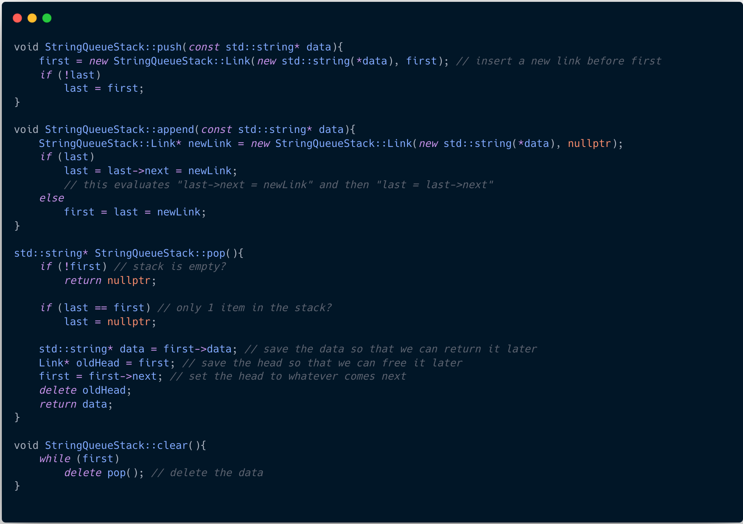
StringQueueStack.cpp

Slide 15
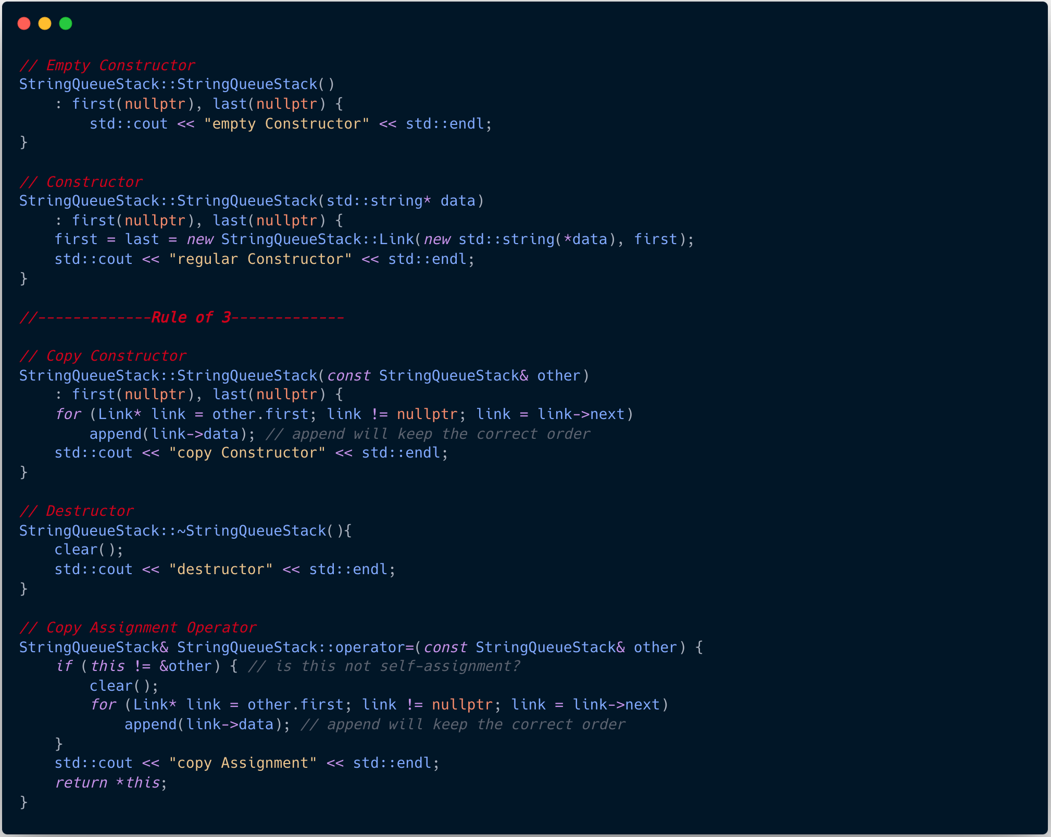
StringQueueStack.cpp

Slide 16
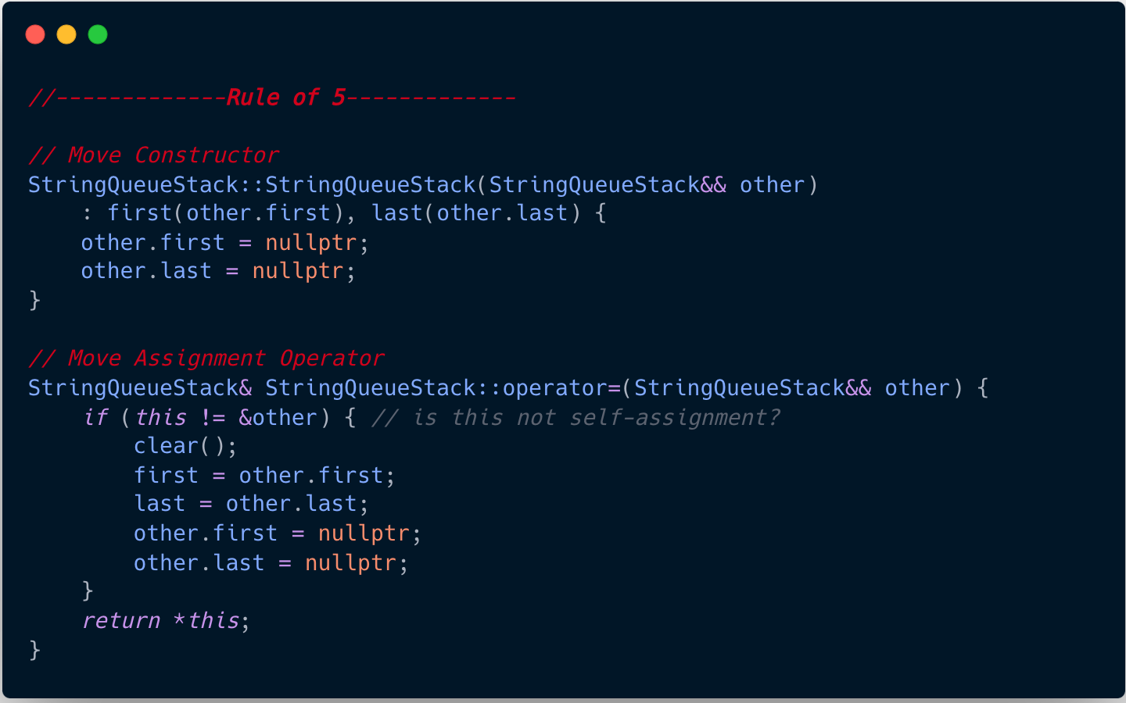
Move Constructor / Assignment Operator

Slide 17
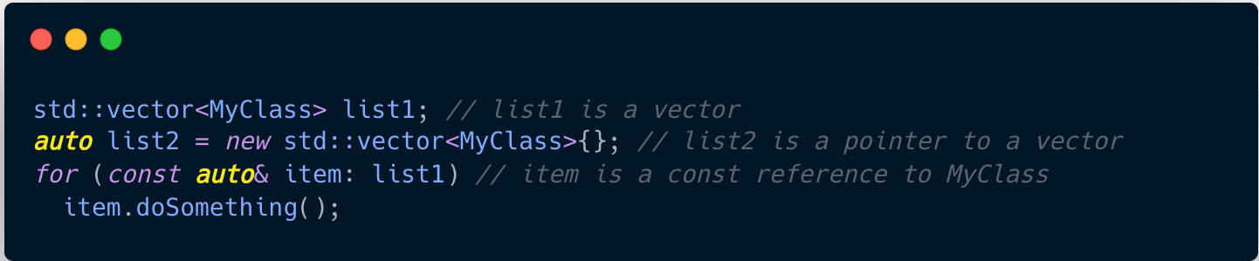
The Placeholder Type Specifier - auto
Used in variable / function declarations instead of an explicit type specifier.
Automatically deduce the type from the variable initializer / function return value.
Generally considered a good practice for - usability, robustness, performance
Can force auto to be a reference / pointer / const

Slide 18
Smart Pointers
Shared pointers
  One or more owners manage the object lifetime.
  Reference counted.
  Automatically deleted when reference count reaches 0.
Unique pointers
  One owner manages the object lifetime.
  Can be moved to a new owner, but not copied or shared.
  Automatically deleted when goes out of scope.
Weak pointers (advanced topic – see in the lesson material).

Slide 19
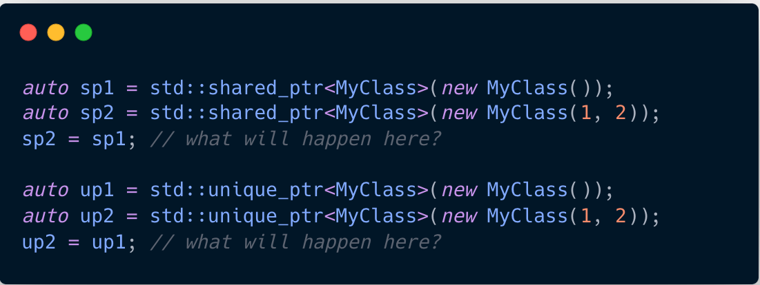
Smart Pointers - Examples
Notes:
1. sp2 deleted and have the same pointer
2. Compilation error

