Slide 1
SPL – PS7
Synchronization and liveness

Slide 2
Overview
Thread Confinement
Immutability
Locking and synchronization
Atomic actions
Guarded methods
Concurrency states
Producers-consumers pattern and blocking queues.

Slide 3
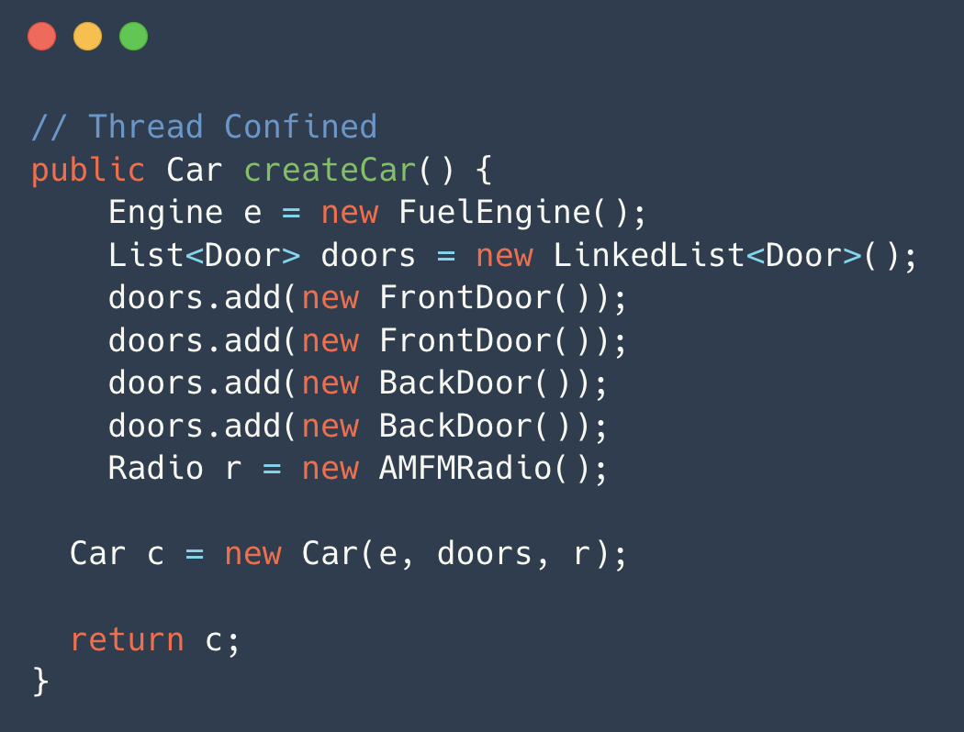
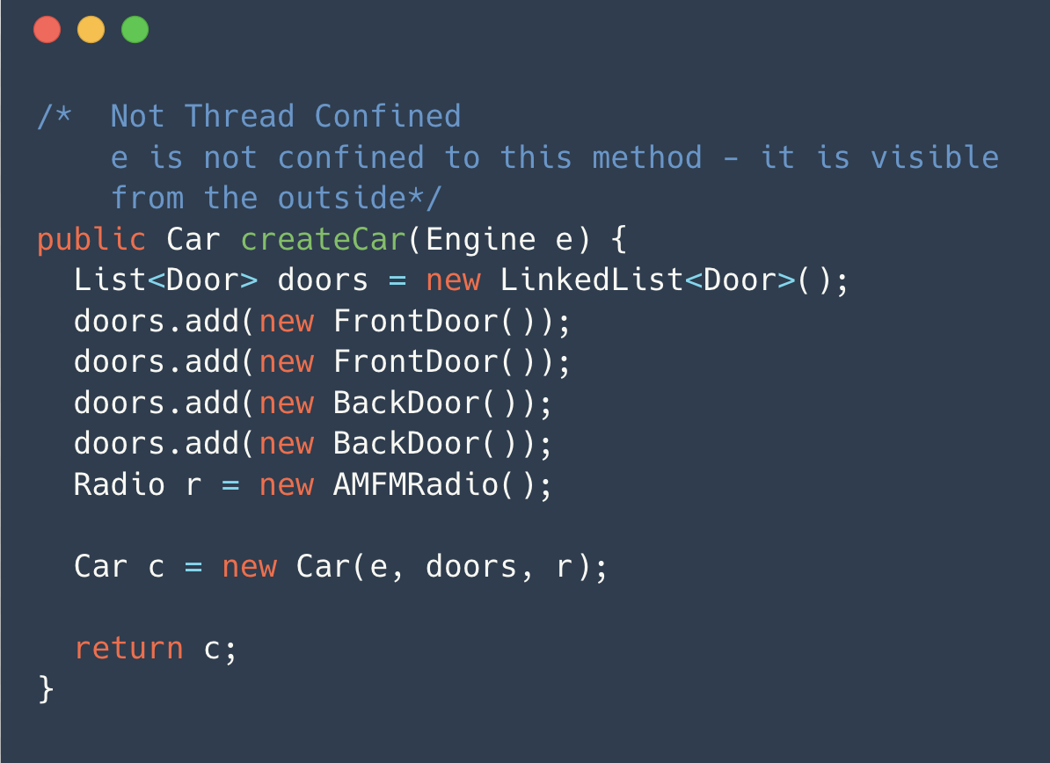
Thread Confinement
The Idea - If a resource is accessed only by one thread, no synchronization is needed.
You can confine certain variables to just one thread.

Slide 4
Immutability
The Idea – Instead of modify an object, return a new one.
A class will be immutable if the following are true:
All of it’s fields are final.
The class is declared final.
The this reference is not allowed to escape during construction.
Any fields that contain references to mutable objects:
  Are private
  Are never returned or exposed to the caller
  Are the only reference to the object they refer to
  Do not change the state of the referenced object after construction.
public class Escape {
private int x;
public Escape(Outside out){
out.readEscape(this);
x = 7;
}
public int getX() {
return x;
}
}
public class Outside {
private int x;
public void readEscape(Escape esc){
x = esc.getX();
}
}

Slide 5
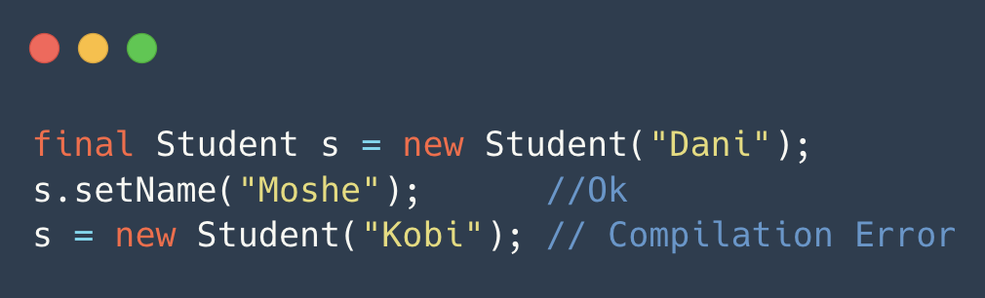
Immutability
An immutable object’s state cannot be changed after construction.
It can be safely used by many threads as a read only object.
For example, the String, and Integer classes in Java are immutable.
The final keyword in Java is similar to the const keyword in C/C++.
final fields can’t be modified, but objects they refer to can be modified if they are mutable.

Slide 6
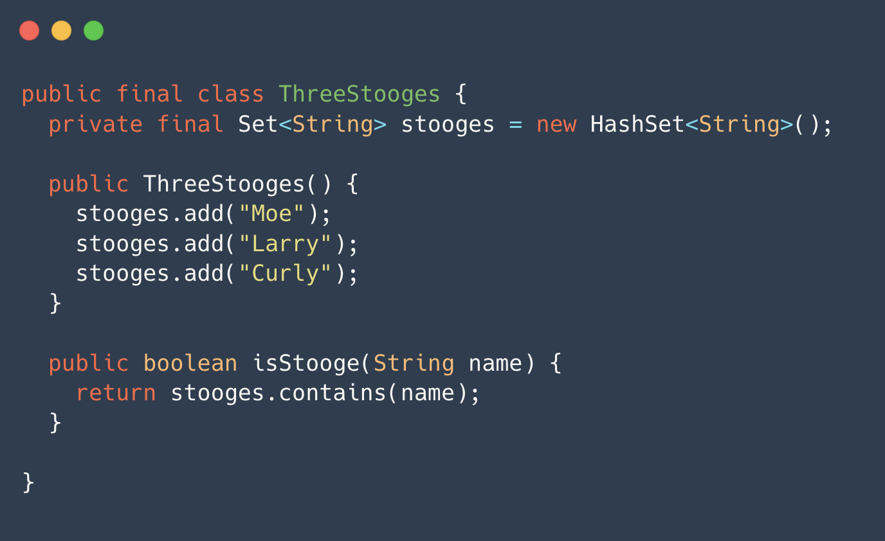
Immutability
The class ThreeStooges is immutable even though it consists of mutable objects.
The class is immutable due to its design, not just by using final keyword.
The class is declared to be final, which means that it cannot have subclasses.
The class member stooges is considered mutable, even though it cannot be changed from outside the class.

Slide 7
Locking/ Synchronization

Slide 8
Locking/ Synchronization
Sometimes we want to allow concurrent access to a resource which isn’t read only.
In concurrent / multi-thread programming, a monitor is a synchronization mechanism that controls concurrent access to an object.
The monitor ensures that only one thread can access a critical section of code at any given time, preventing potential conflicts and ensuring orderly execution.
Locking in Java is done using the “synchronized” keyword.
/* notice the synchronized keyword */
public synchronized void increment(){
count++;
}

Slide 9
Synchronization (cont)
public class Counter {
private int count;
public Counter(){
count = 0;
}
public void increment(){
count++;
}
public int getValue(){
return count;
}
}
Critical Section - part of a program where shared resources (variables, data structures) are accessed and modified.

Slide 10
Synchronization (cont)
public class Counter {
private int count;
public Counter() {
count = 0;
}
public void increment() {
synchronized(this) {
count++;
}
}
public int getValue() {
synchronized(this) {
return count;
}
}
}
public class Counter {
private int count;
public Counter() {
count = 0;
}
public synchronized void increment() { count++;
}
public synchronized int getValue() {
return count;
}
}
public class Counter {
private int count;
private Object someLock;
public Counter() {
count = 0;
someLock = new Object();
}
public void increment() {
synchronized(someLock) {
count++;
}
}
public int getValue() {
synchronized(someLock) {
return count;
}
}
}
We can synchronize on a specific lock (object).
When “synchronized” appears in the signature of the function, the lock used is “this”

Slide 11
Visibility
In a multithreaded environment, each thread may have its own local cache of variables, and changes made by one thread may not be immediately visible to other threads due to these local caches
The ’volatile’ keyword can be used to mark a variable, indicating that its value may be changed by multiple threads concurrently. When a variable is declared as ‘volatile’, it ensures that read and write operations on the variable are immediately visible to other threads.

Slide 12
Atomic operations
Operations that appear to the rest of the system as if they occur at once.
Java provides high level interface for atomic operations in Java’s Atomic library.
public class Counter{
private AtomicInteger count;
public Counter(){
count = new AtomicInteger();
}
public void increment(){
count.incrementAndGet();
}
public int getValue(){
return count.get();
}
}

Slide 13
Atomic operations (cont)
The increment and get method is implemented as follows in Java 8
The comareAndSet action is atomic in Java.
It checks whether the value of current is equal to the value of the variable, and if so, sets the variable.
public final int incrementAndGet() {
for (;;) {
int current = get();
int next = current + 1;
if (compareAndSet(current, next))
return next;
}
}

Slide 14
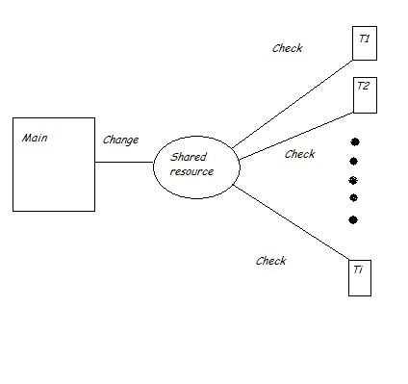
Guarded methods (concept)
The guarded methods model delays the execution of a thread until a condition is satisfied.
There are several approaches for checking if the condition is satisfied.
We’ll show an example.

Slide 15
Busy waiting (a.k.a spinning)
Each thread constantly checks whether the condition is met.
Appropriate in very specific cases, in which the expected waiting time is very short, and we want to react with no delay.

Slide 16
Sleep & Check
Similar to busy waiting, but the thread sleeps for an amount of time between each checking.
Less wasteful of CPU resources.
Introduces a delay in the reaction time of the thread.

Slide 17
Wait & Notify
Supports communication between threads.
A thread voluntarily waits for a specific event to occur.
Another thread can notify the waiting thread.
Supported in Java!
Let’s see an example.

Slide 18
Blocking queues
A blocking queue is a queue that blocks a caller if it tries to put an element into a full queue, or take an element from an empty queue.
The Java API contains an interface for blocking queue.
We’ll show an implementation of a BlockingQueue<E> with wait() and notifyAll()
public interface BlockingQueue<E> {
void put(E o);
E take();
}
In the code examples at SimpleQueue.java

Slide 19
Producers Consumers problem.
The producers-consumers problem deals with the situation in which several producers generate some product, and several consumers consume the products produced.
A producer should block if the queue is full.
A consumer should block if the queue is empty.
This can be solved with the blocking queue we just saw.
(A solution example is in the code example for this PS)
Notes:
There is a code example in the main.java file

Slide 20
Liveness

Slide 21
Liveness
A concurrent application’s ability to execute in a timely manner is known as it’s liveness.
There are several situations that can hinder liveness, we’ll go over some of them in this practical session.

Slide 22
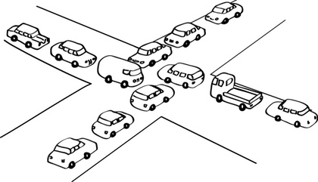
Deadlock
A situation in which two or more threads are blocked, waiting for each other forever.
Can be solved by resource ordering.

Slide 23
Starvation
Describes a situation in which a thread is unable to gain regular access to a shared resource.
Can happen when a shared resource is being held for a long period of time by a “greedy” thread.
Can also happen when using priority scheduling.
Can be solved by introducing fairness to the allocation of the shared resource.
In Java, can be done using fair semaphores.

Slide 24
Livelock
Two threads are unable to make further progress – like in a deadlock.
Unlike deadlock, the threads are not blocked – they are too busy responding to each other to resume work.

