Slide 1




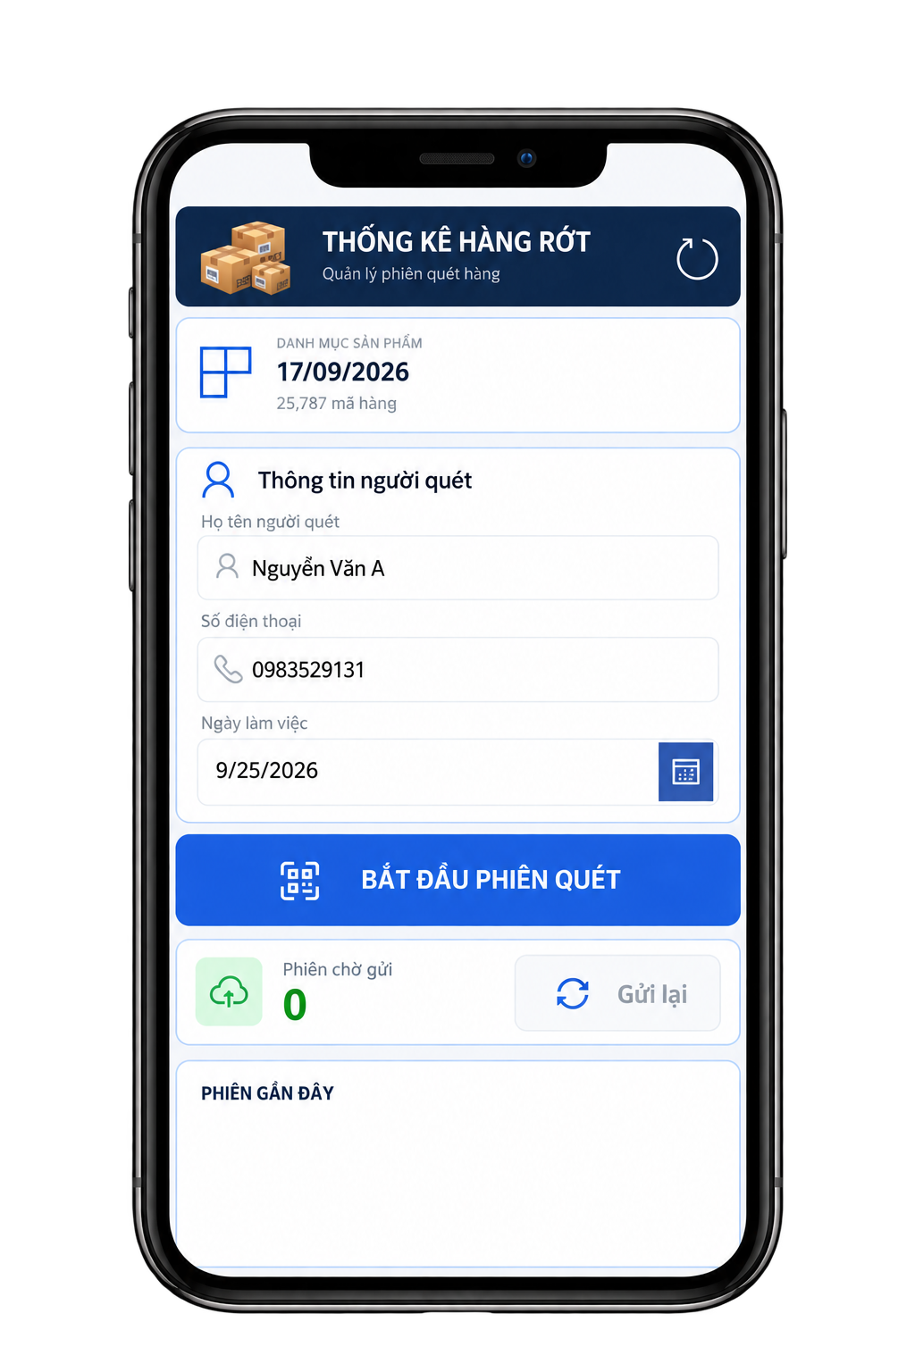







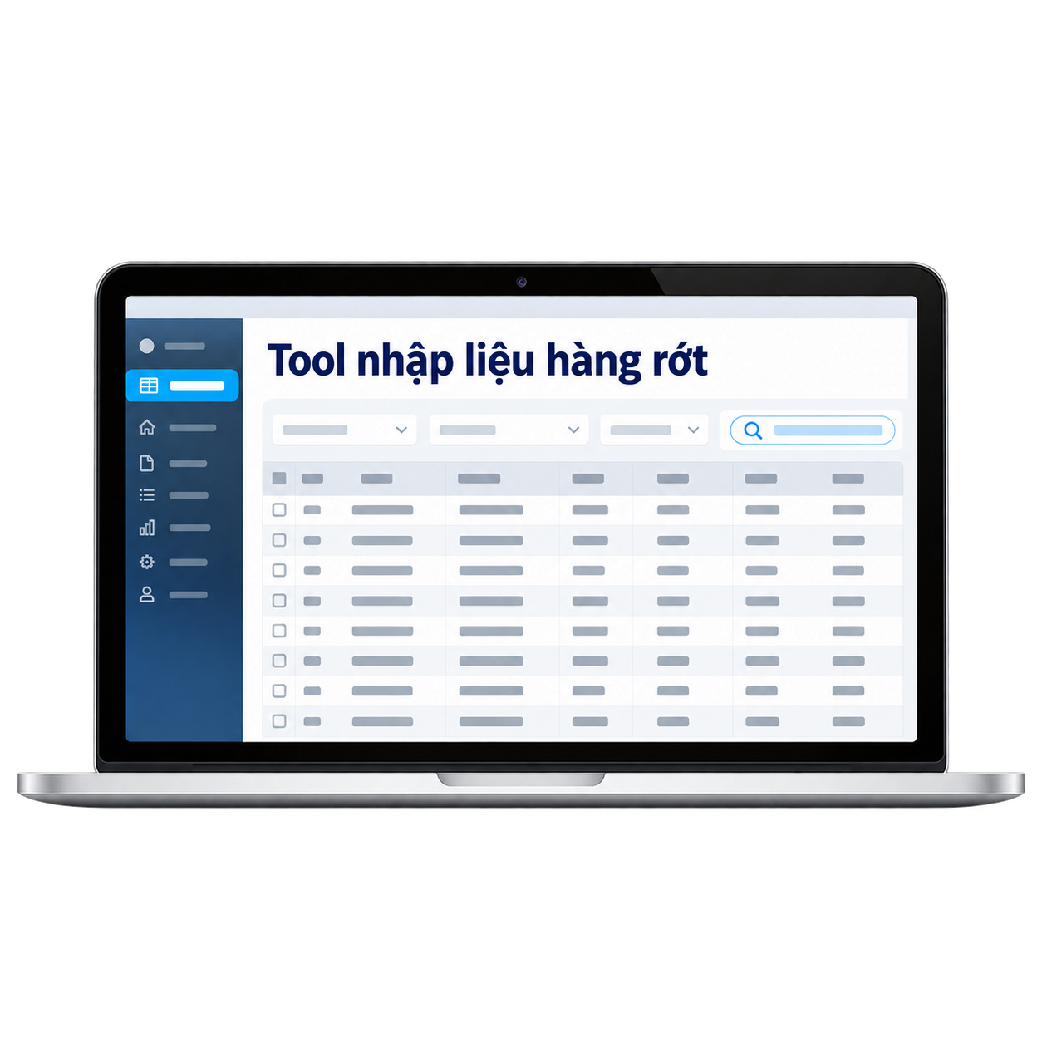


POWER APPS IMPLEMENTATION
LEFT-BEHIND GOODS REPORTING
130 slips / month → 4,420 line items
Business context: B2C outbound goods not loaded onto trucks are left behind daily and must be recorded to create SAP BINs for re-storage and reloading.
01
CURRENT STATE
02
IMPROVEMENT 1
03
IMPROVEMENT 2
On-site Recording
Staff fill in paper slips manually
On-site Recording
Staff fill in paper slips manually
On-site Recording
Staff scan QR codes via Power Apps
36 hrs / month
36 hrs / month
12 hrs / month
Data Entry
Staff process data in Excel
Data Entry
Staff process data via a desktop tool
Data Entry
Staff receive on-site data via email
+
+
+
Tool
Email Inbox
72 hrs / month
12 hrs / month
10 hrs / month
TOTAL - CURRENT STATE
108 hrs / month
TOTAL - IMPROVEMENT 1
48 hrs / month (-55.6%)
SAVED 86 hrs / month (-79.6%)
Total 22 hrs / month | approx. 1,032 hrs / year

