Slide 1

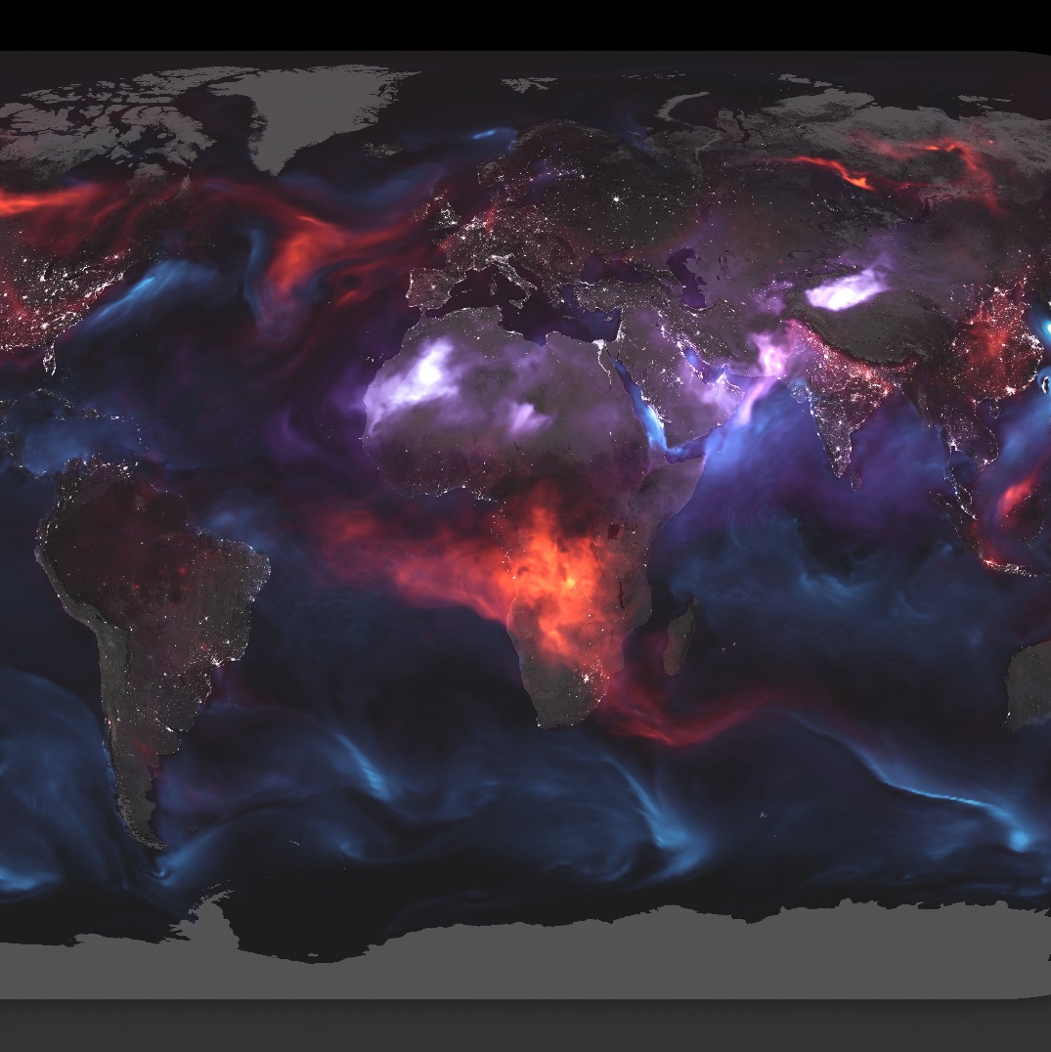
NASA HEATMAPS
DATA MINING PROJECT

Slide 2
STUDENTS
Sefi Hendry
Idan Horovitz

Slide 3

Project Breakdown
Step 4 - Interpret | Step 3 – Model | Step 2 – Creating Our Database | Step 1 - Scraping & Scrubbing | OUR MAIN GOAL & IDEAS
Discussing over our models results, our conclusion about the project and our satisfaction with the overall results | Running machine learning models for each category and analyze the result by visualizing the models . | Explaining how we created our dataframe and what were our first conclusion based on our polished data. | Explaining the way our crawler works how we analyzed images and improved our efficiency and how we dealt with outliers. | Explaining the topic of the research, Our sources to extract data and our thoughts and feelings about the research.

Slide 4

Our Main Goal & Ideas
Our main goal in this project is to find out whether it is possible to predict geological factors such as Land Surface Temperature, Vegetation, Land fire, Net Primary Productivity, Snow Cover and Land Surface Temperature Anomaly only by running machine learning models on their previous heatmaps.
We searched the internet for a reliable discrepancy source and after browsing through several datasets and websites we decided to establish our research on NASA’s website on the heatmaps section
In our point of view, trying to predict the future for a geological environment that have so many factor and variables, can really challenge the methods for machine learning that we learn this semester.

Slide 5
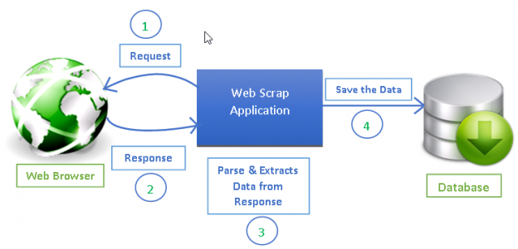
Step 1 – Scraping & Scrubbing

Slide 6
Our Crawler
The method we used to extract the data is by using our crawler which scraped images from NASA web site in the following link.
(https://earthobservatory.nasa.gov/global-maps)
We used the requests library in order to fetch map image URLs from NASA website according to the data we tested.
Since we are extracting images and exploring their pixels, We have used the Pillow library throughout the project in order to parse images pixels as matrices
For each geological category we tested, we used the following functions:
get_by_url – Returns the data we requested from each URL.
get_frame_urls – Returns the URLs for each image in the category requested.
parse_date_from_url – Returns the year and month from each image.
image_url_to_mat – Create a matrix of RGBs for each pixel.(350X700=245,000 pixels)

Slide 7
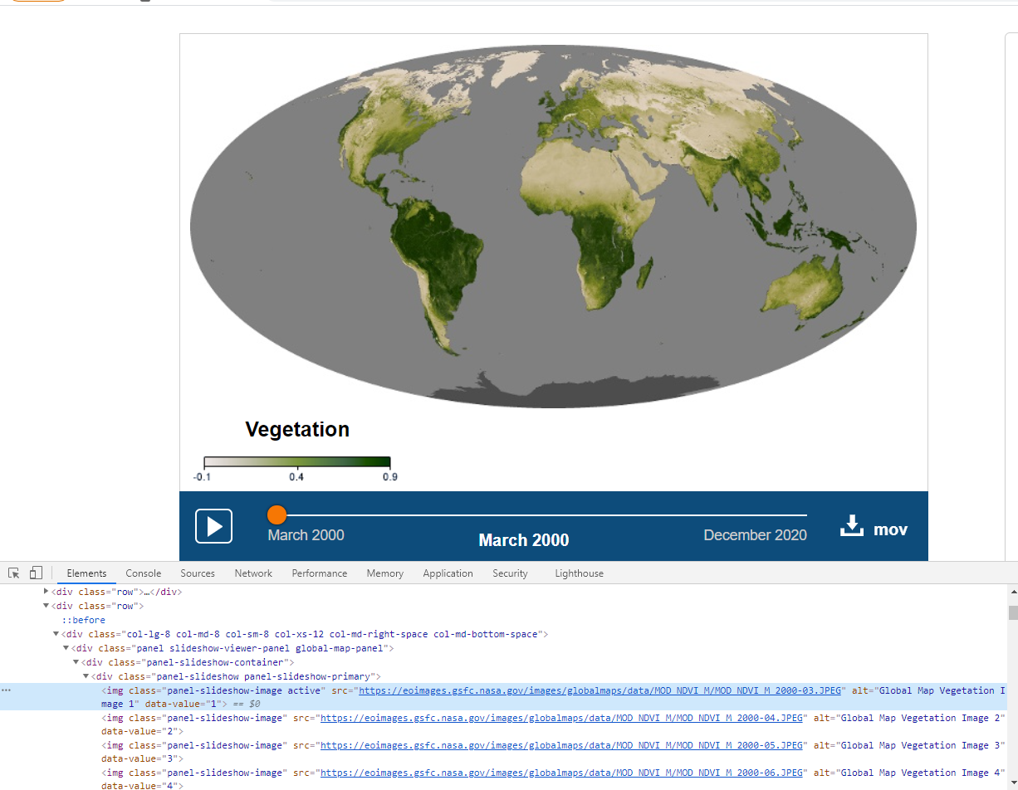
An example of the data gathering by image extracted from her div and her URLs name
The Image
The Category
The Map Scale
The Date
The URL

Slide 8
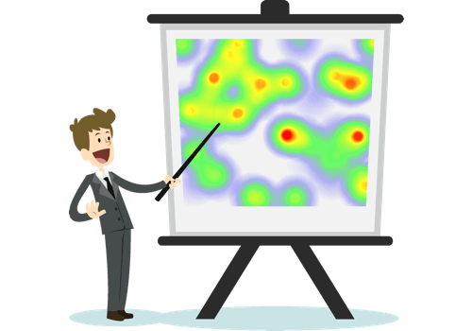
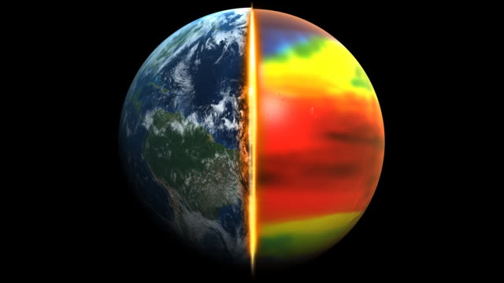
Analyzing Images & Dealing with Outliers

Slide 9
Analyzing Images
The first method we tried to use for scaling images was with iteration and comparing each pixel of each image.
It took us approximately 5 minuets to get the values of only one image (of 250 images in each category)
Taking this long for each image data structing was a real bottle neck for this project and it become a major problem that we had to deal with.
After a long search on the internet, and even consulting on python forums online, we decided to load each image into 3 diminution matrix which each cell represents the pixel index, and his value is RGB’s
As a mean of finding whether a pixel on the heat map is valuable (found on the scale or not) - we decided to compare distances between the pixel and other pixel: 1. Between each pixel on the heatmap and its counterpart on the clean map (1:1) 2. Between each pixel on the heatmap and all of the colors on the scale (1:178) by using the function distance_matrix(), imported from scipy.spatial. In order to calculate those distances we used the following formula:
After we finished the crawler process and imported the pixels of the image into matrices, we used the following functions to analysis the data by comparing and scaling the wanted image to its scale image and default image matrices.
create_outliers_mask – Creates a mask of outliers which indicates which of the coordinates is a valuable pixel. By summing all the corresponding pixels in each map and checking if a pixel remains at 0. Returns a boolean array containing `True` if all values in an index are not 0 and returns False otherwise.
scale_searcher – Returns the starting indices of the scale in a given image.
color_mapper– Given the starting indices of the scale image by the scale searcher and returns an array of the scale image middle strip by their RGBs
map_analyzer– Takes the current image and scale image matrices and evaluate the distances between each pixel to the scale. It returns the closest scale RGBs indices that represent the value for each pixel in terms of quantity to the category.

Slide 10
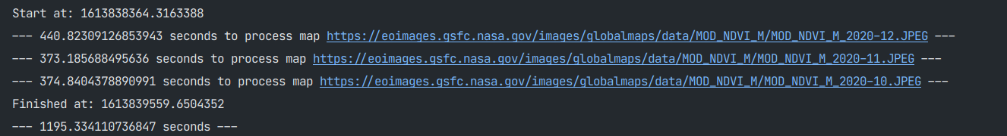
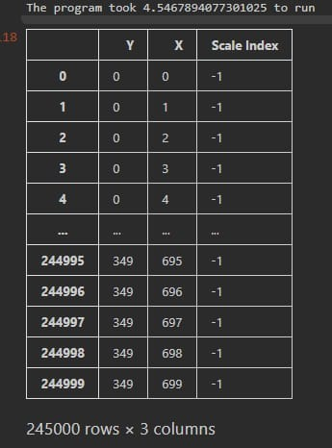
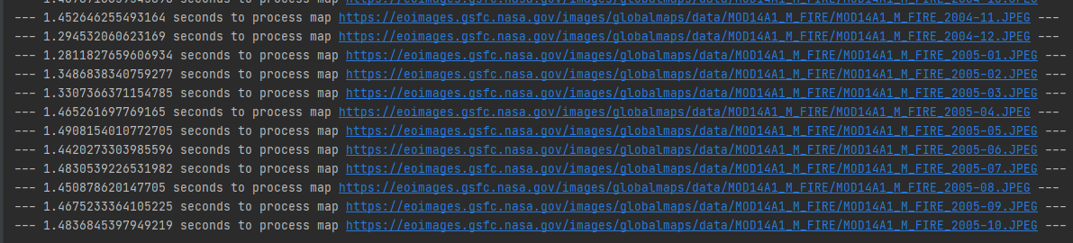
The Efficiency of the Matrices Method
Iteration method run time for image
Matrix output
Matrices method run time for each image

Slide 11
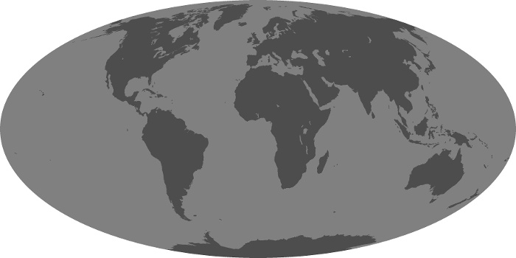
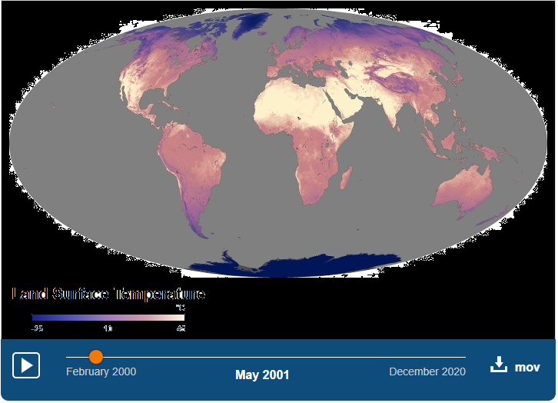
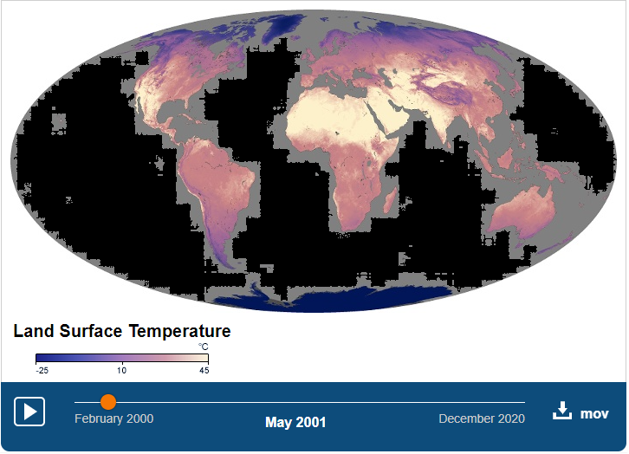
Dealing With Outliers
While gathering data from each image, most of the data is not relevant to the database (Outliers).
Each image contain white frame and gray sea, However while comparing the gray and white color to each other we can see that they have different RGBs caused by image compressing
We dealt with that using the following methods
Comparing each image distance matrix to the default image distance matrix, each pixel that fit exactly to the default image will be set to be -1 (suits as outliers to the matrix)
Comparing each image distance matrix to the scale image distance matrix, each pixel that fit exactly to the scale image will be set to be as the scale image pixel index.
Every pixel that doesn’t fit exactly neither to the default image or the scale image will be set to be where he fit closest(-1 or scale index).

Slide 12


Step 2 – Creating Our Database

Slide 13
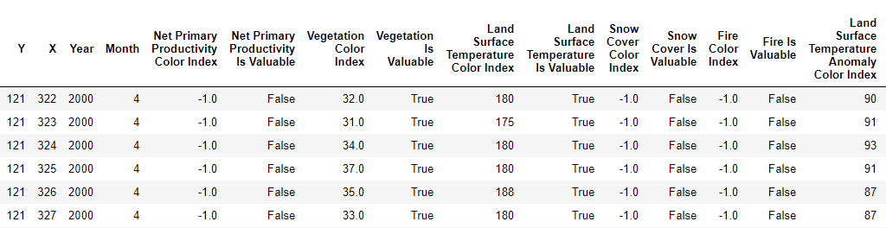
Creating Our Database
In order to create our data frame, we used create_df function. The function receives a dictionary with key of the category name and value of another dictionary with key of tuple [year, month] and value of matrix of the corresponding image values.
Running through all the images of all the categories and all their dates , creating a data frame that each row is a single pixel of each image and the columns are the pixel coordinates, date, value according to the category and if the pixel is valuable or not.

Slide 14
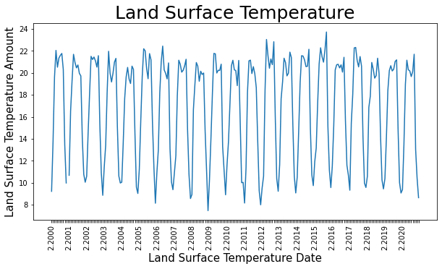
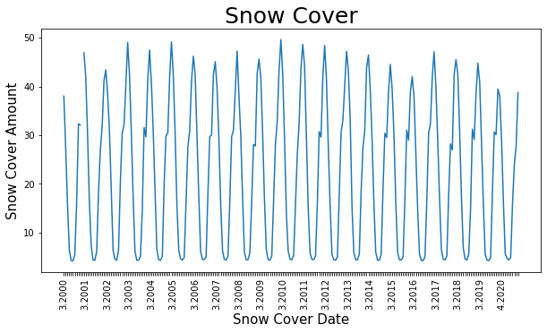
First Conclusion
As data scientists we should search for patterns and intuitive conclusions from our polished data frame.
here are some visuals that we extracted from the database using matplotlib.pyplot

Slide 15
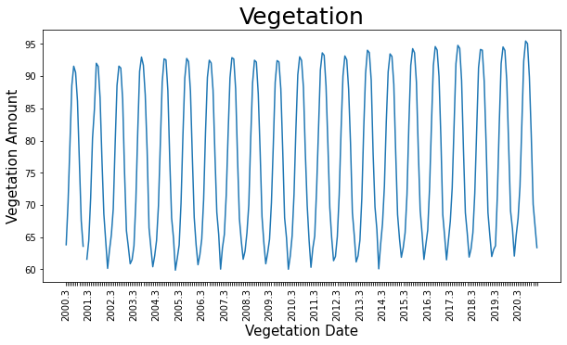
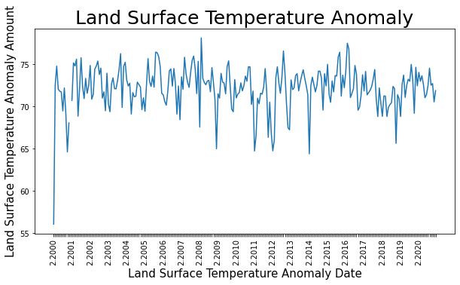
More Visuals

Slide 16
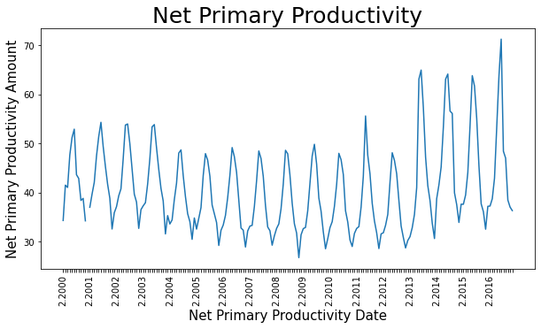
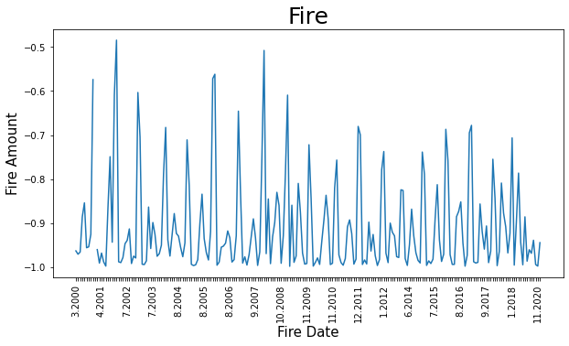
More Visuals

Slide 17
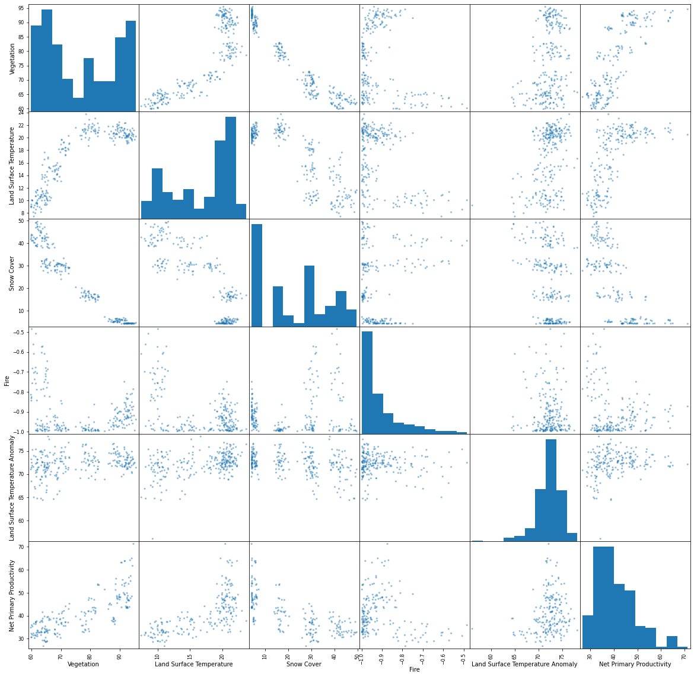
Categories Correlation

Slide 18
First Conclusion Summary
Since our research is about geological environments changes, that are based on repetitive seasons, we got as expected cyclic graph on all plot figures except Land Surface Temperature Anomaly that point out unusual cases.
In addition, we found out that all though the land surface temperature acting cyclic, we can see that over time the graph look unstable, and every year look unique. That conclusion sits with the idea of articles about world climate changing over pollution caused by modern lifestyle.
We were also surprised to see that unlike our expectation to see the amount of world vegetation decreasing over the years over worldwide pollution, we saw that the amount of the world vegetation is escalating up over the past years.

Slide 19


Step 3 – Model

Slide 20
Model
The first step of choosing a model is by understanding our database by which kind of data we have and which kind of data we are trying to predict. In our case each row in our dataframe is a pixel that have index, date, category and category value.
We are trying to predict future values for each category by having previous dates values of the corresponding category.
This means that our machine learning model will not be categorical since each pixel has a numeric value for every category.
We ran the following models for each category and got the following results:

Slide 21
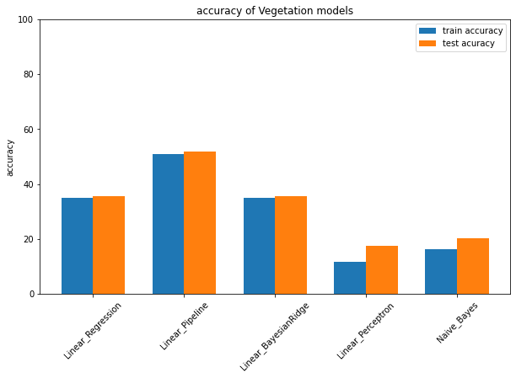
Models Results - Vegetation
We can see that for vegetation category, the linear pipeline model had the most accurate prediction, test accuracy with 51.70% and train accuracy with 50.95%

Slide 22
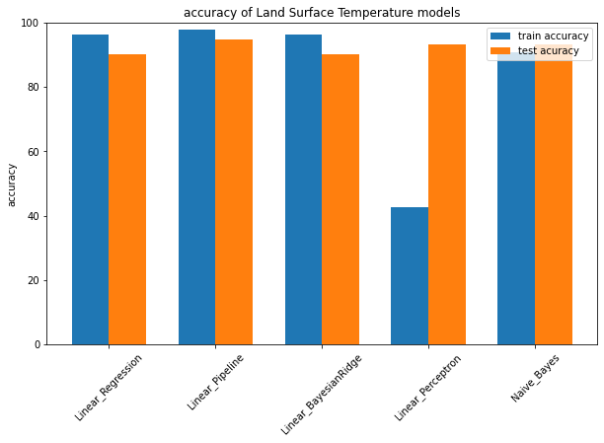
Models Results – Land Surface Temperature
We can see that for land surface temperature category, the linear pipeline model had the most accurate prediction, test accuracy with 94.67% and train accuracy with 97.75%

Slide 23
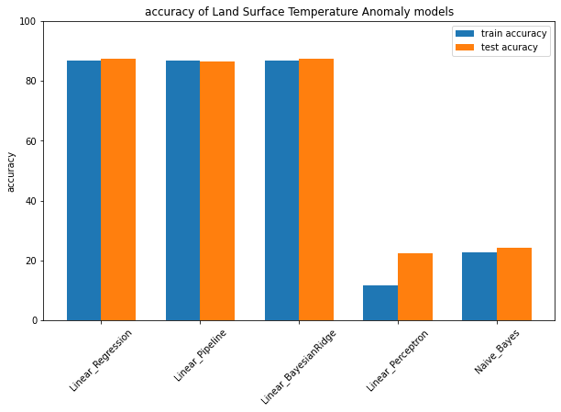
Models Results– Land Surface Temperature Anomaly
We can see that for land surface temperature anomaly category, linear bayesianridge and linear regression got the same result, test accuracy with 87.39% and train accuracy with 86.74%

Slide 24
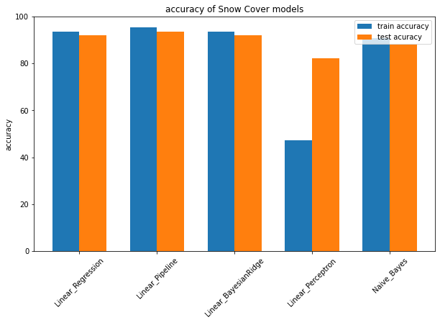
Models Results – Snow Cover
We can see that for snow cover category, the linear pipeline model had the most accurate prediction, test accuracy with 93.56% and train accuracy with 95.26%

Slide 25
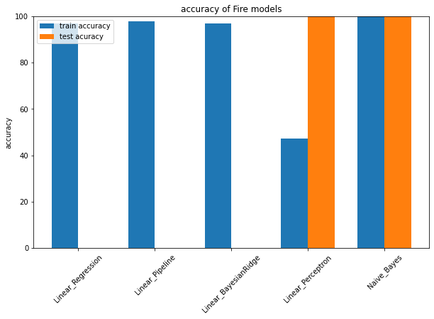
Models Results – Fire
We can see that for fire category, the naive bayes model had the most accurate prediction, test accuracy with 100% and train accuracy with 99.93%

Slide 26
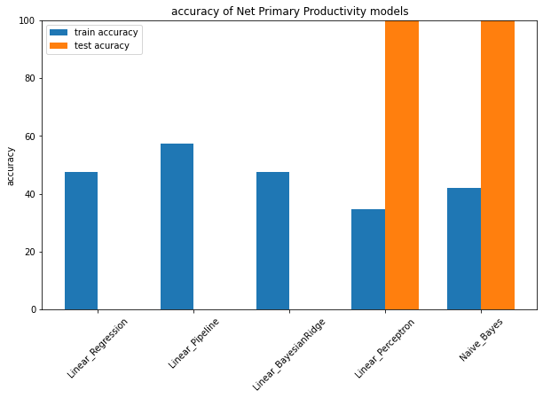
Models Results – Net Primary Productivity Models
We can see that for net primary productivity models category, the naive bayes model had the most accurate prediction.
This model shouldn’t get into consideration because of his under fitting caused by high test accuracy but low train

Slide 27
Step 4 – Interpret
In summery we saw that for each geological category the models prediction worked differently. It makes sense since each of the categories is very individual and have many geological variables that Heatmaps could not deliver . How ever based on our results we can conclude that linear algorithms worked best for our data type.
We were really satisfied to see that most of the models got accurate prediction such as land surface temperature. We came to realize that it makes sense since most of time heat spreads in an area with a consistent manner. Which means that the RGBs in the heatmaps will spread without many changes in big areas.
With correlation to our first conclusion with the daraframe, we discovered that vegetation is not acting predictable since it have so many factors to it, and yet we were satisfied with the model prediction results.
In conclusion, we were amazed by the amount of data that we achieved by exploring heatmaps pixels and enjoyed studding it together with our models

