Slide 1


Information Visualization
Currency Hedging Analysis
28 October 2019
Isaac dos Anjos (nºmec: 78191)
Borys Chystov (nº mec: 78198)

Slide 2
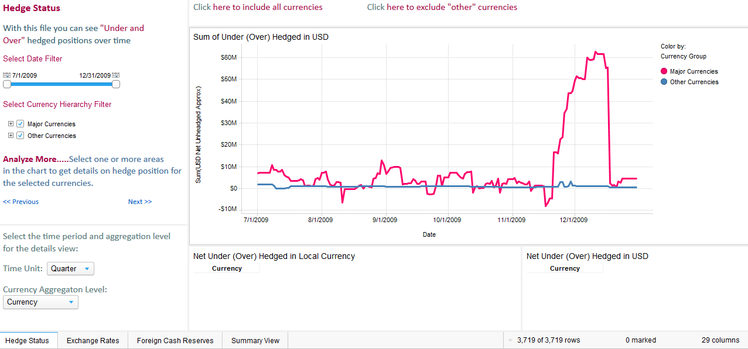
Currency Hedging Analysis
Application to track and analyze currency hedging positions.

Slide 3
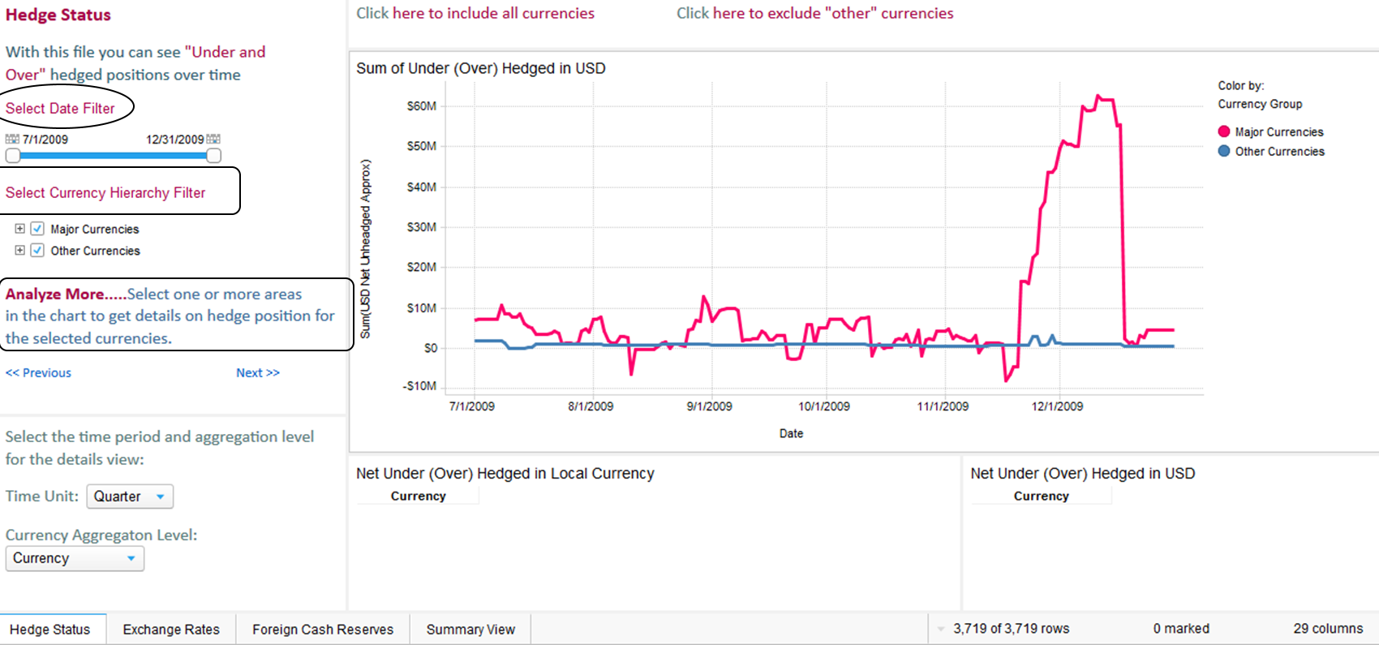
Naive Evaluation

Slide 4
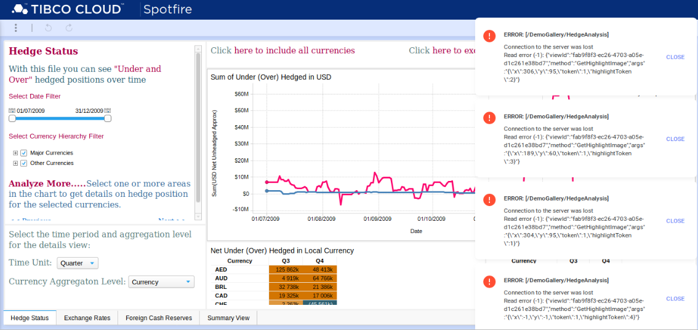
Naive Evaluation

Slide 5
Proper way to evaluate
We used the following heuristics:
Nielsen’s heuristics - Ten Usability Heuristics for User Interface Design;
Forsell & Johanson’s heuristics - Set for Evaluation in Information Visualization;
Zuk & Carpendale’s heuristics - Heuristics for Information Visualization Evaluation.

Slide 6
Nielsen’s Heuristics
Visibility of system status;
Match between system and the real world;
User control and freedom;
Consistency and standards;
Error prevention;
Recognition rather than recall;
Flexibility and efficiency of use;
Aesthetic and minimalist design;
Help users recognize, diagnose, and recover from errors;
Help and documentation.

Slide 7
Forsell & Johanson’s heuristics
Information coding;
Minimal actions;
Flexibility;
Orientation and help;
Spatial organization;
Consistency;
Recognition rather than recall;
Prompting;
Remove the extraneous;
Data set reduction.

Slide 8
Zuk & Carpendale’s heuristics
Ensure visual variable has enough length;
Don’t expect a reading order from color;
Color perception varies with size of colored item;
Local contrast affects color & gray perception;
Consider people with color blindness;
Preattentive benefits increase with field of view;
Quantitative assessment requires position or size variation;
Preserve data to graphic dimensionality;
Put the most data in the least space;
Remove the extraneous (ink);
Consider Gestalt Laws;
Provide multiple levels of detail;
Integrate text wherever relevant.

Slide 9
Nielsen heuristic results – evaluator 1
Problem | Evaluator 1
Consistency and standards: Using the same fonts for texts and hyperlinks shows an inconsistency of standards. | 4
Match between system and the real world: “Select Date filter”, seems quite confusing. Changing it to “select a period of time” or “Select an interval”. | 2
Visibility of system status: Response time or feedback when ever the mouse hovers over a line graph is far to long. | 2
Help and documentation: I’m not familiar with all the filters, there should be a place with all of them. | 1
Recognition rather than recall: If there were flags next to each currency, quickly I can recognize each one. | 3

Slide 10
Nielsen heuristic results – evaluator 2
Problem | Evaluator 2
Visibility of system status: Response time or feedback when ever the mouse hovers over a line graph is far to long. | 2
Match between system and the real world: The only match between the system and the real world is the notification bell. | 2
Consistency and standards: The color type and size of the letters is consistent throughout the web page. The visualization pattern is also similar throughout the website except the tab “summary view”. | 2
Error prevention: There is no need for error prevention in a visualization web page. If an error occurs, it is presented in the notifications section. | 1
Recognition rather than recall: The only issue is that the navigation tab is in the bottom corner. | 1

Slide 11
Nielsen heuristic results – evaluator 2
Problem | Evaluator 2
Aesthetic and minimalistic design: To much information that can be presented in different ways in different layouts. Different options presented in different ways to display the same thing | 4
Help users recognize, diagnose and recover from errors: Errors poorly displayed in notifications section, and are not intuitive | 3
Help and documentation: Actions that can be performed are not self-explanatory, and there is no help from the web page. | 2

Slide 12
Forsell & Johanson’s heuristics
Problem | Evaluator 2
Flexibility: Presents flexibility to display the graphics. Flexibility to select options confuses the users. | 2
Orientation and help: No guidance from the web page to help the user to visualize the pretended information | 2
Consistency | 2
Recognition rather than recall | 1

Slide 13
Zuk & Carpendale’s heuristics
Problem | Evaluator 1
Color perception varies with size of colored item: The application does contain colors which represents sizes, but unfamiliar of the scale. | 1
Consider people with color blindness: The application can represent multiple countries on the platform, thus requiring multiple colors which can interfere the user’s experience if he/she is color blind. | 1
Provide multiple levels of detail: The application can show data of an entire year, but when the use selects a certain day, the graph shouldn’t show 1 dot of data. If the application doesn’t have data a certain levels of details, then they shouldn’t be accessed in first place. | 3

Slide 14
Conclusions

