Slide 1

Practical Spring Boot For TDP
Idan Shalom, 2026
Hands-on workshop

Slide 2

ABOUT ME
Tech Lead | 9 years at AT&T
Experienced: Java, Go, Node.js, Python, JavaScript, C#
Interests
  Tech (obviously)
  Music & Movies
  GYM & Intermittent Fasting

Slide 3
HIGHLIGHTS
README BASED WORKSHOP
HANDS ON!
COVERS MOST OF THE BASIC & IMPORTANT TOPICS OF SPRING BOOT
BUILT INCREMENTALLY
EVERY TOPIC HAS A BRANCH
USE THE REPO AS A REFERENCE
SUPPORT GROUP

Slide 4
Agenda
1
Why a framework? Motivation for Spring Boot
2
Spring Boot essentials What it is and what you get
3
Inversion of Control The principle behind the container
4
Dependency Injection The pattern, applied to real code
5
Hands-on Work the repo branch by branch

Slide 5
MOTIVATION

Slide 6
Why use a web framework?
Routing
Map URLs to handlers — no servlet plumbing
Configuration
Externalized settings and profiles per env
Web Framework
(Spring Boot)
Dependency Injection
Wire components by contract, not by new()
Security
Auth, roles and CSRF protection built in
Error Handling
One place for exceptions and HTTP responses
Data & Testing
Repositories, transactions, test slices
Solved once by the framework - so you write business logic, not plumbing.

Slide 7
What is Spring Boot?
Spring - an umbrella of projects that simplify common problems in day-to-day enterprise development.
Spring Boot - built on top of Spring: a faster, easier way to set up, configure and run applications.
Opinionated by design: best practices baked in, covering most use cases.

Slide 8
What you get out of the box
Spring Boot is used for creating a stand-alone
Spring-based application that you can run easily because it requires minimal Spring configuration.
    No need for web servlets; it has Tomcat embedded.
    Configurations are pre-packaged;
    Just run it, and you have a server up and running.

Slide 9
Inversion of Control (IoC)
  Inversion of Control (IoC) is a design principle where the control of object creation and lifecycle management is transferred from the application code to a container or framework.
Without IoC
Your code creates and owns its dependencies (new Processor(...)).
With IoC
A container creates the objects and hands them to your code.

Slide 10
Purposes of IoC
Decouple what a component does from how its dependencies are built
Greater modularity - a Computer need not know how a Processor is created
Easier testing - isolate components or inject mocks instead of real ones

Slide 11
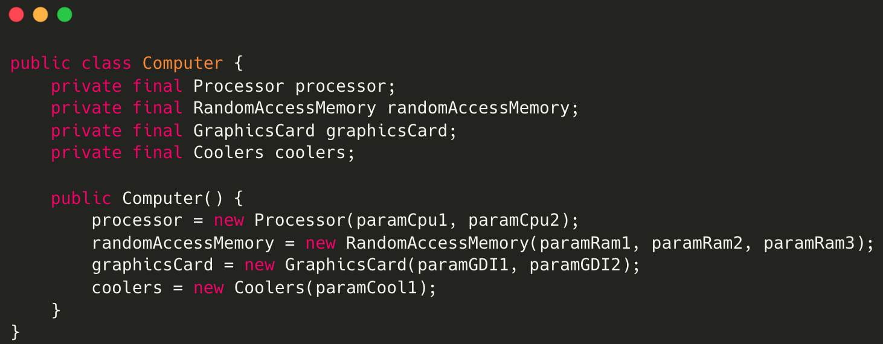
The traditional OOP approach
In traditional OOP programming, when an object (e.g., a Computer) is created, it also instantiates its dependent classes (e.g., Processor, RAM instances):

Slide 12
What could be the problems with this implementation?
Tight coupling between Computer and its components:
We must know how to create every component and which constructor parameters to pass.
A Computer with a different Processor requires yet another Computer class.
Testing is hard - there is no way to inject mocks.
Poor polymorphism.
Leads to implementation-based design.

Slide 13
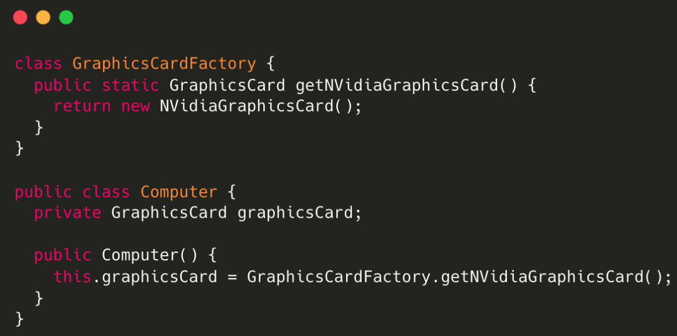
IoC with the Factory pattern
What we gained: control of creating dependent class objects is inverted to the Factory.
What's still wrong: Computer still uses the concrete GraphicCardFactory class, so the classes are not fully loosely coupled.

Slide 14
Dependency Injection
A design pattern used to manage dependencies between objects.
It allows an object to receive the objects it depends on, rather than creating them itself.
This promotes a more modular, testable and maintainable codebase.
DI is one of the SOLID object-oriented principles.
Notes:
Note: Dependency injection is one of the SOLID object-oriented principles.

Slide 15
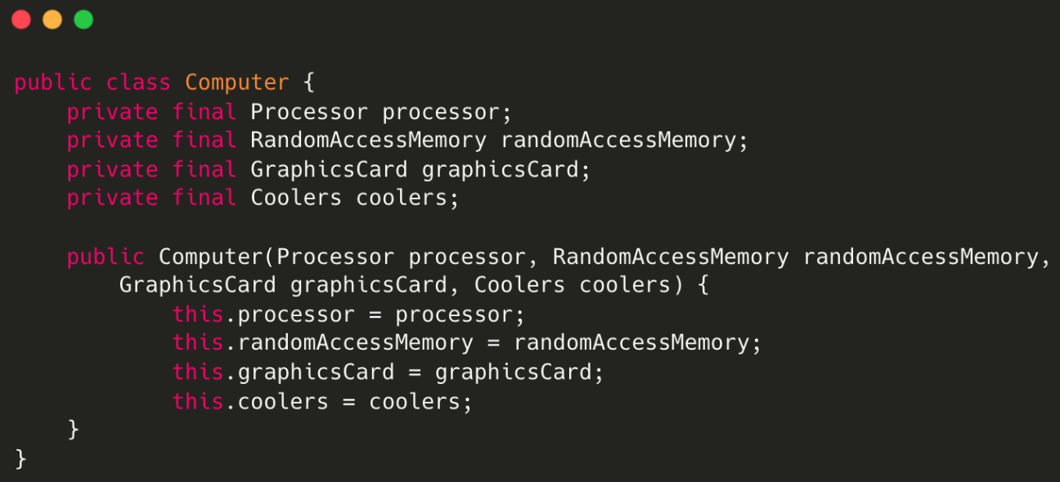
DI applied: the Computer example
Instead of having the Computer object control its dependencies (instantiate them),
let’s supply (inject) them for it!
By using DI, we can rewrite the example without specifying the implementations of the components we want.

Slide 16
Next steps
Clone the repo
The README drives the whole workshop - start there.
Work branch by branch
Every topic has its own branch; use the repo as a reference later.
Join the support group
Bring your questions after the workshop - the group stays open.
Thanks - questions?

