Slide 1
Part 1: create REST microservice with Spring Boot
We will go through the following steps:
Initializing a Spring Boot application
Importing the application
Running an “empty” application and checking it (sanity)
Adding and mapping our first microservice (REST service)
Calling our microservice from the Postman

Slide 2
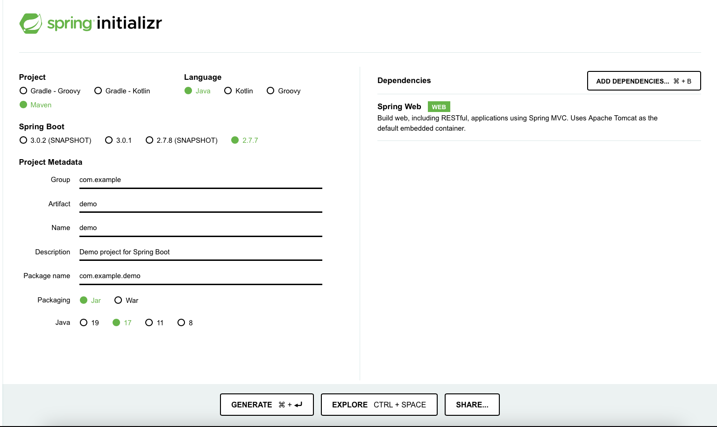
Initializing a Spring Boot application
https://start.spring.io

Slide 3
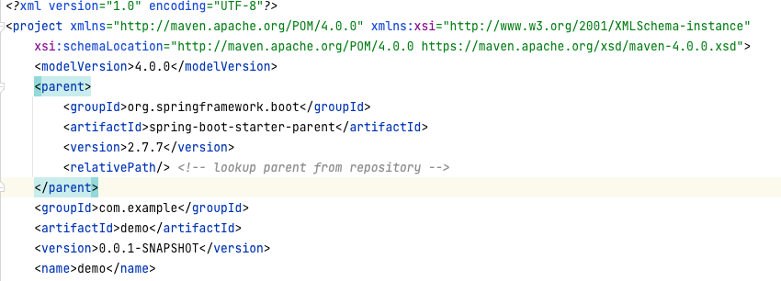
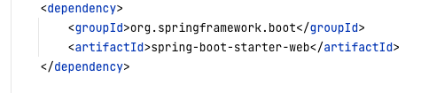
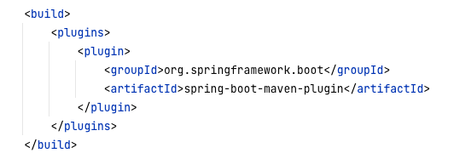
Initializing a Spring Boot application
What do we see in the that pom.xml we get:

Slide 4
Initializing a Spring Boot application: @SpringBootApplication
In the DemoApplication class we see:
@SpringBootApplication public class DemoApplication { public static void main(String[] args) { SpringApplication.run(DemoApplication.class, args); } }

Slide 5
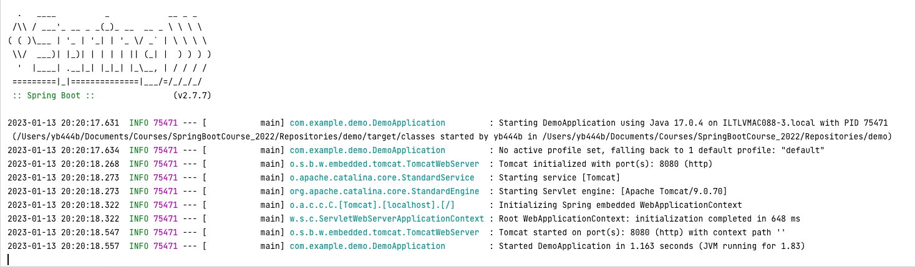
Run the Spring Boot application:
Log example:
Note that:
the application server (Tomcat) is already started;
the microservice is listening to port 8080 (default Tomcat configuration)

Slide 6
Spring actuator
Let’s add something that we can get back without any code… In pom.xml add:
<dependency>
<groupId>org.springframework.boot</groupId>
<artifactId>spring-boot-starter-actuator</artifactId>
</dependency>
Going now to http://localhost:8080/actuator/health
Should result with: {"status":"UP"}
Note: adding to src/main/resources/application.properties the line: management.endpoint.health.show-details=always will show more info for actuator/health

Slide 7
Adding our own microservice
Let's add a new class:
package com.example.demo; import org.springframework.web.bind.annotation.RequestMapping; import org.springframework.web.bind.annotation.RestController; @RestController
@RequestMapping("hello") public class HelloController { @GetMapping(”world") public String index() { return "Hello, world!"; } }
@RequestMapping, @GetMapping, @PostMapping map web requests to Spring Controller methods.

Slide 8
Spring annotations for Microservice Beans
@Component is a generic stereotype for any Spring-managed component. @Repository, @Service, and @Controller are specializations of @Component for more specific use cases (in the persistence, service, and presentation layers, respectively).
@RestController is a specialized version of the controller. It includes the @Controller and @ResponseBody annotations, and as a result, simplifies the controller implementation.

Slide 9
@PathVariable
@RestController @RequestMapping("calculate") public class CalculateController { @GetMapping("/add/{num1}/{num2}") int add1(@PathVariable int num1, @PathVariable int num2) { return num1 + num2; } }
http://localhost:8080/calculate/add/5/7/ -> returns 12

Slide 10
@RequestParam
@GetMapping("/add") int add(@RequestParam int num1, @RequestParam int num2) { return num1 + num2; }
http://localhost:8080/calculate/add?num1=5&num2=7 => 12
We can configure the @RequestParam to be optional, though, with the required attribute. (When the parameter isn't specified, the method parameter is bound to null).
int add(@RequestParam Integer num1, @RequestParam(required=false) Integer num2)
We can configure the @RequestParam to use a default value, using the defaultValue attribute (in this case, required is indeed set to false). Note: value is of String type.
int add(@RequestParam int num1, @RequestParam(defaultValue=“100”) int num2)

Slide 11
JSON on POST
public class CalculateRequest { public int num1; public int num2; }
@PostMapping("/add") public int create(@RequestBody CalculateRequest request) { return request.num1 +request.num2; }
{
"num1": 5,
"num2": 7
}

Slide 12
Complex response: a Map
// inside @RestController
@GetMapping("/numbers")
public Map<Integer, List<String>> numbers() {
var map = new HashMap<Integer, List<String>>();
map.put(1, Arrays.asList(new String[] {"One", "Echad"}));
map.put(2, Arrays.asList(new String[] {"Two", "Shtayim"}));
return map;
}
http://localhost:8080/numbers => {"1":["One","Echad"],"2":["Two","Shtayim"]}

Slide 13
Complex Response – our own object
public class CalculateResponse { public int result; CalculateResponse(int result) { this.result = result; } }
@PostMapping("/add") public CalculateResponse create(@RequestBody CalculateRequest request) { return new CalculateResponse(request.num1 + request.num2); }
http://localhost:8080/calculate/add => { "result": 3 }

Slide 14
Part 2: Testing with Spring Boot
Spring Boot provides several utilities and annotations to help when testing your application. Most developers use the spring-boot-starter-test “Starter”, which imports (in the test scope):
Spring Test & Spring Boot Test - utilities and integration test support for Spring Boot applications.
Junit - the de-facto standard for unit testing Java applications.
AssertJ - a fluent assertion library.
Mockito - a Java mocking framework.
Hamcrest - a library of matcher objects
a number of other useful testing libraries.
<dependency> <groupId>org.springframework.boot</groupId> <artifactId>spring-boot-starter-test</artifactId> <scope>test</scope> </dependency>

Slide 15
Testing with @SpringBootTest
The @SpringBootTest annotation is useful when we need to bootstrap the entire Spring application container.
This annotation creates an application context and loads all beans of the application. It means we can @Autowire any bean that's picked up by component scanning into our test.
@SpringBootTest starts the embedded server and creates a web environment.

Slide 16
Testing With a Mock Environment
By default, @SpringBootTest does not start the server but instead sets up a mock environment for testing web endpoints.
With Spring, we can query our web endpoints using class MockMvc, as shown in the following example:
@AutoConfigureMockMvc @SpringBootTest class SpringMicroserviceDemoApplicationTests { @Autowired MockMvc mockMvc; @Test void testWithMockMvc() throws Exception { var result = mockMvc.perform(get("/hello/index")) .andExpect(status().isOk()) .andReturn() .getResponse() .getContentAsString(); assertThat(result, is(equalTo("Hello, world")));
} }
Use annotation @AutoConfigureMockMvc for operations with MockMvc
In this test mockMvc calls endPoint (“/hello/index”), implemented in the tested application, and verifies that it returns HTTP 200 OK and body “Hello World”.

Slide 17
Testing with @WebMvcTest
If you want to focus only on the web layer and not start a complete ApplicationContext, consider using @WebMvcTest instead.
@WebMvcTest auto-configures the Spring MVC infrastructure and limits scanned beans to @Controller-related beans.
So, if your controller has some dependency to other beans from your service layer, the test won't start until you either load that config yourself or provide a mock for it.
Notes:
Note: @WebMvcTest also auto-configures MockMvc.

Slide 18
@MockBean
Use @MockBean annotation to mock a bean object.
Often, @WebMvcTest is limited to a single controller and is used in combination with @MockBean to provide mock implementations for required dependencies.

Slide 19
Hands-on - Calculator
Implement the following APIs:
GET http://localhost:8080/add/{num1}/{num2}
GET http://localhost:8080/add/?num1={value}&num2={value}, where num2 is optional
POST http://localhost:8080/universalAdd?numeralSystem={DEC_or_HEX}, default value is DEC
The endpoint receives a JSON structure with two fields: num1 and num2 (of type String).
Converts them to integer, summarize and returns another structure – JSON with one field: result.
Recommendations: create a class CalculationService that has a field radix. Use the functions Integer.parseInt and Integer.toString to calculate result according to the radix.
Write tests.

Slide 20
Part 3: Error handling in REST with Spring
What do we expect from the REST microservice error handling?
We want to handle all possible errors and report to the client detailed information about the problem.
We want to build a centralized error-handling mechanism, to consolidate all errors we want to handle in one place. At the same time, we want to provide a default error handling for unexpected exceptions.
The solution – @ResponseStatus, @ExceptionHandler and @RestControllerAdvice annotations and ResponseEntityExceptionHandler class.

Slide 21
@ExceptionHandler
@ExceptionHandler is a Spring annotation that provides a mechanism to treat exceptions thrown during execution of handlers (controller operations).
public class FooController{
//...
@ExceptionHandler({ CustomException1.class, CustomException2.class })
public void handleException() { //
}
}
If we will enter this annotation on methods of controller classes, it will serve as the entry point for handling exceptions thrown within this controller only.

Slide 22
@RestControllerAdvice
Altogether, the most common approach is to use @ExceptionHandler on methods of @RestControllerAdvice classes so that the Spring Boot exception handling will be applied globally for all application controllers (or to a subset of controllers, if specified).
@RestControllerAdvice is an annotation in Spring and, as the name suggests, is “advice” for multiple controllers. It enables the application of a single @ExceptionHandler to multiple controllers. With this annotation, we can define how to treat such an exception in a single place, and the system will call this handler for thrown exceptions on classes covered by this @RestControllerAdvice.

Slide 23
@ResponseStatus
As the name suggests, @ResponseStatus allows us to modify the HTTP status of our response. It can be applied in the following places:
On the exception class itself
Along with the @ExceptionHandler annotation on methods
Along with the @ControllerAdvice annotation on classes

Slide 24
Error Handling – handle custom exception
Create your exception handler and add annotation @RestControllerAdvice.
Extend it from ResponseEntityExceptionHandler, as it already provides some basic handling of Spring MVC exceptions. We’ll add handlers for new exceptions while improving the existing ones.
@RestControllerAdvice
public class AppControllerAdvice extends ResponseEntityExceptionHandler
{
@ExceptionHandler({AccessDeniedException.class})
@ResponseStatus(FORBIDDEN)
protected String handleAccessDeniedException(AccessDeniedException ex) {
return “Access denied!”;
}
}
Define an exception handler function, specify a @ExceptionHandler and the list of exceptions you want to handle
Response code will be HTTPStatus.FORBIDDEN

Slide 25
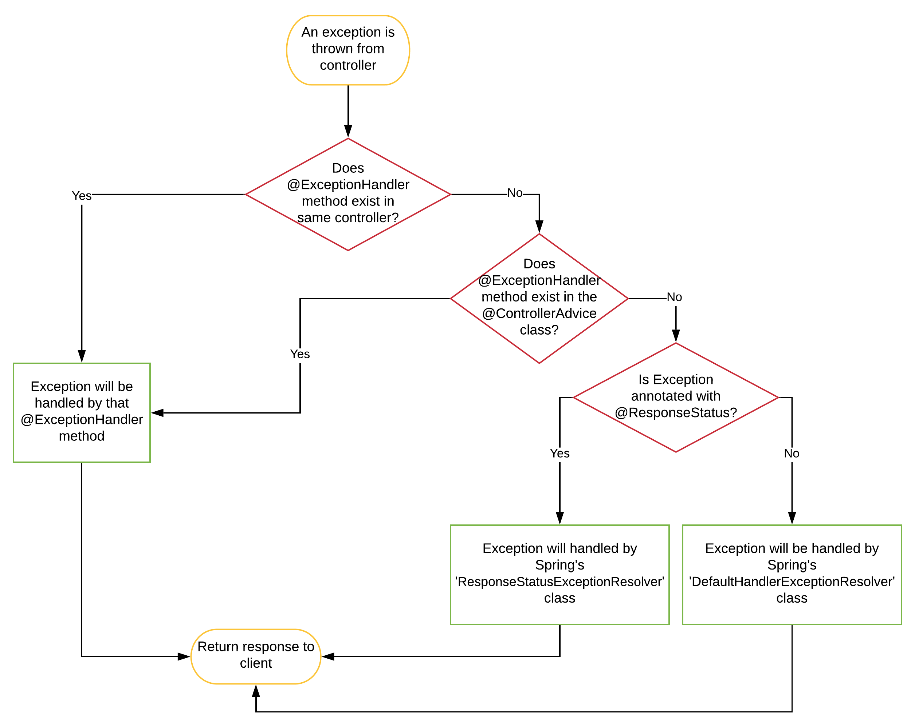
How does Spring process the exception
Have a look through the following flow chart that traces the process of the exception handling by Spring if we have not built our own exception handler:

Slide 26
Hands On – Calculator – error handling
Add error handling to the Calculator service:
Return the message “"Illegal number format exception” in the case invalid numeric value has been sent.
Return the message "Illegal Access!" in the case not supported numeral system has been sent.

Slide 27
Part 4: Configuration in Spring Boot applications
Agenda:
Properties in Java and Spring Boot applications
Load configuration in Spring Boot
@Value
@ConfigurationProperties
Environment bean

Slide 28
Spring Boot – properties sources
There are different options to store or apply configuration in Spring Boot, including:
Java properties files
YAML files
Environment variables
Command-line arguments

Slide 29
Spring Boot – externalized configuration
Spring Boot loads all these properties, they can be easily injected into a managed bean.
Spring Boot loads the properties in a very particular order:
https://docs.spring.io/spring-boot/docs/2.1.13.RELEASE/reference/html/boot-features-external-config.html
Notes:
List of Spring Boot application properties: https://docs.spring.io/spring-boot/docs/current/reference/html/application-properties.html

Slide 30
Spring Boot Configuration - Demo

Slide 31
Configuration in Spring Boot applications
Property values can be injected directly into the application’s beans using the @Value annotation
Bound to structured objects through @ConfigurationProperties
Accessed through Spring’s Environment abstraction

Slide 32
Load configuration values in the code: @Value
Configuration file: | Environment: | System properties:
server.address=127.0.0.1 server.port=8080 | HOME=/Users/yb444b | demo.course=1.0
@Component
public class MyBean {
@Value("${server.address}")
private InetAddress serverAddr;
@Value("${server.port:8080}") here we defined the variable default value - 8080
private int serverPort;
@Value(“${HOME}”)
private String homeDir;
@Value(“${demo.course}”)
private String courseNum;
...
}

Slide 33
Load configuration values in the code: @ConfigurationProperties
@ConfigurationProperties annotation allows isolating a section of properties (with the same prefix) into separate POJO.
Configuration file:
Code:
server.address=127.0.0.1
server.port=8080
server.compression.mime-type= application/json, application/xml
server.max-http-header-size=8KB
@ConfigurationProperties(“server”)
public class ServerConfiguration {
private InetAddress address;
private int port;
private DataSize maxHttpHeaderSize;
private final Compression compression = new Compression();
public static class Compression {
private List<String> mimeTypes = new Array<>();
}
}
Note: setters are mandatory in the @ConfigurationProperties class!

Slide 34
Load configuration values in the code: @ConfigurationProperties (cont.)
@ConfigurationProperties annotation allows isolating a section of properties (with the same prefix) into separate POJO.
Configuration file:
Code:
server.servlet.context-path=/demo
server.servlet.session.persistent=false
@ConfigurationProperties(“server”)
public class ServerConfiguration {
private final Servlet servlet = new Servlet();
public static class Servlet {
private String contextPath;
public static class Session { boolean persistent;
}
private final Session session = new Session();
}
}

Slide 35
@ConfigurationPropertiesScan
The class annotated with @ConfigurationProperties can be injected as any regular Spring bean. For this, use annotation @ConfigurationPropertiesScan
When some class is annotated with @ConfigurationPropertiesScan, Spring will:
Scan all @ConfigurationProperties classes from the current package and its subpackages, and -
Register them as Beans.
Note: @ConfigurationPropertiesScan is often used together with @SpringBootApplication, to activate it for all application classes.
Notes:
@ConfigurationPropertiesScan can be used to scan custom locations for configuration properties classes, for example, @ConfigurationPropertiesScan(“server.security”)

Slide 36
@ConfigurationPropertiesScan: code sample
@Service
public class MyService {
private final ServerConfiguration serverConfig;
public MyService(ServerConfiguration serverConfig) {
this. serverConfig = serverConfig;
}
//...
@PostConstruct
public void openConnection() {
Server server = new Server(serverConfig.getAddress());
// ...
}
}
@ConfigurationPropertiesScan @SpringBootApplication public class MyApp { public static void main(String[] args) { SpringApplication.run(MyApp.class, args); } }

Slide 37
More about @ConfigurationProperties: relaxed binding
Spring Boot supports relaxed binding while mapping properties using @ConfigurationProperties beans, so there is no need to be an exact match between property names and bean properties.
For example,
Kebab case variables can be mapped to the camel case.
app-name can be mapped to appName
Case insensitive mapping
PORT can be mapped to port

Slide 38
Environment variables
Spring Boot provides a pre-made bean of type Environment. This bean can be used to get environment variables.
By default, SpringApplication converts any command line option arguments and adds them to the Spring Environment as well.
public class MyService { Environment environment;
MyService(Environment env) {
this.environment = env;
}
void myFunc() {
String s = environment.getProperty("JAVA_HOME");
Integer ver = environment.getProperty("demo.course", Integer.class);
}
}

Slide 39
Spring Boot Configuration – Using/Injecting Properties - Demo

Slide 40
Hands-On – Configuration
Configure if the function universalAdd is available or not. If universalAdd is not available, and the endpoint is being called, return error 400 Bad Request and a message “The feature is not available”.
Configure minimal and maximal limits of numbers in UniversalCalculateRequest. If a number that is not in the range was received, return error 400 and a message “Bad request: The parameter {num1} must be in the range from {min} to {max}”.
Note: for all these properties, create a section with the same prefix app.universal-add.<>; use @ConfigurationProperties

Slide 41
Hands On - Configuration (cont.)
Add Spring Actuator to your service (page 7). Check how it works.
Try to expose other Actuator endponts using the configuration management.endpoints.web.exposure.include=*
Check the endpoint /actuator/health, /actuator/env, /actuator/beans…
Notes:
https://docs.spring.io/spring-boot/docs/current/reference/html/application-properties.html#appendix.application-properties.actuator
https://www.baeldung.com/spring-boot-actuators

Slide 42
Part 5: Validation with Spring Boot
Java Bean Validation is the de-facto standard for implementing validation logic in the Java ecosystem. It’s well integrated with Spring and Spring Boot.
Spring Boot’s Bean Validation support comes with the validation starter:
<dependency>
<groupId>org.springframework.boot</groupId>
<artifactId>spring-boot-starter-validation</artifactId>
</dependency>

Slide 43
Java Bean Validation
Very basically, Bean Validation works by defining constraints to the fields of a class by annotating them with certain annotations (standard JSR-380).
@NotNull
@Size
@AssertTrue
@Min and @Max
@NotEmpty, @NotBlank
@Pattern
@Positive, @PositiveOrZero, @Negative, @NegativeOrZero
Etc.
Notes:
The complete list of annotations: https://javaee.github.io/javaee-spec/javadocs/javax/validation/constraints/package-summary.html
More details about the bean validation: https://www.baeldung.com/javax-validation

Slide 44
Validator, @Validated and @Valid
Without Spring - to validate if an object is valid, we use a Validator that checks if the constraints are met.
However, Spring does the validation for us. We don’t need to create a Validator. Instead, we can let Spring know that we want to have a certain object validated. This works by using the @Validated and @Valid annotations.
The @Validated annotation is a class-level annotation that we can use to tell Spring to validate parameters that are passed into a method of the annotated class.
We can put the @Valid annotation on method parameters and fields to tell Spring that we want a method parameter or field to be validated.

Slide 45
@RestController validation
In this way, we can validate a RestController user input.
There are three things we can validate for any incoming HTTP request:
Request body,
Path variables,
Query parameters.

Slide 46
@RestController validation: validate path variables
import org.springframework.validation.annotation.Validated;
import javax.validation.constraints.Min;
@RestController @RequestMapping("calculate") @Validated public class CalculateController { @GetMapping("/add/{num1}/{num2}") int add1(@PathVariable @Min(1) int num1,
@PathVariable int num2) { return num1 + num2; }
}
apply @Validated on the class level
add the Beans Validation annotations on path variables

Slide 47
@RestController validation: validate request parameters
import org.springframework.validation.annotation.Validated;
import javax.validation.constraints.Min;
@RestController @RequestMapping("calculate") @Validated public class CalculateController { @GetMapping("/add") int add1(@RequestParam @Max(100) int num) { //… }
}
apply @Validated on the class level
add the Beans Validation annotations on path variables

Slide 48
@RestController validation: validate a request body
import javax.validation.constraints.Max; import javax.validation.constraints.Positive;
public class CalculateRequest { @Positive @Max(100) public int num1; @Positive @Max(100) public int num2; }
add the Beans Validation annotations before the verified fields
Add @Valid to @RequestBody
import javax.validation.Valid;
@RestController @RequestMapping("calculate") public class CalculateController {
@PostMapping("/add") public CalculateResponse create(@Valid @RequestBody CalculateRequest req) { return new CalculateResponse(req.num1 + req.num2); }

Slide 49
Validation failure handling
If a validation of request body fails, a MethodArgumentNotValidException will be triggered. By default, Spring will translate this exception to a HTTP status 400 (Bad Request).
If a validation of path variables or request parameters fails, a ConstraintViolationException will be triggered. By default, Spring will translate it to a Http status 500 (Internal Server Error).
If we want to return a HTTP status 400 instead (which makes sense, since the client provided an invalid parameter, making it a bad request), we can add a custom exception handler.

Slide 50
Configuration properties validation
@ConfigurationProperties properties also can be validated whenever they are annotated with Spring’s @Validated annotation.
Use Bean Validation annotations directly on your configuration class:
import javax.validation.constraints.NotNull;
import javax.validation.constraints.NotEmpty;
@ConfigurationProperties(“server”)
@Validated
public class ServerConfiguration {
@NotNull
private InetAddress address;
private int port;
@Valid
private final Security security = new Security();
public static class Security {
@NotEmpty
public String username; }
}

Slide 51
Hands-On – Validation
Add validation for all endpoints: input parametes must be numbers and in the range from 1 to 100.
Add error handling for all endpoints: if the numbers are not specified or not in the range, the service should return 400 Bad Request and error message “Input validation failed: <error reason>”.
Add tests validating proper handling of validation errors. (At least two tests for every endpoint).
Add configuration validation for app.universal-add: all properties should be specified; min and max values should be positive numbers.

Slide 52
Spring additional features
Beans Scope
Collections
Post Construct, PreDestroy annotations
Lazy Bean Initialization

Slide 53
Part 1: Beans Scope
Application Context
(container)
…
Xyz xyz = ctx.getBean(“xyz”, Xyz.class)
…
A
Bean
xyz
…
Xyz xyz = ctx.getBean(“xyz”, Xyz.class)
…
B
…
Xyz xyz = ctx.getBean(“xyz”, Xyz.class)
…
C

Slide 54
Beans Scope
Scope of a bean describes how many instances should the container manage
There are 6 types of beans scope. The most popular are:
Singleton (default) – the bean’s instance is created exactly once, and the same instance will be injected and used whenever it is requested
Prototype – whenever an instance of a certain bean is requested – a new instance of it will be created
The last four scopes are only available in a web-aware application:
Request – per Http call
Session – per user session
Application – per servlet context
WebSocket - per web socket connection

Slide 55
Beans Scope: examples
public class Person {
private String name;
// code
}
@Bean
@Scope("singleton")
public Person personSingleton() {
return new Person();
}
@Bean
@Scope("prototype")
public Person personPrototype() {
return new Person();
}

Slide 56
Part 2: Spring Collections
Spring supports the automatic definition of various collections:
List (concrete class: ArrayList)
Set (concrete class: HashSet)
Map (concrete class: TreeMap)
Properties (concrete class: Properties)

Slide 57
Spring collections: example
@Configuration public class CollectionsConfig { @Bean public List<MyComponent> componentsList() {
return Array.asList(new MyComponent(“1”), new MyComponent(“2”));
}
}
@Component
public class ComponentsBean {
@Autowired private List<MyComponent> componentsList;
}

Slide 58
Part 3: @PostConstruct
Sometimes you may need access to the bean once it is fully created:
Perform some logical validation and assertions
Setup non-spring dependencies based on injectable beans
Verify autowire decisions
How can you know when a bean is passed through the creation process?
In constructor – setters DI have not been set yet
In each setter – you can’t tell what is the status of other status
Solution - add special annotation (@PostConstruct) to any method you wish (JSR-250)

Slide 59
@PreDestroy
Similar to @PostConstruct, @PreDestroy can be added to a function, and it will be called before the bean is going to be destroyed.
Using @PreDestroy, you can supply a graceful shutdown for your bean.

Slide 60
@PostConstruct and @PreDestroy
Spring calls the methods annotated with @PostConstruct only once, just after the initialization of bean properties.
@Component
public class DbInit {
@Autowired
private UserRepository userRepository;
@PostConstruct
private void postConstruct() {
User admin = new User("admin", "admin password");
User normalUser = new User("user", "user password");
userRepository.save(admin, normalUser);
}
}
A method annotated with @PreDestroy runs only once, just before Spring removes our bean from the application context.
@Component
public class UserRepository {
private DbConnection dbConnection;
@PreDestroy
public void preDestroy() {
dbConnection.close();
}
}

Slide 61
Part 4: Lazy initialization
By default, Spring’s container is created eagerly: it immediately aims to create all beans along with their relationships
Pros:
Fail fast: If there are any problems with wiring – they are discovered immediately when the app comes up
Performance: all beans are up and ready to use during the application lifecycle. No time will be spent for creating a bean as part of the runtime

Slide 62
Lazy initialization
For heavily created beans, and\or ones that are not sure to encounter during the application lifetime, Spring offers lazy bean creation.
If the bean is defined as Lazy, Spring will create it only when needed.
@Component
@Lazy
public class MyLazyBean {
//…
}
AnnotationConfigApplicationContext ctx = new AnnotationConfigApplicationContext();
MyLazyBean theBean = ctx.getBean(MyLazyBean.class);
Notes:
Note:
Default is false
In case the bean is needed for another non-lazy bean – it will still be created eagerly…
Prototype beans are lazy by definition…

Slide 63
Lazy initialization and @Autowired
@Component
@Lazy
public class MyLazyBean {
//…
}
@Component
public class AnotherBean {
@Lazy
@Autowired
private MyLazyBean theLazyBean;
public MyLazyBean getLazyBean() { return theLazyBean; }
}
AnotherBean anotherBean = ctx.getBean(AnotherBean.class);
anotherBean.getLazyBean();

