Slide 1

Practical Spring Boot For TDP
Idan Shalom, 2025

Slide 2

ABOUT ME
Tech Lead | 8 years at AT&T​
Experienced: Java, Go, Node.js, Python, JavaScript, C#
Interests
Music & Movies
Intermittent Fasting & Keto

Slide 3
HIGHLIGHTS
README BASED WORKSHOP
HANDS ON!
COVERS MOST OF THE BASIC & IMPORTANT TOPICS OF SPRING BOOT
BUILT INCREMENTALLY
EVERY TOPIC HAS A BRANCH
USE THE REPO AS A REFERENCE
SUPPORT GROUP

Slide 4
MOTIVATION

Slide 5
Spring Boot
Spring is an umbrella of projects that aim to solve and simplify common problems in the day-to-day development of enterprise applications.
Spring Boot is a project built on top of the Spring Framework. It provides an easier and faster way to set up, configure, and run applications.
Spring Boot is based on the best practices and covers most use cases.

Slide 6
Spring Boot
Spring Boot is used for creating a stand-alone Spring-based application that you can run easily because it requires minimal Spring configuration.
No need for web servlets; it has Tomcat embedded.
Configurations are pre-packaged;
Just run it, and you have a server up and running.

Slide 7
Inversion of Control (IoC)
Inversion of Control (IoC) is a design principle where the control of object creation and lifecycle management is transferred from the application code to a container or framework.

Slide 8
Purposes of IoC
Focus a module on the task it is designed for
Free modules from assumptions about how other systems do what they do, rely on contracts.
Decouple the execution of a task from its implementation
Achieve greater modularity in a program
Make testing easier by isolating components or mocking their dependencies

Slide 9
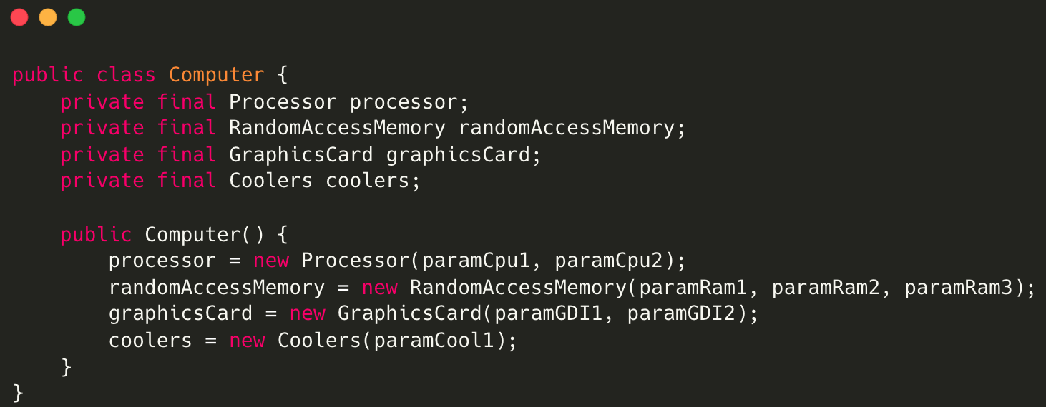
Let’s create a class using the traditional OOP programming approach
In traditional OOP programming, when an object (e.g., a Computer) is created, it also instantiates its dependent classes (e.g., Processor, RAM instances):

Slide 10
What could be the problems with this implementation?
Tight coupling Computer and its components:
We must know how to create every component and which parameters to use exactly in the constructor.
If I’d like to create a Computer with a different Processor, I have to create another class for the Computer.
How can I test my class? how can I inject mocks?
Poor polymorphism
Leads to implementation-based design.

Slide 11
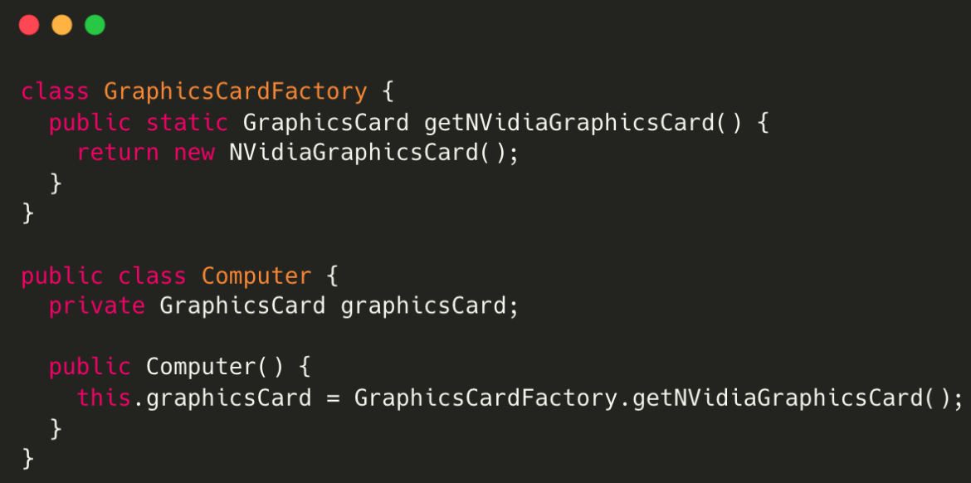
IoC with the Factory pattern
We have inverted the control of creating dependent classs objects to the Factory. However, the Computer class uses the concrete GraphicCardFactory class, so we have not achieved fully loosely coupled classes.

Slide 12
Dependency Injection
A design pattern used to manage dependencies between objects.
It allows an object to receive other objects that it depends on, rather than creating them itself.
This promotes a more modular, testable, and maintainable codebase.
Notes:
Note: Dependency injection is one of the SOLID object-oriented principles.

Slide 13
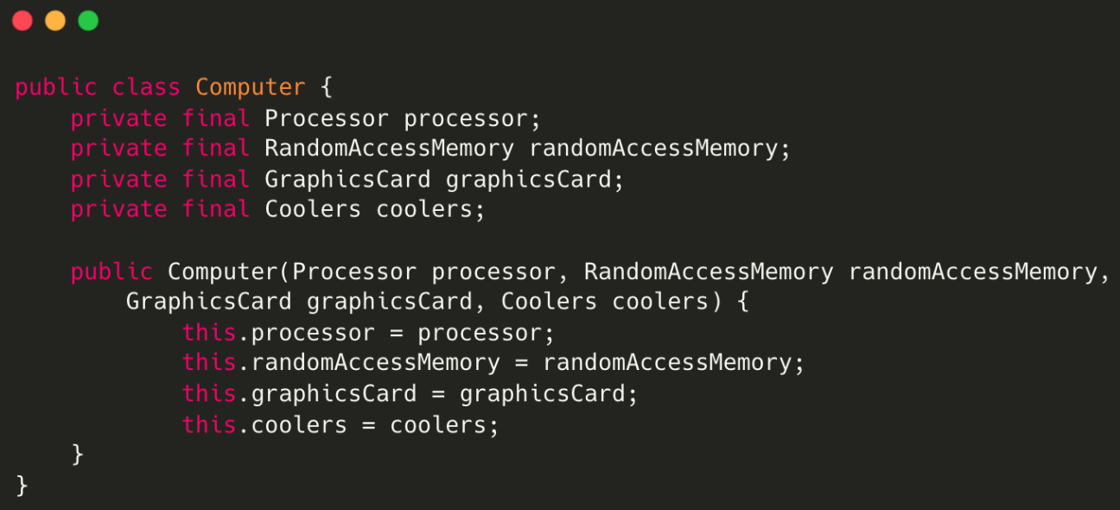
Dependency Injection
Instead of having the Computer object control its dependencies (instantiate them), let’s supply (inject) them for it!
By using DI, we can rewrite the example without specifying the implementations of the components we want.

