Slide 1

Practical Spring Boot For TDP
Idan Shalom, 2024

Slide 2

ABOUT ME
Tech Lead | 7 years at AT&T​
Experienced: C#, Node.js, Java, Go, Python, JavaScript
Interests
Music & Movies
Intermittent Fasting & Keto

Slide 3
HIGHLIGHTS
README BASED WORKSHOP
HANDS ON!
COVERS MOST OF THE BASIC & IMPORTANT TOPICS OF SPRING BOOT
BUILT INCREMENTALLY
EVERY TOPIC HAS A BRANCH
USE THE REPO AS A REFERENCE
SUPPORT GROUP

Slide 4
MOTIVATION

Slide 5
Spring Boot
Spring is an umbrella of projects, that aim to solve and ease common problems in day-to-day development of enterprise applications.
Spring Boot is a project that is built on top of the Spring Framework. It provides an easier and faster way to set up, configure, and run applications.
Spring Boot is based on the best practices and covers most of the use cases.

Slide 6
Spring Boot
Spring Boot is used for creating a stand-alone Spring-based application that you can just run because it needs minimal Spring configuration.
No need for web servlets, it has Tomcat inside;
Configurations are packed inside;
Just run, and you have a Server on air.

Slide 7
Inversion of Control (IoC)
Inversion of Control (IoC) is a design principle where the control of object creation and lifecycle management is transferred from the application code to a container or framework.

Slide 8
Purposes of IoC
To focus a module on the task it is designed for
To free modules from assumptions about how other systems do what they do, rely on contracts.
To decouple the execution of a task from its implementation
Greater modularity of a program
Greater ease in testing a program by isolating a component or mocking its dependencies

Slide 9
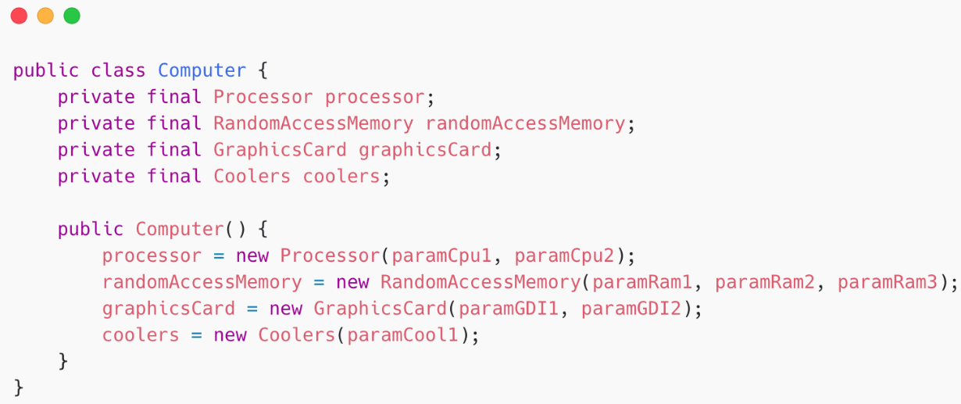
Let’s create a class using traditional OOP programming approach
In traditional OOP programming, upon creation of the object (e.g., Computer), it will also create (new) its dependent classes (e.g., Processor, RAM instances):

Slide 10
What could be the problems with this implementation
Tight coupling between the Computer and its components:
We must know how to create every component, and what parameters exactly should be used in the constructor.
If I want to create a computer with a new CPU, I should create another class for the Computer.
How will I test my class? how will I inject mocks there?
Poor polymorphism
Leads to implementation-based design.

Slide 11
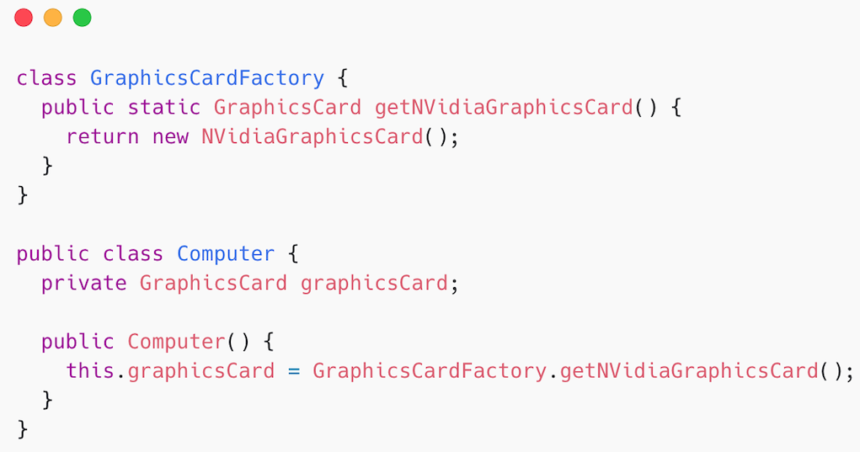
IoC with the Factory pattern
We have inverted the the control of creating an object of a dependent class to the Factory. However, the Computer class uses the concrete GraphicCardFactory class. So – we have not achieved fully loosely coupled classes.

Slide 12
Dependency Injection
A design pattern used to implement IoC. It allows the creation and binding of dependent objects outside of a class and provides those objects to the class through different ways. The injector class injects the service (dependency) to the client (dependent).
Notes:
Note: Dependency injection is one of the SOLID object-oriented principles.

Slide 13
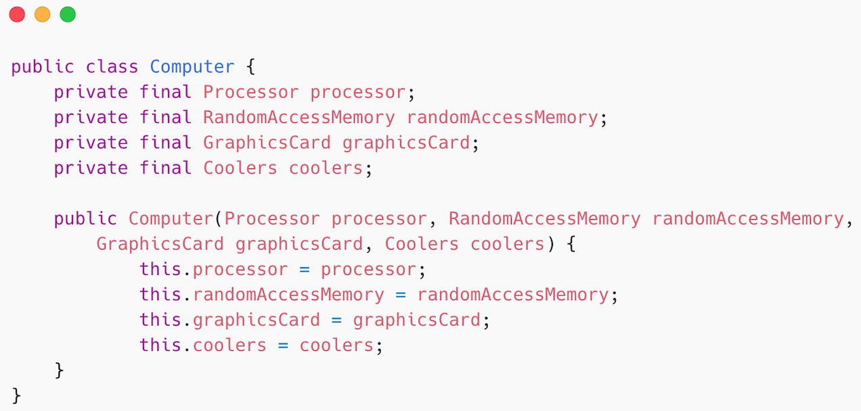
Dependency Injection
Instead of having the Computer object control its dependencies (instantiated them), let’s supply (inject) them for it!
By using DI, we can rewrite the example without specifying the implementation of the components that we want.

