Slide 1


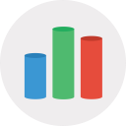

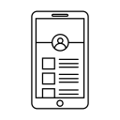

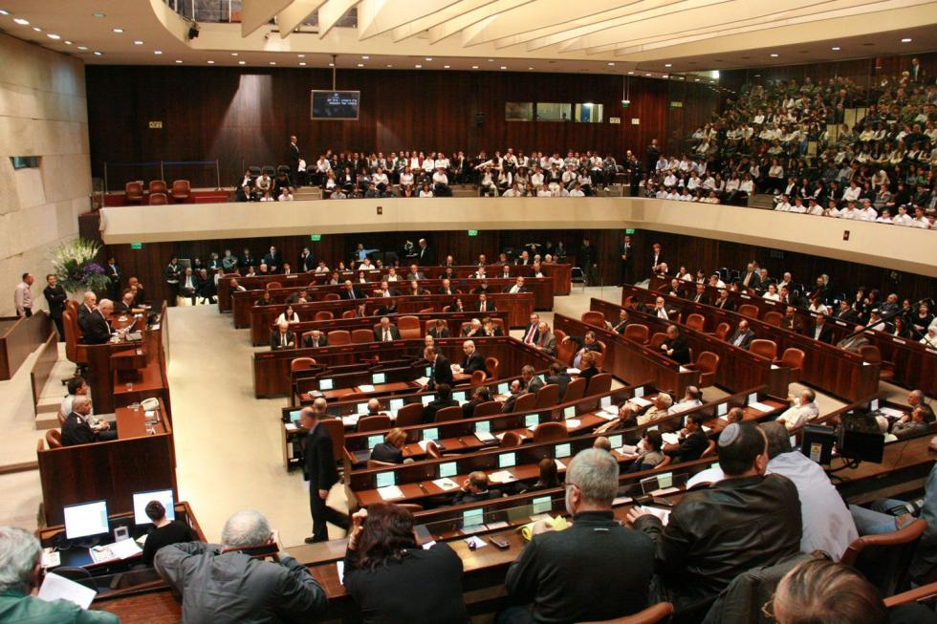

Heimdall
Political application for the average citizen

Slide 2
Political Androgyny
According to the Organisation for Economic Co-operation and Development (OECD):
Public engagement in the decision-making process is important for holding the government to account and maintaining confidence in public institutions. The formal process for public engagement in developing laws and regulations is one way to measure the extent to which people can become involved in government.
The average of public engagement is standing on 2.4 (on a scale 0 to 4).
Israel rate: 0.9!!! (62.5% lower the average)
22%

Slide 3
Political Androgyny
According to the Israel Democracy Institute:
The turnout in the 2015 elections was 72.3% of the eligible voters. Considering that half a million of those registered in the voter register do not live in Israel, the actual voter turnout is over 80%.
This figure is higher than the OECD average of 69%.“ Israel is above average in elections voters!!!
Conclusion – many of the Israeli people vote, but don't make the decision from knowledge or deep (and even shallow) politics research.
22%

Slide 4
Political Androgyny
So way the Israeli people are not willing to be more politically involved?
Well, the main reason is that the information is not easily accessible. Mostly it is written in high language on long documents, which requires people to invest time and effort in understanding the content. As we know people doesn’t like to work hard.
So how can we bring a summary of the information to the people, so it make politically involved easy and fun.
22%

Slide 5
Heimdall(Gatekeeper of Asgard)
Main Heimdall idea:
A user registers anonymously to Heimdall application (with Facebook or Gmail token) .
Marking the party to which he has voted and enter more details like age, current city and field of work.
Enjoy the app:
User notify about new laws that was voted in the Knesst
User notify about status changes in an existing laws.
User can see a law briefing.
User has the ability of get statistics about his votes, and general distribution such as different parties, ages, living areas, job fields, etc.
User as the ability to get percentage match data for parties according to his votes.
User can add a new law briefing.
User can mark a law as “like” or “dislike”.
It’s that simple!
22%

Slide 6
Heimdall(Gatekeeper of Asgard)
Main Heimdall purpose:
Make to average citizen more involved in the day-to-day laws.
Recommend for each user, which party he really support according the statistics.
Be the Gatekeeper of democracy!
22%

Slide 7
MUCH Politics! VERY Crowd!
We will use the power of the crowd in order to show the people how much each party represents it’s constituents. Since each user would vote for/against laws being passed, we will show statistics averaged across all users demonstrating how much each party’s law proposals and votes reflects/does not reflect the opinions of it’s constituents.
The document describing the law is long and hard to read, so the app would present the users with a summary of the laws. By default this summary is also scraped from the web, but we will add an option for users to offer their own summary, and rate other user’s summary. Highly rated summaries would be presented alongside the default summaries.
In terms of motivation to use the app, the current political climate in Israel is just right.
People feel that their government is not serving their interests, and what is more Israeli than the need to not let anyone fool you. Our app will show for each user how much the party he voted for serves his interests, and also show him the party which best serves it’s interests.
22%

Slide 8
Technical Information
Team Members:
Eilon Weinfeld
Idan Tavor
Inbar Moskovich
Ofer Handel
Ram Hillel
Students to Computer Science & Electrical Engineering
Politics Enthusiastic
22%

Slide 9
Work Plan
Division of labor and technologies:
Eilon Weinfeld + Idan Tavor:
Scraping the data from the Knesset website
Extracting relevant text from different file types using apache tika.
Set up a relational db – neo4j and Insert the data to it.
Inbar Moskovich:
Frontend using Firebase which is a mobile development platform by google.
Building application that communicate the backend, and manage the user anonymous log in, using android studio.
Ofer Handel + Ram Hillel:
Backend using Flask which is python framework that suits REST API.
The backend pass to and from the frontend Json requests and response.
Build db structure (“tables”)
22%

Slide 10
Work Plan
לעשות פה שרטוט יפה כזה כמו שעופר עשה לפרוייקט גמר.
טלפון אנדרויד- מדבר עם שרת- שמדבר עם מסד נתונים בצורת גרף- שמדבר עם סקרפר כזה.
להוסיף תמונות של כל הטכנולוגיות שמשתמשים בהם. אנדרויד. דג'נגו. פייתון. Neo4j
22%

Slide 11
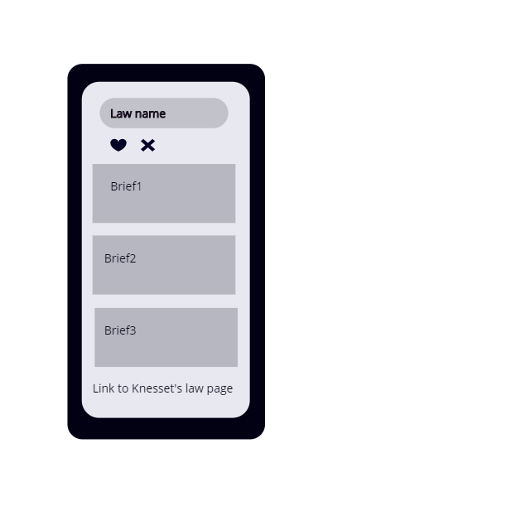
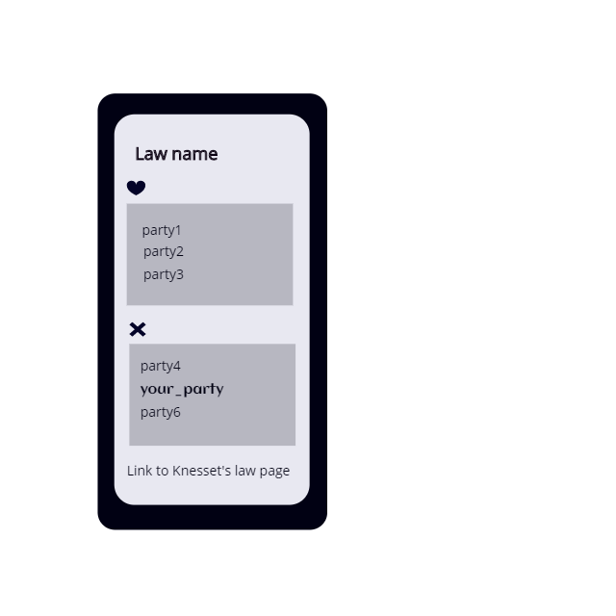
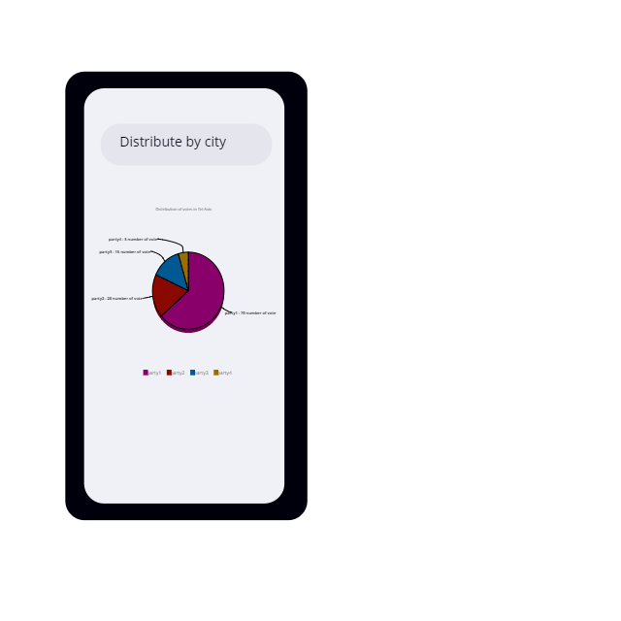
Heimdall Design
22%

Slide 12
Work Plan
Problems that you may encounter
Spam: only Facebook or Gmail users can sign-in, Facebook and Google is dealing with spammers.
Incentive: interest in the personal statistics and recommendations.
Sources of information: Scraping the Knesset web site.
Reliability: unfortunately we can't assure the user will not “make a mess” and write spam.
Indulgent assumption: we assume the user use the web as it should be used.
22%

Slide 13
"The ballot is stronger than the bullet" Abraham Lincoln

