Slide 1

Heimdall(Gatekeeper of Asgard)
Political application for the average citizen
“הדמוקרטיה היא הגנת האדם מפני ממשלת מדינתו”
ישעיהו לייבוביץ'

Slide 2
Team Members
Eilon Weinfeld
Idan Tavor
Inbar Moskovich
Ofer Handel
Ram Hillel
Computer Science & Electrical Engineering Students
Politics Enthusiastics

Slide 3
Motivation
According to the Organization for Economic Co-operation and Development (OECD):
“Public engagement in the decision-making process is important for holding the government to account and maintaining confidence in public institutions. The formal process for public engagement in developing laws and regulations is one way to measure the extent to which people can become involved in government.”
The average of public engagement is standing on 2.4 (on a scale 0 to 4).
Israel rate: 0.9!!! (62.5% lower the average)
Israel is 36/38 (!!)

Slide 4
Motivation
According to the Israel Democracy Institute:
The turnout on the 2015 elections was 72.3% of the eligible voters. Considering that half a million of those registered in the voter register do not live in Israel, the actual voter turnout is over 80%.
This figure is higher than the OECD average of 69%.“ Israel is above average in elections voters!!!
Conclusion – many of the Israeli people vote, but don't make the decision from knowledge or deep (or even shallow) politics research.

Slide 5
MUCH Politics! VERY Crowd. WOW.
Make the average citizen more involved in the day-to-day laws.
The law briefing is presented to the user – the average user is LAZY, need אמל"ק
A user registers anonymously to Heimdall application (with Facebook or Gmail token) .
Enjoy the app:
User will be notified about new laws that was voted in the Knesset
User will be able to see a law briefing.
User will get statistics about his votes, and general distribution such as different parties, ages, living areas, job fields, etc.
User will recommendations for parties according to his votes.
User can mark a law as “upvote” or “downvote”.
It’s that simple!

Slide 6






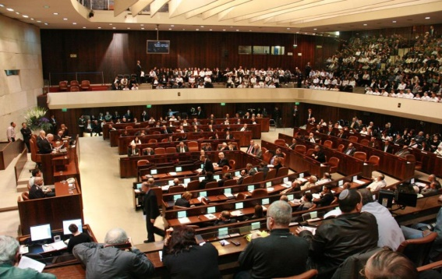



Why The Crowd Will Be Willing To Source??
People want to know, but the process is too frustrating (Worst UX award goes to → Knesset Site )
Anonymous Votes
Where do I stand in relation to others?

Slide 7
Main Heimdall Purpose…
Make to average citizen more involved in the day-to-day laws.
Recommend for each user, which party he really support according the statistics.
Be the Gatekeeper of democracy!

Slide 8
Pitfalls – “The average US citizen will cross the sea to protect democracy, but will not cross the road to vote in the elections”
Spam: only Facebook or Gmail users can sign-in, Facebook and Google is dealing with spammers.
Incentive: interest in the personal statistics and recommendations.
Sources of information: Scraping the Knesset web site.
Reliability: unfortunately we can't assure the user will not “make a mess” and write spam, and this is our Indulgent assumption

Slide 9
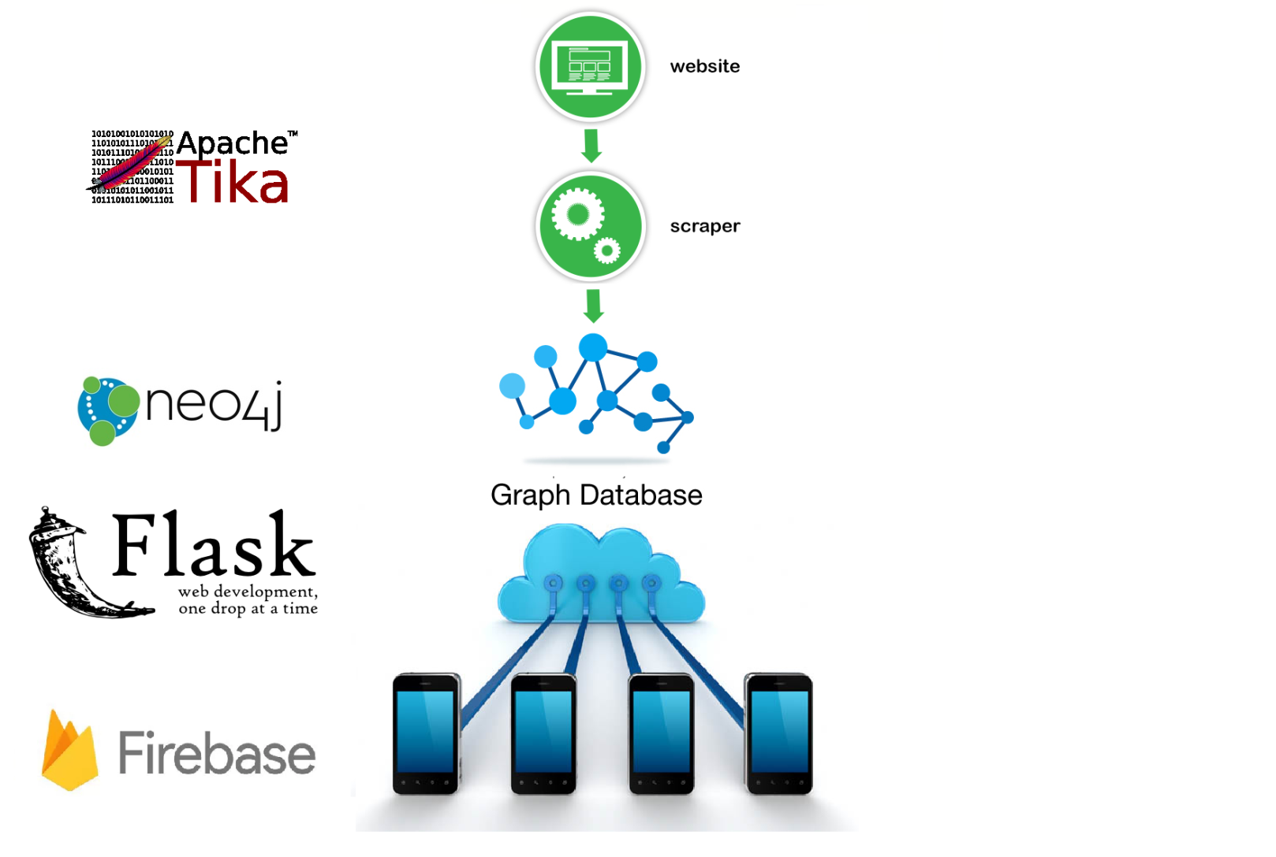


(Neo4J)
-[: UPVOTE ]->
(Cypher)

Slide 10
Division of labor and technologies:
Eilon Weinfeld + Idan Tavor:
Scraping the data from the Knesset website.
Extracting relevant text from different file types using Apache-Tika.
Set up a Graph Based DB – Neo4J and feed data to it.
Inbar Moskovich:
Frontend using Firebase - mobile development platform by Google.
Building an Andriod application which implements the user anonymous login, and the overall user experience.
Ofer Handel + Ram Hillel:
Backend using Flask - python framework REST API applications.
Build DB schema

Slide 11
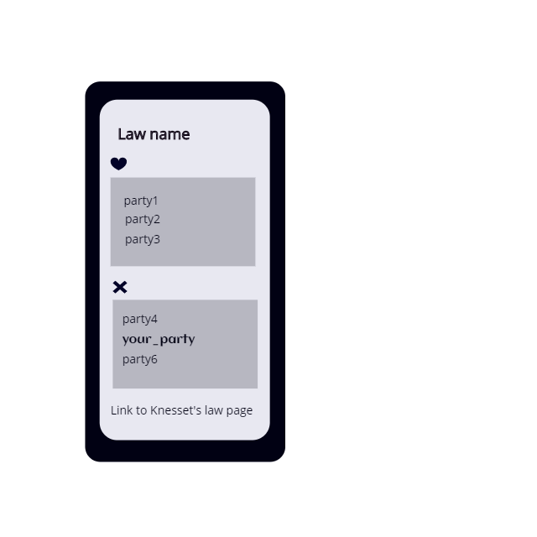
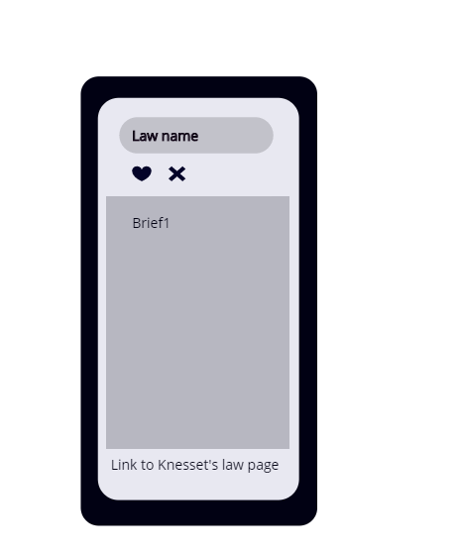
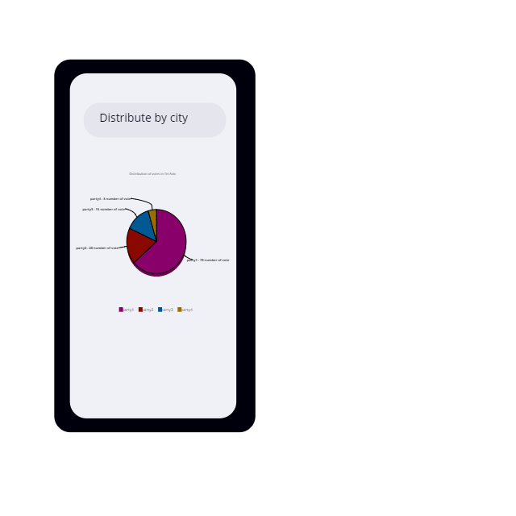
Application Views

Slide 12
"The ballot is stronger than the bullet" Abraham Lincoln

