Slide 1
Intelligent
Investor Platform
Live demo focus
• Calculate budget buckets
• Save/load profiles
• CI/CD green run
• Kubernetes self-healing
DevOps Capstone Project · Financial planning web app with production-style delivery
Docker · CI/CD · Testing · Kubernetes
Git workflow: feature → dev → stage → main
Code
Tests
Build
Compose
E2E
Docker Hub
K8s
Presented by Idan Veprinski
01
Notes:
Open with the project goal: a finance app built to demonstrate a complete DevOps lifecycle, not just UI features.

Slide 2
Project Goal
Intelligent Investor · DevOps Capstone
Turn an academic web app into a complete DevOps delivery system
PROBLEM
SOLUTION
A personal finance app is easy to demo locally, but harder to deliver reliably.
Manual setup creates “works on my machine” risk
Database state must persist across restarts
Tests must run automatically before delivery
Deployment should be reproducible
Salary
Input
4 Budget
Buckets
15-Year
Projection
Saved
Profiles
Definition of success
Application runs with one Docker Compose command
Unit, integration and browser E2E tests pass in CI
Docker image is published automatically
Kubernetes deployment demonstrates resilience
02
Notes:
Explain that the project was built as a DevOps project first: reproducibility, testing and delivery are graded heavily.

Slide 3
Application Features
Intelligent Investor · DevOps Capstone
A small finance product with enough behavior to test and deliver
Live Web Dashboard
Calculated Output
Fixed Costs 52.5%
Savings 10%
Investments 10%
Guilt-Free 27.5%
Profiles
Save current plan
Refresh list
Load profile after reload
Gross Salary: 10,000 ₪
Bank Net: optional override
Projection: 5 / 10 / 15 years
PROJECTION CHART
7% annual return assumption · monthly investment compounding
03
Notes:
Show the live app here: enter salary, calculate, save profile, refresh and load.

Slide 4
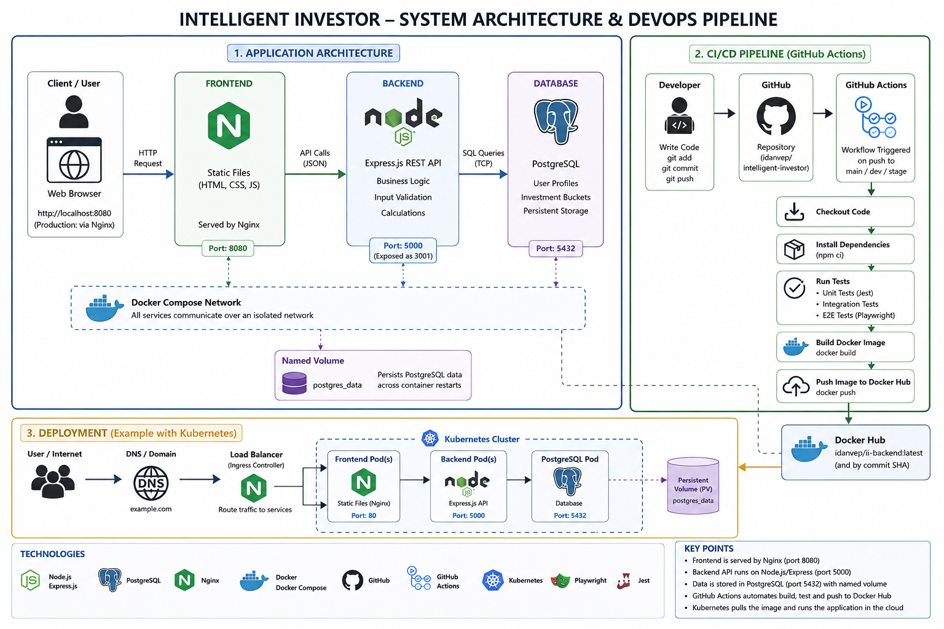
System Architecture
Intelligent Investor · DevOps Capstone
Application architecture, CI/CD pipeline and target Kubernetes view
Note: Kubernetes section is documented as the target deployment view; local kind implementation runs backend + PostgreSQL.
04
Notes:
Use this slide to explain the whole system before drilling into the layers. Mention Docker Compose is the local runtime and kind is the Kubernetes environment.

Slide 5
Backend API Design
Intelligent Investor · DevOps Capstone
Express routes stay thin; financial logic is tested separately
REST ENDPOINTS
SEPARATION OF CONCERNS
GET /health
App alive + DB connected
POST /calculate
Express
Routes
calculator.js
Pure functions
PostgreSQL
JSONB storage
Budget buckets + projection
POST /profiles
Save profile to PostgreSQL
GET /profiles
List saved profiles
GET /profiles/:id
Load a specific profile
Design choices
Input validation at API boundary
Financial math isolated for unit testing
Profiles and calculations persisted as JSONB
Health endpoint validates DB availability
05

Slide 6
Data & Persistence
Intelligent Investor · DevOps Capstone
PostgreSQL provides durable storage for calculations and profiles
TABLES
PERSISTENCE LAYERS
last_calculation
• id SERIAL PK
• result JSONB
• created_at
profiles
• id SERIAL PK
• profile_name
• years CHECK 1–15
• result JSONB
• created_at
Docker Compose
Named volume
db_data
Kubernetes
PVC
ii-postgres-pvc
Why JSONB?
PostgreSQL data survives container / pod restarts
The calculation result is a structured object containing the salary, bucket allocation and yearly projection. JSONB keeps the result self-contained while PostgreSQL still handles persistence, indexing options and backups.
06

Slide 7
Docker Compose Runtime
Intelligent Investor · DevOps Capstone
One command starts the full local environment
KEY FILES
docker-compose.yml
backend/Dockerfile
backend/.dockerignore
.env.example
db/init.sql
frontend
Nginx
:8080
backend
Node / Express
:3001 → :5000
db
PostgreSQL
:5432
Command
.env
POSTGRES_USER
POSTGRES_PASSWORD
POSTGRES_DB
docker compose up --build -d
07

Slide 8
Testing Strategy
Intelligent Investor · DevOps Capstone
Automated checks catch logic, API and browser-level failures
Unit tests
Pure financial math: net estimate, buckets and projection
COMMANDS
cd backend && npm test
npm run test:e2e
GitHub Actions runs all checks automatically
Unit
calculator.js
Integration tests
/health, /calculate and /profiles with mocked DB
Integration
Supertest API tests
QUALITY GATE
Docker image is pushed only after the complete automated test suite passes.
E2E tests
Real browser calculates, saves, refreshes and reloads a profile
E2E
Playwright browser test
08

Slide 9
CI/CD Pipeline
Intelligent Investor · DevOps Capstone
GitHub Actions turns a push into a verified Docker image
Push
Install
Test
Compose
E2E
Build
Deliver
feature / dev / stage / main
backend + E2E dependencies
unit + integration
start full stack + health check
Playwright browser test
backend Docker image
push latest + SHA to Docker Hub
SECURE CONFIGURATION
DELIVERY ARTIFACT
Docker Hub credentials stored as GitHub repository secrets
.env is ignored; .env.example documents required variables
Pipeline creates temporary .env for CI Compose run
idanvep/ii-backend:latest
idanvep/ii-backend:<commit-sha>
The pipeline performs Continuous Delivery to Docker Hub. Cloud deployment is a future extension.
09

Slide 10
Git Workflow
Intelligent Investor · DevOps Capstone
Every feature moves through the same controlled path
Examples of feature branches used
Why this matters
feature/github-actions
feature/frontend-dashboard
feature/profiles
feature/kubernetes
feature/e2e-testing
feature/environment-config
Each feature can be validated independently
Git history clearly shows the project evolution
Broken changes are stopped before main
The same CI gate runs on every branch
feature/*
Small isolated changes
dev
Integration branch
stage
Pre-release validation
main
Stable branch
Docker Hub
latest + SHA
10

Slide 11
Kubernetes on kind
Intelligent Investor · DevOps Capstone
Local cluster used to demonstrate orchestration behavior
kind cluster: intelligent-investor
ConfigMap
DB host, port, name, user
Backend Deployment
3 replicas
readiness + liveness
Control Plane
API server + scheduler
PostgreSQL
1 replica
PVC storage
Secret
DB_PASSWORD
DEMONSTRATED OPERATIONS
Self-healing: delete a Pod, Kubernetes restores 3 replicas
Scaling: scale backend from 3 to 5 and back
Rolling update: replace image gradually
Rollback: recover after ImagePullBackOff
PVC
ii-postgres-pvc
11

Slide 12
Demo Plan & Takeaways
Intelligent Investor · DevOps Capstone
Recommended 15-minute presentation flow
1
Open app
Calculate with 10,000 salary
PROJECT RESULT
A complete DevOps lifecycle around a working application
2
Profiles
Save, refresh, reload
Reproducible local runtime
Automated quality gates
Published backend image
Kubernetes orchestration proof
Clear Git history and documentation
3
Docker
Show compose services
4
CI/CD
Show green Actions + Docker Hub
5
Kubernetes
Pods, self-healing, rollback
FUTURE IMPROVEMENTS
Cloud Run / GKE deployment · authentication · monitoring dashboards · API gateway · database migrations
12
Notes:
Close by being honest: CI delivers to Docker Hub and Kubernetes is local kind. Cloud deployment is a clear next step, not part of the current implementation.

