Slide 1
Localisation using inertial sensors and wireless networks
Supervisor:
Dr Mark Johnson
Peter Anderson
CSIRO summer intern
February 2012

Slide 2
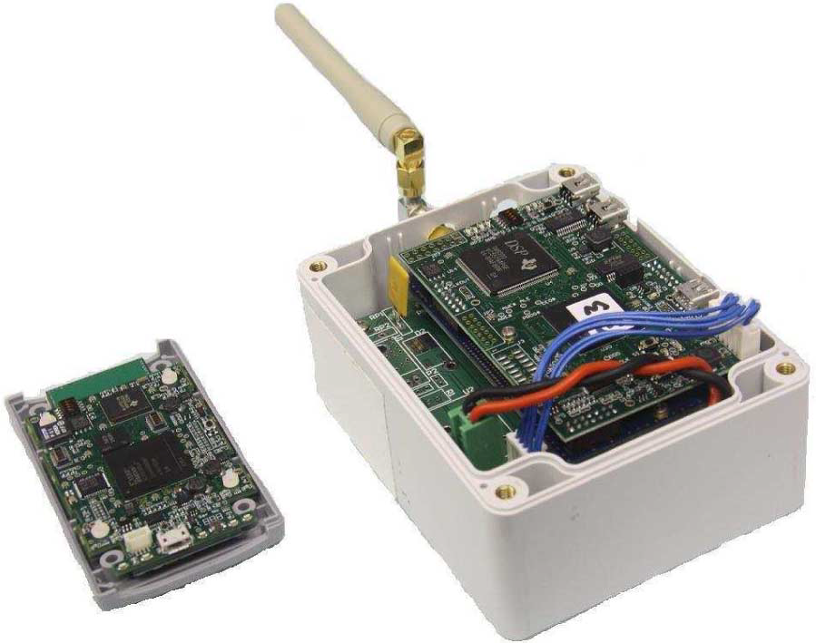

Background
CSIRO has developed WASP (Wireless Ad-hoc System for Positioning)
High accuracy time of arrival (TOA) based wireless ranging
Provides position updates of mobile nodes using surveyed stationary nodes
Works outdoors, indoors and underground
Applications include athlete tracking, mining & emergency services

Slide 3
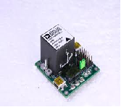
Problem
Devise an algorithm to integrate data from an Inertial Measurement Unit (IMU) with position observations from WASP.
Analog Devices ADIS16405 IMU includes:
3-axis accelerometer (measures acceleration)
3-axis gyroscope (measures rate of turn)
3-axis magnetometer (electronic compass)
Complementary nature of WASP and IMU:
WASP positioning is stable in the long term but does not capture orientation or short term dynamics
IMU’s capture short term dynamics but suffer from medium and long-term drift

Slide 4
Importance of WASP / IMU integration
 | WASP | WASP + inertial measurement unit
Characteristics:
Update rate | ~ 10 Hz | 820 Hz
Accuracy | ~ 0.2 m | Potential improvement
Signal loss | Uncertainty grows rapidly | 5 - 10 seconds of stable positioning
Outputs:
Position | Yes | Yes
Velocity | No | Yes
Acceleration | No | Yes
Orientation | No | Yes

Slide 5
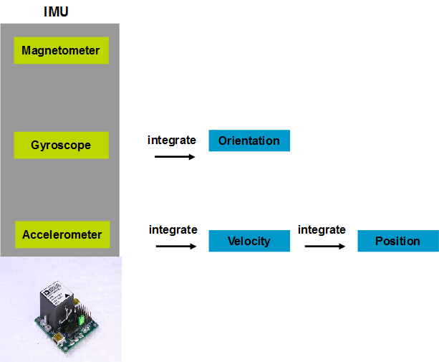
The challenge

Slide 6
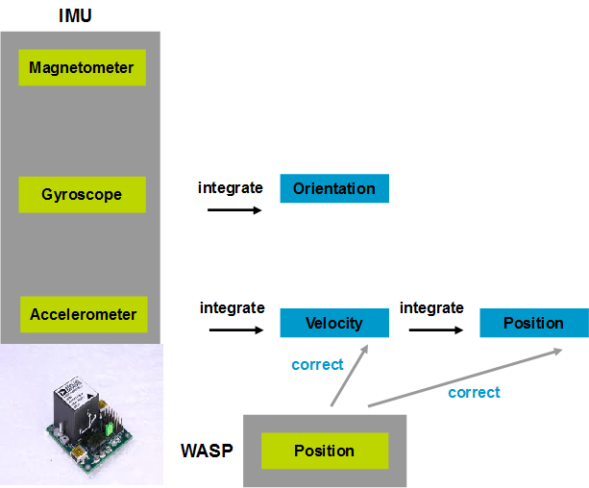
The challenge

Slide 7
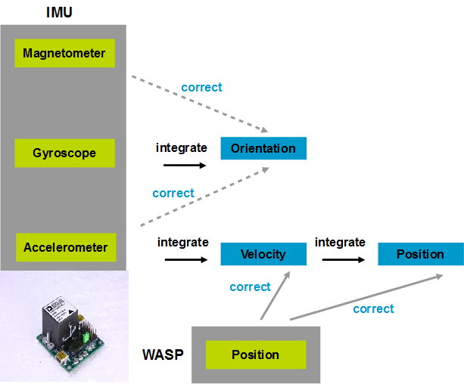
The challenge

Slide 8
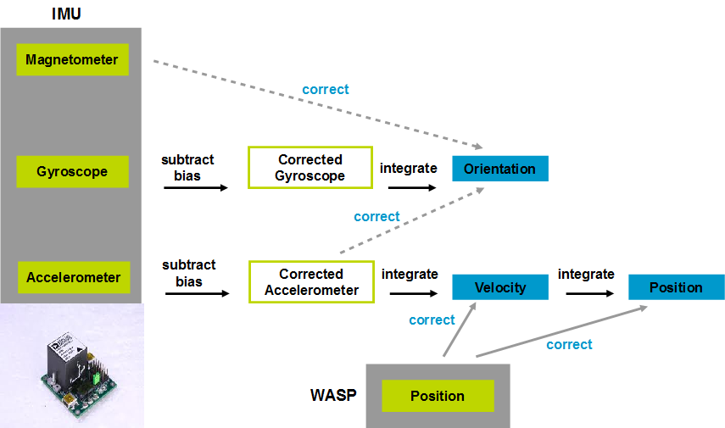
The challenge

Slide 9
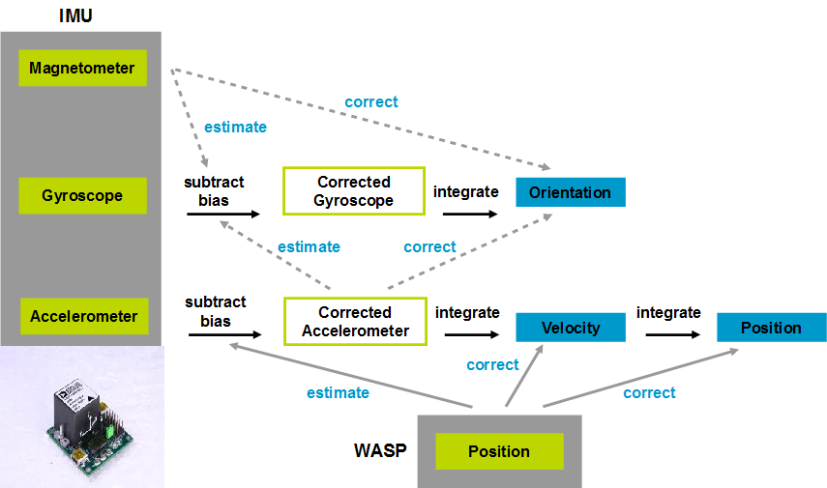
The challenge

Slide 10
Approach
“Dual” because it estimates both the state (navigation errors) and parameters (sensor biases) of the system
Use a dual indirect Kalman filter
velocity error
position error
orientation error
gyro bias
accelerometer bias
Output
820Hz
acceleration
velocity
position
orientation
-
Navigation Equations
IMU
+
+
gravity north
x
“Indirect” because it tracks errors in position, velocity and acceleration, not the actual quantities
10Hz
-
+
gravity error
north error
Kalman Filter
+
+
WASP
+
position
-
position error
Kalman Filter: An optimal algorithm for tracking the state of a system from noisy observations

Slide 11
Preliminary results
2 minute outdoor person tracking:
IMU track overlaps with WASP
Now with velocity, acceleration & orientation outputs as well
40
20
x
y
Acc ms-2
0
z
-20
-40
0
20
40
60
80
100
120
140
time in secs
4
x
2
y
Vel ms-1
z
0
-2
-4
0
20
40
60
80
100
120
140
time in secs
10
x
0
y
-10
z
Position m
-20
-30
-40
0
20
40
60
80
100
120
140
time in secs
200
R
100
P
Roll Pitch Yaw deg
Y
0
-100
-200
0
20
40
60
80
100
120
140
time in secs

Slide 12
Preliminary results
Zooming in on a section of track:
The much greater update rate of the IMU can be seen
Plotting the orientation shows that it is generally performing ok

Slide 13
Progress Summary
 | WASP | WASP + inertial measurement unit
Characteristics:
Update rate | ~ 10 Hz | 820 Hz
Accuracy | ~ 0.2 m | Potential improvement
Signal loss | Uncertainty grows rapidly | 5 - 10 seconds of stable positioning
Outputs:
Position | Yes | Yes
Velocity | No | Yes
Acceleration | No | Yes
Orientation | No | Yes

Slide 14


Thank you
ICT / Wireless & Networking
Peter Anderson
Summer Intern
Phone: 02 9372 4429
Email: p.anderson@csiro.au
Acknowledgments
I would like to acknowledge the support and encouragement of my supervisors Mark Johnson and Thuraiappah Sathyan.
Contact Us
Phone: 1300 363 400 or +61 3 9545 2176
Email: enquiries@csiro.au Web: www.csiro.au

Slide 15


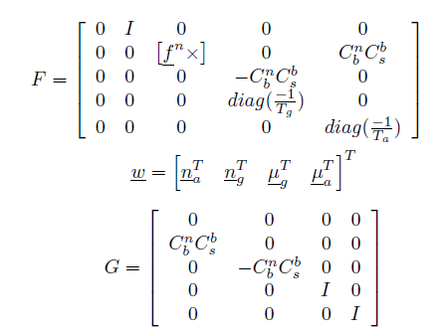
Kalman filter process model

Slide 16


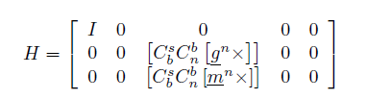
Kalman filter measurement model

