Slide 1



financial_sample
View in Power BI
Last data refresh:
24/10/2023 13:10:41 UTC
Downloaded at:
24/10/2023 13:12:00 UTC

Slide 2
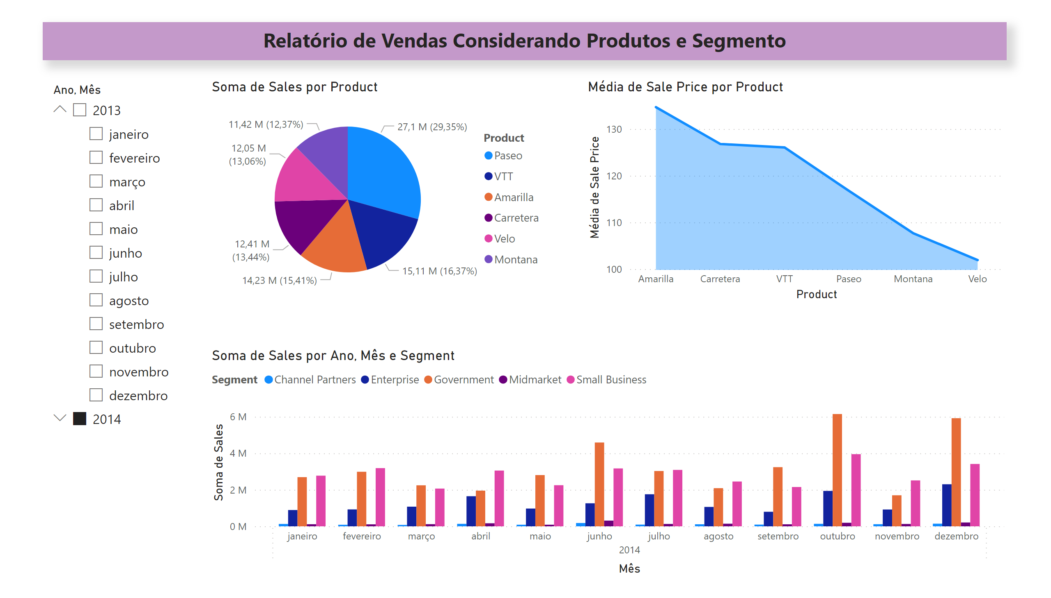
Página 1
Notes:
textbox
No alt text provided
slicer
No alt text provided
pieChart
No alt text provided
stackedAreaChart
No alt text provided
clusteredColumnChart
No alt text provided

Slide 3
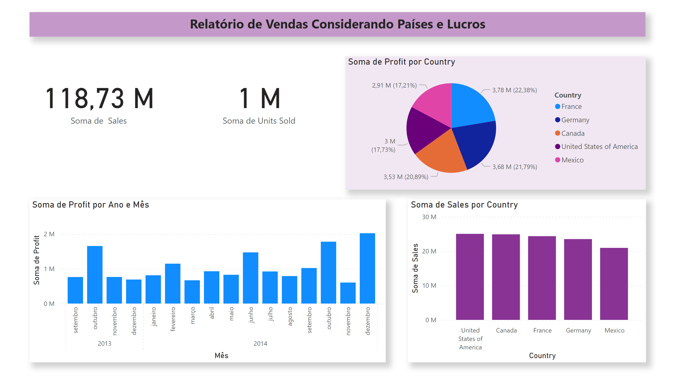
Página 2
Notes:
textbox
No alt text provided
card
No alt text provided
card
No alt text provided
pieChart
No alt text provided
clusteredColumnChart
No alt text provided
clusteredColumnChart
No alt text provided

Slide 4
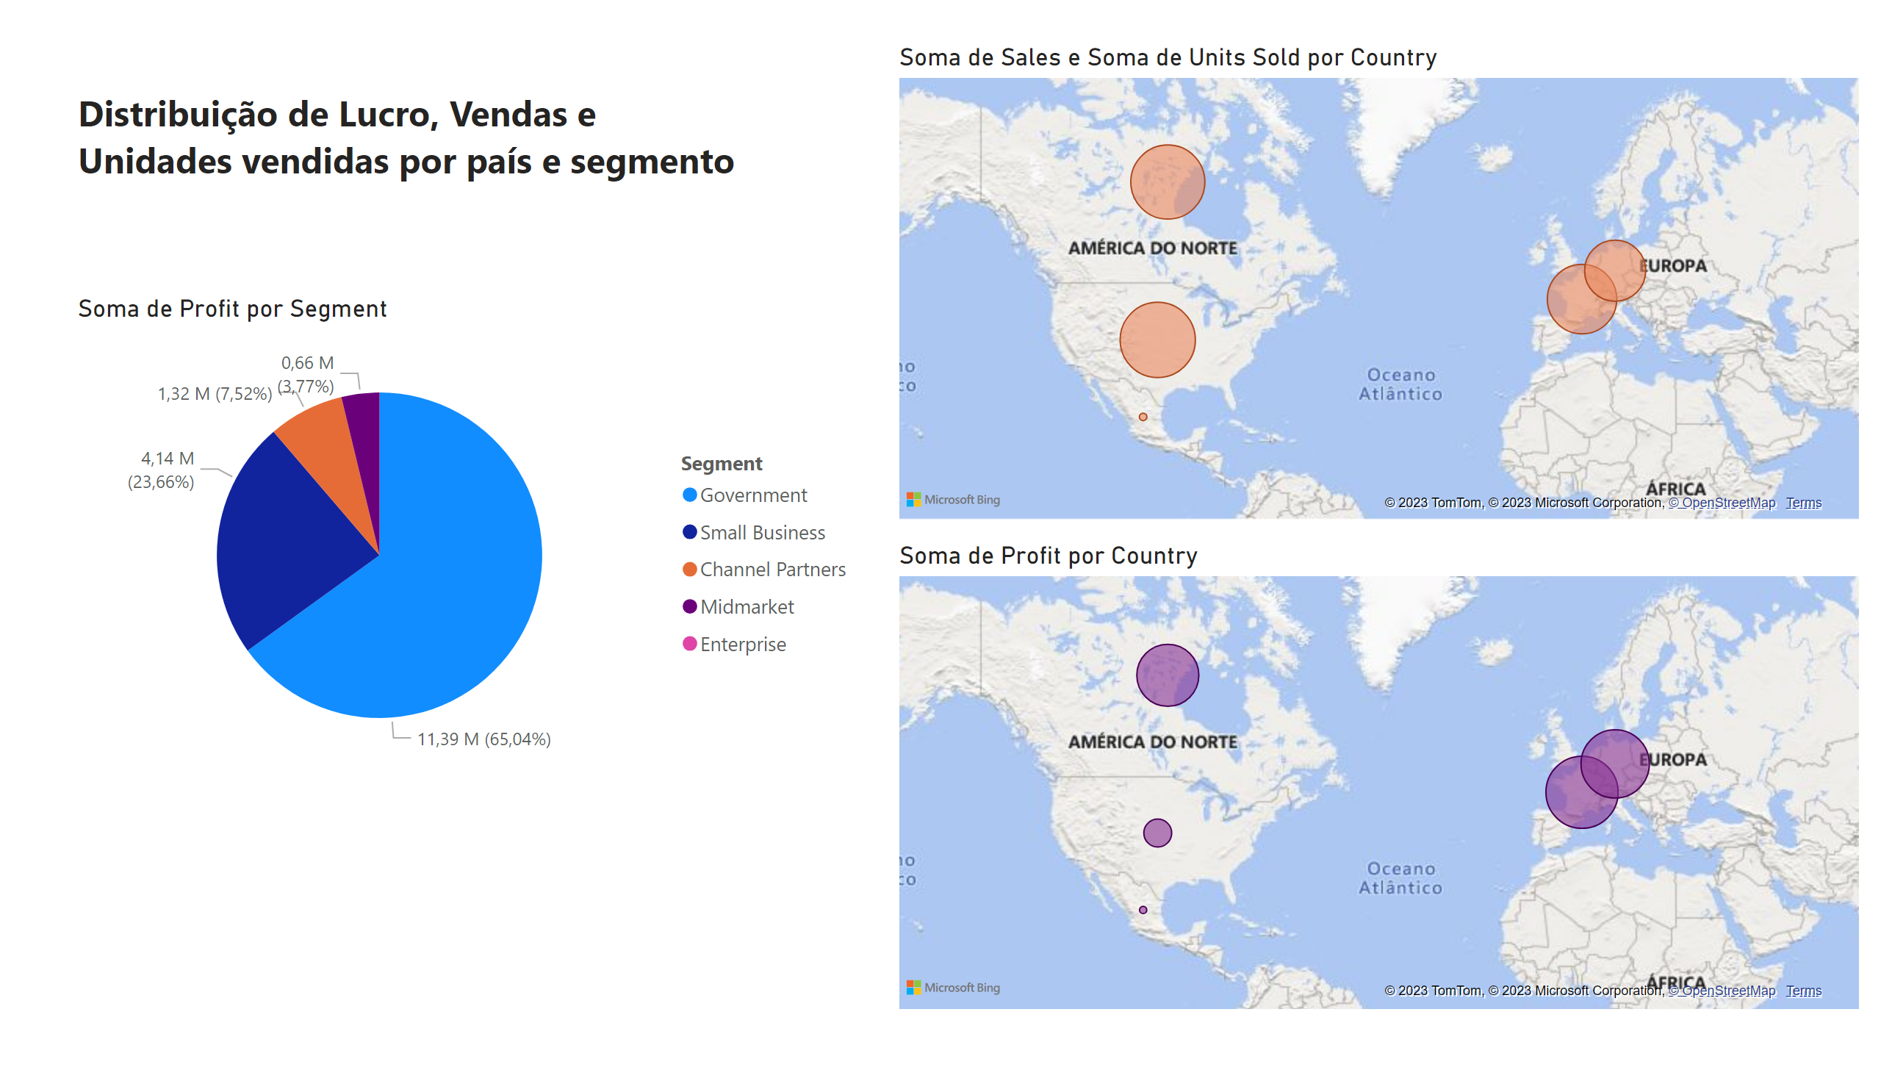
Página 3
Notes:
textbox
No alt text provided
map
No alt text provided
map
No alt text provided
pieChart
No alt text provided

