Slide 1
Exam in
Statistics and Machine Learning 1:
Statistical Foundations
Case: Credit Card Fraud
15.01.2018
By Ida Johanne Austad

Slide 2
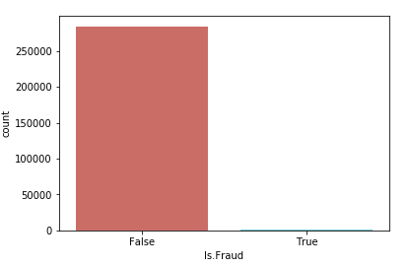
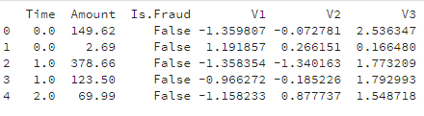
Data Description & Quality
Assessment
Count class
Origin
Collected and analysed during a research collaboration between Worldline and the Machine Learning Group of Université Libre de Bruxelles.
Transactions made by credit cards in September 2013 by europeans - over the course of two days.
492 frauds out of 284,807 transactions.
Quality assessment
Used by a trustworthy research project and institution.
Limited timeframe, only europeans.
“Unknown” variables .
No missing data.
Conclusion: Professor Spiegelhalter’s Star rating: 3 stars.
Features
Is.Fraud - the (categorical) response variable
True in case of fraud.
False otherwise.
Time Seconds elapsed since the first transaction in the dataset.
Amount Transaction size.
V1-28 “Unknown” numerical variables
PCA Transformed and thus independant.
1

Slide 3
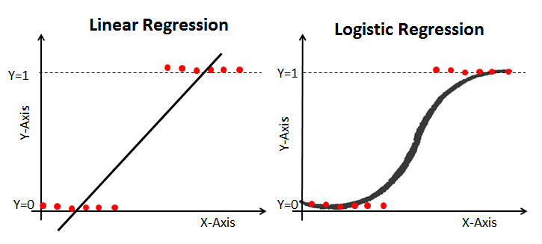
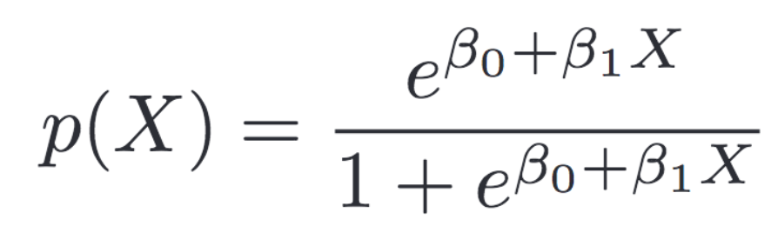
Credit Card Fraud Detection:
A Classification Problem
Goal Predict whether a transaction is fraudulent or not
The problem is a classification problem because our dependant variable is categorical (binary)
→ Build a Logistic Regression model
Assumptions made by Logistic Regression
The dependent variable must be categorical.
The variables should be independent
Uses Maximum Likelihood Estimation to estimate the coefficients
Figure 1
Figure 1: https://www.datacamp.com/community/tutorials/understanding-logistic-regression-python
2

Slide 4
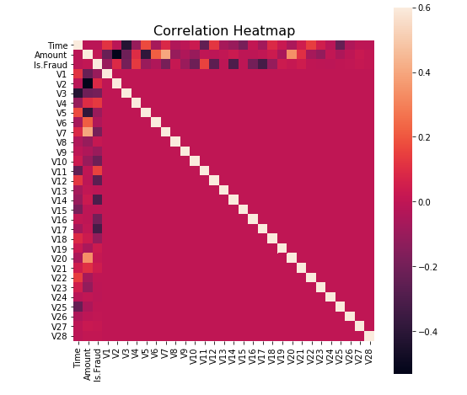
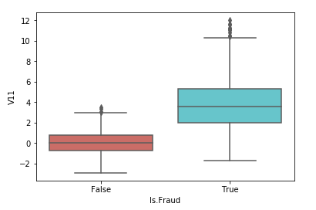
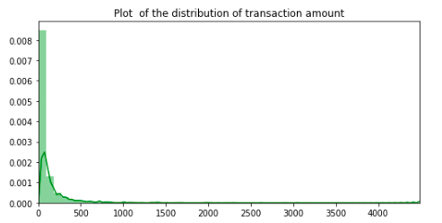
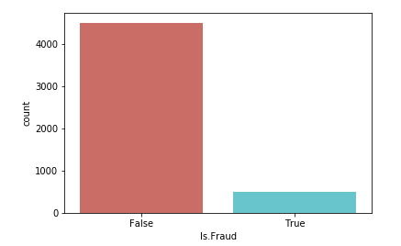
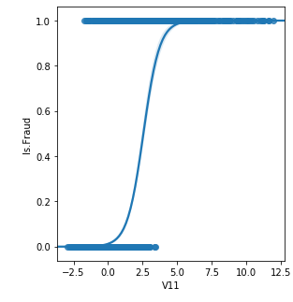
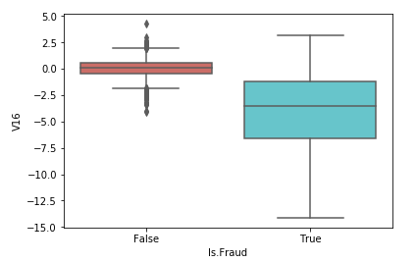
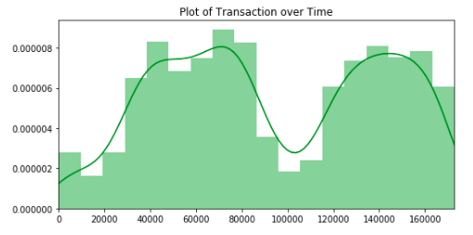
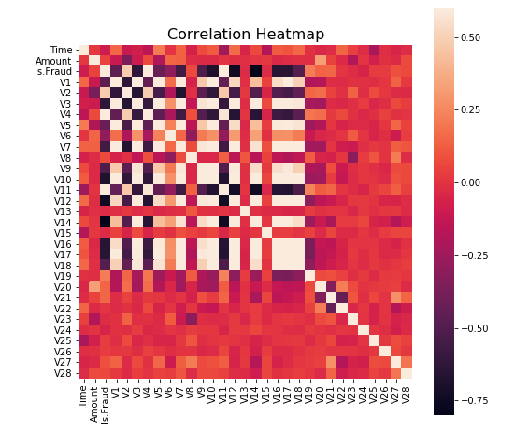
Exploratory Data Analysis
Full dataset
Box plot: V11 + Is.Fraud
Count class
Regression model
Box plot: V16 + Is.Fraud
Sub-dataset 3
Provided sub-datasets
Not fraud: 90.16 % of the dataset Fraud: 9.84 % of the dataset
Original
Not fraud: 99.83 % of the dataset Fraud: 0.17 % of the dataset
Null values
None
3

Slide 5
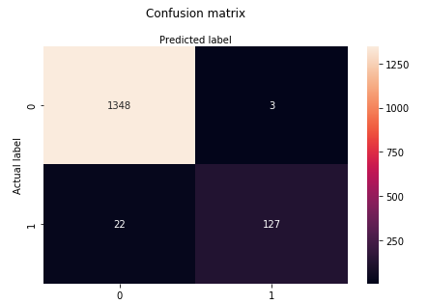
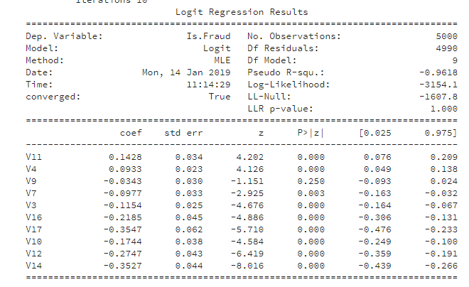
Model 1: Using provided subsample
With feature selection based in correlation & using sub-sample 3
There is 10 values which are notably correlated with Is.Fraud: V11 0.667525 V4 0.642631 V9 -0.505866 V7 -0.555423 V3 -0.629008 V16 -0.650788 V17 -0.655985 V10 -0.684346 V12 -0.736712 V14 -0.794821
(sub-dataset 3)
#split the data into test and train sets
X_train, X_test, y_train, y_test = train_test_split(X,y,
test_size = 0.3, random_state = 0)
Transactions train dataset: 3500 Transactions test dataset: 1500 Total transactions: 5000
#fit model and test
logreg = LogisticRegression()
logreg.fit(X_train, y_train)
y_pred = logreg.predict(X_test)
logit = sm.Logit(df_selected3['Is.Fraud'],df_selected3[train_cols])
result = logit.fit()
print(result.summary())
array([[ 0.39727837, 0.95886159, -0.13039493, -0.16831292, -0.2842786 , -0.98797702, -1.00909374, -0.92577482, -0.96267919, -1.2210314 ]])
logreg.predict_proba(X.iloc[[4512]].values)
[[0.00182076 0.99817924]]
Results
Accuracy: 0.98
precision recall f1-score support False 0.98 1.00 0.99 1351 True 0.98 0.85 0.91 149 avg / total 0.98 0.98 0.98 1500
logreg.coef_
array([[ 0.39727837, 0.95886159, -0.13039493, -0.16831292, -0.2842786, -0.98797702, -1.00909374, -0.92577482, -0.96267919, -1.2210314 ]])
logreg.predict_proba(X.iloc[[1]].values)
array([[0.99136495, 0.00863505]])
4

Slide 6
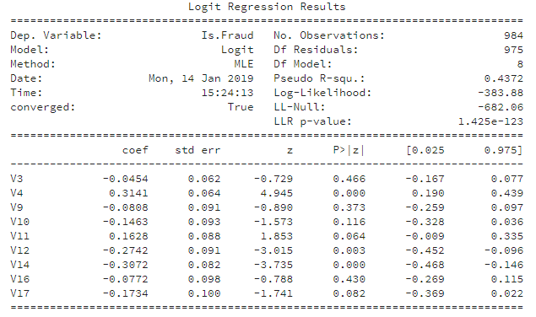
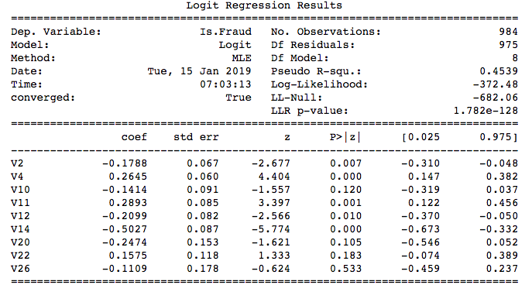
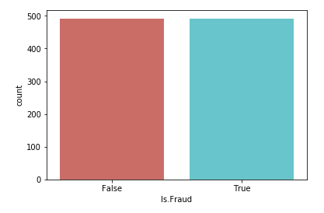
Models Using Undersampling & Feature Selection
Model 2: with Undersampling
Imbalanced dataset affects the model we build.
How to handle imbalanced datasets:
Choose metrics wisely
Resample data
Undersample to balance the classes by randomly selecting observations from the majority class up to the point where the classes are balanced.
fraud_class = under_sample_data['Is.Fraud'].value_counts()
print(fraud_class)
True 492 False 492
Model 3: with Undersampling and Feature Selection
Recursive Feature Elimination (rfe from SciKit Learn)
Accuracy: 0.92
precision recall f1-score support False 0.89 0.95 0.92 138 True 0.95 0.90 0.93 158 avg / total 0.92 0.92 0.92 296
Accuracy: 0.94
precision recall f1-score support False 0.93 0.95 0.94 148 True 0.95 0.93 0.94 148 avg / total 0.94 0.94 0.94 296
5

Slide 7
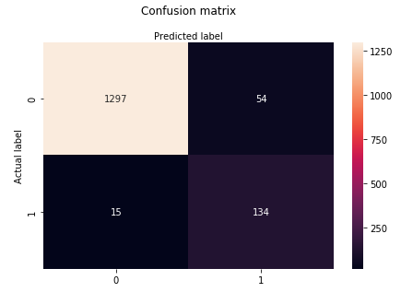
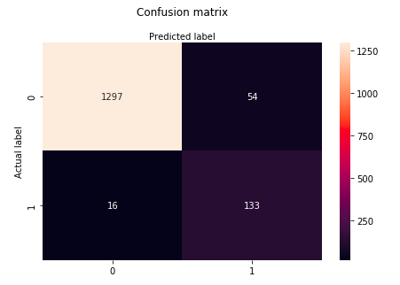
Comparison of our models
 | Model 1 | Model 2 | Model 3
Feature selection | Based on correlation | Based on correlation | Recursive Feature Elimination
Model training set | Subsample 3 | Undersampled version of subsample 3 | Undersampled version of subsample 3
Selected features | 'V3', 'V4', V7, 'V9', 'V10', 'V11', 'V12', 'V14', 'V16', 'V17' | 'V3', 'V4','V9', 'V10', 'V11', 'V12', 'V14', 'V16', 'V17' | 'V2', 'V4', 'V10', 'V11', 'V12', 'V14', 'V20', 'V22', 'V26'
Test results using subsample 3 | Accuracy: 0.98 | Accuracy: 0.95 | Accuracy: 0.95
6

