Slide 1

Design of a Dual Automatic Door Control System with Optocoupler Isolation and Docking Charging Mechanism Based on Arduino Mega and ESP32
NAME
NIM
ADVISOR
: YANUARDI
: 221344031
:Ir. Hertog Nugroho, M.Sc., Ph.D.
D4 TELECOMMUNICATIONS ENGINEERING ELECTRICAL ENGINEERING DEPARTMENTBANDUNG STATE POLYTECHNIC
2025

Slide 2

Background & Objectives
Automation Requirements: Drone stations require precise and secure moving –
doors.Security Issues: Noise from high-torque motors risks damaging
microcontrollers.IoT Integration: Wireless monitoring without delay is
required.Charging: The charging mechanism must be automatic and secure (interlock).
BackGround

Slide 3
Background & Objectives
Synchronization: Adjusts two stepper motors with 2.
precision timing.Charging: Automatic charging
mechanism with interlock.Protection: Optocoupler
isolation & limit switch for safety.IoT Monitor: ESP32 web server for real-time control.
Objectives

Slide 4

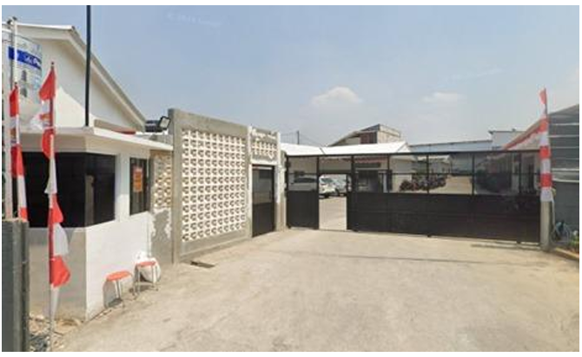

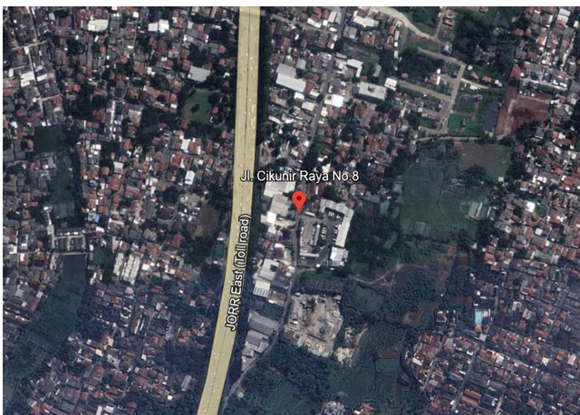
Time and Place of Implementation
This internship will be held on:
Date: July 1, 2025 to January 2, 2026
Time: 8:00 a.m. to 5:30 p.m. WIB (Western Indonesian Time)
Location: PT. Solusi Intek Indonesia
At Workshop 08 Cikunir, located at Cikunir Raya No. 8, RT.004/RW.011, Jatimekar, Jatiasih District, Bekasi City, West Java 17422.
Company Location

Slide 5
THEORETICAL BASIS & IMPLEMENTATION

Slide 6
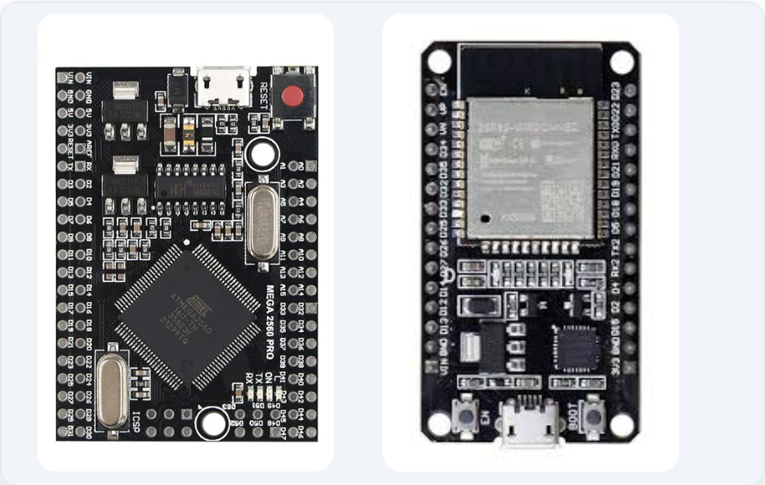
Theoretical Basis: Controller
Arduino Mega 2560
Main control unit. Selected for its 54 I/O pins and 4 UART hardware. Handles motor and sensor logic.2.
2.ESP32
WiFi communication module. Functions as a standalone web server that sends commands to Mega via Serial.

Slide 7
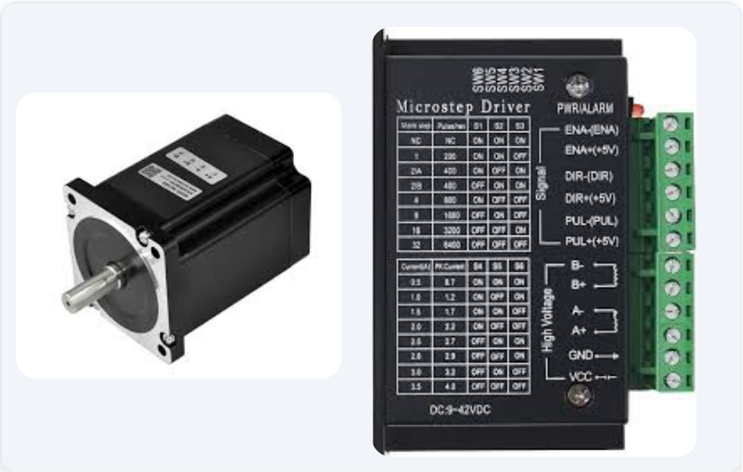
Theoretical Basis: Actuator
HUIYINN Stepper MotorStrong
holding torque to support door loads. Precise movement per step (1.8 degrees).
2. B6600 DriverMotor
current amplifier (up to 4A) with Microstepping feature for extremely smooth movement.

Slide 8
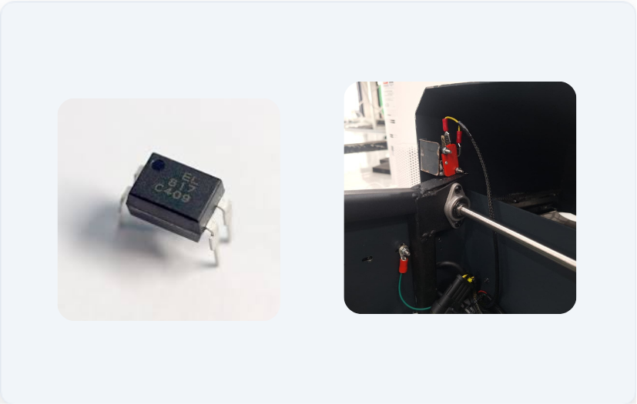
Theoretical Basis: Protection
PC817 OptocouplerIsolates the Arduino's 5V signal from the motor's 30V voltage using light. Prevents damage caused by Back-EMF.
Limit SwitchMechanical limit sensor (NO) to detect the end position of the door and stop the motor automatically.

Slide 9
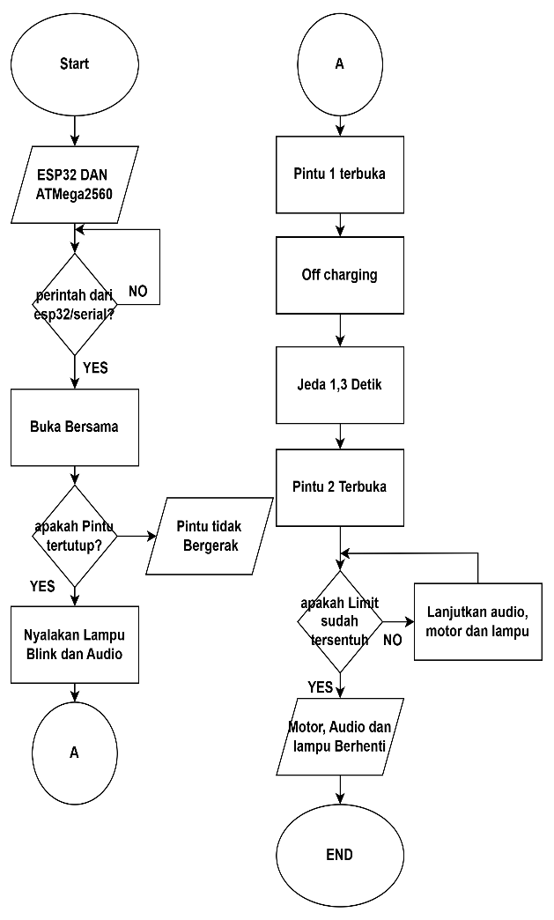
Control Logic
Non-Blocking (millis)
Enables multitasking: the motor moves while reading sensors without a ‘delay()’ pause.
2. Async Web Server
The ESPAsyncWebServer library handles HTTP requests in the background without blocking the system.

Slide 10
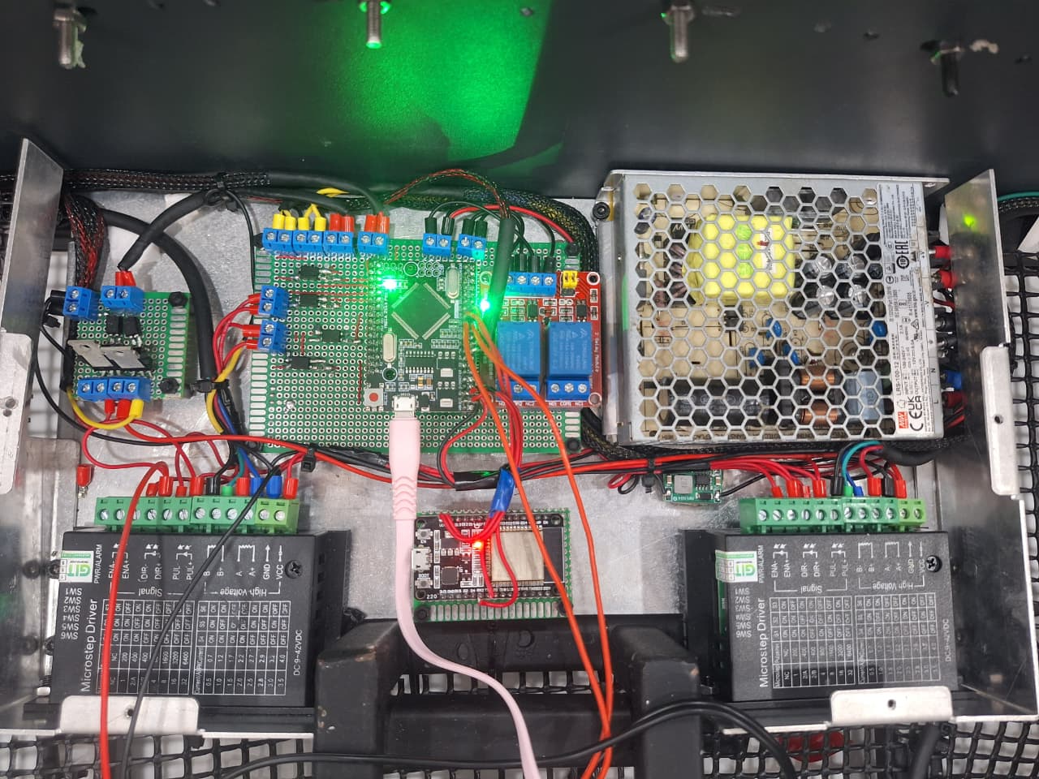
Hardware Assembly
Preparation: Prepare Mega, ESP32, TB6600 Driver, and 30V Power Supply.
PCB Prototype: Solder the Optocoupler and terminal block for a sturdy signal path.
Wiring: Connect the Serial2 (Mega) communication path to Serial2 (ESP32).

Slide 11
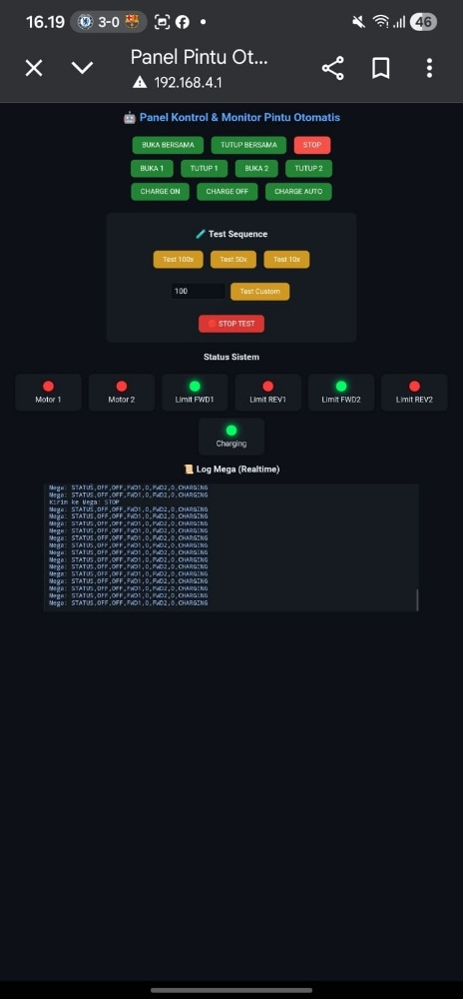
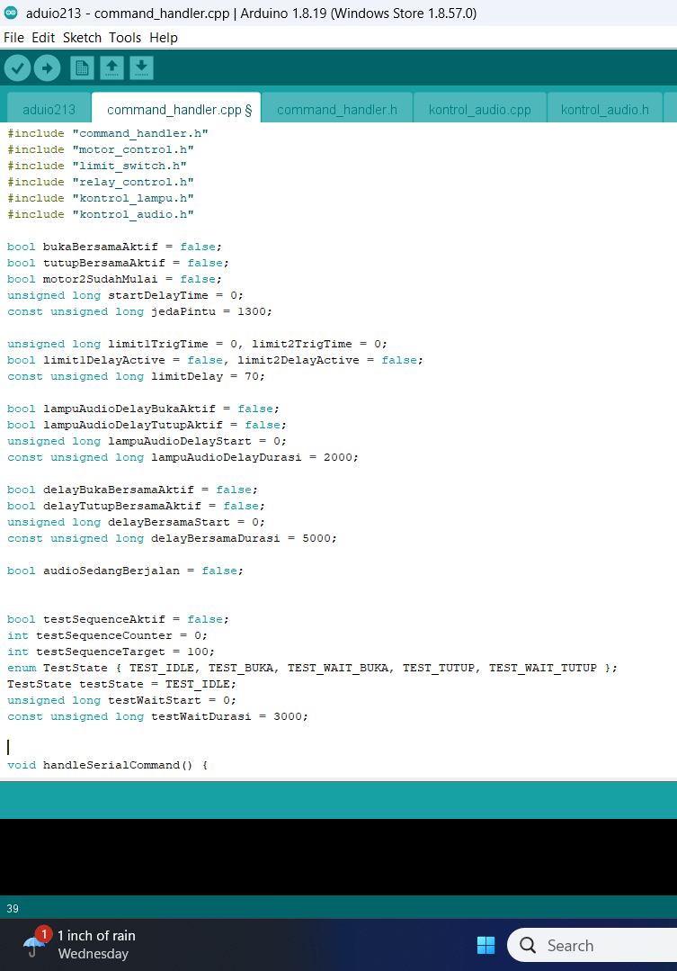
Pemrogramming & UI
Mega Firmware: Motor logic and sensor interlock program with millis().
ESP32 Web: Creating an HTML/CSS/JS interface stored in program memory.
Serial Data: Protocol for sending real-time status from Mega to Web.

Slide 12
TESTING & ANALYSIS

Slide 13
Methodology & Testing
1.
Partial Testing: Motor, Limit Switch, Insulation
2.
Communication Test: UART ESP32 – ATMega2560
3.
Functional Testing: Synchronization & Charging
4.
IoT Test: Web Server Latency.

Slide 14
Motor Performance Test
Results & Analysis
The OPEN_1/CLOSE_1 command is responded to correctly.
Smooth Movement Due to TB6600
MicrosteppingNo ‘Step Loss’ on normal door load

Slide 15
Protection System Test
Limit Switch
The motor stops < 120 ms after the switch is pressed. Debounce works well to prevent signal bouncing.
Optocoupler
The signal is transmitted using light, so that Back-EMF or voltage surges from the motor will never damage the microcontroller.

Slide 16
Communication Test
Test Item | Observation | Results
send command | Accepted in full by Mega | successful
Send Status | Real-time updates (500ms) | successful
Stability | No corrupt data | STABLE

Slide 17
Synchronization Test
OPEN_TOGETHER mode
Motor 1 runs -> Pause 1300ms -> Motor 2 runs.
CLOSE_TOGETHER mode
Motor 2 runs -> pause1300ms -> Motor 1 .
Precision timing is executed by millis().

Slide 18
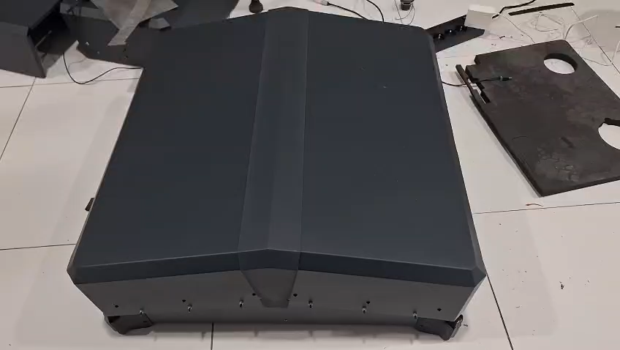
Synchronization Test Video

Slide 19
WebUI Latency Test
Respon Time
150 – 300 ms
Average time from button click to motor movement
Findings
There is a slight visual lag if the log data is too long, but it does not interfere with control functions.

Slide 20
System Analysis
Reliability
The system is stable in long-term testing.No crashes
Integration
ATMega2560 and ESP32 work harmoniously to connect physical hardware and the web.

Slide 21
System Conclusion
Succesful Control : Dual automatic door system is functional and precise
Effective Protection : Optocoupler & Limit Switch successfully protect hardware
IoT Running : ESP32 Web Server is stable for real-time monitoring
Ready to Use : Suitable for use as a docking station prototype

Slide 22
Development Recommendations
Upgrade Server
Using the SIM800L and SIM7600 modules, automatic door systems can be controlled and monitored via a mobile application anytime, anywhere.
Encoder Motor
Add an encoder to the Closed-Loop system for absolute positioning

Slide 23
Optimization Recommendations
Protocol MQTT
Implementation of Cloud IoT for remote access via the Internet.
Watchdog Timer
Enable watchdog for auto-restart if the system freezes.

Slide 24
Thank You
YANUARDI – 221344031

