Slide 1
Sorting, Searching Algorithms
Kuan Sao I

Slide 2
Content
Sorting Algorithms
Selection sort
Insertion sort
Bubble sort
Quick Sort
Searching Algorithms
Linear Search
Binary Search
Jump Search
Interpolation Search
TSP vs SFP

Slide 3
Sorting Algorithms
Selection sort
Insertion sort
Bubble sort
Quick Sort

Slide 4
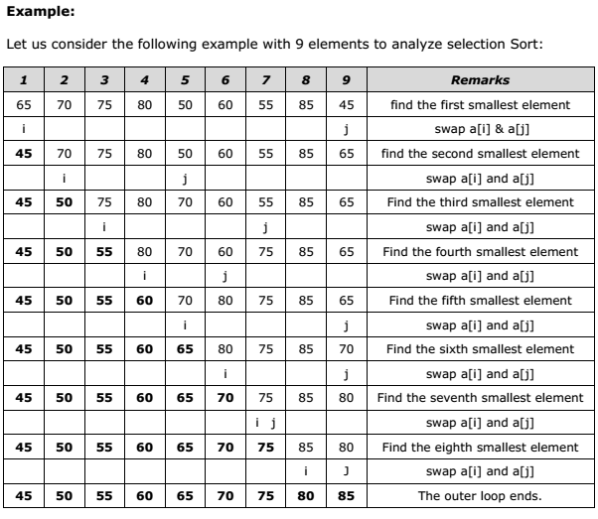
1. Selection sort
Notes:
http://examradar.com/selection-sort/

Slide 5
1. Selection sort
Step 1
Step 2
Loop 1st
[27 10 32 2]
fixed
bucket
compare & change position
Is 27 > 10? → true
swap 27 and 10 -> [10 27 32 2]
Is 10 > 32? → false
do nothing [10 27 32 2]
Is 10 > 2? → true
swap 10 and 2 -> [2 27 32 10]

Slide 6
1. Selection sort
Step 3
Step 4
Loop 2nd
[2 27 32 10]
fixed
bucket
compare & change position
Is 27 > 32? → false
do nothing -> [2 27 32 10]
Is 27 > 10? → true
swap 27 and 10 [2 10 32 27]

Slide 7
1. Selection sort
Step 5
Step 6
Loop 3nd
[2 10 27 32]
fixed
bucket
compare & change position
Is 27 > 32? → false
do nothing -> [2 10 27 32]

Slide 8
1. Selection sort
Step 5
Step 6
Loop 4nd
[2 10 27 32]
fixed
bucket
return
[2 10 27 32]

Slide 9
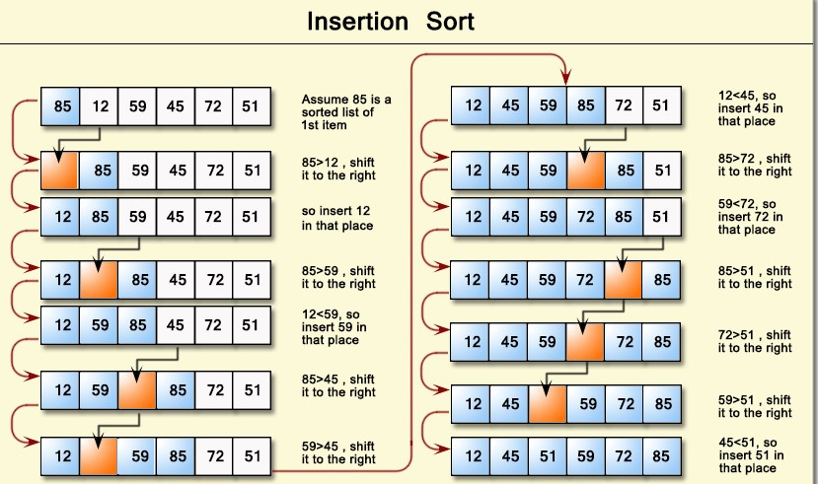
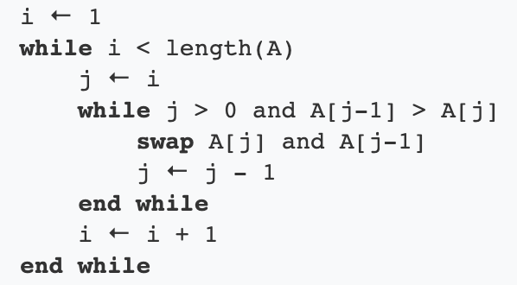
2. Insertion sort
Notes:
http://onlinejudgesolution.blogspot.com/2017/08/insertion-sort-in-array-c-code.html

Slide 10
2. Insertion sort
Step 1
Step 2
Loop i = 1st
[37 10 29 15]
key = A[i=1] = 10
j = i - 1 = 1 - 1 = 0
compare & change position
Is j >= 0 & key < A[0] 37? → true
A[j + 1] = A[j = 0] = 37
[37 37 29 15]
j = j – 1 = -1
A [-1 + 1 = 0] = key = 10
[10 37 29 15]

Slide 11
2. Insertion sort
Step 3
Step 4
Loop i = 2st
[10 37 29 15]
key = A[i=2] = 29
j = i - 1 = 2 - 1 = 1
compare & change position
Is j >= 0 & key < A[1] 37? → true
A[j + 1 = 2] = A[j = 1] = 37
[10 37 37 15]
j = 1 – 1 = 0
A [0 + 1 = 1] = key = 29
[10 29 37 15]

Slide 12
2. Insertion sort
Step 5
Step 6
Loop i = 3st
[10 29 37 15]
key = A[i=3] = 15
j = i - 1 = 3 - 1 = 2
compare & change position
Is j >= 0 & key < A[j = 2] 37? → true
A[j + 1 = 3] = A[j = 2] = 37
[10 29 37 37]
j = 2 – 1 = 1
Is j >= 0 & key < A[j = 1] 29? → true
A[j + 1 = 2] = A[ j=1] = 29
[10 29 29 37]
j = 1 – 1 = 0
A [0 + 1 = 1] = key = 15
[10 15 29 37]

Slide 13
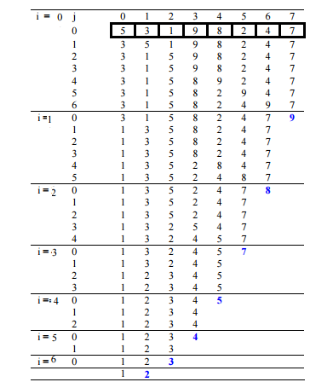
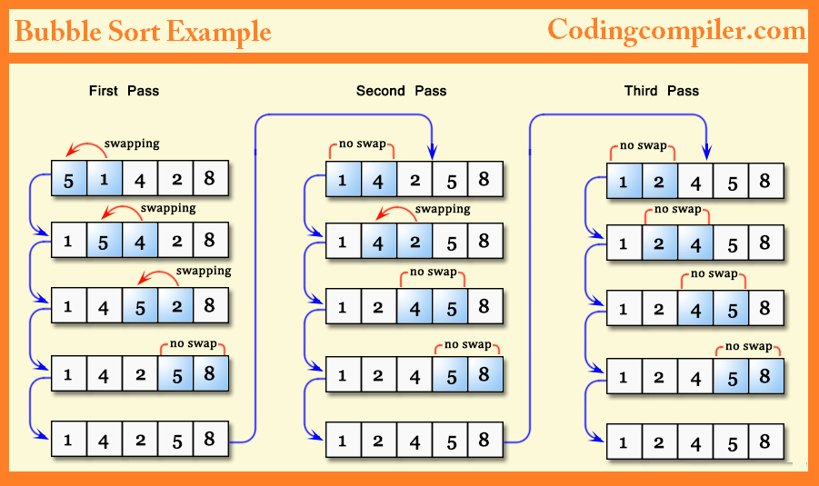
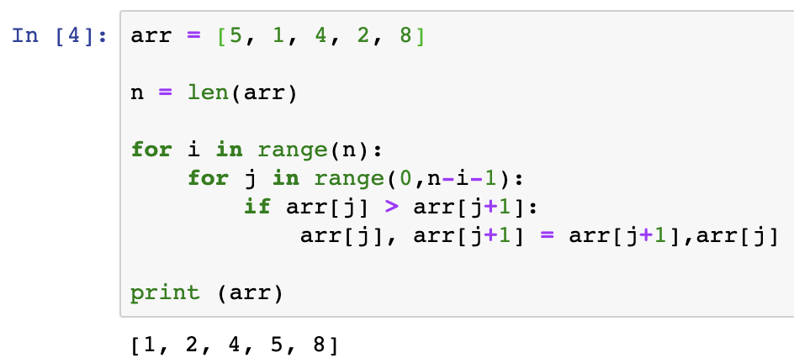
3. Bubble sort
Notes:
https://www.geeksforgeeks.org/bubble-sort/
https://codingcompiler.com/bubble-sort-program-in-c-using-function/

Slide 14
3. Bubble sort
Step 1
Step 2
[5, 1, 4, 2, 8]
n = 5
i = 0 (~n=5)
j = 0 (~ n - i - 1 = 5 - 0 - 1 = 4)
is arr[j=0] 5 > arr[j+1] 1 ? -> true
swap arr[0], arr [1]
[ 1, 5, 4, 2, 8]

Slide 15
3. Bubble sort
Step 3
Step 4
[ 1, 5, 4, 2, 8]
n = 5
i = 0 (~n=5)
j = 1 (~ n - i - 1 = 5 - 0 - 1 = 4)
is arr[j=1] 5 > arr[j+1] 4 ? -> true
swap arr[1], arr [2]
[ 1, 4, 5, 2, 8]

Slide 16
3. Bubble sort
Step 5
Step 6
[1, 4, 5, 2, 8]
n = 5
i = 0 (~n=5)
j = 2 (~ n - i - 1 = 5 - 0 - 1 = 4)
is arr[j=2] 5 > arr[j+1]2 ? -> true
swap arr[2], arr [3]
[1, 4, 2, 5, 8]

Slide 17
3. Bubble sort
Step 7
Step 8
[1, 4, 2, 5, 8]
n = 5
i = 0 (~n=5)
j = 3 (~ n - i - 1 = 5 - 0 - 1 = 4)
is arr[j=3] 5 > arr[j+1]8 ? -> false
do nothing
[1, 4, 2, 5, 8]

Slide 18
3. Bubble sort
Step 9
Step 10
[1, 4, 2, 5, 8]
n = 5
i = 1 (~n=5)
j = 0 (~ n - i - 1 = 5 - 1 - 1 = 3)
is arr[j=0]1 > arr[j+1]4 ? -> false
do nothing
[1, 4, 2, 5, 8]

Slide 19
3. Bubble sort
Step 11
Step 12
[1, 4, 2, 5, 8]
n = 5
i = 1 (~n=5)
j = 1 (~ n - i - 1 = 5 - 1 - 1 = 3)
is arr[j=1]4 > arr[j+1]2 ? -> true
swap arr[1] and arr[2]
[1, 2, 4, 5, 8]

Slide 20
3. Bubble sort
Step 13
Step 14
[1, 2, 4, 5, 8]
n = 5
i = 1 (~n=5)
j = 2 (~ n - i - 1 = 5 - 1 - 1 = 3)
is arr[j=2]4 > arr[j+1]5 ? -> false
do nothing
[1, 2, 4, 5, 8]

Slide 21
3. Bubble sort
Step 15
Step 16
[1, 2, 4, 5, 8]
n = 5
i = 2 (~n=5)
j = 0 (~ n - i - 1 = 5 - 2 - 1 = 2)
is arr[j=0]1 > arr[j+1]2 ? -> false
do nothing
[1, 2, 4, 5, 8]

Slide 22
3. Bubble sort
Step 17
Step 18
[1, 2, 4, 5, 8]
n = 5
i = 2 (~n=5)
j = 1 (~ n - i - 1 = 5 - 2 - 1 = 2)
is arr[j=1]2 > arr[j+1]4 ? -> false
do nothing
[1, 2, 4, 5, 8]

Slide 23
3. Bubble sort
Step 19
Step 20
[1, 2, 4, 5, 8]
n = 5
i = 3 (~n=5)
j = 0 (~ n - i - 1 = 5 - 3 - 1 = 2)
is arr[j=0]1 > arr[j+1]2 ? -> false
do nothing
[1, 2, 4, 5, 8]

Slide 24
3. Bubble sort
Step 21
Step 22
[1, 2, 4, 5, 8]
n = 5
i = 3 (~n=5)
j = 1 (~ n - i - 1 = 5 - 3 - 1 = 2)
is arr[j=1]2 > arr[j+1]4 ? -> false
do nothing
[1, 2, 4, 5, 8]

Slide 25
3. Bubble sort
Step 23
Step 24
[1, 2, 4, 5, 8]
n = 5
i = 4 (~n=5)
j = 0 (~ n - i - 1 = 5 - 4 - 1 = 0)
do nothing
[1, 2, 4, 5, 8]

Slide 26
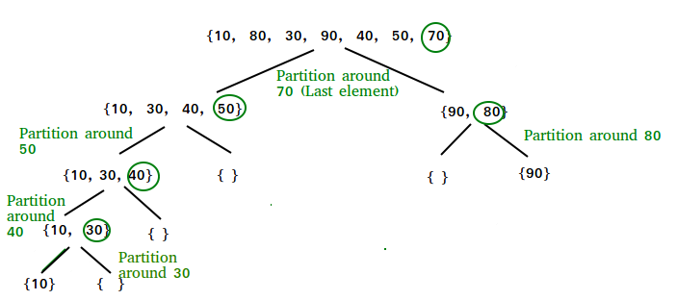
4. Quick Sort
Notes:
https://www.geeksforgeeks.org/quick-sort/

Slide 27
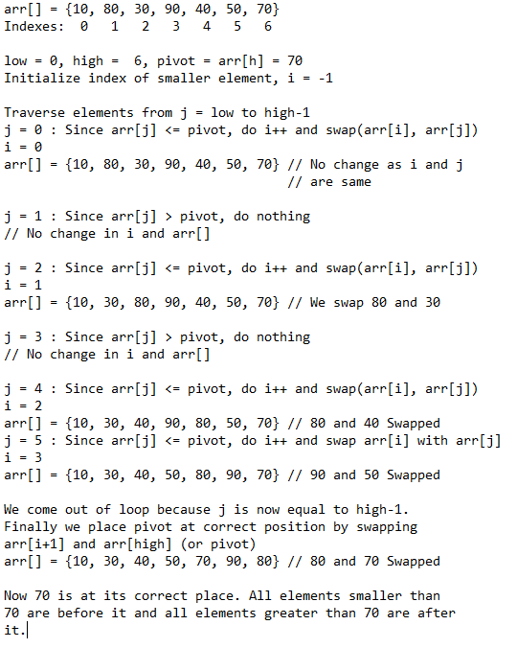
4. Quick Sort

Slide 28
Searching Algorithms
Linear Search
Binary Search
Jump Search
Interpolation Search

Slide 29
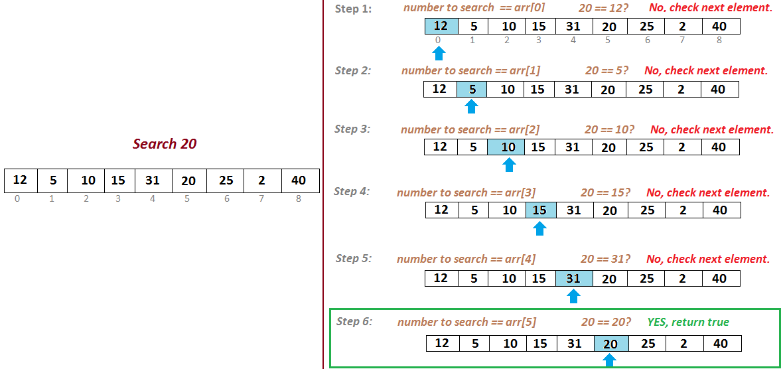
1. Linear Search
Notes:
http://javabypatel.blogspot.com/2017/09/linear-search-algorithm-in-java.html

Slide 30
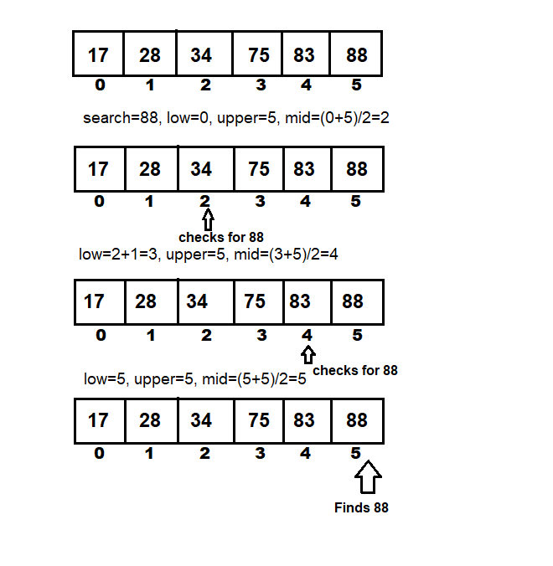
2. Binary Search (sorted arr)
Notes:
https://www.solutionfactory.in/posts/C-program-to-Search-element-using-Binary-Search-Algorithm

Slide 31
3. Jump search (sorted arr)
id | 0 | 1 | 2 | 3 | 4 | 5 | 6 | 7 | 8 | 9 | 10 | 11 | 12 | 13 | 14 | 15
arr | 0 | 1 | 1 | 2 | 3 | 5 | 8 | 13 | 21 | 34 | 55 | 89 | 144 | 233 | 377 | 610
step = sqrt(len(arr)) = sqrt(16) = 4
search = 55
STEP 1: Jump from index 0 to index 4; STEP 2: Jump from index 4 to index 8; STEP 3: Jump from index 8 to index 12; STEP 4: Since arr[12]=144 > 55 ; jump back a step to come to index 8. STEP 5: Perform linear search from index 8 to get the element 55.
Return 55 id is arr[10]
Notes:
https://www.geeksforgeeks.org/jump-search/

Slide 32
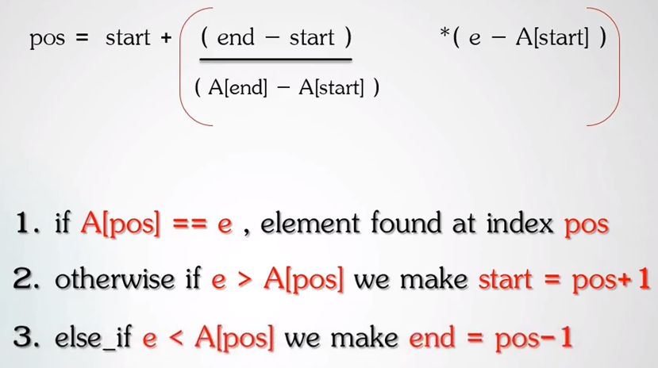
4. Interpolation Search
Notes:
Interpolation Search Algorithm | Searching Algorithm

Slide 33
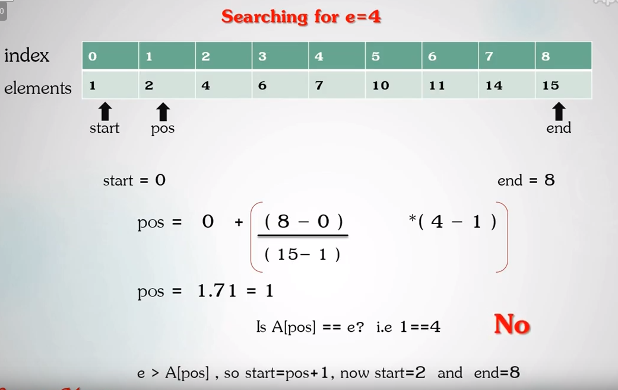
4. Interpolation Search (sorted arr)

Slide 34
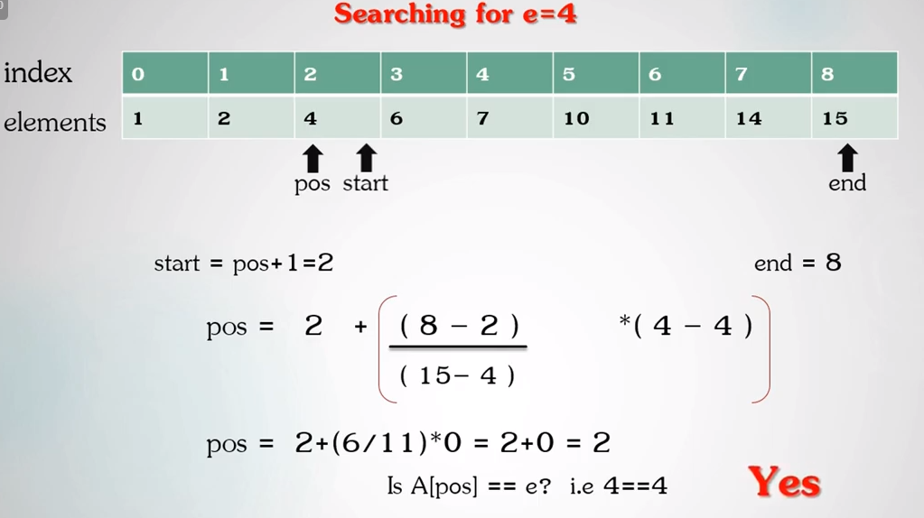
4. Interpolation Search

Slide 35
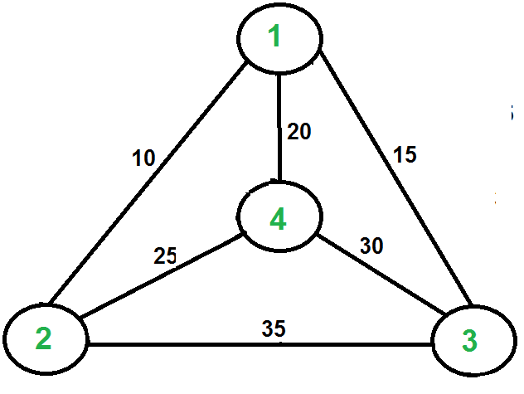
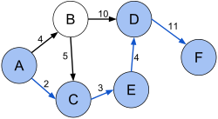
TSP vs SFP
Travelling Salesman Problem (TSP): Given a set of cities and distance between every pair of cities, the problem is to find the shortest possible route that visits every city exactly once and returns to the starting point.
Shortest path problem (SFP) : In graph theory, the shortest path problem is the problem of finding a path between two vertices (or nodes) in a graph such that the sum of the weights of its constituent edges is minimized.

