Slide 1
Recommendation System
14th Aug 2019
Kuan Sao I

Slide 2
Structure of RS filtering info
Demographic filtering
Collaborative filtering
Content-based filtering
Hybrid filtering
User based
Item based
Model based
SVD
LSI
Reinforcement
MDP S, A, R, Pr
Memory based (KNN CF)
User status
Item information
Mix methods
TF-idf
Profile of user's orientation
KNN
Rocchio's (Relevance Feedback)
Linear classifiers
Probabilistic methods
Rule induction ( if-then rule )

Slide 3
Dimensionality Reduction Method
The neighborhood approaches based on rating correlation:
Limited coverage:
This assumption is very limiting, as users having rated a few or no common items may still have similar preferences.
Sensitivity to sparse data:
Sparsity is a problem common to most recommender systems due to the fact that users typically rate only a small proportion of the available items.
A common solution for these problems is to fill the missing ratings with default values, such as the middle value of the rating range, and the average user or item rating.
A more reliable approach is to use content information to fill out the missing ratings.
For instance, the missing ratings can be provided by autonomous agents called filterbots, that act as ordinary users of the system and rate items based on some specific characteristics of their content. The missing ratings can instead be predicted by a content-based approach.

Slide 4
Dimensionality Reduction Method
Dimensionality reduction methods address the problems of limited coverage and sparsity by projecting users and items into a reduced latent space that captures their most salient features.
Because users and items are compared in this dense subspace of high-level features, instead of the “rating space”, more meaningful relations can be discovered.
In particular, a relation between two users can be found, even though these users have rated different items.
As a result, such methods are generally less sensitive to sparse data.

Slide 5
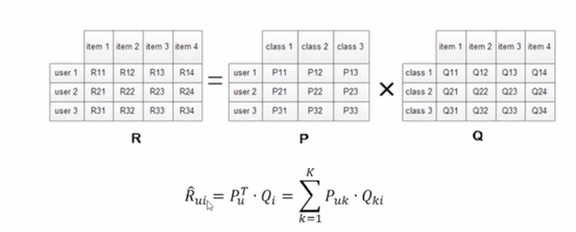
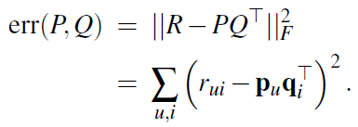
LSI
A popular dimensionality reduction approach to item recommendation is Latent Semantic Indexing (LSI).
In this approach, the |U|×|I| user-item rating matrix R of rank n is approximated by a matrix ˆR = PQ⊤ of rank k < n, where P is a |U|×k matrix of users factors and Q a |I|×k matrix of item factors.
Intuitively, the u-th row of P, pu ∈ Rk, represents the coordinates of user u projected in the k-dimensional latent space.
Likewise, the i-th row of Q, qi ∈ Rk, can be seen as the coordinates of item i in this latent space.

Slide 6
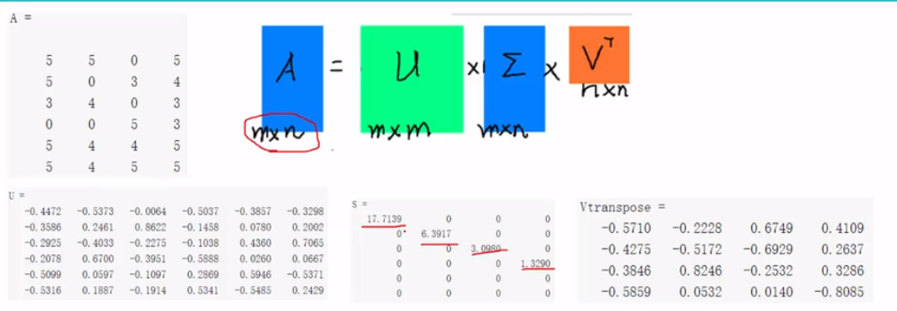



LSI+SVD
Matrices P and Q are normally found by minimizing the reconstruction error defined with the squared Frobenius norm:
Minimizing this error is equivalent to finding the Singular Value Decomposition (SVD) of R:
where U is the |U|×n matrix of left singular vectors, V is the |I|×n matrix of right singular vectors, and Σ is the n×n diagonal matrix of singular values.
Denote by Σk, Uk and Vk the matrices obtained by selecting the subset containing the k highest singular values and their corresponding singular vectors, the user and item factor matrices correspond to:
Once P and Q have been obtained, the typical model-based prediction of a rating rui is:

Slide 7

LSI
There is, however, a major problem with applying SVD to the rating matrix R: most values rui of R are undefined, since there may not be a rating given to i by u.
Although it is possible to assign a default value to rui, as mentioned above, this would introduce a bias in the data.
More importantly, this would make the large matrix R dense and, consequently, render impractical the SVD decomposition of R.
The common solution to this problem is to learn P and Q using only the known ratings.
where λ is a parameter that controls the level of regularization.

Slide 8

Reinforcement Learning
In reinforcement learning, the purpose or goal of the agent is formalized in terms of a special reward signal passing from the environment to the agent.
At each time step, the reward is a simple number. The learner and decision-maker is called the agent. The thing it interacts with, comprising everything outside the agent, is called the environment.
These interact continually, the agent selecting actions and the environment responding to those actions and presenting new situations to the agent.
A complete speciation of an environment defines a task , one instance of the reinforcement learning problem.
At each time step, the reward is a simple number.
Informally, the agent's goal is to maximize the total amount of reward it receives.
This means maximizing not immediate reward, but cumulative reward in the long run.
Notes:
https://mc.ai/introduction-to-reinforcement-learning/

Slide 9
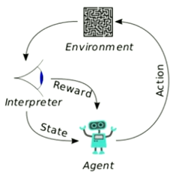
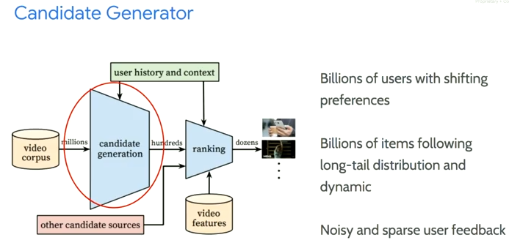
Reinforcement Learning for RS
Building agents that take actions in some environment so as to maximize some notion of cumulative reward.
Agent: candidate generator
State: user interest, context
Reward: user satisfaction
Action: nominate from a catalog of millions of videos

Slide 10
MDP
A reinforcement learning task that satisfies the Markov property is called a Markov decision process, or MDP.
A particular finite MDP is defined by its state and action sets and by the one-step dynamics of the environment.
Given any state and action s and a, the probability of each possible pair of next state and reward, s’; r, is denoted:
These quantities completely specify the dynamics of a finite MDP.

Slide 11



MDP
Given the dynamics as specied by (3.6), one can compute anything else one might want to know about the environment, such as the expected rewards for state{action pairs,
the state-transition probabilities,
and the expected rewards for state{action{next-state triples,
.

Slide 12
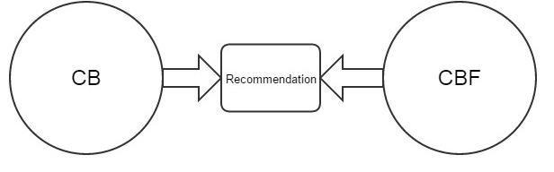
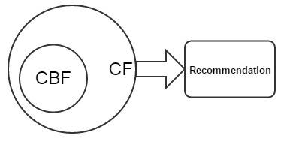
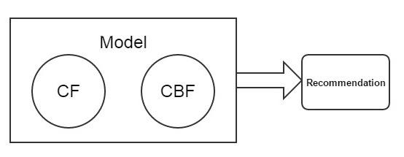
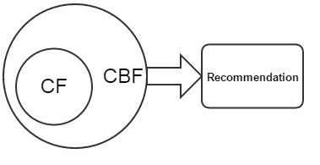
Hybrid Recommendation System
4 ways
7 classes
Weighted
Switching
Mixed
Feature Combination
Feature Augmentation
Cascade
Meta-level

Slide 13
4 ways to implement
Content-based filtering ("cold-start")
Collaborative filtering (accurate recommendations)
Hybrid schemes
Figure 5 shows the methods that incorporate CF characteristics into a CBF approach.
Figure 4 illustrates the methods for construction of a unified utility system with both CBF and CF characteristics.
In this method by combining some features of CBF and CF one unified model is constructed that can improve effectiveness of recommendation process.
Figure 3 shows the methods that integrate CBF characteristics into the CF approach.
So that it will overcome the cold start problem in collaborative filtering and overspecialization problem of content-based filtering.
Figure 2 shows the methods that estimate CBF and CF recommendations individually and subsequently combine them to yield better recommendations across the board.

Slide 14
7 classes of Hybrid RS
Weighted
Different recommendation components scores are combined statistically. This class aggregates scores from each factor using additive formula.
Switching
From available recommendation components system chooses particular component and applies the picked out one.
Mixed
Different recommender provides their recommendation that will be introduced together. This class is based on merging and presentation of multiple rated list into single rated list.
Feature Combination
Contributing and actual recommender are two different recommendation components are exist for this class. The working of actual recommender is depends on the data modified by the contributing one. The contributing one throws features of one source on to the other components source.
Feature Augmentation
This class is similar to the feature combination hybrids but only difference is that the contributor gives novel characteristic. It is more elastic than feature combination method.
Cascade
This class play an role of tie breaker. Here for every recommender assign some priority and according to that assign priority, lower priority recommenders play an tie breakers role over higher priority.
Meta-level
Their exist contributing and actual recommenders but the early one completely substitutes the data for the latter one.
Notes:
https://medium.com/@jockeyng/%E6%B7%B7%E5%90%88%E6%8E%A8%E8%96%A6-hybrid-f9a7de086a7f
混合推薦(Hybrid)
https://lianhaimiao.github.io/2018/01/06/%E6%8E%A8%E8%8D%90%E7%B3%BB%E7%BB%9F%E6%96%B9%E6%B3%95%E5%B0%8F%E7%BB%93-%E4%B8%8A/
推荐系统方法小结(上)
http://b.7dtime.com/B01M7P3GNI/13/1.html
1. 9.2 算法设计层面的混合方法

Slide 15
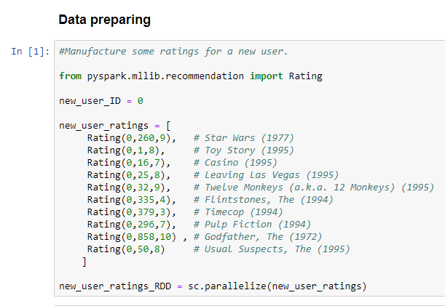
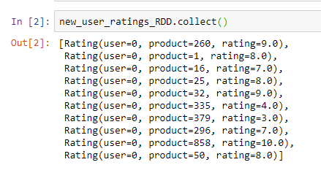
Recommend movies using ALS

Slide 16
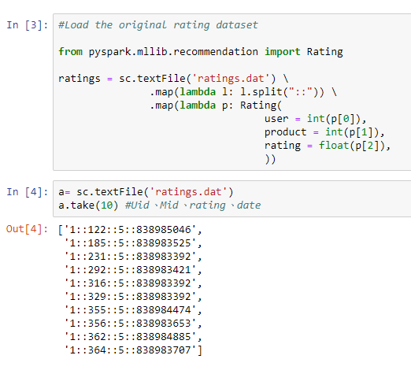
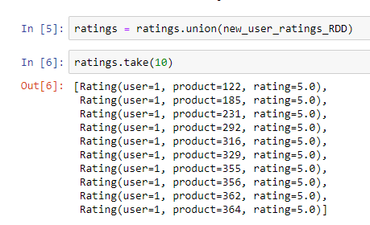
Recommend movies using ALS

Slide 17
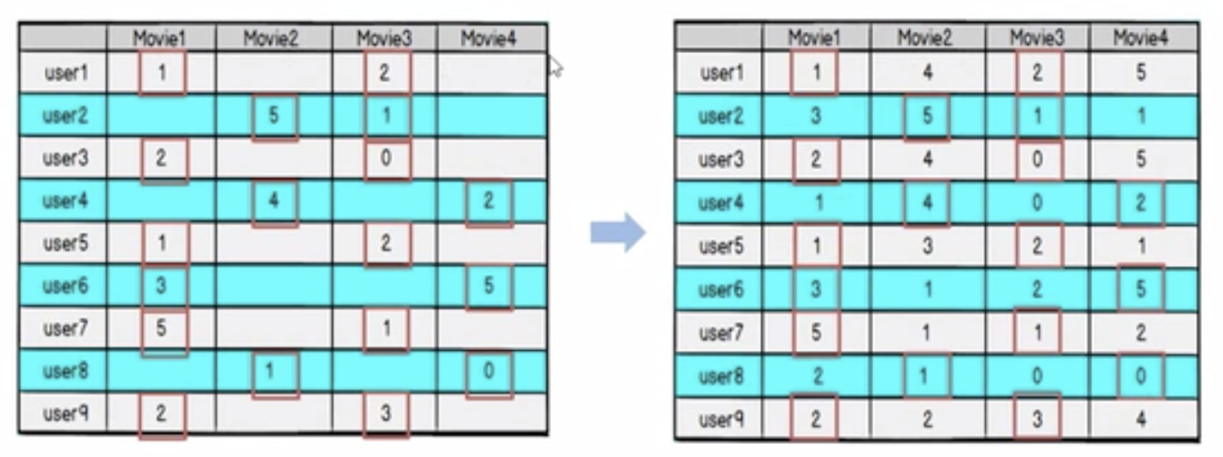
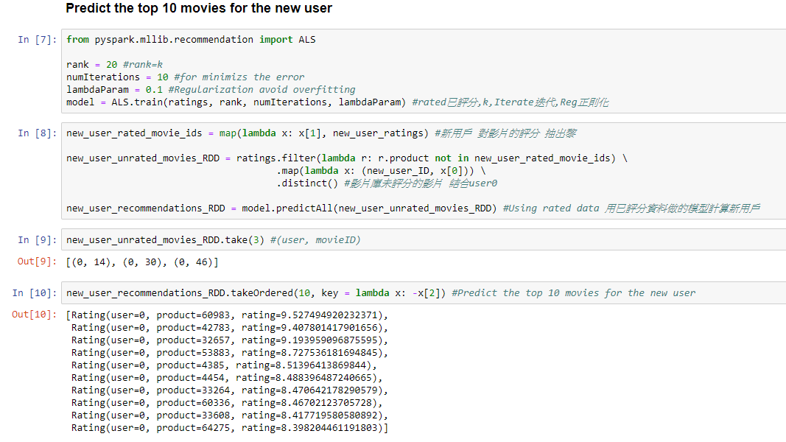
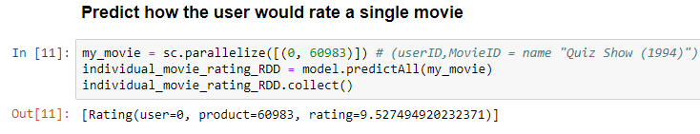
Recommend movies using ALS
K=Implicit factor

Slide 18
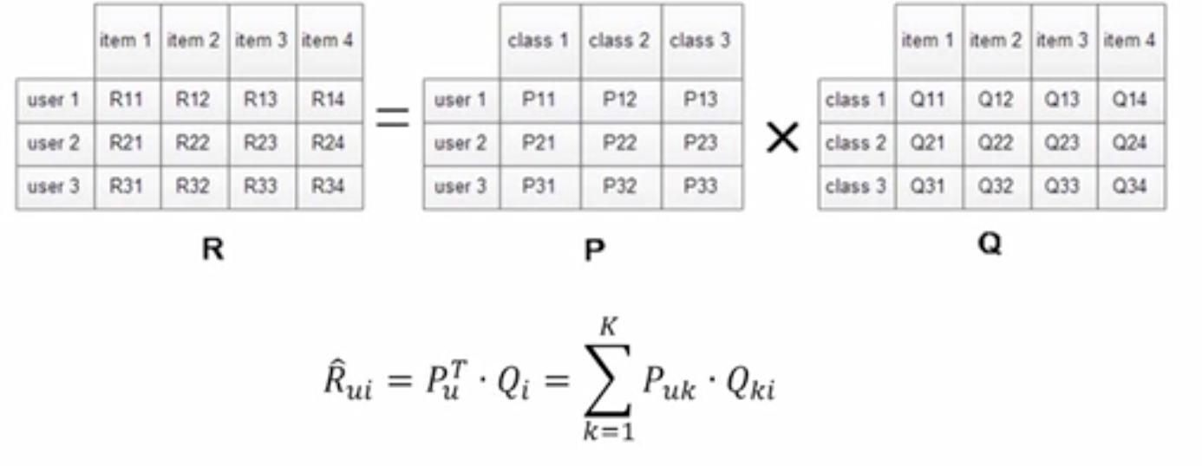

Alternating Least Squares (ALS/SVD++)
Prediction accuracy is improved by considering also implicit feedback, which provides an additional indication of user preferences.
Implicit type: purchase record, surfing record, search mode, mouse movement, etc.

Slide 19

Alternating Least Squares (ALS/SVD++)
Flow:
Initial Q0 for Q, (can be 0 or mean value)
Fix Q0 value, calculate P0
Fix P0 value, calculate Q1
Fix Q1 value, calculate P1
Iterate above steps
Until cost function/ loss factor C decreased (Predicted deviation) (Iteratation limitation )
Notes:
https://www.bilibili.com/video/av52890357/?p=35
https://zhuanlan.zhihu.com/p/24220475
协同过滤(ALS)算法介绍及Spark MLlib调用实例(Scala/Java/Python)
https://blog.csdn.net/oucpowerman/article/details/49847979
矩阵分解模型（1）：ALS学习算法

Slide 20
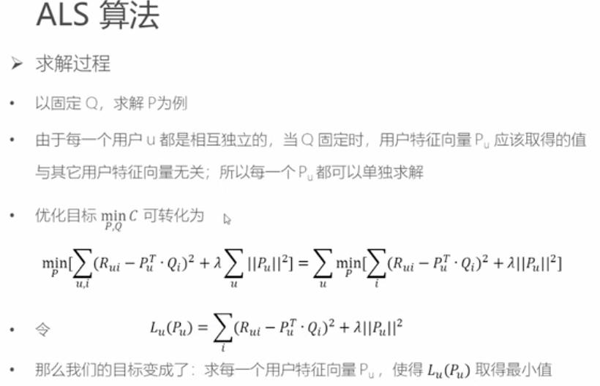
ALS

Slide 21
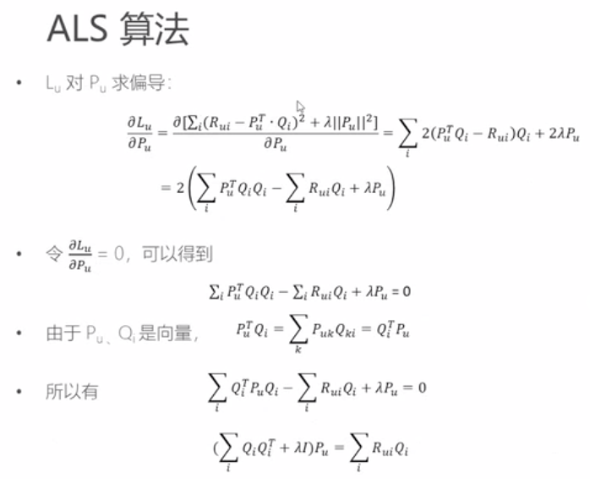
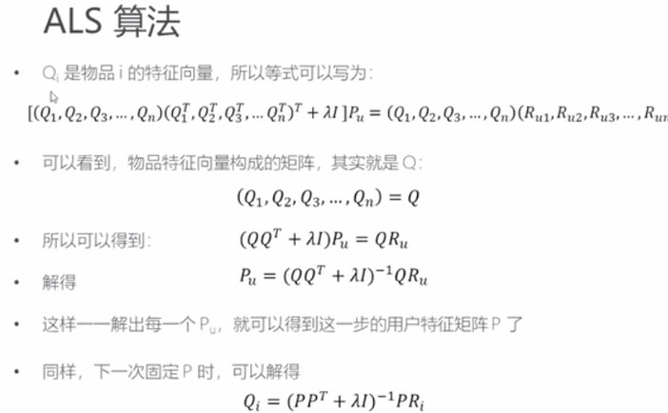
ALS

Slide 22
The End Recommendation System
14th Aug 2019
Kuan Sao I

