Slide 1
Simulated Annealing , Ant Colony Optimization in Recommendation System
2nd Oct 2019
Kuan Sao I

Slide 2
Content
Review
RS & types
K-means
Simulated Annealing
Using SA to combine K-means with CF for RS application
Ant Colony Optimization Introduction

Slide 3

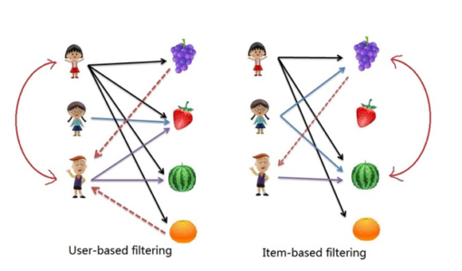
RS & types
Recommender Systems (RSs) are software tools and techniques providing suggestions for items to be of use to a user.
Types:
Demographic filtering(DF)
Collaborative filtering(CF)
Content-based filtering (CBF)
Hybrid approach (HA)
user profiles
interaction with users and items
Item descriptions and user profiles
mix above methods

Slide 4
K-means Clustering
K-means Clustering
dividing data points into homogeneous K classes or clusters by the mean value.
Notes:
https://medium.com/@imparth/k-means-clustering-algorithm-34807a7cec71

Slide 5
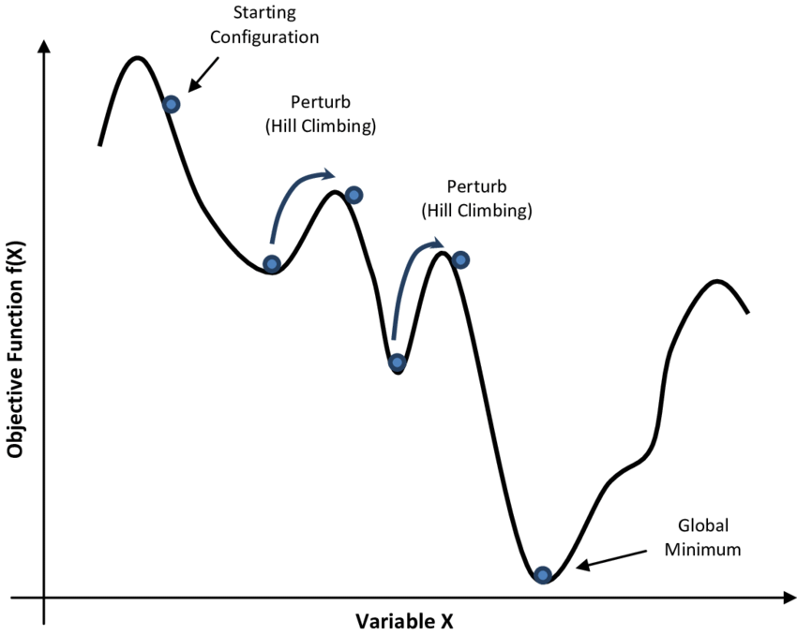
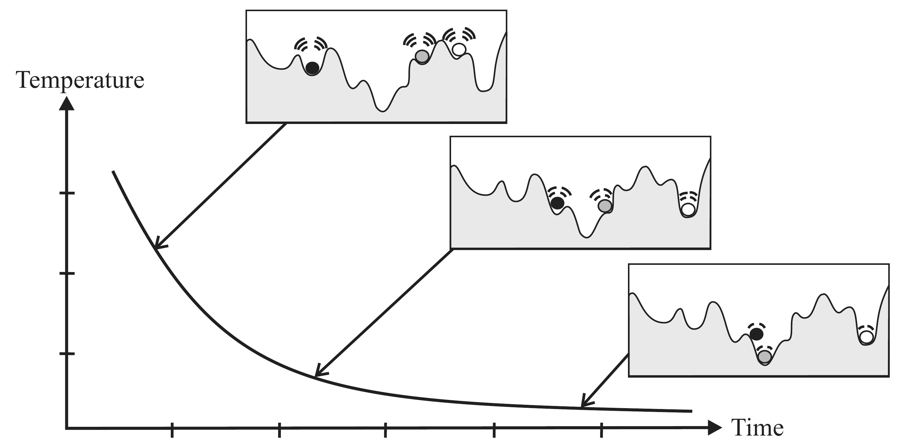
Simulated Annealing
Simulated annealing (SA) is a probabilistic technique for approximating the global optimum of a given function.
Specifically, it is a metaheuristic* to approximate global optimization in a large search space for an optimization problem.
Metaheuristic is a higher-level procedure or heuristic designed to find, generate, or select a heuristic (partial search algorithm) that may provide a sufficiently good solution to an optimization problem, especially with incomplete or imperfect information or limited computation capacity.
.
Notes:
https://en.wikipedia.org/wiki/Simulated_annealing
https://www.researchgate.net/figure/Simulated-Annealing-optimization-of-a-one-dimensional-objective-function_fig1_308786233

Slide 6
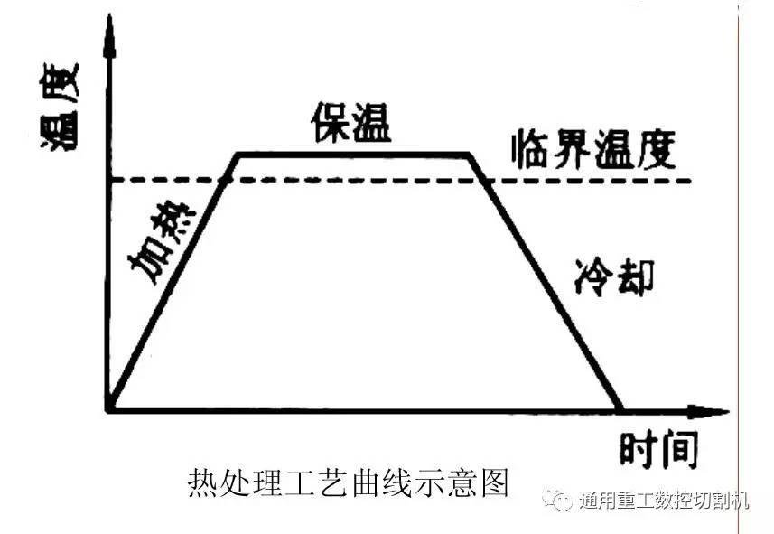
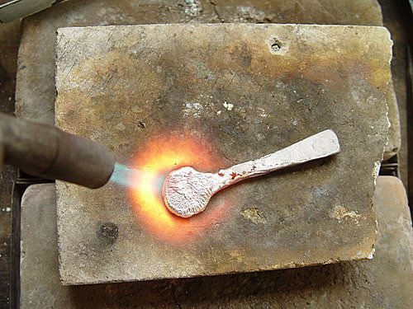
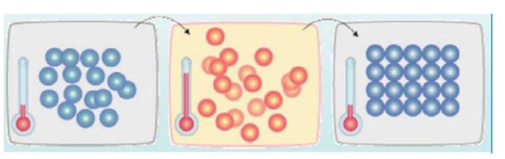
Simulated Annealing
Annealing is a heat treatment that alters the physical and sometimes chemical properties of a material to increase its ductility (延展性) and reduce its hard ness as well as molecular rearrangement.
Annealing Process:
Heating
Isothermal
Cooling
Temp.
Isothermal
Threshold temp.
Heating
Cooling
time

Slide 7
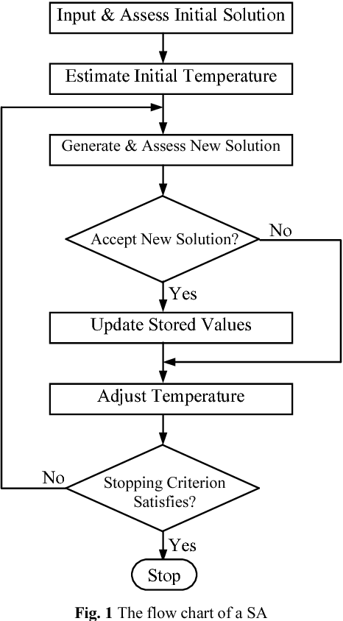
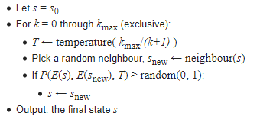
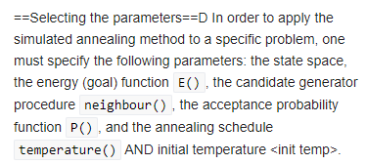
Simulated Annealing
It starts from a state s₀ and continues until a maximum of k_{max} steps have been taken.
In the process, the call neighbour(s) should generate a randomly chosen neighbour of a given state s; the call random(0, 1) should pick and return a value in the range [0, 1], uniformly at random.
The annealing schedule is defined by the call temperature(T), which should yield the temperature to use, given the fraction T of the time budget that has been expended so far.
Notes:
In order to apply the simulated annealing method to a specific problem, one must specify the following parameters: the state space, the energy (goal) function E(), the candidate generator procedure neighbour(), the acceptance probability function P(), and the annealing schedule temperature() AND initial temperature <init temp>.
https://en.wikipedia.org/wiki/Simulated_annealing

Slide 8
Using SA to combine K-means with CF for RS application
[10] K-means clustering - item-based collaborative
[10] proposed a general recommendation system. The main contribution is enhancing the item-based collaborative filtering approach by using K-means clustering.
1- The rating history for each user is used.
2- From the user’s rating history, find the similarity between items. Recommend items that meet the user’s preferable attributes. Overcome the scalability barrier by using collaborative filtering approach with K-means clustering.
3- They only satisfy one stakeholder who is the Movie audience news reader.
4- They generate an item-based collaborative result. Then, they generate a K-means clustering result from the collaborative filtering result. Finally, they combine results by using a Simulated Annealing algorithm. Movie fan
Input: rating history
Output: predicted rating ‘x’ (recommend item)
Collaborative Filtering – item based – KNN
Clustering
Simulated Annealing
Input: clustered rating
Output: search best rating from same cluster ‘z’
Input: predicted rating
Output: cluster predicted rating by item ‘y’
Notes:
[10]Application of Using Simulated Annealing to Combine Clustering with Collaborative Filtering for Item Recommendation
Towards an Effective Crowdsourcing Recommendation System

Slide 9

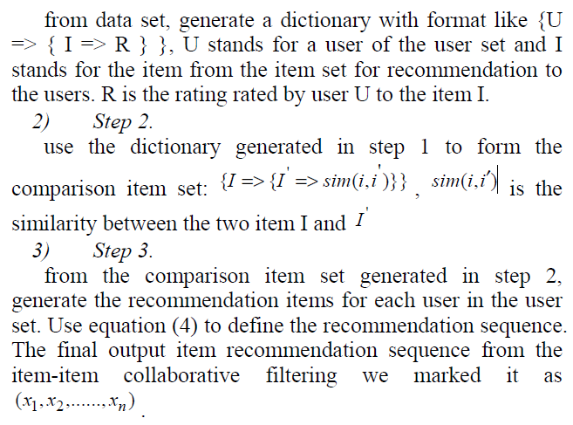
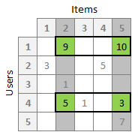

Collaborative Filtering – item based – KNN
Clustering
Simulated Annealing
xn
Notes:
[10]Application of Using Simulated Annealing to Combine Clustering with Collaborative Filtering for Item Recommendation

Slide 10
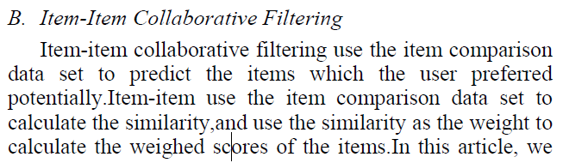
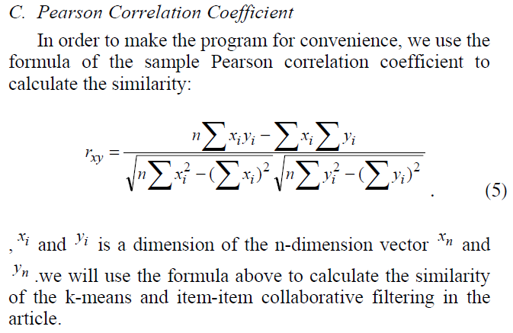
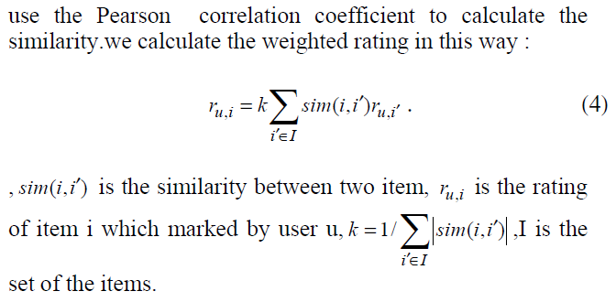
Collaborative Filtering – item based – KNN
Clustering
Simulated Annealing
Notes:
[10]Application of Using Simulated Annealing to Combine Clustering with Collaborative Filtering for Item Recommendation

Slide 11
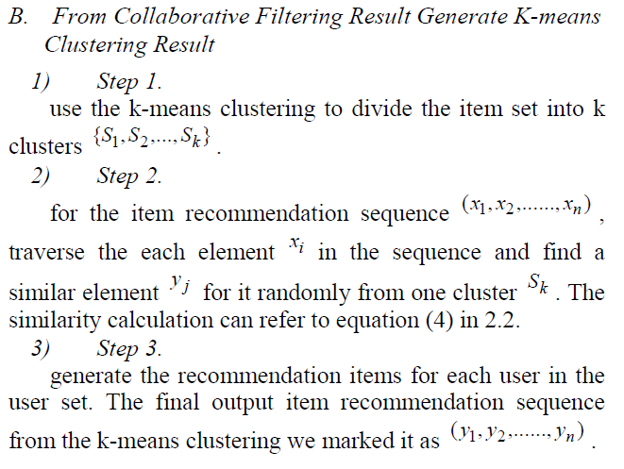
Collaborative Filtering – item based – KNN
Clustering
Simulated Annealing
6
9
7
8
n
2
Xi = 7
yj
Yj+1
sk
Notes:
[10]Application of Using Simulated Annealing to Combine Clustering with Collaborative Filtering for Item Recommendation

Slide 12
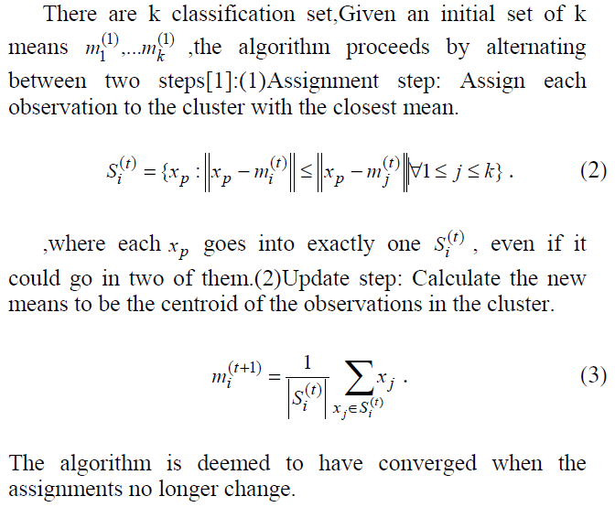
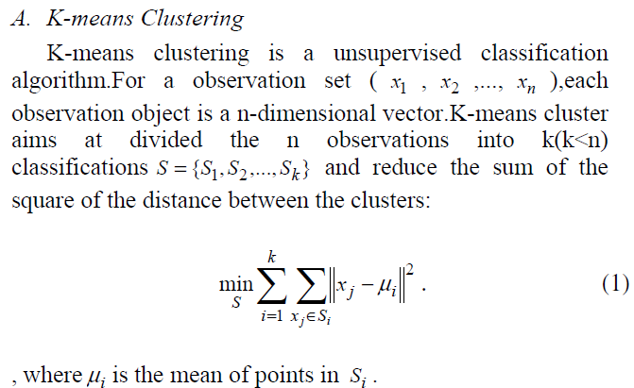
Collaborative Filtering – item based – KNN
Clustering
Simulated Annealing
Notes:
[10]Application of Using Simulated Annealing to Combine Clustering with Collaborative Filtering for Item Recommendation

Slide 13
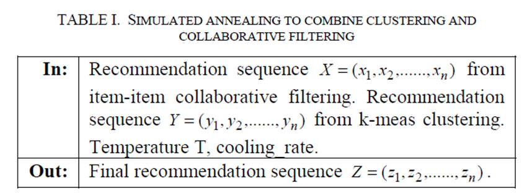
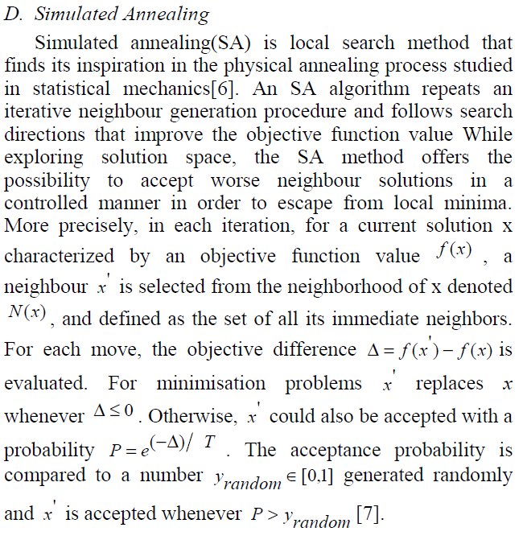
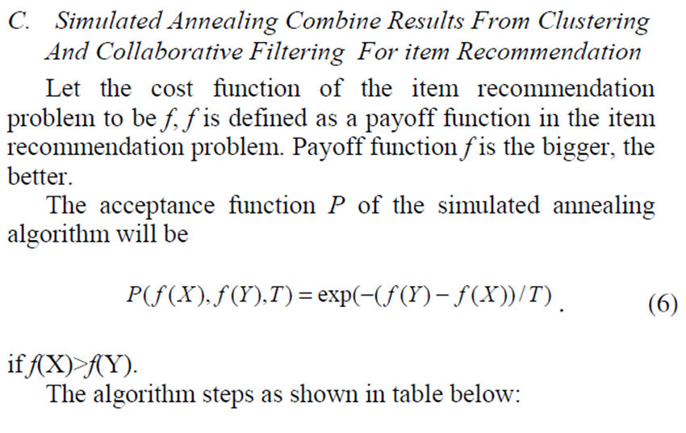
Collaborative Filtering – item based – KNN
Clustering
Simulated Annealing
Notes:
[10]Application of Using Simulated Annealing to Combine Clustering with Collaborative Filtering for Item Recommendation

Slide 14
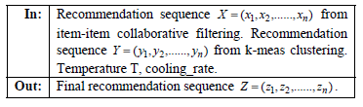
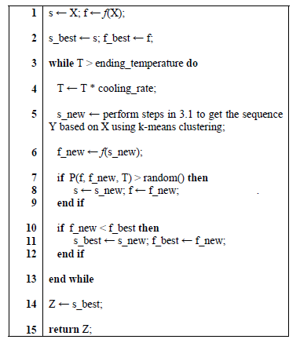
Collaborative Filtering – item based – KNN
Clustering
Simulated Annealing
6
7
7
8
n
9
xi
sk
yj
yj
yj
Notes:
[10]Application of Using Simulated Annealing to Combine Clustering with Collaborative Filtering for Item Recommendation

Slide 15
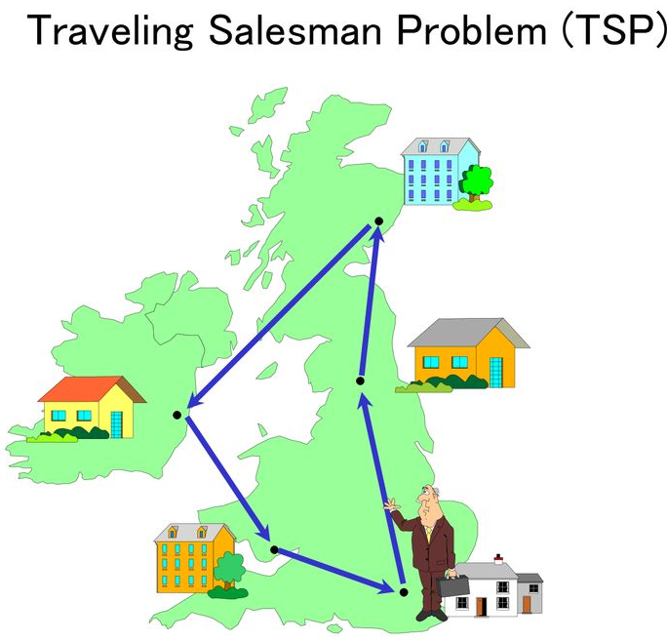
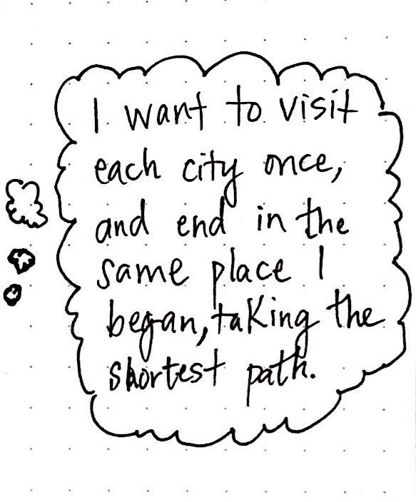
Ant Colony Optimization
Ant Colony Optimization (ACO) is a new natural computation algorithm from mimic the behaviours of ants colony, and proposed by Italian scholar M. Dorigo(1991).
The original intention of ACO is to solve the complicated combination optimization problems, such as traveling salesman problem (TSP).
ACO is based on observations about ant colonies and their mutual behaviour.
Notes:
Student Courses Recommendation Using Ant Colony Optimization
By Janusz Sobecki and Jakub M. Tomczak

Slide 16
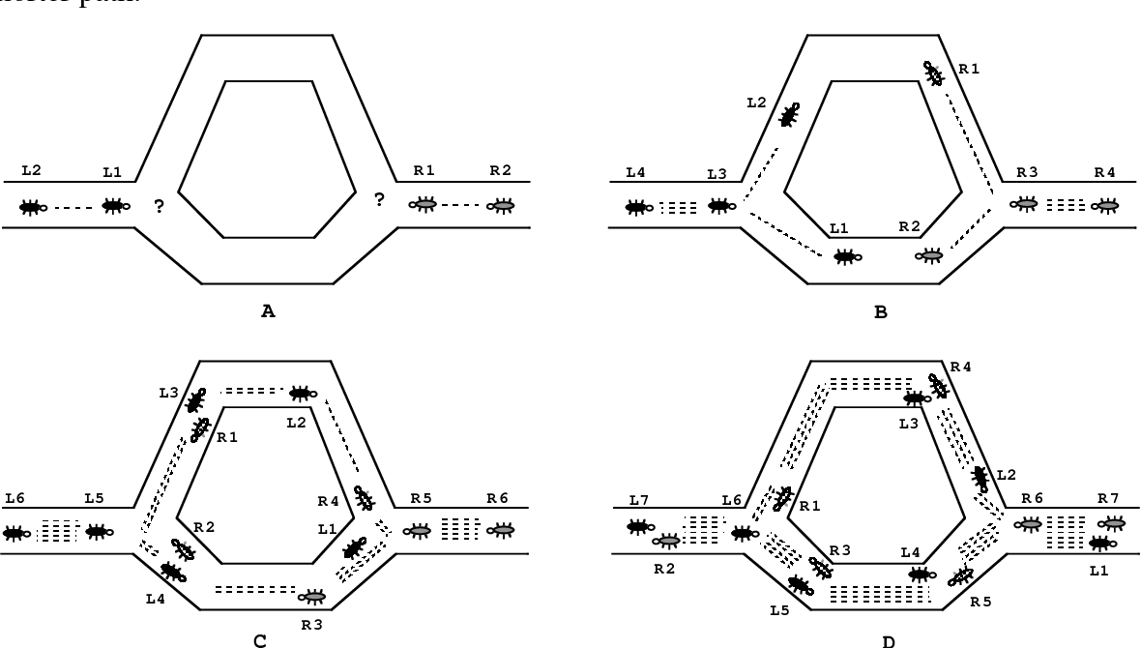
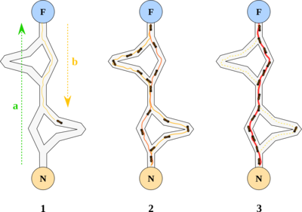
Ant Colony Optimization
Ant Colony
The main idea of using ant colony metaphor is that living ants, despite their being almost blind, are able to find their way from the nest to food and back.
They are able to do it because ant colony communicates through of a chemical substance called pheromone.
As the ant moves from the nest to food, the pheromone is released on its path.
Notes:
Student Courses Recommendation Using Ant Colony Optimization
By Janusz Sobecki and Jakub M. Tomczak
Ant Colony System: A Cooperative Learning Approach to the Traveling Salesman Problem
蚂蚁从蚁巢 (N) 出发到达食物源所在地 (F)，取得食物后再折返回蚁巢。整个过程中蚂蚁有多种路径可以选择，单位时间内路径上通过蚂蚁的数量越多，则该路径上留下的信息素浓度越高。因此，最短路径上走过的蚂蚁数量越多，则后来的蚂蚁选择该路径的机率就越大，从而蚂蚁通过信息的交流实现了寻找食物和蚁巢之间最短路的目的。
https://leovan.me/cn/2019/04/heuristic-algorithms/

Slide 17
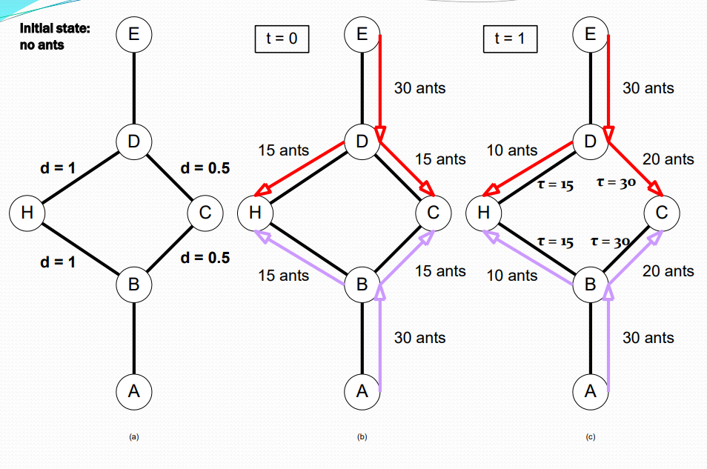
Ant Colony Optimization
Ant Colony (con’d)
Ants are able to perceive this pheromone and recognize its density.
These ants have a larger probability to move along the path that has the greater hormone density.
Notes:
https://www.slideshare.n
Student Courses Recommendation Using Ant Colony Optimization
By Janusz Sobecki and Jakub M. Tomczak
et/idforjoydutta/ant-colony-optimization-23180597?from_action=save

Slide 18
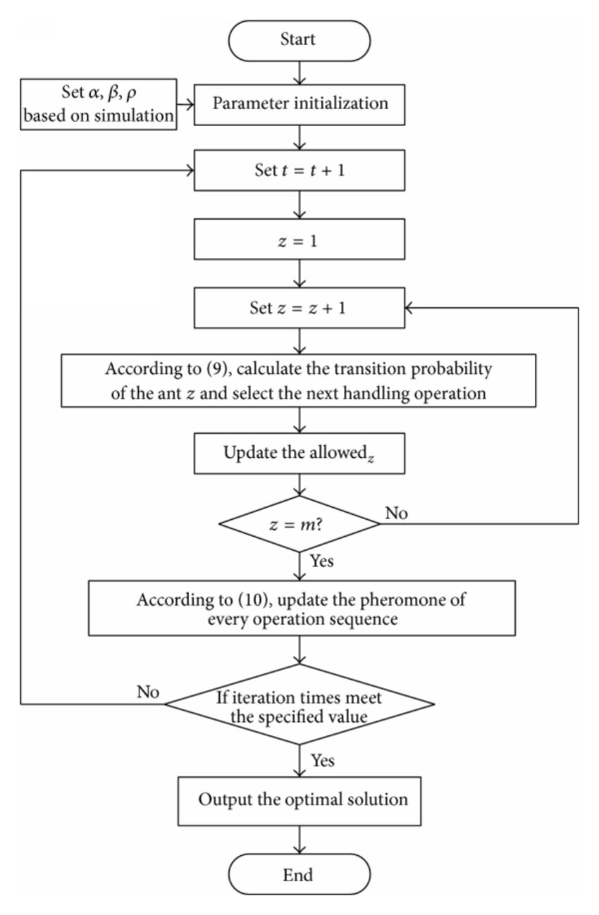
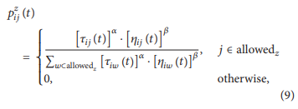

Ant Colony Optimization
Main steps of the ACO algorithm implementation proposed in the paper (L.Wong, X. Zhu) are introduced in the following subsections.
Critical Parameters Setting.
Transition Rule.
Pheromone Updating.
Notes:
Rail Mounted Gantry Crane Scheduling Optimization in Railway Container Terminal Based on Hybrid Handling Mode
基於混合處理模式的, 鐵路 集裝箱 碼頭 ,軌道式 龍門 起重機 調度 優化

Slide 19
Ant Colony Optimization
Critical Parameters Setting. ACO algorithms have some critical parameters that influence the performance dramatically, such as the heuristic coefficients 𝛼, 𝛽 and pheromone hangover coefficient 𝜌.
Notes:
Rail Mounted Gantry Crane Scheduling Optimization in Railway Container Terminal Based on Hybrid Handling Mode
基於混合處理模式的, 鐵路 集裝箱 碼頭 ,軌道式 龍門 起重機 調度 優化

Slide 20
Ant Colony Optimization
Transition Rule. The transition direction of the ant 𝑧 (𝑧 = 1, 2, . . . , 𝑚) is determined by the operation sequence intensity in the ant moving process,
𝑝𝑧 𝑖𝑗(𝑡)is the transition probability of the ant 𝑧 moving from operation 𝑖 to operation 𝑗 in period 𝑡, which is calculated by
Notes:
Rail Mounted Gantry Crane Scheduling Optimization in Railway Container Terminal Based on Hybrid Handling Mode
基於混合處理模式的, 鐵路 集裝箱 碼頭 ,軌道式 龍門 起重機 調度 優化

Slide 21
Ant Colony Optimization
where 𝜏𝑖𝑗(𝑡) is the operation sequence intensity between operation 𝑖 to operation 𝑗,
𝜂𝑖𝑗(𝑡) is the visibility of operation 𝑖 to operation 𝑗,
𝜂𝑖𝑗(𝑡) = 1/𝑑𝑖𝑗.
𝑑𝑖𝑗 is the distance between operation 𝑖 and operation 𝑗.
allowed𝑧 is the set of optional operations.
The operation sequence intensity can be described as an adaptive memory and is regulated by the parameter 𝛼.
The latter criteria can be described as a measure of desirability and are called visibility.
It represents the heuristic function mentioned above and is regulated by the parameter 𝛽.
Notes:
Rail Mounted Gantry Crane Scheduling Optimization in Railway Container Terminal Based on Hybrid Handling Mode
基於混合處理模式的, 鐵路 集裝箱 碼頭 ,軌道式 龍門 起重機 調度 優化

Slide 22
Ant Colony Optimization
Pheromone Updating. In order to avoid heuristic information covered by pheromone hangover, the pheromone need be updated when all ants accomplish one circulation. The pheromone of operation sequence in period 𝑡+𝑛 can be undated by
Notes:
Rail Mounted Gantry Crane Scheduling Optimization in Railway Container Terminal Based on Hybrid Handling Mode
基於混合處理模式的, 鐵路 集裝箱 碼頭 ,軌道式 龍門 起重機 調度 優化

Slide 23
Ant Colony Optimization
where 𝜌 (0<𝜌<1) is the pheromone hangover coefficient.
Δ𝜏𝑖𝑗(𝑡) is the pheromone increment of operation sequence (𝑖, 𝑗).
Δ𝜏𝑧 𝑖𝑗(𝑡) is the pheromone embedded in operation sequence (𝑖, 𝑗) by the ant 𝑧 in the circulation.
If the ant 𝑧 passes the (𝑖, 𝑗)in this circulation,
Δ𝜏𝑧 𝑖𝑗(𝑡) = 𝑄/𝐿𝑧. Otherwise, Δ𝜏𝑧 𝑖𝑗(𝑡) = 0.
𝑄 is the pheromone amount released by the ant 𝑧 in one circulation.
𝐿𝑧 is the moving distance amount of the ant 𝑧 in one circulation.
Notes:
Rail Mounted Gantry Crane Scheduling Optimization in Railway Container Terminal Based on Hybrid Handling Mode
基於混合處理模式的, 鐵路 集裝箱 碼頭 ,軌道式 龍門 起重機 調度 優化

Slide 24
ACO Applications
Scheduling Problem
Job-shop scheduling problem (JSP)
Open-shop scheduling problem (OSP)
Resource-constrained project scheduling problem (RCPSP)
Group-shop scheduling problem (GSP)
Vehicle routing problem
Multi-depot vehicle routing problem (MDVRP)
Period vehicle routing problem (PVRP)
Split delivery vehicle routing problem (SDVRP)
Stochastic vehicle routing problem (SVRP)
Vehicle routing problem with time windows (VRPTW)
Assignment problem
Quadratic assignment problem(QAP)
Generalized assignment problem (GAP)
Frequency assignment problem (FAP)
Redundancy allocation problem
Set problem
Set covering problem(SCP)
Set partition problem (SPP)
Multiple knapsack problem (MKP)
Maximum independent set problem (MIS)
Notes:
https://www.slideshare.net/idforjoydutta/ant-colony-optimization-23180597?from_action=save

Slide 25
ACO Applications
Others
Connection-oriented network routing
Connectionless network routing
Data mining
Discounted cash flows in project scheduling
Distributed Information Retrieval
Grid Workflow Scheduling Problem
Image processing
Intelligent testing system
System identification
Protein Folding
Power Electronic Circuit Design
Notes:
https://www.slideshare.net/idforjoydutta/ant-colony-optimization-23180597?from_action=save

Slide 26
Related methods
Genetic algorithms (GA) maintain a pool of solutions rather than just one. The process of finding superior solutions mimics that of evolution, with solutions being combined or mutated to alter the pool of solutions, with solutions of inferior quality being discarded.
Simulated annealing (SA) is a related global optimization technique which traverses the search space by generating neighboring solutions of the current solution. A superior neighbor is always accepted. An inferior neighbor is accepted probabilistically based on the difference in quality and a temperature parameter. The temperature parameter is modified as the algorithm progresses to alter the nature of the search.
Reactive search optimization focuses on combining machine learning with optimization, by adding an internal feedback loop to self-tune the free parameters of an algorithm to the characteristics of the problem, of the instance, and of the local situation around the current solution.
Notes:
https://www.slideshare.net/idforjoydutta/ant-colony-optimization-23180597?from_action=save

Slide 27
Related methods
Tabu search (TS) is similar to simulated annealing in that both traverse the solution space by testing mutations of an individual solution. While simulated annealing generates only one mutated solution, tabu search generates many mutated solutions and moves to the solution with the lowest fitness of those generated. To prevent cycling and encourage greater movement through the solution space, a tabu list is maintained of partial or complete solutions. It is forbidden to move to a solution that contains elements of the tabu list, which is updated as the solution traverses the solution space.
Stochastic diffusion search (SDS), an agent-based probabilistic global search and optimization technique best suited to problems where the objective function can be decomposed into multiple independent partial-functions.
etc
Notes:
https://www.slideshare.net/idforjoydutta/ant-colony-optimization-23180597?from_action=save

Slide 28
Advantages and disadvantages of (ACO)
Advantages
Can search among a population in parallel
Can give rapid discovery of good solutions
Can adapt to changes such as new distances
Have guaranteed convergence
Disadvantages
Probability distribution can change for each iteration
Have a difficult theoretical analysis
Have dependent sequences of random decisions
Have more experimental than theoretical research
Have uncertain time to convergence
Notes:
Review of optimization techniques applied for the integration of
distributed generation from renewable energy sources

Slide 29
Common extensions
Ant Colony System (ACS)
In the Ant Colony System algorithm, the original Ant System was modified in three aspects: (i) the edge selection is biased towards exploitation (i.e. favoring the probability of selecting the shortest edges with a large amount of pheromone); (ii) while building a solution, ants change the pheromone level of the edges they are selecting by applying a local pheromone updating rule; (iii) at the end of each iteration, only the best ant is allowed to update the trails by applying a modified global pheromone updating rule.^{[25]}
Elitist Ant System
In this algorithm, the global best solution deposits pheromone on its trail after every iteration (even if this trial has not been revisited), along with all the other ants.
Max-Min Ant System (MMAS)
This algorithm controls the maximum and minimum pheromone amounts on each trail. Only the global best tour or the iteration best tour are allowed to add pheromone to its trail. To avoid stagnation of the search algorithm, the range of possible pheromone amounts on each trail is limited to an interval [τ_{max},τ_{min}]. All edges are initialized to τ_{max} to force a higher exploration of solutions. The trails are reinitialized to τ_{max} when nearing stagnation.^{[26]}
Rank-based Ant System (ASrank)
All solutions are ranked according to their length. Only a fixed number of the best ants in this iteration are allowed to update their trials. The amount of pheromone deposited is weighted for each solution, such that solutions with shorter paths deposit more pheromone than the solutions with longer paths.
Continuous Orthogonal Ant Colony (COAC)
The pheromone deposit mechanism of COAC is to enable ants to search for solutions collaboratively and effectively. By using an orthogonal design method, ants in the feasible domain can explore their chosen regions rapidly and efficiently, with enhanced global search capability and accuracy. The orthogonal design method and the adaptive radius adjustment method can also be extended to other optimization algorithms for delivering wider advantages in solving practical problems.^{[27]}
Recursive Ant Colony Optimization
It is a recursive form of ant system which divides the whole search domain into several sub-domains and solves the objective on these subdomains.^{[28]} The results from all the subdomains are compared and the best few of them are promoted for the next level. The subdomains corresponding to the selected results are further subdivided and the process is repeated until an output of desired precision is obtained. This method has been tested on ill-posed geophysical inversion problems and works well.^{[29]}
Notes:
https://en.wikipedia.org/wiki/Ant_colony_optimization_algorithms
https://www.slideshare.net/idforjoydutta/ant-colony-optimization-23180597

Slide 30
Conclusion
ACO is a recently proposed metaheuristic approach for solving hard combinatorial optimization problems(NP HARD Problems).
Artificial ants implement a randomized construction heuristic which makes probabilistic decisions.
The cumulated search experience is taken into account by the adaptation of the pheromone trail.
ACO Shows great performance with the “ill-structured” problems like network routing.
In ACO Local search is extremely important to obtain good results.
Notes:
https://www.slideshare.net/idforjoydutta/ant-colony-optimization-23180597?from_action=save

Slide 31
Further studies
ACO in RS application
ACO clustering / optimization method for Hybrid Approach
E.g. DBSCAN, PSO, DBPSO, DBAntCluster, etc.
ACO clustering based on feature weight in RS
ACO extensions
Other
Crowdsourcing
Deep learning for recommender systems
Platform: Acumos vs PaddlePaddle
Notes:
Acumos intro
PaddlePaddle intro
PaddlePaddle application
Y. Wu, Y. Du and L. Li, “A research of collaborative filtering recommendation based on ant colony algorithm” in 2011 International Conference on Uncertainty Reasoning and Knowledge Engineering, pages 58-61, IEEE, 2011.
J. Sobecki, J. M. Tomczak, “Student Courses Recommendation Using Ant Colony Optimization” in Intelligent Information and Database Systems - Second International Conference, Proceedings: Preface, pages 124-133, ACIIDS, 2010 .
R.Janani, ‘A Hybrid Approach for Improving Text Document Clustering’

