Slide 1
Dijkstra Algorithm
Kuan Sao I
9th October 2019

Slide 2
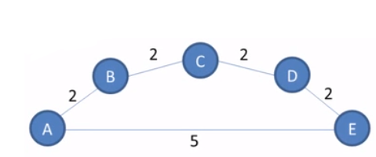
Dijkstra's algorithm
Dijkstra's algorithm (or Dijkstra's Shortest Path First algorithm, SPF algorithm)is an algorithm for finding the shortest paths between nodes in a graph.
It was conceived by Dutch computer scientist Edsger W. Dijkstra In 1956 and published three years later.

Slide 3
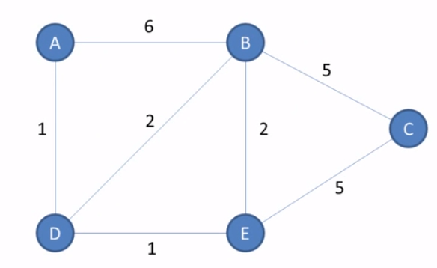
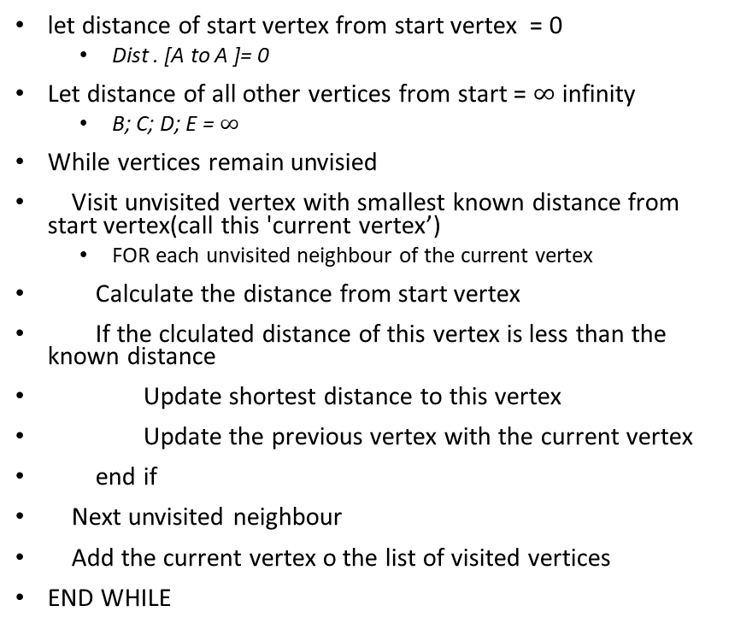
SPF
Visited | A
Unvisit | B, C, D, E
let distance of start vertex from start vertex = 0
Dist . [A to A ]= 0
Let distance of all other vertices from start = $∞$ infinity
B; C; D; E = $∞$
While vertices remain unvisied
Visit unvisited vertex with smallest known distance from start vertex(call this 'current vertex’)
FOR each unvisited neighbour of the current vertex
Calculate the distance from start vertex
If the clculated distance of this vertex is less than the known distance
Update shortest distance to this vertex
Update the previous vertex with the current vertex
end if
Next unvisited neighbour
Add the current vertex o the list of visited vertices
END WHILE
Shortest path: A, D, E, B, C, A
Visited | A, D, E, B
Unvisit | C
Notes:
Visited
Unvisit

Slide 4
SPF
Goal
Vertex | Shortest distance from A | Previous vertex
A | 0
B | 3 | D
C | 7 | E
D | 1 | A
E | 2 | D
Visited | A
Unvisited | B, C, D, E
Visited | A, D, E, B, C
Unvisited
Shortest path: A, D, E, B, C

Slide 5
SPF
Step1
Vertex | Shortest distance from A | Previous vertex
A | 0
B | ∞
C | ∞
D | ∞
E | ∞
∞
∞
∞
∞
Visited | A
Unvisited | B, C, D, E

Slide 6
SPF
Step2
Vertex | Shortest distance from A | Previous vertex
A | 0
B | 6 | A
C | ∞
D | 1 | A
E | ∞
6
∞
1
∞
Visited | A, D,
Unvisited | B, C, E

Slide 7
SPF
Step3
Vertex | Shortest distance from A | Previous vertex
A | 0
B | 3 | D
C | ∞
D | 1 | A
E | 2 | D
3
∞
1
2
Visited | A, D, E
Unvisited | B, C,

Slide 8
SPF
Step4
Vertex | Shortest distance from A | Previous vertex
A | 0
B | 3 | D
C | 5+1+1=7 | E
D | 1 | A
E | 2 | D
3
5
1
2
Visited | A, D, E, B
Unvisited | C,

Slide 9
SPF
Step4
Vertex | Shortest distance from A | Previous vertex
A | 0
B | 3 | D
C | 7 | E
D | 1 | A
E | 2 | D
3
7
1
2
Visited | A, D, E, B, C
Unvisited

Slide 10
SPF
Q1: SPF for SPF
Q2: SPF to TSP
TSP: have to visit all the nodes by the shortest path
SPF: have to find the shortest path from A to C(not need visit all the nodes)
Goal
Vertex | Shortest distance from A | Previous vertex
A | 0
B | 3 | D
C | 7 | E
D | 1 | A
E | 2 | D
Visited | A
Unvisited | B, C, D, E
Visited | A, D, E, B, C
Unvisited
Shortest path: A, D, E, B, C

Slide 11
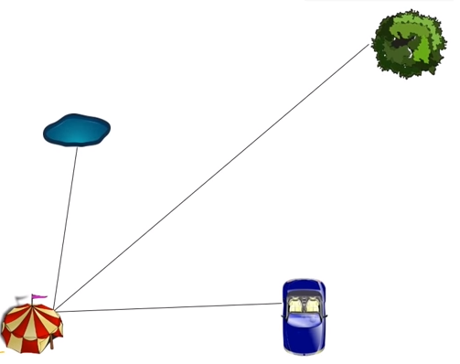
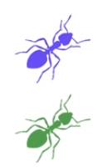

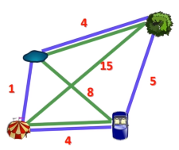
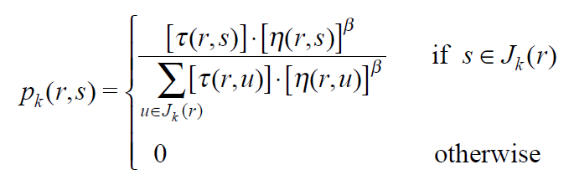
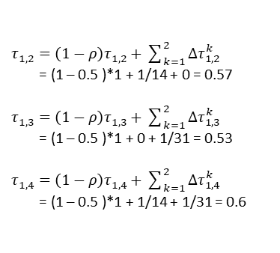

ACO
$$Δτ_{r,s}^{k}=\frac{1}{L_{k}}$$
k ant travels on the edge r,s
k1: L1 = 4 + 5 + 4 + 1 = 14 -> $Δτ_{r,s}^{1}$ = 1/14
k2: L2 = 4 + 8 + 4 + 15 = 31 -> $Δτ_{r,s}^{2}$ = 1/31
76%
Node 3
5%
Node 2
Node 1
Node 4
19%
(Heuristic approach)
Choose a node to move
Generate a path
Calculate total distance(length) of the path
Generate all path for all ants
Spread pheromone
Get the shortest path
$τ_{1,2}^{}=\left(1−ρ\right)τ_{1,2}^{}+\sum_{k=1}^{2}{Δτ_{1,2}^{k}}$
= (1 – 0.5 )*1 + 1/14 + 0 = 0.57
$τ_{1,3}^{}=\left(1−ρ\right)τ_{1,3}^{}+\sum_{k=1}^{2}{Δτ_{1,3}^{k}}$
= (1 – 0.5 )*1 + 0 + 1/31 = 0.53
$τ_{1,4}^{}=\left(1−ρ\right)τ_{1,4}^{}+\sum_{k=1}^{2}{Δτ_{1,4}^{k}}$
= (1 – 0.5 )*1 + 1/14 + 1/31 = 0.6
Node 3
Node 2
𝛼
𝛼
Node 1
Node 4

Slide 12
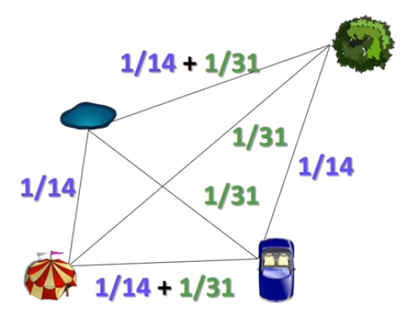
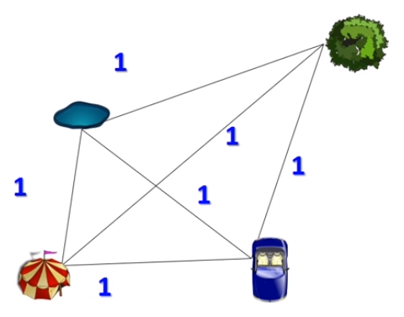
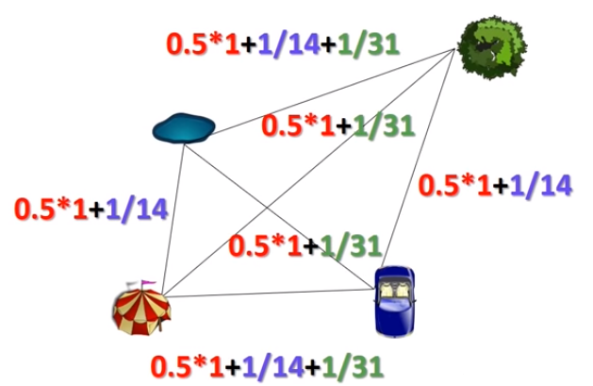

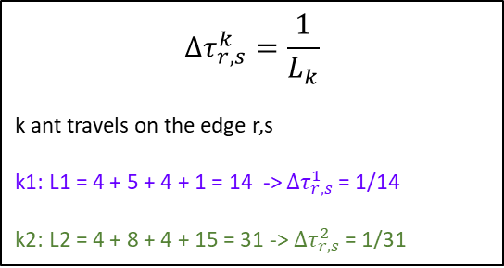
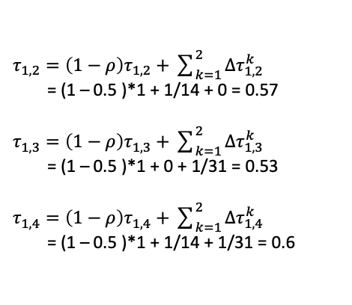

E.g. τ
𝛼
𝛼
Node 2
Node 3
k = 1 (purple path)
k = 2 (green path)
$$Δτ_{r,s}^{k}=\frac{1}{L_{k}}$$
k ant travels on the edge r,s
k1: L1 = 4 + 5 + 4 + 1 = 14 -> $Δτ_{r,s}^{1}$ = 1/14
k2: L2 = 4 + 8 + 4 + 15 = 31 -> $Δτ_{r,s}^{2}$ = 1/31
Node 1
Node 3
Node 4
Node 2
Let pheromone graph as $τ_{0}^{}=$1 for each path
Node 3
Node 1
Node 2
Node 4
Node 1
Node 4
Dist. | n1 | n2 | n3 | n4
n1 | 0 | 1 | 15 | 4
n2 | 1 | 0 | 4 | 8
n3 | 15 | 4 | 0 | 5
n4 | 4 | 8 | 5 | 0
$τ_{1,2}^{}=\left(1−ρ\right)τ_{1,2}^{}+\sum_{k=1}^{2}{Δτ_{1,2}^{k}}$
= (1 – 0.5 )*1 + 1/14 + 0 = 0.57
$τ_{1,3}^{}=\left(1−ρ\right)τ_{1,3}^{}+\sum_{k=1}^{2}{Δτ_{1,3}^{k}}$
= (1 – 0.5 )*1 + 0 + 1/31 = 0.53
$τ_{1,4}^{}=\left(1−ρ\right)τ_{1,4}^{}+\sum_{k=1}^{2}{Δτ_{1,4}^{k}}$
= (1 – 0.5 )*1 + 1/14 + 1/31 = 0.6
𝛼 = 1, 𝛽 = 1, m = 2, $ρ$ = 0.5
Notes:
A statistical analysis of parameter values for the rank-based ant colony optimization algorithm for the traveling salesperson problem
https://www.researchgate.net/publication/220636414_A_statistical_analysis_of_parameter_values_for_the_rank-based_ant_colony_optimization_algorithm_for_the_traveling_salesperson_problem
Ant Colony System: A Cooperative Learning Approach to the Traveling Salesman Problem
https://www.researchgate.net/publication/220636414_A_statistical_analysis_of_parameter_values_for_the_rank-based_ant_colony_optimization_algorithm_for_the_traveling_salesperson_problem

Slide 13
E.g. Probability
Node 2
Node 3
k = 1 (purple path)
k = 2 (green path)
Node 1
Node 3
Node 4
Node 2
k=1,
p1(1,2) = (0.57)^1 * (1/1)^ 1 /
((0.57)^1 * (1/1)^1 +
(0.57)^1 * (1/15)^1 +
(0.57)^1 * (1/4)^1)) = 0.76
p1(1,3) = (0.53)^1 * (1/15)^ 1 /
((0.53)^1 * (1/1)^1 +
(0.53)^1 * (1/15)^1 +
(0.53)^1 * (1/4)^1)) = 0.05
p1(1,4) = (0.60)^1 * (1/4)^ 1 /
((0.60)^1 * (1/1)^1 +
(0.60)^1 * (1/15)^1 +
(0.60)^1 * (1/4)^1)) = 0.19
𝛼
𝛼
Node 1
Node 4
where: η(r,s) =1/d (r,s)
E.g. η(n1,n4) =1/4 (dist: n1 to n4)
Dist. | n1 | n2 | n3 | n4
n1 | 0 | 1 | 15 | 4
n2 | 1 | 0 | 4 | 8
n3 | 15 | 4 | 0 | 5
n4 | 4 | 8 | 5 | 0
76%
Node 3
5%
Node 2
roulette random number in [0,1]:
0≤ r ≤0.05 = Node 3
0.05< r ≤ (0.05 + 0.19 = 0.24) = Node 4
0.24< r ≤ (0.24 + 0.76 = 1.00 ) = Node 2
𝛼 = 1, 𝛽 = 1, m = 2, $ρ$ = 0.5
Node 1
Node 4
19%
Notes:
A statistical analysis of parameter values for the rank-based ant colony optimization algorithm for the traveling salesperson problem
https://www.researchgate.net/publication/220636414_A_statistical_analysis_of_parameter_values_for_the_rank-based_ant_colony_optimization_algorithm_for_the_traveling_salesperson_problem
Ant Colony System: A Cooperative Learning Approach to the Traveling Salesman Problem
https://www.researchgate.net/publication/220636414_A_statistical_analysis_of_parameter_values_for_the_rank-based_ant_colony_optimization_algorithm_for_the_traveling_salesperson_problem

