Slide 1


4th March 2019
KUAN SAO I​​
201855817​​
Dept. of IT Convergence and Application Engineering​​

Slide 2
Content
Spark
RDD
DataFrame
MLib
ML Package

Slide 3
Spark
Open-source
Distributed querying and processing
MapReduce
Up to 100 times faster than Apache Hadoop when data is stored in memory
Up to 10 times when accessing disk
Notes:
Apache Spark is an open-source powerful distributed querying and processing engine. It provides flexibility and extensibility of MapReduce but at significantly higher speeds: Up to 100 times faster than Apache Hadoop when data is stored in memory and up to 10 times when accessing disk.

Slide 4
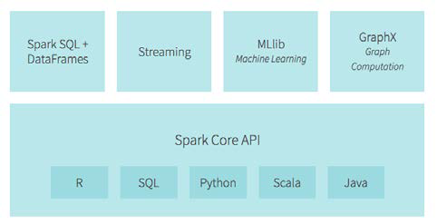
Spark
Read, transform, and aggregate data
Train and deploy statistical models
Java, Scala, Python, R and SQL
MLlib and ML for machine learning
GraphX and GraphFrames for graph processing
Spark Streaming (DStreams and Structured)
Notes:
Apache Spark allows the user to read, transform, and aggregate data, as well as train
and deploy sophisticated statistical models with ease. The Spark APIs are accessible
in Java, Scala, Python, R and SQL. Also, delivered with Apache Spark are several
already implemented and tuned algorithms, statistical models, and frameworks:
MLlib and ML for machine learning, GraphX and GraphFrames for graph
processing, and Spark Streaming (DStreams and Structured).

Slide 5
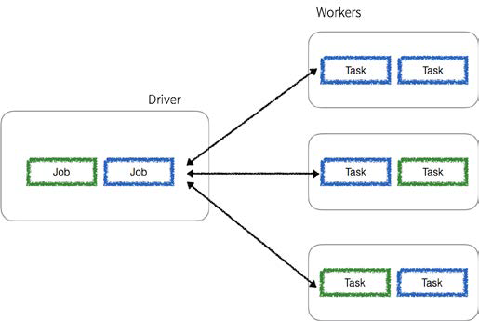
Spark
Any Spark application spins off a single driver process on the master node that then directs executor processes distributed to a number of worker nodes as noted in the following diagram:
Notes:
Any Spark application spins off a single driver process (that can contain multiple jobs) on the master node that then directs executor processes (that contain multiple tasks) distributed to a number of worker nodes as noted in the following diagram:

Slide 6
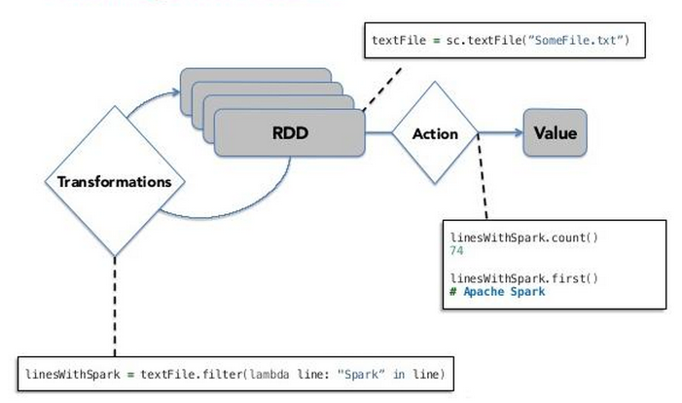
RDD
JVM objects - Resilient Distributed Datasets
RDDs are the backbone of Spark -the dataset is distributed; it is split into chunks based on some key and distributed to executor nodes.
Parallel, lazy
Spark Operations: Transformations and Actions
Notes:
Apache Spark is built around a distributed collection of immutable Java Virtual Machine (JVM) objects called Resilient Distributed Datasets (RDDs for short).
RDDs are the backbone of Spark: the dataset is distributed; it is split into chunks based on some key and distributed to executor nodes.
RDDs operate in parallel. This is the strongest advantage of working in Spark: Each transformation is executed in parallel for enormous increase in speed.
RDD transformation operations are lazy in a sense that they do not compute their results immediately.
The transformations are only computed when an action is executed and the results need to be returned to the driver.
RDDs have two sets of parallel operations: transformations and actions.

Slide 7
RDD
Transformations :
Shape the dataset
Actions :
Execute the scheduled task on the dataset
.map(...)
.filter(...)
.flatMap(...)
.distinct(...)
.sample(...)
.leftOuterJoin(...)
.repartition(...)
.take(...)
.collect(...)
.reduce(...)
.count(...)
.saveAsTextFile(...)
.foreach(...)
Notes:
Transformations shape your dataset. These include mapping, filtering, joining, and transcoding the values in your dataset.
Actions, execute the scheduled task on the dataset; once you have finished transforming your data you can execute your transformations.

Slide 8
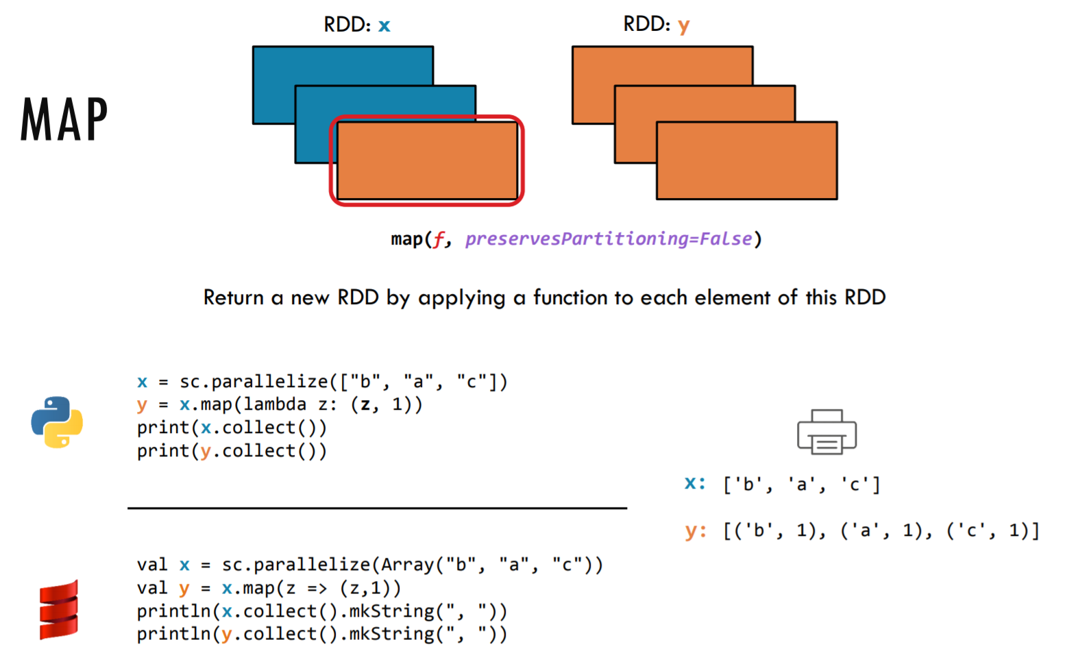
Example
Notes:
RDDs can be created by 2 ways:
1.Parallelizing existing collection.
2.Loading external dataset from HDFS.

Slide 9
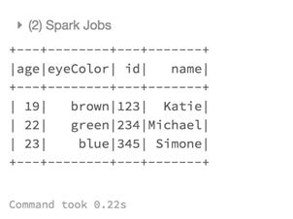
DataFrame
A DataFrame is an immutable distributed collection of data that is organized into named columns analogous to a table in a relational database.

Slide 10
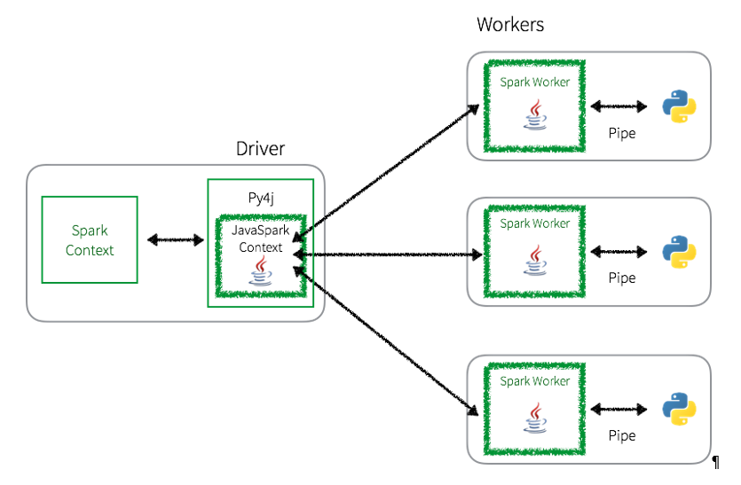
DataFrame
Whenever a PySpark program is executed using RDDs, there is a potentially large overhead to execute the job.
Once these tasks are pushed out to the Spark Worker(s), PythonRDD objects launch Python subprocesses using pipes to send both code and data to be processed within Python:
Notes:
Whenever a PySpark program is executed using RDDs, there is a potentially large
overhead to execute the job. As noted in the following diagram, in the PySpark
driver, the Spark Context uses Py4j to launch a JVM using the JavaSparkContext.
Any RDD transformations are initially mapped to PythonRDD objects in Java.
Once these tasks are pushed out to the Spark Worker(s), PythonRDD objects launch
Python subprocesses using pipes to send both code and data to be processed within
Python:

Slide 11
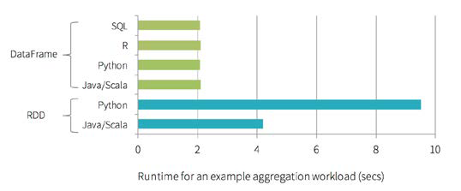
DataFrame
The significance of DataFrames and the Catalyst Optimizer (and Project Tungsten) is the increase in performance of PySpark queries when compared to non-optimized RDD queries.
With DataFrames, not only was there a significant improvement in Python performance, there is now performance parity between Python, Scala, SQL, and R.
Notes:
The significance of DataFrames and the Catalyst Optimizer (and Project Tungsten) is the increase in performance of PySpark queries when compared to non-optimized RDD queries.
As shown in the following figure, prior to the introduction of DataFrames, Python query speeds were often twice as slow as the same Scala queries using RDD. Typically, this slowdown in query performance was due to the communications overhead between Python and the JVM:

Slide 12
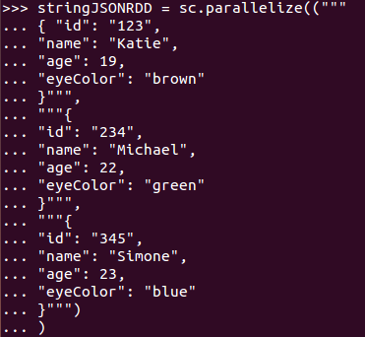
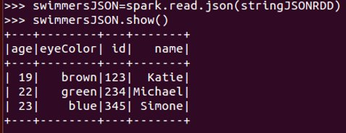
Example

Slide 13
MLib
At the high level, MLlib exposes three core machine learning functionalities:
Data preparation: Feature extraction, transformation, selection, hashing of categorical features, and some natural language processing methods
Machine learning algorithms: Some popular and advanced regression, classification, and clustering algorithms are implemented
Utilities: Statistical methods such as descriptive statistics, chi-square testing, linear algebra (sparse and dense matrices and vectors), and model evaluation methods

Slide 14
Example
Built a linear regression classification model.
Using a portion of the US 2014 and 2015 birth data.
Downloaded from https://www.cdc.gov/nchs/data_access/vitalstatsonline.htm
From the total of 300 variables we selected 85 features that will be used to build the models.
Also, out of the total of almost 7.99 million records, we selected a balanced sample of 45,429 records: 22,080 records where infants were reported dead and 23,349 records with infants alive.

Slide 15
Flow
Loading and transforming the data
Predicting infant survival
Creating the final dataset
Getting to know the data
Descriptive statistics
Creating an RDD of LabeledPoints
Correlations
Statistical testing
Splitting into training and testing
Logistic regression in MLlib

Slide 16
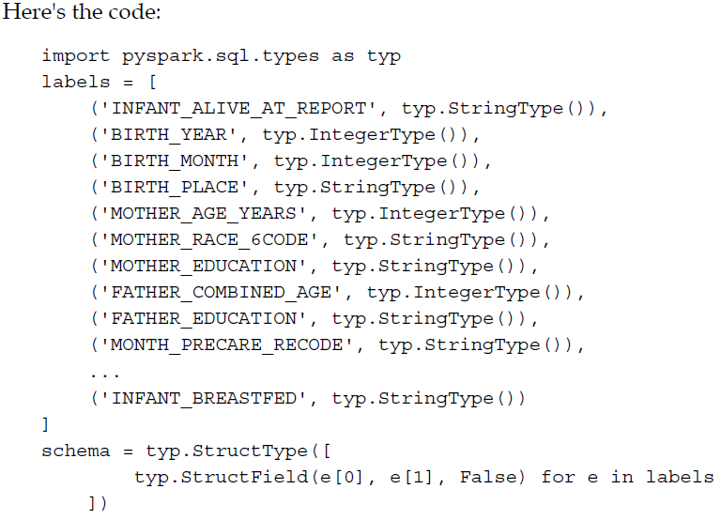
Loading and transforming the data

Slide 17

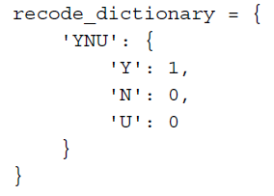
Loading and transforming the data

Slide 18
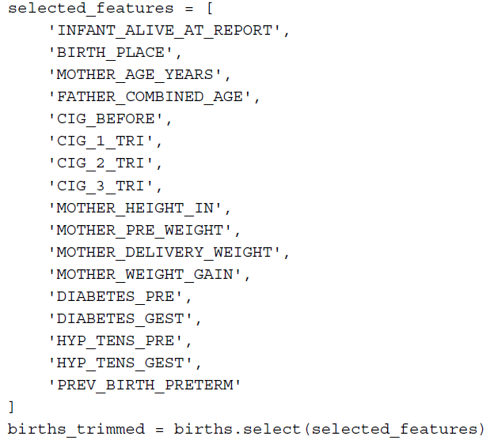
Loading and transforming the data

Slide 19
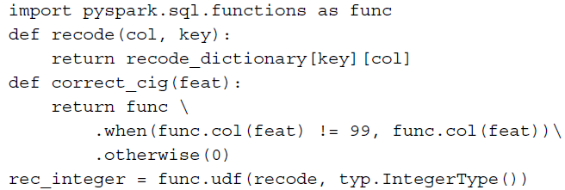
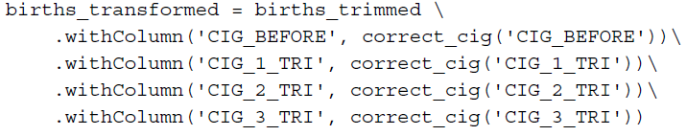
Loading and transforming the data

Slide 20
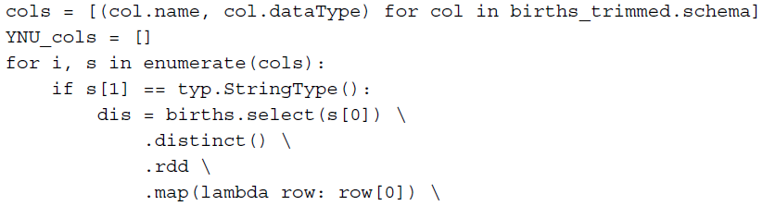

Loading and transforming the data

Slide 21
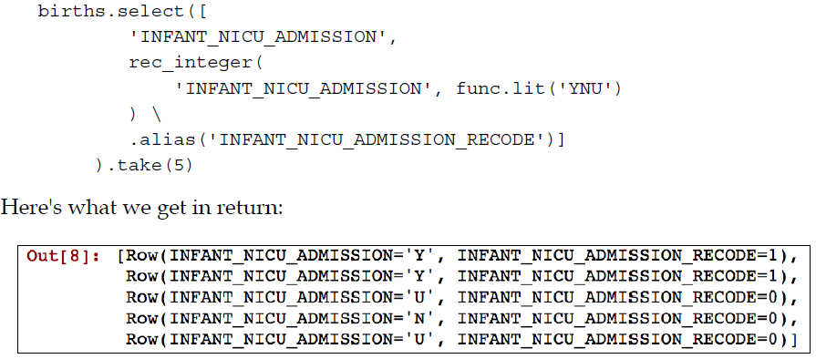
Loading and transforming the data

Slide 22
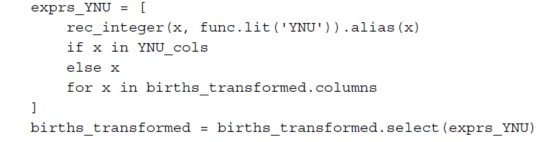
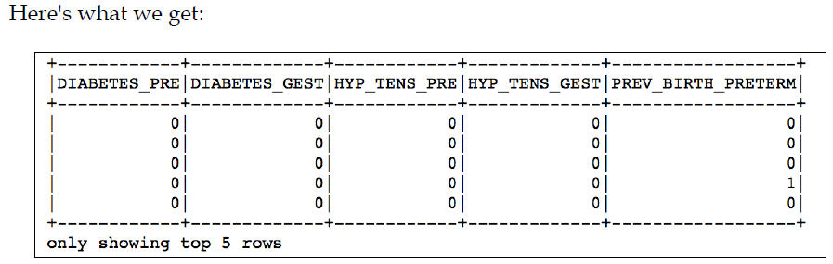
Loading and transforming the data

Slide 23
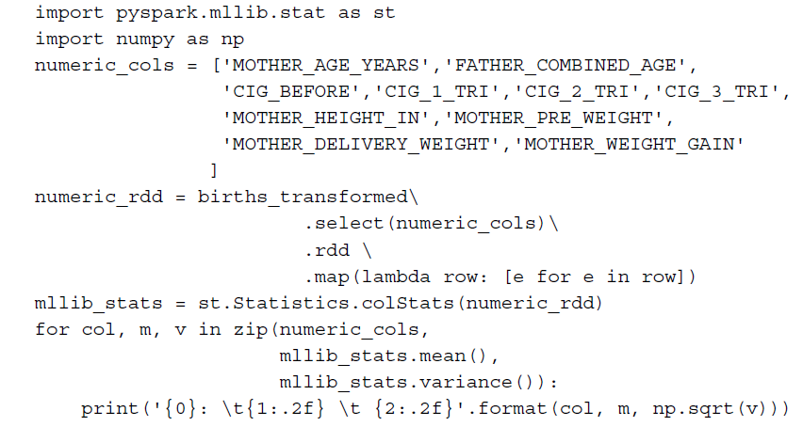
Getting to know the data Descriptive statistics

Slide 24
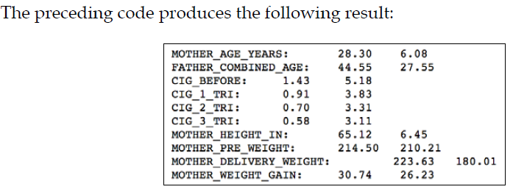
Getting to know the data Descriptive statistics

Slide 25
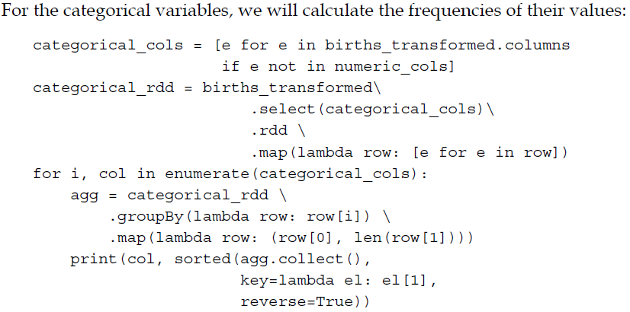
Getting to know the data Descriptive statistics

Slide 26
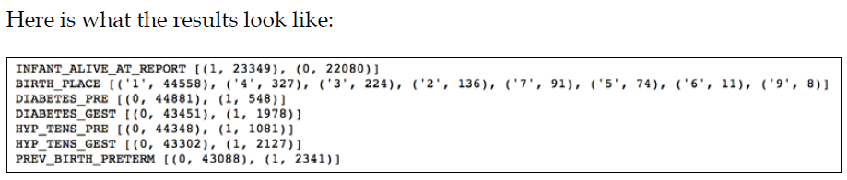
Creating the final dataset Descriptive statistics

Slide 27
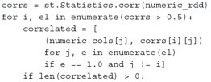
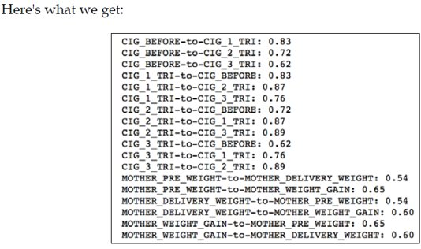

Creating the final dataset Correlations

Slide 28
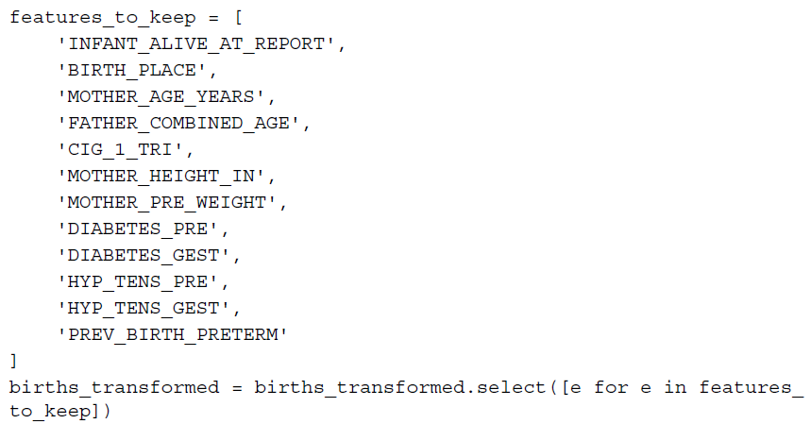
Creating the final dataset Correlations

Slide 29
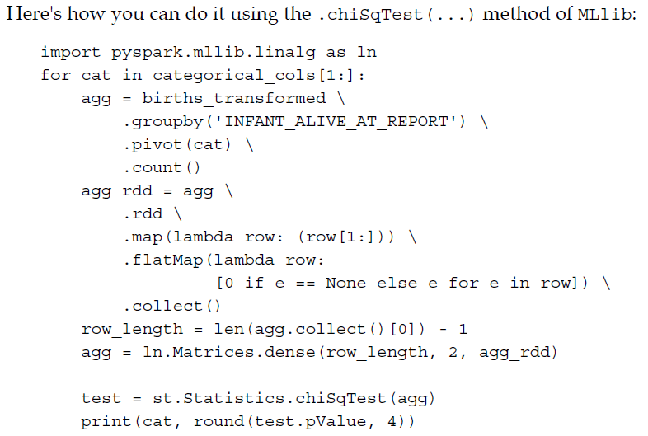
Getting to know the data Statistical testing

Slide 30
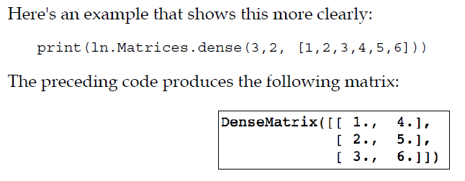
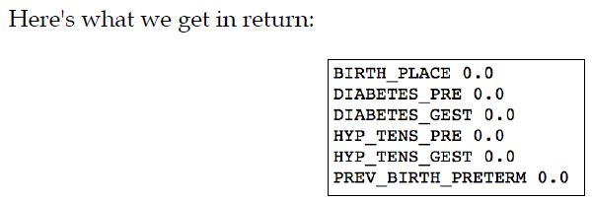
Getting to know the data Statistical testing

Slide 31
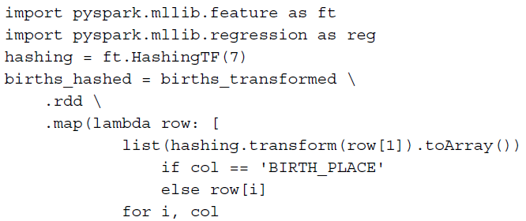
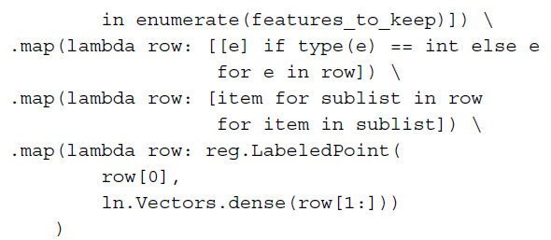
Creating the final dataset Creating an RDD of LabeledPoints

Slide 32
Creating the final dataset Splitting into training and testing

Slide 33
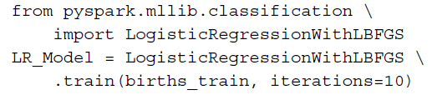
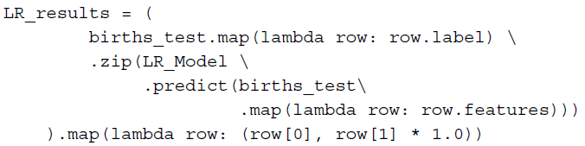
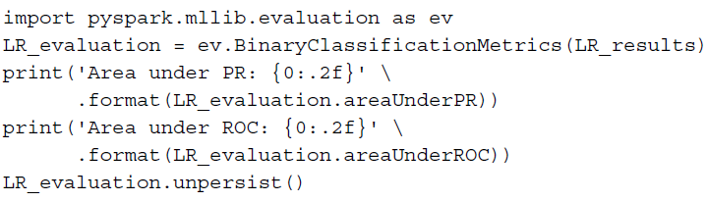

Predicting infant survival Logistic regression in MLlib

Slide 34
ML Package
PySpark ML: the official main machine learning library for PySpark.
MLlib package in Spark that operated strictly on RDDs.
ML part of Spark that operates strictly on DataFrames.
At the top level, the package exposes three main abstract classes: a Transformer, an Estimator, and a Pipeline.

Slide 35
Transformer
Transformer: A Transformer is an algorithm which can transform one DataFrame into another DataFrame.
E.g., an ML model is a Transformer which transforms DataFrame with features into a DataFrame with predictions.
Notes:
The Transformer class, like the name suggests, transforms your data by (normally) appending a new column to your DataFrame.

Slide 36
Estimator
Estimator: An Estimator is an algorithm which can be fit on a DataFrame to produce a Transformer.
E.g., a learning algorithm is an Estimator which trains on a DataFrame and produces a model.
Estimators can be thought of as statistical models that need to be estimated to make predictions or classify your observations.
Classification
Regression
Clustering

Slide 37
Pipeline
Pipeline: A Pipeline chains multiple Transformers and Estimators together to specify an ML workflow.
A Pipeline in PySpark ML is a concept of an end-to-end transformation-estimation process (with distinct stages) that ingests some raw data (in a DataFrame form), performs the necessary data carpentry (transformations), and finally estimates a statistical model (estimator).

Slide 38
ML 6.2.1~6.4.3
https://hub.packtpub.com/ml-package/

Slide 39
Reference
Learning PySpark by Tomasz Drabas, Denny Lee
Build data-intensive applications locally and deploy at scale using the combined powers of Python and Spark 2.0
https://github.com/drabastomek/learningPySpark

Slide 40
The End Thank you
KUAN SAO I​​
201855817​​
Dept. of IT Convergence and Application Engineering​​

