Slide 1
Python
K-NN(k-Nearest Neighbours Algorithm)

Slide 2
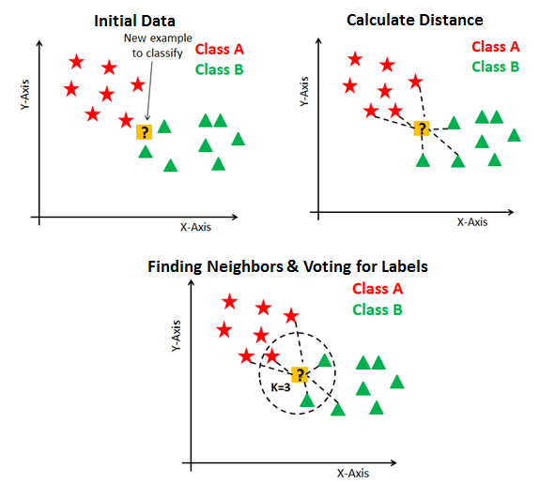
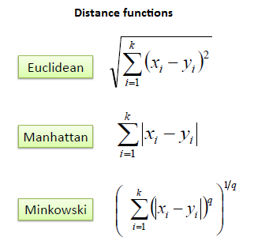
K-NN
Supervised Learning
Solve the classification model problems
Create an imaginary boundary to classify the data
To predict that to the nearest of the boundary line
** Choose right k-value (to avoid overfitting and underfitting of the dataset)
K-NN Classification
- Used to predict class for new data
- choose k-nearest neighbours and predict class of new data with most chosen class
K-NN Regression
- Used to predict value of new data
- choose k-nearest neighbours and predict target value of new data with the average of K’s target value
K-NN works
1) Calculate distance
2) Find Nearest neighbors
3) Vote for labels

Slide 3
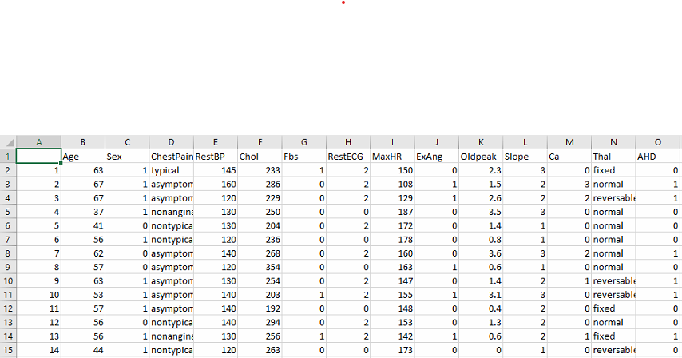
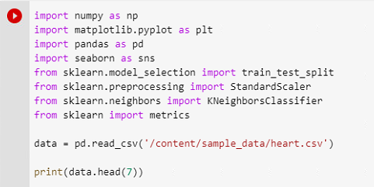
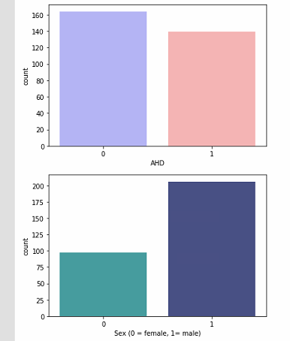
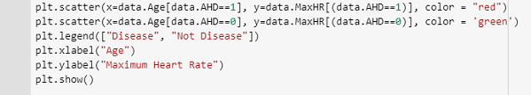
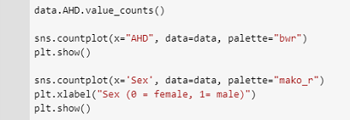
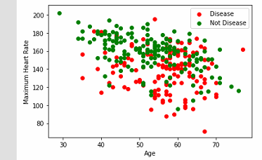
Heart disease classifier using K-NN algorithm
pandas
- an open source
- BSD-licensed library providing high-performance
- easy-to-use data structures and data analysis tools for the Python programming language.
Seaborn
- python data visualization library based on matplotlib
Sklearn
- Simple and efficient tools for data mining and data analysis
- Accessible to everybody, and reusable in various contexts

Slide 4
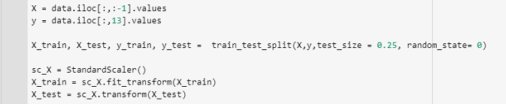
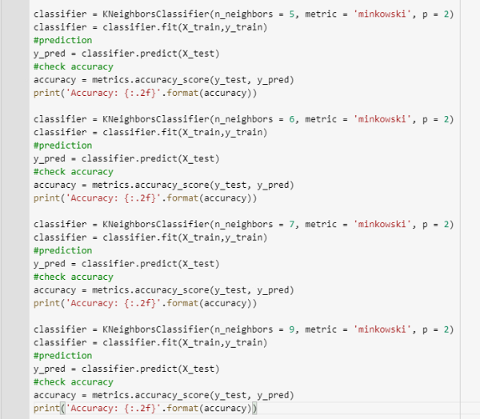
X(matrix of independent variables)
y(vector of the dependent variable)
data.iloc[<row selection>, <column selection>] -> pandas selection methods
train_test_split() -> split arrays or matrices into random train and test subsets
StandardScaler() -> removing the mean and scaling to unit variance
Fit_transform() -> compute mean and variance and then perform standardization
Accuracy_score() -> accuracy classification score
Accuracy: 0.82 (k=5)
Accuracy: 0.86 (k=6)
Accuracy: 0.87 (k=7) ←
Accuracy: 0.86 (k=9)

Slide 5
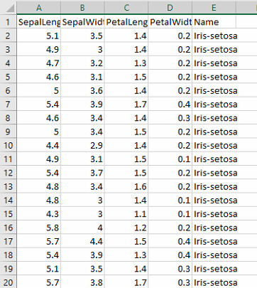
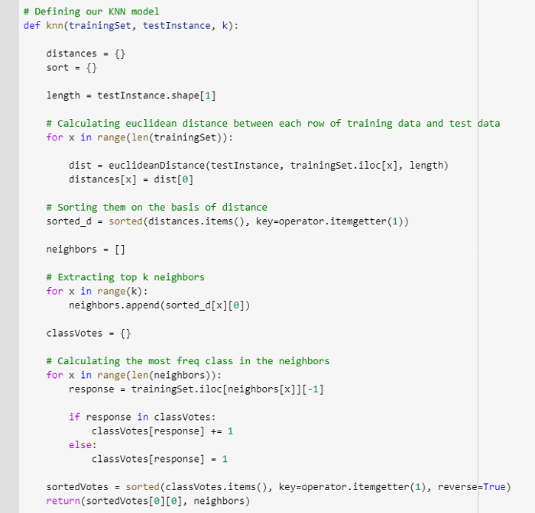
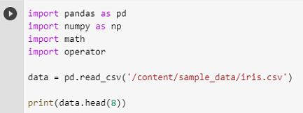
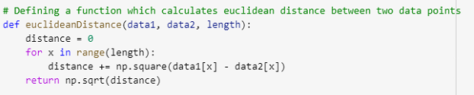
Predict class using K-NN algorithm

Slide 6
