Slide 1

FROM DATA TO DISCOVERY:
EXPLORATORY DATA ANALYSIS OF YOUTUBE VIDEOS
IN JAPAN

Slide 2



Group members
NGUYEN VUONG QUYNH TRANG
HOANG MINH HIEU
22229565
22229527

Slide 3
RESEARCH QUESTION 1
&
HYPOTHESIS
OVERVIEW
Table of Contents
RESEARCH QUESTION 2
&
HYPOTHESIS
CONCLUSION

Slide 4
Overview
This dataset comprises information on 600 music videos from the YouTube Data API, focusing on the Japanese region.
The analysis explored the relationships between video characteristics (length, upload time) and viewership metrics (views count).

Slide 5

Research Question: How does video length affect view count?
Hypothesis: Shorter videos receive more views than longer videos
Research Question 1 & Hypothesis

Slide 6
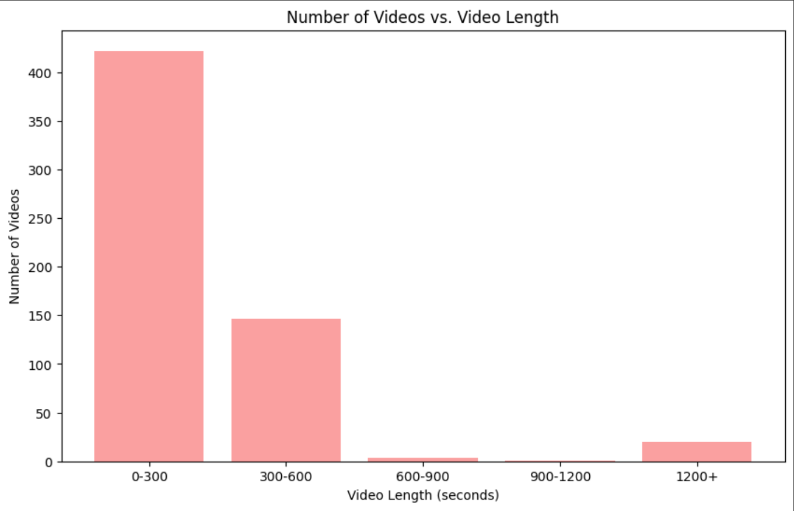

Slide 7
Most videos are under 1200 seconds (20 minutes)
Video Count
vs
Video Length
Highest number of videos (>400) focused on 0-300 seconds (0-5 minutes)
The video count shows that the general type of videos on YouTube Japan is short videos.

Slide 8
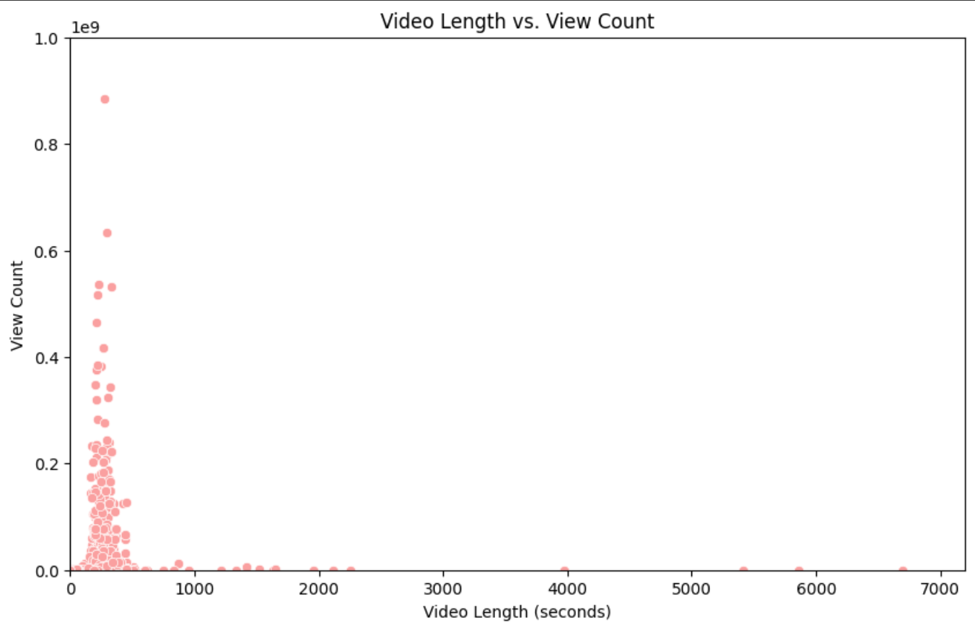

Slide 9
It highlights a concentration of high video views within a specific video length range:
300-600 seconds (5-10 minutes)
Video Length
vs
Views Count
The video has the highest view was 885497168 views
(Lemon - Kenshi Yonezu )
The views count shows that YouTube viewers in Japan prefer short videos (such as music videos )

Slide 10
Correlation between video length and view count: -0.05889642350536293
Hypothesis: Shorter videos receive more views than longer videos
Result:
=>
Compare the result to our Hypothesis

Slide 11
Research Question: What is the relationship between the release date (e.g., day of the week, month, season) and the number of views a video receives?
Hypothesis: Videos released on weekends receive higher views compared to those released during weekdays, or during summer receive higher views due to more leisure time for viewers.
Research Question 2 & Hypothesis

Slide 12
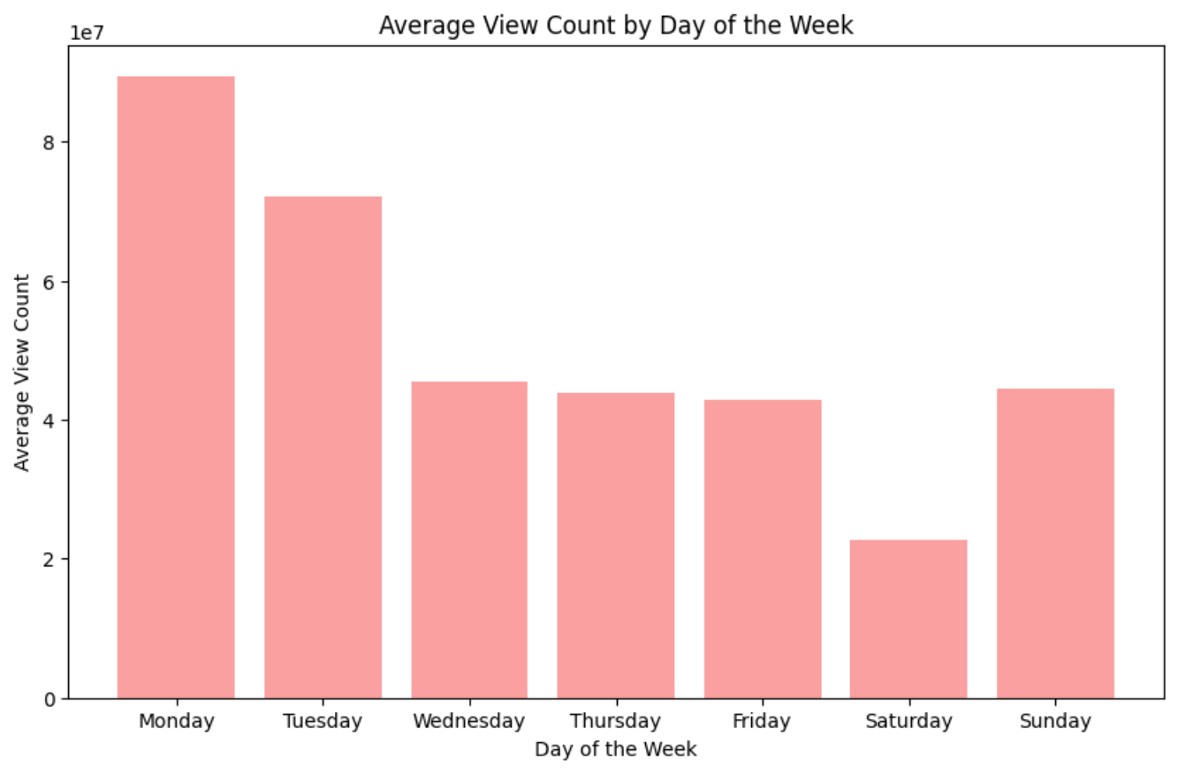

Slide 13
Videos released on Monday have higher view than videos release on other days of the week
Views Count
vs
Release date
(Day of the week)
Videos released on Saturday have the lowest average views count

Slide 14
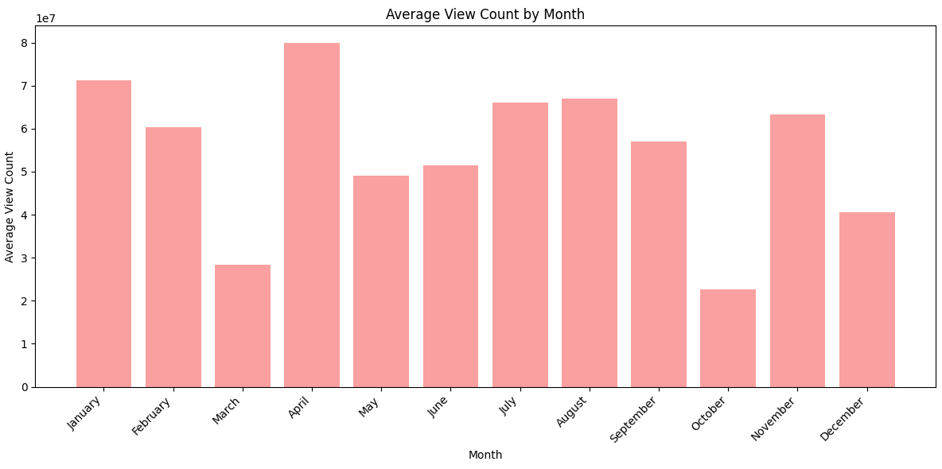

Slide 15
Videos released in March and October have lower views count than videos released in other months
Views Count
vs
Release date
(Month)
Videos released in April have the highest average views count

Slide 16
Hypothesis: Videos released on weekends receive higher views compared to those released during weekdays, or during summer receive higher views due to more leisure time for viewers.
Result:
=>
Compare the result to our Hypothesis

Slide 17




ADD A MAIN POINT
ADD A MAIN POINT
Briefly elaborate on what you want to discuss.
Briefly elaborate on what you want to discuss.
Conclusion
ADD A MAIN POINT
ADD A MAIN POINT
Briefly elaborate on what you want to discuss.
Briefly elaborate on what you want to discuss.

Slide 18
Write your topic or idea
ADD A MAIN POINT
ADD A MAIN POINT
ADD A MAIN POINT
Briefly elaborate on what
you want to discuss.
Briefly elaborate on what
you want to discuss.
Briefly elaborate on what
you want to discuss.

Slide 19
ADD A MAIN POINT
ADD A MAIN POINT
Briefly elaborate on what
you want to discuss.
Briefly elaborate on what
you want to discuss.
References
ADD A MAIN POINT
ADD A MAIN POINT
Briefly elaborate on what
you want to discuss.
Briefly elaborate on what
you want to discuss.

Slide 20

Thank you for listening

