Slide 1
Ian Crane
Metis
Data Science
Fall 2014

Slide 2
Visualizing Trends in Music

Slide 3


+
Musical Parameters
Audio Qualities
Album Metadata
Popularity

Slide 4
Rock bands (mostly) active for at least 30 years
Aerosmith
Allman Brothers
The Beach Boys
Cheap Trick
Chicago
The Cure
The Eagles
Fleetwood Mac
Genesis
Golden Earring
Iron Maiden
Jethro Tull
Journey
Judas Priest
Kiss
Metallica
Motorhead
Pink Floyd
Queen
Red Hot Chili Peppers
The Rolling Stones
Rush
Simple Minds
Slayer
U2
Van Halen
The Who
Yes
ZZ Top

Slide 5
Are the older songs of these bands still the most popular?

Slide 6
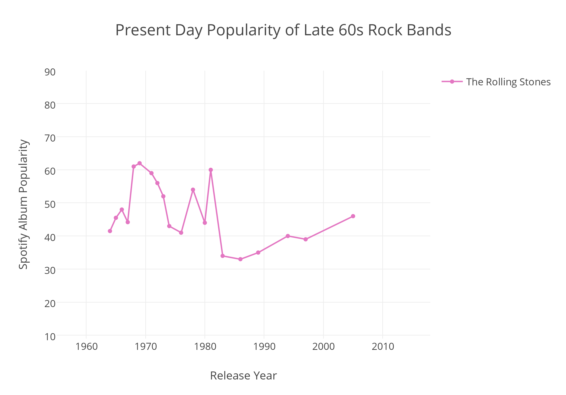

Slide 7
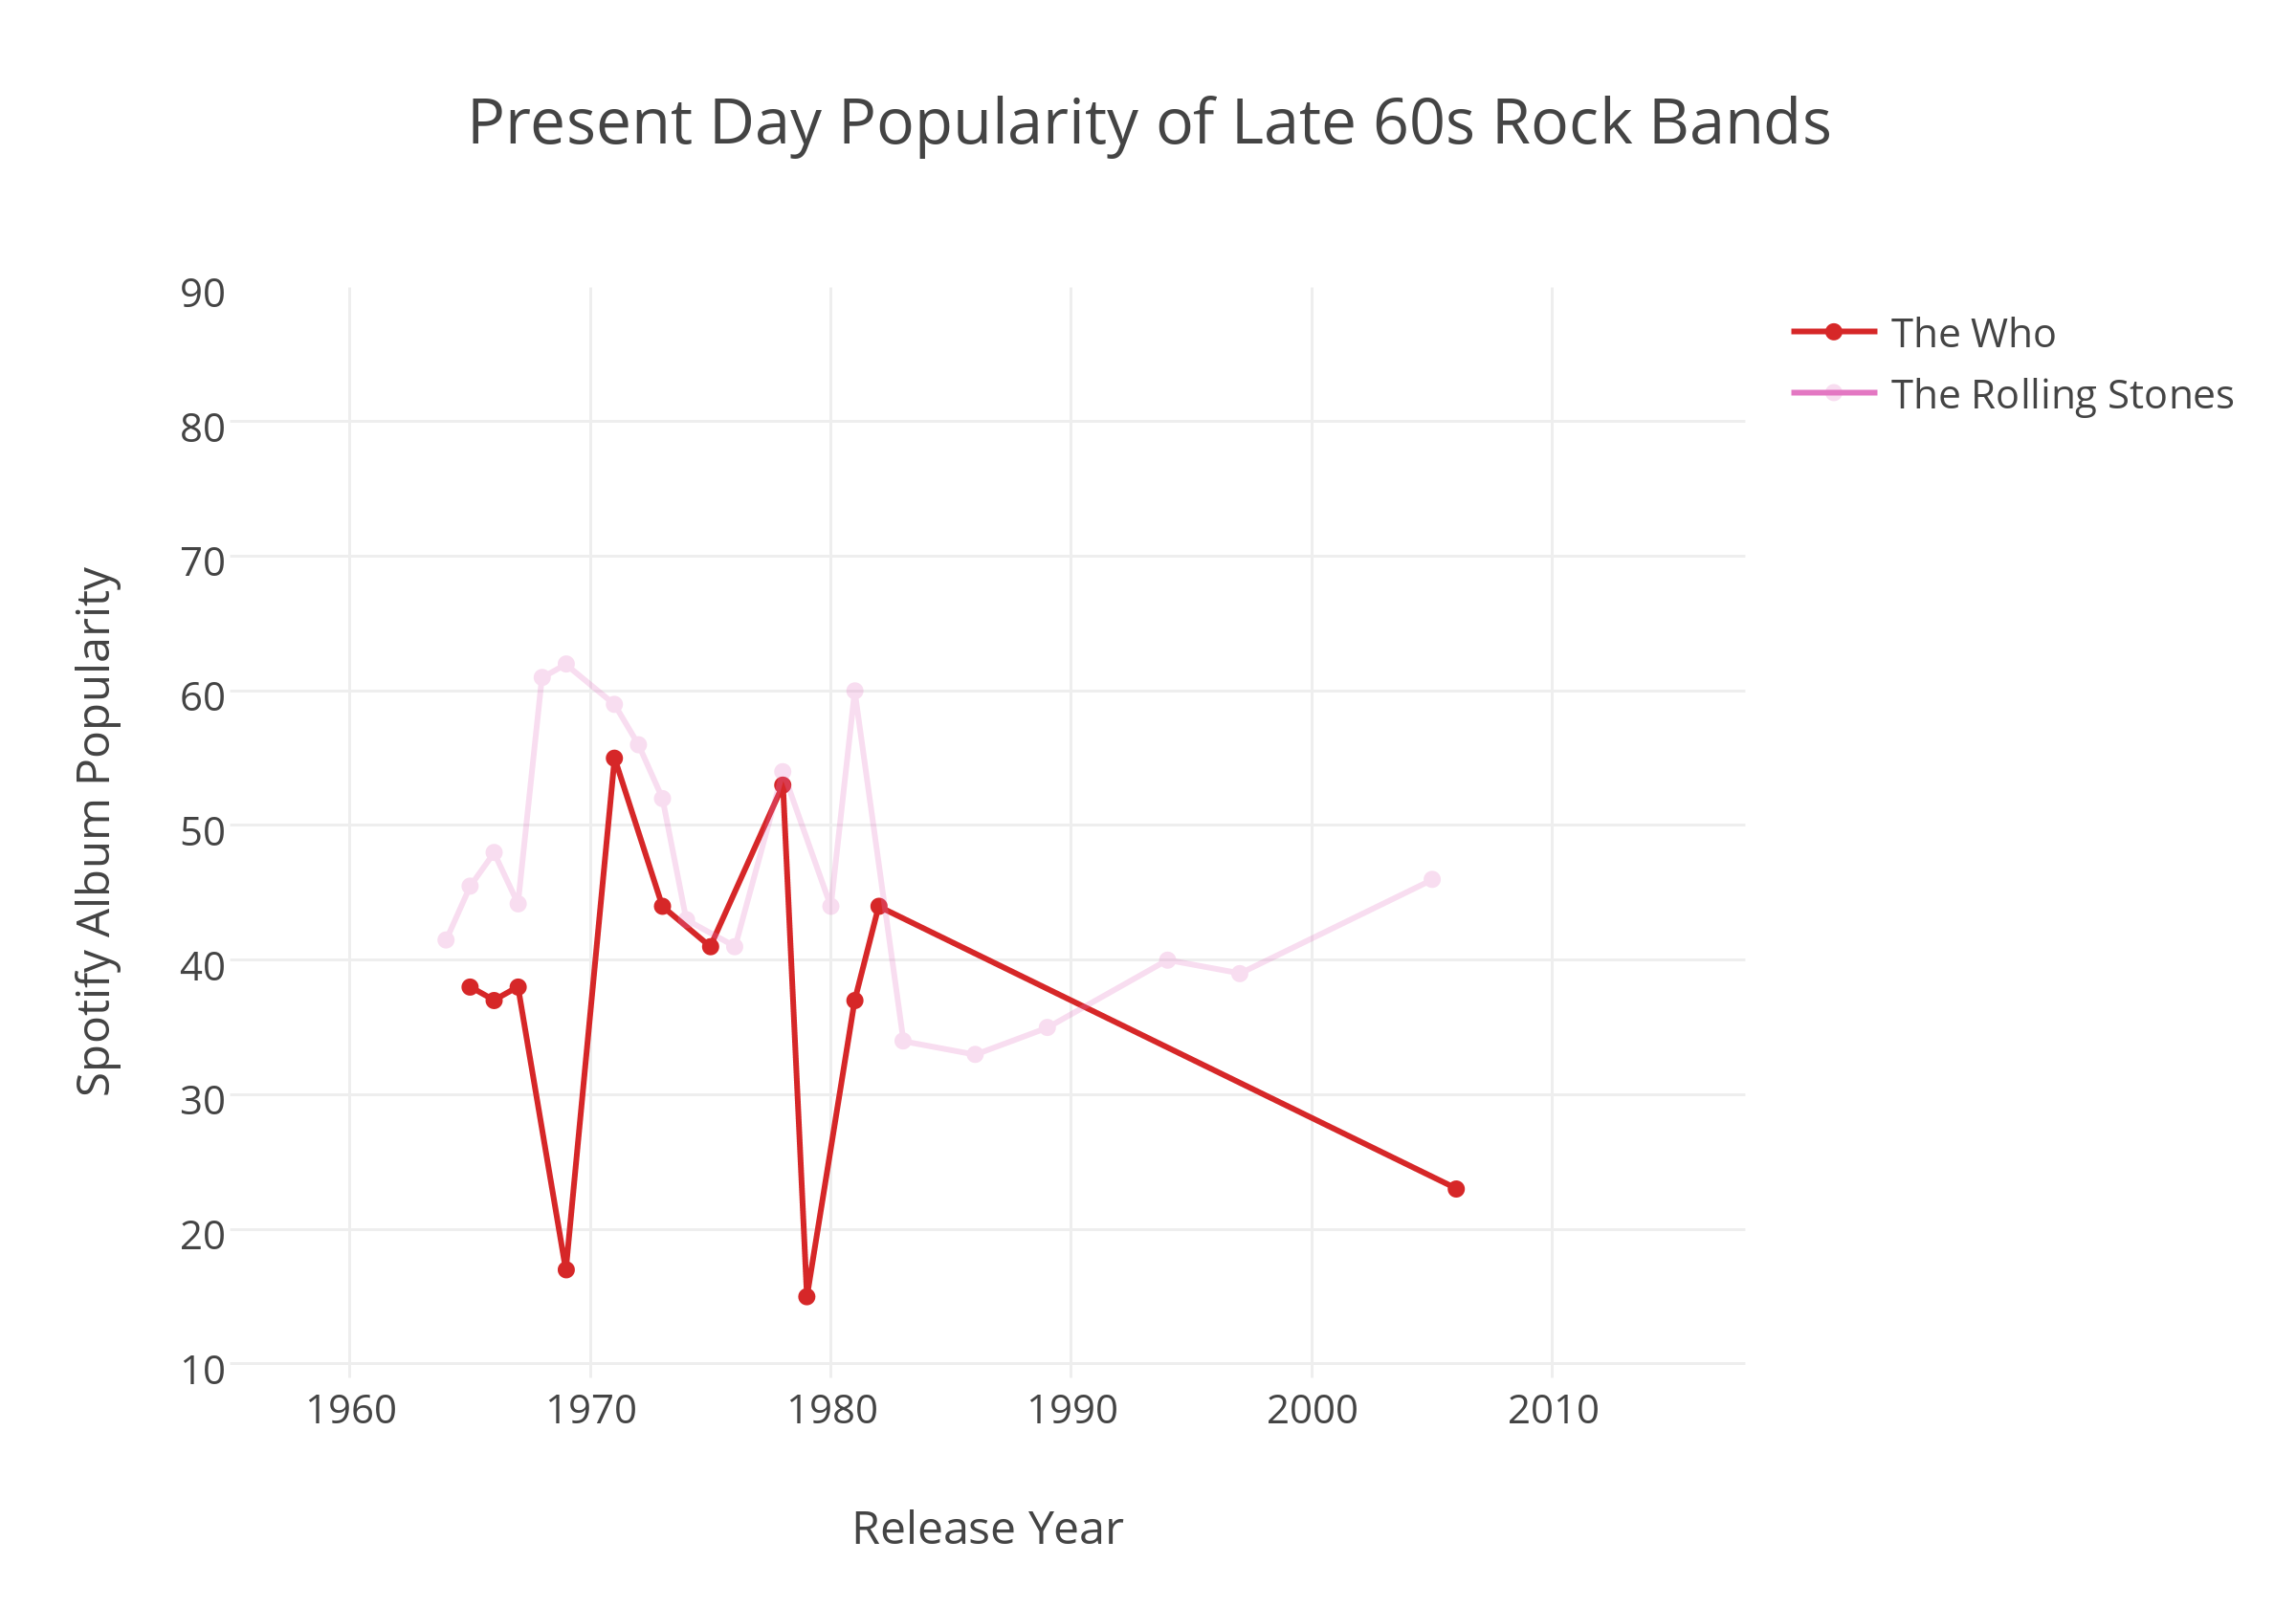

Slide 8
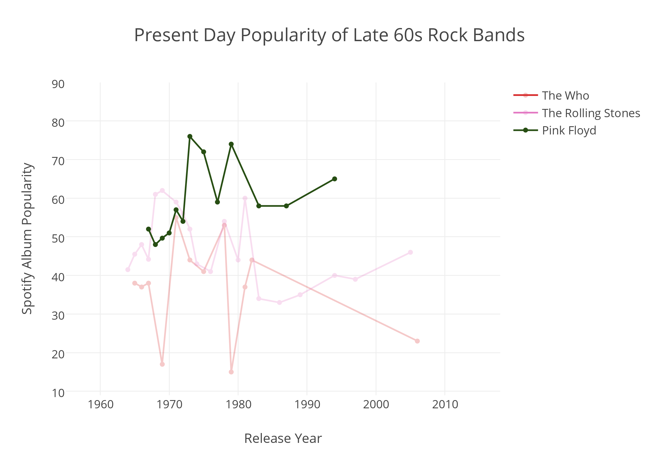

Slide 9
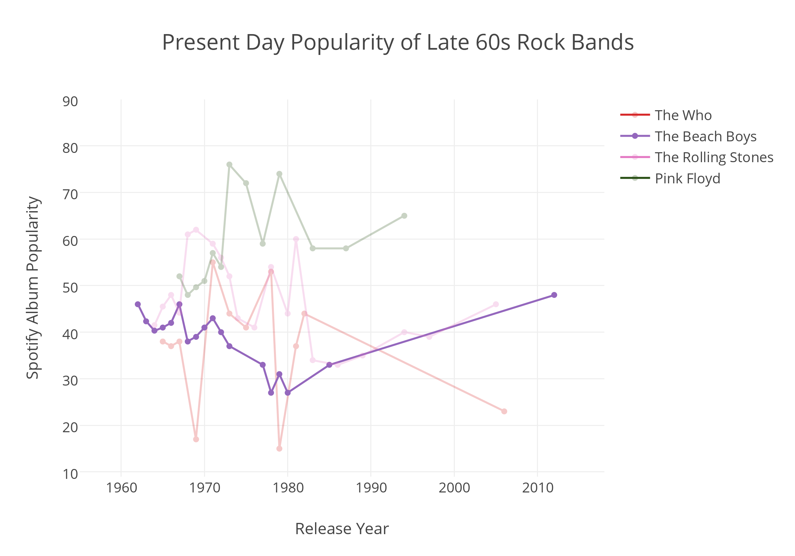

Slide 10
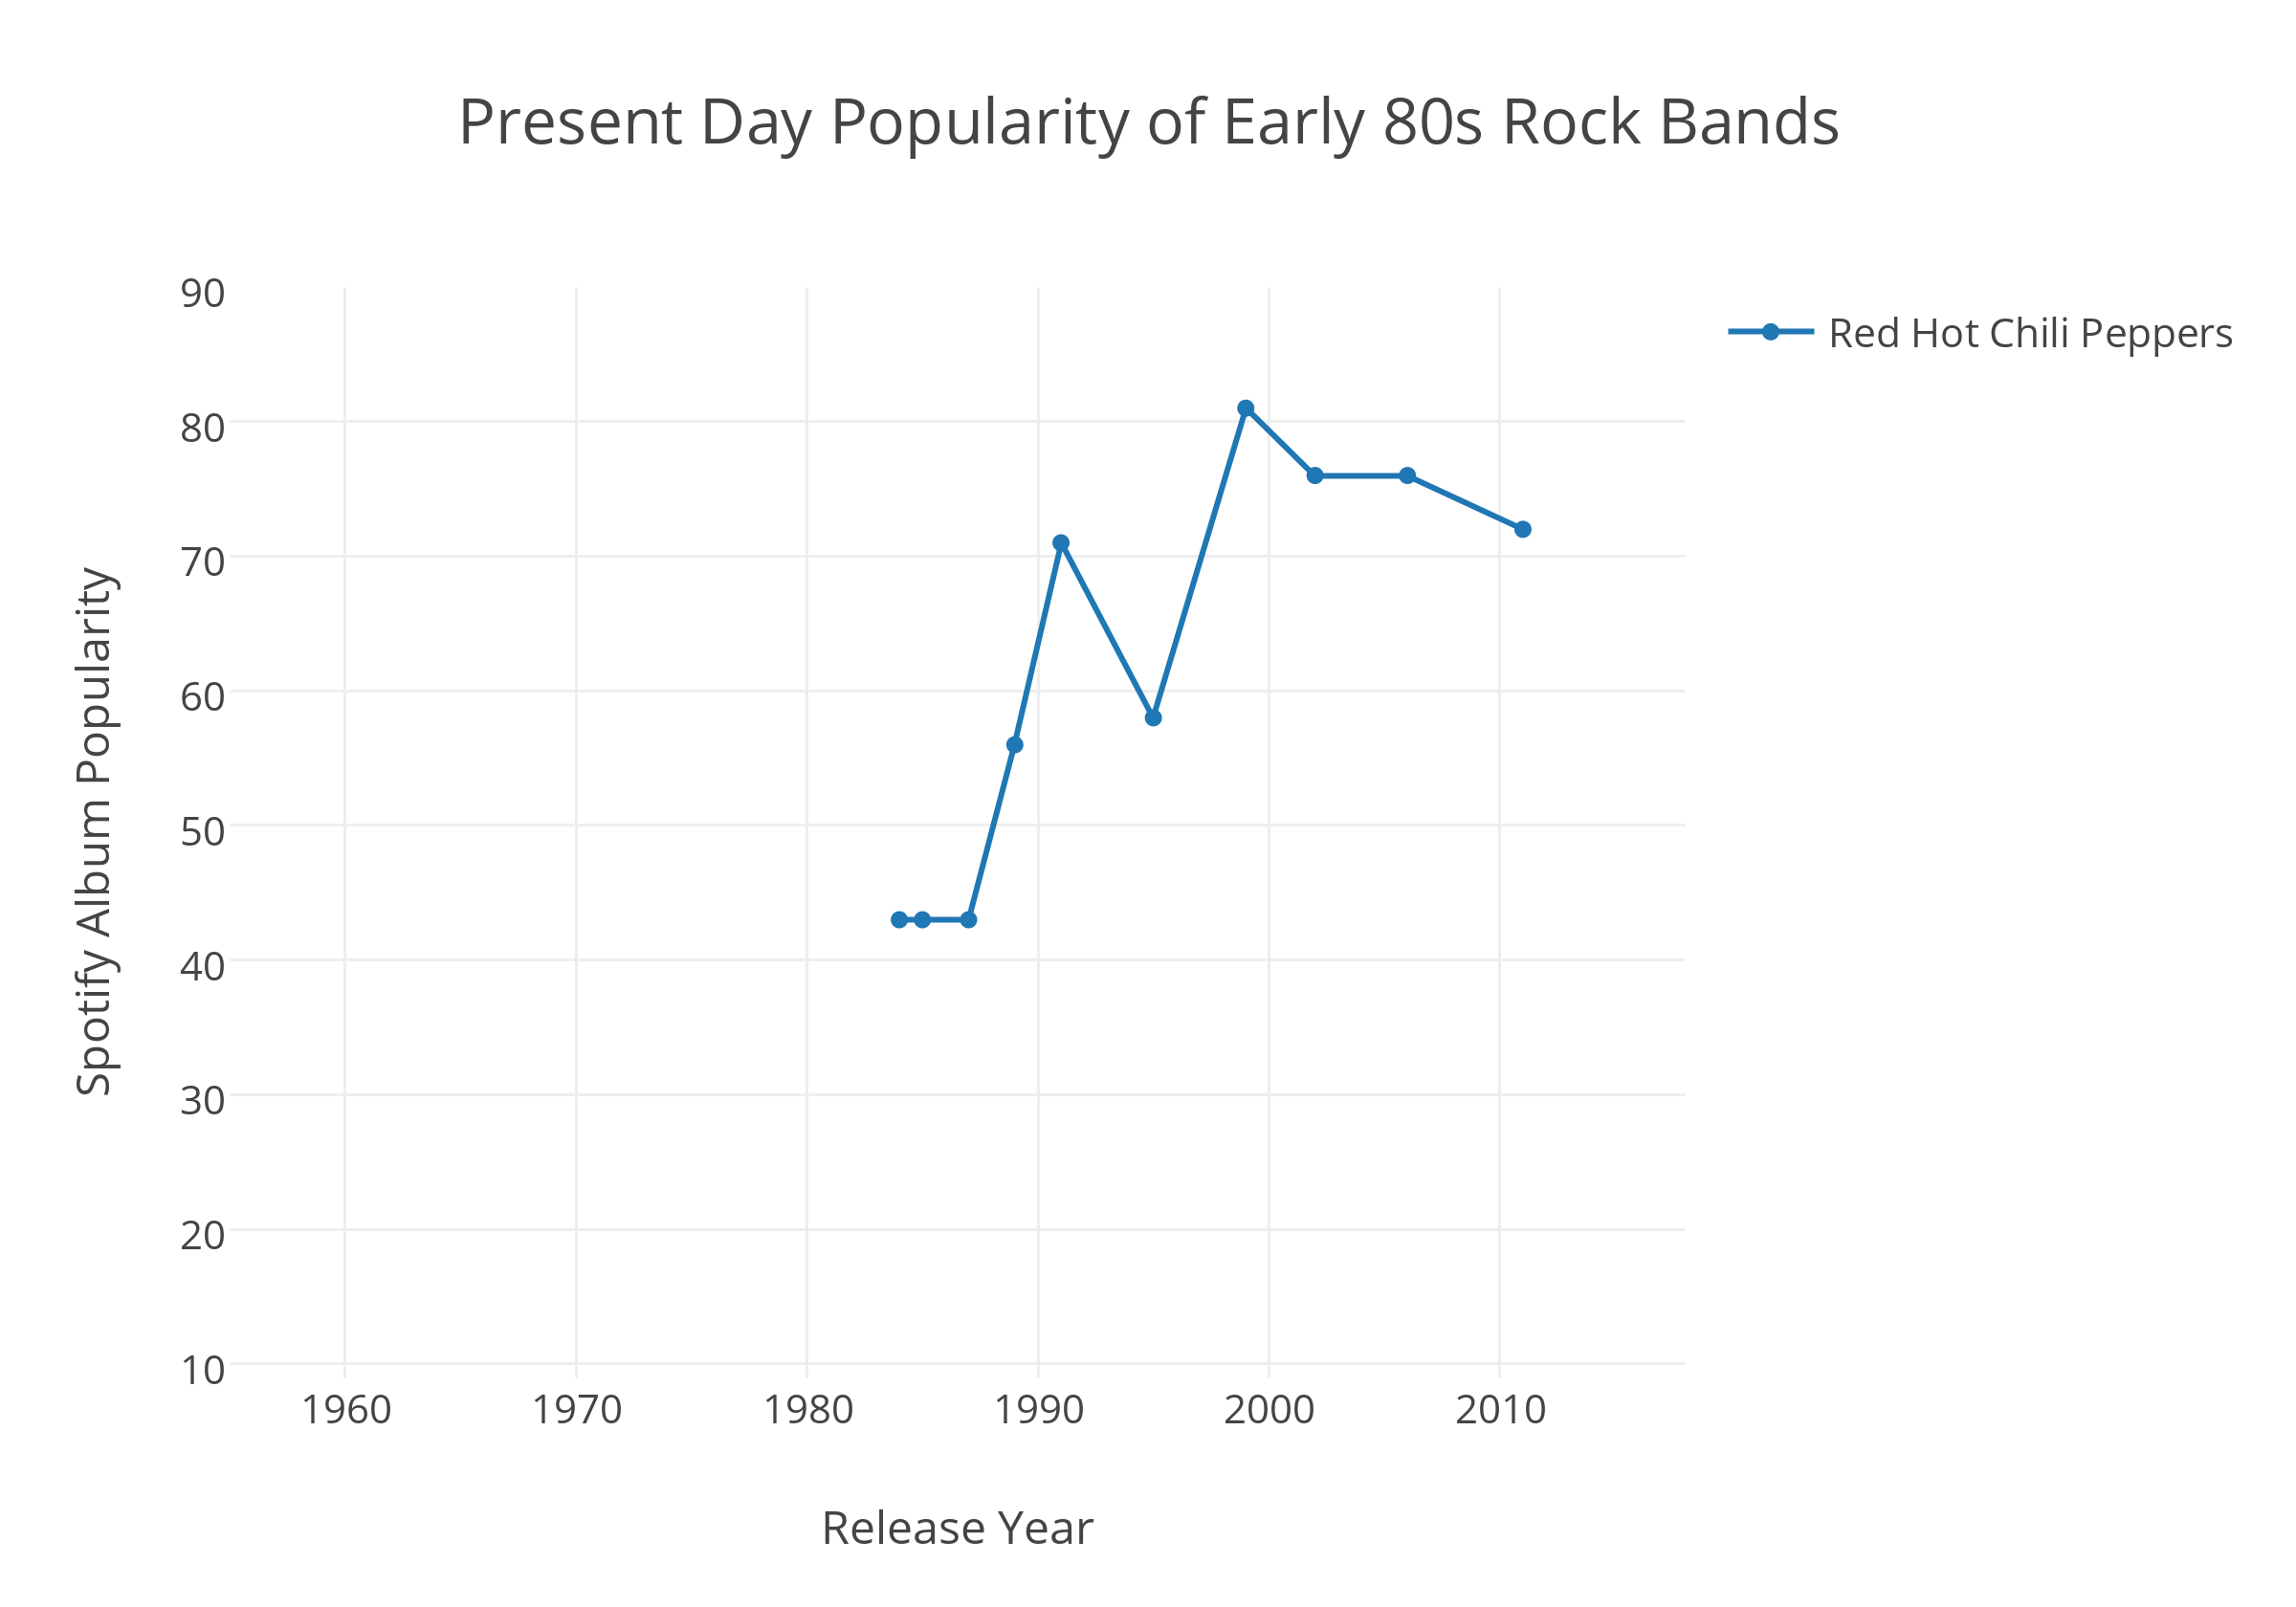

Slide 11
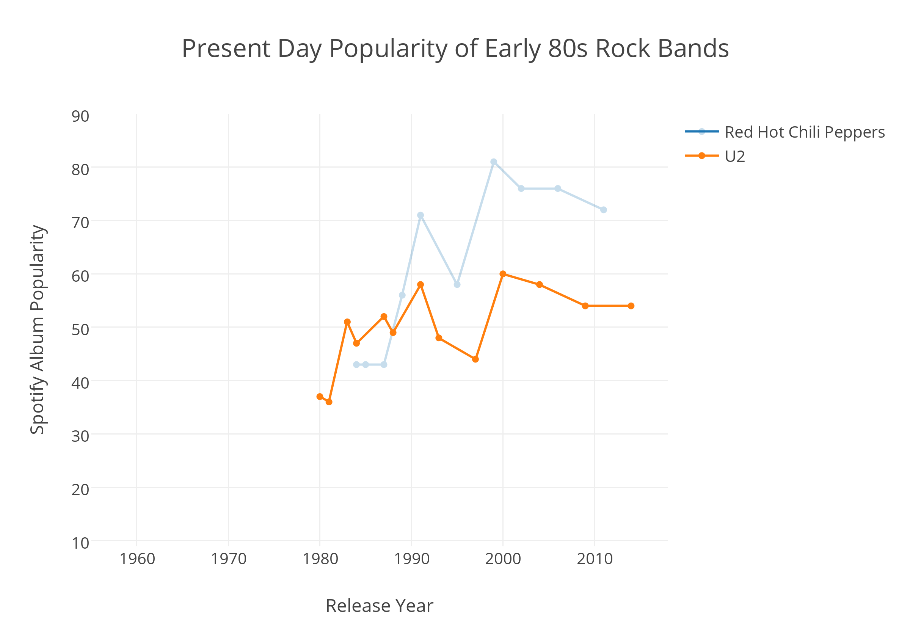

Slide 12
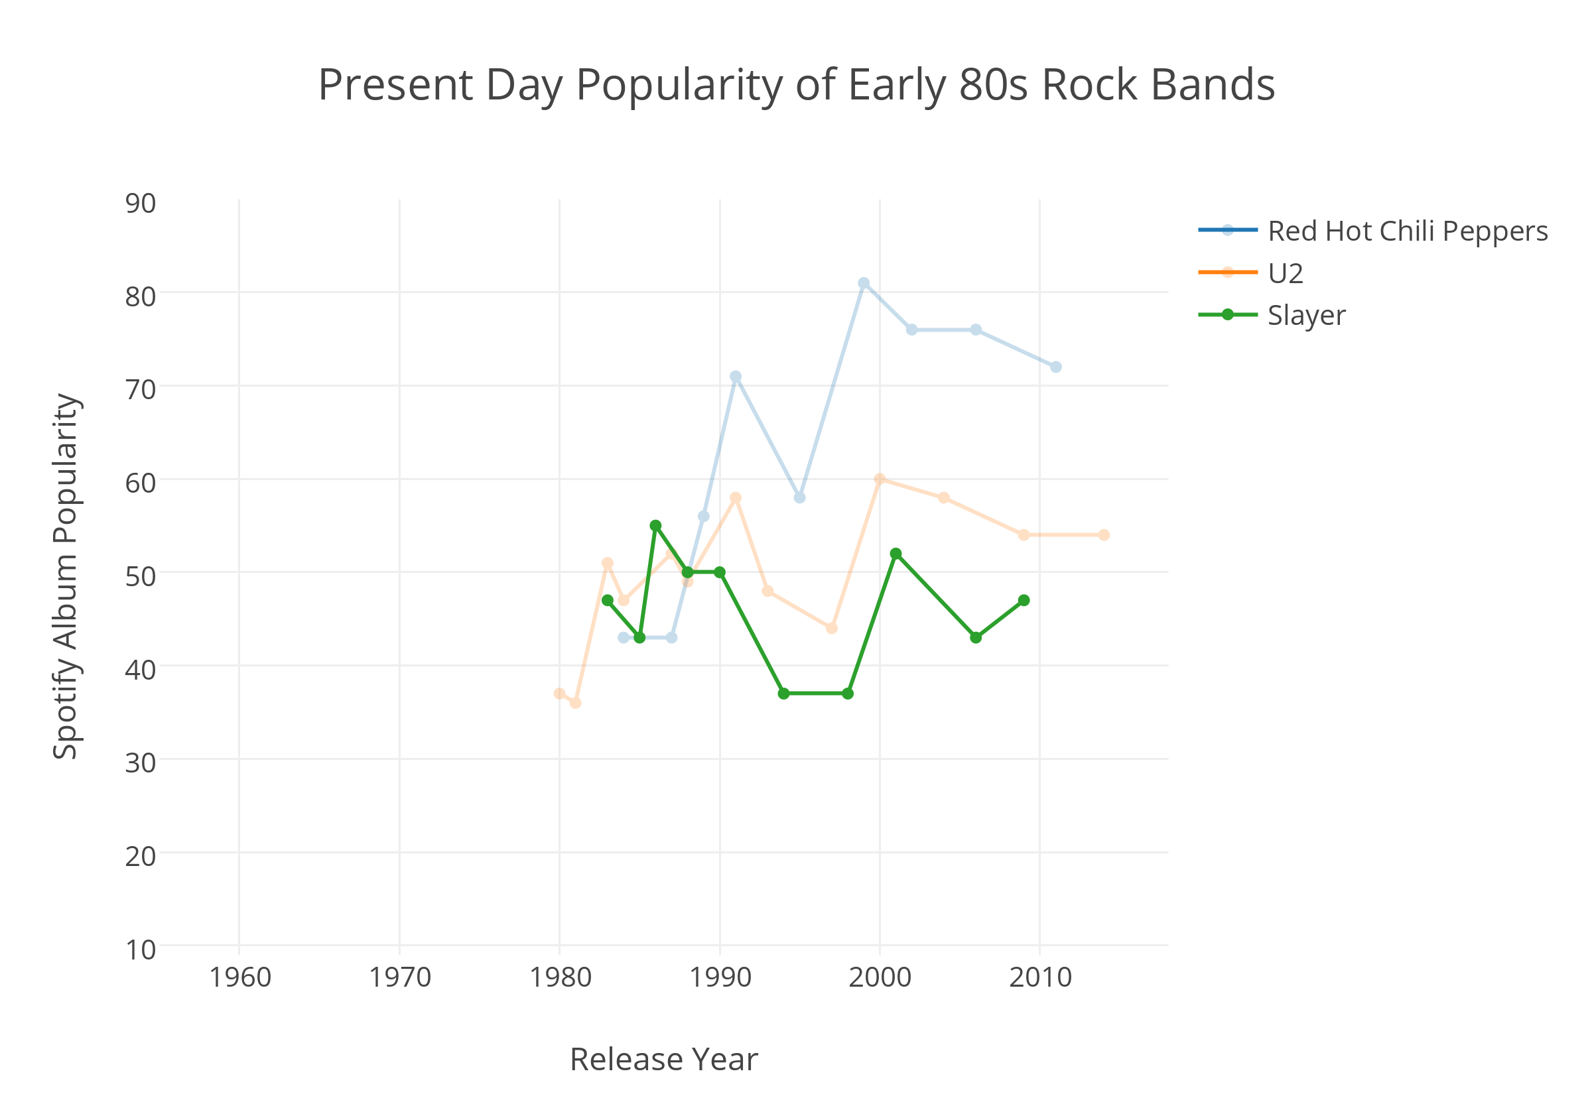

Slide 13
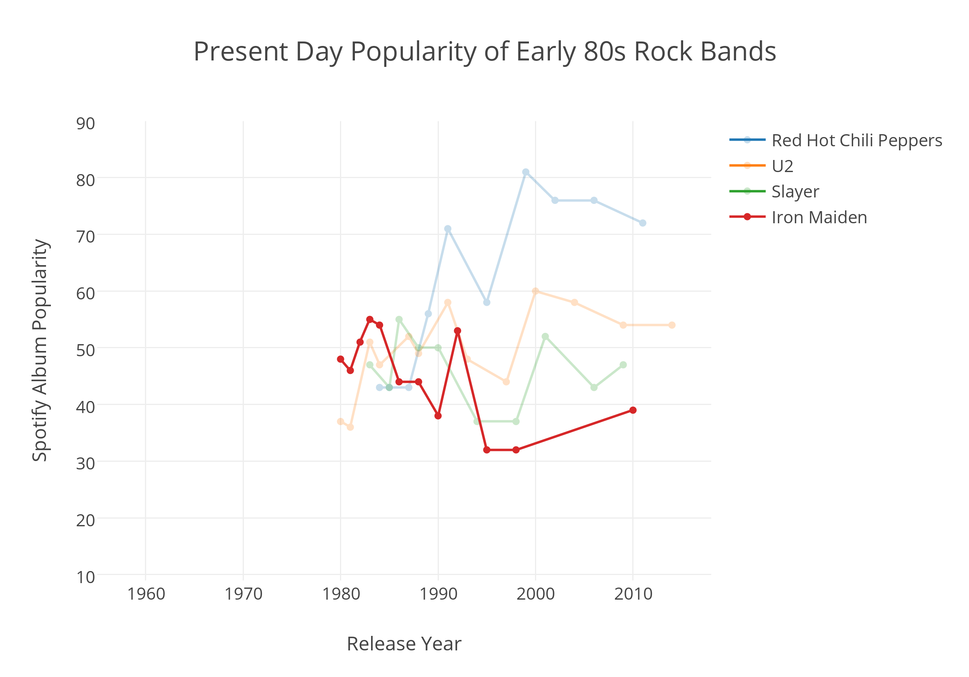

Slide 14
But what about musical parameters?

Slide 15
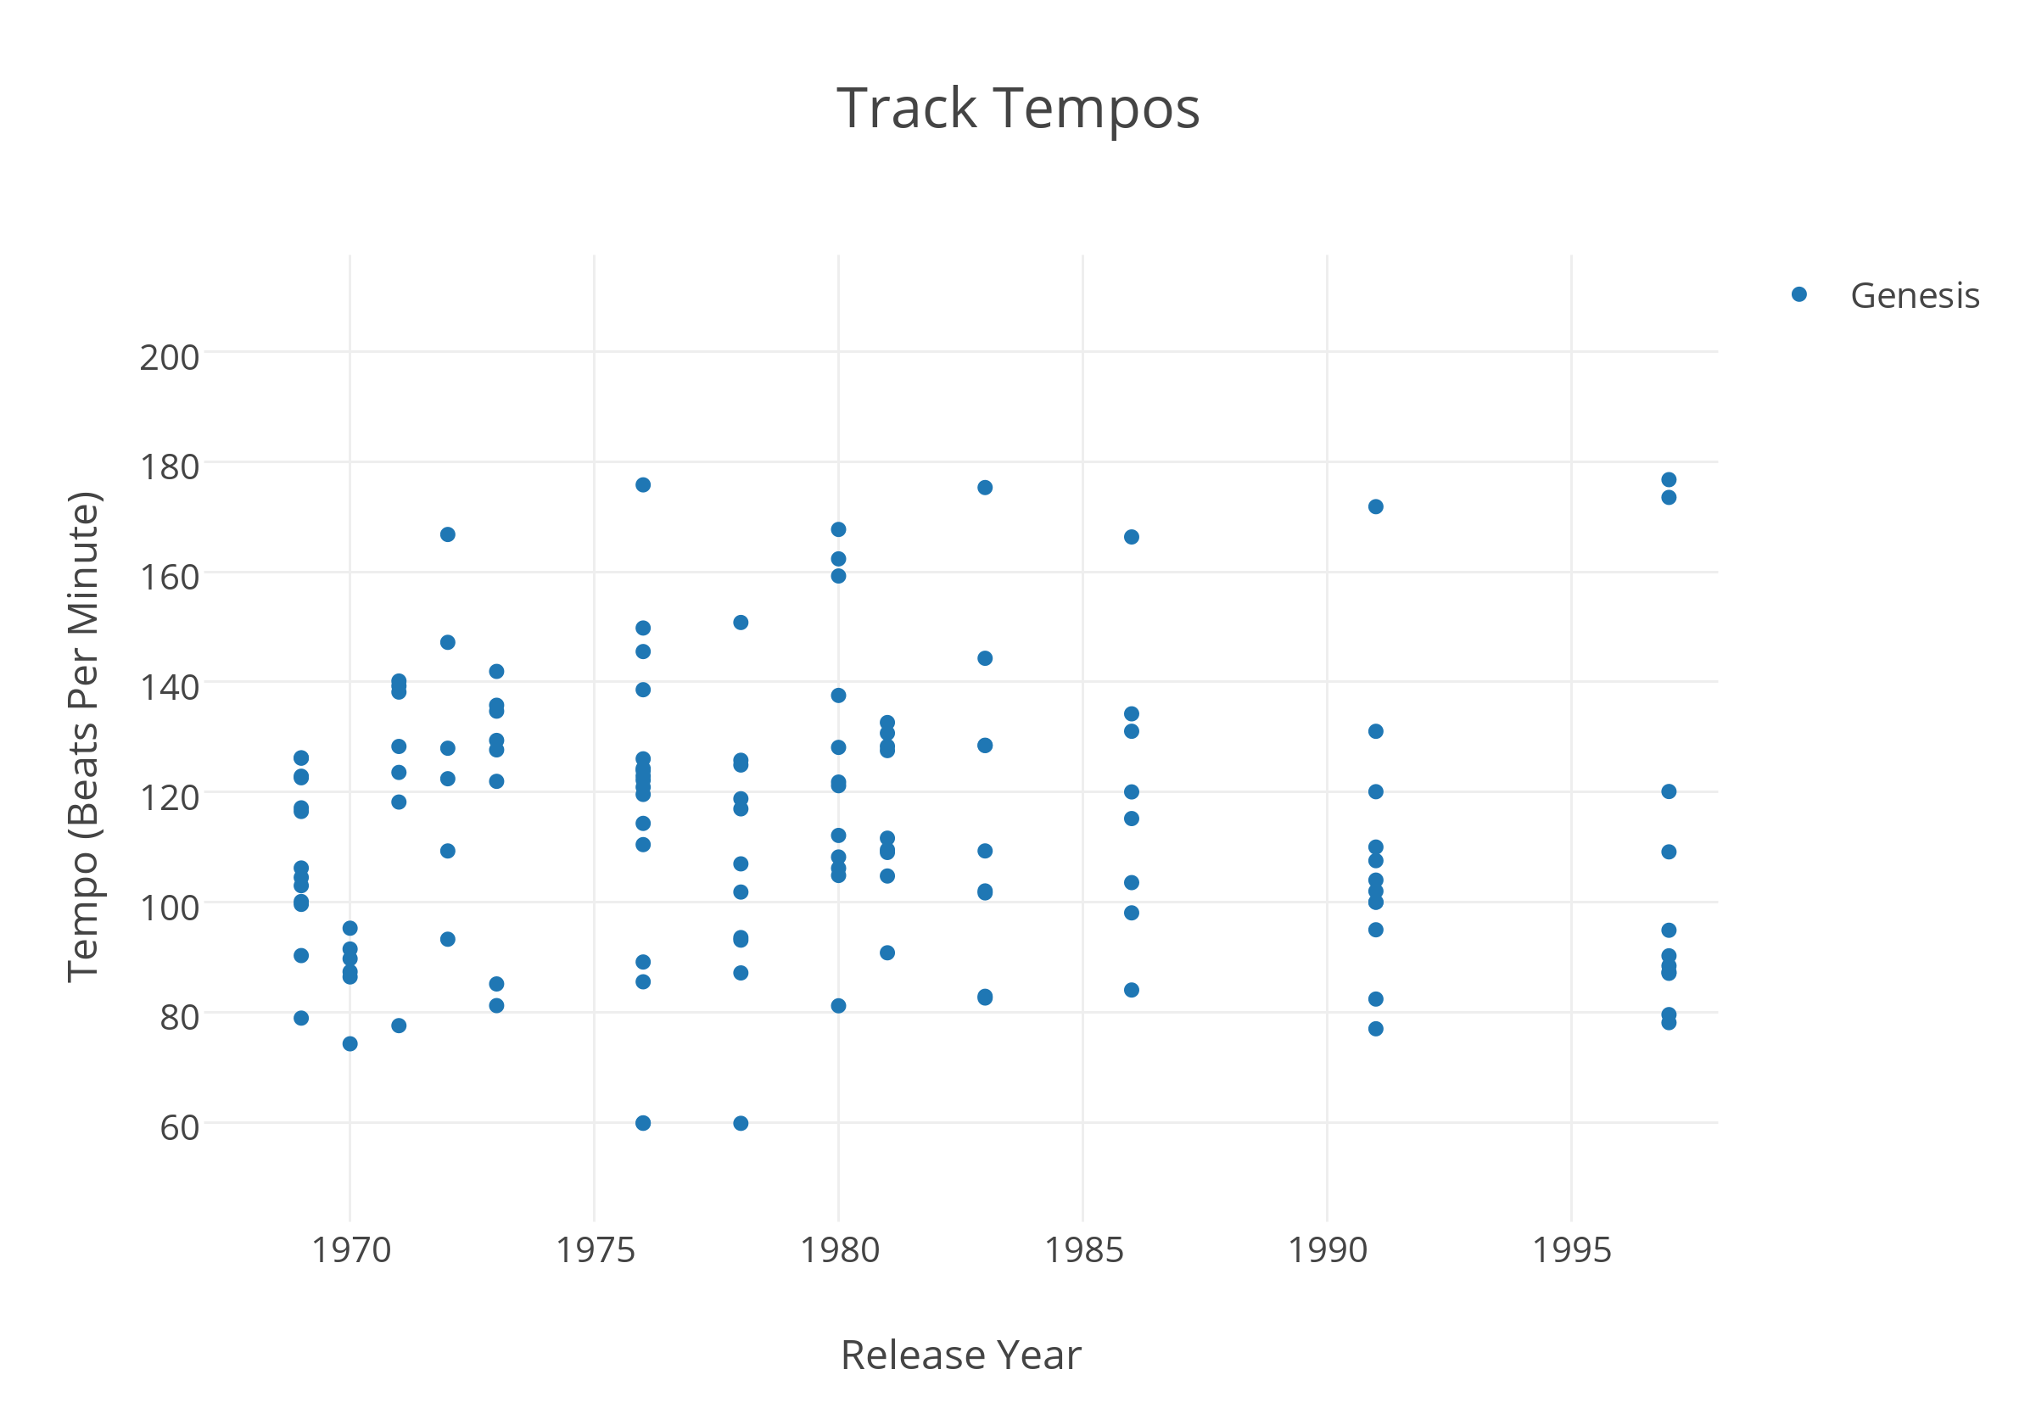

Slide 16
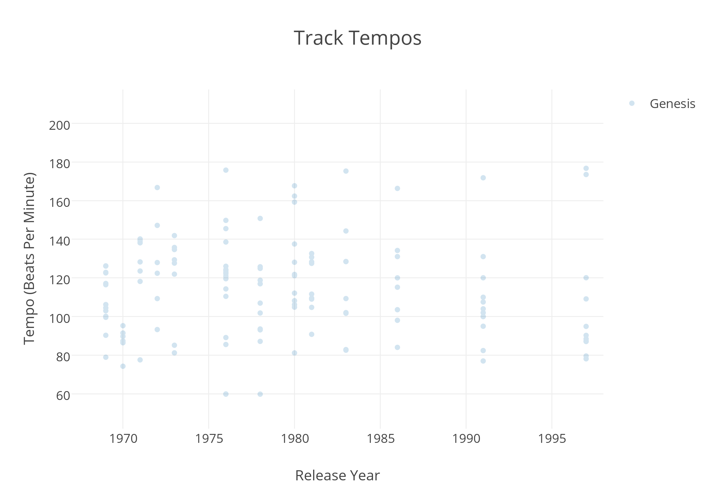

Slide 17
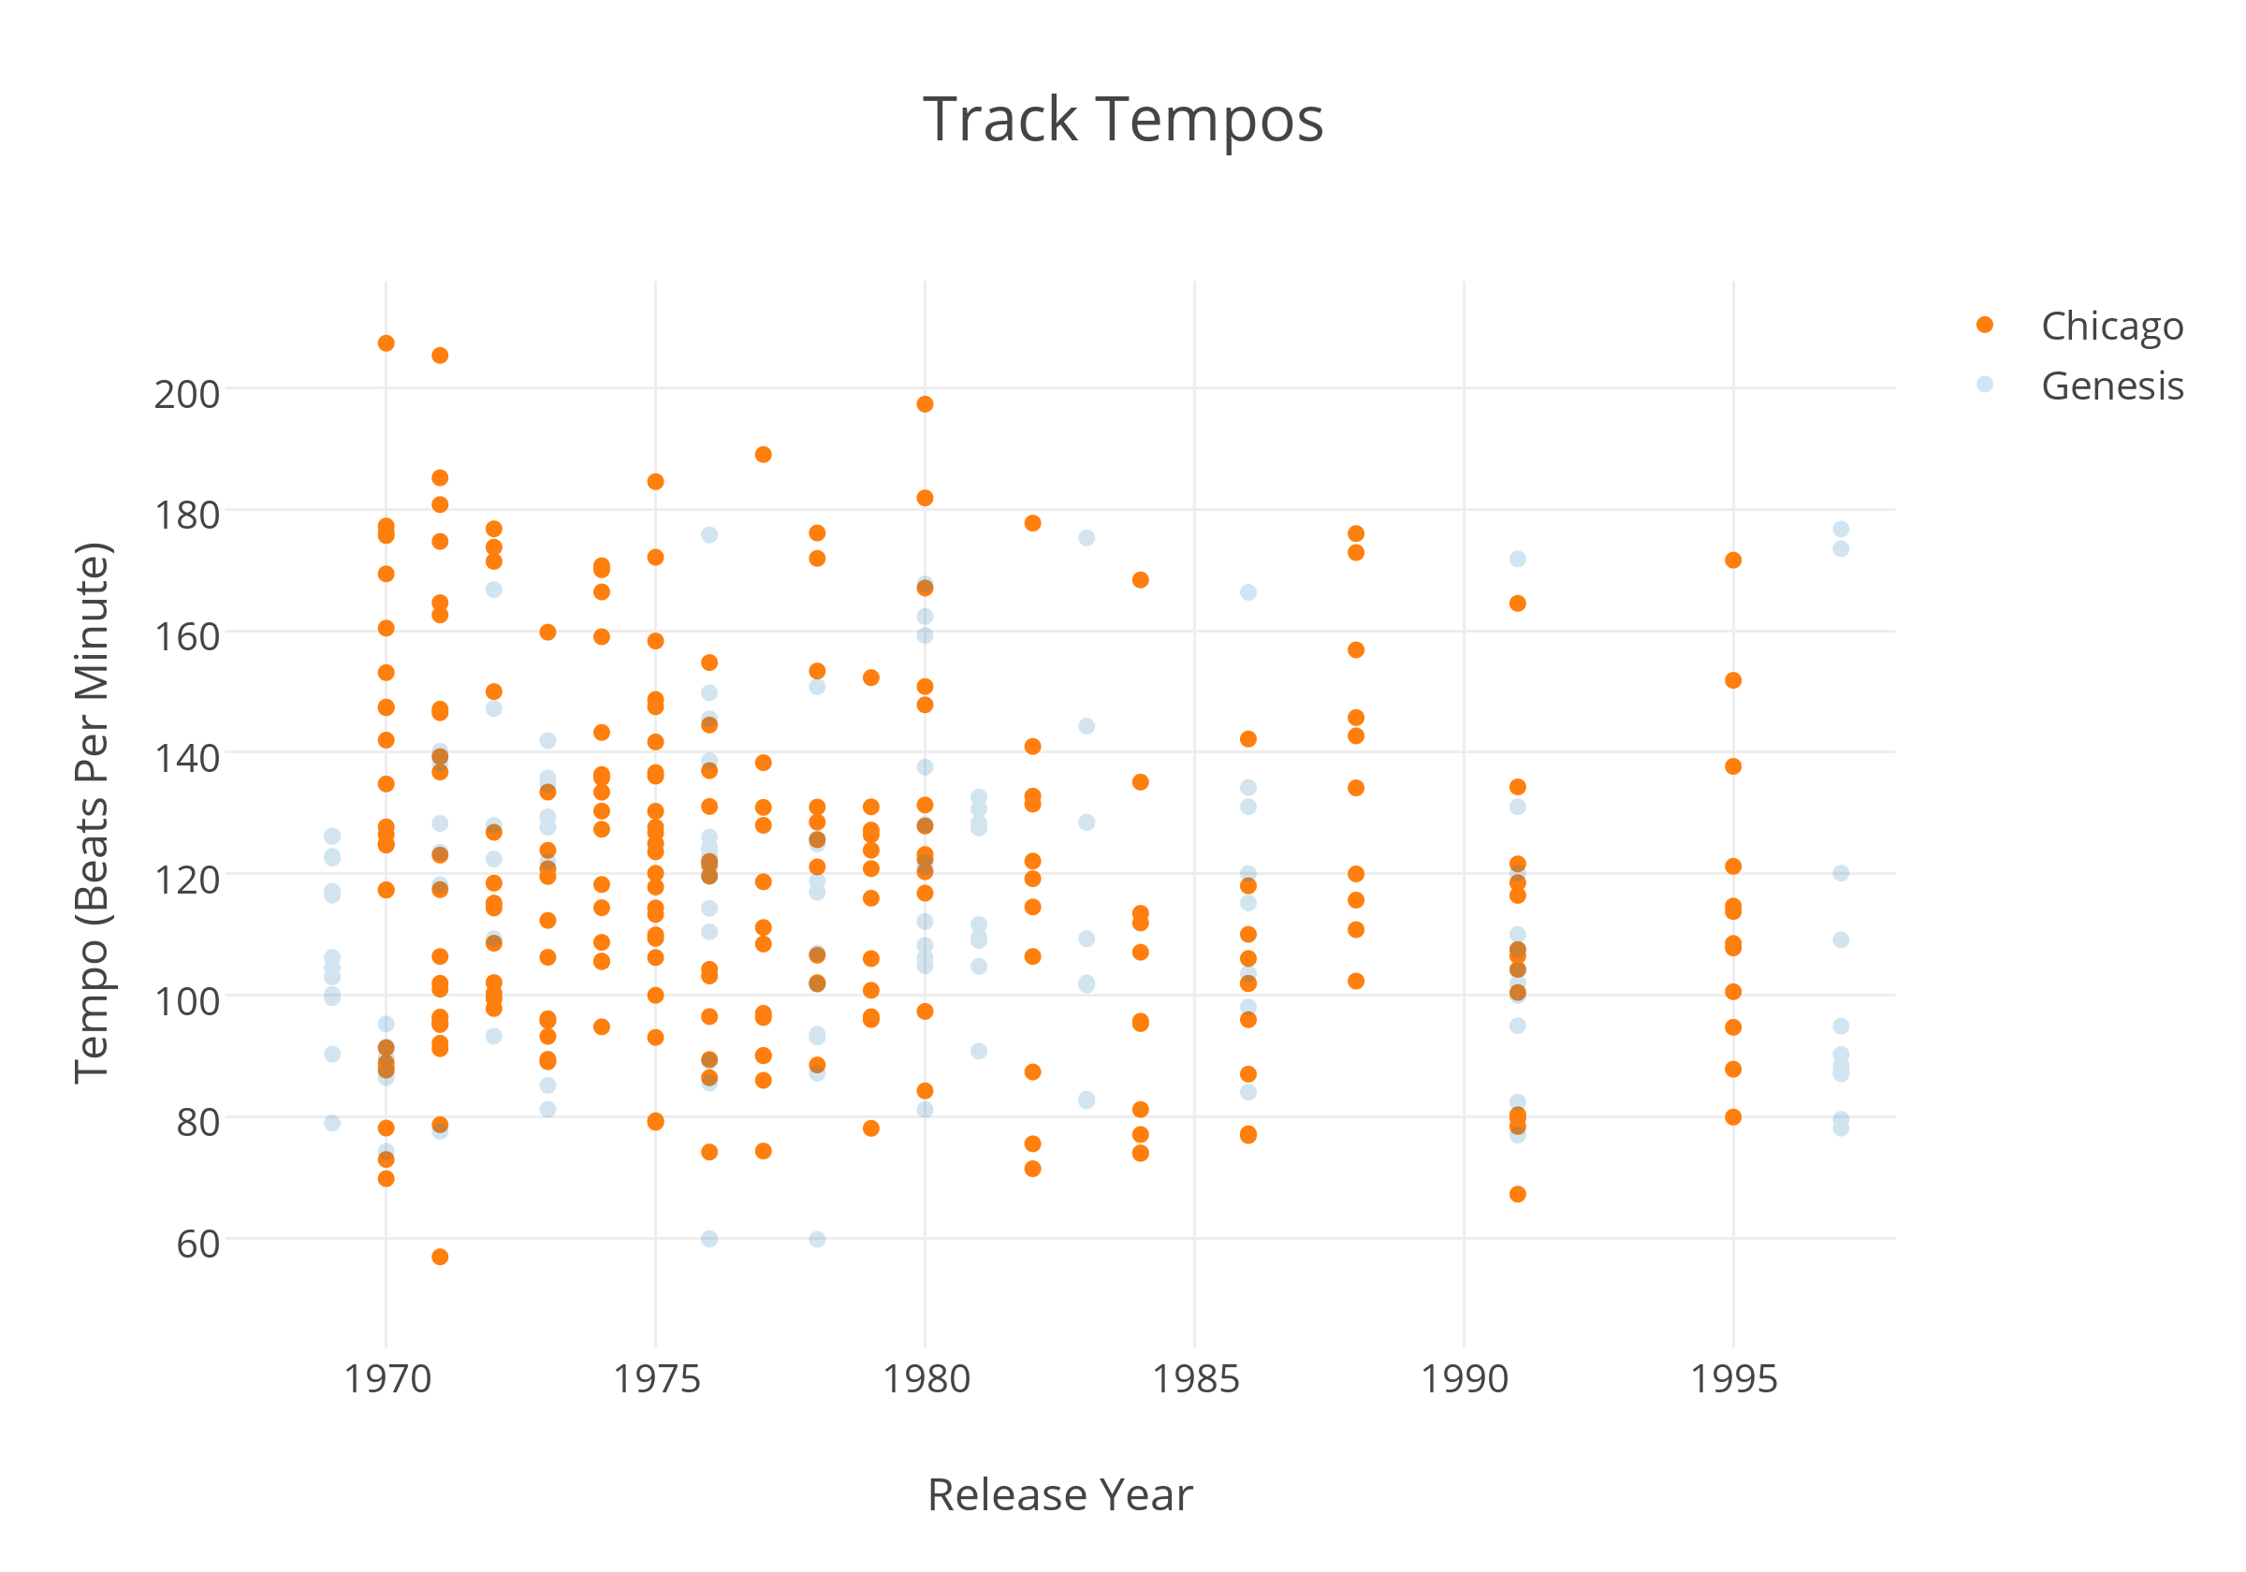

Slide 18
This only scratches the surface of visualizing music trends

Slide 19
https://plot.ly/16/~idcrane/#

