Slide 1
Can we predict the East Asian success of movies?
Ian Crane
Project Luther

Slide 2
East Asia
China, Hong Kong, Taiwan
Japan
South Korea
Mongolia
North Korea
Notes:
For this project, East Asia is defined as these seven countries (/regions – China, Hong Kong and Taiwan are each their own market). However, BoxOfficeMojo.com doesn’t have information for Mongolia or North Korea – Mongolia is not a big market, and a movie studio probably isn’t worried about distributing in North Korea anytime soon.

Slide 3
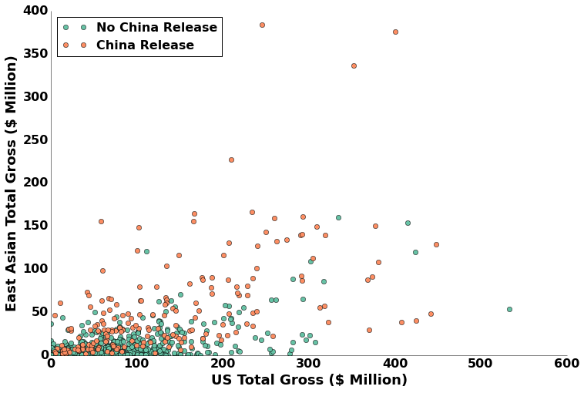

Slide 4
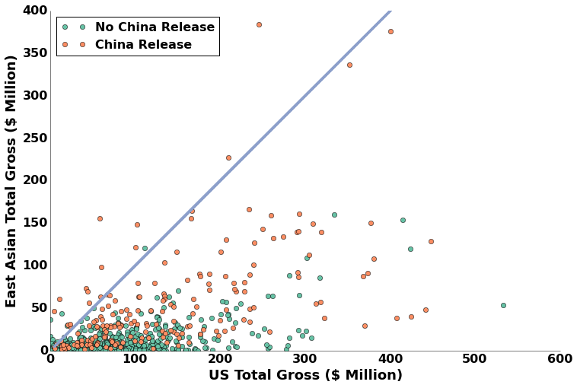

Slide 5
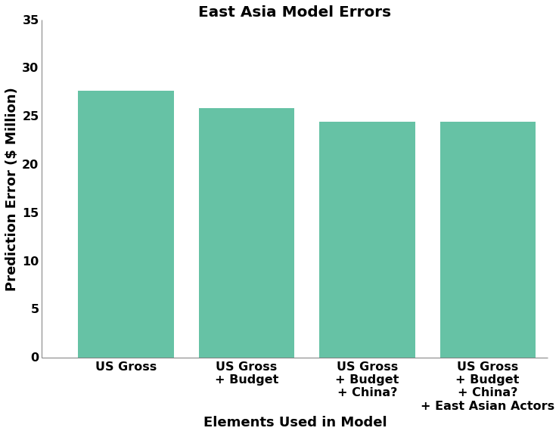

Slide 7
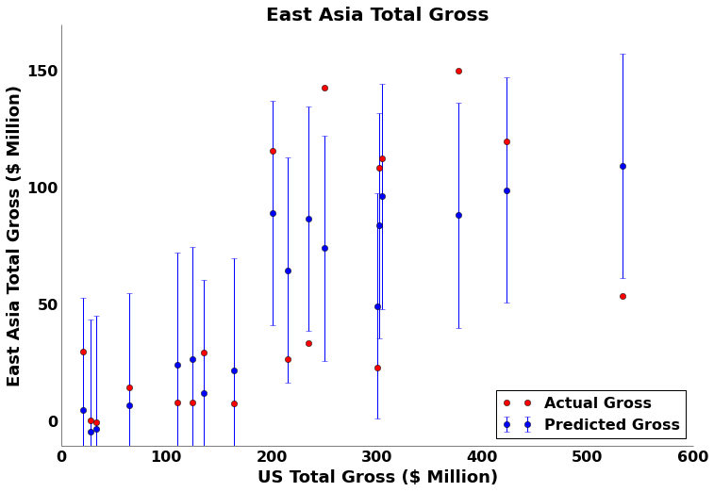

Slide 8
What doesn’t help the models
(Number of Regional Actors)
Other East Asian Countries
Release Date Delay
MPAA Rating

Slide 9
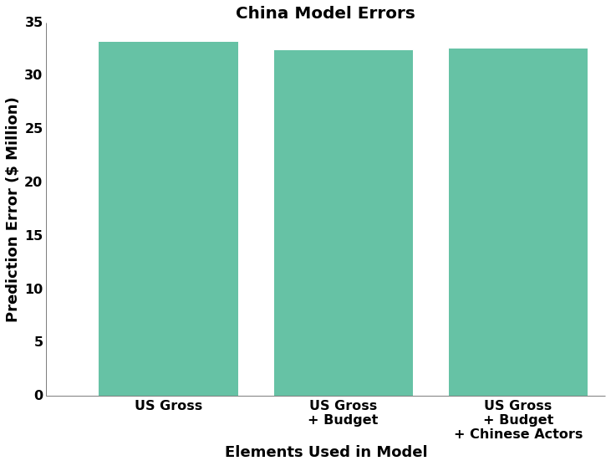

Slide 10
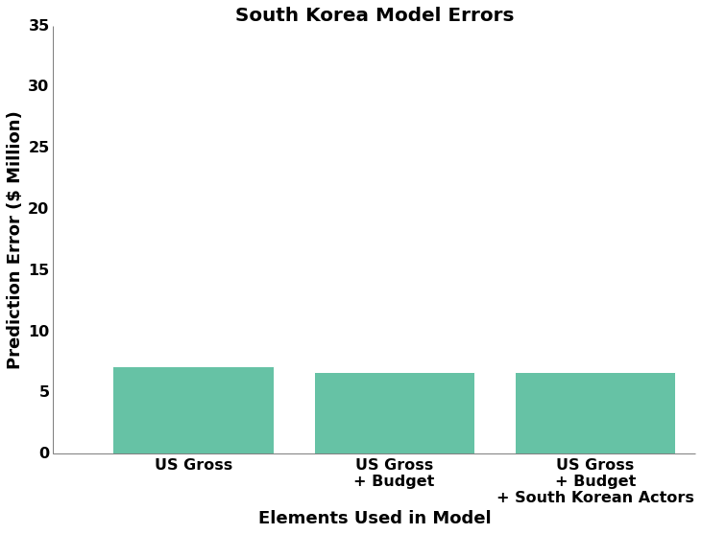

Slide 11
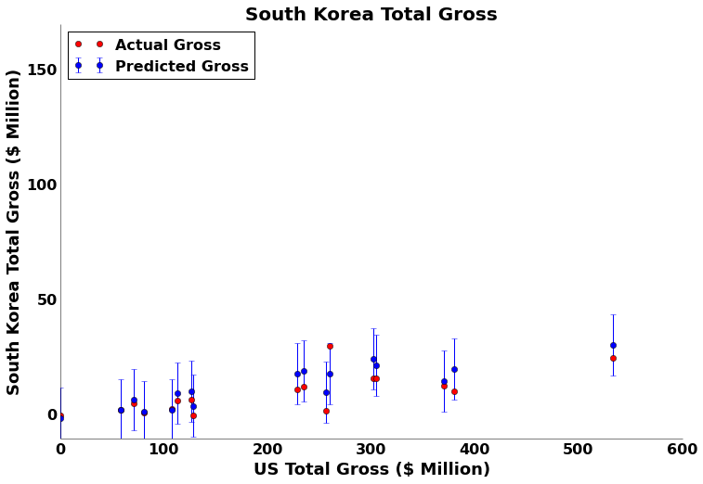

Slide 12
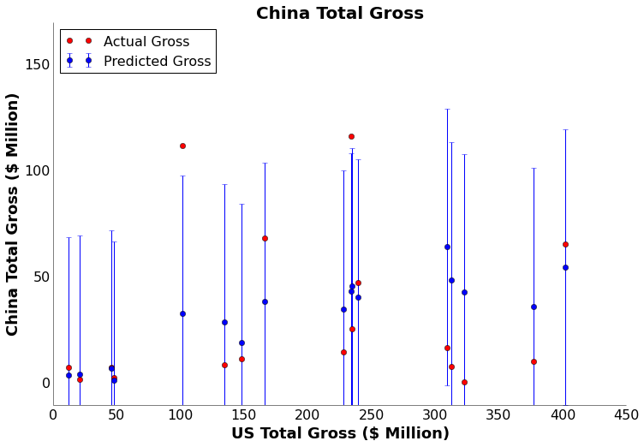

Slide 13
Key Points
China:
High risk, high reward
South Korea:
Low risk, low reward
Other Markets:
Between South Korea and China

Slide 15
Next Steps
Complete lists of actor nationalities
Genre information

Slide 16
