Slide 1
Medical assistant project
Prepared by:
Voronova Anastasiya
Doroshenko Ilya
Noskov Andrey

Slide 2
Task description
Dataset – Health Care Magic 100k
Input : User describe his health problems
Output: Bot gives some advices
Solution for task: text-generation model
Baseline: LLaMA (7B) (also tried facebook/opt-125m, bad accuracy)
Finetuning of baseline for particular task

Slide 3
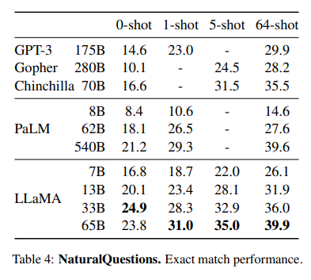
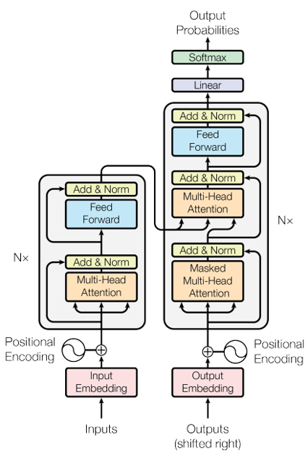
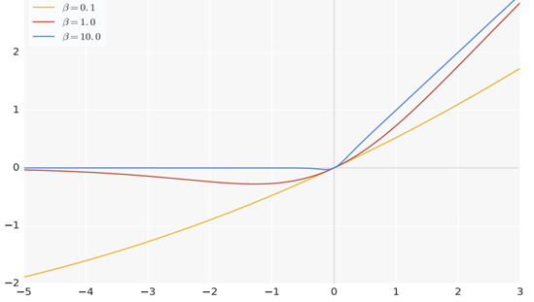
LLaMA arch
Size: the smaller 7B model needs about 17Gb
Pass@k metrics comparing to other models
SwiGLU(x) = x*sigmoid(beta*x) + (1 - x*sigmoid(beta*x))(Wx + b)

Slide 4
Old Progress
Built pipeline for model learning
Preprocessed dataset
Ineffectively tried usage of facebook/opt-125m model
Ongoing LLaMA model

Slide 5
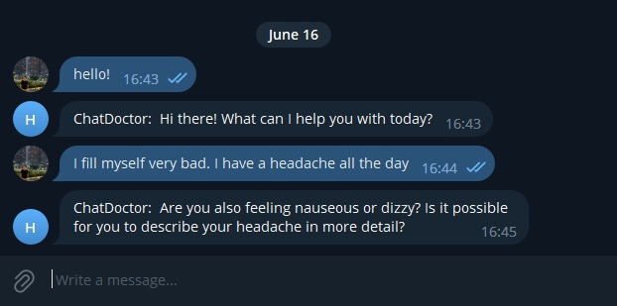
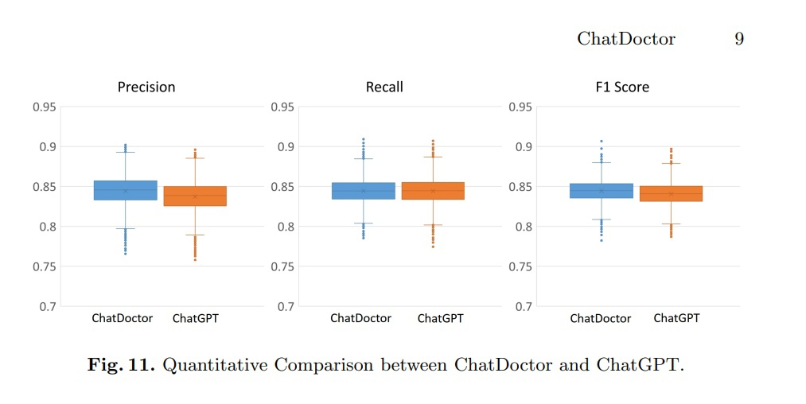
Updated Progress
Added new model – LLaMa
Used pretrained weights from dataset
It could be integrated in some real server, now only works fast only for few users (HW limitations)
Integrated Telebot
https://t.me/hse_health_bot
Result - Works like a real assistant

Slide 6
References
Heath Care Magic 100k Dataset (https://huggingface.co/datasets/wangrongsheng/HealthCareMagic-100k-en)
LLaMA model repo (https://github.com/facebookresearch/llama/tree/main)

