Slide 1

Staffing Vacancies in SY 23-24 for October 1, 2024 Cycle Created by Research & Analytics

Slide 2
What is the Nature of Staffing Vacancies at IDEA?
1) How long are vacancies at IDEA for teacher roles?
2) How many vacancies are at IDEA for teacher roles?
3) What is the highest number of vacancies during a single time period?
(time = week, month, quarter, semester)
4) Graphs, box plots, and histograms of data.

Slide 3
Data Background
Jobvite Data for HA and Staffing – shows when a job is posted or filled
Employee Data: Tyler Munis, Power Schools – shows employee number, name, course name taught, school year, hire date, start date, FMLA data for leave
Subjects: Math, English Language Arts, Science, Social Studies
“Grade” is binned into 1st – 5th, 6th – 8th, and 9th-12th, unless otherwise denoted by the course name to a specific individual grade for that course.
Region is inclusive of all Texas regions, and campus includes all Texas schools that have accountability ratings A-F.
Time periods are derived from role posting date, hire date, and start date.

Slide 4
Vacancy Data
Vacancies are for teaching positions
Vacancies are when there is an opening for a teaching role that needs to be filled
Vacancies can vary in length of time (from the time the position is open or posted, to the time the role is filled – and there is no longer that vacancy).

Slide 5
Vacancy: Region
All regions in Texas contained vacancies for teacher roles.

Slide 6
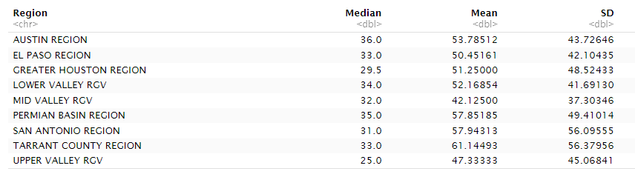
Median, Mean, and SD by Region for Vacancy Length (in Days)
Austin had the highest median for vacancy length and Upper Valley RGV had the lowest median. Tarrant County had the highest mean vacancy length, whereas Mid Valley RGV had the lowest mean. Tarrant County had the highest standard deviation and Mid Valley RGV had the lowest standard deviation for vacancy length in days.

Slide 7

Summary Statistics for Vacancy Lengths After Grouping by Region

Slide 8
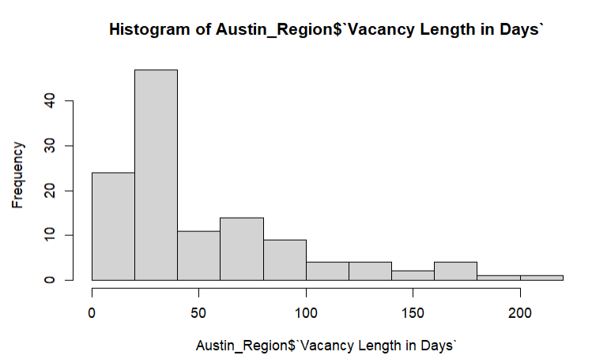
Austin Vacancy Lengths in Days

Slide 9
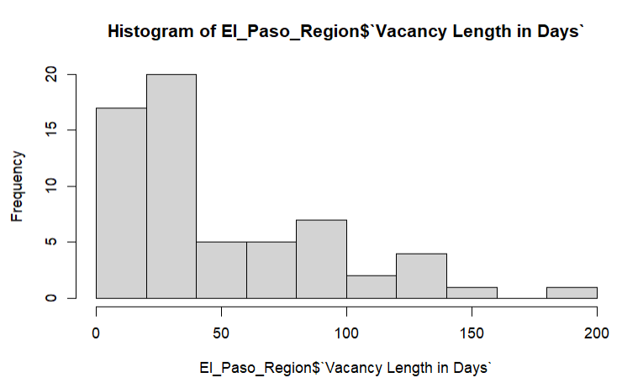
El Paso Vacancy Lengths in Days

Slide 10
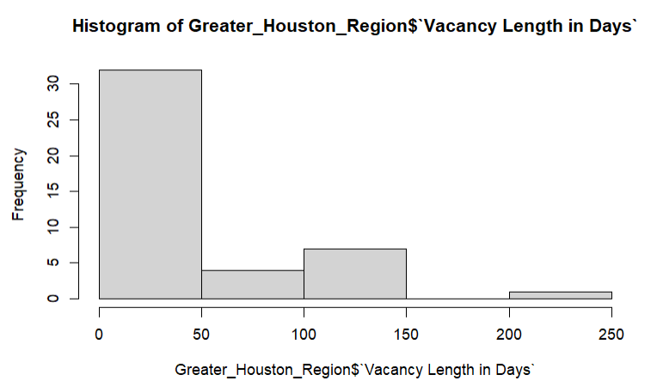
Greater Houston Area Vacancy Lengths in Days

Slide 11
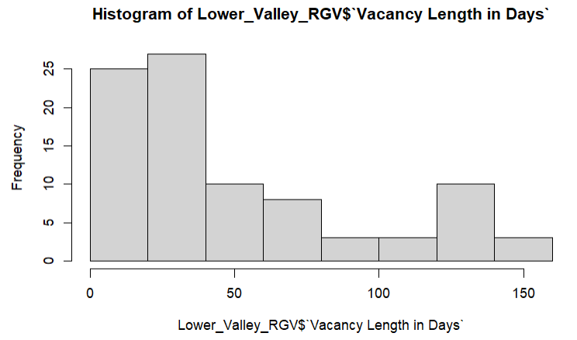
Lower Valley RGV Vacancy Lengths in Days

Slide 12
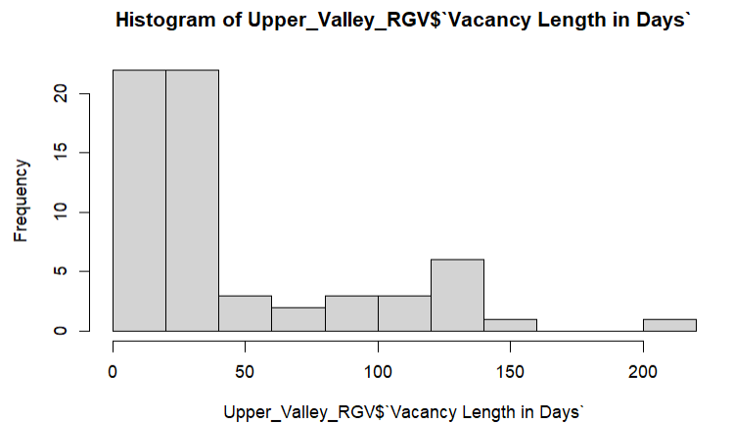
Upper Valley RGV Vacancy Lengths in Days

Slide 13
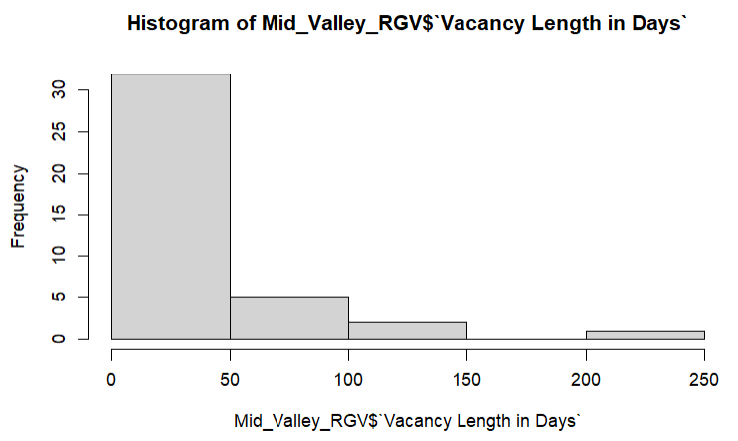
Mid Valley RGV Vacancy Lengths in Days

Slide 14
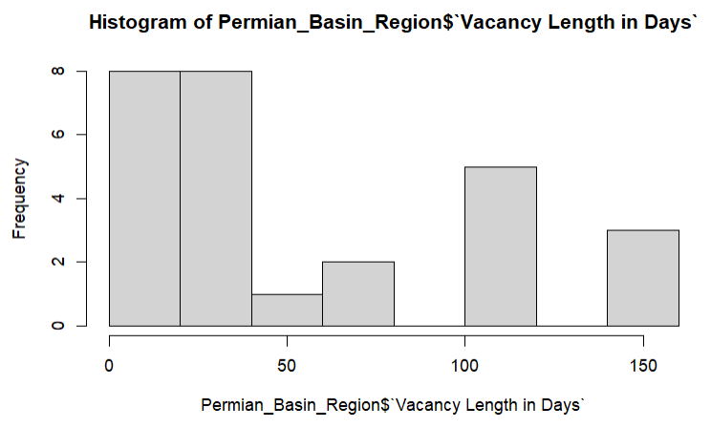
Permian Basin Vacancy Lengths in Days

Slide 15
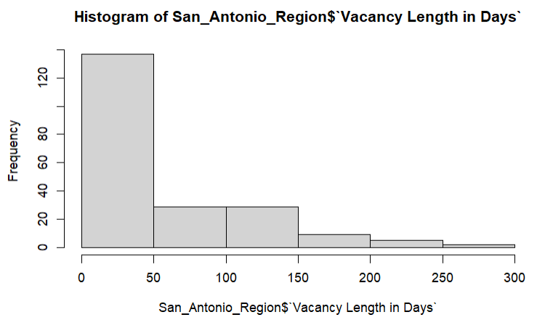
San Antonio Vacancy Lengths in Days

Slide 16
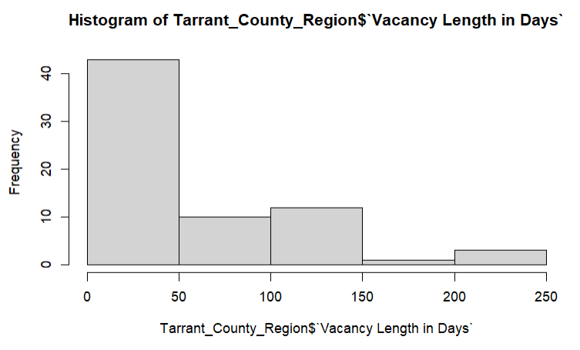
Tarrant County Vacancy Lengths in Days

Slide 17
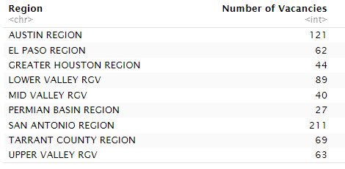
Number of Staffing Vacancies Varied by Region
San Antonio had the highest count of Staffing Vacancies and Permian Basin had the lowest.

Slide 18
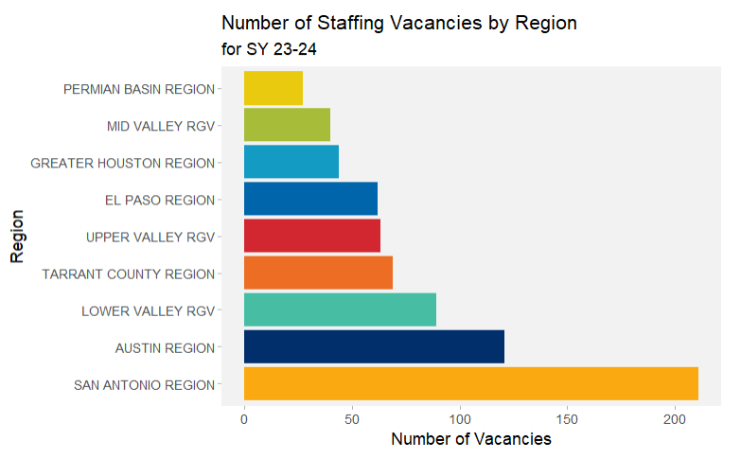
Number of Staffing Vacancies were Highest in San Antonio, Followed by Austin.

Slide 19
Vacancy: Campus
All Campuses in Texas where there were vacancies in SY 23-24.

Slide 20
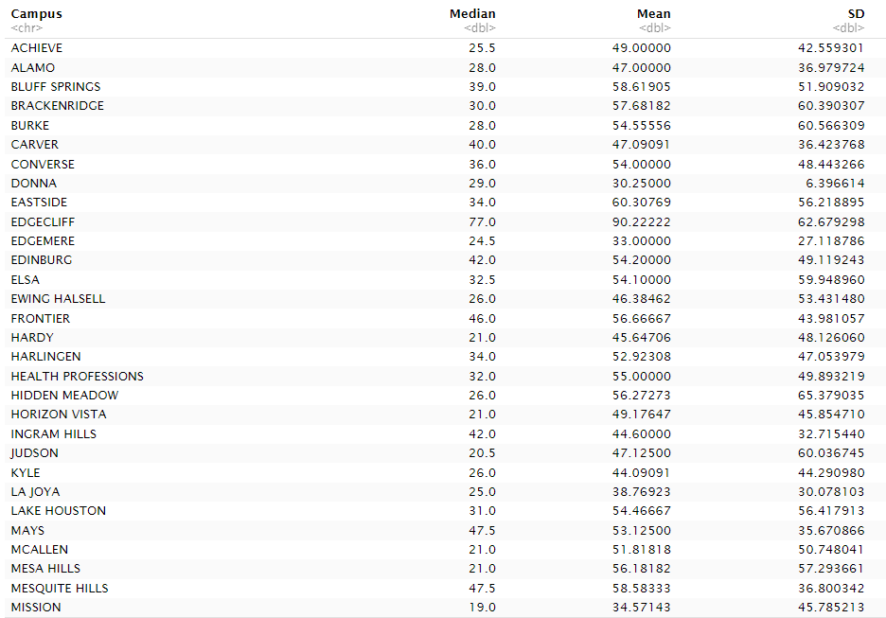
Median, Mean, and SD by Campus for Vacancy Length (in Days) – Part 1

Slide 21
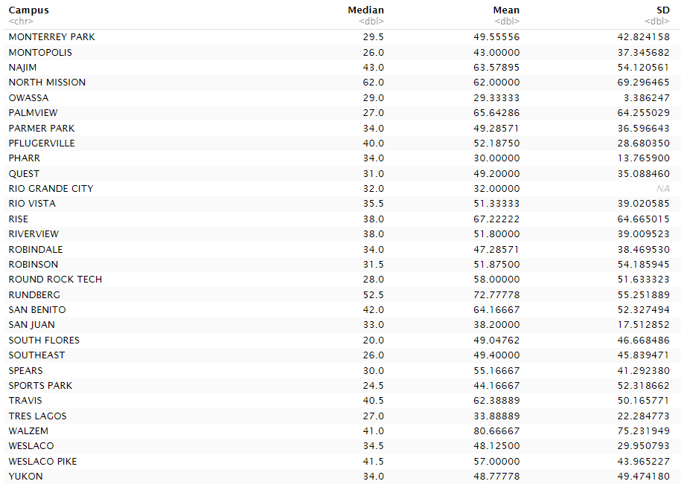
Median, Mean, and SD by Campus for Vacancy Length (in Days) – Part 2

Slide 22

Summary Statistics for Vacancies After Grouping by Campus

Slide 23
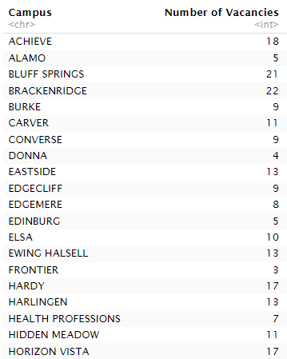
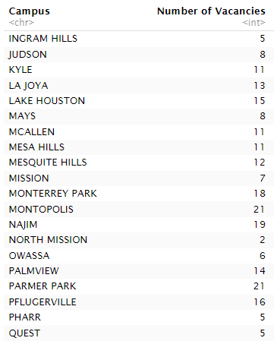
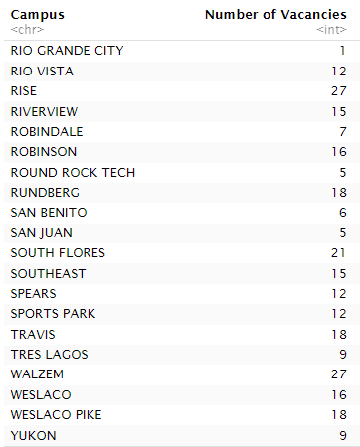
Number of Staffing Vacancies Varied by Campus

Slide 24
Vacancy: Subject
Includes four subjects:
Math
English Language Arts
Science
Social Studies

Slide 25
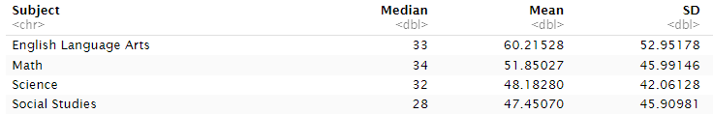
Summary Statistics for Vacancy Length in Days by Subject
The highest median vacancy length was Math at 34 days, and the lowest median was Science at 32 days. The largest mean vacancy length was for English Language Arts (60.2 days) and the lowest was for Social Studies (47.5). The largest standard deviation for vacancy length was for English Language Arts (53.0), and the lowest was for Science (42.1 days).

Slide 26
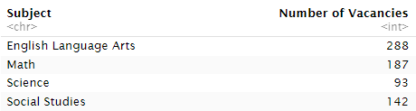
Number of Staffing Vacancies Varied by Subject
English Language Arts had the highest number of staffing vacancies (288) and Science had the lowest number of vacancies at 93.

Slide 27

Summary Statistics for Number of Vacancies after Grouping by Subject
Both English Language Arts and Math were above the median and mean numbers of staffing vacancies after grouping by subject.

Slide 28
Reading Histograms
Number of days Vacant (Vacancy length in days) is shown on the horizontal axis
Number of vacancies (frequency) within a range of a particular length is on the vertical axis
The number of vacancies that had the same length of time (the vacancies were open for a similar number of days).

Slide 29
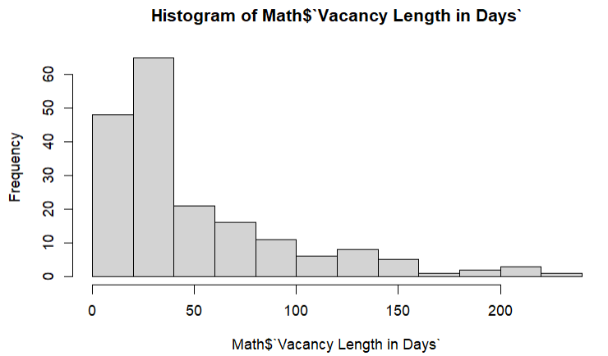
Math Vacancy Lengths in Days
The highest frequencies of vacancies were less than 50 days.

Slide 30
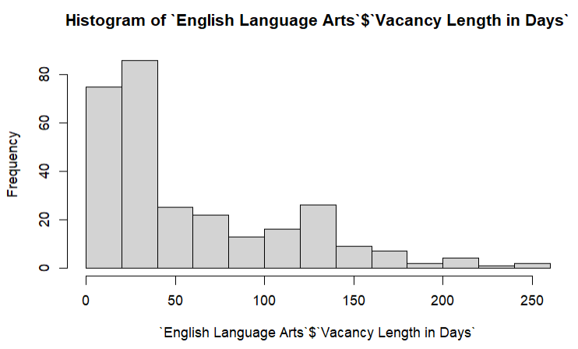
English Language Arts Vacancy Lengths in Days
The highest frequencies of vacancies were less than 50 days.

Slide 31
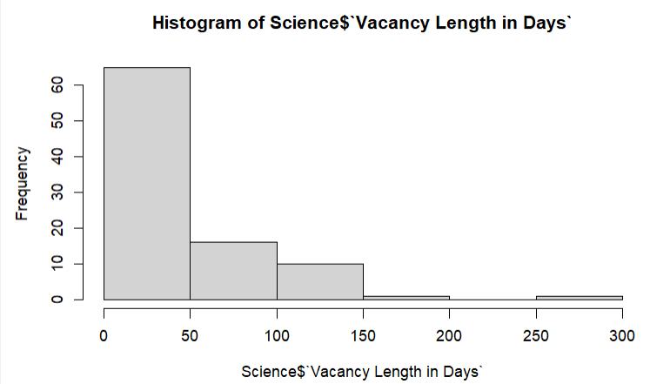
Science Vacancy Lengths in Days
The highest frequency of vacancies was less than 50 days. The next highest frequency of vacancies was 50-100 days.

Slide 32
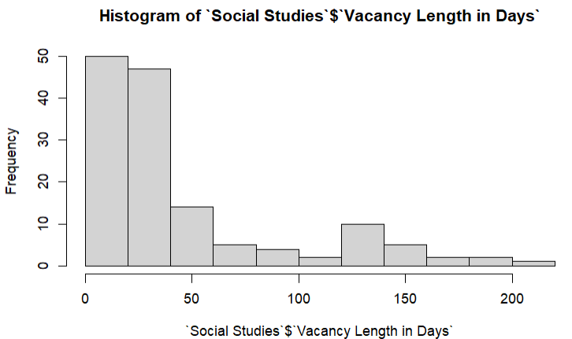
Social Studies Vacancy Lengths in Days
The two highest frequencies of vacancies had lengths that were less than 50 days.

Slide 33
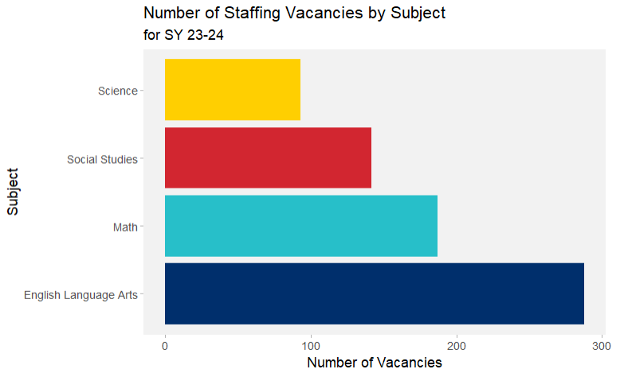
Number Staffing Vacancies were Highest in English Language Arts
Each subject across Texas had a different number of staffing vacancies. English Language arts had the most at 288, followed by Math at 187, then Social Studies with 142. Science had the lowest vacancies with 93.

Slide 35
FMLA Data
FMLA is Family Medical Leave and is time off for medical or family (such as having a child) absences
FMLA leave length of time is counted in days, starting from the first day the employee is absent with leave to the return-to-work date.
FMLA leave can vary in length of time (depending on how many days the employee applied for and was approved for).

Slide 36
FMLA: Region
Regions in Texas who had teachers that took leave for FMLA

Slide 37
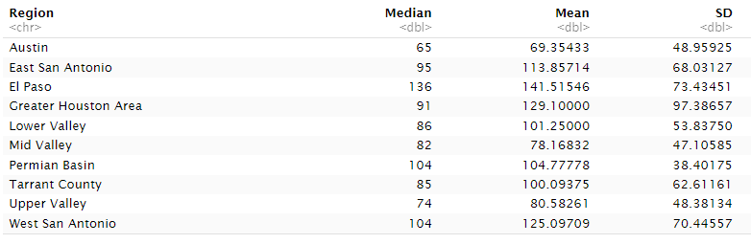
Median, Mean, and SD by Region for FMLA Length (in Days)

Slide 38
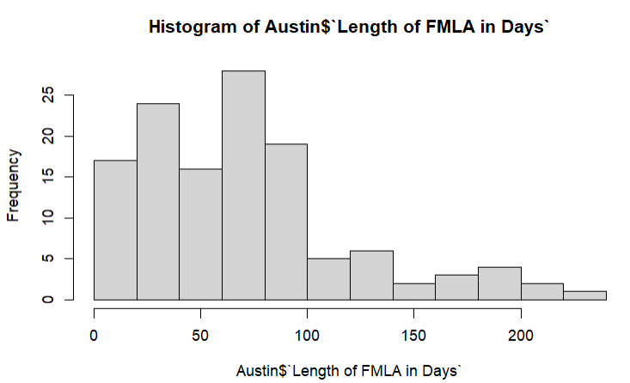
Histogram of FMLA Lengths (in Days) for Austin

Slide 39
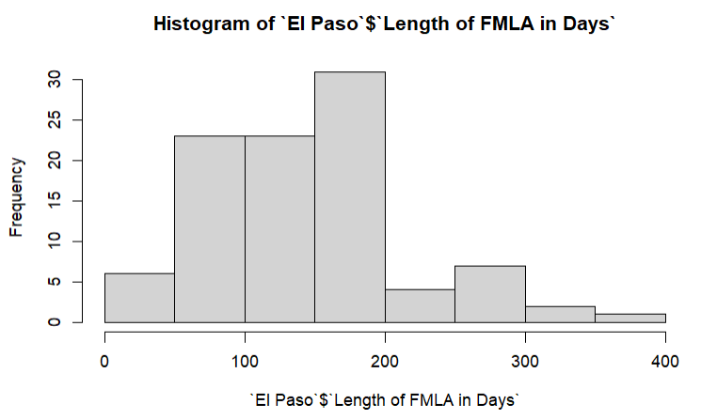
Frequency of FMLA Lengths (in Days) for El Paso

Slide 40
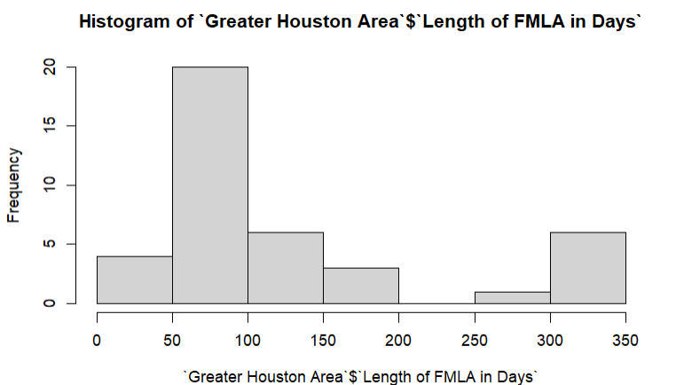
Frequency of FMLA Lengths (in Days) for Greater Houston Area

Slide 41
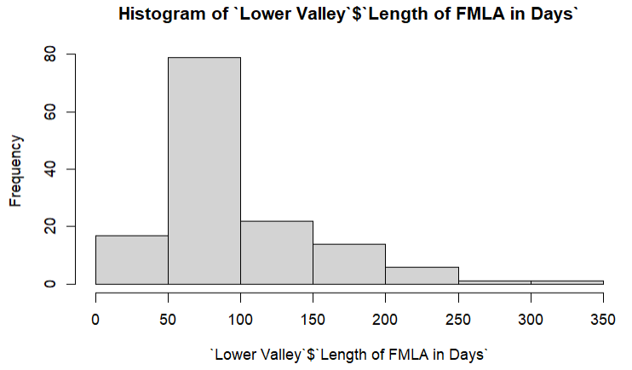
Frequency of FMLA Lengths (in Days) for Lower Valley RGV

Slide 42
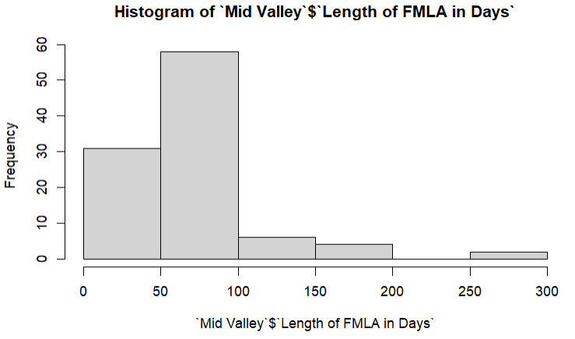
Frequency of FMLA Lengths (in Days) for Mid Valley RGV

Slide 43
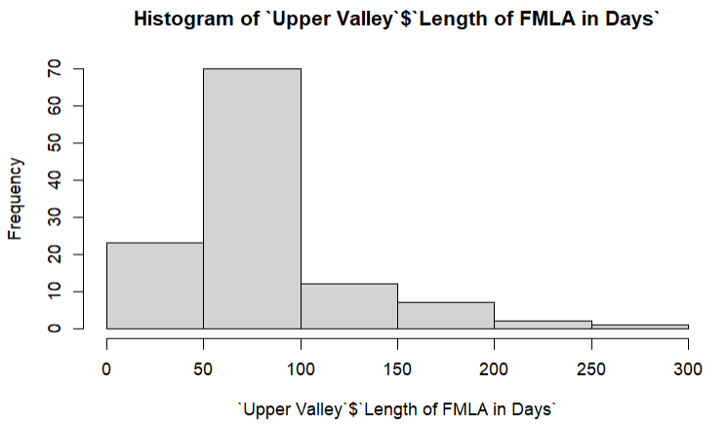
Frequency of FMLA Lengths (in Days) for Upper Valley RGV

Slide 44
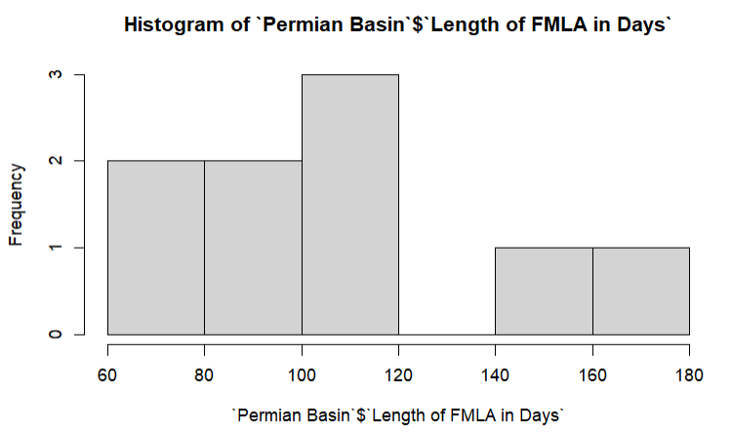
Histogram of FMLA Lengths (in Days) for Permian Basin

Slide 45
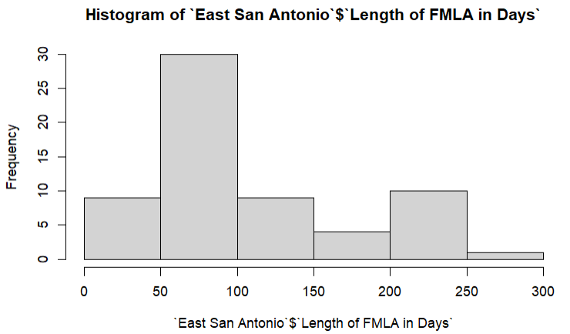
Histogram of FMLA Lengths (in Days) for East San Antonio

Slide 46
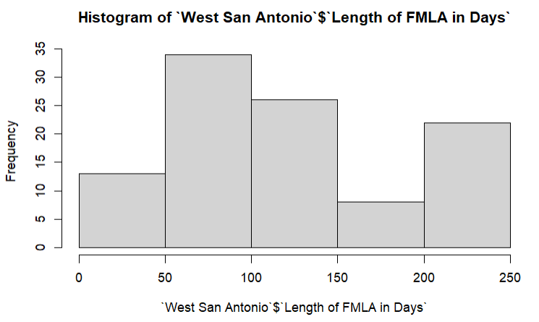
Frequency of FMLA Lengths (in Days) for West San Antonio

Slide 47
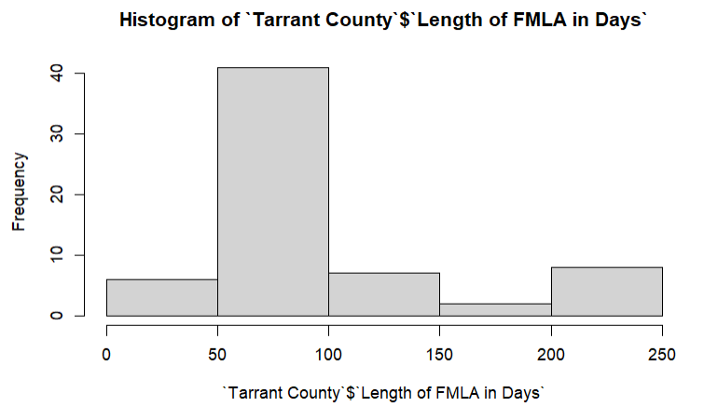
Frequency of FMLA Lengths (in Days) for Tarrant County

Slide 48
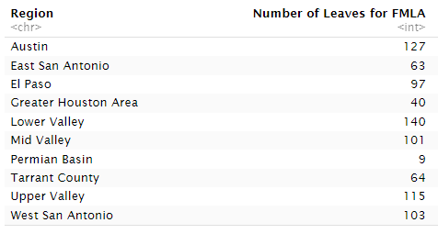
Number of Teacher Leaves from FMLA Varied by Region
Lower Valley RGV had the highest count of teacher leaves from FMLA, and Permian Basin had the lowest.

Slide 49
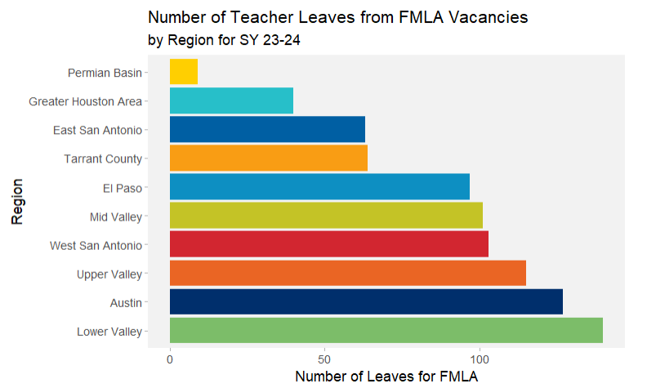
Number of Teacher Leaves from FMLA were Highest in Lower Valley RGV, Followed by Austin.
The highest number of Teacher leaves from FMLA was in the Lower Valley RGV (140) and Austin (127), and the lowest was in Permian Basin (9).

Slide 50
FMLA: Campus
Campuses in Texas who had teachers that took leave for FMLA

Slide 51
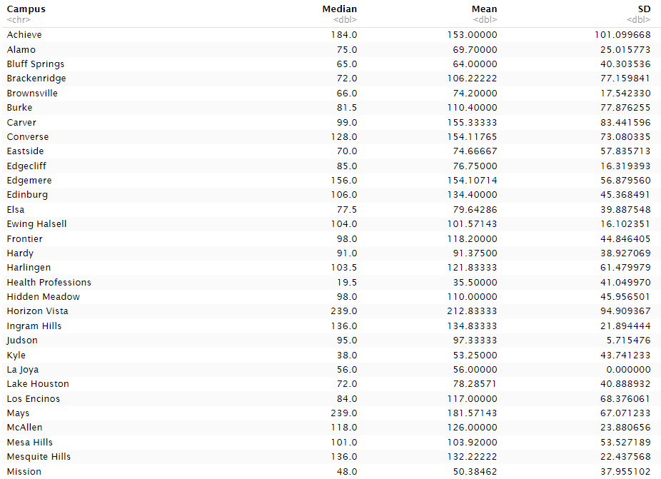
Median, Mean, and SD by Campus for Teacher Leave from FMLA (in Days) – Part 1

Slide 52
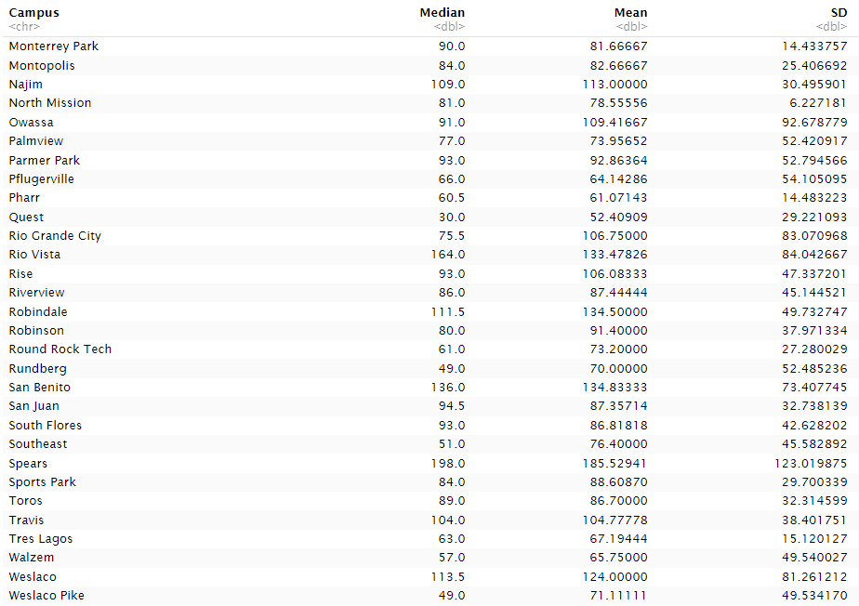
Median, Mean, and SD by Campus for Teacher Leave from FMLA (in Days) – Part 2

Slide 53
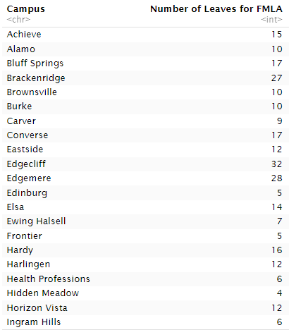
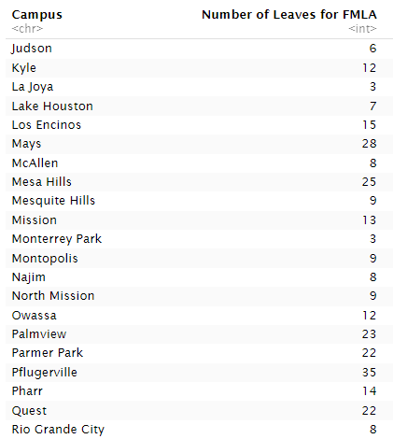
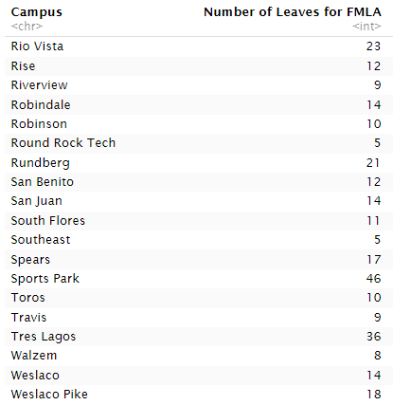
Number of Teacher Leaves from FMLA Varied by Campus

Slide 54

Summary Statistics for Number of Teacher Leaves from FMLA After Grouping by Campus

Slide 55
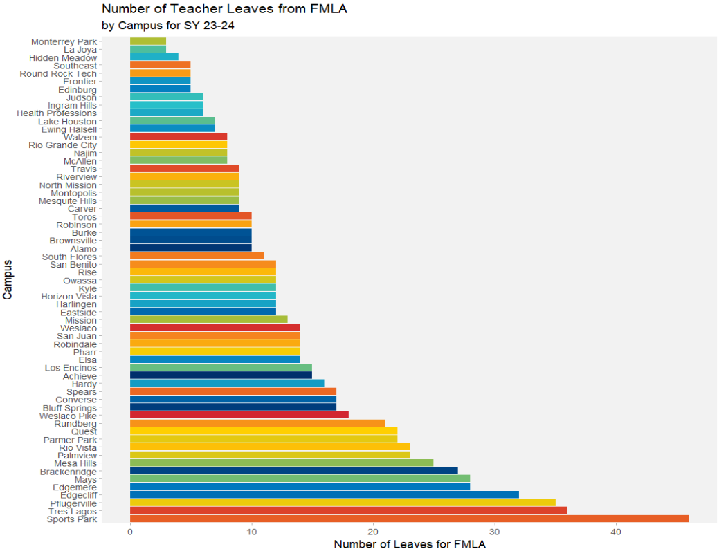
Number of Teacher Leaves from FMLA were highest in Sports Park
Number of Teacher FMLA leaves were highest in Sports Park (46) followed by Tres Lagos (36) and Pflugerville (35), and lowest in Monterrey Park (3) and La Joya (3).

Slide 56
FMLA: Subject
Includes four subjects:
Math
English Language Arts
Science
Social Studies

Slide 57
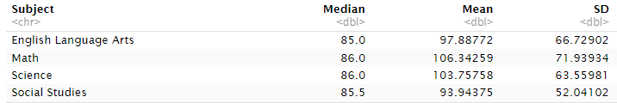
Summary Statistics for Teacher Leave (in Days) from FMLA by Subject
The highest median FMLA leave was tied between Math and Science at 86.0 and the lowest median was English Language Arts at 85 days. The largest mean FMLA was for Math (106.3 days) and the lowest was for Social Studies (93.9 days). The largest standard deviation for FMLA was for Math at 71.9 days, and the lowest was for Social Studies at 52.0 days.

Slide 58
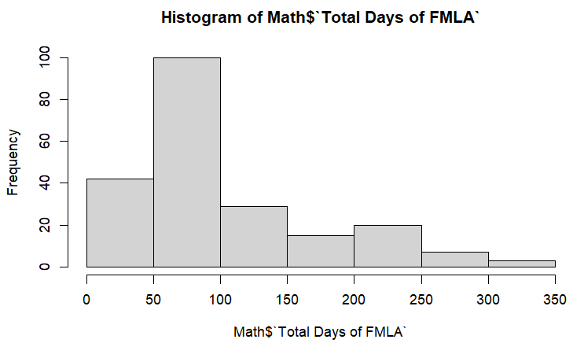
Math: Total Days of FMLA

Slide 59
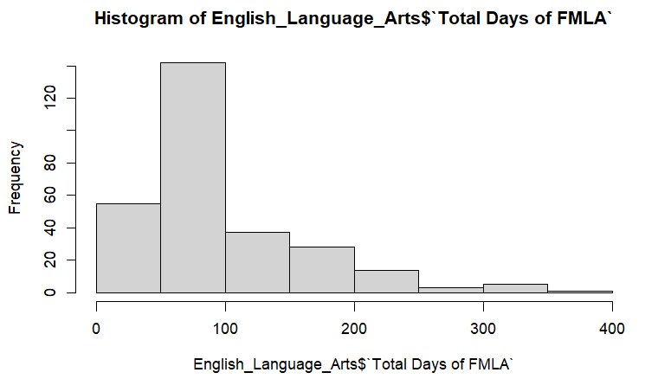
English Language Arts: Total Days of FMLA

Slide 60
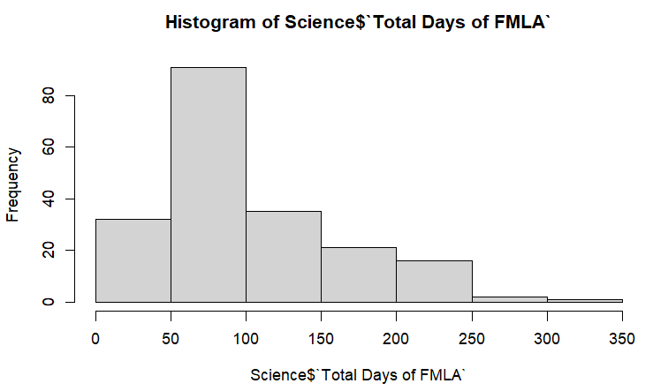
Science: Total Days of FMLA

Slide 61
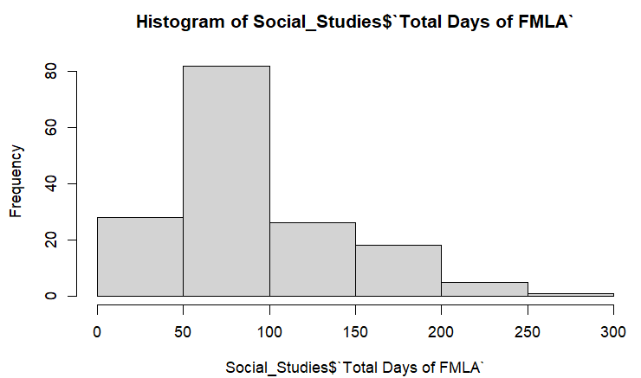
Social Studies: Total Days of FMLA

Slide 62
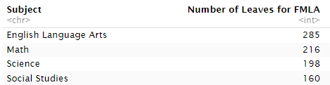
Number of Leaves Taken for FMLA by Subject
English Language Arts had the highest count of teachers leaves from FMLA for any subject at 285 leaves. This was followed by Math at 216 leaves and Science at 198 leaves. Social Studies was the subject with the fewest count of teacher leaves from FMLA, with 160 leaves.

Slide 63
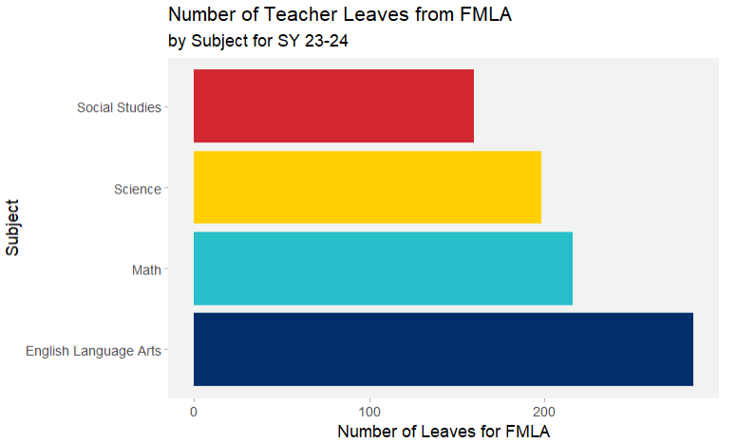
Number of Teacher Leaves from FMLA Varied by Subject
English Language Arts had the highest count of FMLA leaves by teachers at 285, followed by Math at 216 leaves. Next was Science with 198 leaves, and last was Social Studies with 60 teacher leaves from FMLA.

Slide 64

Summary Statistics for Number Teacher Leaves from FMLA, After Grouping by Subject
English Language Arts and Math were above both the mean and median when looking at teacher leaves from FMLA by subject. Science and Social Studies were the subjects that were both below the median and mean count after grouping by subject.

