Slide 1

Staffing Vacancies in SY 23-24 for October 1, 2024 Cycle Created by Research & Analytics

Slide 2
What is the Nature of Staffing Vacancies at IDEA?
1) How long are vacancies at IDEA for teacher roles?
2) How many vacancies are at IDEA for teacher roles?
3) What is the highest number of vacancies during a single time period?
(time = week, month, quarter, semester)
4) Graphs, box plots, and histograms of data.

Slide 3
Data Background
Jobvite Data for HA and Staffing – shows when a job is posted or filled
Employee Data: Tyler Munis, Power Schools – shows employee number, name, course name taught, school year, hire date, start date, FMLA data for leave
Subjects: Math, English Language Arts, Science, Social Studies
“Grade” is binned into 1st – 5th, 6th – 8th, and 9th-12th, unless otherwise denoted by the course name to a specific individual grade for that course.
Region is inclusive of all Texas regions, and campus includes all Texas schools that have accountability ratings A-F.
Time periods are derived from role posting date, hire date, and start date.

Slide 4
Vacancy Data
Vacancies are for teaching positions
Vacancies are when there is an opening for a teaching role that needs to be filled
Vacancies can vary in length of time (from the time the position is open or posted, to the time the role is filled – and there is no longer that vacancy).

Slide 5
Vacancy: Region
All regions in Texas contained vacancies for teacher roles.

Slide 6
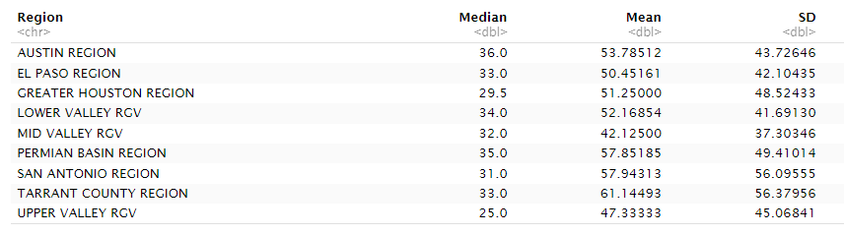
Median, Mean, and SD by Region for Vacancy Length (in Days)
Austin had the highest median for vacancy length and Upper Valley RGV had the lowest median. Tarrant County had the highest mean vacancy length, whereas Mid Valley RGV had the lowest mean. Tarrant County had the highest standard deviation and Mid Valley RGV had the lowest standard deviation for vacancy length in days.

Slide 7

Summary Statistics for Vacancy Lengths After Grouping by Region

Slide 8
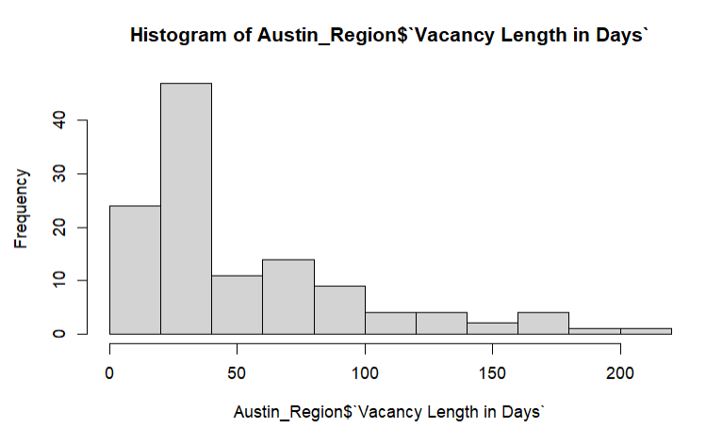
Austin Vacancy Lengths in Days
For Austin, the two highest frequencies of vacancies were both less than 50 days.

Slide 9
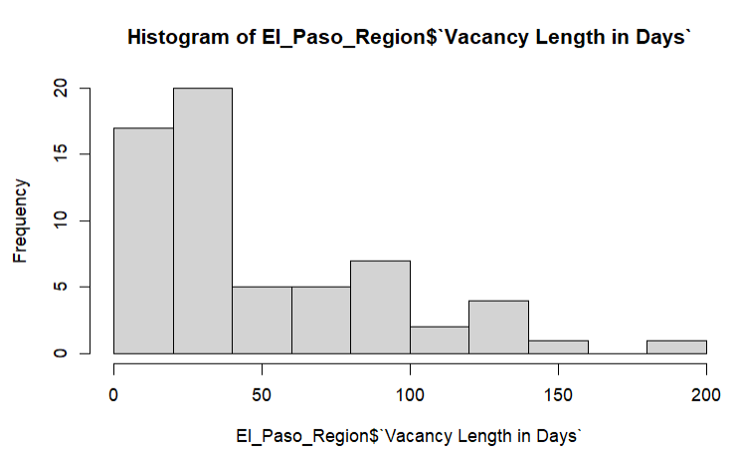
El Paso Vacancy Lengths in Days
In El Paso, the highest frequencies of vacancies were less than 50 days.

Slide 10
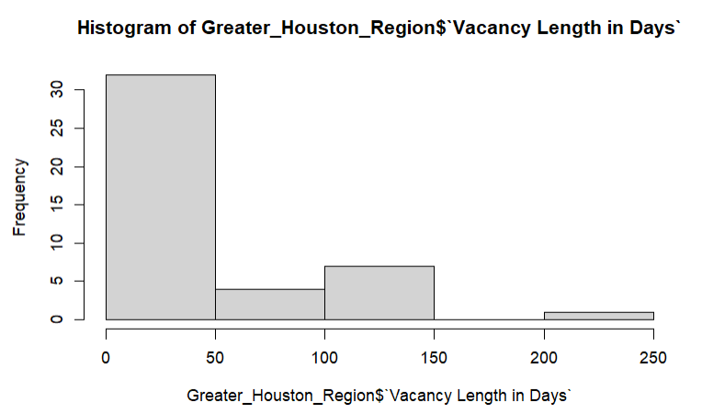
Greater Houston Area Vacancy Lengths in Days
The highest frequency of vacancies was less than 50 days for Greater Houston Area.

Slide 11
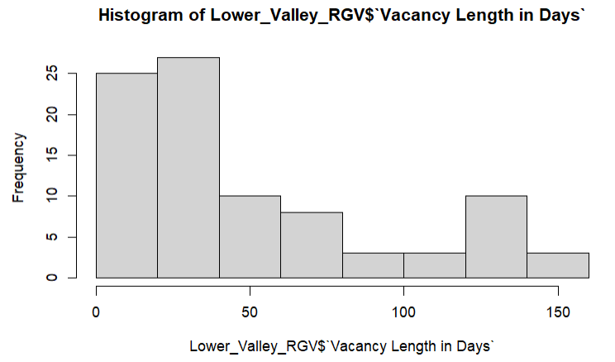
Lower Valley RGV Vacancy Lengths in Days
The highest frequency of vacancies was less than 50 days for Lower Valley RGV.

Slide 12
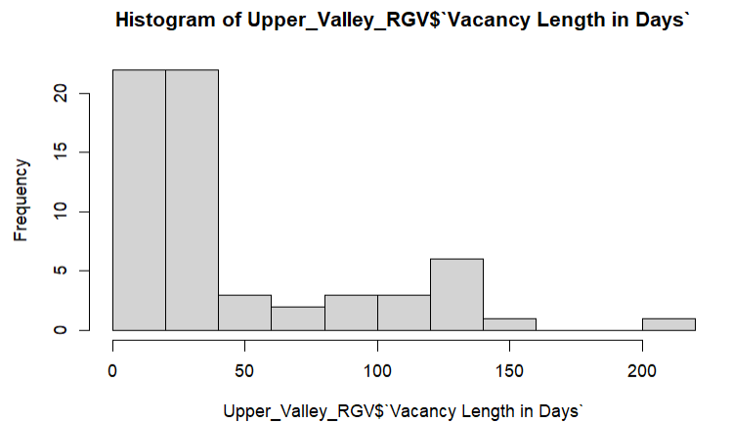
Upper Valley RGV Vacancy Lengths in Days

Slide 13
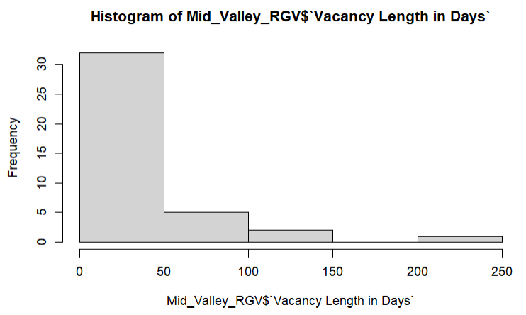
Mid Valley RGV Vacancy Lengths in Days

Slide 14
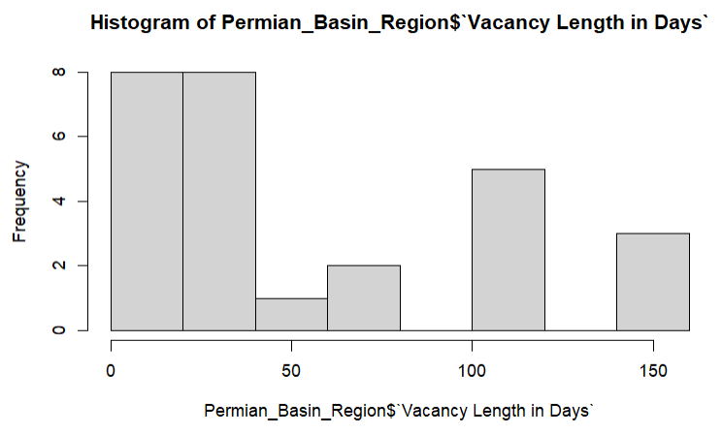
Permian Basin Vacancy Lengths in Days
The two highest frequencies of vacancies were less than 50 days for Permian Basin, and the next highest frequency was over 100 days.

Slide 15
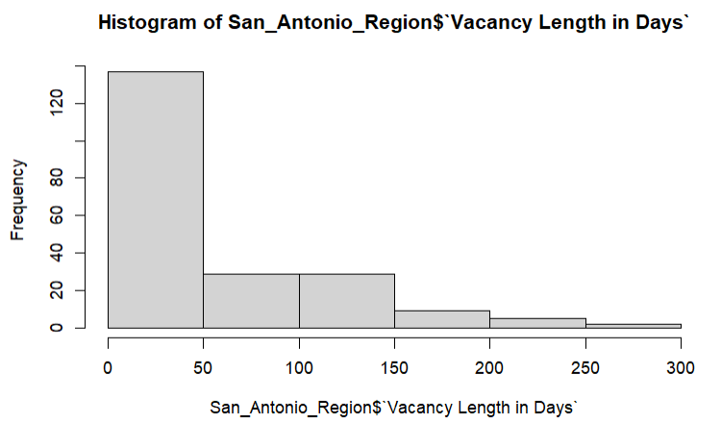
San Antonio Vacancy Lengths in Days

Slide 16
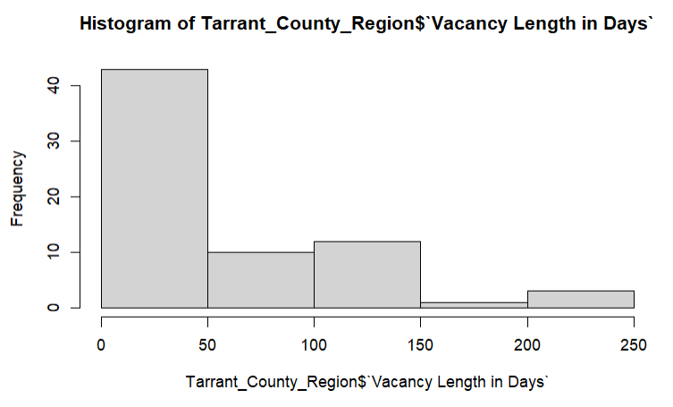
Tarrant County Vacancy Lengths in Days

Slide 17
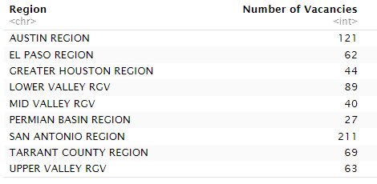
Number of Staffing Vacancies Varied by Region
San Antonio had the highest count of Staffing Vacancies and Permian Basin had the lowest.

Slide 18
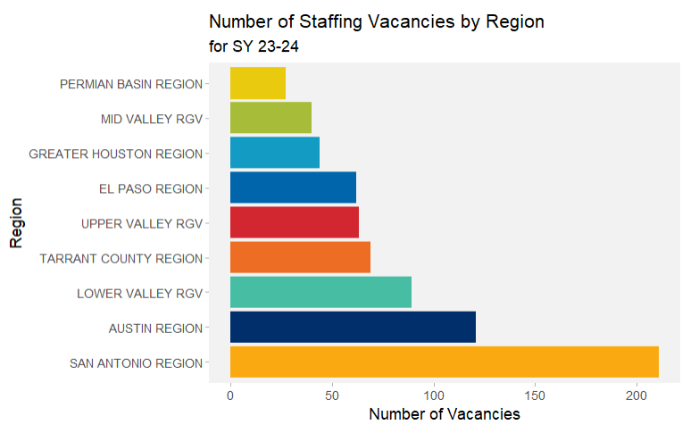
Number of Staffing Vacancies were Highest in San Antonio, Followed by Austin.
While San Antonio had the highest number of vacancies, Permian Basin and Mid Valley RGV had the two lowest numbers of vacancies. El Paso, Upper Valley RGV, and Tarrant County had similar numbers of vacancies.

Slide 19
Vacancy: Campus
All Campuses in Texas where there were vacancies in SY 23-24.

Slide 20
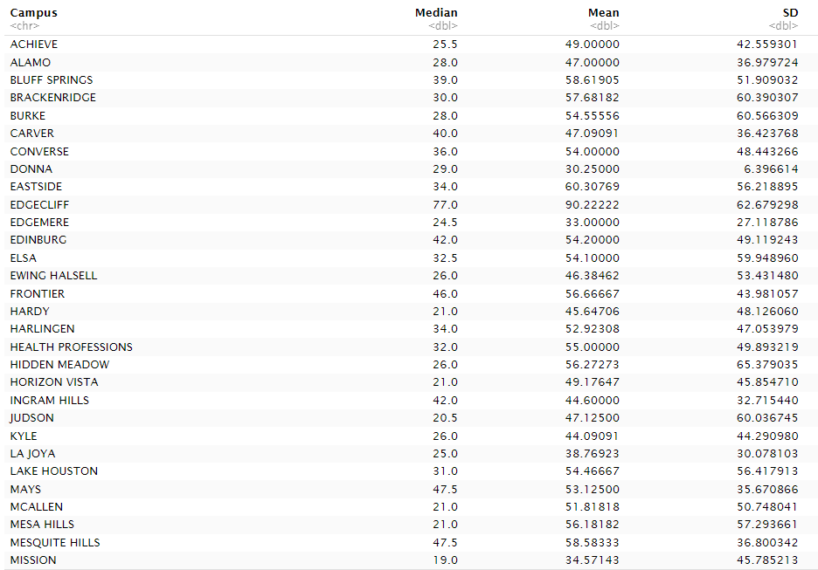
Median, Mean, and SD by Campus for Vacancy Length (in Days) – Part 1

Slide 21
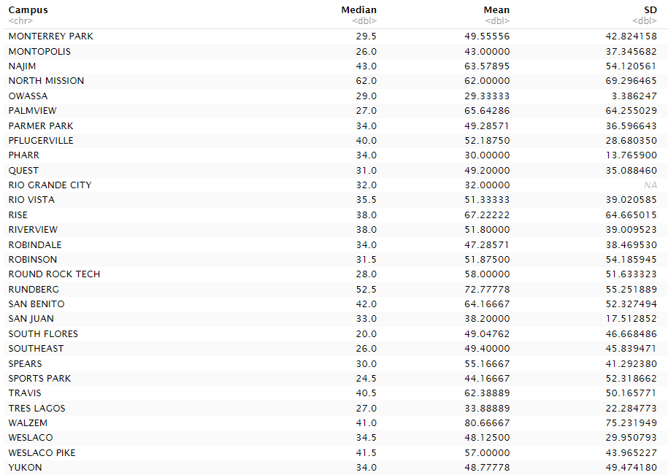
Median, Mean, and SD by Campus for Vacancy Length (in Days) – Part 2

Slide 22

Summary Statistics for Vacancies After Grouping by Campus

Slide 23
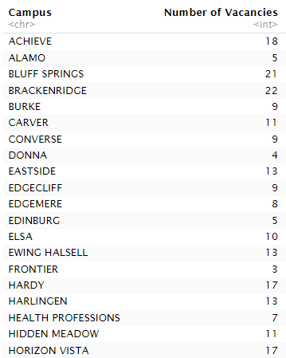
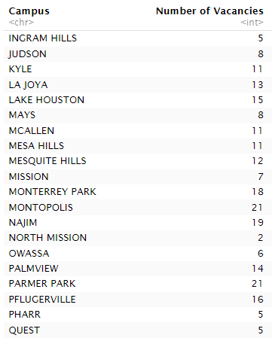
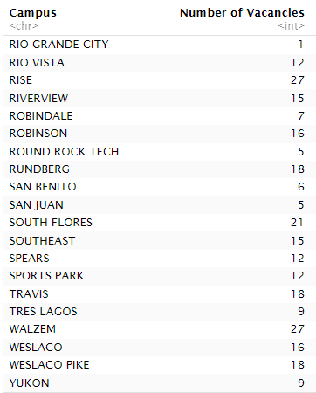
Number of Staffing Vacancies Varied by Campus

Slide 24
Vacancy: Subject
Includes four subjects:
Math
English Language Arts
Science
Social Studies

Slide 25
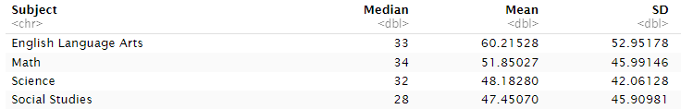
Summary Statistics for Vacancy Length in Days by Subject
The highest median vacancy length was Math at 34 days, and the lowest median was Science at 32 days. The largest mean vacancy length was for English Language Arts (60.2 days) and the lowest was for Social Studies (47.5). The largest standard deviation for vacancy length was for English Language Arts (53.0), and the lowest was for Science (42.1 days).

Slide 26
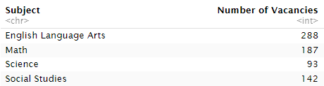
Number of Staffing Vacancies Varied by Subject
English Language Arts had the highest number of staffing vacancies (288) and Science had the lowest number of vacancies at 93.

Slide 27

Summary Statistics for Number of Vacancies after Grouping by Subject
Both English Language Arts and Math were above the median and mean numbers of staffing vacancies after grouping by subject.

Slide 28
Reading Histograms
Number of days Vacant (Vacancy length in days) is shown on the horizontal axis
Number of vacancies (frequency) within a range of a particular length is on the vertical axis
The number of vacancies that had the same length of time (the vacancies were open for a similar number of days).

Slide 29
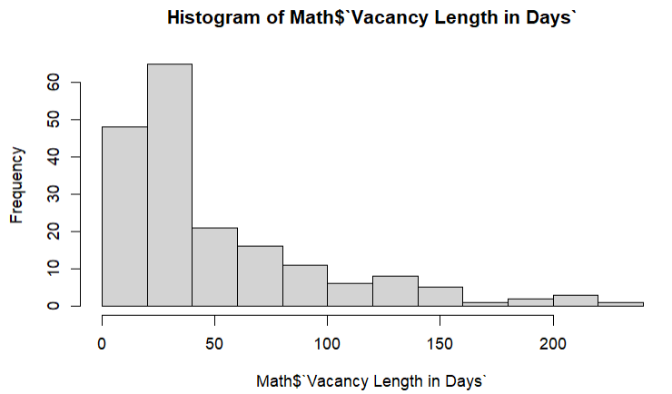
Math Vacancy Lengths in Days
The highest frequencies of vacancies were less than 50 days.

Slide 30
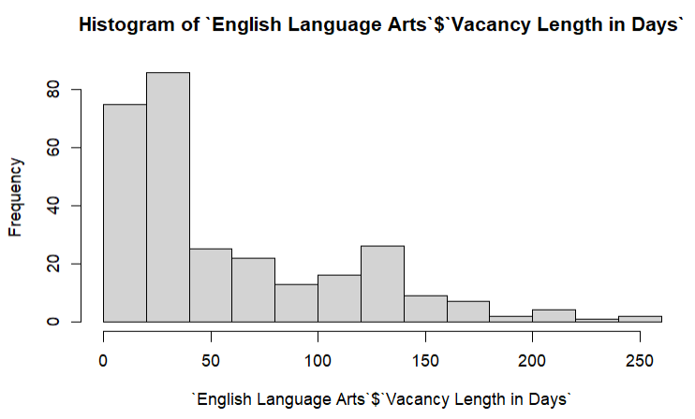
English Language Arts Vacancy Lengths in Days
The highest frequencies of vacancies were less than 50 days.

Slide 31
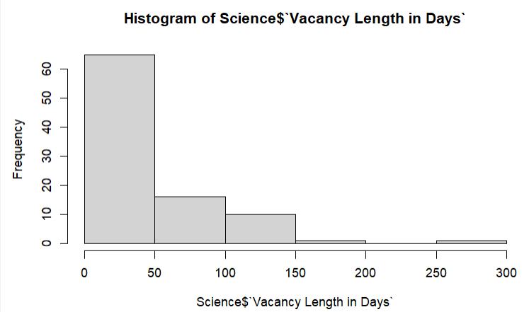
Science Vacancy Lengths in Days
The highest frequency of vacancies was less than 50 days. The next highest frequency of vacancies was 50-100 days.

Slide 32
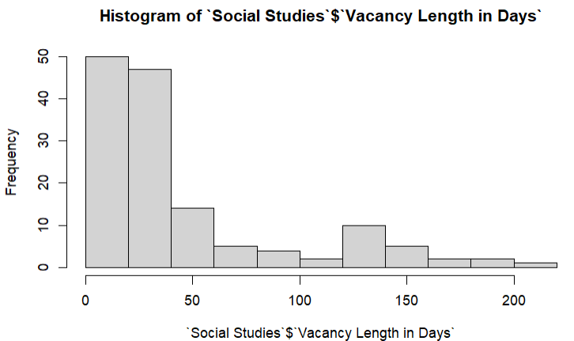
Social Studies Vacancy Lengths in Days
The two highest frequencies of vacancies had lengths that were less than 50 days.

Slide 33
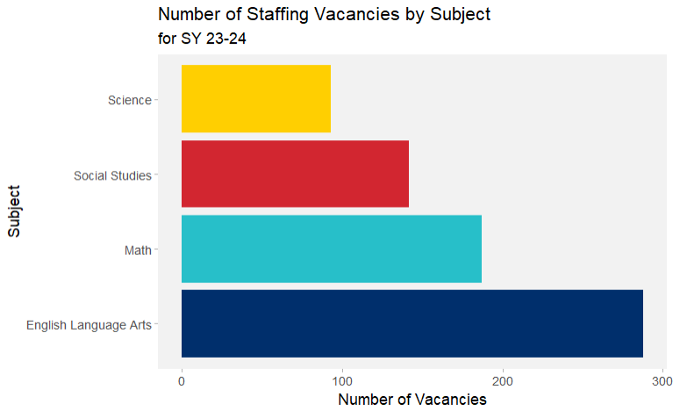
Number Staffing Vacancies were Highest in English Language Arts
Each subject across Texas had a different number of staffing vacancies. English Language arts had the most at 288, followed by Math at 187, then Social Studies with 142. Science had the lowest vacancies with 93.

Slide 34
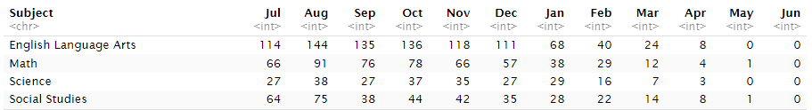
Number of Vacancies per Month by Subject (July 2023 – June 2024)

Slide 35
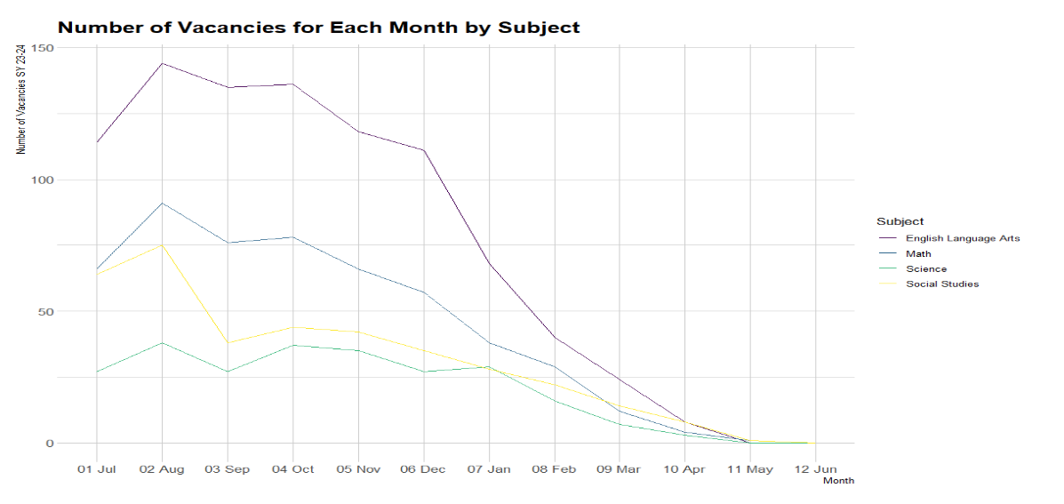
Number of Vacancies Per Month by Similar Shapes per Subject

Slide 36
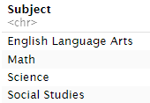
Number of Vacancies per Week by Subject (July 2023 – June 2024)

Slide 38
FMLA Data
FMLA is Family Medical Leave and is time off for medical or family (such as having a child) absences
FMLA leave length of time is counted in days, starting from the first day the employee is absent with leave to the return-to-work date.
FMLA leave can vary in length of time (depending on how many days the employee applied for and was approved for).

Slide 39
FMLA: Region
Regions in Texas who had teachers that took leave for FMLA

Slide 40
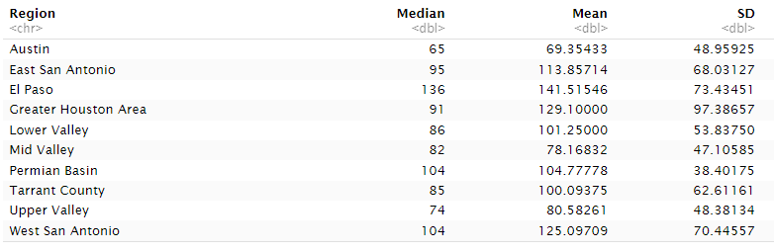
Median, Mean, and SD by Region for FMLA Length (in Days)

Slide 41
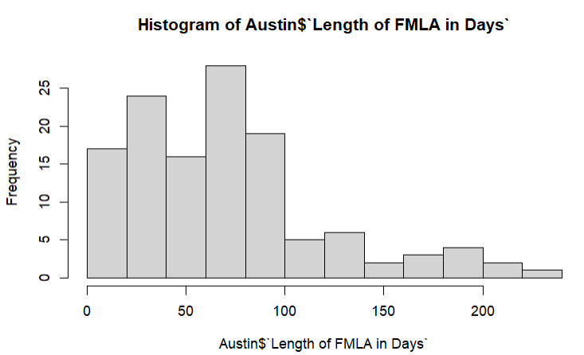
Histogram of FMLA Lengths (in Days) for Austin

Slide 42
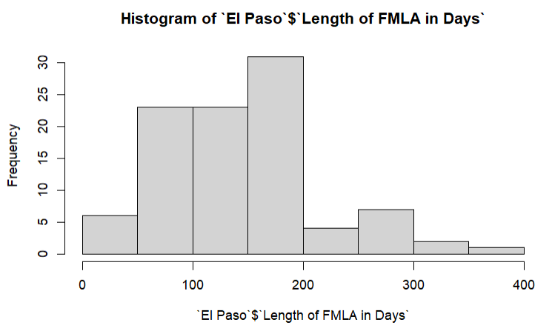
Frequency of FMLA Lengths (in Days) for El Paso
The highest frequency of length of FMLA for teachers was between 150 and 200 days in El Paso.

Slide 43
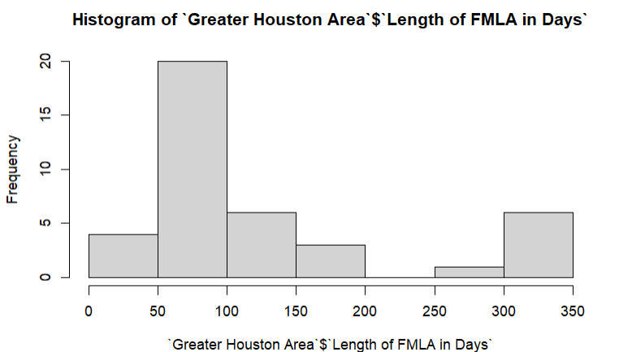
Frequency of FMLA Lengths (in Days) for Greater Houston Area

Slide 44
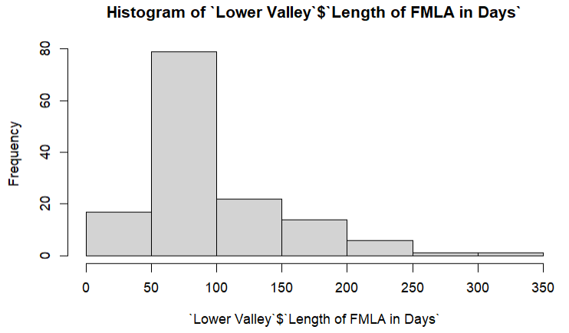
Frequency of FMLA Lengths (in Days) for Lower Valley RGV
The highest frequency of length of FMLA for teachers was between 50 and 100 days in Lower Valley RGV, with the next highest frequency between 100 to 150 days.

Slide 45
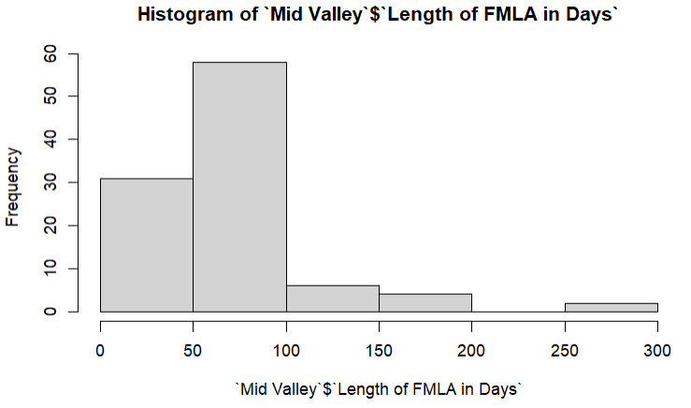
Frequency of FMLA Lengths (in Days) for Mid Valley RGV

Slide 46
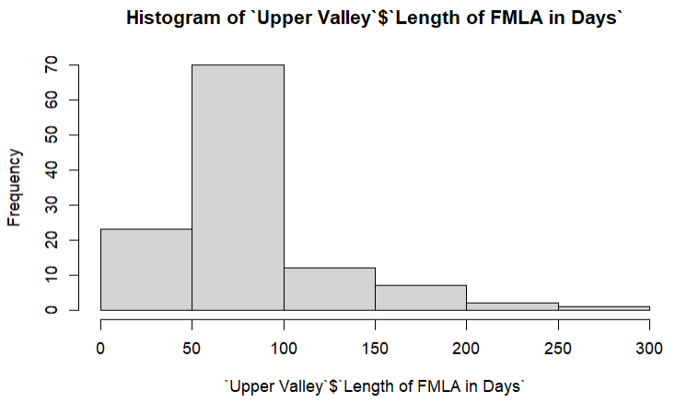
Frequency of FMLA Lengths (in Days) for Upper Valley RGV

Slide 47
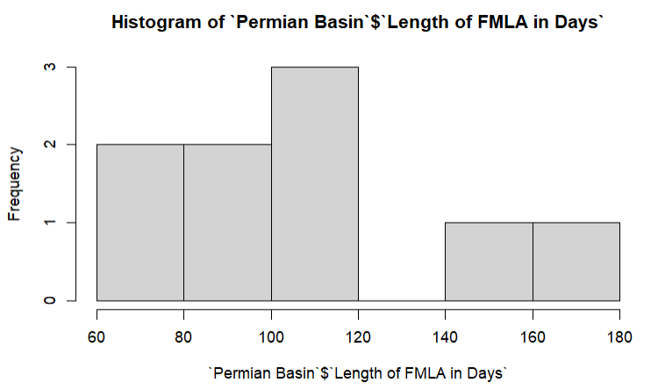
Histogram of FMLA Lengths (in Days) for Permian Basin

Slide 48
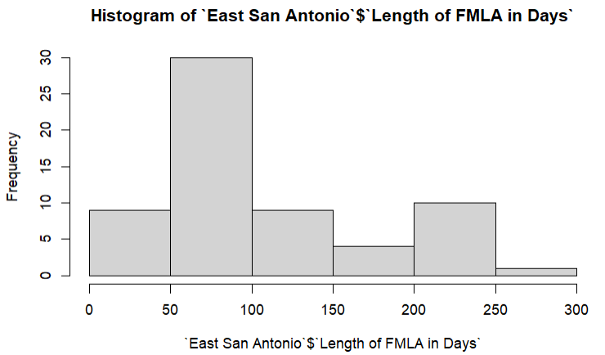
Histogram of FMLA Lengths (in Days) for East San Antonio

Slide 49
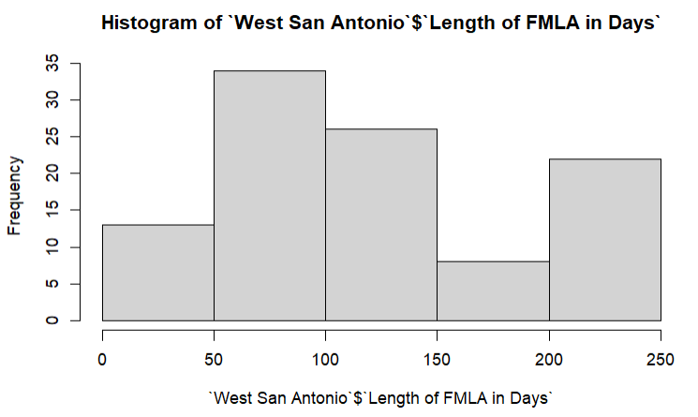
Frequency of FMLA Lengths (in Days) for West San Antonio

Slide 50
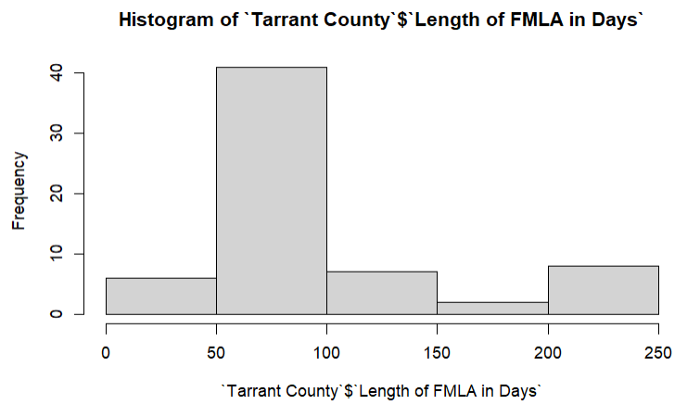
Frequency of FMLA Lengths (in Days) for Tarrant County

Slide 51
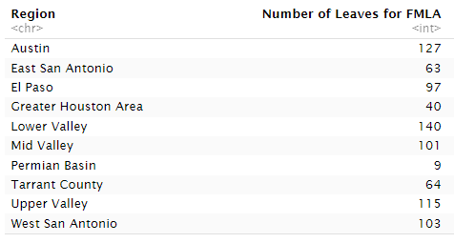
Number of Teacher Leaves from FMLA Varied by Region
Lower Valley RGV had the highest count of teacher leaves from FMLA, and Permian Basin had the lowest.

Slide 52
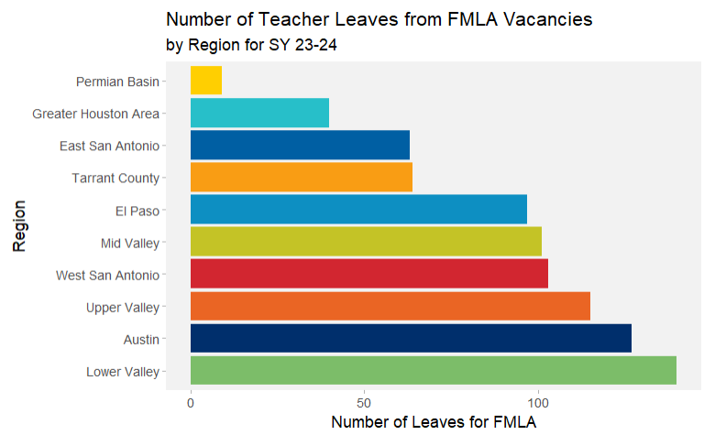
Number of Teacher Leaves from FMLA were Highest in Lower Valley RGV, Followed by Austin.
The highest number of Teacher leaves from FMLA was in the Lower Valley RGV (140) and Austin (127), and the lowest was in Permian Basin (9).

Slide 53
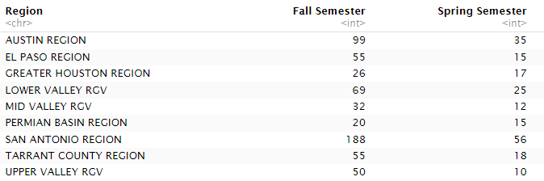
Number of Vacancies Per Semester by Region (Fall 2023 & Spring 2024)
The highest number of vacancies was in San Antonio in the Fall Semester for SY 23-24. The lowest number was 10 vacancies in Upper Valley RGV.

Slide 54
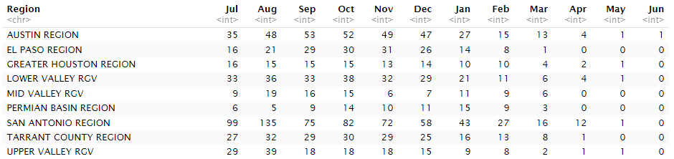
Number of Vacancies Per Month by Region (From July 2023 to June 2024)

Slide 55
FMLA: Campus
Campuses in Texas who had teachers that took leave for FMLA

Slide 56
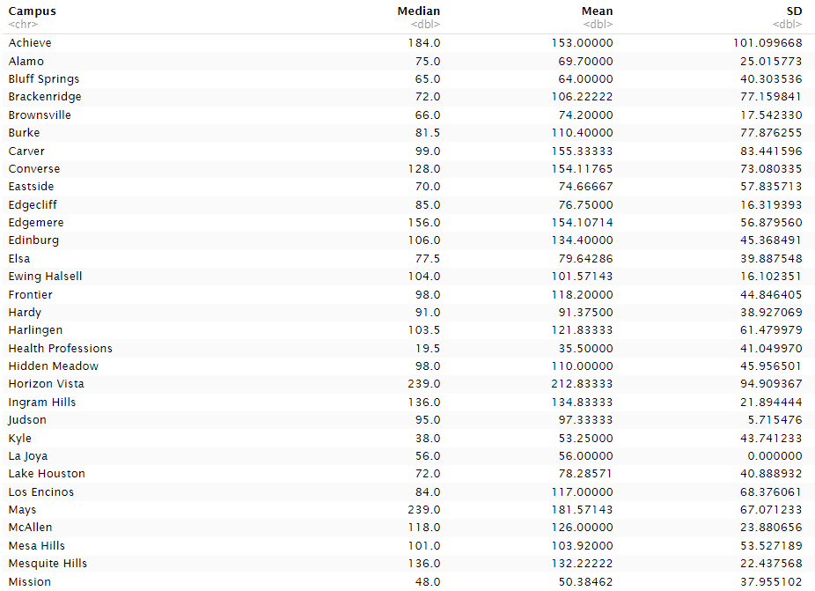
Median, Mean, and SD by Campus for Teacher Leave from FMLA (in Days) – Part 1

Slide 57
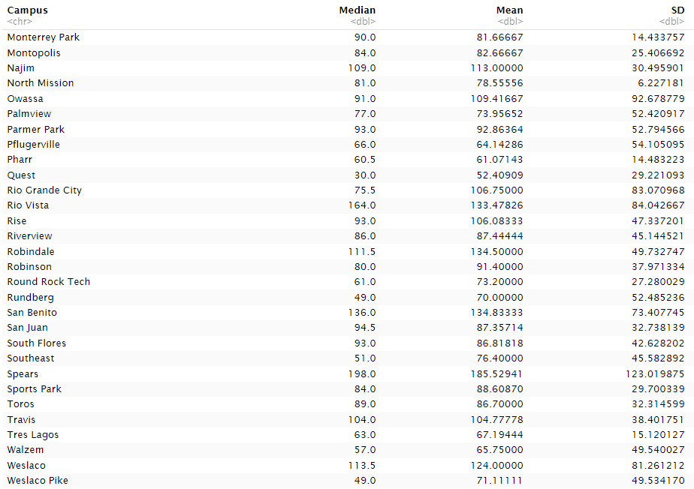
Median, Mean, and SD by Campus for Teacher Leave from FMLA (in Days) – Part 2

Slide 58
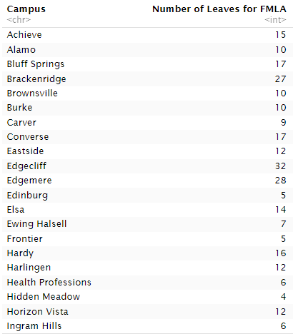
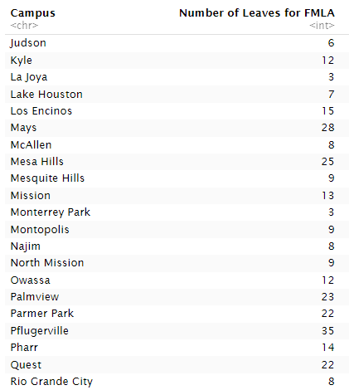
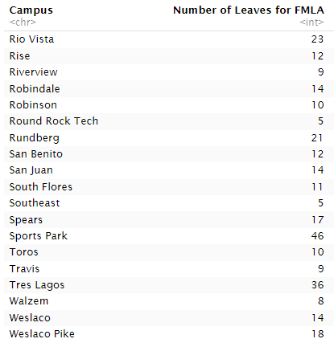
Number of Teacher Leaves from FMLA Varied by Campus

Slide 59

Summary Statistics for Number of Teacher Leaves from FMLA After Grouping by Campus

Slide 60
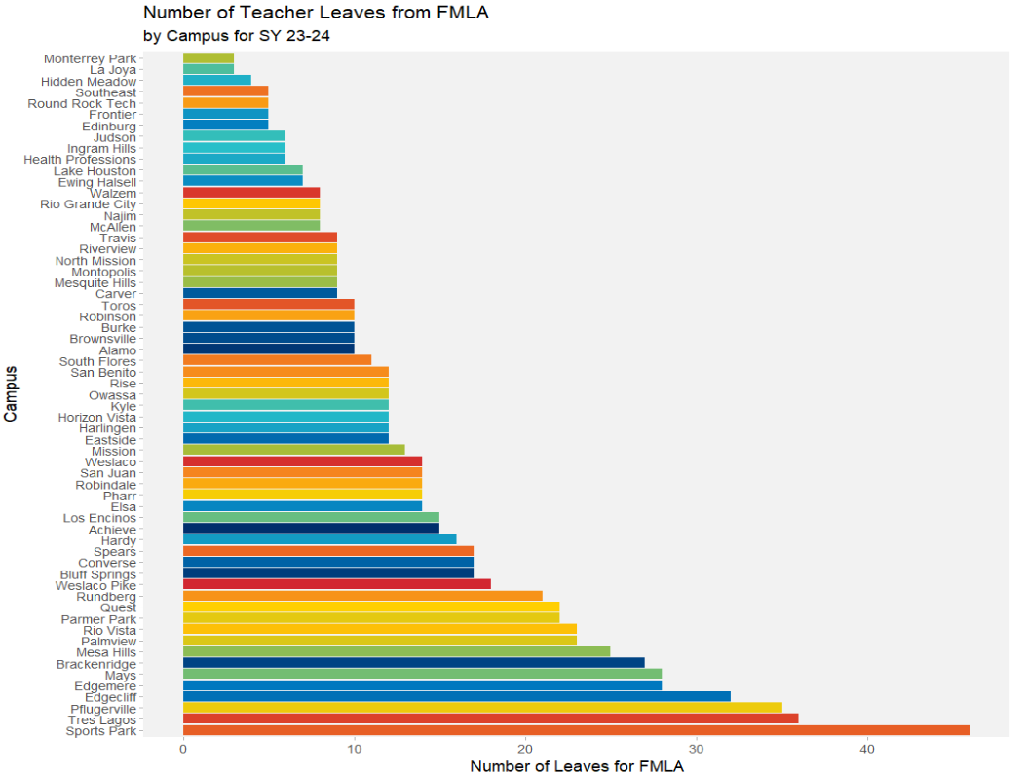
Number of Teacher Leaves from FMLA were highest in Sports Park
Number of Teacher FMLA leaves were highest in Sports Park (46) followed by Tres Lagos (36) and Pflugerville (35), and lowest in Monterrey Park (3) and La Joya (3).

Slide 61
FMLA: Subject
Includes four subjects:
Math
English Language Arts
Science
Social Studies

Slide 62
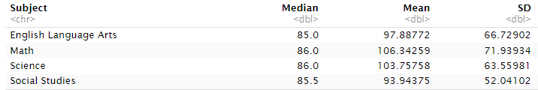
Summary Statistics for Teacher Leave (in Days) from FMLA by Subject
The highest median FMLA leave was tied between Math and Science at 86.0 and the lowest median was English Language Arts at 85 days. The largest mean FMLA was for Math (106.3 days) and the lowest was for Social Studies (93.9 days). The largest standard deviation for FMLA was for Math at 71.9 days, and the lowest was for Social Studies at 52.0 days.

Slide 63
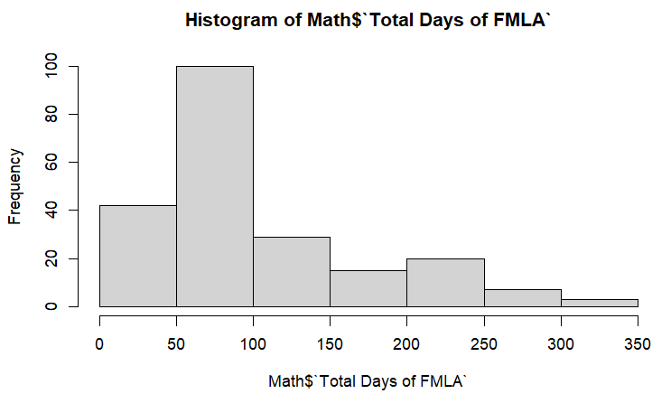
Math: Total Days of FMLA

Slide 64

English Language Arts: Total Days of FMLA

Slide 65

Science: Total Days of FMLA

Slide 66

Social Studies: Total Days of FMLA

Slide 67

Number of Leaves Taken for FMLA by Subject
English Language Arts had the highest count of teachers leaves from FMLA for any subject at 285 leaves. This was followed by Math at 216 leaves and Science at 198 leaves. Social Studies was the subject with the fewest count of teacher leaves from FMLA, with 160 leaves.

Slide 68

Number of Teacher Leaves from FMLA Varied by Subject
English Language Arts had the highest count of FMLA leaves by teachers at 285, followed by Math at 216 leaves. Next was Science with 198 leaves, and last was Social Studies with 60 teacher leaves from FMLA.

Slide 69

Summary Statistics for Number Teacher Leaves from FMLA, After Grouping by Subject
English Language Arts and Math were above both the mean and median when looking at teacher leaves from FMLA by subject. Science and Social Studies were the subjects that were both below the median and mean count after grouping by subject.

